Slide 1
MedRail
Clinical services an AI agent can discover, use, and pay for — no account, no API key, no permission from anyone except the patient.
Algorand Foundation Global x402 Challenge · Team Litchi — Aditya Arnav, Rudra Pratap, Yuvraj Singh
Live API: medrail.onrender.com · App: medrail-1.onrender.com
Consent contract: Algorand TestNet App ID 768743428
3 priced endpoints over x402, settled in USDC
Payment + on-chain consent + audit append, one call
Team Litchi — Aditya Arnav · Rudra Pratap · Yuvraj Singh

Slide 2
Healthcare's front door only opens for humans
Agents can't pay for a single call. Patients can't grant machine-readable, revocable consent.
• Every clinical API wants an account, an API key, a signature
• Agents hold funds but no identity — they can't buy one call
• Consent is a PDF or a checkbox: not machine-readable, not revocable
• Patients can't grant one named agent access, then revoke it
• Access logs sit in a vendor's database that nobody can verify
2
sides of
one broken
handshake
MedRail · Team Litchi · Algorand x402 Global Challenge
2/6

Slide 3
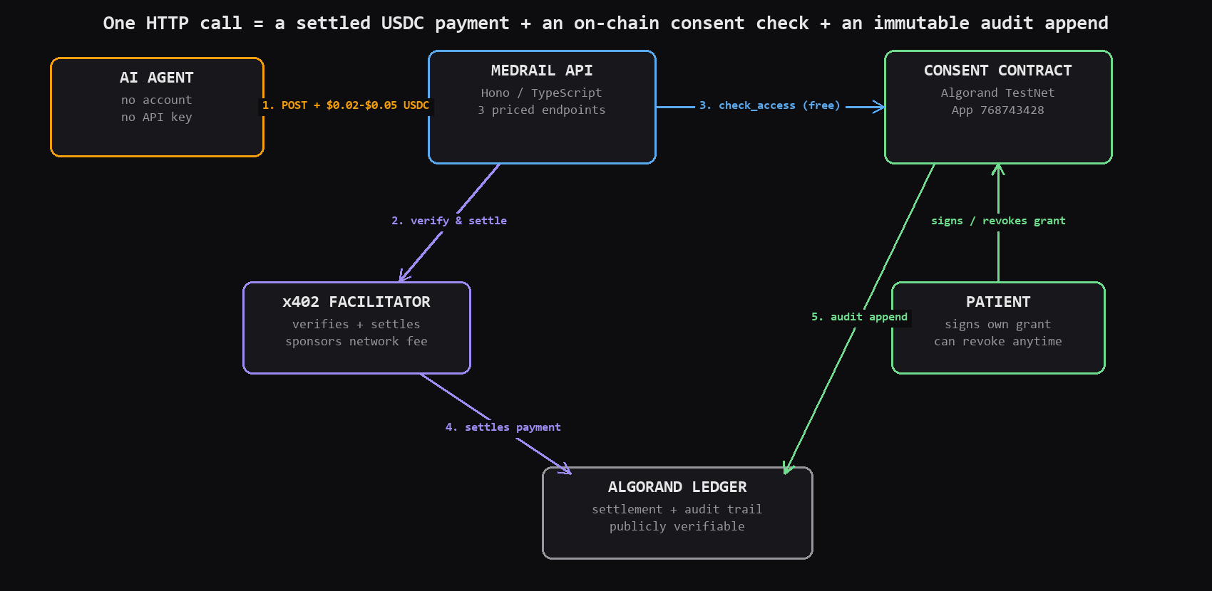
Payment, Consent, and Audit — In One HTTP Call
Three priced clinical endpoints an agent can discover and pay for, with no account and no API key.
• POST /v1/triage — $0.02, x402-gated, deterministic red-flag scoring
• POST /v1/interaction-check — $0.02, x402-gated, curated drug-interaction table
• POST /v1/records/summary — $0.05, x402 payment PLUS on-chain patient consent
• One paid call = settled USDC + authorization check + audit append, atomic
• Consent lives in Algorand contract App 768743428 — the patient signs, not us
MedRail · Team Litchi · Algorand x402 Global Challenge
3/6

Slide 4
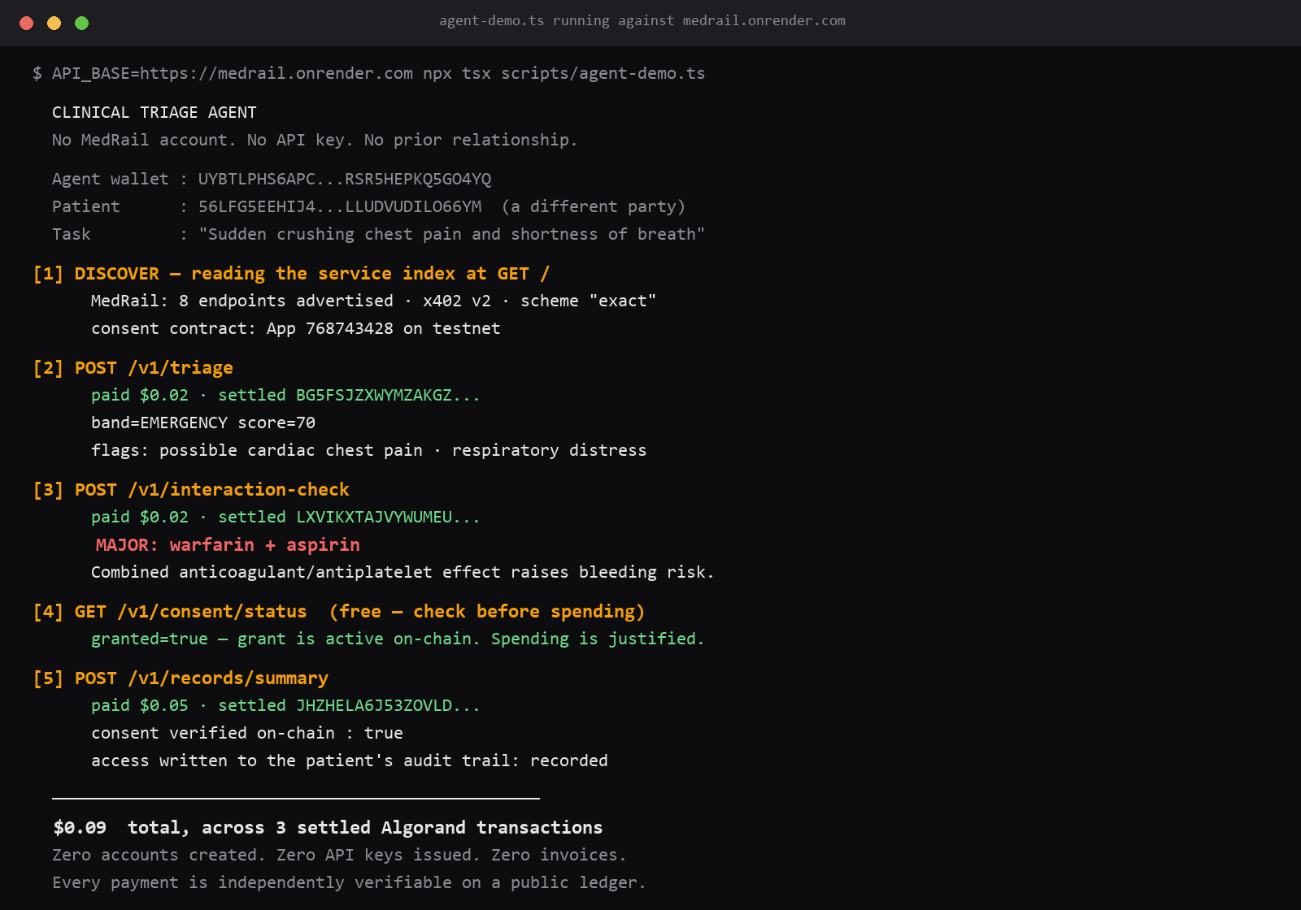
Not a mockup — settled on-chain, live right now
One real agent run against the deployed API, every claim checkable on a public explorer.
• $0.02 triage + $0.02 interaction-check + $0.05 records summary = $0.09
• 3 settled USDC transactions on Algorand TestNet, not simulated
• Sender, receiver, and MedRail are three separate keypairs
• Consent verified on-chain against App ID 768743428 before records unlock
• Honest caveat: wallets funded from our TestNet float — not external revenue
MedRail · Team Litchi · Algorand x402 Global Challenge
4/6

Slide 5
A $0.02 Call That Actually Costs $0.02
Algorand + x402 make micropayments, free authorization reads, and on-chain audit economically real.
• Facilitator sponsors network fees — the calling agent holds zero ALGO
• Consent check is a free algod simulate call, so authorization is free
• Grants and audit entries live in Algorand box storage, first-class on-chain state
• Deterministic rule engines, not ML — ADR-007, a safety choice against clinical hallucination
• contracts/ algopy 28 tests · api/ Hono+TypeScript 93 tests · web/ Next.js
MedRail · Team Litchi · Algorand x402 Global Challenge
5/6

Slide 6
The rail works. The next payment should come from a stranger.
Everything we're not claiming yet, and exactly what we do next.
KNOWN LIMITATIONS
WHAT'S NEXT
• Self-funded TestNet wallets — genuine settlement, not external revenue
• Single API instance, no metrics yet, synthetic record content
• TestNet only — App ID 768743428, MainNet not deployed
• MainNet deployment of the same contract and resource server
• Two rule-engine fixes — triage negation, short-string false positives
• A stranger's agent finds us on Bazaar and pays
MedRail · Team Litchi · Algorand x402 Global Challenge
6/6

