Slide 1
STUDENT MANAGER SYSTEM
PREPARED BY
HARIHARAN D
43110304

Slide 2
ABSTRACT
The Student Manager System is a web-based full-stack application designed to maintain and manage student information effectively.
The system allows users to add, update, delete, and view student details through a simple user-friendly interface.
It combines an interactive frontend built using HTML, CSS, and JavaScript with a powerful Spring Boot backend that performs CRUD operations and stores data securely in a database.

Slide 3
EXISTING SYSTEM
Most traditional student data management is manual or stored in Excel sheets.
Data updates are time-consuming and error-prone.
Limited accessibility and no centralized control.
Lack of real-time updates and automated processing.

Slide 4
PROPOSED SYSTEM
A web-based solution that automates student record management.
Provides quick operations like Add, View, Edit, Delete.
Uses a centralized database to store and manage data.
Allows fast retrieval and updates through RESTful APIs.
User-friendly interface accessible from any browser.

Slide 5
ADVANTAGES
Fast and easy management of student details
Secure data storage with MySQL
Simple UI/UX design using HTML, CSS, JS
Platform independent (works on any device)
Real-time updates and dynamic interface

Slide 6
DISADVANTAGES
Requires an active internet connection
Backend setup needed before use
Limited user authentication (if not implemented)
Cannot function offline

Slide 7
HARDWARE REQUIREMENTS
Component | Specification
Processor | Intel Core i3 or above
RAM | Minimum 4 GB
Storage | 500 MB for project files
Operating System | Windows 10 / 11 or Linux / macOS
Browser | Google Chrome / Edge / Firefox

Slide 8
SOFTWARE REQUIREMENTS
Software | Purpose
JDK 17 or above | Java Development
Spring Boot 3 | Backend framework
Maven | Dependency management
MySQL / H2 DB | Database
Eclipse IDE | Development
HTML, CSS, JS | Frontend UI
Browser | Client interface

Slide 9
MODULES
Student Management Module – add, view, update, delete students
Database Module – manages student data persistence
API Communication Module – connects frontend with backend

Slide 10
MODULE DESCRIPTION
Student Management Module Handles CRUD operations through user interface.
Database Module Stores student information in MySQL and retrieves it via JPA.
API Communication Module Uses RESTful endpoints (/api/students) for data exchange between frontend and backend.

Slide 11
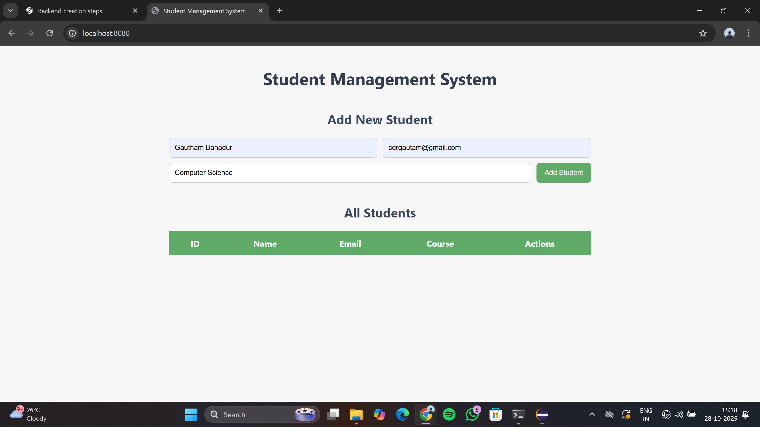
SAMPLE OUTPUT

Slide 12
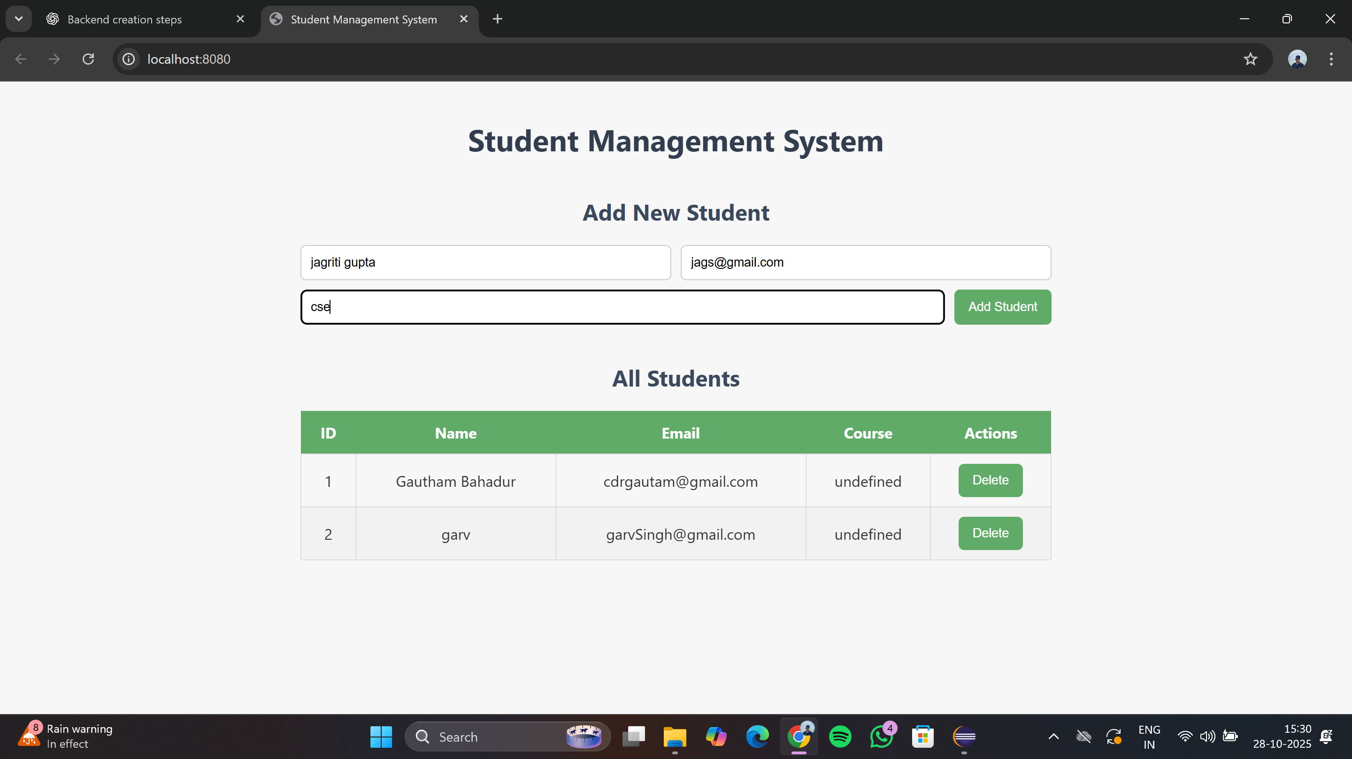
SAMPLE OUTPUT

Slide 13
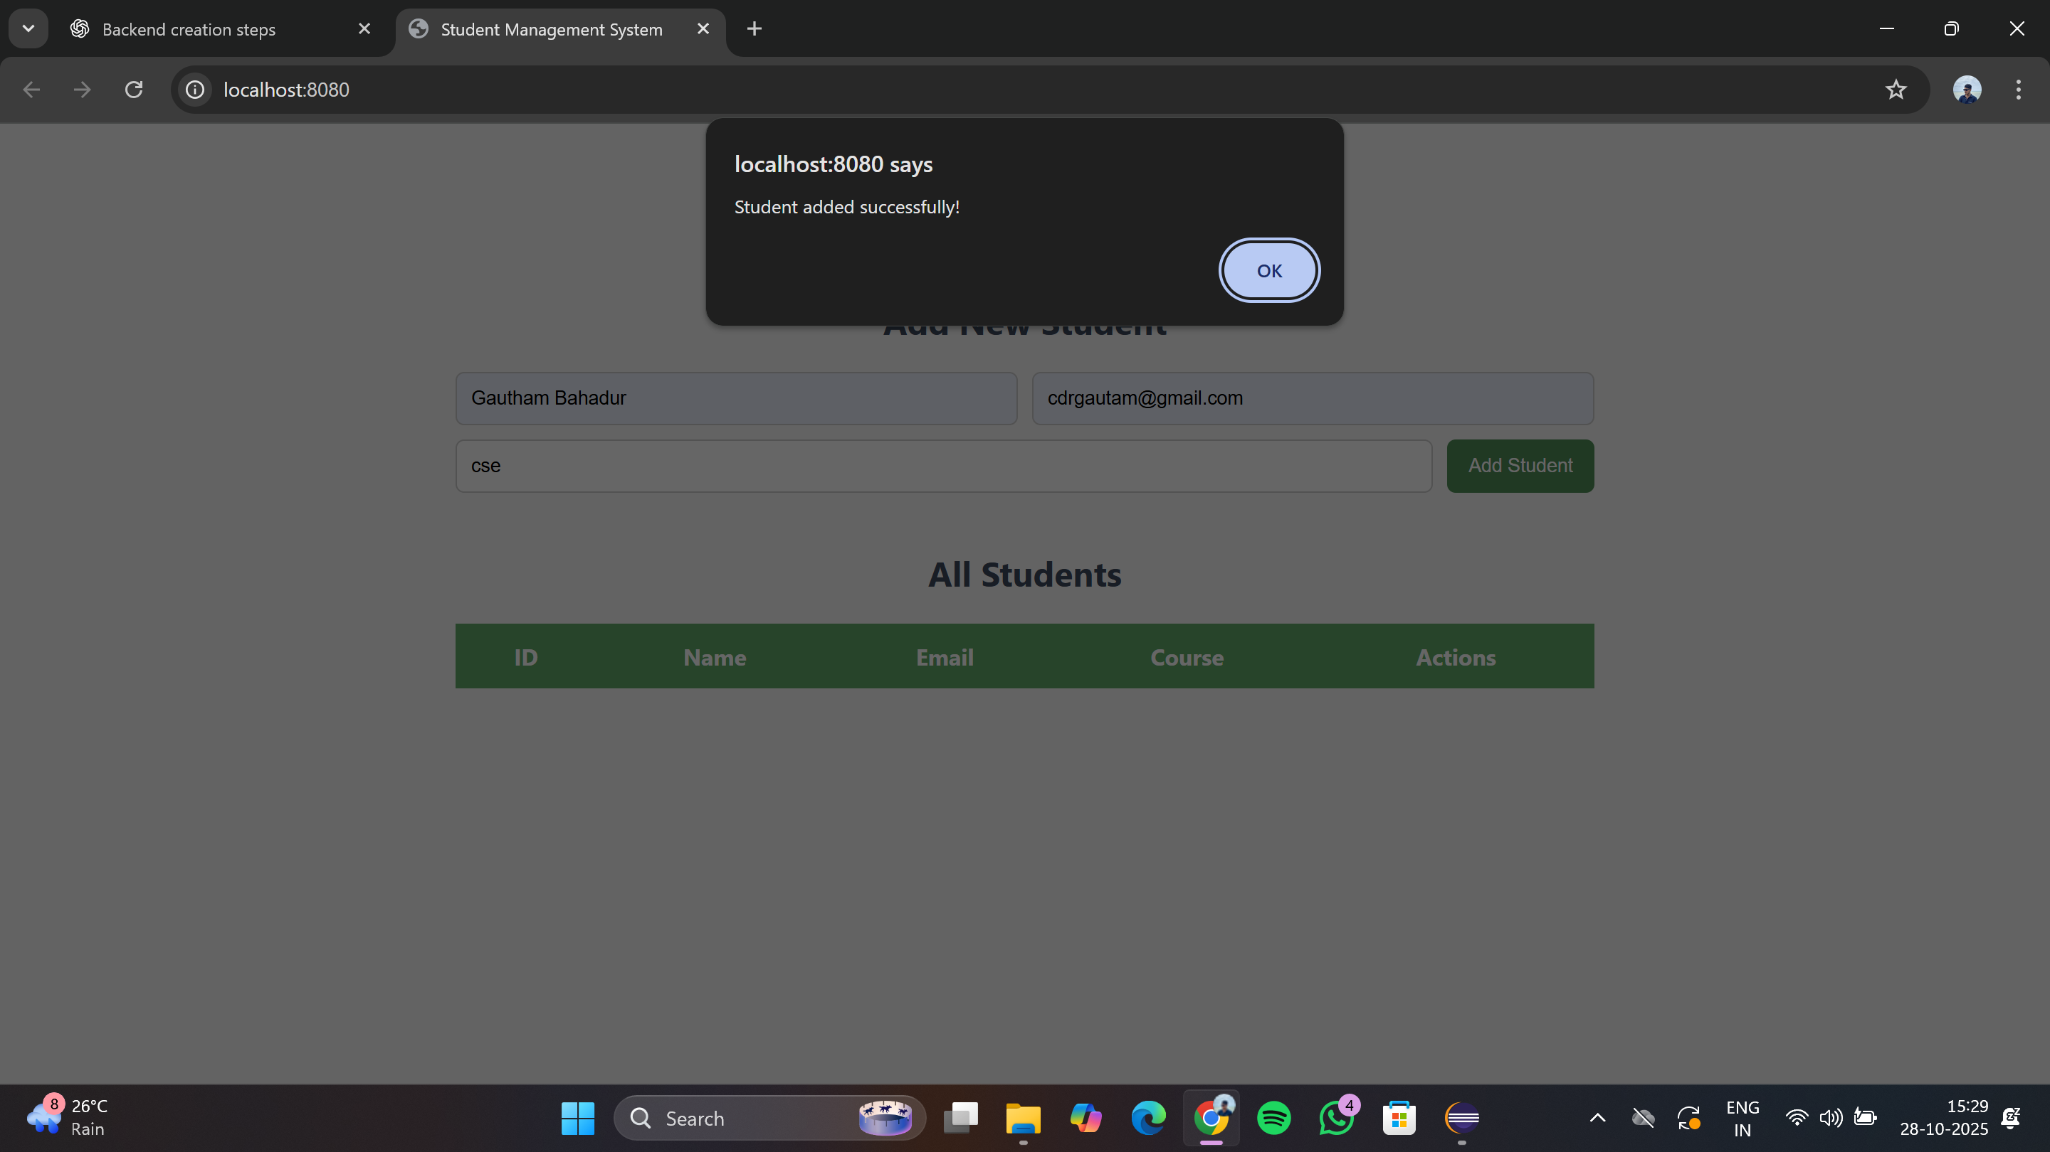
SAMPLE OUTPUT

Slide 14
CONCLUSION
The Student Manager System successfully demonstrates a simple yet efficient full-stack web application that integrates frontend and backend technologies for complete data management.
It eliminates manual work, improves accuracy, and provides a scalable foundation for future enhancements such as login authentication, advanced analytics, and report generation.

