Slide 1

TSP using ACO over CUDA

Slide 2
ABSTRACT
This project uses the famous NP Hard Travelling Salesman Problem which has no polynomial time solution as of yet to implement the concept of parallel programming and analyze the results.
Firstly, we shall apply the Ant Colony Optimization algorithm (a probabilistic technique for solving computational problems) to solve the problem. In ACO, the artificial ants incrementally build solutions by moving on the graph. The solution construction process is based by a pheromone model, that is, a set of parameters associated with graph components (either nodes or edges) whose values are modified at runtime by the artificial ants. And secondly, we shall use CUDA parallel computing platform to implement the same and analyze the variations in the time required of computation. CUDA is NVIDIA’s parallel computing architecture that enables dramatic increases in computing performance by harnessing the power of the GPU (graphics processing unit). It enables a very high level of task parallelism. By doing this project, we aspire to learn the importance of using probabilistic approaches to solve complex problems and enhance the understanding of parallel programming.

Slide 3
Travelling Salesman Problem (TSP)
The travelling salesman problem (TSP) asks the following question: "Given a list of cities and the distances between each pair of cities, what is the shortest possible route that visits each city and returns to the origin city?" It is an NP-hard problem in combinatorial optimization, important in operations research and theoretical computer science.

Slide 4
Ant Colony Optimisation (ACO)
Ant colony optimization (ACO) is a population-based metaheuristic that can be used to find approximate solutions to difficult optimization problems. In ACO, a set of software agents called artificial ants search for good solutions to a given optimization problem. To apply ACO, the optimization problem is transformed into the problem of finding the best path on a weighted graph. The artificial ants (hereafter ants) incrementally build solutions by moving on the graph. The solution construction process is stochastic and is biased by a pheromone model, that is, a set of parameters associated with graph components (either nodes or edges) whose values are modified at runtime by the ants.

Slide 5
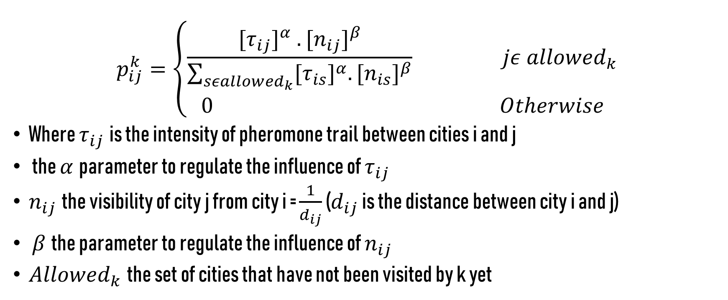
Original Model The probability to select city j by an ant k, sitting at city i is given by:
$$p_{ij}^{k}=\left\{\begin{aligned}\frac{{[τ_{ij}]}^{α} .{{[n}_{ij}]}^{β}}{\sum_{{sεallowed}_{k}}{{{[τ}_{is}]}^{α}.{{[n}_{is}]}^{β}}} jε {allowed}_{k} \\ 0 Otherwise\end{aligned}\right.$$
Where $τ_{ij}$is the intensity of pheromone trail between cities i and j
the $α$parameter to regulate the influence of $τ_{ij}$
$n_{ij}$the visibility of city j from city i = $\frac{1}{d_{ij}}$ ($d_{ij}$ is the distance between city i and j)
$β$the parameter to regulate the influence of $n_{ij}$
${Allowed}_{k}$the set of cities that have not been visited by k yet

Slide 6
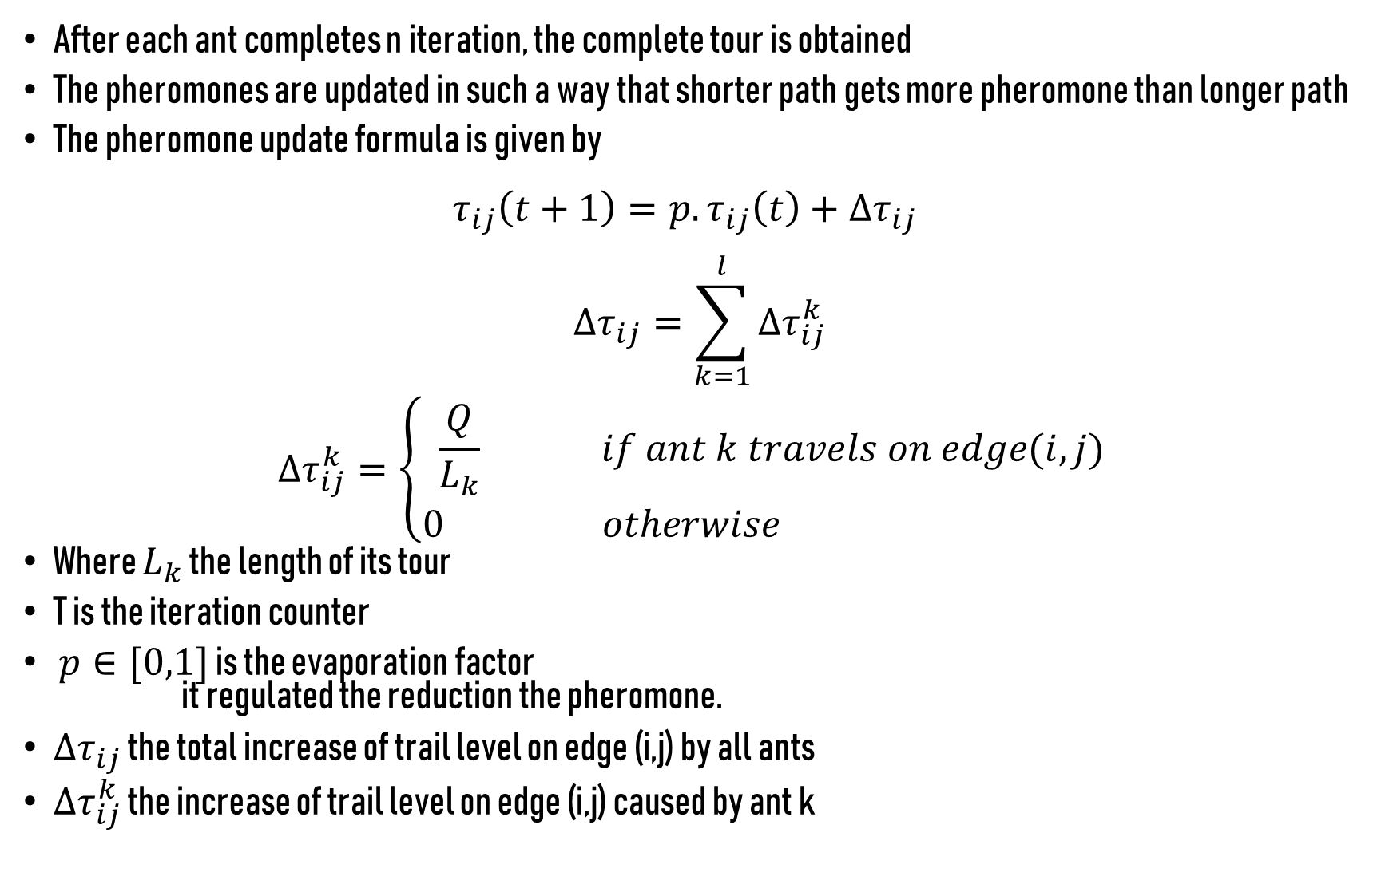
After each ant completes n iteration, the complete tour is obtained
The pheromones are updated in such a way that shorter path gets more pheromone than longer path
The pheromone update formula is given by $τ_{ij}\left(t+1\right)=p.τ_{ij}\left(t\right)+∆τ_{ij}$
$$∆τ_{ij}=\sum_{k=1}^{l}{∆τ_{ij}^{k}}$$
$$∆τ_{ij}^{k}=\left\{\begin{aligned}\frac{Q}{L_{k}} if ant k travels on edge(i,j) \\ 0 otherwise \end{aligned}\right.$$
Where $L_{k}$ the length of its tour
T is the iteration counter
$p∈[0,1]$ is the evaporation factor it regulated the reduction the pheromone.
$∆τ_{ij}$ the total increase of trail level on edge (i,j) by all ants
$∆τ_{ij}^{k}$ the increase of trail level on edge (i,j) caused by ant k

Slide 7
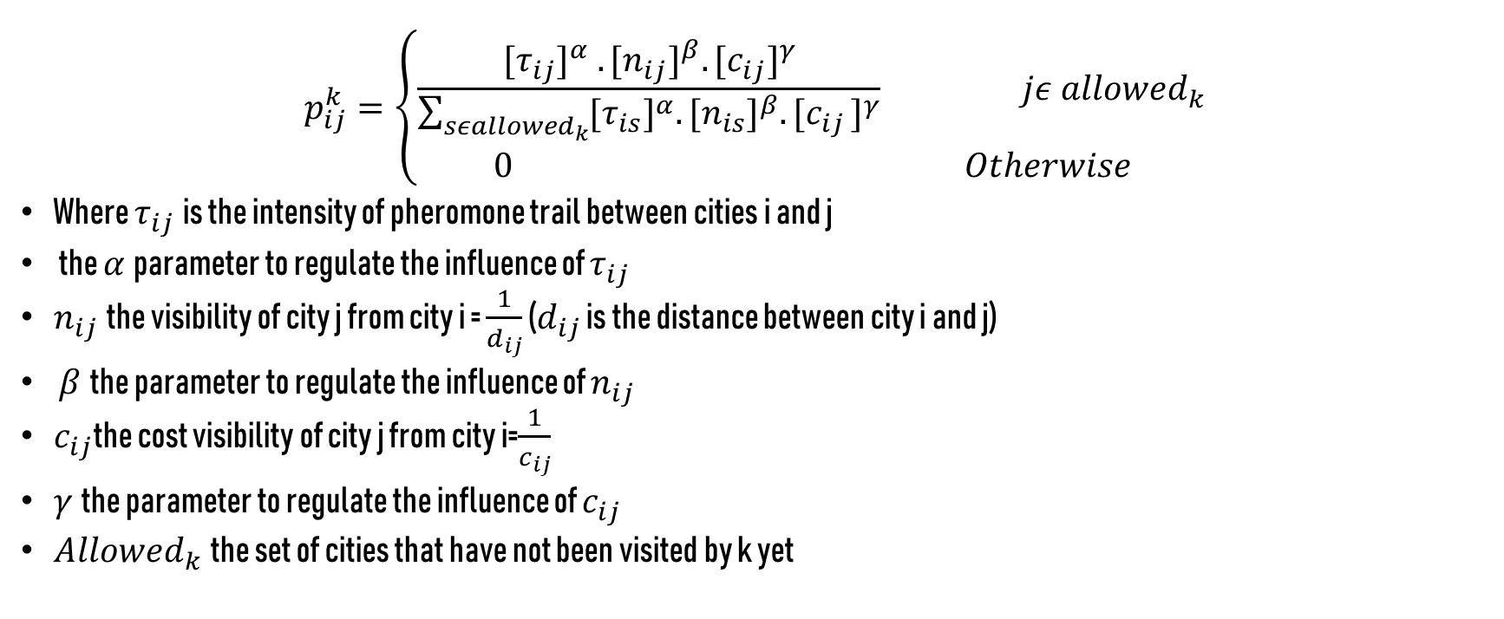
Modified Model Probability to select city j by an ant k (taking distance and cost), sitting at city i is given by:
$$p_{ij}^{k}=\left\{\begin{aligned}\frac{{[τ_{ij}]}^{α} .{{[n}_{ij}]}^{β}. {{[c}_{ij}]}^{γ}}{\sum_{{sεallowed}_{k}}{{{[τ}_{is}]}^{α}.{{[n}_{is}]}^{β}{{.[c}_{ij}]}^{γ}}} jε {allowed}_{k} \\ 0 Otherwise\end{aligned}\right.$$
Where $τ_{ij}$is the intensity of pheromone trail between cities i and j
the $α$parameter to regulate the influence of $τ_{ij}$
$n_{ij}$the visibility of city j from city i = $\frac{1}{d_{ij}}$ ($d_{ij}$ is the distance between city i and j)
$β$the parameter to regulate the influence of $n_{ij}$
$c_{ij}$the cost visibility of city j from city i=$\frac{1}{c_{ij}}$
$γ$the parameter to regulate the influence of $c_{ij}$
${Allowed}_{k}$the set of cities that have not been visited by k yet

Slide 8
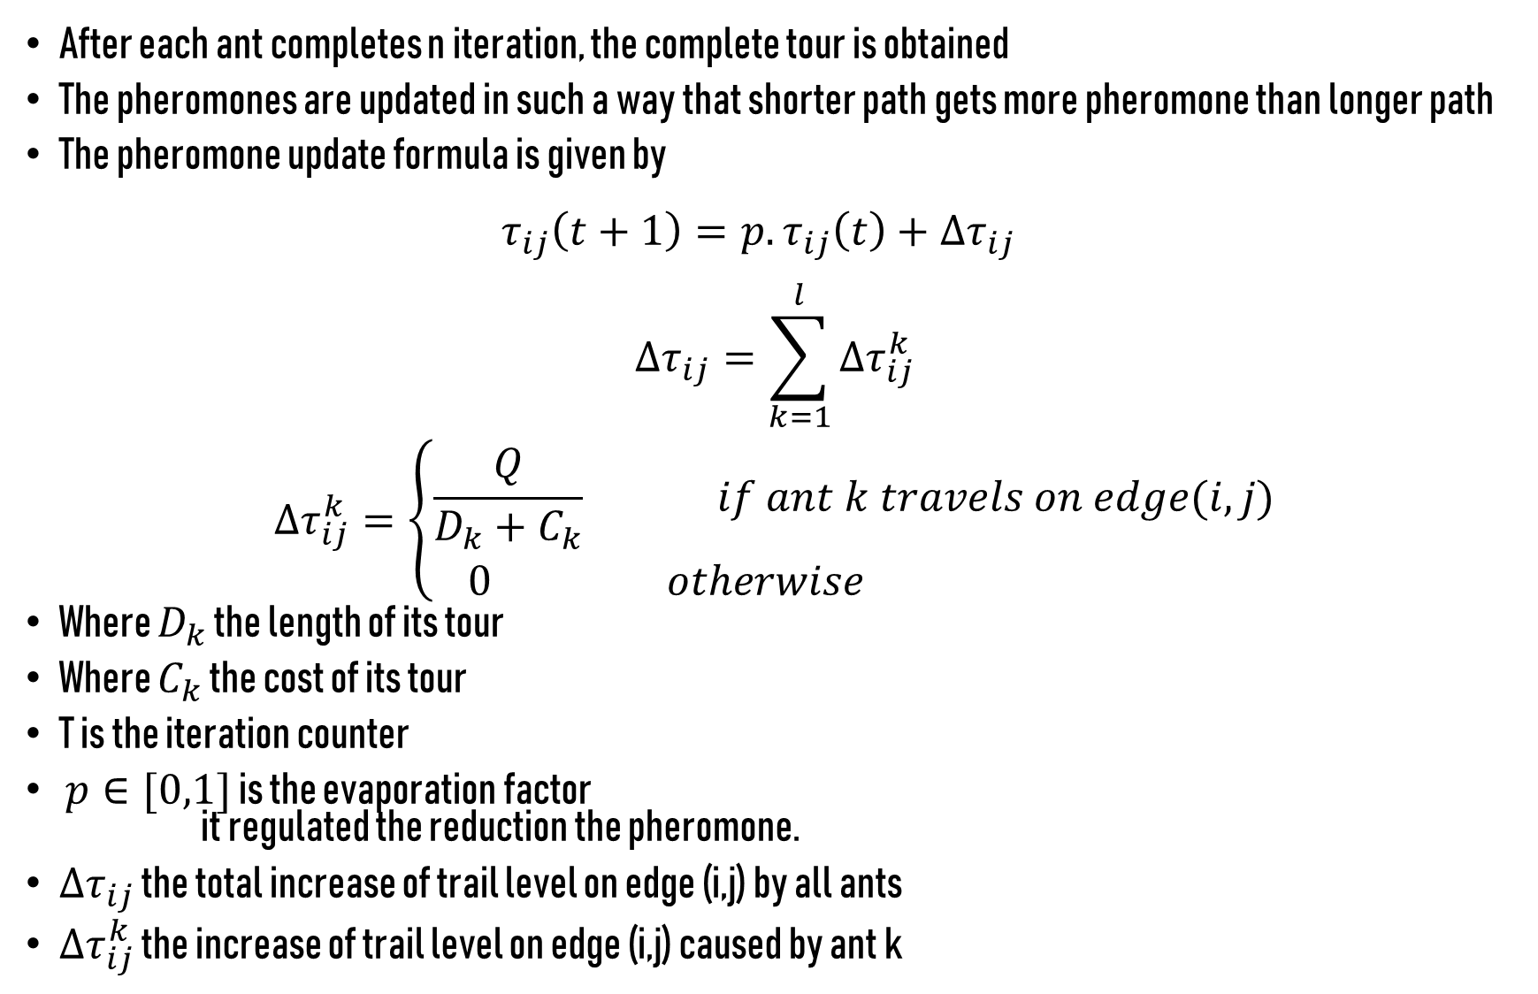
After each ant completes n iteration, the complete tour is obtained
The pheromones are updated in such a way that shorter path gets more pheromone than longer path
The pheromone update formula is given by $τ_{ij}\left(t+1\right)=p.τ_{ij}\left(t\right)+∆τ_{ij}$
$$∆τ_{ij}=\sum_{k=1}^{l}{∆τ_{ij}^{k}}$$
$$∆τ_{ij}^{k}=\left\{\begin{aligned}\frac{Q}{D_{k}+C_{k}} if ant k travels on edge(i,j) \\ 0 otherwise \end{aligned}\right.$$
Where $D_{k}$ the length of its tour
Where $C_{k}$ the cost of its tour
T is the iteration counter
$p∈[0,1]$ is the evaporation factor it regulated the reduction the pheromone.
$∆τ_{ij}$ the total increase of trail level on edge (i,j) by all ants
$∆τ_{ij}^{k}$ the increase of trail level on edge (i,j) caused by ant k

Slide 9
CUDA (Compute Unified Device Architecture)
CUDA is a parallel computing platform and application programming interface (API) model created by Nvidia. It allows software developers and software engineers to use a CUDA enabled graphics processing unit (GPU) for general purpose processing. This approach termed GPGPU (General-Purpose computing on Graphics Processing Units). The CUDA platform is a software layer that gives direct access to the GPU's virtual instruction set and parallel computational elements, for the execution of compute kernels.

Slide 10
NOTES
HOST -> CPU
DEVICE-> GPU( Normal computation capacity but numerous cores).
PTX assembly language for CUDA.
NVCC complier.
FUNCTION QUALIFIERS:
_global_ -> called by host, runs on device. Kernels are marked by this qualifiers.
_device_ -> called by device. Runs on device kernel helper functions.
_host_ -> Normal host function (or no qualifiers)

Slide 11
Data must be copied back and forth.
CUDA API for Device Memory Management.
cudaMalloc(void **devPtr,size_t sizeInBytes) : Reserves memory on device’s global memory.
cudaFree(voud **devPtr) : Free space
cudaMemcpy(void *dest,void *src,size_t sizeinbytes,enum direction)
Direction : cudaMemcpyDeviceToHost, cudaMemcpyDeviceToHost

