Slide 1

Piyush Bamel 16BCE1221 Kaustubh Nagar 16BCE1338

Slide 2
Target Audience
Farmers, Agriculture Enthusiasts and Agriculture Officers

Slide 3
Problem Statement
Farmers follow their conventional ways/ don’t have adequate resources about which crop to grow when and where
Lacs of kilos of grains wasted due to plantation of wrong crops.
Destruction of harvest due to natural disasters or sudden climatic changes
Many students/enthusiasts have to grow through a wide numbers of web pages which is tiresome or boring, which in turn leads to lack of interest

Slide 4
Brief Destruction
This website will educate farmers and other agricultural students the best crop that can be grown in a certain climatic region with factors like amount of rainfall, type of soil, temperature and many more playing a major role in the result. It also has course material to educate farmers in smarter farming techniques using modern technology and also gives agricultural students access to course material posted by different universities that offer agriculture related courses. The farmers are notified about the disasters and solutions they can take in order to minimize the damage caused. It also informs the local agriculture officers in the region so that the farmers that do not have the access may be notified by the authorities and preventive measures can be taken in time.

Slide 5
It suggests user the crop he/she should grow on the basis of the input.
We’ll be suggesting crops on the basis of the following factors Precipitation, Temperature, soil type (nitrogen, phosphorus and sulphur).
Before anything we have created a dataset on our own by merging the given datasets with the following fields Crop name and then with the above mentioned factors for an ideal crop.

Slide 6
Technical Requirements
Machine Learning
HTML
CSS
AJAX
R Studio
Data analytics
PHP

Slide 7
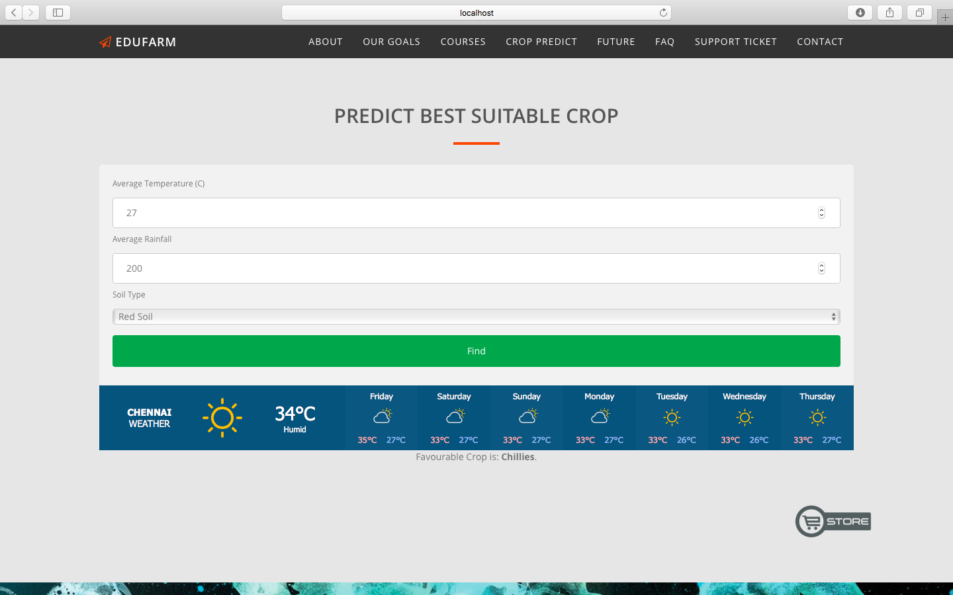
Feature 1
After user inputs the fields, we’ll be suggesting the crop to be grown using our own created prediction model which is using multinomial logistic regression executed using machine learning. With this we would also be displaying the suggested crop.

Slide 8
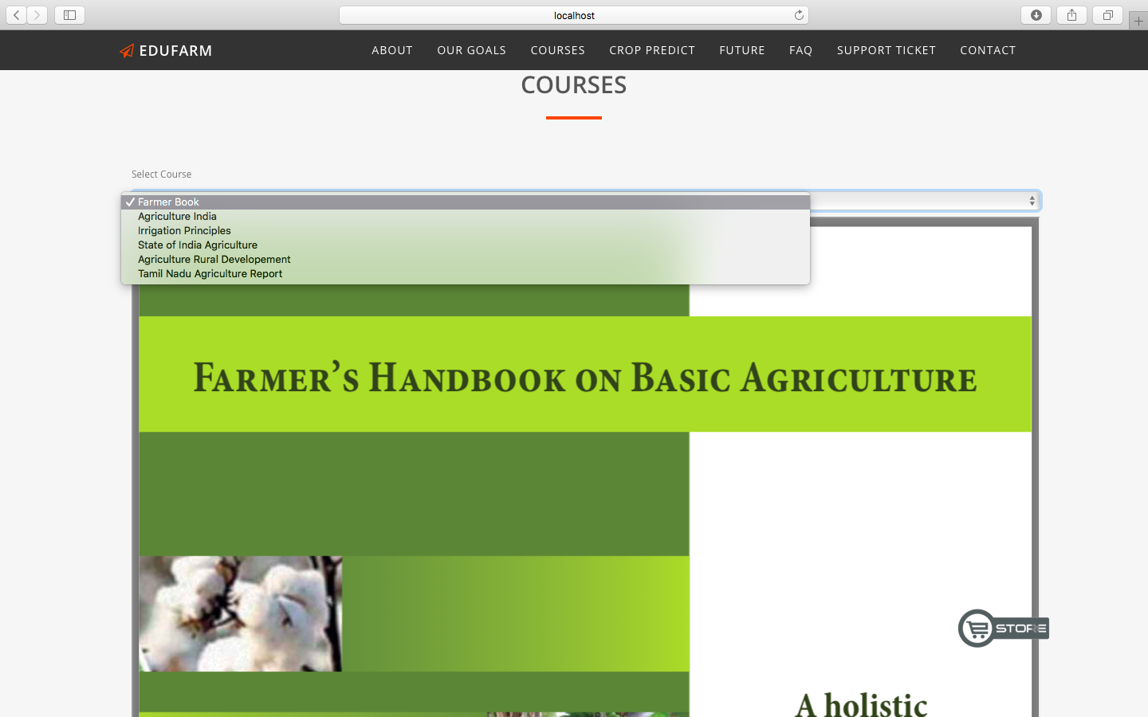
Feature 2
Application has all the course material to educate farmers in smarter farming techniques using modern technology and also gives agricultural students access to course material posted by different universities that offer agriculture related courses. Main focus was to just provide a very simple and easy way for students to access information easily.

Slide 9
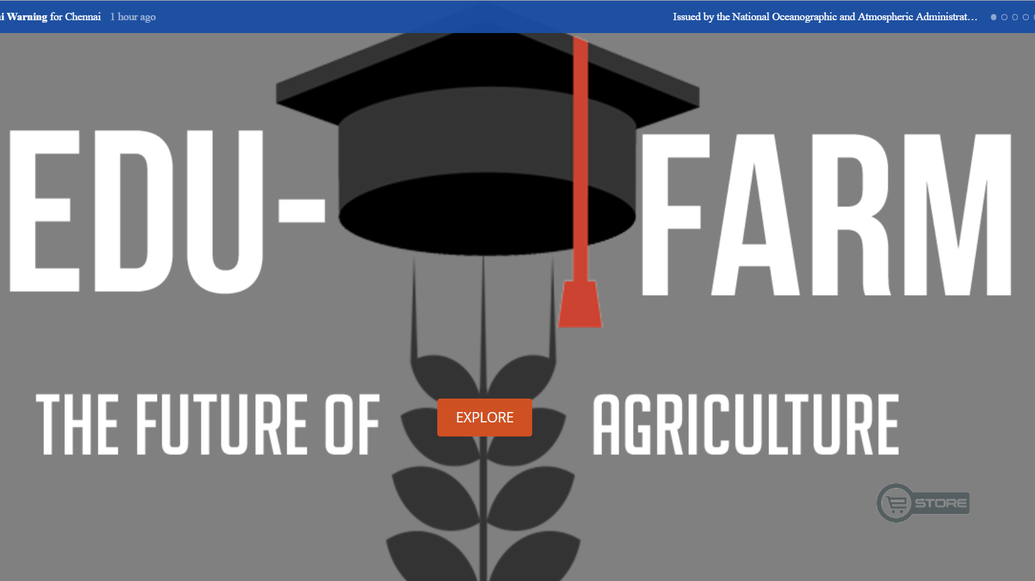
Feature 3
A calamity warning system that with inform user about any possible danger to the crops

Slide 10
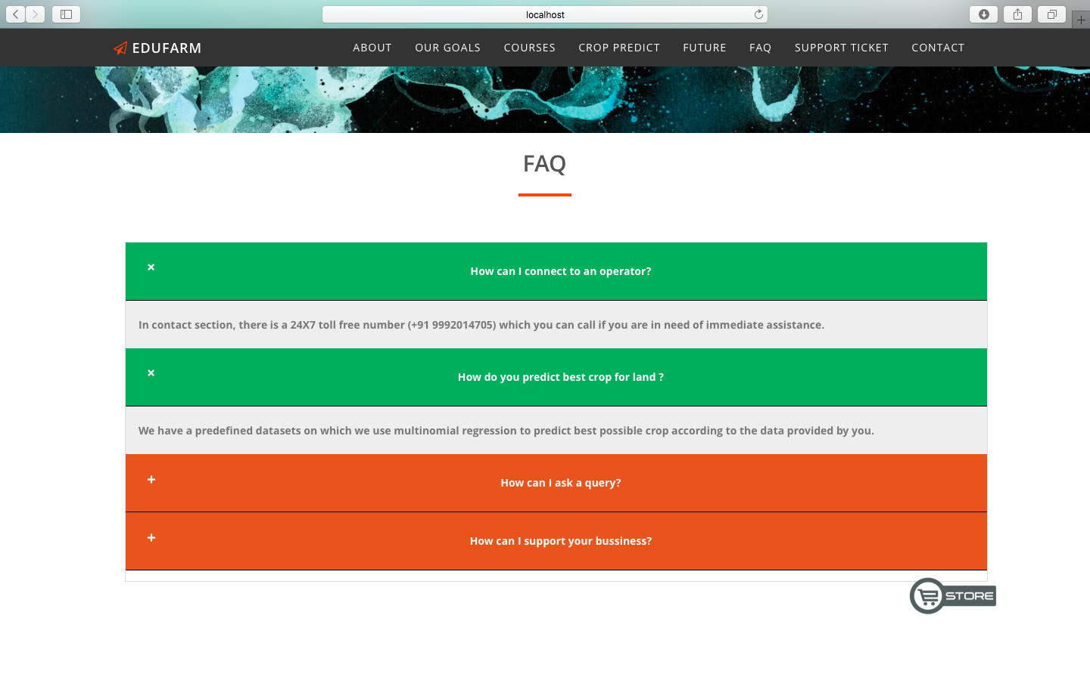
Feature 4
FAQ present to answer commonly asked questions of the user to make their experience delightful and hassle free.

Slide 11
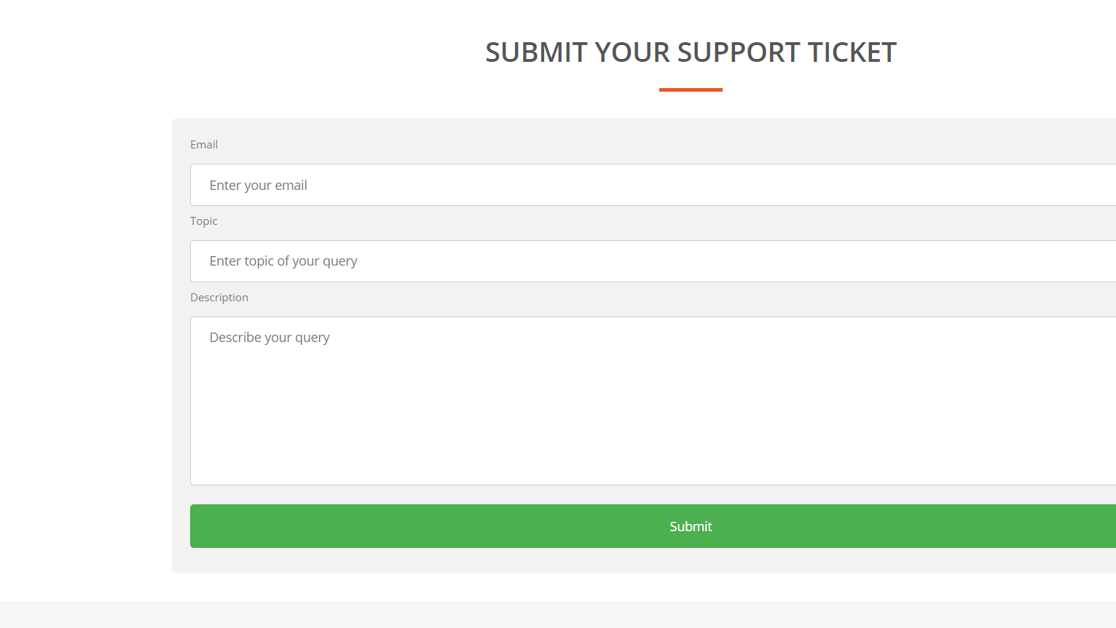
Feature 5
A Support Ticket system helps user who need expert assistance

Slide 12
FUTURE SCOPE
This is not a final implementation. There is a lot of scope for improvement both in terms of user interactivity and general features. Augmented Reality can be included to give suggestions on methods of farming.
Development for private sector(Revenue Model)

