Slide 1
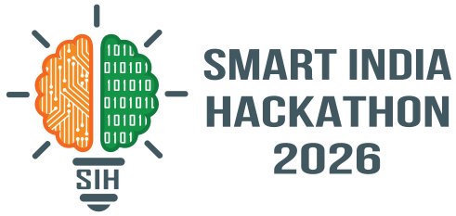

SMART INDIA HACKATHON 2026
• Problem Statement ID – SIH26103
• Problem Statement Title - Integrated Government Project Monitoring & Intelligence Platform
• Theme- Infrastructure & Governance
• PS Category- Software
• Team ID- SIH26103
• Team Name - Team VeriX
• Project Name - SetuX ("From Reported Progress to Verified Progress")

Slide 2

SetuX
Bridging Infrastructure Monitoring to Verified Progress
Proposed Solution & Approach
📋 Project Ingestion
📷 Field Evidence
⚡ Risk Intelligence
📊 Command Center
👥 Verified Outcomes
1
Project Monitoring: Centralized tracking of physical, financial, and milestone status across all projects.
End-to-End Workflow
2
Progress & Evidence: Multi-source progress backed by geo-tagged photos, documents & inspection logs.
1. Data Ingestion
2. Field Evidence
3. AI/ML Predict
4. Risk Fusion
5. Risk & Impact
6. Early Alerts
7. Officer Action
8. Stakeholders
Project Plans, BOQ, Milestones
Geo-photos, Inspections
Delay & Cost Forecaster
Multi-Factor Scoring
GIS Heatmap & Slippage
Escalation Warnings
Intervention & Review
Audit Logs & Public View
3
Risk Intelligence: Multi-factor scoring evaluating milestone delays, cost escalation & vendor risk.
4
Predictive Analytics: Machine learning models forecasting potential cost overruns and schedule delays.
Continuous Verification & Audit Trail
(Field inspections, milestone validations, verified outcomes)
5
Early Warnings: Proactive alerts and trigger thresholds notifying officers before slippage escalates.
6
Executive Reporting: Automated, audit-ready briefing reports and executive dashboards for quick decisions.
🌐 Hosted Application
Click here
🐙 GitHub Repository
Click Here
SMART INDIA HACKATHON 2026

Slide 3
TECHNICAL APPROACH
Technology Used
Data Sources
• Project Plans / DPR
• Milestone Schedules
• Financials / BOQ
• Geo-coordinates
Work Flow Diagram
View Live GIS Map
(Leaflet + OSM)
• Ingestion Preprocessing
• Feature Engineering (Milestone drift, BOQ variance)
• Overrun Prediction (scikit-learn)
• Rule Risk Scoring
Data Processing & AI
Risk Fusion
Integrated Risk Score
(Low / Medium / High / Critical Weighted Ensemble)
Risk & Impact Analysis
• Slippage Heatmap (GIS)
• Financial & Milestone Impact on Corridors
Early Warning & Alerts
• Officer In-App Alerts
• Audit Log Generation
• Executive PDF Reports
Data Processing
• Python / FastAPI
• Pydantic Schemas
• SQLAlchemy ORM
• NumPy / Pandas
User /
Officer
Open
SetuX
Upload Progress
(Evidence & Logs)
(FastAPI + SQLite)
AI/ML Model
• scikit-learn Engine
• Cost Overrun Regr.
• Delay Risk Classifier
• Rule Risk Indicators
Database
• SQLite (MVP)
• PostgreSQL Schema
• Audit Event Logs
Field Engineers / Project Leads
Senior Authorities / Administrators
• Submit milestone progress updates
• Upload geo-tagged inspection photos
• View assigned task schedules
• Log delay reasons & site constraints
• Monitor nationwide project risk dashboard
• Review predicted cost & time overruns
• Verify evidence & approve milestones
• Export executive audit & briefing reports
Maps & GIS
• Leaflet / OSM
• GeoJSON Pins & Poly
• Spatial Risk Heatmap
User Interface
• React 18 / Vite
• Tailwind CSS
• Recharts Analytics
• Lucide Icons
Deployment
• Uvicorn ASGI
• RESTful Architecture
• GitHub / Docker
3

Slide 4
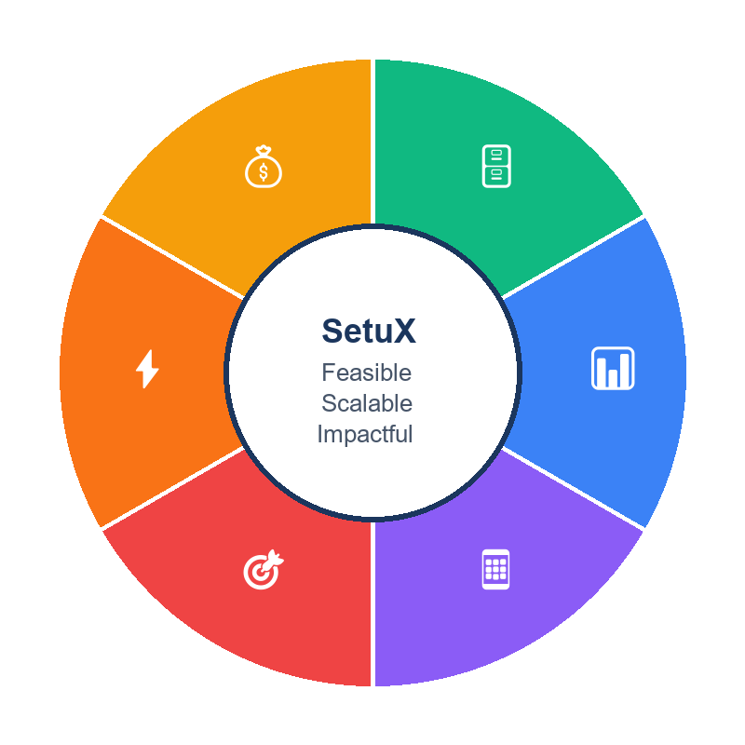
FEASIBILITY AND VIABILITY
Feasibility of the Idea
Challenges Faced & Strategies to Overcome
Available Data Sources
Standard DPRs, milestone schedules, financial allocations, and field progress logs.
Cost-Effective
Built on modern open-source stack, eliminating expensive proprietary licensing.
Fragmented Project Data in Silos
Multi-source disparate spreadsheets delay decision visibility.
Unified Ingestion & Dashboard
Standardized REST API ingestion creates a single pane of glass monitoring system.
Subjective Progress Reporting
Field claims without evidence lead to unaccounted project delays.
Evidence-Backed Verification
Geo-tagged photos, BOQ logs & inspection checkpoints validate field progress.
Technically Viable
Proven React + FastAPI stack with scikit-learn predictive modeling & Leaflet GIS.
Scalable Solution
Modular REST API architecture easily expanding from local works to national portfolios.
Unforeseen Cost & Time Overruns
Delays discovered only after critical budget slippages occur.
ML Risk Intelligence Engine
scikit-learn predictive models forecast overrun probability & schedule drift.
Complex Multi-Site Spread
Difficult to track geographical progress across highway corridors.
GIS Interactive Mapping
Leaflet + OpenStreetMap maps all projects with visual risk heatmaps.
Field Practical
Lightweight web architecture with responsive UI & offline-tolerant data entry.
Actionable Insights
Intuitive risk scores, time/cost overrun forecasts, and spatial project maps.
Administrative Reporting Burden
Manual compilation of executive summaries wastes officer time.
Automated Executive Reports
Instant PDF generation with structured KPI summaries & audit logs.
4

Slide 5
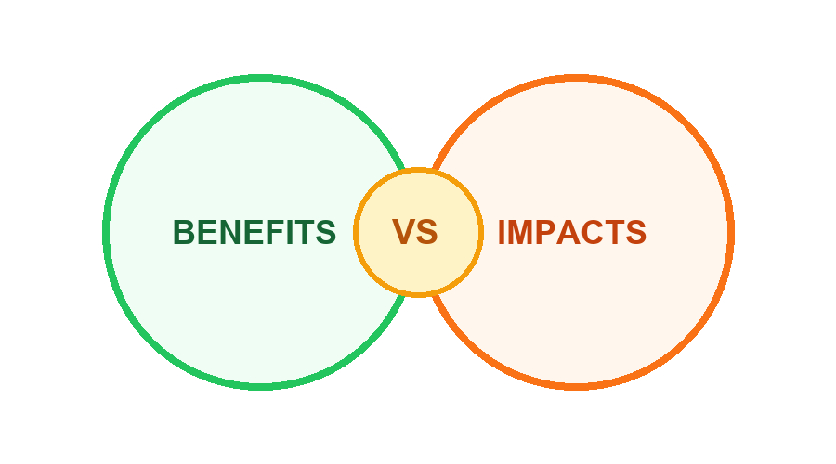
BENEFIT AND IMPACT
Unified Project Monitoring
Centralized real-time visibility across physical, financial, and milestone metrics.
01
01
Timely Officer Intervention
Proactive alerts enable administrative action before minor delays become critical overruns.
Evidence-Supported Progress
Geo-tagged photos, documents, and inspection logs validate claimed progress.
02
Enhanced Accountability
Verifiable progress submissions reduce discrepancy between reported and actual field status.
02
Predictive Risk Intelligence
Multi-factor risk engine detects schedule slippages and cost anomalies early.
03
Optimized Resource Allocation
High-risk projects are highlighted for targeted intervention and budget management.
03
Geospatial Infrastructure Mapping
Interactive GIS tracking enables regional and corridor-level oversight.
04
Improved Governance Visibility
Standardized monitoring framework ensures consistent oversight across departments.
Audit-Ready Reporting
Automated executive briefings and complete audit trails streamline compliance.
04
05
5

Slide 6
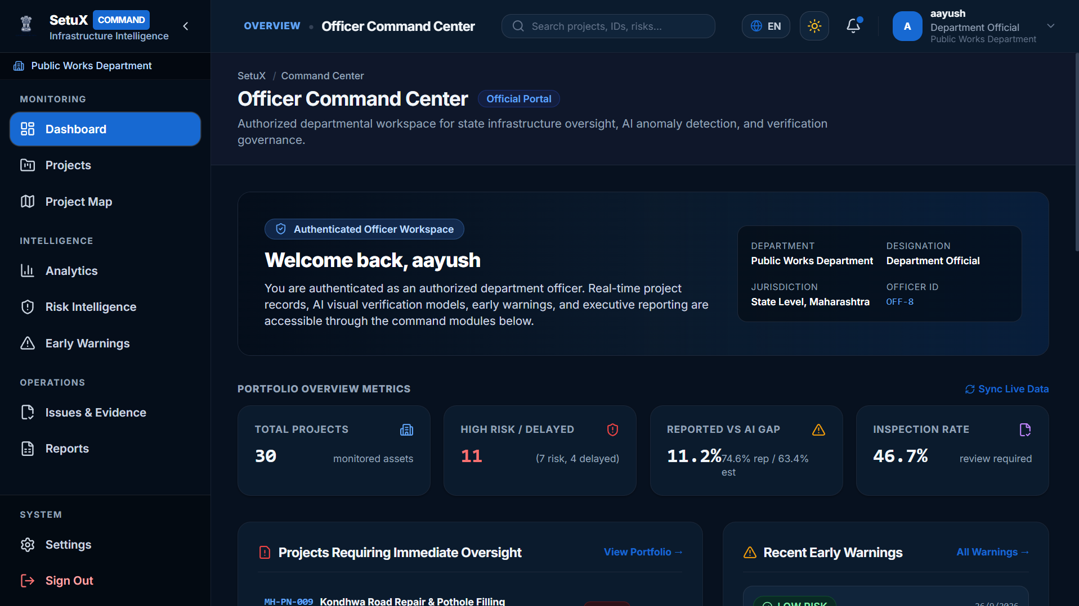
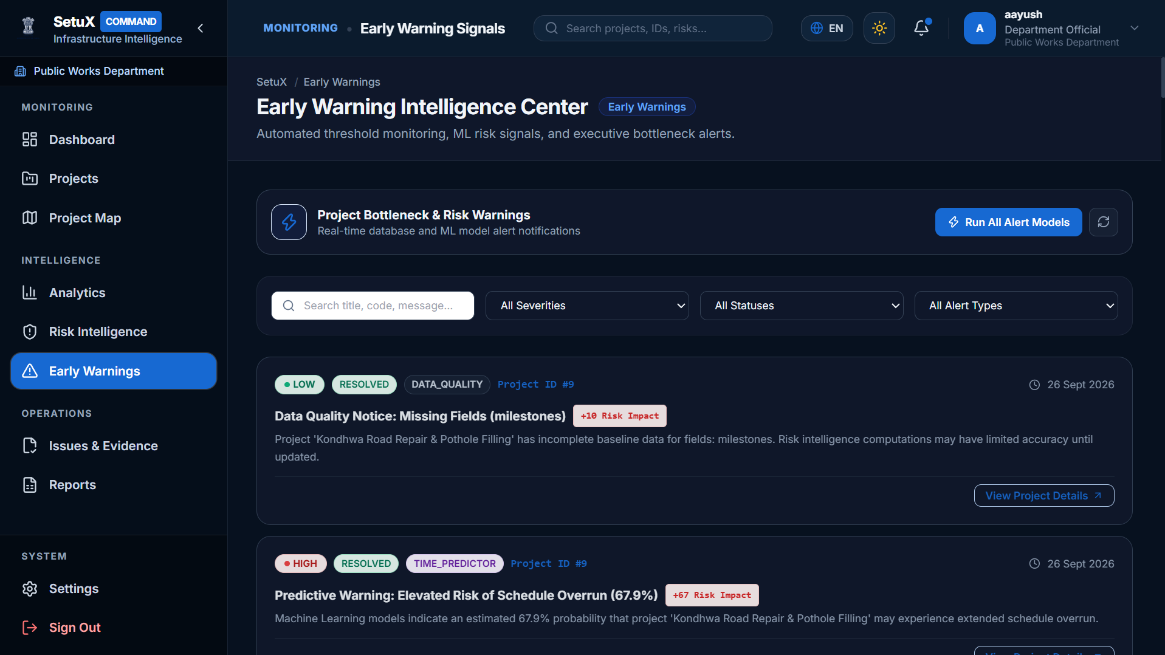
RESEARCH AND REFERENCES
• Ministry of Statistics and Programme Implementation (MoSPI)
• Infrastructure and Project Monitoring Division (IPMD) — National project monitoring norms & flash reporting system.
https://mospi.gov.in/infrastructure-and-project-monitoring-division-ipmd
• Government of India — PM GatiShakti National Master Plan
• Multi-modal infrastructure connectivity, spatial planning and institutional project monitoring framework.
https://gati-shakti.gov.in/
• Project Monitoring Group (PMG) / DPIIT
• Institutional mechanism for fast-tracking resolution of issues and milestone monitoring in mega projects.
https://pmg.dpiit.gov.in/
• scikit-learn: Machine Learning in Python — 2026
• Pedregosa et al., JMLR. Applied for infrastructure cost overrun regression and schedule delay risk classification.
https://scikit-learn.org/stable/
• FastAPI & High-Performance Asynchronous Python Framework
• Production-ready REST API architecture with Pydantic schema validation for robust government data pipelines.
https://fastapi.tiangolo.com/
• Leaflet & OpenStreetMap Open Geospatial Standards
• Open-source interactive GIS visualization for project corridors, geo-tagged checkpoints and spatial heatmaps.
https://leafletjs.com/
D
A
S
H
B
O
A
R
D
6

