Slide 1
Module 3 Importing, exporting and changing data
Python for Data Processing (basics)

Slide 2
Content
Functions
Modules
Numpy
Pandas
Importing and exporting data
Working with data

Slide 3
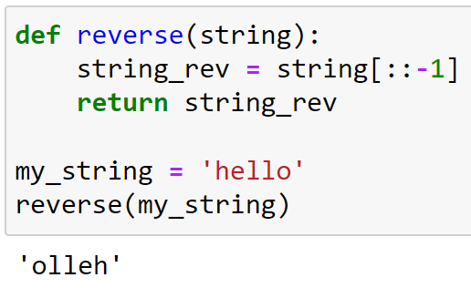
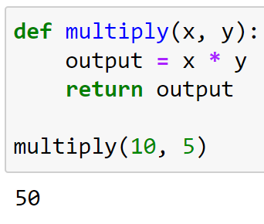
Functions
A function is a block of organized, reusable code that is used to perform a single, related action
There are many prebuilt functions, like print(), len(), range()
Can you name some functions?
You can create your own function

Slide 4
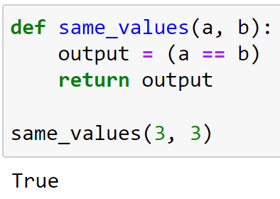
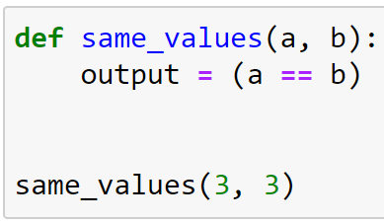
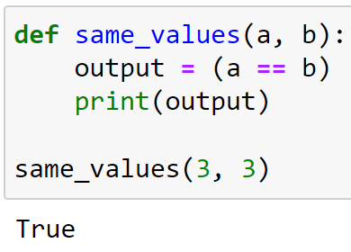
Functions – Format
Start defining a function using def
Set function name and input name(s) (between brackets)
Watch colon and indentation!
return the output of the function (optionally)

Slide 5
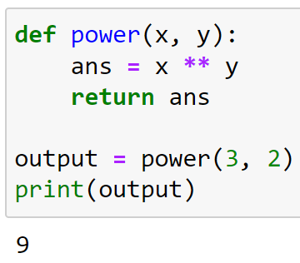
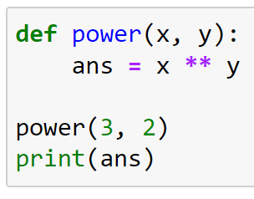
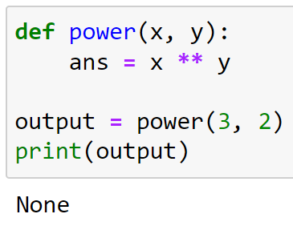
Functions – Examples
return is crucial for letting Python remember the output of a function
Variables created within a function will not be remembered by Python

Slide 6
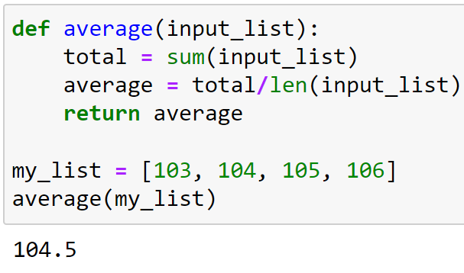
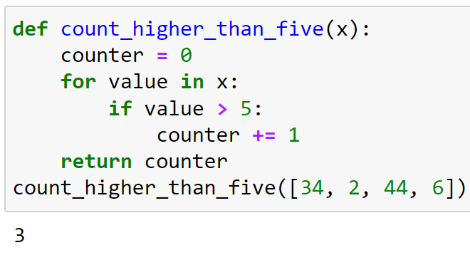
Functions – Examples
Some more examples:

Slide 7
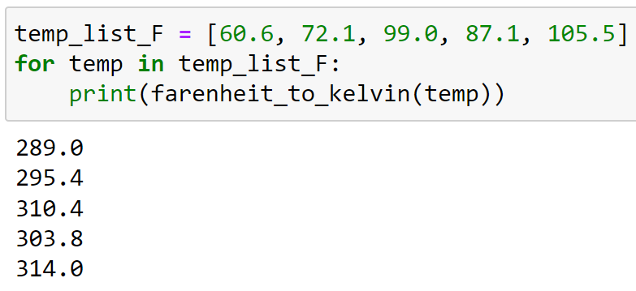
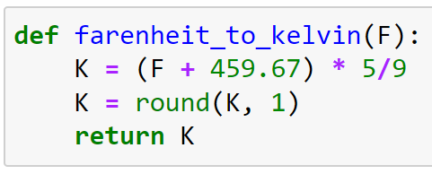
Functions – F to K example
From degrees Fahrenheit to degrees Kelvin
Formula: K = (F + 459.67) * 5/9
Function name? Input?

Slide 8
Modules
A module is a file with Python code
A module allows you to logically organize your Python code
For example, to reuse a handy function that you have built
With the import statement, we can import modules, so that we can use the contents of the module

Slide 9

Modules – Your own module
In the exercises we will create our own module
Copy the code from your function to a text file (notepad)
Save the file in same folder as exercises notebook
Change .txt into .py
Import the module using import and the filename
Now you can use you function
Ask help once you arrive at this exercise!

Slide 10
Modules from others
Python and Anaconda already have many modules (packages) available
For example, numpy and pandas, which we will use
Other modules you need to download and install first
There are many, many, many modules available with many, many, many functionalities
For almost any problem you have, there is a module/function available
IMPORTANT: Internet is your friend!

Slide 11

Modules – Numpy
Python contains many modules
One important module (or package) is numpy
To use numpy or any other package you need to import
Otherwise, you will get this error

Slide 12
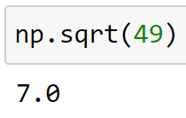
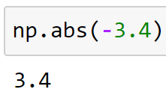
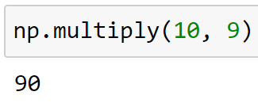
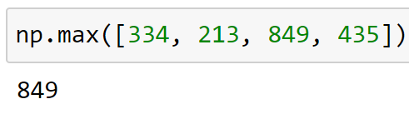
Numpy – Mathematics
Numpy is a very useful module/package
With numpy we can do mathematical operations

Slide 13

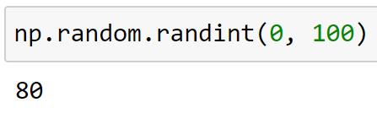

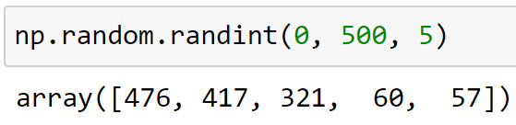
Numpy – Random
Numpy can be used for creating random numbers
To create fake data, randomize a process, do statistical tests, etc.
For example, using np.random.randint()
There are many options with numpy
Remember: try using tab and ?

Slide 14
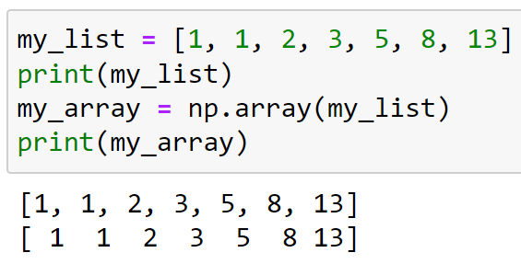
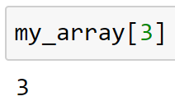
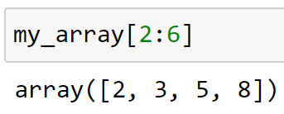
Numpy arrays
A numpy array is a collection of data (just like lists and dictionaries)
A numpy array can be created by turning some other collection into an array with the method np.array()
Accessing and slicing works just as with lists (and strings)

Slide 15
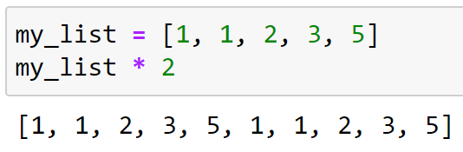
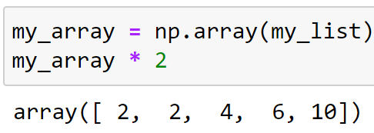
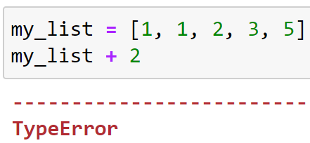
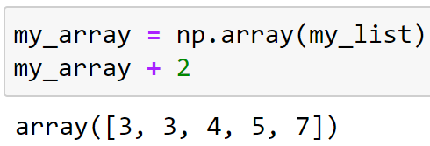
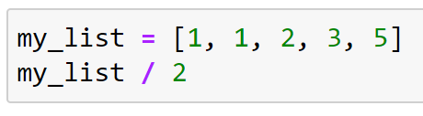
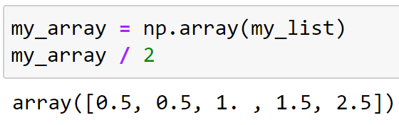
Numpy arrays
Mathematical operations are different with np.arrays than with lists!

Slide 16
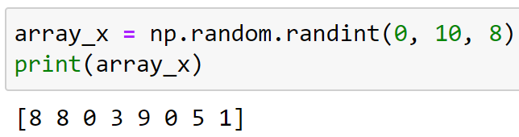
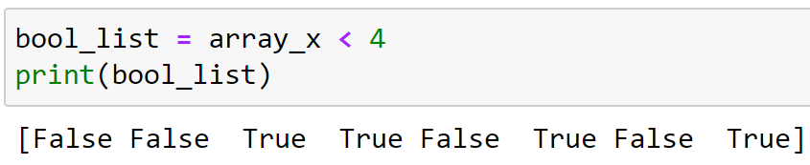
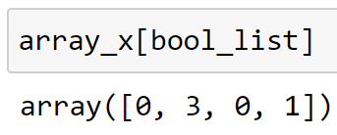
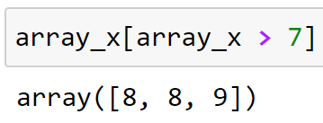
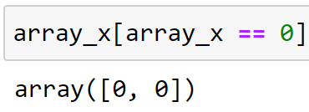
Boolean slicing
With numpy arrays you can also slice by using booleans
A list (or array) of booleans can be created by using conditional statements

Slide 17
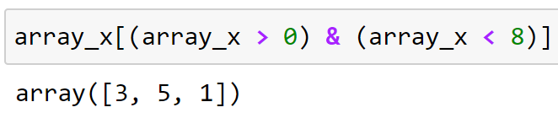
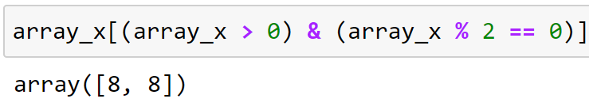
Boolean slicing
You can combine booleans
Watch the and-sign &
Put brackets around the conditions ( )

Slide 18
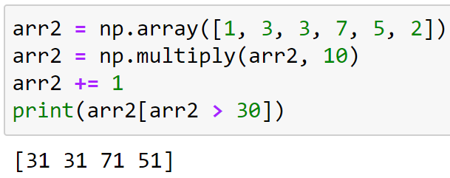
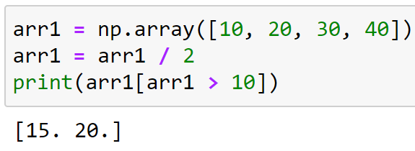
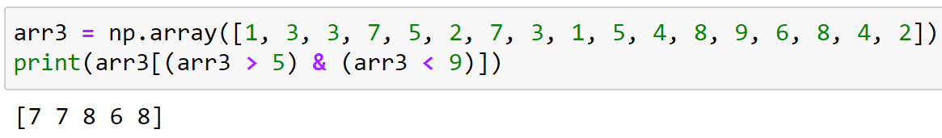
Boolean slicing
Some more examples

Slide 19

Good luck!

