Slide 1
MultiLayers Canopy Root Soil Model (MLCan) Interface
CEE550
Jan 27, 2011

Slide 2
CONTENT
Multilayer canopy root soil model (MLCan) Overview
MLCan Interface
Examples

Slide 3
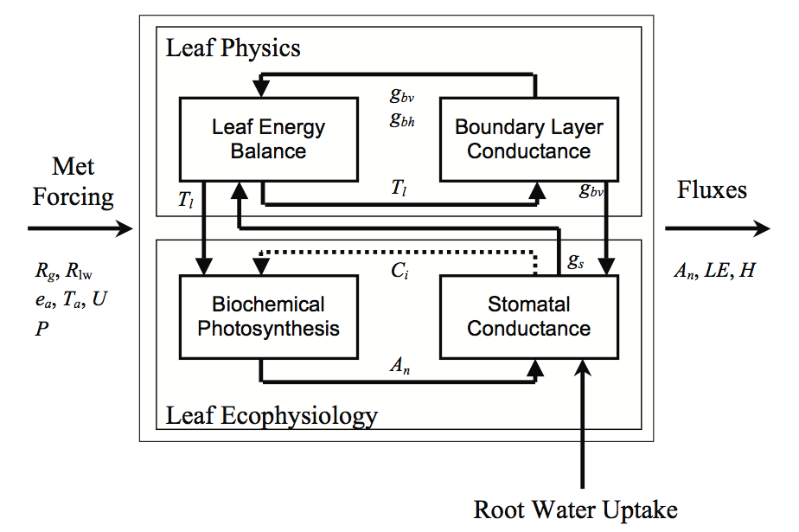
Overview
Facilitate modeling steps
Better visualizations
Save time
Skip reading codes and syntaxs
BUT
Less flexible
Understanding principles is still required
Drewry et al., 2010

Slide 4
MLCan Interface 1.0

Slide 5
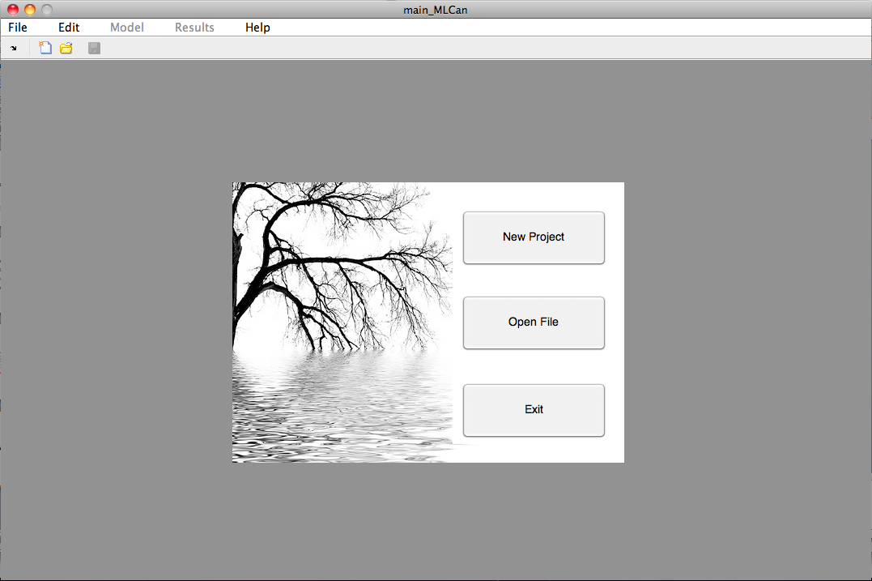
OPENING SCREEN

Slide 6
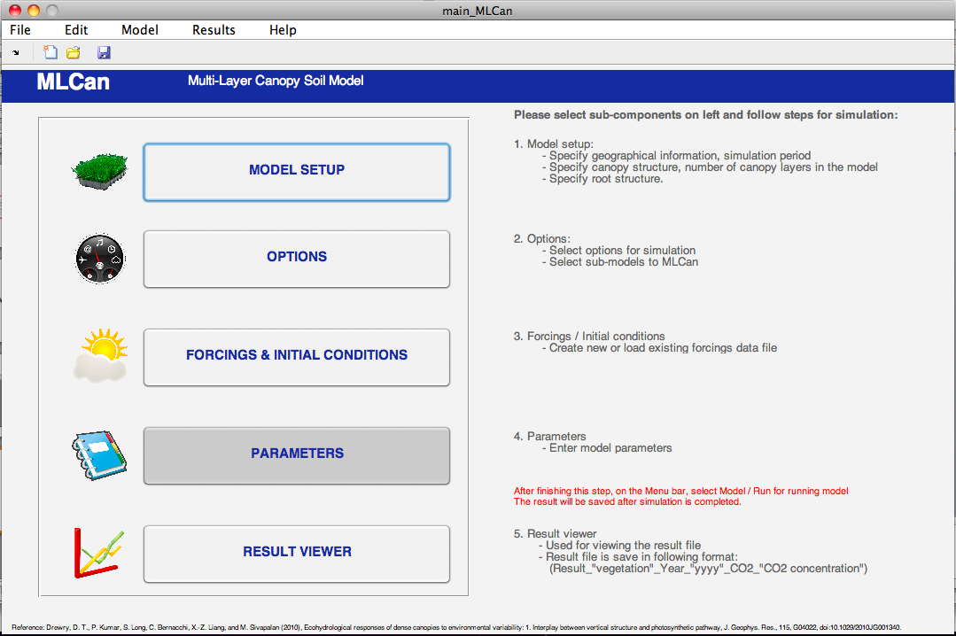
MAIN WINDOW
Menu
Toolbar
Instructions
Sub-components

Slide 7
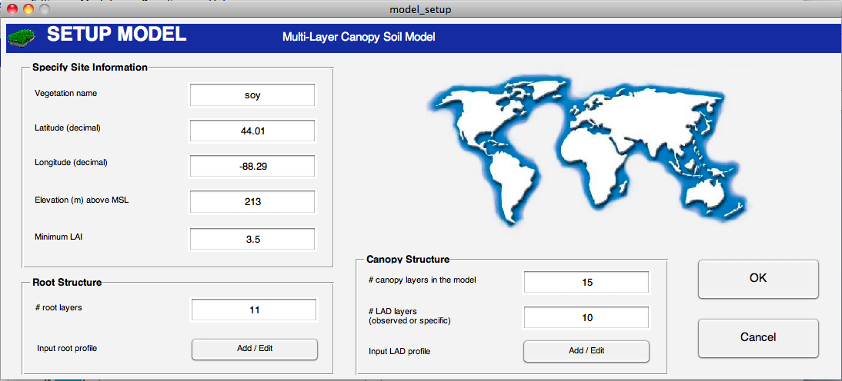
MODEL SETUP

Slide 8
Minimum LAI

Slide 9
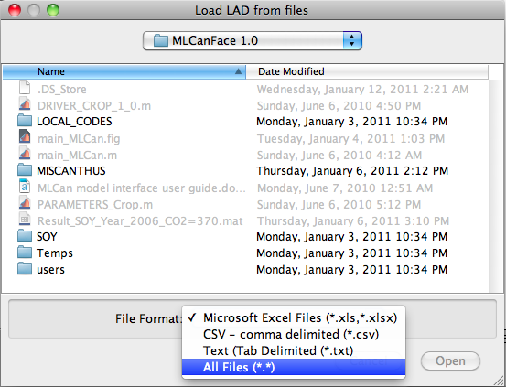
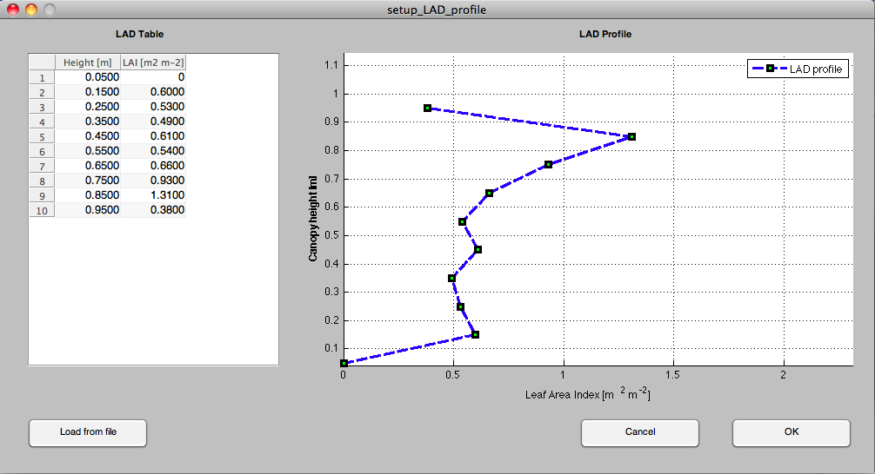
MODEL SETUP – CANOPY
LAI: Leaf Area Index
LAD: Leaf Area Density
How do we enter information?
- Manually or Import
WHY IS CANOPY STRUCTURE IMPORTANT?

Slide 10
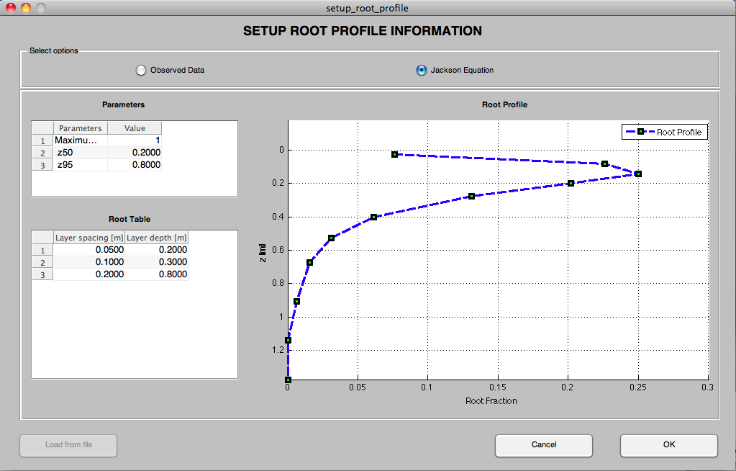
MODEL SETUP - ROOT
Where: z₅₀ and z₉₅ are depths from the surface above which 50 % and 95% of all roots are located.
ROOT STRUCTURE?

Slide 11
MAIN WINDOW

Slide 12
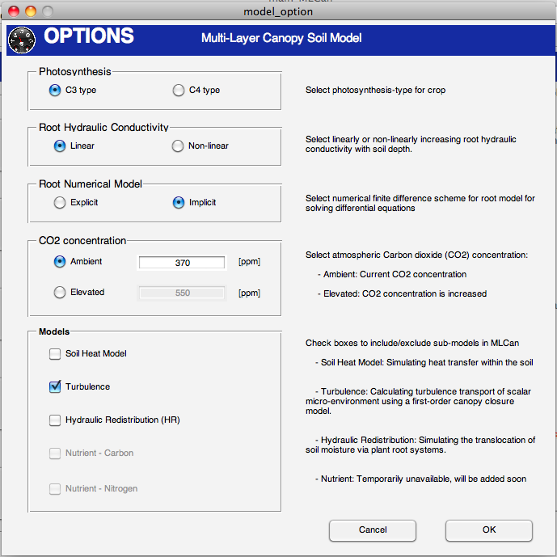
OPTIONS

Slide 13
MAIN WINDOW

Slide 14
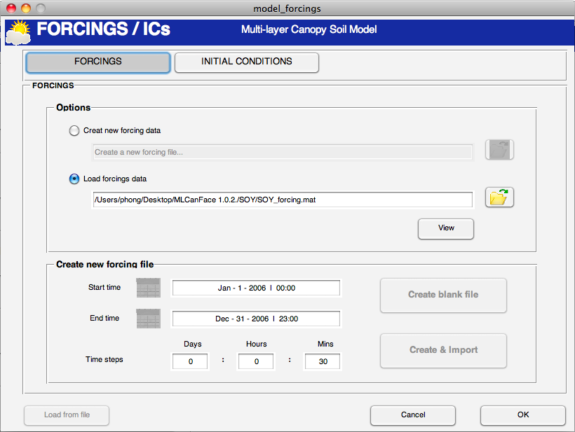
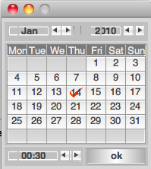
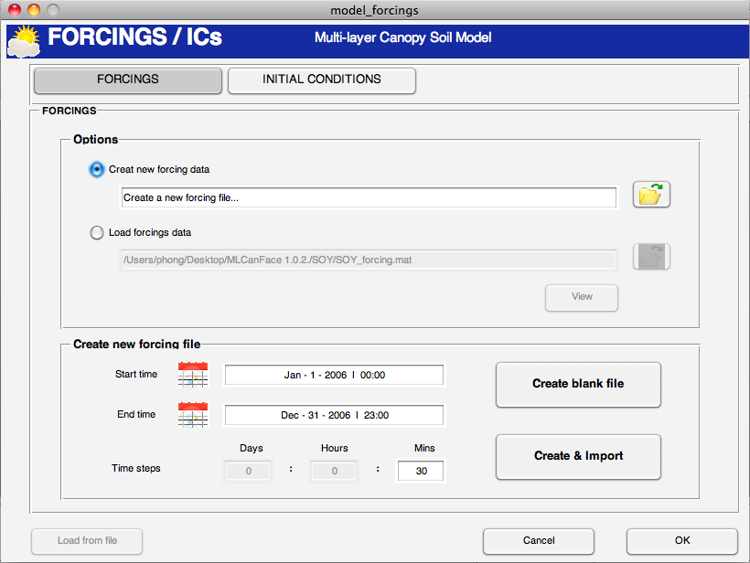
FORCINGS
Precipitation
Air temperature
Global radiation
Longwave downward
Wind speed
Atmospheric saturation vapor
And so on
Choose a name
Choose a date
Remember to choose the file after it is created to drive the model

Slide 15
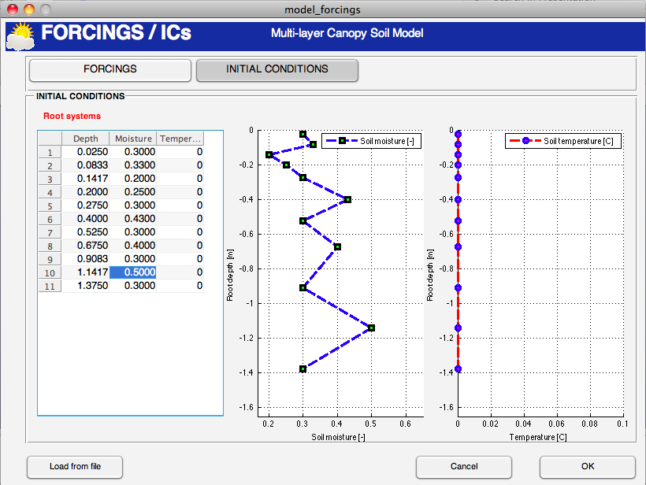
INITIAL CONDITIONS
Where does the root depth come from?
Why do we need Initial conditions?

Slide 16
MAIN WINDOW

Slide 17
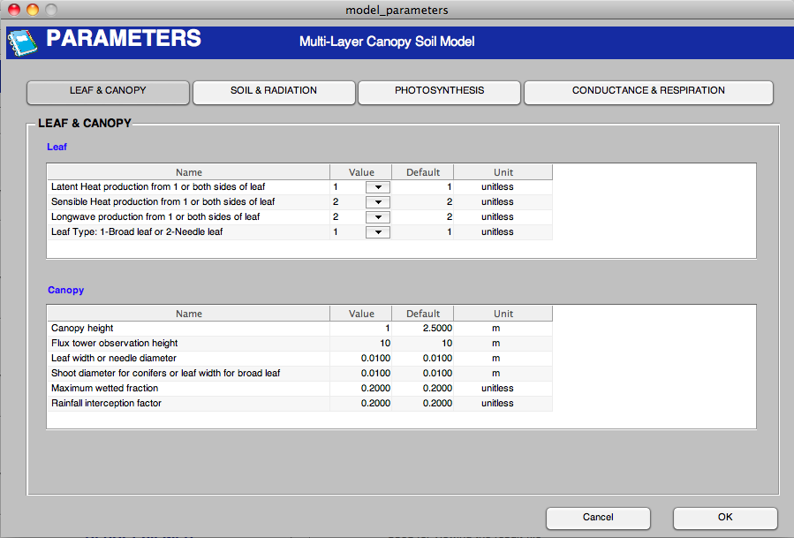
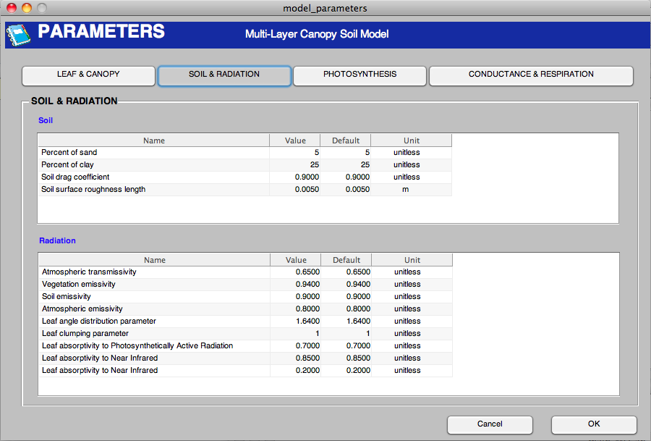
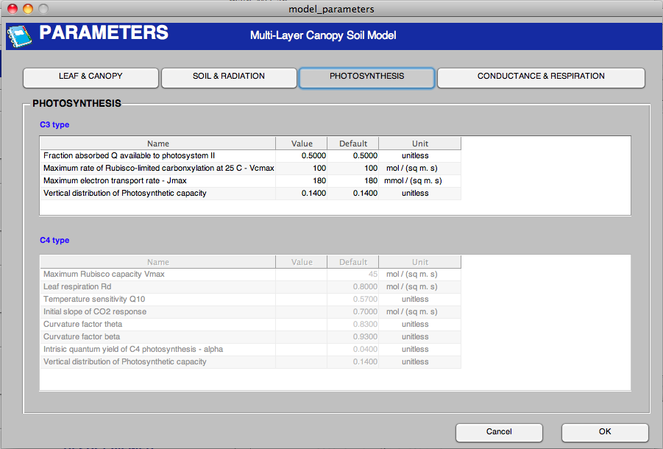
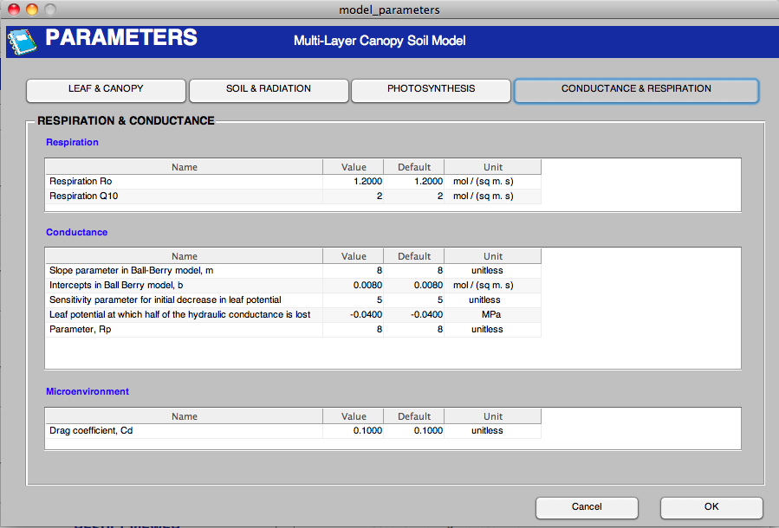
PARAMETERS

Slide 18
MAIN WINDOW

Slide 19
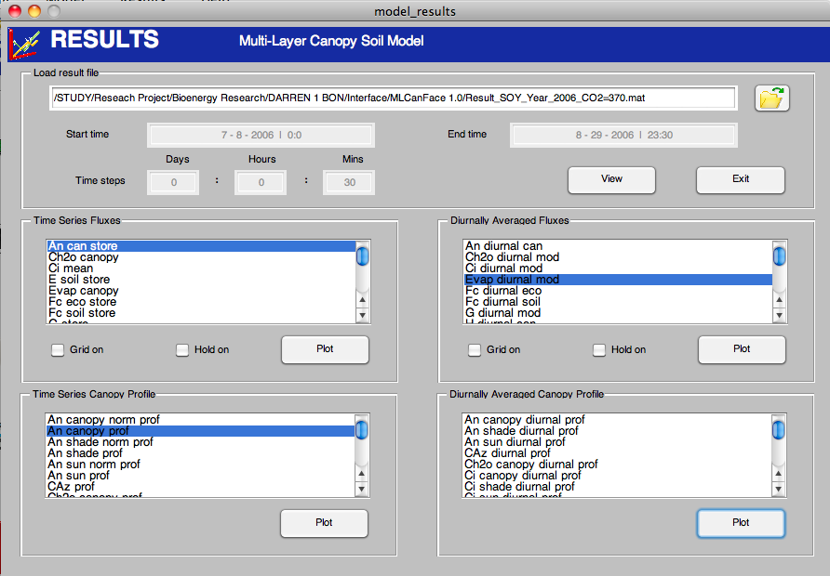
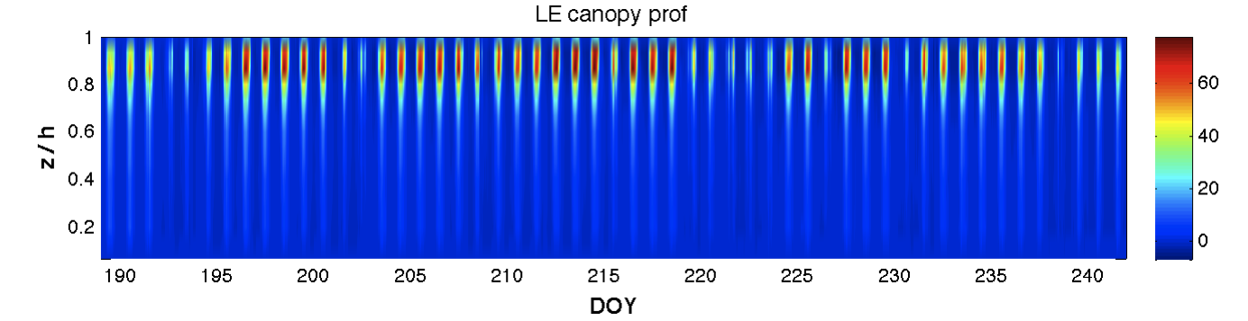
MLCan RESULT VIEWER

Slide 20
EXAMPLES
Corn (C4) and Soybean (C3)
Data: Ameriflux website
Bondville, IL
Lat: 40.01 (degree)
Long: -88.29 (degree)
Elevation: 213 (m)
Corn: year 2005
Soy: year 2006

