Slide 1


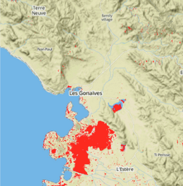
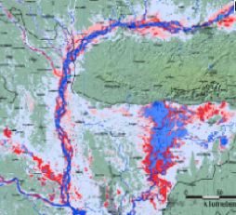
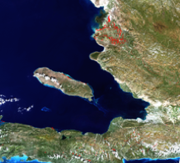
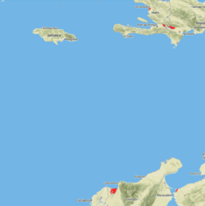
Flood Mapping Workshop Huntsville, AL Apr 14-16th, 2015
Pat Cappelaere
pat@cappelaere.com

Slide 2
Pre-Requisites
Laptop with PowerPoint, Git, Navicat or pgAdmin, TextMate/VIM
http://git-scm.com/
http://www.navicat.com/
http://www.pgadmin.org/
http://macromates.com/
Account on GitHub
https://github.com/
git clone https://github.com/vightel/FloodMapsWorkshop.git
Or git pull to get latest update
Account on Amazon AWS – Need AWS Instance, RDS and S3
http://aws.amazon.com/
Account on EarthExplorer
http://earthexplorer.usgs.gov/
Account on EarthData
https://earthdata.nasa.gov/data/near-real-time-data/data/hazards-and-disasters/
Facebook and Twitter Handles & Application keys
https://developers.facebook.com/
https://dev.twitter.com/

Slide 3
Participants
Name | Org | Contact
Africa Flores | NASA/MSFC/UAH | africaixmucane.florescordova@nasa.gov
Billy Ashmall | NASA/MSFC/USRA | billy.ashmall@nasa.gov
Chris Stanton | NASA/MSFC/USRA
Eric Anderson | NASA/MSFC/USRA | eric.anderson@nsstc.uah.edu
Lance Gilliland | NASA/MSFC/USRA

Slide 4
Goals and Expectations
Understand NASA Architecture Framework For Disasters
Create A New Regional Product
Publish Product And Make It Accessible On The Web
Spanish Language Accessible
Disseminate Via Facebook/Twitter

Slide 5






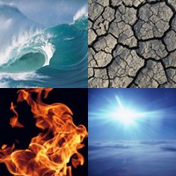


Architecture
Degree of Connectivity < 6
Satellites
Social Networks
Water
Earth
Surface Water Reference
Flood Extents
Flood Forecast
Daily Precipitation
Landslide Catalog/Forecast
Earthquakes
Soil Moisture,
Vegetation Health,
NDVI
Night Surface Temperature
[Big] Data
Active Fires
Burn Scars
Clouds
Temperature?
Wind
Pollution
Societal
Products
Fire
Air
I Want This In My Local Area

Slide 6

Or One Could Do This…
Sources
Process
Visualize
Publisher
API
Consumer

Slide 7
Or One Could Do This…
Sources
API
P
Visualize
Consumer
P
P

Slide 8

For Workshop
Social Networks
Discovery
Sharing
Mimic
Metrics
Sources
Publisher/Consumer
Consumer

Slide 9








What We Will Accomplish Today
AWS RDS
AWS S3
Scientist
Data
/tmp
Product
.py
AWS Virtual Instance
Infrastructure: Amazon Web Service (AWS) Elastic Cloud (EC2) Virtual Instance, Storage (S3) and Relational Database Service (RDS)
Run: Python Algorithms, Put product in S3

Slide 10


Development Environment
AWS RDS
AWS S3
Data
Products
.py
Infrastructure: Laptop, Storage (S3) and Relational Database Service (RDS)
Run: Python Algorithms, Put product in S3

Slide 11
Generate Existing Products
Create your own bucket on S3
Customize config.py
Generate EarthQuakes (USGS)
GeoJSON
Generate Active Fires (MODIS)
GeoJSON
Generate VHI (NOAA)
topojson

Slide 12
Publish Products
Check Accessibility on the Web
Publisher only
Check API
Check Spanish Language
YAML
Transifex https://www.transifex.com/
Make (and update repo or cheat)
Facebook & Twitter
Sharing and Discovery

Slide 13
Product Requirements
Name (geoss)
Source
S3 subfolder
Actual product (.gz)
GeoJSON (http://geojson.org/ )
Or Topojson (https://github.com/mbostock/topojson )
[Shape] (conversion via OGR2OGR)
http://www.gdal.org/ogr2ogr.html
Thumbnail > 200x200
- Map Info
- Style
- Legend
- Credits
- Product Page

Slide 14
Let’s Get Started
Pick a New Product
MODIS Burned Areas, Chlorophyll…
NDVI, EVI
GFS Temperature/Precipitation Forecast
NOAA Snow/Ice Cover…
CHIRPS 5-day product…
Write Python Processing Script to generate product for your location (for several days)
Make sure to create optional shapefile as well
Make sure products go to your S3 bucket/subfolder and are accessible

Slide 15
Next
Add new source (config)
Add new product selection (GUI)
Add OpenSearch Query, Style, Legend, Credits
Update Language Support As Necessary
Add Server Support
Test using Local Browser
Git Commit / Push
Test AWS Instance
Share With Facebook/Twitter
Celebrate (or Debug)
Demonstrate How you did it

Slide 16
Accomplishment
How to Develop Locally and Publish to Amazon S3
Mac / Windows VM
New Products Generation (Python)
MODIS Active Fires (GeoJSON)
MODIS Burned Areas (toposjon)
VIIRS Chlorophyll-A (netCDF)
USGS Quakes
NOAA Vegetation Health Index
TRMM/GPM 24hr
EF5: Inundation Maps, Soil Moisture, SWE, StreamFlow
Modify Publisher
Modify Routes (RCMRD/ICIMOD)
Publish To Facebook/Twitter
Translation (Spanish)

