Slide 1


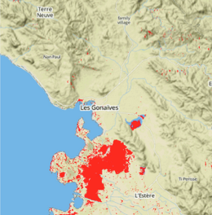
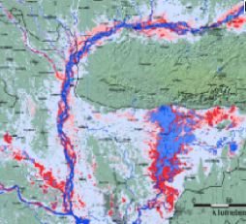
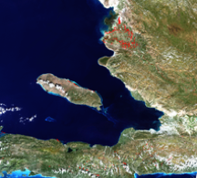
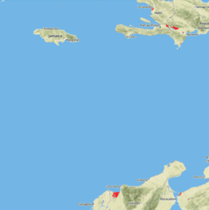
Flood Mapping Workshop Kathmandu, Nepal Day 2 Mar 11th, 2015
Pat Cappelaere
pat@cappelaere.com

Slide 2
Agenda
Review Day 1 9:30-10:30
Open GeoSocial API Video
GeoApp Video
Publish-Subscribe Architecture
Break Up
Database/Hand Customization 11:00 – 3:00
RCMRD (Kenya)
ICIMOD (Nepal)
Reconfigure for Namibia
Process Radarsat 2 data
FTP data

Slide 3
Agenda (2)
3:00-5:00
RCMRD/ICIMOD Presentation on work done and results
JOSM / OSM Waterpedia issues
Review of Billy’s issues (presentation)
Have we addressed all the issues to satisfaction?
Action Items
Config Documentation for ADPC to configure for Thailand
Windows Instructions
Workshop Instruction Update for ADPC
Goal: Get ADPC up ASAP to baseline level (Software Install/Database/Hand)
Thursday
Flood map Publisher/Consumer
Language Customization
Friday Debrief/Feedback
Recap
Clear Path/Vision Moving Forward?
How hard is it really to get up and going?
Feedback to Dalia

Slide 4
Arusha Workshop (Apr 27th)
Participants (Namibia, WB?)
Screencast/Videocast?
Swahili / Nepali Translations
Demonstration of Multi-lingual Publisher
GeoSocial Integration Workshop
Discovery/sharing demo and workshop
Facebook/Twitter apps & Metrics
Product tagging
ADPC
Demonstrate Thailand Instance Up and Running
Discuss Potential Product (Rice Paddies Estimation?)

Slide 5
Arusha Workshop (Apr 27th)
Regional Product Publishing & Prototyping
RCMRD
Daily Frost Map Publisher Prototype
Daily Flood Forecast Publisher (based on Crest and small basin)
Show case Local Flood Maps (Radarsat2, EO-1, L8, Modis) From Consumer
ICIMOD
Show case Local Flood Maps (Radarsat2, EO-1, L8, Modis)
Daily Snow/Ice Cover Product
Central America
Daily Landslide Forecast
Daily Precipitation
Flood Forecast based on GFMS
Namibia Node
Custom Consumer
River gauges/CREST…
USAID?
SRTM 2?
Flood Filling for false negatives
HAND customization?

Slide 6
Bangkok Workshop (June/July?)
Operationalization of Architecture
Regional Portal Integration Q&A/Issues
Continue ADPC Regional Hub Customization
New Product Demos
Other Satellite Sources
Radarsat-2/DigitalGlobe
Palsar-2
VIIRS?
Planet-Labs?
Mobile App Consumer?
Labor/Cost Metrics
Product Crowd sourcing
Digital Currency

