Slide 1

Flood Mapping Workshop
Pat Cappelaere / Stu Frye
pat@cappelaere.com
stuart.w.frye@nasa.gov

Slide 2
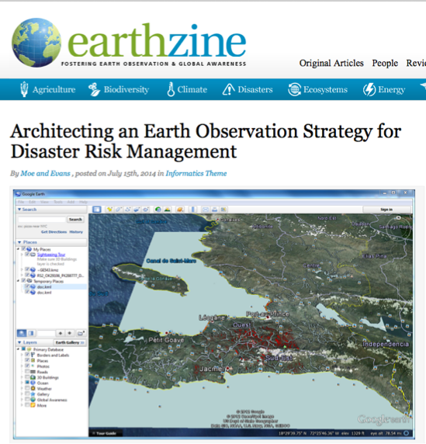
This is Part of A
Bigger Picture
http://www.earthzine.org/2014/07/15/architecting-an-earth-observation-strategy-for-disaster-risk-management/

Slide 3
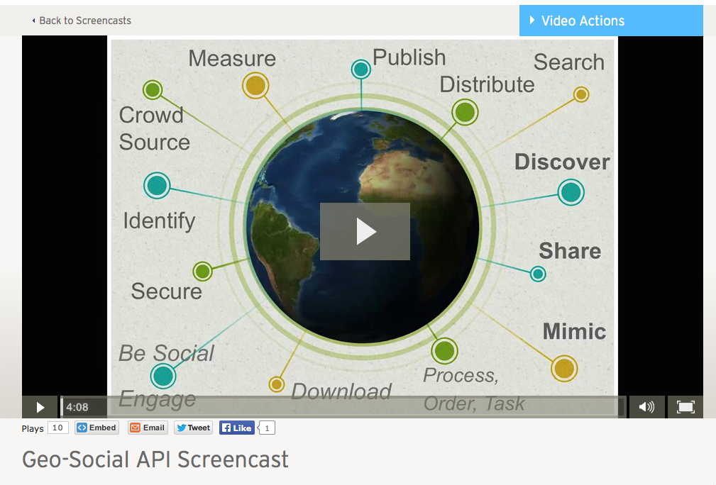
Open GeoSocial Video

Slide 4
Multi-Faceted
Process Data From Multiple Satellites, Sensors, Models and Citizen Scientists
Generate Multiple Products For Multiple Hazards (GEOSS Disasters SBA)
Multiple Scale (Global/Regional/Local)
Multiple Languages
Satellites:
EO-1
MODIS (TERRA/AQUA)
Radarsat-2
Landsat-8
TRMM/GPM
SMAP
COSMO/SkyMed
ALOS-2
Sentinel-1
Models:
GFMS
WRF
Landslide Model

Slide 5
Multi-Faceted
Process Data From Multiple Satellites, Sensors, Models and Citizen Scientists
Generate Multiple Products For Multiple Hazards (GEOSS Disasters SBA)
Multiple Scale (Global/Regional/Local)
Multiple Languages
Landslides
Floods
Fires
Quakes…

Slide 6
Multi-Faceted
Process Data From Multiple Satellites, Sensors, Models and Citizen Scientists
Generate Multiple Products For Multiple Hazards (GEOSS Disasters SBA)
Multiple Scale (Global/Regional/Local)
Multiple Languages

Slide 7
Multi-Faceted
Process Data From Multiple Satellites, Sensors, Models and Citizen Scientists
Generate Multiple Products For Multiple Hazards (GEOSS Disasters SBA)
Multiple Scale (Global/Regional/Local)
Multiple Languages
English
Spanish
Portuguese
French
Italian
German

Slide 8








Architecture
Degree of Connectivity < 6
Satellites
Social Networks
[Big] Data
Societal
Products
I Want This In My Local Area

Slide 9

Architecture
Degree of Connectivity < 6
Satellites
Social Networks
API
Mobile
Application
API
Regional
Node
Regional
Node
Regional
Node
[Big] Data
API
Web
Application
Publisher
Publisher
Societal
Products
Publisher
Publisher

Slide 10
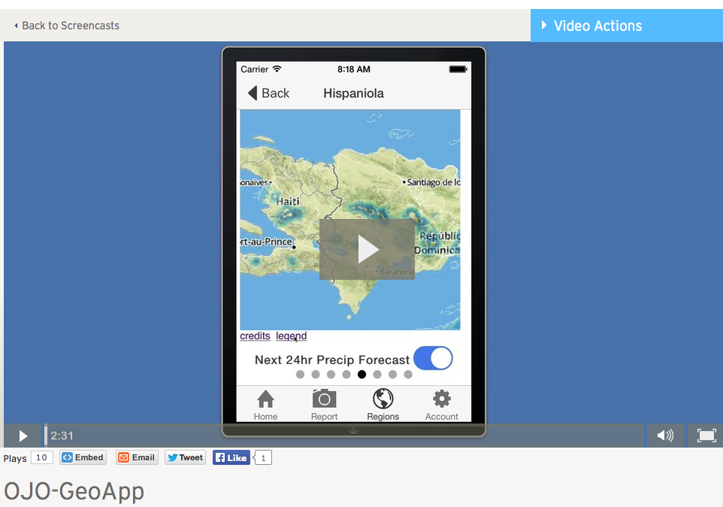
OJO-GeoApp

Slide 11






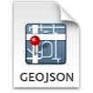

What We Hope To Accomplish Today
AWS S3
AWS RDS
Scientist
Radarsat-2
Flood Map
AWS Virtual Instance
Infrastructure: Amazon Web Service (AWS) Elastic Cloud (EC2) Virtual Instance, Storage (S3) and Relational Database Service (RDS)
Run: Python Algorithms
Use: DEM, HAND, OpenStreetMap Reference Water

Slide 12

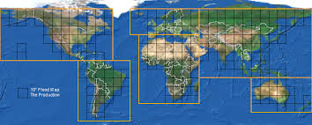


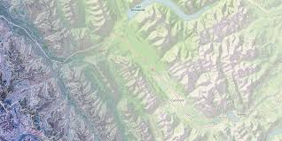
Then Publish/Consume…
Scientist
Radarsat-2
CSA/MDA FTP
SGF
EO-1
Landsat-8
NASA OAS NRT
Publisher
MODIS
API
Consumer
(Dashboard)
http://ojo-streamer.herokuapp.com
End Users

Slide 13


And Later Archive…
Regional Flood Database
Publisher
Global Flood Partnership
Global Flood Database

Slide 14
Let’s Get Started…
OpenStreetMap
POSTGRES
Database
HydroSHEDS
Regional HAND (Height Above Nearest Drainage)
Radarsat-2
Flood Map
AWS Virtual Instance
TODO:
Instantiate AWS Virtual Instance
Instantiate AWS Relational Database Service
Populate Database
Get HydroSHEDS Data & Generate HAND
Process Radarsat-2 SGF File
Publish It
Infrastructure: AWS, RDS
DEM, HAND, Reference Water

