Slide 1


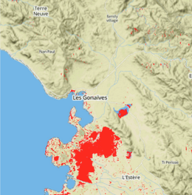
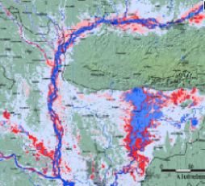
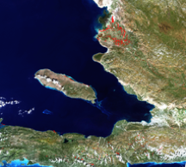
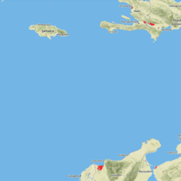
Flood Mapping Workshop Huntsville, AL Sept 24-25, 2014
Pat Cappelaere / Stu Frye
pat@cappelaere.com
stuart.w.frye@nasa.gov

Slide 2
Pre-Requisites
Laptop with PowerPoint, Git, Navicat or pgAdmin, TextMate/VIM
http://git-scm.com/
http://www.navicat.com/
http://www.pgadmin.org/
http://macromates.com/
Account on GitHub [I need to know your handle to make you collaborator]
https://github.com/
git clone https://github.com/vightel/FloodMapsWorkshop.git
cd FloodMapsWorkshop
View FloodMappingWorkshop.pptx
Account on Amazon AWS
http://aws.amazon.com/
Account on EarthExplorer
http://earthexplorer.usgs.gov/
Access to Radarsat-2 data

Slide 3
Participants
Name | Org | Contact
Ashutosh Limaye | MSFC-ZP11 | ZP11ashutosh.limaye@nasa.gov
Eric Anderson | NASA/MSFC/UAH | eric.anderson@nasa.gov
Africa Flores | NASA/MSFC/UAH | africaixmucane.florescordova@nasa.gov
Kris Stanton | NASA/MSFC/USRA | kris.stanton@nasa.gov
Francis Delgado | NASA/MSFC/USRA | francisco.delgadoolivares@nasa.gov
Billy Ashmall | NASA/MSFC/USRA | billy.ashmall@nasa.gov
Anastasia Wahome | RCMRD | awahome@rcmrd.org
Faith Mitheu | RCMRD | fmitheu@rcmrd.org
Denis Macharia | RCMRD | dmacharia@rcmrd.org

Slide 4
Goals and Expectations
Understand overall architecture for disasters
Introduction to floodmap processing, visualization and distribution
Understand current issues and limitations
Be able [eventually] to instantiate a regional node to process, visualize and distribute GEOSS floodmap products from various satellites (Radarsat-2, EO-1, L8, MODIS…) or sites such DFO, OAS…

Slide 5
Part I Goals
Disaster Architecture Overview
Instantiate VI and Database
Load Database & Generate HAND
Process Manually
Radarsat2, EO-1, Landsat-9, MODIS, DFO
Visualize Data
Crowd-source with JOSM, OSM and WaterPedia
Create Flood Event Records and Use GitHub

Slide 6
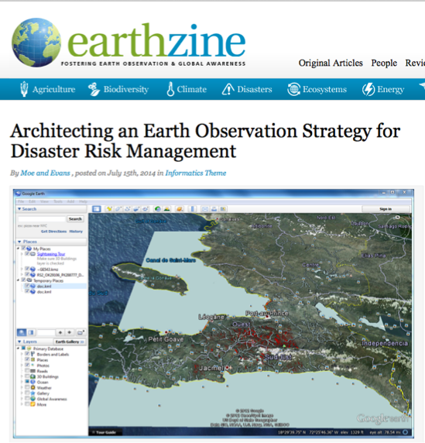
This is Part of A
Bigger Picture
http://www.earthzine.org/2014/07/15/architecting-an-earth-observation-strategy-for-disaster-risk-management/

Slide 7
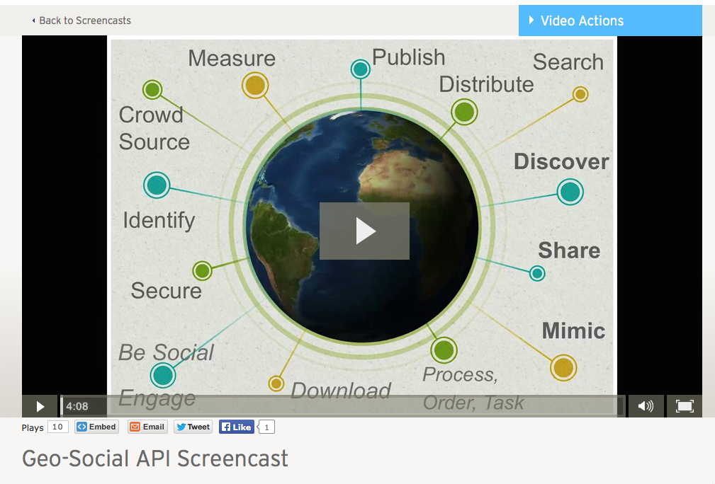
Open GeoSocial Video

Slide 8
Multi-Faceted
Process Data From Multiple Satellites, Sensors, Models and Citizen Scientists
Generate Multiple Products For Multiple Hazards (GEOSS Disasters SBA)
Multiple Scale (Global/Regional/Local)
Multiple Languages
Satellites:
EO-1
MODIS (TERRA/AQUA)
Radarsat-2
Landsat-8
TRMM/GPM
SMAP
COSMO/SkyMed
ALOS-2
Sentinel-1
Models:
GFMS
WRF
Landslide Model

Slide 9
Multi-Faceted
Process Data From Multiple Satellites, Sensors, Models and Citizen Scientists
Generate Multiple Products For Multiple Hazards (GEOSS Disasters SBA)
Multiple Scale (Global/Regional/Local)
Multiple Languages
Landslides
Floods
Fires
Quakes…

Slide 10
Multi-Faceted
Process Data From Multiple Satellites, Sensors, Models and Citizen Scientists
Generate Multiple Products For Multiple Hazards (GEOSS Disasters SBA)
Multiple Scale (Global/Regional/Local)
Multiple Languages

Slide 11
Multi-Faceted
Process Data From Multiple Satellites, Sensors, Models and Citizen Scientists
Generate Multiple Products For Multiple Hazards (GEOSS Disasters SBA)
Multiple Scale (Global/Regional/Local)
Multiple Languages
English
Spanish
Portuguese
French
Italian
German

Slide 12








Architecture
Degree of Connectivity < 6
Satellites
Social Networks
[Big] Data
Societal
Products
I Want This In My Local Area

Slide 13

Architecture
Degree of Connectivity < 6
Satellites
Social Networks
API
Mobile
Application
API
Regional
Node
Regional
Node
Regional
Node
[Big] Data
API
Web
Application
Publisher
Publisher
Societal
Products
Publisher
Publisher

Slide 14
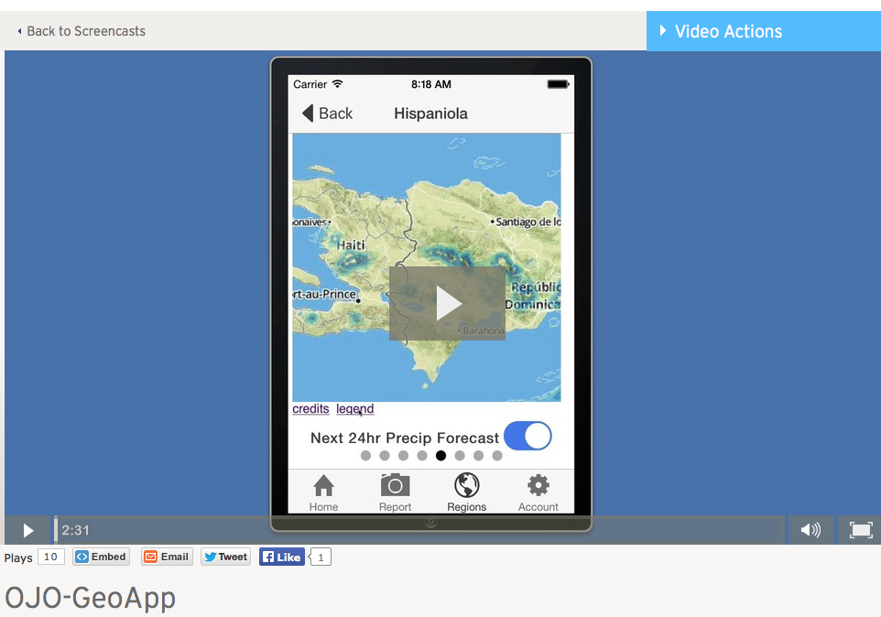
OJO-GeoApp

Slide 15






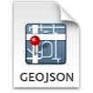

What We Hope To Accomplish Today
AWS S3
AWS RDS
Scientist
Radarsat-2
Flood Map
AWS Virtual Instance
Infrastructure: Amazon Web Service (AWS) Elastic Cloud (EC2) Virtual Instance, Storage (S3) and Relational Database Service (RDS)
Run: Python Algorithms
Use: DEM, HAND, OpenStreetMap Reference Water

Slide 16

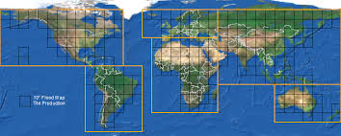


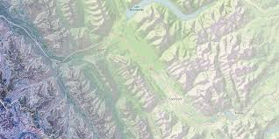
Then Publish/Consume…
Scientist
Radarsat-2
CSA/MDA FTP
SGF
EO-1
Landsat-8
NASA OAS NRT
Publisher
MODIS
API
Consumer
http://ojo-streamer.herokuapp.com
End Users

Slide 17

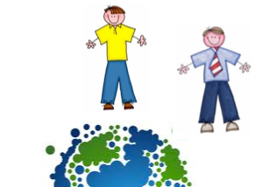
And Later Archive…
Regional Flood Database
Publisher
Global Flood Partnership
Global Flood Database

Slide 18
Let’s Get Started…
OpenStreetMap
POSTGRES
Database
HydroSHEDS
Regional HAND (Height Above Nearest Drainage)
Radarsat-2
Flood Map
AWS Virtual Instance
TODO:
Instantiate AWS Virtual Instance
Instantiate AWS Relational Database Service
Populate Database with OSM data (water)
Get HydroSHEDS Data & Generate HAND
Process Radarsat-2 SGF File
Publish It
Infrastructure: AWS, RDS
DEM, HAND, Reference Water

Slide 19
OpenStreetMap Regional Database
Rationale:
Regional Surface Reference Water Quick Start
Usage:
Height Above Nearest Drainage
Optional Map Layer For Visualization
Could be updated at will (WaterPedia)
cd ./data/osm
Show load_all.sh
Discuss water.style

Slide 20
Height Above Nearest Drainage (HAND)
Reference:
Renno & al, 2008
C.D. Renno, A.D. Nobre… Journal of Hydrology 2011.03.051
Paper
http://www.researchgate.net/publication/232042361_Author%27s_personal_copy_Height_Above_the_Nearest_Drainage__a_hydrologically_relevant_new_terrain_model
Slide Presentation
http://www.authorstream.com/Presentation/kritikakothari-1967411-hand-hydrologically-relevant-new-terrain-model/

Slide 21
Why A New HAND?
Did not want to use a conditioned DEM
Had access to actual water reference
No need to infer it and modify DEM to flow water
Needed python code
Can be regionally customized with better DEM/Water reference
Any feedback is welcome

Slide 22
Building HAND
Follow README Instructions

Slide 23
Intro to File Formats
PDF, PNG, JPG
TIFF, KML/KMZ
GeoJSON
TopoJSON
OSM XML bz2
No Data
Rasters Are Too Large
http://geojson.org/
https://github.com/mbostock/topojson
http://wiki.openstreetmap.org/wiki/OSM_XML

Slide 24
Visualization Tools
geojson.io Note: Use Chrome as Browser
mapshaper.org
Javascript Libraries
D3.js
Mapbox.js
Design Studio & Hosted Solutions
Mapbox Studio

Slide 25
Workshop Data Sources
Radarsat2
EO-1
Landsat-8
MODIS
Dartmouth Flood Observatory
Sentinel-1, ALOS-2, TerraSAR-X…

Slide 26
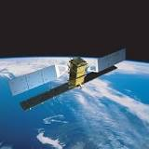
Radarsat-2
Overview
Beam Modes
File Formats (SGF)
Order Desk
Archives

Slide 27
Radarsat2 Processing
Ex:
radarsat_processing.py --scene RS2_OK33065_PK325251_DK290050_F6F_20120825_230857_HH_SGF -v
Algorithm Flow
Initialization
Process data
Use HH data
Threshold (mean/2)
De-speckle (Median Filter)
Morph and Smooth (octagon grey opening)
Reproject to EPSG 4326
Mask Out Coastal Data, Watersheds…
Mask Out HAND
Convert to topojson and simplify 50%
Generate Artifacts
Load in Database
load_radarsat2.py –scene RS2_OK33065_PK325251_DK290050_F6F_20120825_230857_HH_SGF -v

Slide 28
Radarsat-2 Artifacts
Topojson
surface_water.topojson.gz
Simplified GeoJSON
surface_water.json.gz
OSM XML
surface_water.osm.bz2
Thumbnail (Facebook)
surface_water_osm.png
osm marshes and water layers…

Slide 29
Open Issues
Co-Registration
Proprietary Solution
PCI Geomatics (can be scripted)
NASA Solution in the works

Slide 30
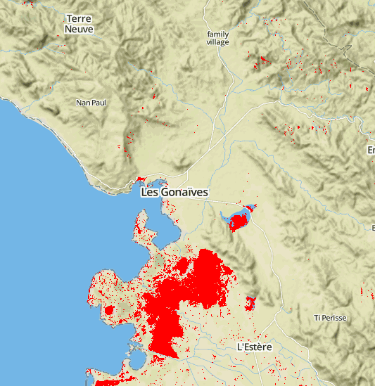
Visualize It
mapshaper.org
geojson.io Note: Use Chrome as Browser
Drag topojson or geojson file onto browser
Play with simplification of mapshaper
Quick annotate and share with geojson.io

Slide 31
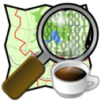
JOSM
Download It
Load surface_water.osm.bz2 directly
Check OSM Tagging
Think WaterPedia Concept
Improve Reference Surface Water
Connect to Private OSM runtime…
Crowd Sourcing V&V

Slide 32

DFO Flood Maps and Flood Events
Dartmouth Flood Observatory
Pakistan Flood 2014
Get Simplified GeoTIFF and associated jpg and rename appropriately for that day
Generate topojson (and geojson)
dfo_watermap.py -v --scene 20140921_Bangladesh_4178
Load database
load_dfo --scene 20140921_Bangladesh_4178
Get Mapbox Studio
Generate/Publish Style (requires MapBox Account)

Slide 33

GeoJSON and GitHUB for Distributed Flood Records
Global Flood Catalog Demo Idea

Slide 34

USGS Earth Explorer EO-1 and Landsat-8 Data Sets
Pre-requisites
Account on EarthExplorer
eo1, l8 tables loaded in database
Get archived scenes from EO-1, L8… in CSV formats for your AOI and <10% clouds
Load them in the database to allow for on-demand processing
Update on a regular basis
Allows users to query for potential good archived data and request processing
Or manually select/download scenes for processing

Slide 35
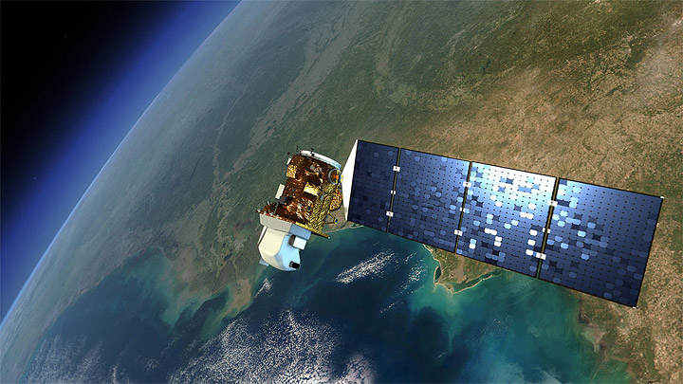
Manual Landsat-8 Flood Mapping
Get an Landsat-8 <scene>
>cd $WORKSHOP_DIR/data/l8
>mkdir <scene>
>ftp or wget <scene>.tgz to that folder
>tar -xvf <scene>.tgz
# Generate Composite for V&V
>landsat8_composite_toa.py --scene <scene> --red 4 --green 3 --blue 2
>landsat8_composite_toa.py --scene <scene> --red 5 --green 6 --blue 4
>landsat8_composite_toa.py --scene <scene> --red 7 --green 5 --blue 4
# Process it
>landsat8_toa_watermap.py --scene <scene> -v
>landsat8_to_topojson.py --scene <scene> -v
>landsat8_browseimage.py --scene <scene> -v
# Load it
> load_l8.py --scene <scene> -v
Notes:
Algorithm is using MNDWI and TOA, uses internal cloud masking (bqa)
HAND masking could be added easily (see radarsat script)
Could use another algorithm from DFO (see website)

Slide 36
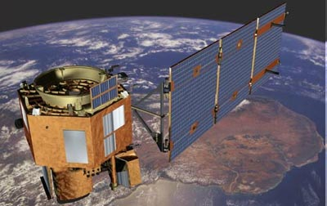
Manual EO-1 Flood Mapping
Get an EO-1 <scene>
>cd $WORKSHOP_DIR/data/eo1_ali
>mkdir <scene>
>ftp or wget <scene>.tgz to that folder
>tar -xvf <scene>.tgz
# Generate Composite for V&V [ 5-4-3 for example]
>eo1_ali_composite.py --scene EO1A0090472014197110P0_SG1_01 --red 5 --green 4 --blue 3
# Generate Cloud Mask
>eo1_ali_cloudmask.py --scene EO1A0090472014197110P0_SG1_01
# Generate Water map
>eo1_ali_watermap.py --scene EO1A0090472014197110P0_SG1_01
# Generate Flood vectors
>eo1_to_topojson.py --scene EO1A0090472014197110P0_SG1_01
# Generate BrowseImage
>eo1_ali_browseimage.py --scene EO1A0090472014197110P0_SG1_01
Notes:
ALI Instrument for wider coverage ~35sqkm @30m
Algorithm uses MNDWI and TOA
HAND masking could be added easily (see radarsat script)
Results could be improved with Atmospheric Correction
Needs Haze removal if Atmospheric Correction is not used…

Slide 37
Manual MODIS Flood Maps
Go To NASA OAS Server
Find your Tile of Interest
Select 2-day product composite
Select year and day of year
Download MWP GeoTIFF to ~/data/modis/YYYY/doy/TILE
>cd $WORKSHOP_DIR/python
>modis.py -y 2012 -d 234 -t 080W020N -p 2 –v
NOTES:
You really need to mask the Coastal Waters
Need to add HAND (see radarsat-2)
Need to remove Tile limitation and just support user AOI request
This should really be done on the OAS side (and support global vectorization)

Slide 38

Part I Recap
Disaster Architecture Overview
Instantiate VI and Database
Load Database & Generate HAND
Manual Processing of
Radarsat2, EO-1, Landsat-9, MODIS, DFO
Visualization of Data
JOSM, OSM and WaterPedia
Create Flood Event Records and Use GitHub

