Slide 1


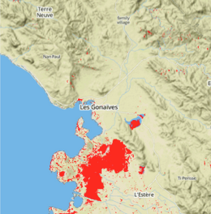
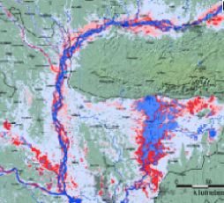
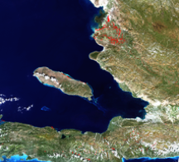
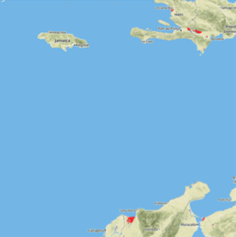
Flood Mapping Workshop – Part II Open GeoSocial API
Pat Cappelaere / Stu Frye
pat@cappelaere.com
stuart.w.frye@nasa.gov

Slide 2
Open GeoSocial API
Very high level API to shield complexity of lower level OGC interfaces
Integrates with Facebook/Twitter for distribution/discovery/analytics
You want to distribute Information
Tell a Story!

Slide 3
Goals
Understand Publisher Example working in standalone mode
Note: Consumer Example is in another section
Publish Data from Radarsat2, EO1, L8, MODIS, DFO
Make Shareable Products on Social Networks

Slide 4





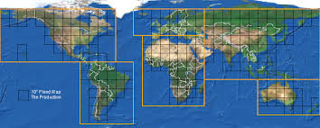




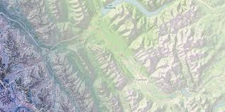
Regional Publishers/Consumers
Scientist
Radarsat-2
CSA/MDA FTP
SGF
EO-1
Landsat-8
NASA OAS NRT
Publisher
MODIS
API
Consumer
End Users

Slide 5
Technology
OpenSearch
Activity Streams + Actions
GeoJSON/Topojson Vector format
OpenStreetMap
MapBox
Facebook OpenGraph, Twitter API
GitHub
Implementation
Node.js, Express.js, Javascript (server/client side)
But consumers could be implemented in other languages such as Ruby, Java, Python…
MapBox Custom Maps, MapBox Studio
MapBox.js, D3.js…

Slide 6
Pre-Requisites
Get Facebook Login
Create a Facebook App Publisher (and a Consumer)
Get App ID/Secret
Get Twitter Login
Twitter Card
Get a MapBox Account
Get some map ids
Papertrail for Logs
GitHub Account
(Flood events… Landslide events..)

Slide 7
Getting Started
Make a Local Copy For Publisher App
Build
npm install
Customize Local Copy As Necessary
GIT Configuration Management
Git add/commit/push
Create your own regional fork
Collaborators make pull requests for changes

Slide 8
Next Steps
cd $WORKSHOP_DIR/node
Customize
config.yaml
setting.js
Go through code…

Slide 9
Set Envs
export FACEBOOK_APP_SECRET=
export FACEBOOK_APP_ID=
export FACEBOOK_PROFILE_ID=
export TWITTER_SITE=
export TWITTER_SITE_ID=
export TWITTER_CREATOR=
export TWITTER_CREATOR_ID=
export TWITTER_DOMAIN=
export DATABASE_URL=
export COOKIEHASH=

Slide 10
Database
Provision Database: Postgres/PostGIS…
Add tables…
Make sure the database is loaded
EO1, L8, Radarsat2,DFO…
Users? (see id management slide)
Web Sessions?
Not implemented for demo code
Add web.session

Slide 11
Securing Publisher
Require Consumer Application Registration
See demo
How to use App ID & token…
Publisher checks Facebook App token for valid Application
HAWK is used to secure transactions
http://alexbilbie.com/2012/11/hawk-a-new-http-authentication-scheme/

Slide 12
User Login
Do not require YALP
Identity Management is too complex
Implement Mozilla Persona
Does not seem to work on mobile phones but fine on desktops
Or Implement Identity Infrastructure (or Identity as a Service)
Auth0, Auth0.js…
What about Digital Rights Management?

Slide 13
User Policy
You can have access if you have a legitimate email address
Need for analytics/accountability
Might be black-listed
Kept in database (profile)
Can be used to set additional capabilities (admin…) or digital rights

Slide 14
Start Publisher
Commit Changes
Go to Remote Instance and Clone Repo or Run Locally
Manual Start
node server.js
[nodemon server.js]
[foreman server.js]
Auto Start
Define a Procfile…
Other considerations
Multiple workers
Load balancing…
Alternate: HEROKU instead of AWS discussion…

Slide 15
Demo Script
User Login
Search Products
Visualize Products
Product Tagging
Sharing Products
Application Registration

Slide 16
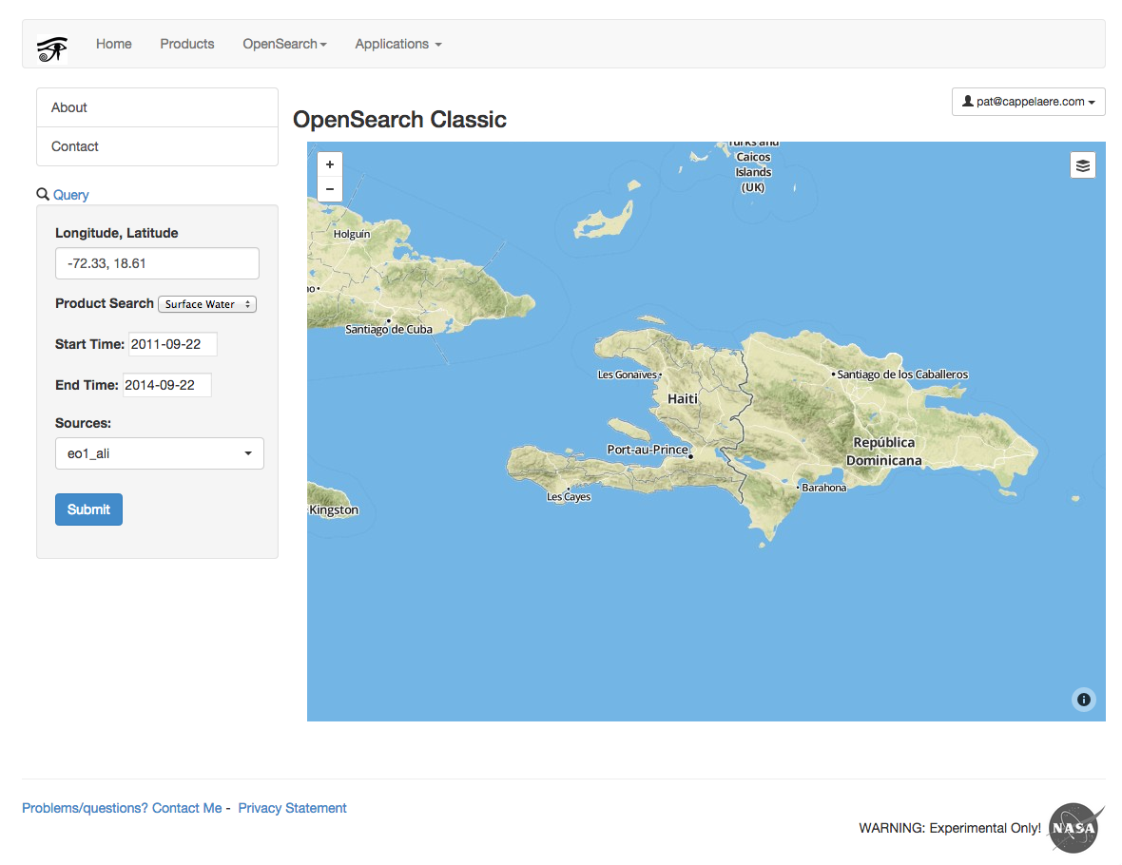

Slide 17
Search Examples
Radarsat-2
Gonaives 2012-08-25
RS2_OK33065_PK325251_DK290050_F6F_20120825_230857_HH_SGF
EO-1
Port-au-Prince 2014-07-15
EO1A0090472014197110P0_SG1_01
Landsat-8
Port-au-Prince/Gonaives 2013-12-22
LC80090472013357LGN00
MODIS
Port-au-Prince/Gonaives 2012-08-21
DFO
2014-09-21_Bangladesh_4178 / 09-19 / 09-11
2014-09-21_Pakistan_4179 / 09-19 / 09-11

Slide 18
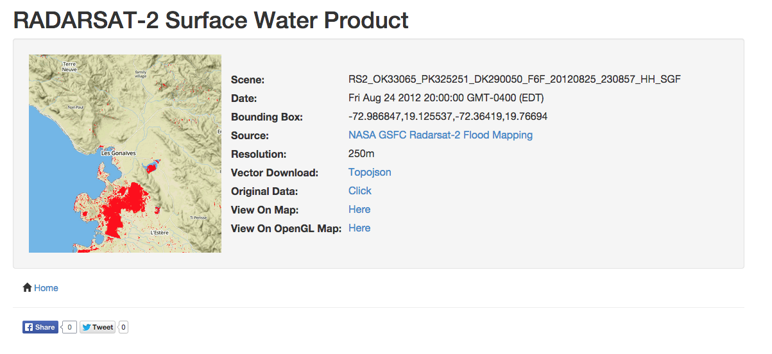

Slide 19
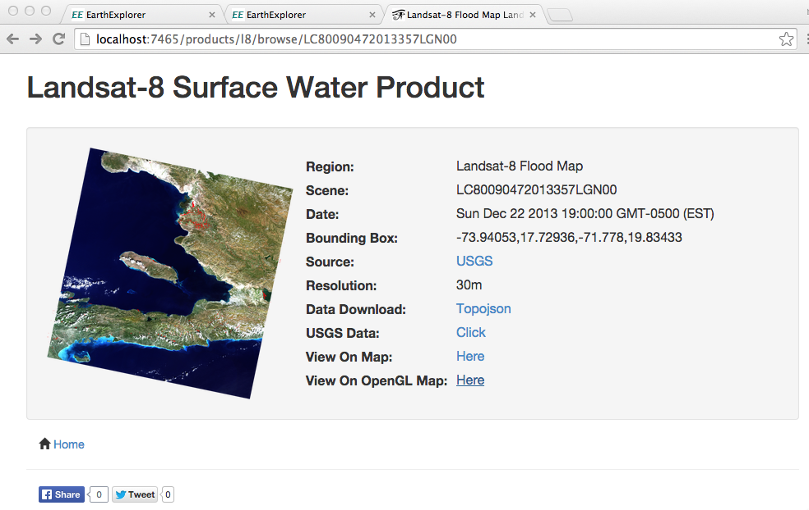

Slide 20
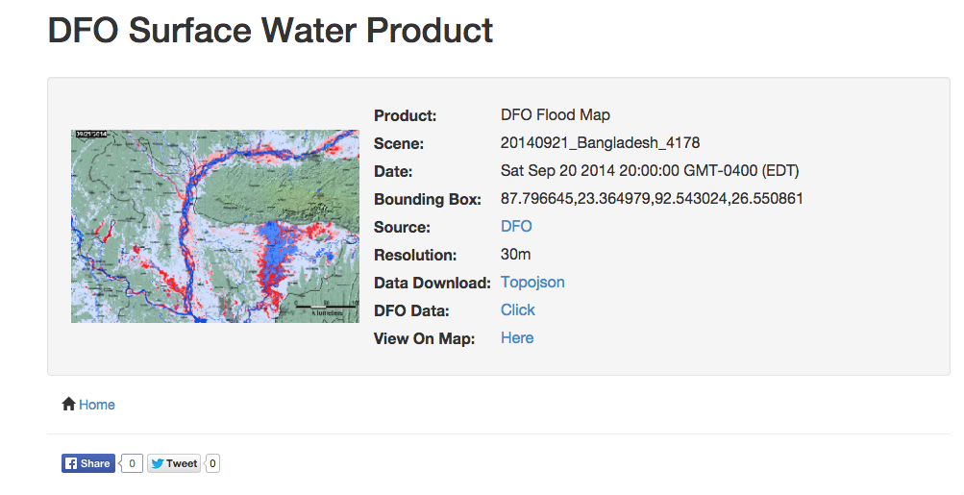

Slide 21
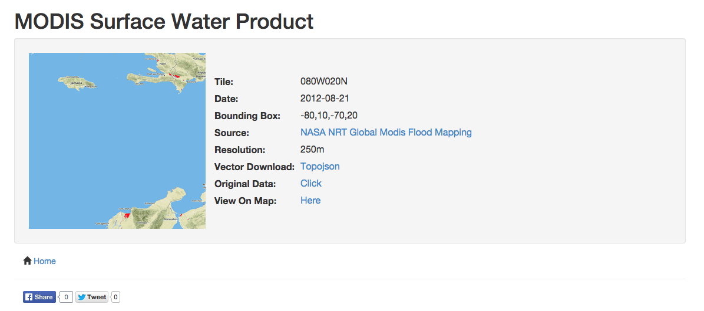

Slide 22
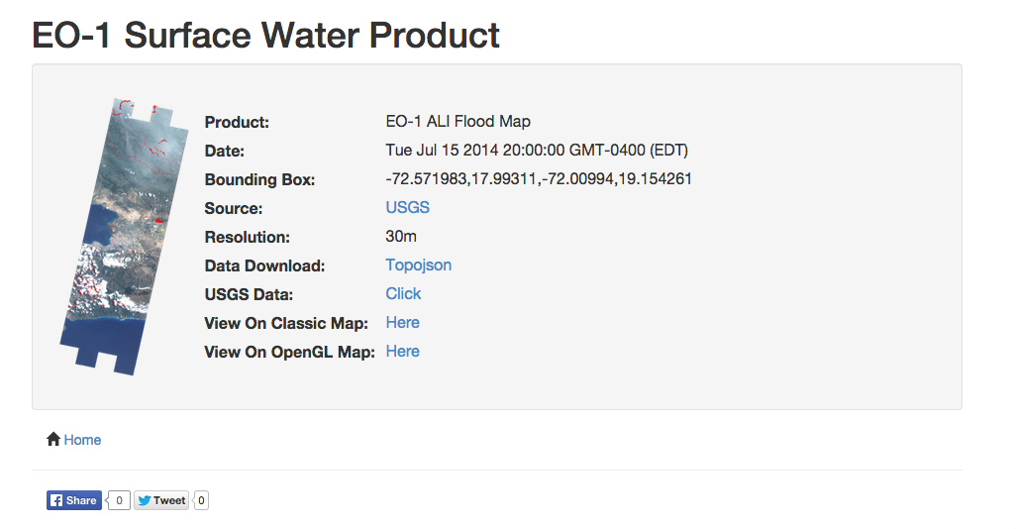

Slide 23
Notes
More likely to be one publisher per product
GUI/Visualization more likely to be on the consumer side
Product Page is critical for Publishing

Slide 24
OpenSearch Discovery and Description Document
OpenSearch Document
Auto-Discovery
http://localhost:7465
View source
Find link rel=‘search’ and find href
http://localhost:7465/opensearch/description

Slide 25
Query
GET "http://localhost:7465/opensearch?
q=surface_water
&lat=18.58
&lon=-72.36
&startTime=2014-07-01
&endTime=2014-09-22
&sources=eo1_ali”
Other Params
itemsPerPage (10)
startIndex
Limit
Product Query
Location (lat/lon or bbox)
Debatable
Note: Pagination is not implemented in example publisher
To see queries: View/Developer/Javascript Console

Slide 26
Results
http://localhost:7465/opensearch?q=surface_water&lat=18.58&lon=-72.36&startTime=2014-07-01&endTime=2014-09-22&sources=eo1_ali
Please Notice
Output in JSON
OpenSearch Result Items
Items: [ Id, image, properties, actions ]
Similar to http://opensearch.org output in xml
http://www.opensearch.org/Specifications/OpenSearch/1.1#OpenSearch_response_elements
http://tools.ietf.org/html/draft-snell-activitystreams-actions-06
We Need NASA/ESIP/GEOSS concordance on “actions” & product types
Download, Browse, Process, Task…

Slide 27
Advanced Topics (Out-of-scope)
Returning Other WCS-type Products like TRMM Precipitation or Soil Moisture
Need Legend
Need Default Map Styling
Need Translation Support

Slide 28
FB/Twitter Tags
http://localhost:7465/products/eo1_ali/browse/EO1A0090472014197110P0_SG1_01
View source
<head>
<!-- Twitter Tags -->
<meta name="twitter:card" content="summary_large_image">
<meta name="twitter:site" content="@geobliki">
<meta name="twitter:site:id" content="6456652">
<meta name="twitter:creator" content="@cappelaere">
<meta name="twitter:creator:id" content="6178752">
<meta name="twitter:domain" content="geobliki.com">
<!-- Open Graph Tags (accepted by Twitter as well -->
<meta property="fb:app_id" content="563515000387604" />
<meta property="fb:profile_id" content="100003853468544" />
<meta property="og:type" content="ojo-nasa:geoss_product" />
<meta property="og:title" content="geoss.surface_water" />
<meta property="og:description" content="EO-1 ALI Flood Map" />
<meta property="og:image" content="http://localhost:7465/products/eo1_ali/… />
<meta property="og:url" content="http://localhost:7465/products/eo1_ali/browse/… />
<meta property="og:updated_time" content="Tue Jul 15 2014 20:00:00 GMT-0400 (EDT)" />
<meta property="og:created_time" content="Tue Jul 15 2014 20:00:00 GMT-0400 (EDT)" />
<meta property="place:location:latitude" content="17.9931" />
<meta property="place:location:longitude" content="-72.2494" />
App Namespace
Need Consensus

Slide 29

Part II Recap
Understand Publisher example working in standalone mode
Publish Data from Radarsat2, EO1, L8, MODIS, DFO
Make Shareable Products on Social Networks

Slide 30
Questions

