Slide 1


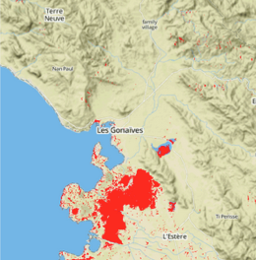
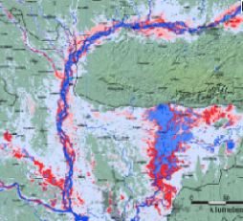
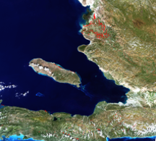
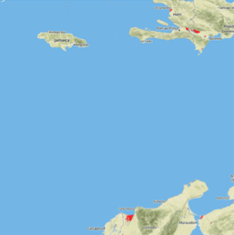
Flood Mapping Workshop – Part III Consumer App
Pat Cappelaere / Stu Frye
pat@cappelaere.com
stuart.w.frye@nasa.gov

Slide 2
Goals
Test Consumer API Example
Connect securely to Publisher and retrieve result of an OpenSearch
Demonstrate Ease-of-use of Open GeoSocial API

Slide 3
Pre-requisites
Publisher running locally or remotely
Facebook Consumer Application Registration
ID, Secret
Register Consumer at the Publisher Node
Need Node.js installed and running locally
More info
https://github.com/vightel/ojo-doc/blob/master/consumer_guide.md

Slide 4
Get Code and Customize it
Git clone https://github.com/vightel/ojo-doc
cd consumer_code/javascript
Build
npm install
Setup ENVs
fbAppId
fbSecret
Customize Opensearch url
Run
node example.js

Slide 5
TODO
Copy Publisher Query/Visualization Code to Consumer
Discover New Publishers
(FB Opengraph Query or GEOSS GeoDAB)

Slide 6

Part III Goals
Demonstrate Ease-of-use of Open GeoSocial API

