Slide 1
Import complex geological model into HydroModPy
Available in HydromodPy for hydrodynamics parameters:
Homogeneous
Decreasing hydraulic conductivity with depth
Horizontal layers with varying depth and hydrodynamic parameters
Vertical definition of “zones” of heterogeneities in the parameters from the surface to the bottom
How can we introduce a complex geological model into Hydromodpy that can interpret nonlinear interfaces and varying depths as well as fine-structures (fault zones, etc..) ?

Slide 2
The methodology behind the extrapolation of geological model to MODFLOW grid
Loop for each cell of the MODFLOW grid:
Calculate the distance between this cell and each cell of the geological model.
Find the shorter distance.
Return the index of the geological model cell.
Store the index.
Each cell of the MODFLOW model is associated to a cell of the geological model
Advantage: if parameters of geological model change, the index can be
used again, avoiding the calculation.
Can be time consuming for bigger model.
Adaptation of the idea, to calculate the distance only with cells around.

Slide 3
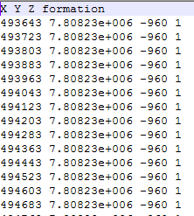
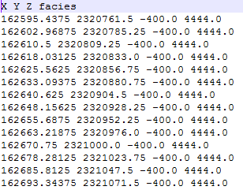
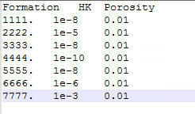
How to use in HydroModPy
What is needed:
MODFLOW discretization ( DEM + depth discretization) => Directly obtained from the HydroModPy routine.
2 external files
XYZ file for the geological model
txt file for the parameters of the layers

Slide 4
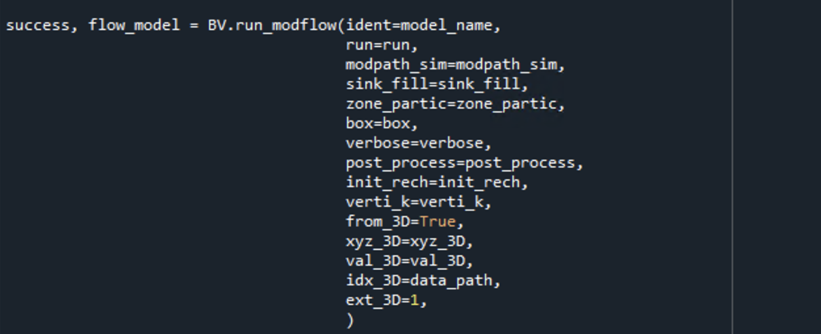
How to use in HydroModPy
From_3D = True
xyz_3D : path to the xyz file
val_3D : path to the parameters file
idx_3D : where to store the index if needed
ext_3D : extrapolation method (1 for indexing method; 2 for Hatari lab method (less efficient))

Slide 5
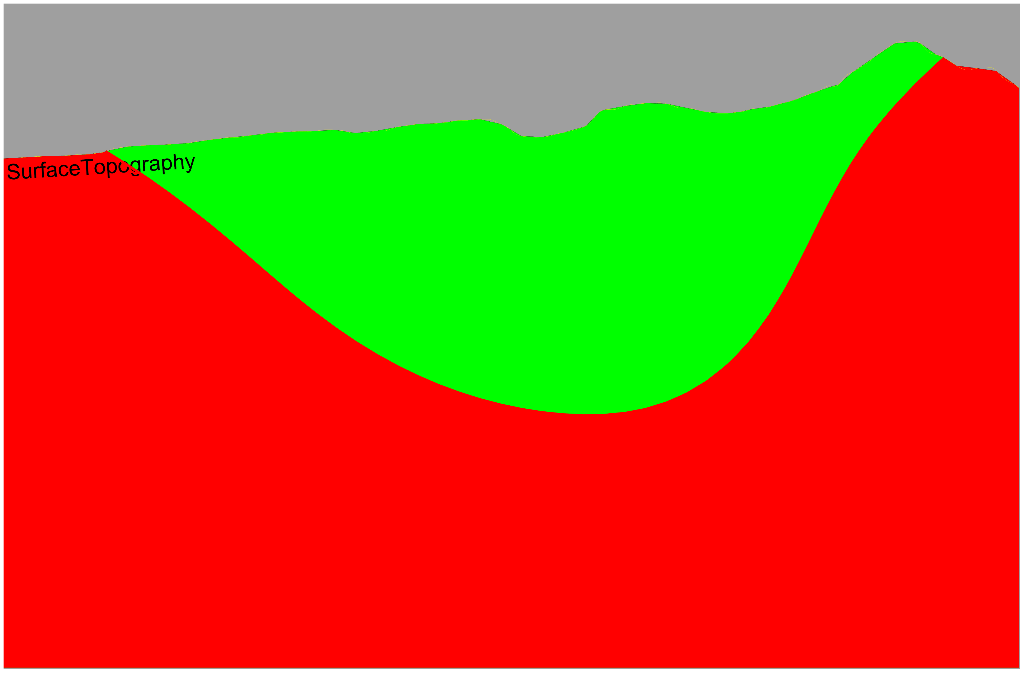
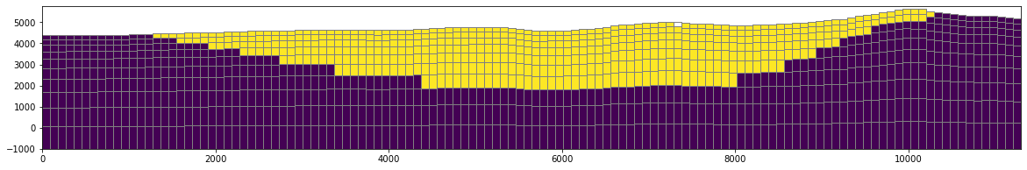
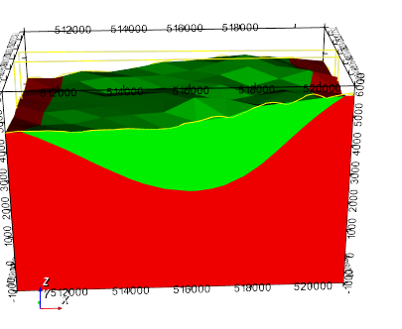
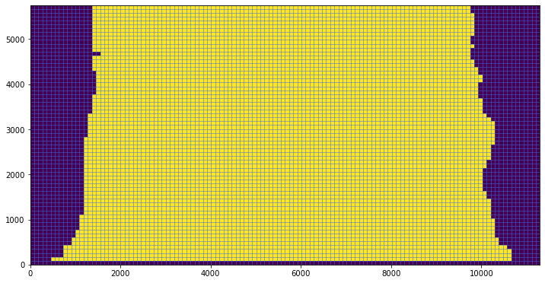
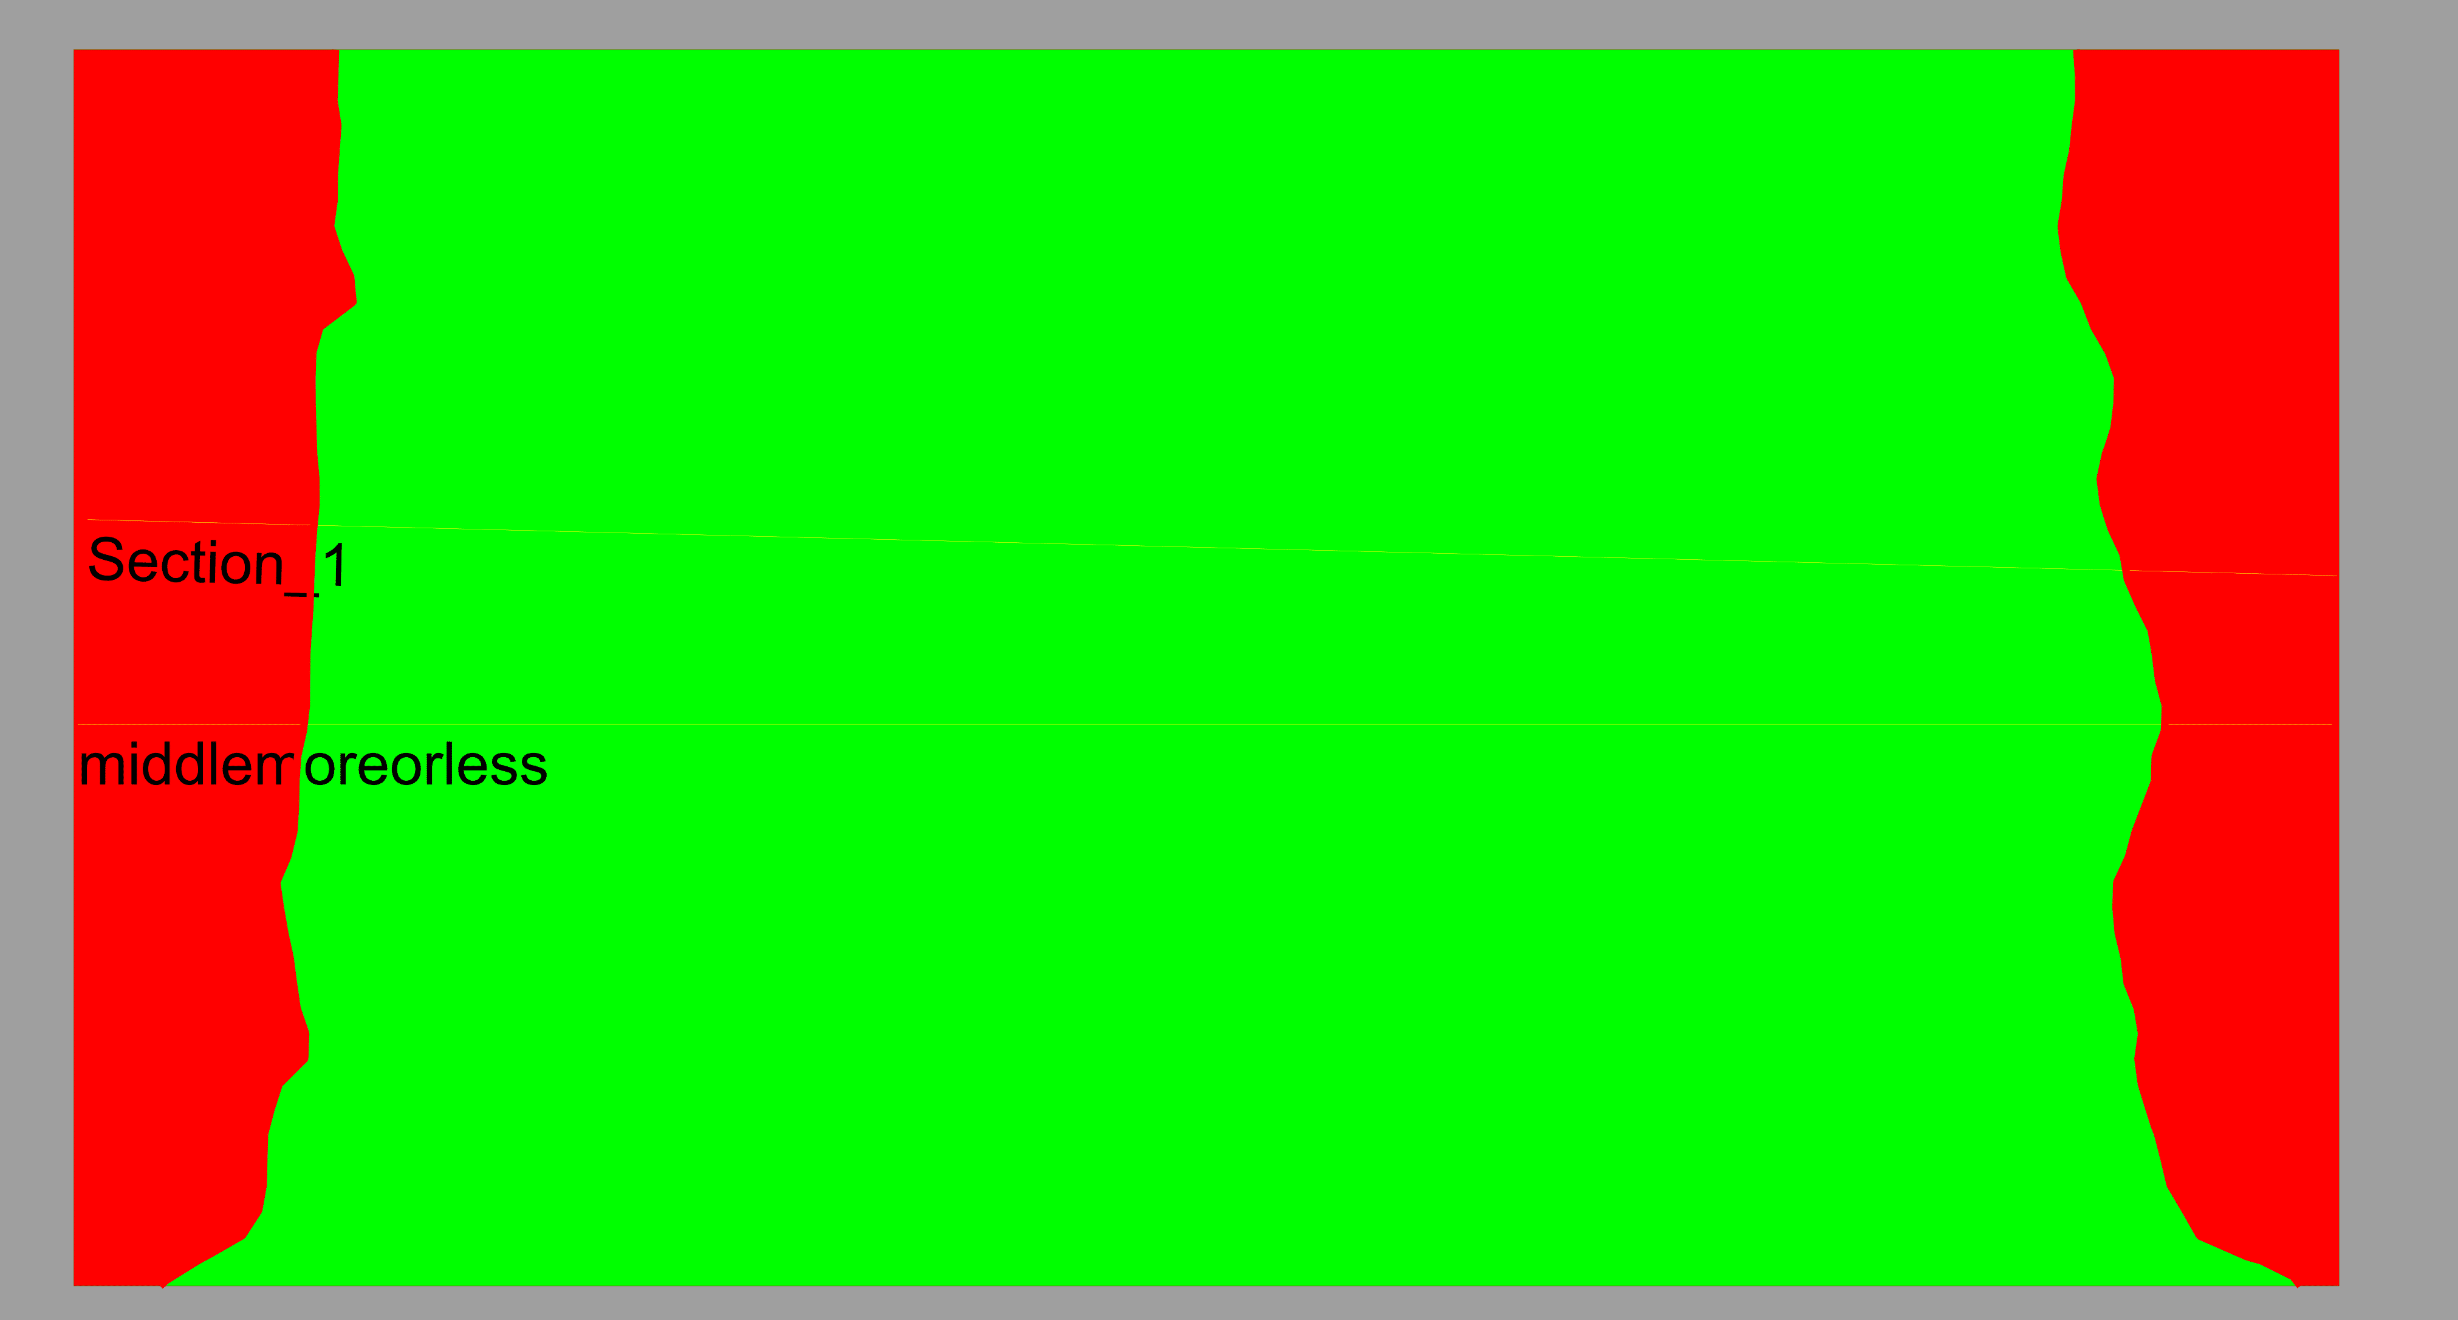
Example : Simple 2 layers fold
Cross section
Surface

Slide 6
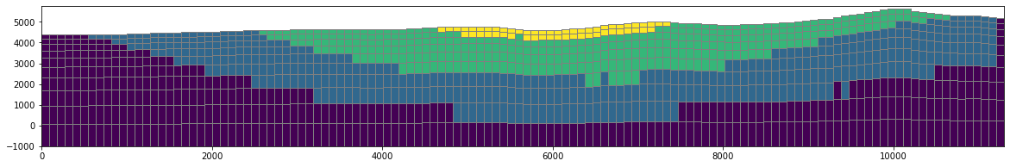
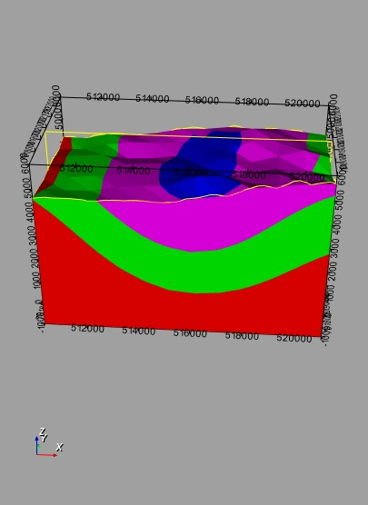
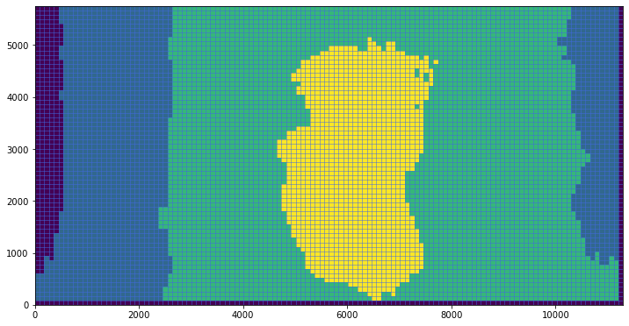
Example : 4 layers fold
Cross section
Surface

Slide 7
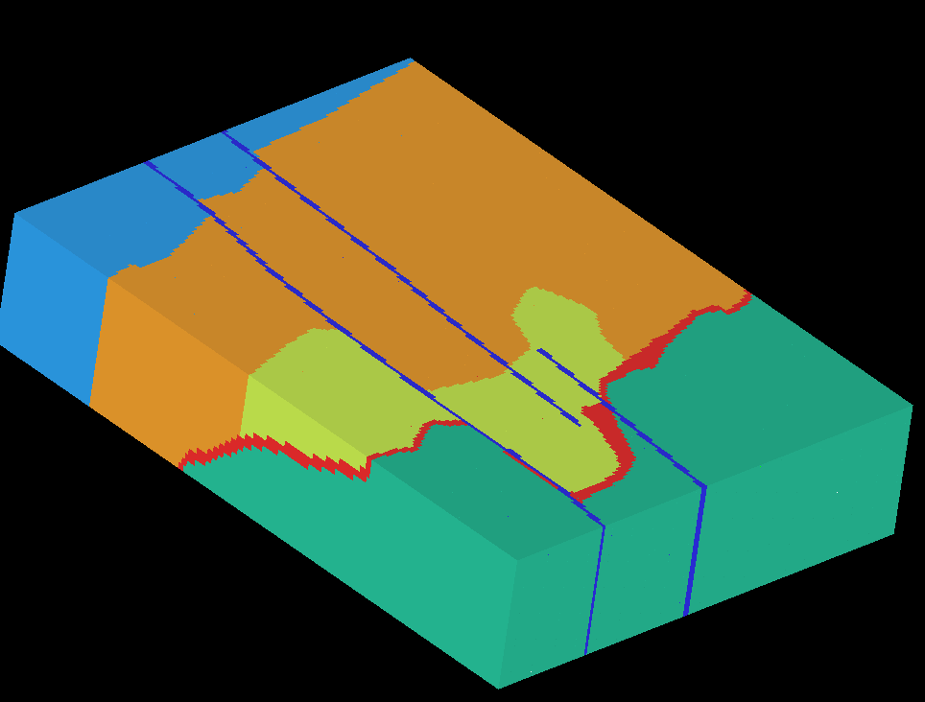
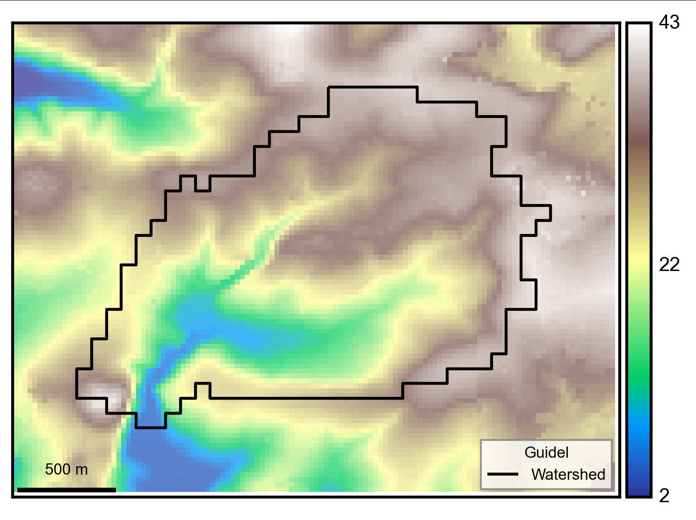
(Real) Example : Guidel case
Starting point :
3D geological model (XYZ file)
Gauging station coordinates
BD Alti 25m DEM
HydroModPy
Automatic catchment extraction
Geological extrapolation
Groundwater flow model

Slide 8
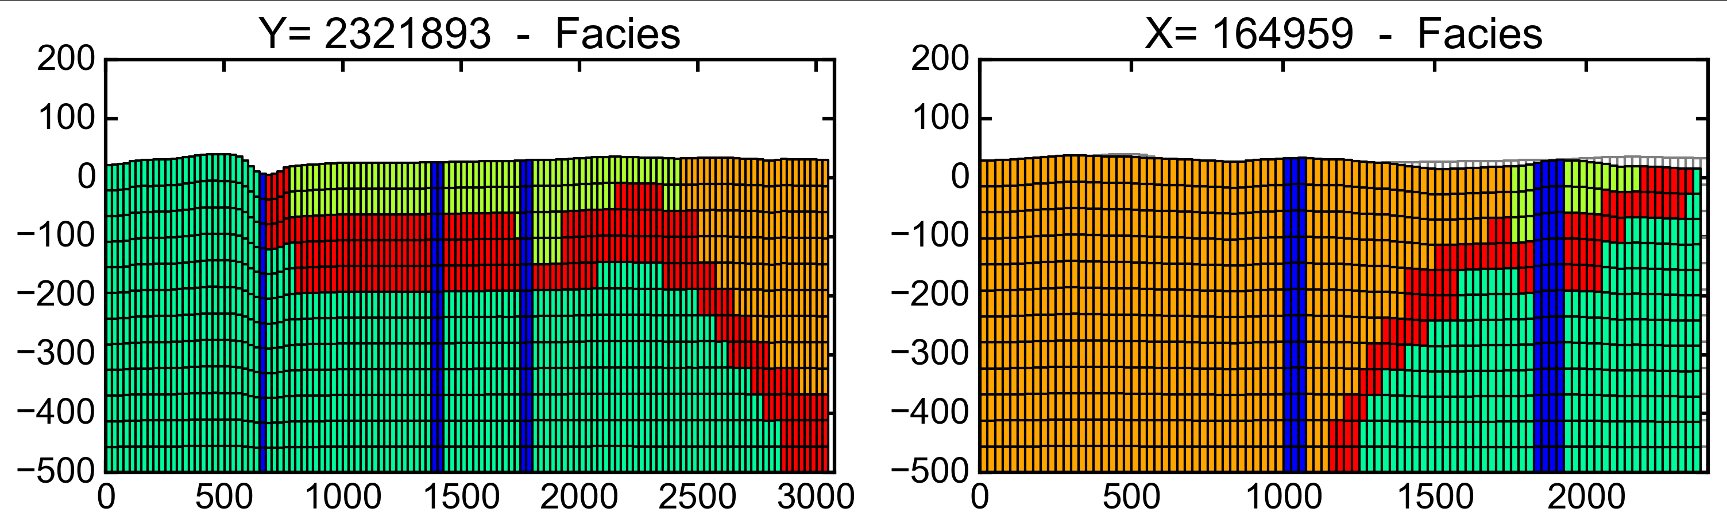
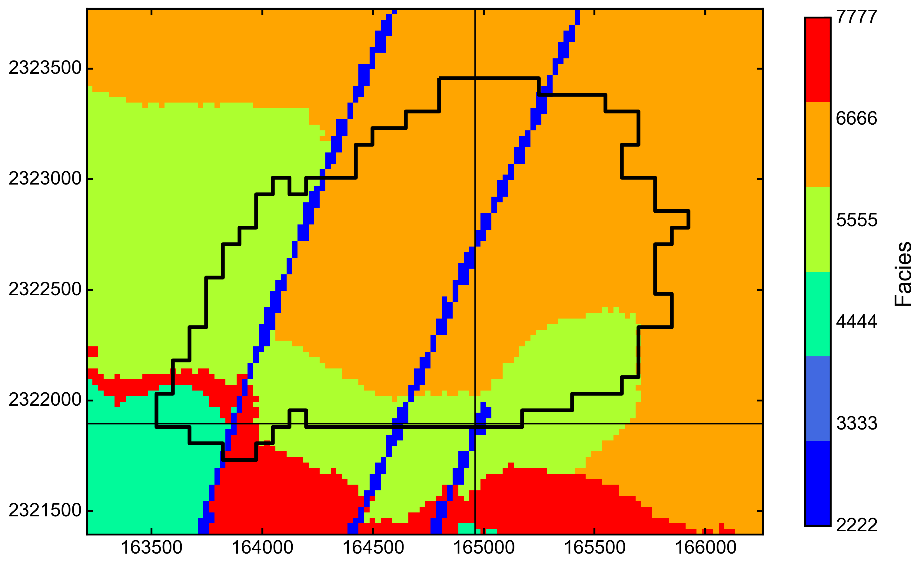
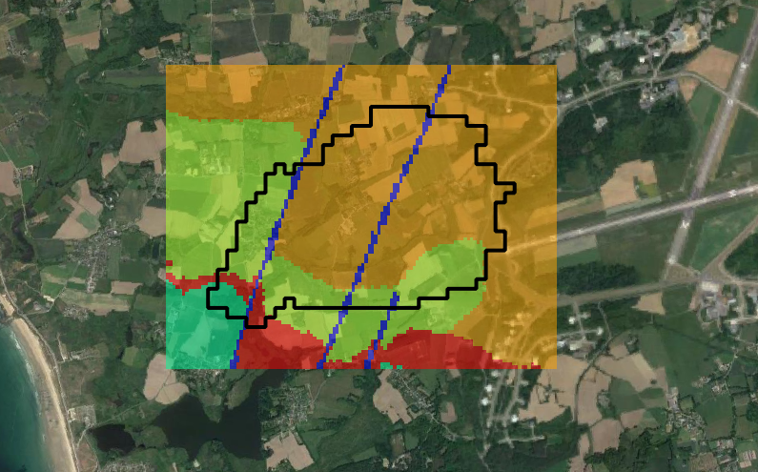
(Real) Example : Guidel case
Geological extrapolation results

