Slide 1
Semi-Automation Tool for Digitization of the Bounding Polygon
CHS Atlantic
Developed by Michel Leger
November 21, 2019
Batch Processing Steps Added January 16, 2021

Slide 2
Downsizing the Gridded Resolution
Downsize the Resolution of the Surface. This can be done through the “Import Wizard” in Caris Base Editor (Method 1) or can be done in QGIS (Method 2)**
Downsizing the resolutions is done to reduce processing time and to reduce the possibility of the model crashing which during testing has occurred with higher resolution datasets.
**See Batch Processing on Slide 21 for automation of downsizing and exporting to geotiffs of multiple files

Slide 3
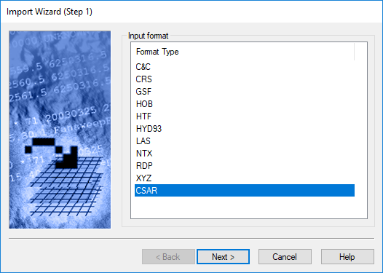
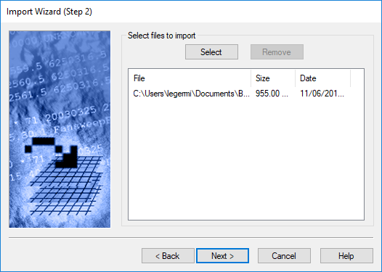
Downsizing Resolution Method 1
File-Import-Import Wizard or the icon
Select CSAR
Select your CSAR files to Import

Slide 4
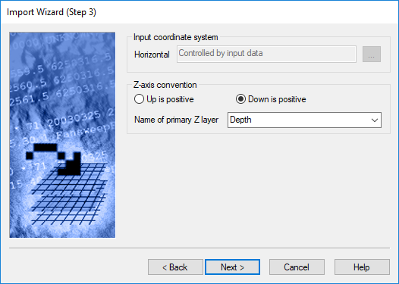
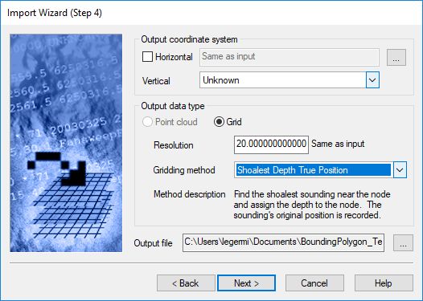
Down Sizing Resolution Method 1
Change Grid size to a value between 10 and 20m
Check down is Positive for z-axis conversion
No other parameters are changed in the windows following

Slide 5
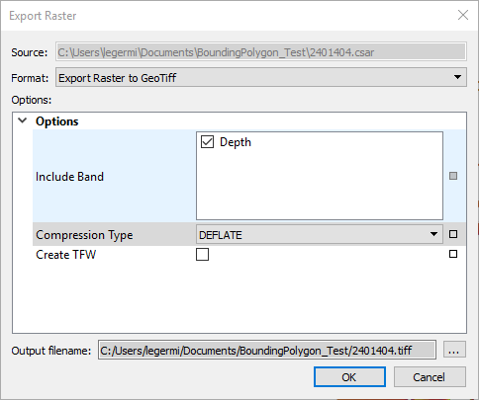
Exporting Surface as a Geotiff
Export Surface as a GeoTiff:
Select the CSAR surface in the Layers window
File- Export- Raster
Set Format to Export Raster to Geotiff
Give it an out file name and location

Slide 6
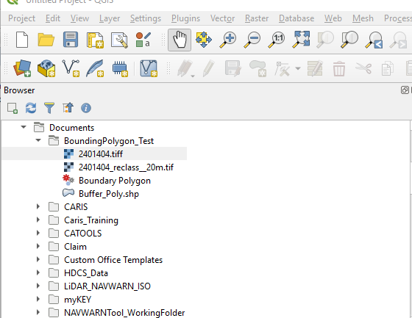
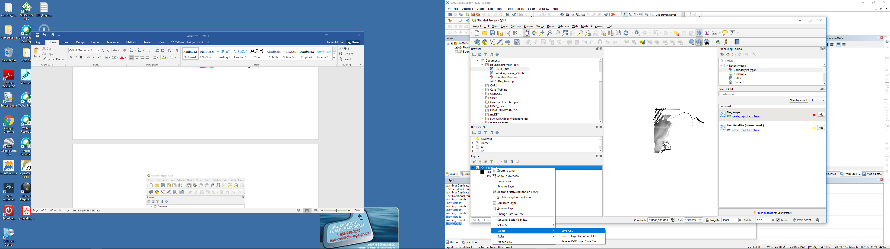
Down Sizing Resolution Method 2
In QGIS use the Browse Window to locate the GeoTiff.
Double click or drag to open file
Right click the layer and save as

Slide 7
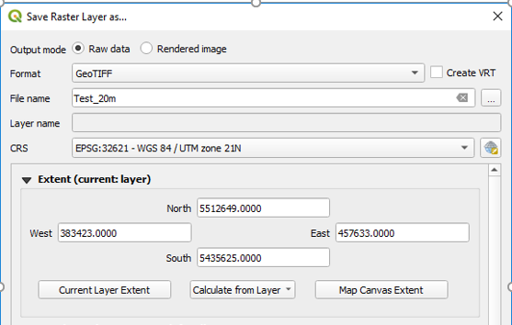
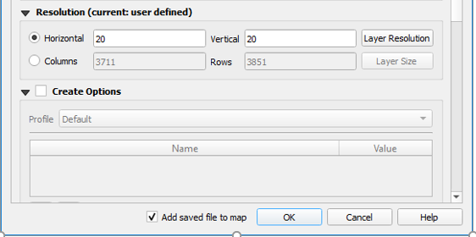
Down Sizing Resolution Method 2
Give a file name and location
Set the Resolution to the same value between 10-20m

Slide 8

Adding the QGIS Model File (Only need to be done once)
Under the Processing Toolbox window on the right of the QGIS application find the Models icon(the one with 3 gears)
On the drop down menu select the Add model to Toolbox
Select the Bounding_Polygon_Tool.model3
This will save the model into QGIS memory for future use

Slide 9
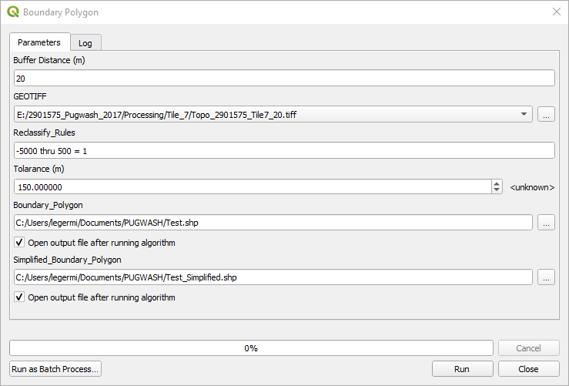
Executing the Model
In the search bar type “CHS” or “BDB” the model “Bounding Polygon” will appear
Double click Bounding Polygon to open the model window
Buffer Distance is defaulted to 100m, but may need to be adjusted depending on dataset
Specify the GeoTiff for the process
Reclassify Rules are set to -5000 thru to 500. By this over exaggeration of the depths (-) and elevations (+) it ensure all cell values are changed to 1 during reclassification.
Set the Tolerance to change the maximum length of edges, default is 150m (Douglas- Peucker)
Provide a filename and location for the Polygons to be created

Slide 10
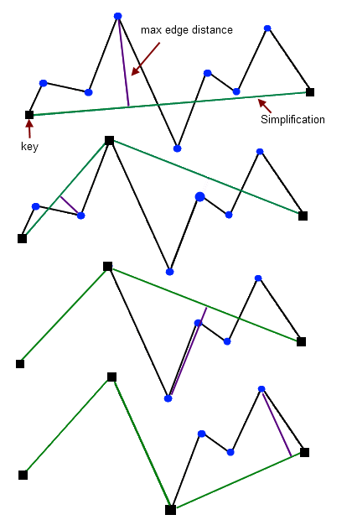
Polygon Non-Simplified vs Simplified
Douglas- Peucker Algorithm
The outputs from the Model include two polygons:
Non- Simplified Polygon can be imported into Caris for further smoothing, used a Bounding Polygon
Simplified Polygon can be imported into Caris, and as exported as GML from Caris to be used as the limit polygon in the VALSRC CHSDir record, used as bounding polygon if not satisfied with non-simplified polygon after smoothing
See next slide for additional way to create CHSDir limits
http://psimpl.sourceforge.net/douglas-peucker.html

Slide 11
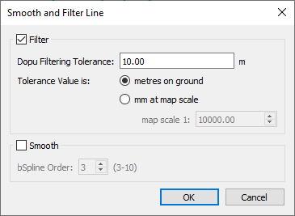
Simplifying Polygon in Base Editor
Additionally a copy of the Non-simplified polygon that can be used as the limits in CHSDir can be created
Use Edit-Lines-SmoothandfilterLines.
Find a desirable maximum distance value that balances the shape and look of the simplified polygon, but still be less that 450 vertex allowing the limits to be used in the CHSDir limits for the Source.

Slide 12
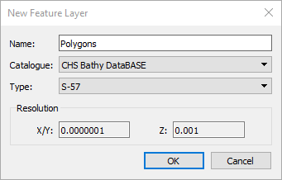
Importing the Shapefile to Base Editor
Create a New Feature: Create-New Feature Layer
Give the feature a name and set the Catalogue to Bathy DataBASE or CHS Bathy DataBASE
Select the Feature Layer from the Layers Window
File-Import-Object Import Utility

Slide 13
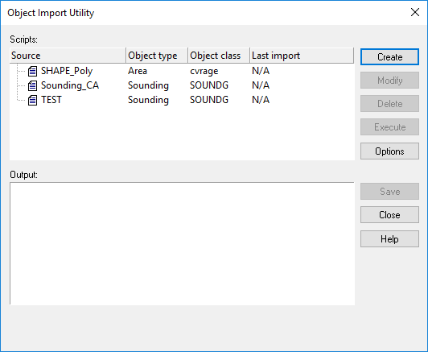
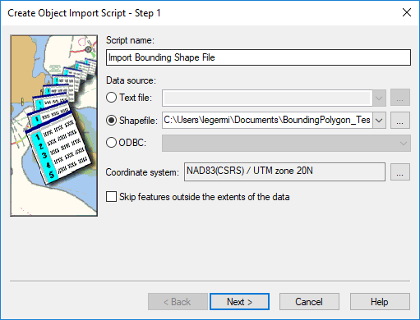
Setting up Object Import Utility
If first import a Script must be created, selected create
Give a Name, The path to the Shapefile, and the CRS

Slide 14
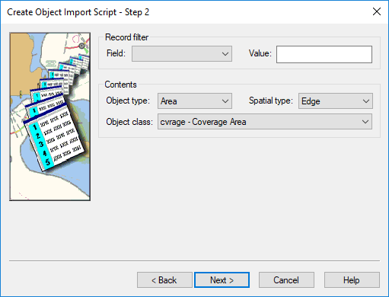
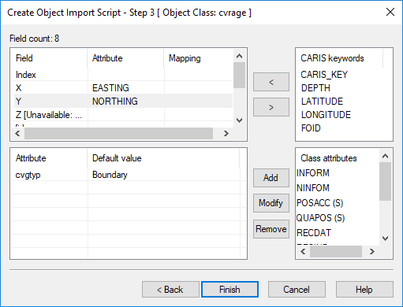
Setting up Object Import Utility
Map the Easting to the X Field and the Northing to the Y field, and Map the cvgtyp Attribute as Boundary
Change the Object class type to cvrage

Slide 15
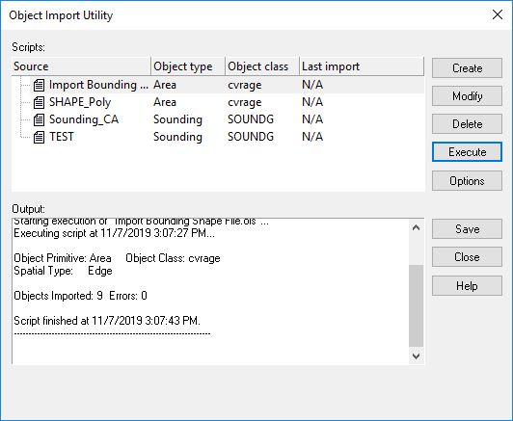
Import Polygons
Select Script and Press Execute
Once finished ensure that no errors occurred and press close
Objects can now be imported into a feature layer
For future imports this script only needs to be modified to match correct import files and CRS.

Slide 16
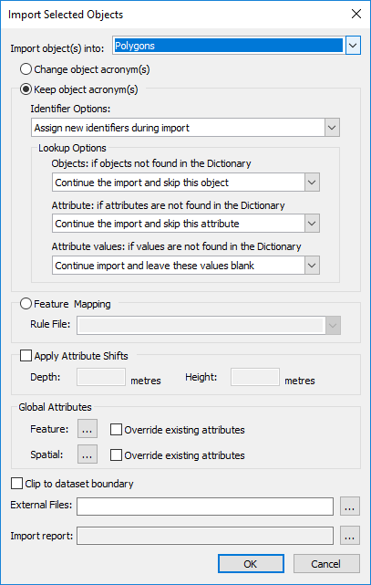
Import Polygons
Select all features in the OUI Import then File-Import-Import Selected Object-Selected
Use Keep Object acronyms
Save the polygon Feature file

Slide 17
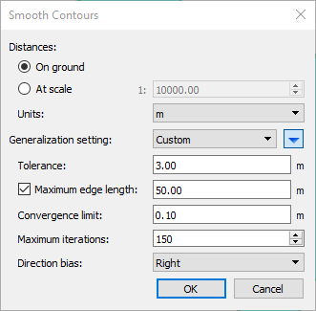
Smoothing the Polygon (Improving the Visual Appeal of the Polygons)
Smoothing the polygons helps to improve the visualization of each polygon by simplifying the polygon created using the buffer.
Select all Features in the Polygon Layer
Edit- Contour- Smooth Contours
Set the Parameters as shown:
Tolerance 3.00
Maximum Edge Length to 50.00
Convergence Limit 0.10
Maximum Iteration 150

Slide 18
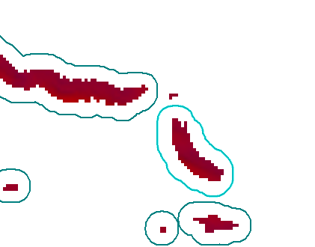
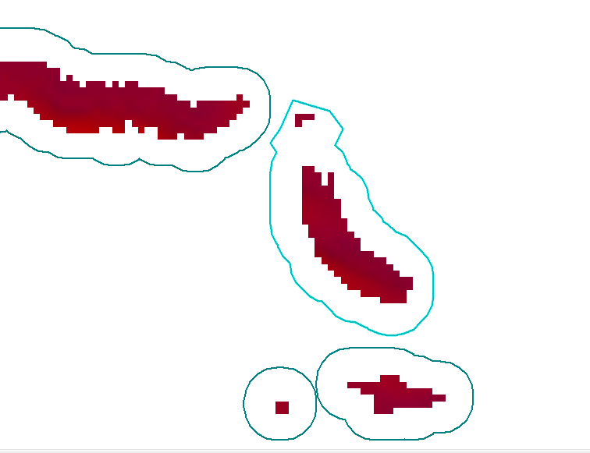
Manual Adjustments to Bounding Polygons
It may be necessary to edit the boundaries of the polygons created due the polygons being created from a lower resolution grid. So far this is very minimal amount of effort and is more efficient than manual digitization of the all bounding polygons.

Slide 19
Adding Polygon to Surface Bounding Polygon
Select the Polygon Feature Layer and ensure that the Repeat New Feature Icon is toggled on Set the Polygon Feature Layer as the Snap/Grab Target
Change the Bounding Polygon to “Convex”
Right click the Bounding Polygon layer, select all features and delete existing polygons, Right click- Remove selected Polygon Boundary (this will need to be repeated for the amount of boundaries that exist in the layer)
Right click Digitize New Polygon Boundary and use the “Grab” to select boundaries from the Polygon feature layer. After each selection press enter, then repeat the selection process
Save changes with File Save (ensure the Surface or Bounding Polygon layer is selected)

Slide 20
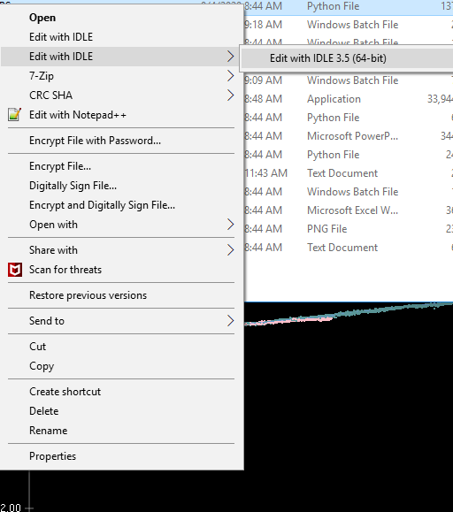
Batch Processing: Opening Application
Install Base Editor 4.4 and Python 3.5 from the Software Center
Save “Boundary_Polygon.py to your computer
Right Click “Boundary_Polygon.py” – Edit with Idle – Edit with IDLE 3.5(64 bit)
Press Run- Run Module or Press F5

Slide 21
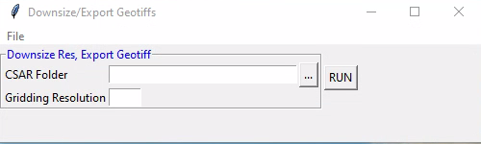
Batch Processing: Downsizing CSARs and Exporting Geotiffs
Select Folder with CSAR files
These will be downsized according to the user value provided and will be exported into Geotiffs to use with the QGIS portion of this process

Slide 22
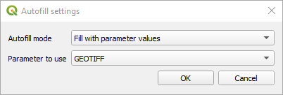
Batch Processing: Running Batch with QGIS Model
Select Run as Batch Process
Select Geotiffs – It will create a new row for each file
Select the location to save the shape files- Provide a file name “P_.shp”, and complete the Auto Fill settings as shown To the same for the simplified polygon but use “S_.shp” as file name.
Select Run

Slide 23
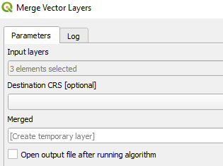
Batch Processing: Combining Shapefiles
This step is not necessary but will reduces time spent importing the shapefiles into Base Editor.
Using the QGIS Processing Tool Bar, Search for the Merge Vector Layer Process
Select the Shapefiles and provide and output files
This can Process can be done using the Batch option if you want to merge the BDB Polygons into one shapefiles and the CHSDir simplified polygons into another

Slide 24
Considerations
Ability to Batch Process a Folder of Surfaces – January 2021
Automate Export to Raster (Caris Batch and Python) – January 2021
Testing with Point Cloud Converted to Gridded Rasters (case by Case resampling due to line spacing)
Further automate this process with an additional step to change resolution within the Model
Through Resample tool
Use Caris Batch to create a hob file from WKT file (removes need to use the Object import Utility)
Python Script that runs Export to Raster, Resample Resolution, Model processes, import as a hob file, and smooth polygons
Question for Caris to see if this is possible within Base Editor(at a reasonable processing time), suggestion to have functionality

Slide 25
