Slide 1



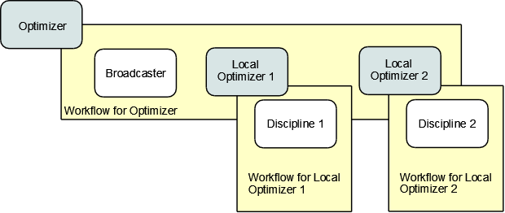
Static Databases
Land/Water
WOS/Linux
Energy
WOS
Text File
Zip Models
Input Files
Economic
???
Problem Parser
Models’
Parsers
Execute models
(baseline)
Dynamic (User)
Databases
Problem Object
Models’
Objects
Write\Read
Outputs
Optimization module
MDAO Formulation
Formulation
Object
Land/Water
Model
Energy
Model
Execute model
Execute model
OpenMDAO
pyOPT
pyOptSparse
mpi4py

