Slide 1
Agenda (XSEDE – 5/14/2018)
Goals
Provide Eric and Eroma with a list of needed python libraries and software
Will provide some “off-the-shelf” optimization examples for testing
https://www.dropbox.com/s/vlp85uz5wnkkxyb/MDO%20Tests.zip?dl=0
Test SWAT model
https://www.dropbox.com/s/0290htgm1wnx1kf/SWAT_test.zip?dl=0
Plan next steps for deployment of “Dummy-problem”
Code parallelization needs
Cluster needs and details
Deadline: 05/31/2018
Objectives
Provide overview of code architecture
Brainstorm ideas about parallelization needs and its most appropriate implementation
Discuss coding language/software needs
Get help on the compilation of python libraries
Verify resources’ accounts (e.g., access/account setups)
Participants
Sammy, Meghna, Suresh, Eroma, Eric

Slide 2
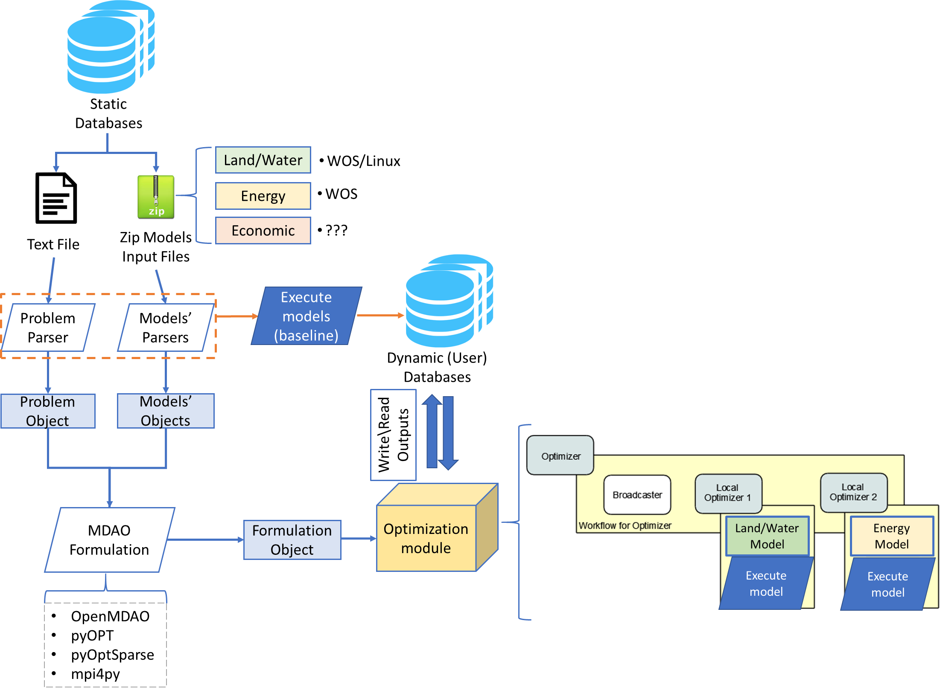
Overview of Code Architecture

Slide 3
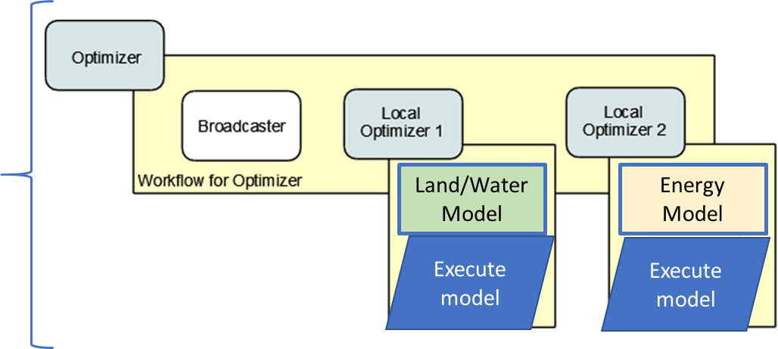
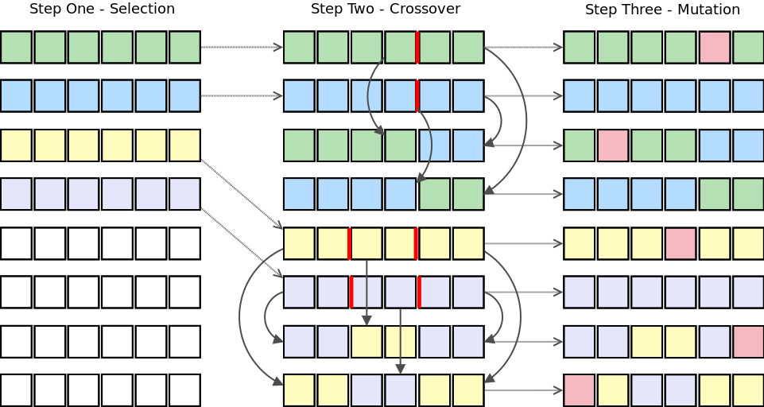
Parallelization & Cluster Needs
Simulation – Optimization
Evolutionary algorithms (i.e., Genetic Algorithms)
Model’s parameters
Execute model
Calculate
Metrics
1
2
…
Shared memory

Slide 4
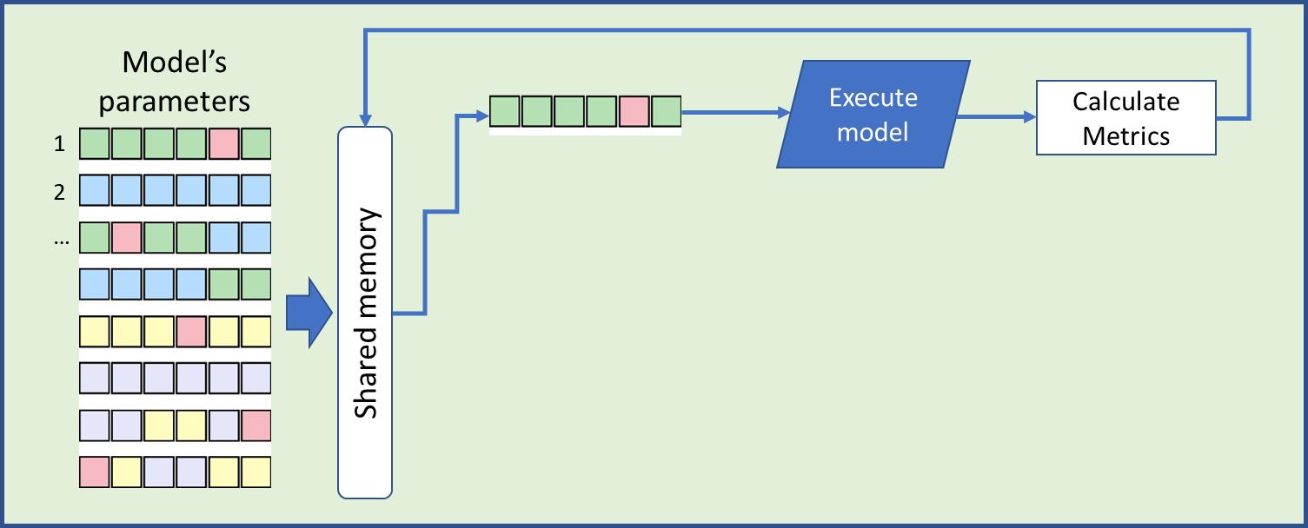
Parallelization & Cluster Needs
Global Optimizer
Local Optimizer
Local Optimizer

Slide 5
Software Needs
Python libraries
Critical libraries
scipy, matplotlib, pyopt, opemmdao, pyomo, pyutilib, pyodbc, mpi4py, statsmodel, mysql
pyOptSparseDriver (NEED HELP!) - https://github.com/mdolab/pyoptsparse
Fails to compile or upload to python
NEED it as it allows: Multi-objective and (in theory) parallelization
Spatial data libraries:
pysal, gdal, pyshp
GLPK solvers - https://sourceforge.net/projects/winglpk/
Resources & Accounts:
XSEDE's Single Sign On (SSO) hub
TACC
Version control software - GitHub?
Project management tools - Jira??
Any other??

Slide 6
