Slide 1
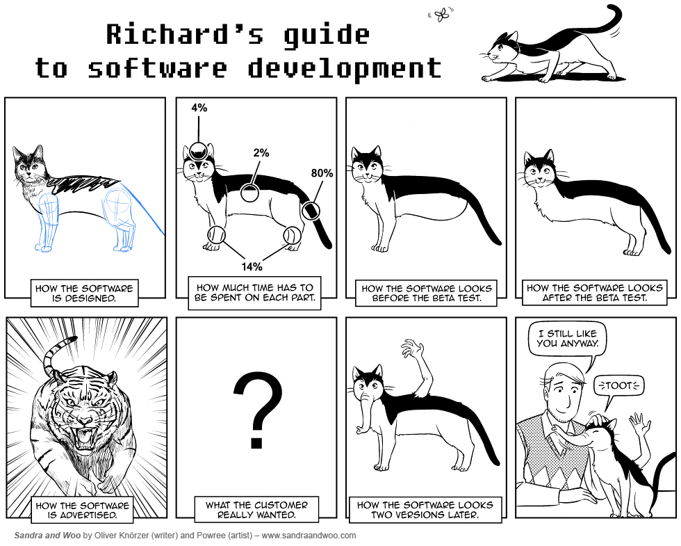

Slide 2
Test problem: Dummy of a Dummy
Driver
Broadcaster
Local Optimizer 1
Local Optimizer 2
Comp
Comp1

Slide 3
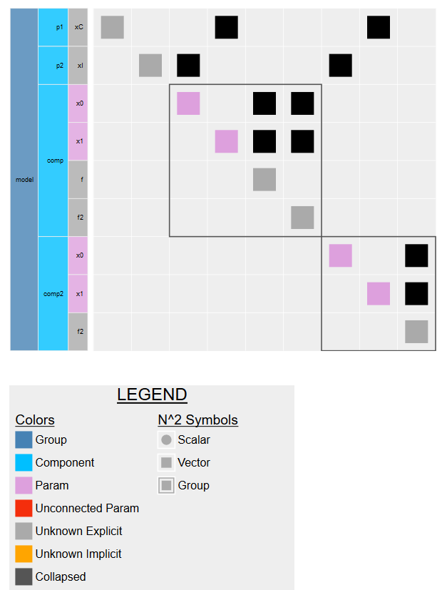
http://htmlpreview.github.io/?https://github.com/Hydroinformatics/InterACTWEL/blob/Dev/src/PySWAT/SWAT_post_process/dev/n2.html

Slide 4
Optimization formulation
Design variables: x0, x1
Disciplines
Comp:
Objective: Min f + f2
f = a*(x1 - b*x0² + c*x0 - d)² + e*(1-g)*cos(x0) + e
f2 = x0² + c*x0*x1
Comp1:
Objective: Min f2
f2 = x0² + c*x0*x1
Constraints:
x0 (integer): [-5,10]
x1 (continuous): [0,15]

Slide 5
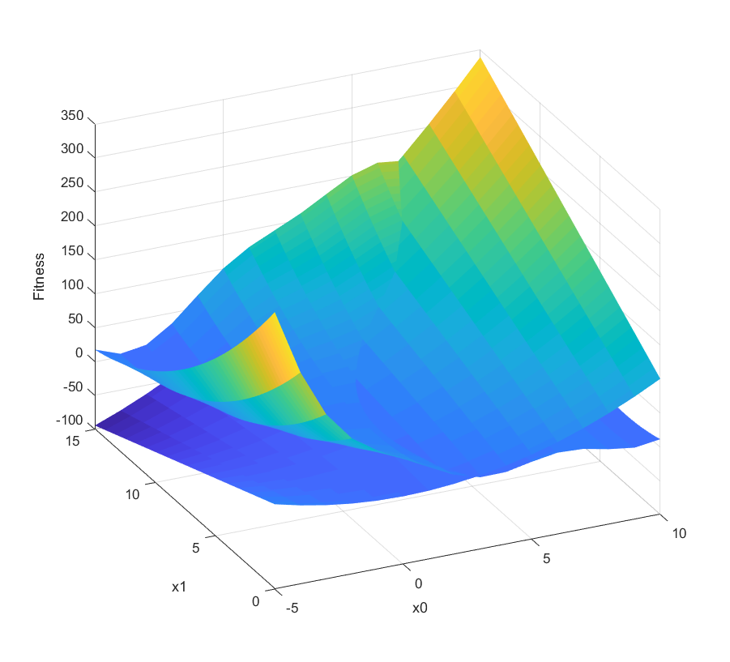
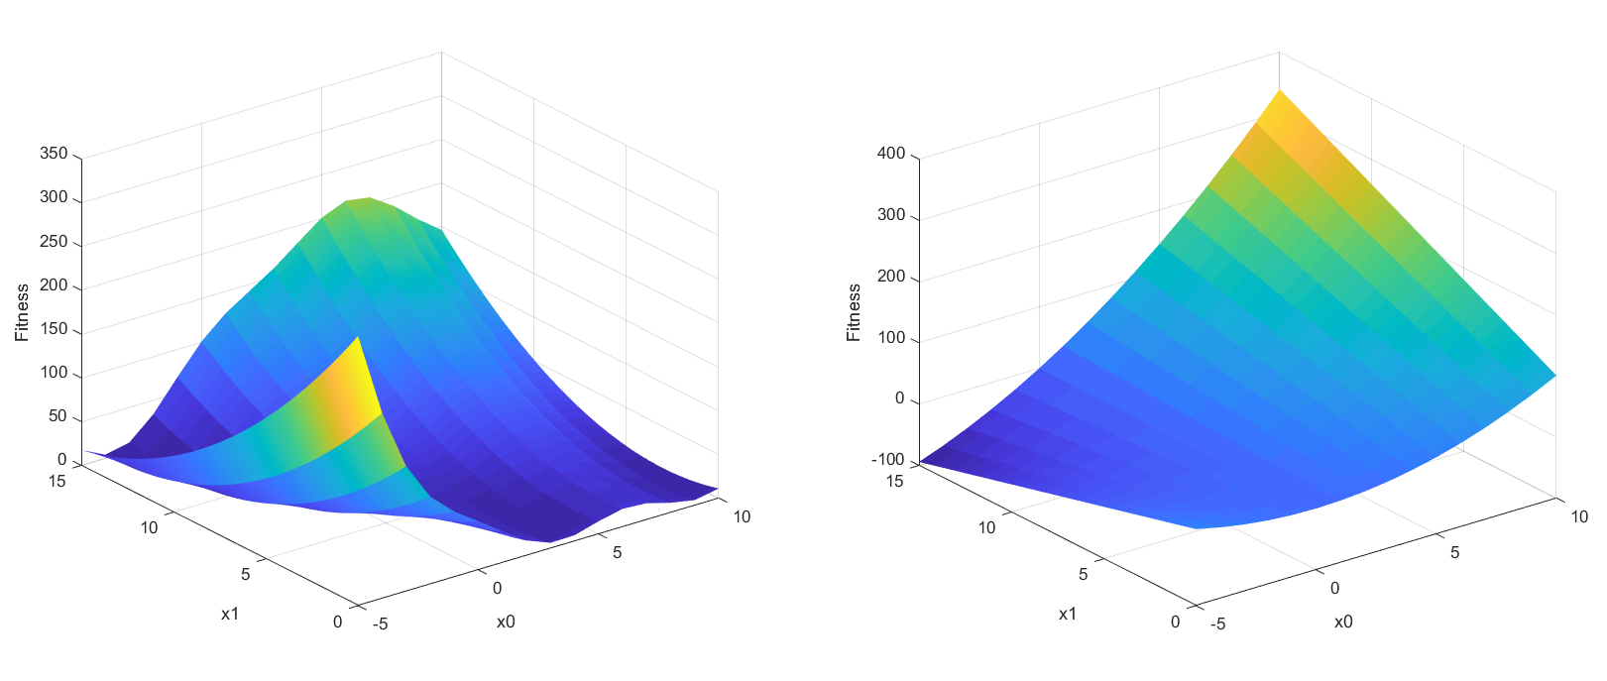
Solution space
Comp
Comp1

Slide 6
Scenario 1
Objectives
Max Comp
Min Comp1
Solution
x0 = -5
x1 = 0
Comp
Comp1

Slide 7
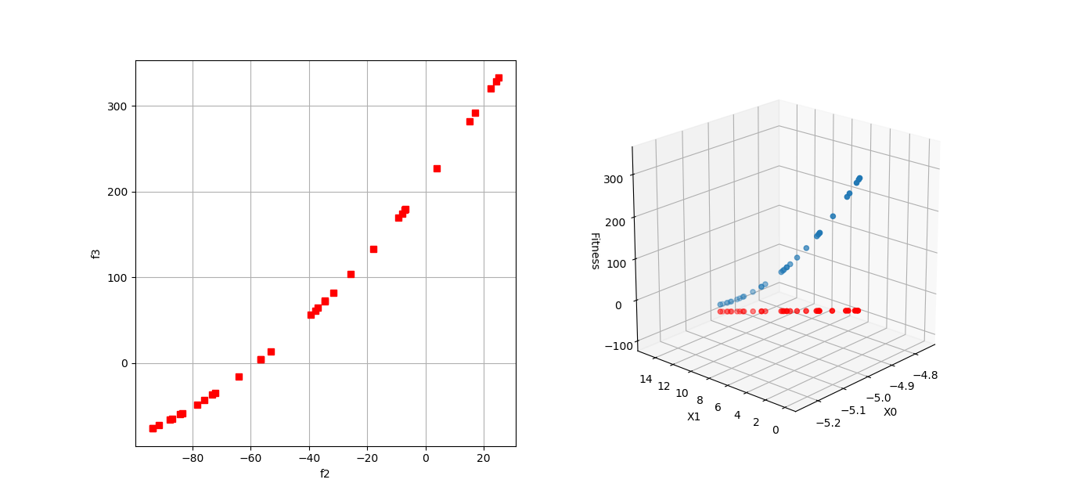
Scenario 1: Pareto front

