Slide 1

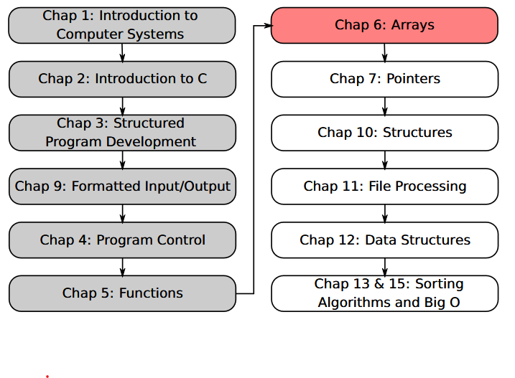
SU FACULTY of ENGINEERING
Computer Programming 143 lectures | 19 August 2026
PROGRAMMING IN C
6. Arrays I
Lecture 13| Arrays introduction
Declaring arrays
Examples using arrays
Isaac Khobo, PhD (ilkhobo@sun.ac.za)
Chapters 6: Arrays
Notes:
Welcome to lecture 13

Slide 2

SU FACULTY of ENGINEERING
Computer Programming 143 lectures | 19 August 2026
Array
What is an array?
A collection of elements of the same data type
Store multiple values under single variable name
Fixed size throughout the program*
datatype arrayName[n] = {element0 ,
element1 ,
element2, … } ;
FORMAT

Slide 3
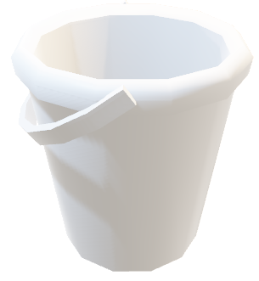
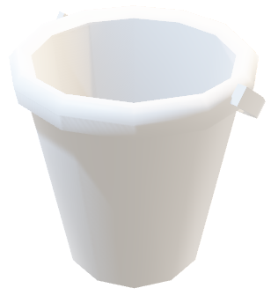
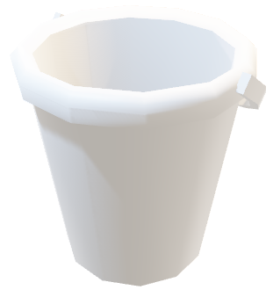
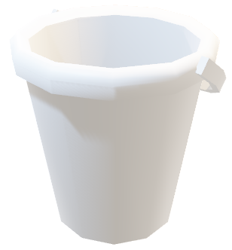
siya
C
-10
D
-15
leah
21
5.21
7.71
7.71
luca
athena
1
9.65
9
B
1.2
A
isaac
Array

Slide 4

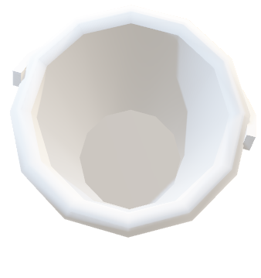
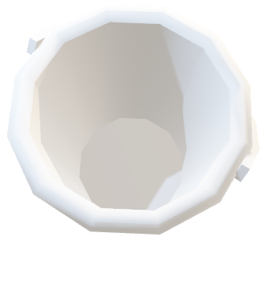
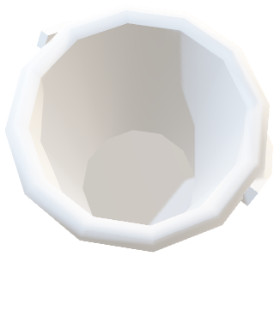
siya
C
-10
D
-15
leah
21
5.21
7.71
7.71
luca
athena
1
9.65
9
B
1.2
A
isaac
int
float
char
string

Slide 5
siya
C
D
leah
5.21
7.71
7.71
luca
athena
9.65
B
1.2
A
isaac
1
-15
-10
9
21
int
float
char
string

Slide 6
siya
C
D
leah
luca
athena
B
A
isaac
1
-15
-10
9
7.71
21
5.21
7.71
9.65
1.2
int
float
char
string

Slide 7
siya
leah
luca
athena
isaac
1
-15
-10
9
7.71
A
21
5.21
B
7.71
9.65
C
D
1.2
int
float
char
string

Slide 8
isaac
1
-15
-10
leah
9
7.71
A
21
5.21
B
7.71
9.65
C
athena
siya
D
1.2
luca
int
float
char
string

Slide 9
SU FACULTY of ENGINEERING
Computer Programming 143 lectures | 19 August 2026
Array
What is an array?
A collection of elements of the same data type
Store multiple values under single variable name
Fixed size throughout the program*
datatype arrayName[n] = {element0 ,
element1 ,
element2, … } ;
FORMAT

Slide 10
SU FACULTY of ENGINEERING
Computer Programming 143 lectures | 19 August 2026
Array
What is an array?
datatype arrayName[n] = {element0 ,
element1 ,
element2, … } ;
A collection of elements of the same data type
Store multiple values under single variable name
Fixed size throughout the program*
FORMAT

Slide 11
SU FACULTY of ENGINEERING
Computer Programming 143 lectures | 19 August 2026
Array
What is an array?
datatype arrayName[n] = {element0 ,
element1 ,
element2, … } ;
A collection of elements of the same data type
Store multiple values under single variable name
Fixed size throughout the program*
data type
The datatype of your elements (NB: array is a collection of elements of the same data type.)

Slide 12
SU FACULTY of ENGINEERING
Computer Programming 143 lectures | 19 August 2026
Array
What is an array?
datatype arrayName[n] = {element0 ,
element1 ,
element2, … } ;
A collection of elements of the same data type
Store multiple values under single variable name
Fixed size throughout the program*
Array name
Identifier for your array, i.e., how’s it’s identified by the compiler

Slide 13

SU FACULTY of ENGINEERING
Computer Programming 143 lectures | 19 August 2026
Array
What is an array?
datatype arrayName[n] = {element0 ,
element1 ,
element2, … } ;
A collection of elements of the same data type
Store multiple values under single variable name
Fixed size throughout the program*
Elements of the array
Values that are collected by the array and their indexes (position in the array)

Slide 14
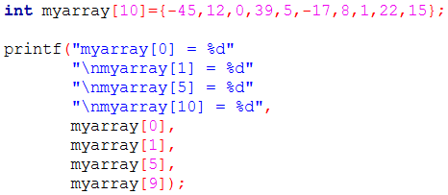
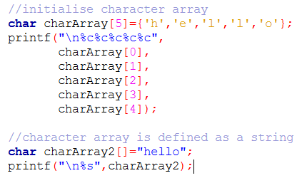
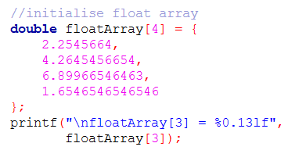
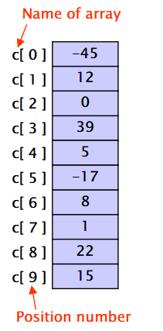
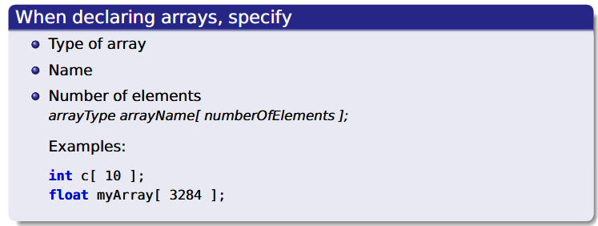
Example 1
Array of integers
Example 2
Example 3:
character arrays
Array of floats/doubles

Slide 15
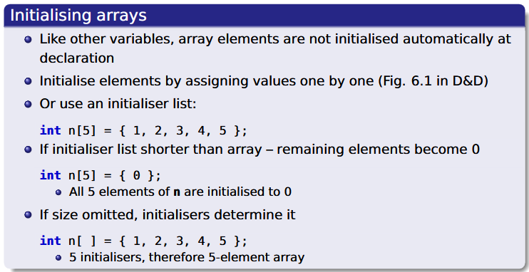
SU FACULTY of ENGINEERING
Computer Programming 143 lectures | 19 August 2026
Array
Initialising arrays rules

Slide 16
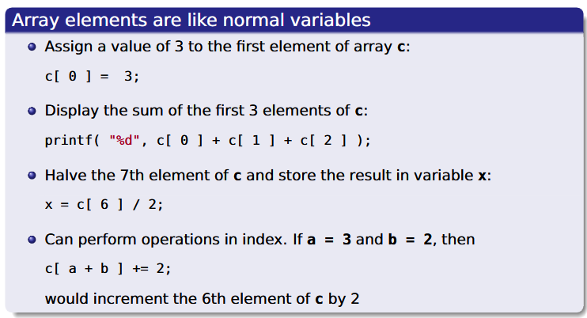
SU FACULTY of ENGINEERING
Computer Programming 143 lectures | 19 August 2026
Array
Perform arithmetic with arrays

Slide 17
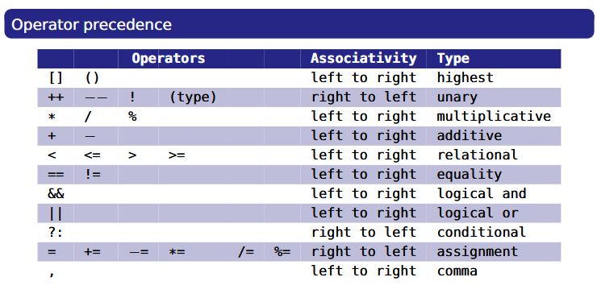
SU FACULTY of ENGINEERING
Computer Programming 143 lectures | 19 August 2026
Array
Perform arithmetic with arrays

Slide 18
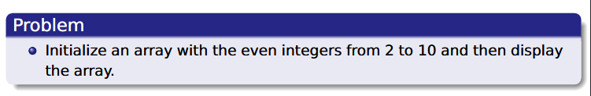
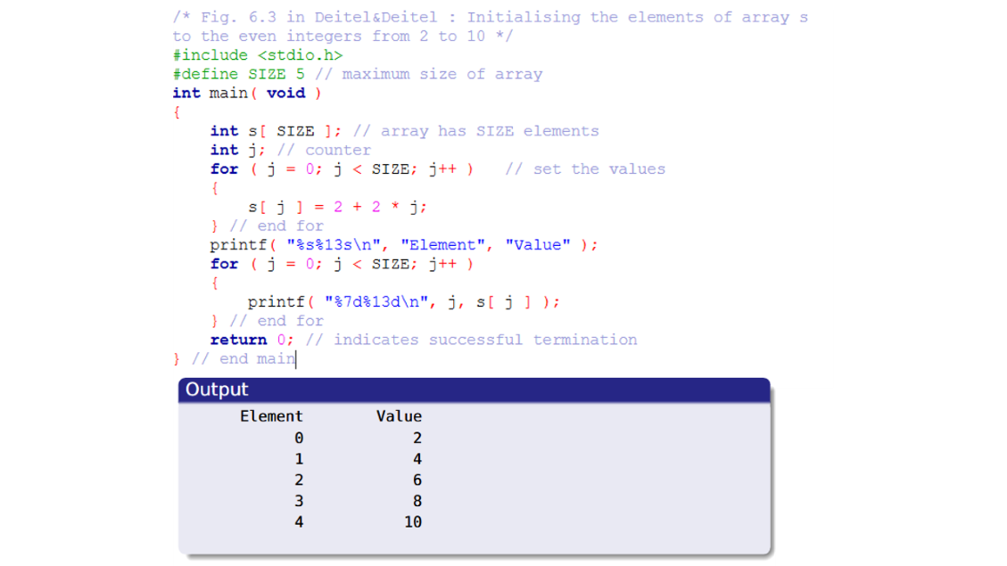
SU FACULTY of ENGINEERING
Computer Programming 143 lectures | 19 August 2026
Array: examples

Slide 19
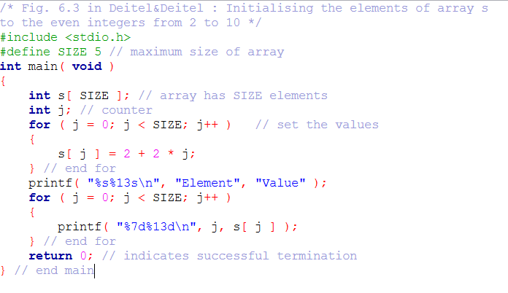
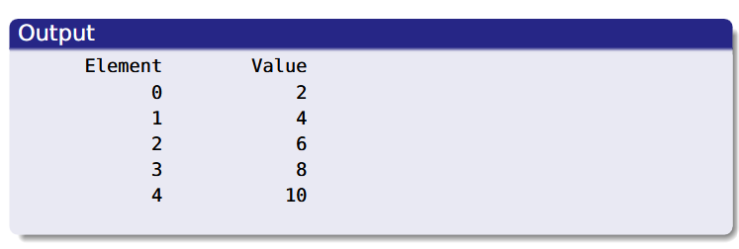

Slide 20
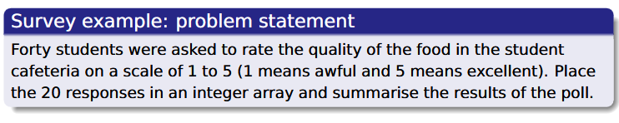
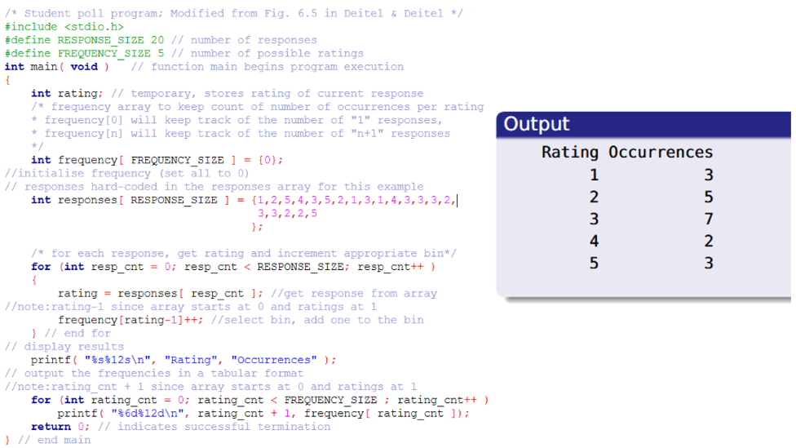
SU FACULTY of ENGINEERING
Computer Programming 143 lectures | 19 August 2026
Array: examples

Slide 21
