Slide 1

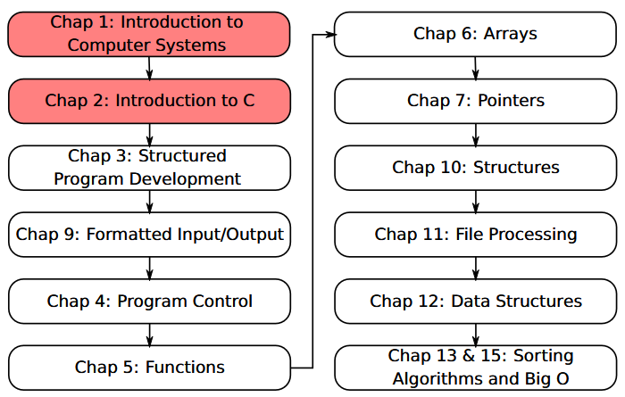
SU FACULTY of ENGINEERING
Computer Programming 143 lectures | 20 July 2026
A. WELCOME TO CP143
WELCOME TO CP143
1. Module Overview
Lecture 1| Computer Systems
Programming Languages
Simple C Program 1: Printing Text
Isaac Khobo, PhD (ilkhobo@sun.ac.za)
Chapter 1&2: Comp Systems & intro to C

Slide 2
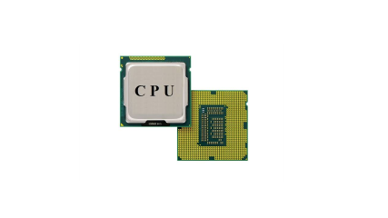
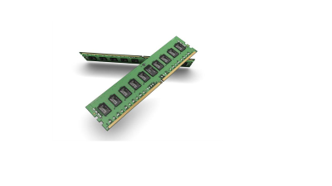
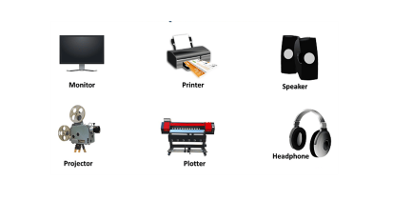
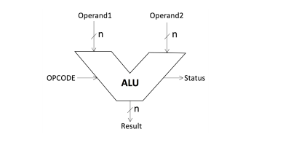
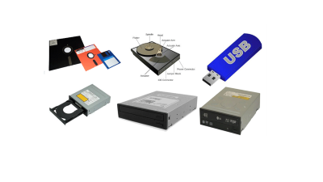

SU FACULTY of ENGINEERING
Computer Programming 143 lectures | 20 July 2026
WHAT IS A COMPUTER?
A device capable of performing computations and making logical decisions
Output Units (usr info)
CPU(supervision/coordination)
Input Units (usr info)
COMPUTER??
Secondary storage units
ALU (computation)
RAM (rapid access/program )
INTRODUCTION pg. 3

Slide 3


Slide 4
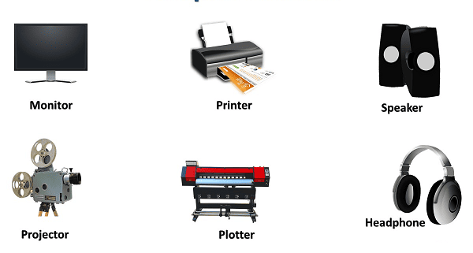

Slide 5
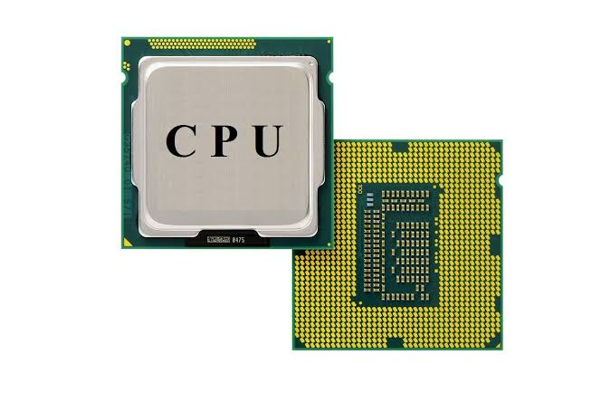

Slide 6
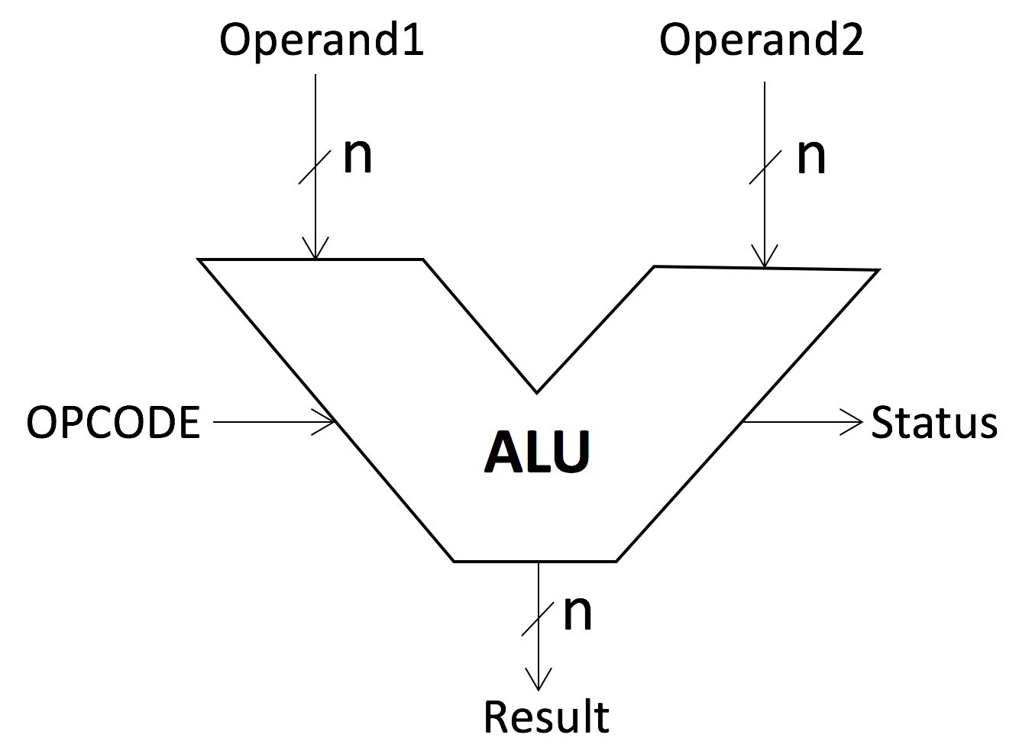

Slide 7
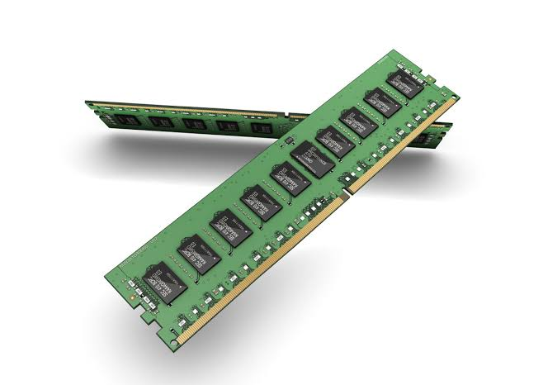

Slide 8
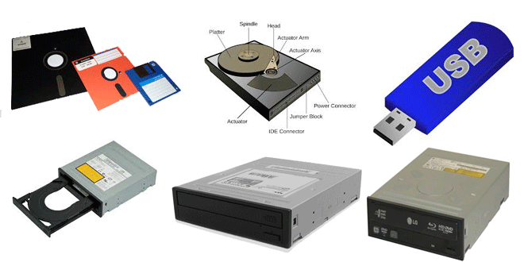

Slide 9
SU FACULTY of ENGINEERING
Computer Programming 143 lectures | 20 July 2026
WHAT IS A PROGRAMMING LANGUAGE?
A formal, structured set of instructions and syntax used by humans to communicate with computers and create applications (software)
MACHINE LANGUAGE
ASSEMBLY LANGUAGE
HIGH-LEVEL LANGUAGES
3 TYPES OF PROGRAMMING LANGUAGES
INTRODUCTION pg. 4

Slide 10
SU FACULTY of ENGINEERING
Computer Programming 143 lectures | 20 July 2026
WHAT IS A PROGRAMMING LANGUAGE?
A formal, structured set of instructions and syntax used by humans to communicate with computers and create applications (software)
String of numbers giving machine specific instructions
Examples:
+1300042774
+1400593419
+1200274027
MACHINE LANGUAGE
ASSEMBLY LANGUAGE
HIGH-LEVEL LANGUAGES
3 TYPES OF PROGRAMMING LANGUAGES
INTRODUCTION pg. 4

Slide 11
SU FACULTY of ENGINEERING
Computer Programming 143 lectures | 20 July 2026
WHAT IS A PROGRAMMING LANGUAGE?
A formal, structured set of instructions and syntax used by humans to communicate with computers and create applications (software)
String of numbers giving machine specific instructions
Examples:
+1300042774
+1400593419
+1200274027
English-like abbr. representing elementary comp. operations (translated by assemblers).
Examples:
LOAD BASEPAY
ADD OVERPAY
STORE GROSSPAY
MACHINE LANGUAGE
ASSEMBLY LANGUAGE
HIGH-LEVEL LANGUAGES
3 TYPES OF PROGRAMMING LANGUAGES
INTRODUCTION pg. 4

Slide 12
SU FACULTY of ENGINEERING
Computer Programming 143 lectures | 20 July 2026
WHAT IS A PROGRAMMING LANGUAGE?
A formal, structured set of instructions and syntax used by humans to communicate with computers and create applications (software)
String of numbers giving machine specific instructions
Examples:
+1300042774
+1400593419
+1200274027
English-like abbr. representing elementary comp. operations (translated by assemblers).
Examples:
LOAD BASEPAY
ADD OVERPAY
STORE GROSSPAY
Codes similar to everyday English. Uses mathematical notations. Translated by compilers.
Example:
grossPay = basePay + overTimePay
MACHINE LANGUAGE
ASSEMBLY LANGUAGE
HIGH-LEVEL LANGUAGES
3 TYPES OF PROGRAMMING LANGUAGES
INTRODUCTION pg. 4

Slide 13
SU FACULTY of ENGINEERING
Computer Programming 143 lectures | 20 July 2026
BENEFITS: PROGRAMMING IN C LANGUAGE
Programming principles are easy to learn in C
Provides a foundation from which to learn higher level languages (c++/java)
Essential for embedded applications
Many libraries for mathematical and scientific applications available
C PROGRAMMING pg. 5

Slide 14
SU FACULTY of ENGINEERING
Computer Programming 143 lectures | 20 July 2026
TYPICAL C PROGRAM DEVELOPMENT ENVIRONMENT
C programs consist of pieces/modules called functions (adv: programmer knows how it works, disadv: computational expensive). But C LIBS can be used
DEVELOPMENT ENV. (IDE)
C LANGUAGE
C STANDARD LIBRARY
C PROGRAM STAGES: edit, pre-process, compile, link, load, execute
INTRODUCTION pg. 6

Slide 15
SU FACULTY of ENGINEERING
Computer Programming 143 lectures | 20 July 2026
TYPICAL C PROGRAM DEVELOPMENT ENVIRONMENT
C programs consist of pieces/modules called functions (adv: programmer knows how it works, disadv: computational expensive). But C LIBS can be used
An IDE is software that provides a comprehensive set of features for software development
Examples:
Code::Blocks
Visual Studio/VSCode
CLion
DEVELOPMENT ENV. (IDE)
C LANGUAGE
C STANDARD LIBRARY
C PROGRAM STAGES: edit, pre-process, compile, link, load, execute
INTRODUCTION pg. 6

Slide 16
SU FACULTY of ENGINEERING
Computer Programming 143 lectures | 20 July 2026
TYPICAL C PROGRAM DEVELOPMENT ENVIRONMENT
C programs consist of pieces/modules called functions (adv: programmer knows how it works, disadv: computational expensive). But C LIBS can be used
An IDE is software that provides a comprehensive set of features for software development
Examples:
Code::Blocks
Visual Studio/VSCode
CLion
Contains functions. These are building blocks. Adv: Save time, disadv: know exactly how the functions work and memorise all of them
Example:
<stdio.h> :: printf(), scanf(),etc
<string.h> :: strlen(), strcmp()
DEVELOPMENT ENV. (IDE)
C STANDARD LIBRARY
C LANGUAGE
C PROGRAM STAGES: edit, pre-process, compile, link, load, execute
INTRODUCTION pg. 6

Slide 17
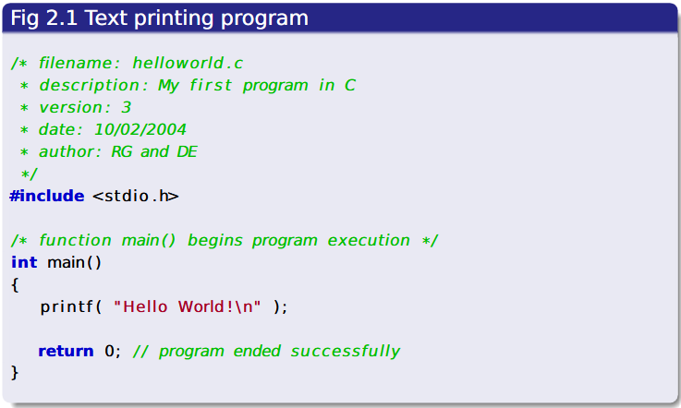
SU FACULTY of ENGINEERING
Computer Programming 143 lectures | 20 July 2026
TYPICAL C PROGRAM DEVELOPMENT ENVIRONMENT
C programs consist of pieces/modules called functions (adv: programmer knows how it works, disadv: computational expensive). But C LIBS can be used
An IDE is software that provides a comprehensive set of features for software development
Examples:
Code::Blocks
Visual Studio/VSCode
CLion
Source code/program, instructions
Contains functions. These are building blocks. Adv: Save time, disadv: know exactly how the functions work and memorise all of them
Example:
<stdio.h> :: printf(), scanf(),etc
<string.h> :: strlen(), strcmp()
DEVELOPMENT ENV. (IDE)
C LANGUAGE
C STANDARD LIBRARY
C PROGRAM STAGES: edit, pre-process, compile, link, load, execute
INTRODUCTION pg. 6

Slide 18

SU FACULTY of ENGINEERING
Computer Programming 143 lectures | 20 July 2026
SIMPLE C PROGRAM
Simple C PROGRAMMING SCRIPT
INTRODUCTION pg. 7

Slide 19
SU FACULTY of ENGINEERING
Computer Programming 143 lectures | 20 July 2026
COMMENTS (GREEN)
Used to describe program
Text surrounded by /* and */ is ignored by compiler
Remainder of line after // is ignored by compiler
Simple C PROGRAMMING SCRIPT
INTRODUCTION pg. 7

Slide 20
SU FACULTY of ENGINEERING
Computer Programming 143 lectures | 20 July 2026
Libraries/functions (Blue)
Pre-processor directive
Tells the computer to include the contents of the specified file with the
source code
<stdio.h> allows standard input/output operations
Simple C PROGRAMMING SCRIPT
INTRODUCTION pg. 7

Slide 21
SU FACULTY of ENGINEERING
Computer Programming 143 lectures | 20 July 2026
int main()
C programs always contain one or more functions, exactly one of which
must be main
Parenthesis used to indicate a function
int means that main “returns” an integer value to calling function or
batch process
Simple C PROGRAMMING SCRIPT
INTRODUCTION pg. 7

Slide 22
SU FACULTY of ENGINEERING
Computer Programming 143 lectures | 20 July 2026
Braces { and }
Braces ({ and }) indicate a block
The bodies of all functions must be contained in braces
{
//Block contents
}
Simple C PROGRAMMING SCRIPT
INTRODUCTION pg. 7

Slide 23
SU FACULTY of ENGINEERING
Computer Programming 143 lectures | 20 July 2026
printf( "Hello World!\n" )
Instructs computer to perform an action
Specifically, prints the string of characters within quotes (" ")
Escape character (\)
Indicates that printf should do something out of the ordinary
\n is the newline character
Entire line called a statement
All statements must end with a semicolon (;)
Simple C PROGRAMMING SCRIPT
INTRODUCTION pg. 7

Slide 24
SU FACULTY of ENGINEERING
Computer Programming 143 lectures | 20 July 2026
return 0
A way to exit a function
return 0, in this case, means that the program terminated normally
Simple C PROGRAMMING SCRIPT
Chapter 1 pg. 7

