Slide 1

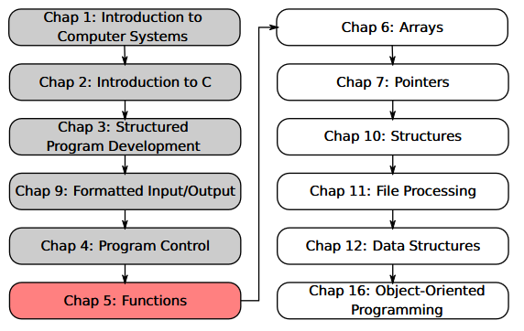
SU FACULTY of ENGINEERING
Computer Programming 143 lectures | 11 August 2026
PROGRAMMING IN C
5. Functions II
Lecture 10| Review of functions
Header files
Calling functions (by-value vs by-reference)
Random number generation
Isaac Khobo, PhD (ilkhobo@sun.ac.za)
Chapters 5 Functions

Slide 2
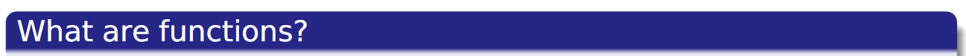

SU FACULTY of ENGINEERING
Computer Programming 143 lectures | August 2026
Functions review
DECODED
functionName (argument1 , argument2 , … ) ;
FORMAT

Slide 3
SU FACULTY of ENGINEERING
Computer Programming 143 lectures | August 2026
Functions Review
stdio.h: printf(), scanf()
math.h: sqrt(), pow(), exp()
Example: x = cos(1.15);
C standard library functions
calculateMean(), calculateMedian(), calculateminVal()
Example:
int maximum(int x, int y, int z)
User-defined functions
DECODED
functionName (argument1 , argument2 , … ) ;
FORMAT

Slide 4
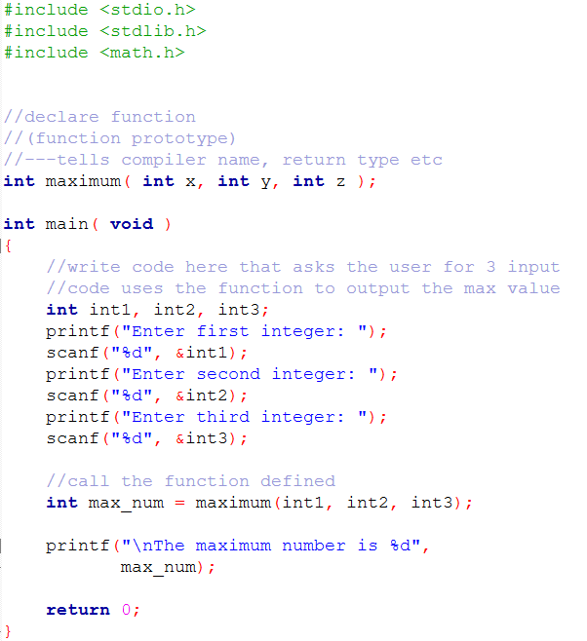
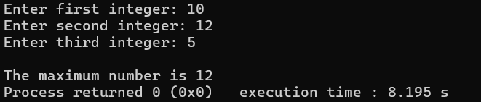
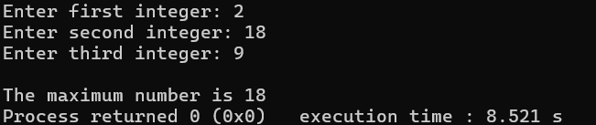
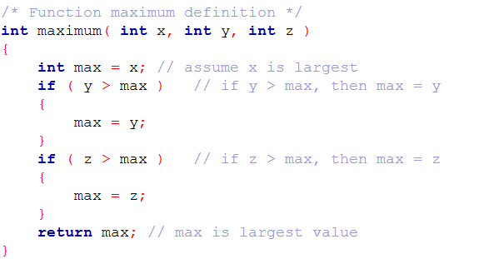
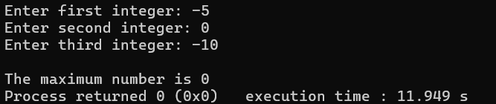
SAMPLE OUTPUT 1
SAMPLE OUTPUT 2
SAMPLE OUTPUT 3

Slide 5
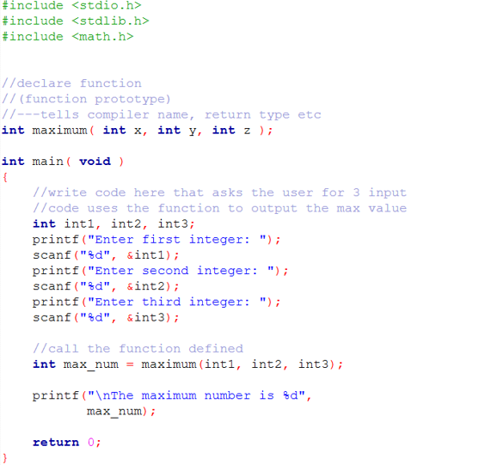
SU FACULTY of ENGINEERING
Computer Programming 143 lectures | 11 August 2026
Header files
HEADER FILES
DECODED

Slide 6
SU FACULTY of ENGINEERING
Computer Programming 143 lectures | 11 August 2026
Header files
HEADER FILES
DECODED
<Stdio.h>
printf()
scanf()

Slide 7
SU FACULTY of ENGINEERING
Computer Programming 143 lectures | 11 August 2026
Header files
HEADER FILES
DECODED
<stdlib.h>
exit()
atoi()
div()
rand()*

Slide 8
SU FACULTY of ENGINEERING
Computer Programming 143 lectures | 11 August 2026
Header files
HEADER FILES
DECODED
math.h
pow()
ceil()
floor()
sqrt()
fmod()

Slide 9
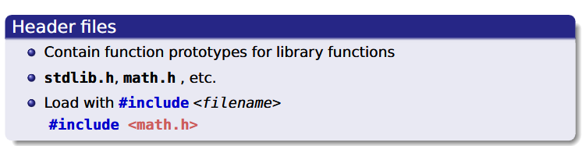
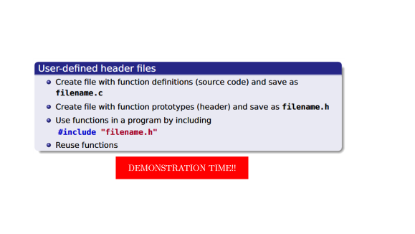
SU FACULTY of ENGINEERING
Computer Programming 143 lectures | 11 August 2026
Header files
DECODED
#include <stdio.h>:
printf(), scanf()
#include < math.h>:
sqrt(), pow(), exp()
C standard library functions
#include “functionName.h”:
Example:
#include “calculateAverage.h”:
User-defined functions

Slide 10
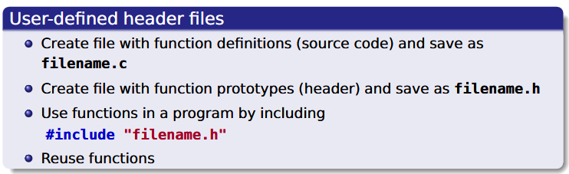
DEMONSTRATION TIME!!

Slide 11
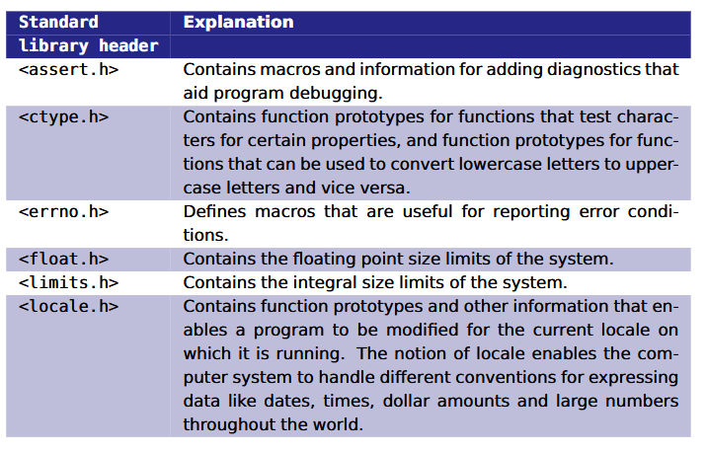
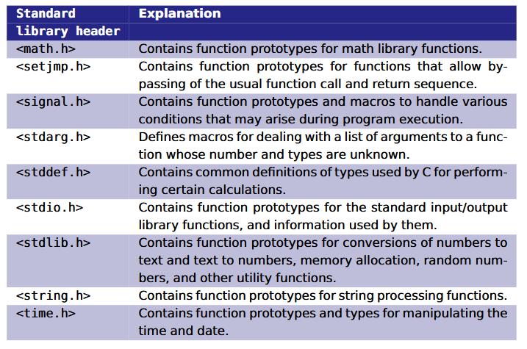
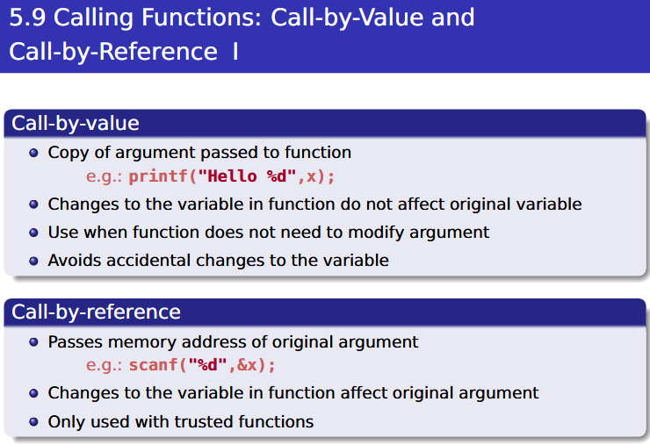
SU FACULTY of ENGINEERING
Computer Programming 143 lectures | 11 August 2026
Header files: NOTES
DECODED

Slide 12
DECODED

Slide 14
SU FACULTY of ENGINEERING
Computer Programming 143 lectures | 11 August 2026
Random number generation
Simulating uncertainty or chance?
DECODED
Examples
Rolling dice
Lottery numbers
Game
spawns

Slide 15
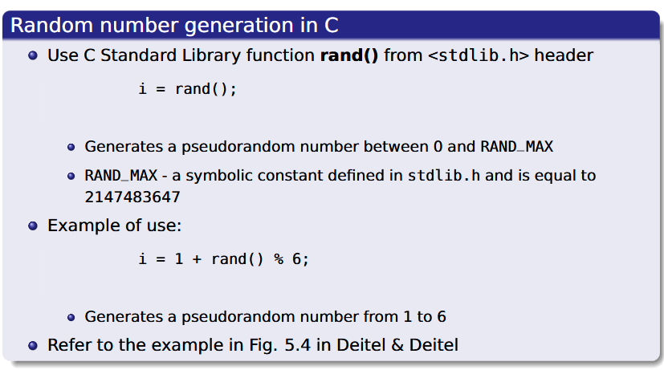
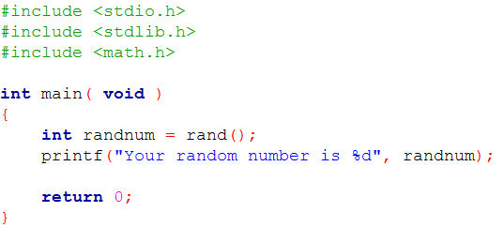
SU FACULTY of ENGINEERING
Computer Programming 143 lectures | 11 August 2026
Random number generation
DECODED
<stdlib.h> & rand()
Sample code

Slide 16
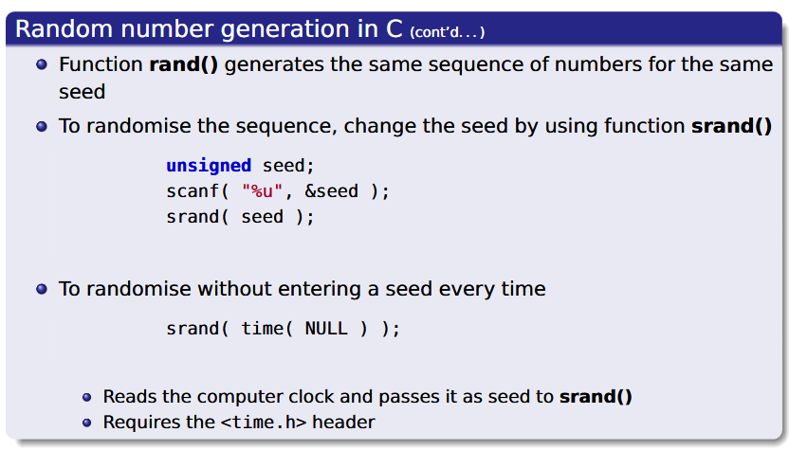
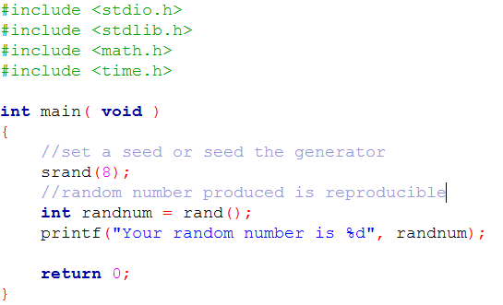
SU FACULTY of ENGINEERING
Computer Programming 143 lectures | 11 August 2026
Random number generation
DECODED
<stdlib.h> & rand () & srand ()
Sample code

Slide 17
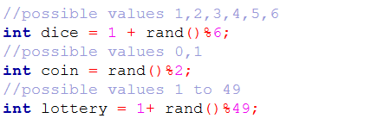
SU FACULTY of ENGINEERING
Computer Programming 143 lectures | 11 August 2026
Random number generation
Random numbers within a range
DECODED

Slide 18
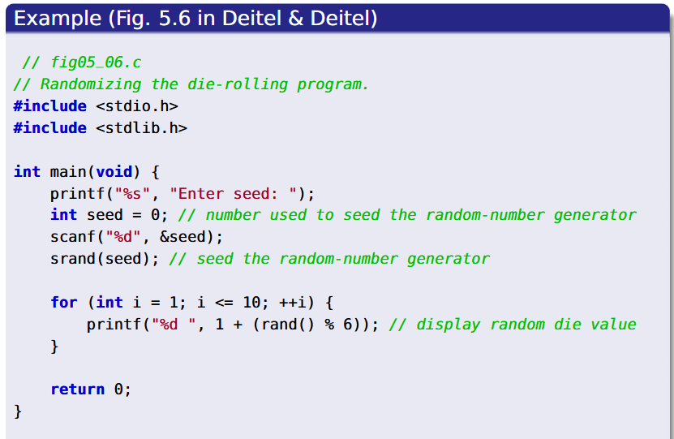
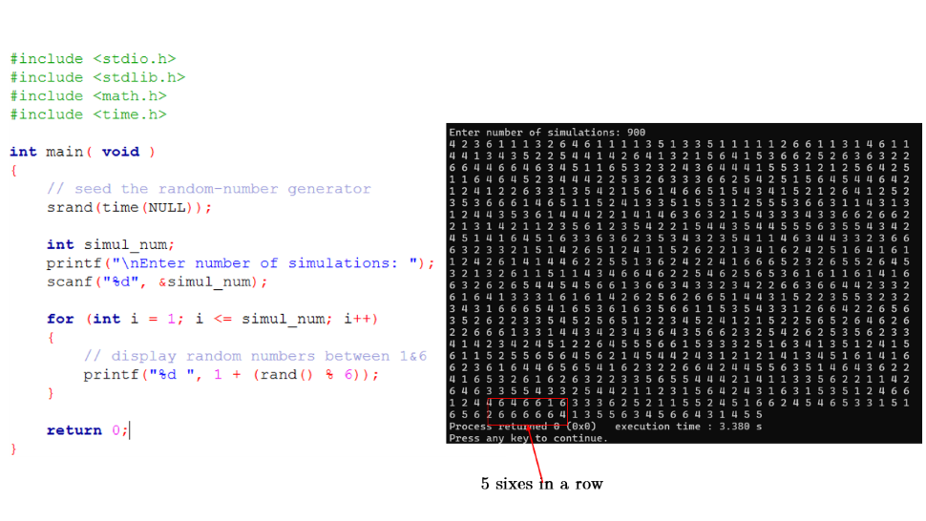
SU FACULTY of ENGINEERING
Computer Programming 143 lectures | 11 August 2026
Random number generation
EXAMPLE die rolling program
DECODED

Slide 19
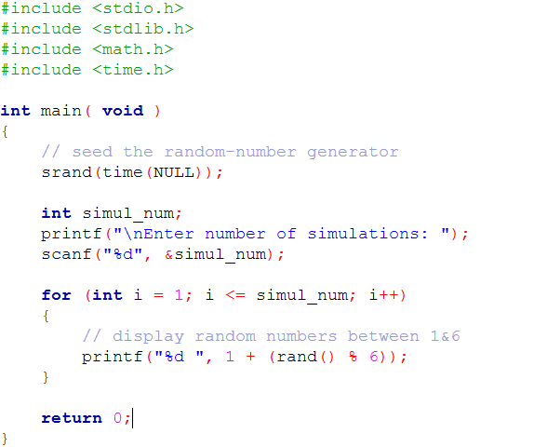
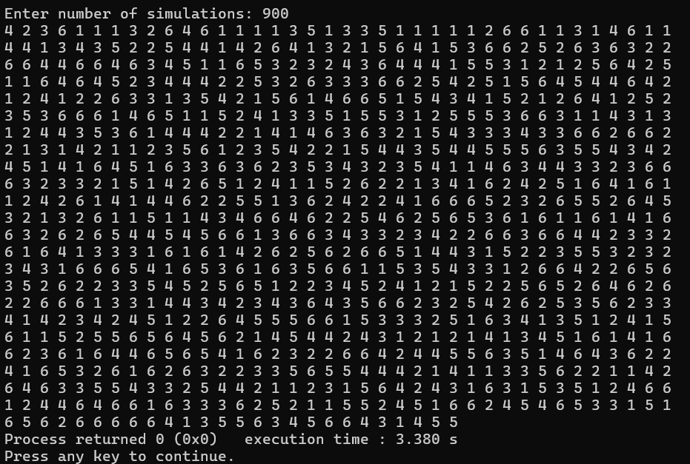
5 sixes in a row

