Slide 1

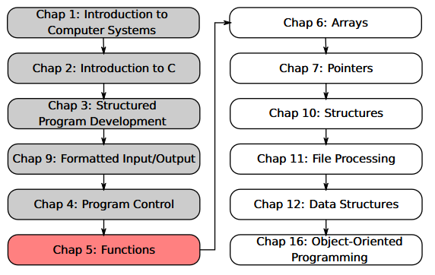
SU FACULTY of ENGINEERING
Computer Programming 143 lectures | 14 August 2026
PROGRAMMING IN C
5. Functions III
Lecture 11| Enumerations
A game of chance
Storage classes
Scope rules
Isaac Khobo, PhD (ilkhobo@sun.ac.za)
Chapters 5 Functions

Slide 2




SU FACULTY of ENGINEERING
Computer Programming 143 lectures | 14 August 2026
Data types recap
C’s built-in (primitive) data types
int
char
float
double
integers
Characters/strings
Floating-point
Double floating-point

Slide 3
SU FACULTY of ENGINEERING
Computer Programming 143 lectures | 14 August 2026
Data types recap
C’s built-in (primitive) data types
int
char
float
double
integers
Characters/strings
Floating-point
Double floating-point

Slide 4
SU FACULTY of ENGINEERING
Computer Programming 143 lectures | 14 August 2026
Data types recap
C’s built-in (primitive) data types
int
char
float
double
integers
Characters/strings
Floating-point
Double floating-point

Slide 5
SU FACULTY of ENGINEERING
Computer Programming 143 lectures | 14 August 2026
Data types recap
C’s built-in (primitive) data types
int
char
float
double
integers
Characters/strings
Floating-point
Double floating-point

Slide 6
SU FACULTY of ENGINEERING
Computer Programming 143 lectures | 14 August 2026
Data types recap
C’s built-in (primitive) data types
int
char
float
double
integers
Characters/strings
Floating-point
Double floating-point

Slide 7
SU FACULTY of ENGINEERING
Computer Programming 143 lectures | 14 August 2026
Data types recap
What is an enum?
User-defined type, assigning meaningful names to a set of integer constants
C’s built-in (primitive) data types
int
char
float
double
integers
Characters/strings
Floating-point
Double floating-point

Slide 8

SU FACULTY of ENGINEERING
Computer Programming 143 lectures | 14 August 2026
Data types recap
FORMAT
enum enumName {CONSTANT0 ,
CONSTANT1 ,
CONSTANT2, … } ;
What is an enum?
User-defined type, assigning meaningful names to a set of integer constants
C’s built-in (primitive) data types
int
char
float
double
integers
Characters/strings
Floating-point
Double floating-point

Slide 9
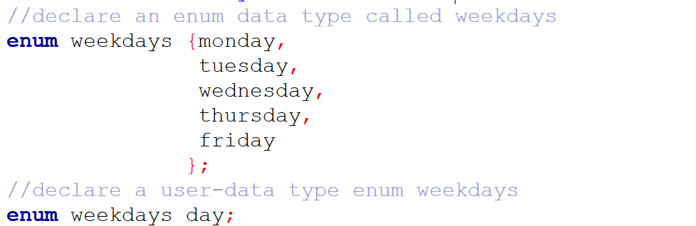
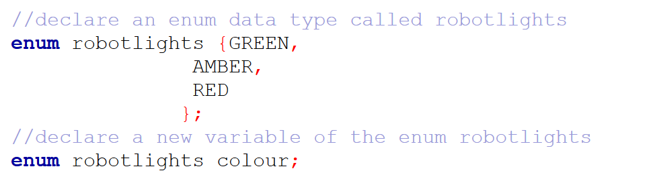
Example 1
Example 2

Slide 10
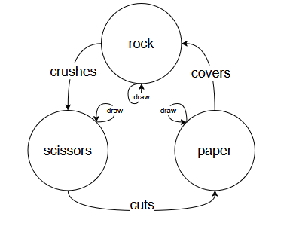
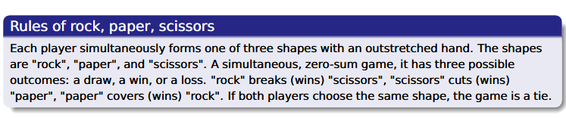
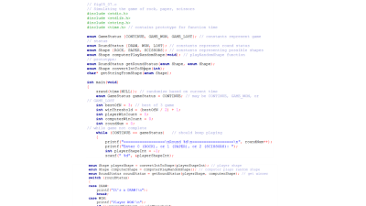
SU FACULTY of ENGINEERING
Computer Programming 143 lectures | 14 August 2026
Enumerations: a game of chance
C code
With enums

Slide 11
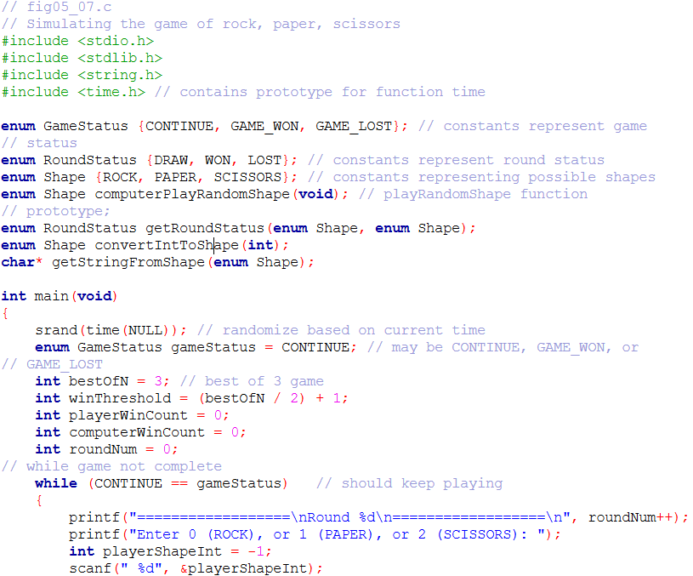
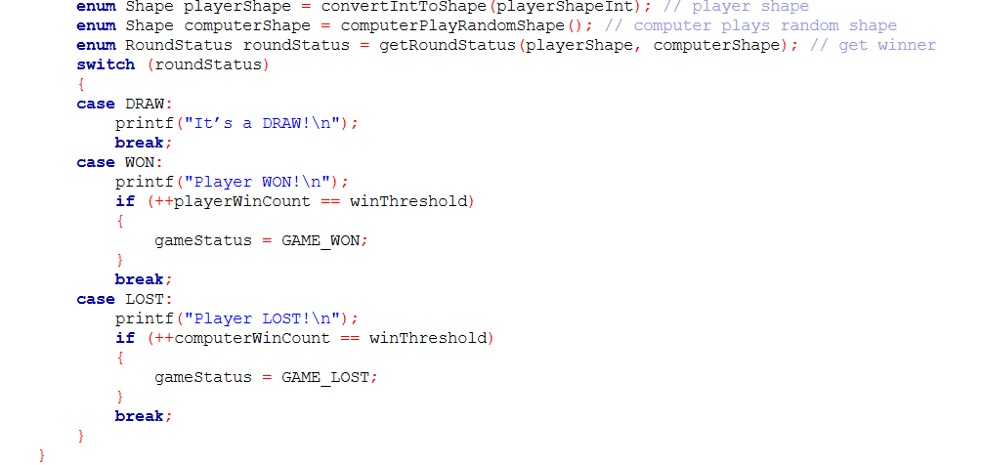
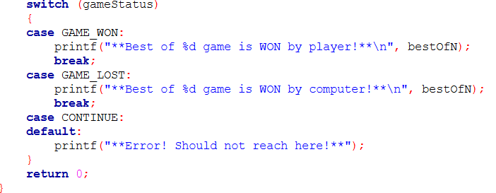
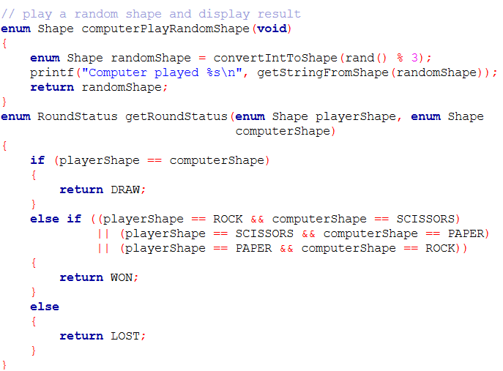
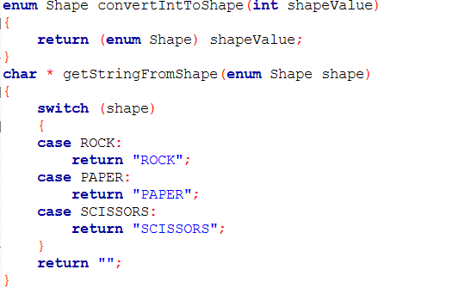

Slide 14
SU FACULTY of ENGINEERING
Computer Programming 143 lectures | 14 August 2026
Enumerations: a game of chance
C code
With enums

Slide 15
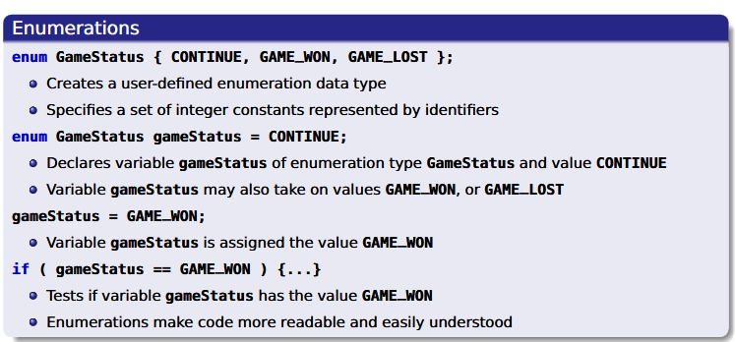
SU FACULTY of ENGINEERING
Computer Programming 143 lectures | 14 August 2026
Enumerations: a game of chance

Slide 16
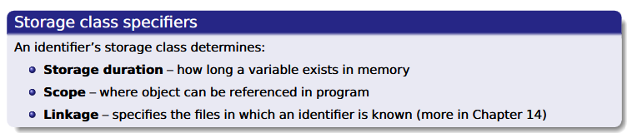
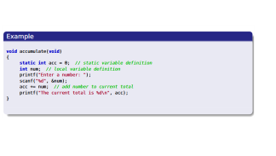
SU FACULTY of ENGINEERING
Computer Programming 143 lectures | 14 August 2026
Storage classes & scope
Variables exist for certain section of program (block of code)
Exist while block is active
Destroyed when block is exited
Local variables
Variables exist for entire program execution
static: local variables defined in functions.
Keep value after function ends
Only known in their own function
Global variables
Example from notes

Slide 17
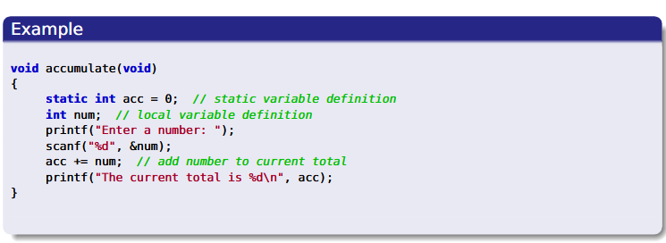

Slide 18
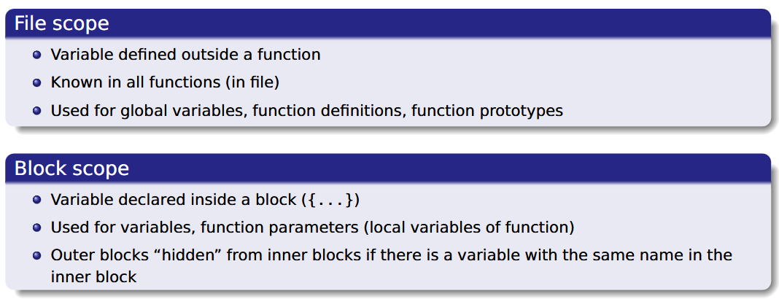
SU FACULTY of ENGINEERING
Computer Programming 143 lectures | 14 August 2026
Scope rules

