Slide 1

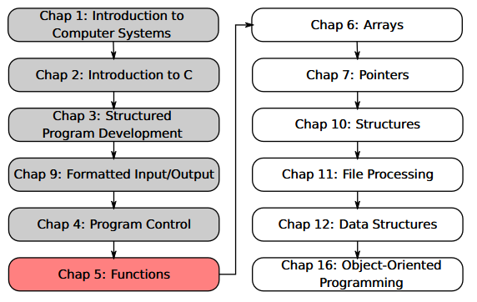
SU FACULTY of ENGINEERING
Computer Programming 143 lectures | 17 August 2026
PROGRAMMING IN C
5. Functions IV
Lecture 12| Recap (data types & scope rules)
Recursion
Example: Fibonacci sequence
Recursion vs iteration
Isaac Khobo, PhD (ilkhobo@sun.ac.za)
Chapters 5 Functions

Slide 2




SU FACULTY of ENGINEERING
Computer Programming 143 lectures | 17 August 2026
Recap
C’s built-in (primitive) data types
int
char
float
double
integers
Characters/strings
Floating-point
Double floating-point
User-defined data types
enum
enumerations

Slide 3
SU FACULTY of ENGINEERING
Computer Programming 143 lectures | 17 August 2026
Recap
User-defined data types
C’s built-in (primitive) data types
enum
int
char
float
double
enumerations
integers
Characters/strings
Floating-point
Double floating-point

Slide 4
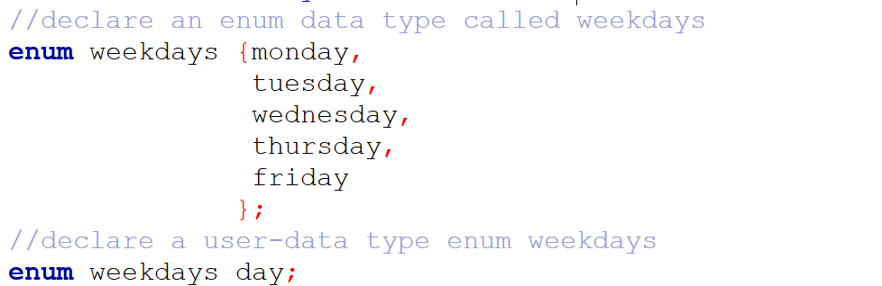
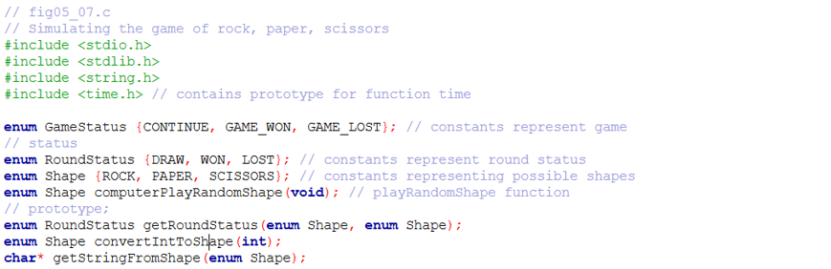
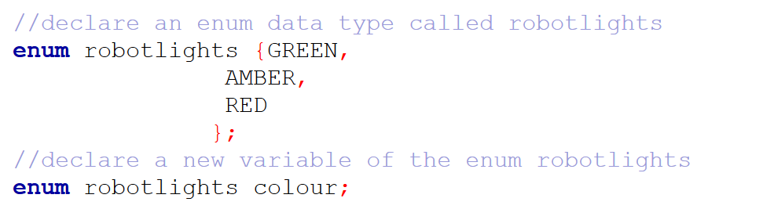
SU FACULTY of ENGINEERING
Computer Programming 143 lectures | 17 August 2026
Recap
User-defined data types
C’s built-in (primitive) data types
enum
Example 1
int
char
float
double
Example 3
Example 2
enumerations
integers
Characters/strings
Floating-point
Double floating-point

Slide 5
SU FACULTY of ENGINEERING
Computer Programming 143 lectures | 17 August 2026
Recap
User-defined data types
C’s built-in (primitive) data types
enum
Example 1
int
char
float
double
Example 3
Example 2
enumerations
integers
Characters/strings
Floating-point
Double floating-point

Slide 6


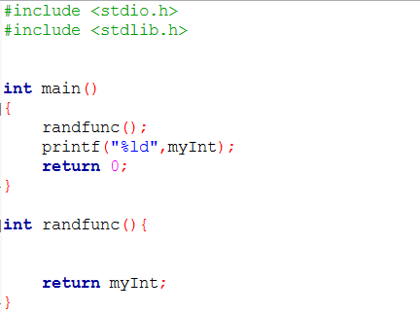
SU FACULTY of ENGINEERING
Computer Programming 143 lectures | 17 August 2026
Recap
User-defined data types
C’s built-in (primitive) data types
enum
Example 1
int
char
float
double
Example 3
Example 2
enumerations
integers
Characters/strings
Floating-point
Double floating-point
Storage & scope
variable

Slide 7
SU FACULTY of ENGINEERING
Computer Programming 143 lectures | 17 August 2026
Recap
Storage & scope
User-defined data types
C’s built-in (primitive) data types
enum
Example 1
int
char
float
double
Example 3
Example 2
variable
enumerations
integers
Characters/strings
Floating-point
Double floating-point

Slide 8
SU FACULTY of ENGINEERING
Computer Programming 143 lectures | 17 August 2026
Recap
Storage & scope
User-defined data types
C’s built-in (primitive) data types
enum
GLOBAL variable
int
char
float
double
Example 1
Example 3
Example 2
enumerations
integers
Characters/strings
Floating-point
Double floating-point

Slide 9
SU FACULTY of ENGINEERING
Computer Programming 143 lectures | 17 August 2026
Recap
Storage & scope
User-defined data types
C’s built-in (primitive) data types
enum
Example 1
int
char
float
double
Example 3
Example 2
LOCAL variable
enumerations
integers
Characters/strings
Floating-point
Double floating-point

Slide 10
SU FACULTY of ENGINEERING
Computer Programming 143 lectures | 17 August 2026
Recap
Storage & scope
User-defined data types
C’s built-in (primitive) data types
enum
Example 1
int
char
float
double
Example 3
Example 2
LOCAL variable
enumerations
integers
Characters/strings
Floating-point
Double floating-point

Slide 11
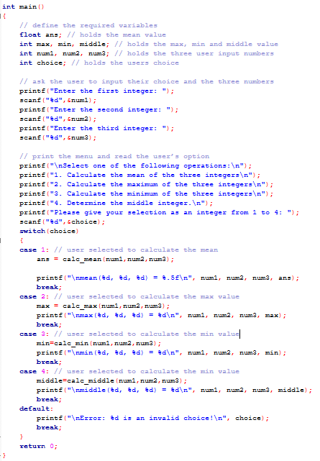
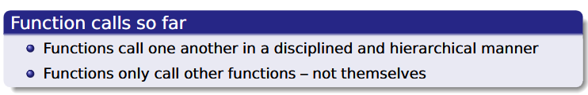
SU FACULTY of ENGINEERING
Computer Programming 143 lectures | 17 August 2026
Recursion
Recursion is when a function calls itself, either directly or indirectly through another function
recursion
Sample code (Practical 4)

Slide 12
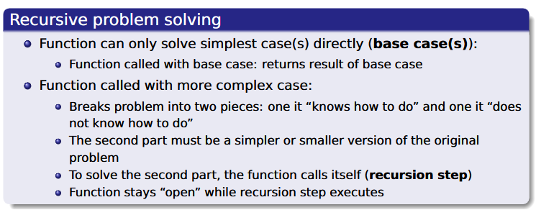
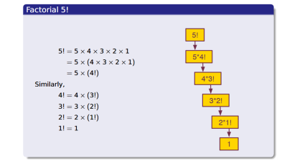

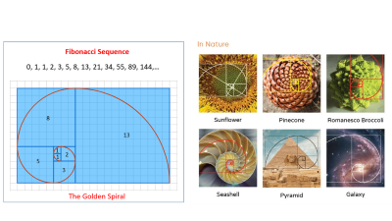
SU FACULTY of ENGINEERING
Computer Programming 143 lectures | 17 August 2026
Recursion
Recursion is when a function calls itself, either directly or indirectly through another function
recursion
EXAMPLES OF RECURSIVE PROBLEM SOLVING
Finding the smallest Russian doll
factorials n! = n(n-1)!
Fibonacci sequence

Slide 14
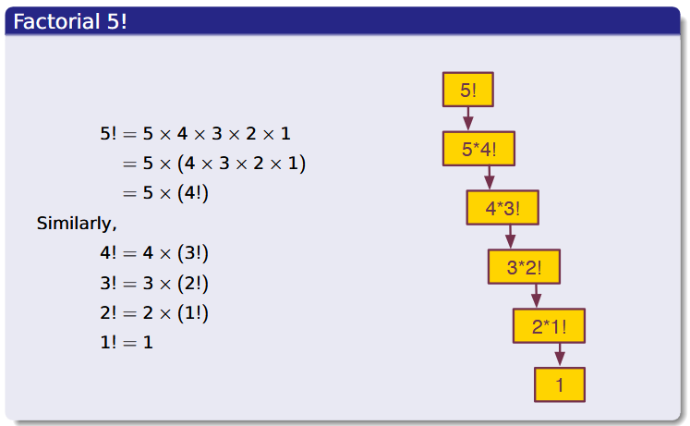

Slide 15
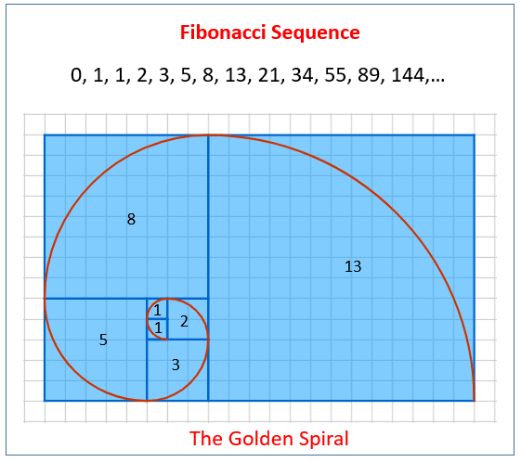
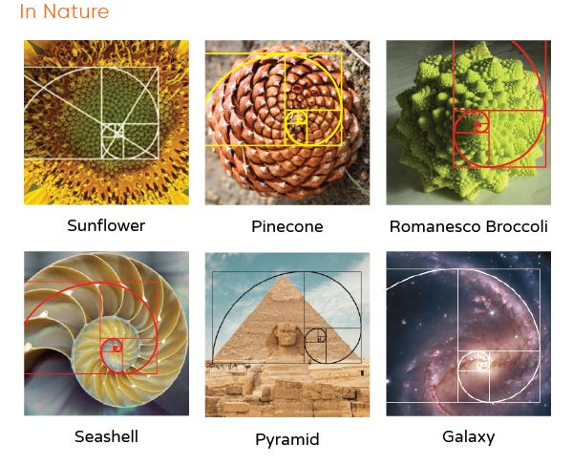

Slide 16
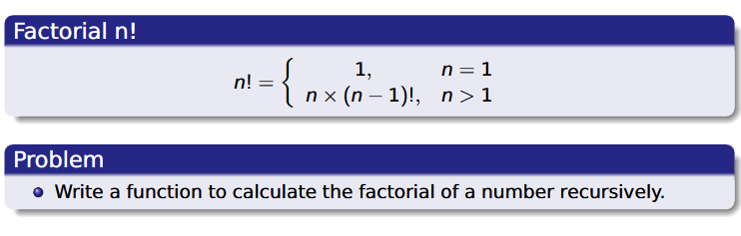
SU FACULTY of ENGINEERING
Computer Programming 143 lectures | 17 August 2026
Example 1: factorials
Recursion is when a function calls itself, either directly or indirectly through another function
recursion

Slide 17

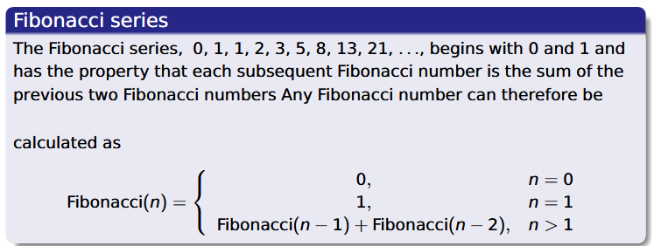
SU FACULTY of ENGINEERING
Computer Programming 143 lectures | 17 August 2026
Example 2: Fibonacci sequence
Recursion is when a function calls itself, either directly or indirectly through another function
recursion

Slide 18
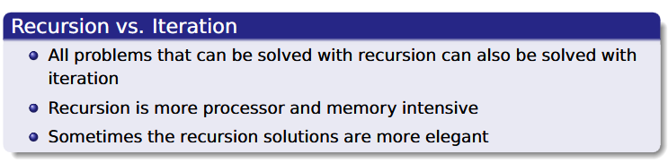
SU FACULTY of ENGINEERING
Computer Programming 143 lectures | 17 August 2026
Recursion
Recursion is when a function calls itself, either directly or indirectly through another function
recursion

