Slide 1

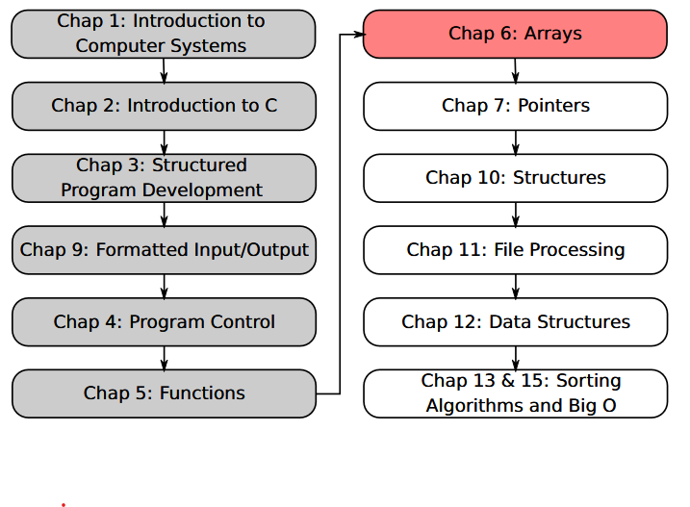
SU FACULTY of ENGINEERING
Computer Programming 143 lectures | 21 August 2026
PROGRAMMING IN C
6. Arrays II
Lecture 14| Storing & manipulating strings
Passing strings to functions
Searching arrays: linear and binary search
Isaac Khobo, PhD (ilkhobo@sun.ac.za)
Chapters 6: Arrays
Notes:
Welcome to lecture 14. Today’s content focuses on storing and manipulating strings or array of characters

Slide 2
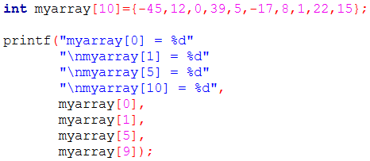
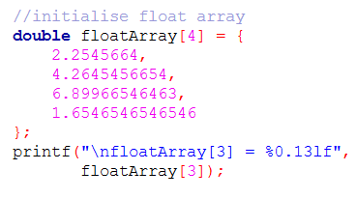
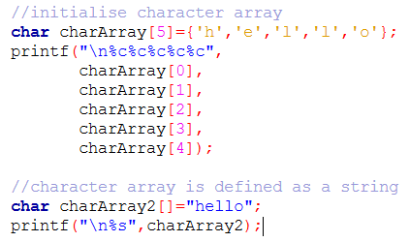
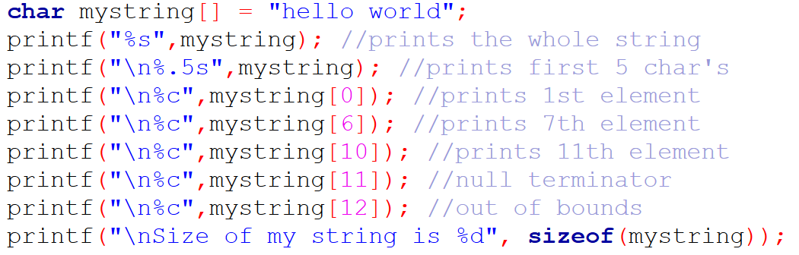
SU FACULTY of ENGINEERING
Computer Programming 143 lectures | 21 August 2026
Short recap
CLARIFICATION ON INITIALISING ARRAYS WITH FEWER ELEMENTS THAN ITS SIZE
Notes:
We have already learning how to declare and initialise arrays of integers, doubles, or characters. I just want to clarify a few things

Slide 3
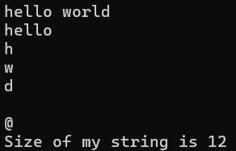
SU FACULTY of ENGINEERING
Computer Programming 143 lectures | 21 August 2026
Short recap
CLARIFICATION ON DECLARING ARRAYS WITH {x}

Slide 4
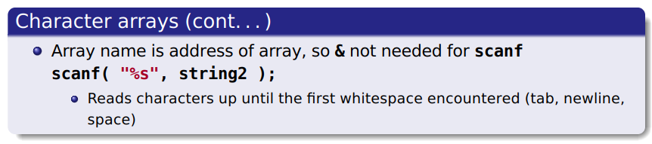
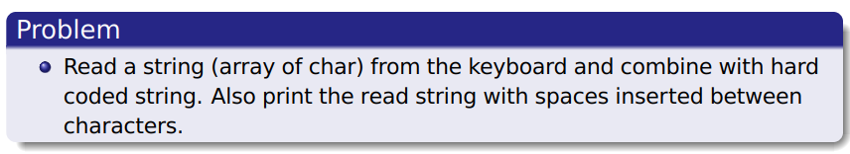
SU FACULTY of ENGINEERING
Computer Programming 143 lectures | 21 August 2026
Store and manipulation of strings
EXAMPLE

Slide 5
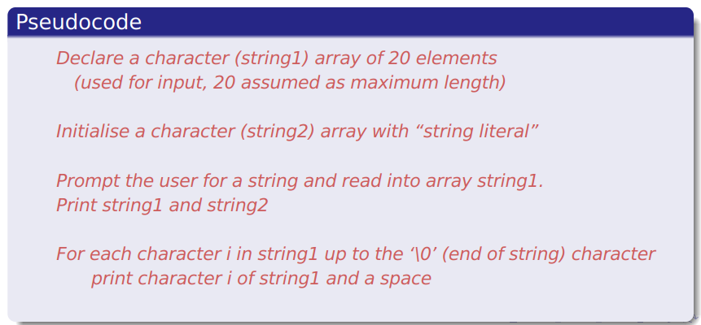
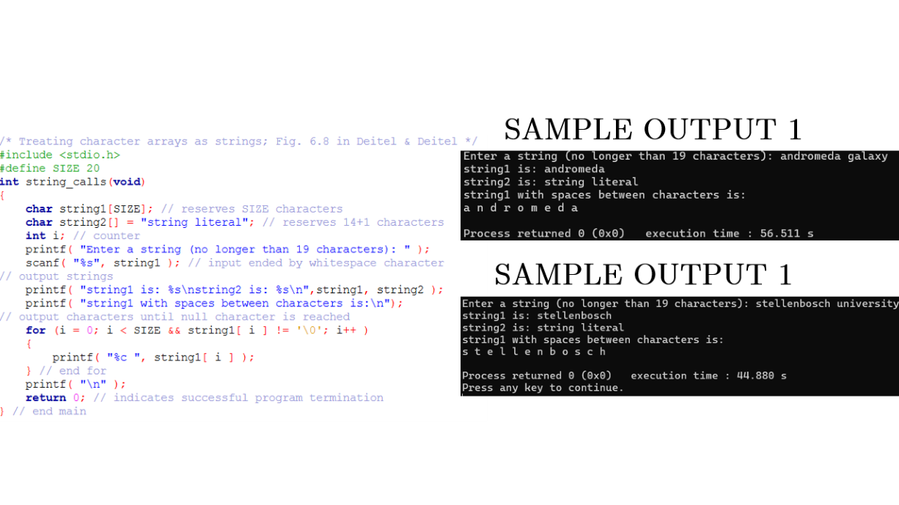
SU FACULTY of ENGINEERING
Computer Programming 143 lectures | 21 August 2026
Store and manipulation of strings

Slide 6
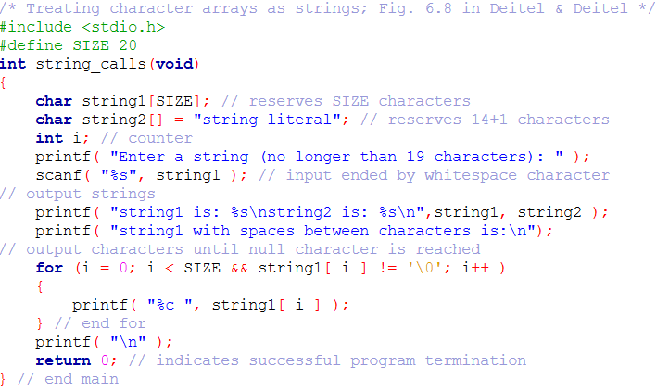
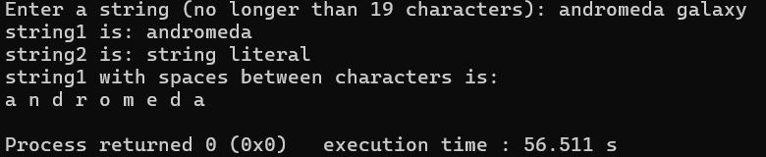
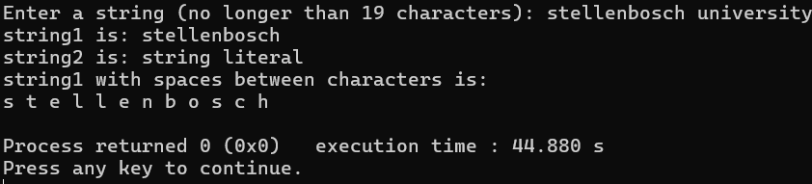
SAMPLE OUTPUT 1
SAMPLE OUTPUT 1

Slide 7
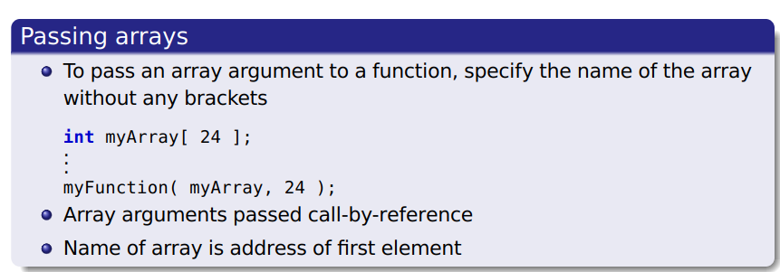
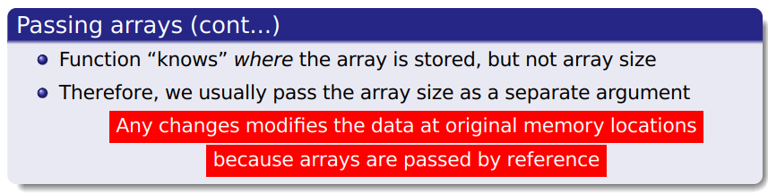
SU FACULTY of ENGINEERING
Computer Programming 143 lectures | 21 August 2026
Passing arrays to functions

Slide 8
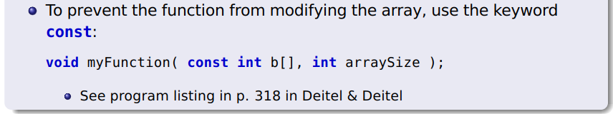
SU FACULTY of ENGINEERING
Computer Programming 143 lectures | 21 August 2026
Passing arrays to functions
Function prototype
void myFunction= {int myArray[] ,
int arraySize } ;

Slide 9
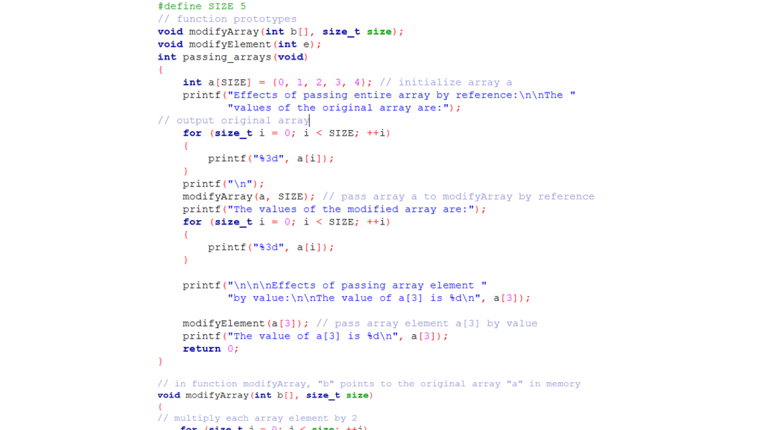
SU FACULTY of ENGINEERING
Computer Programming 143 lectures | 21 August 2026
Passing arrays to functions
Demonstration of passing arrays and individual elements

Slide 10
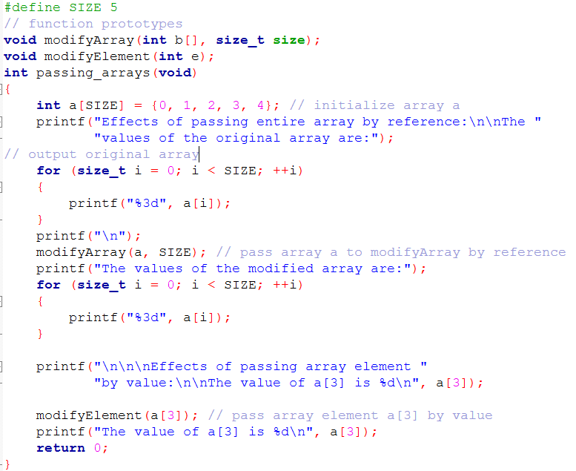
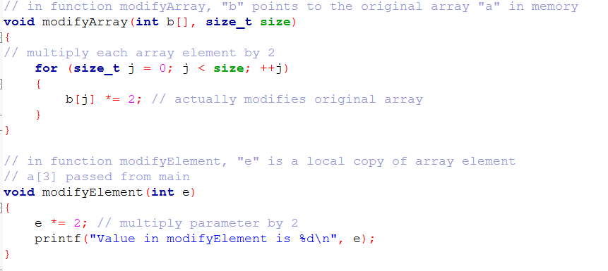
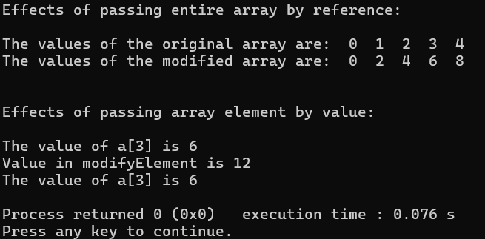

Slide 12
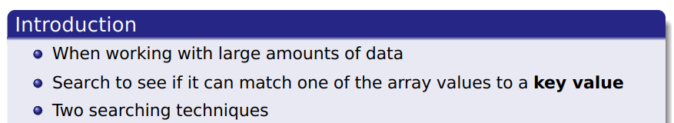
SU FACULTY of ENGINEERING
Computer Programming 143 lectures | 21 August 2026
Searching arrays

Slide 13
SU FACULTY of ENGINEERING
Computer Programming 143 lectures | 21 August 2026
Searching arrays
LINEAR SEARCH
BINARY SEARCH

Slide 14

SU FACULTY of ENGINEERING
Computer Programming 143 lectures | 21 August 2026
Searching arrays
Compare each element of array with key value
Useful for small and unsorted arrays
Assumes unique key values, e.g. student numbers
Array does not have to be sorted
LINEAR SEARCH
BINARY SEARCH

Slide 15
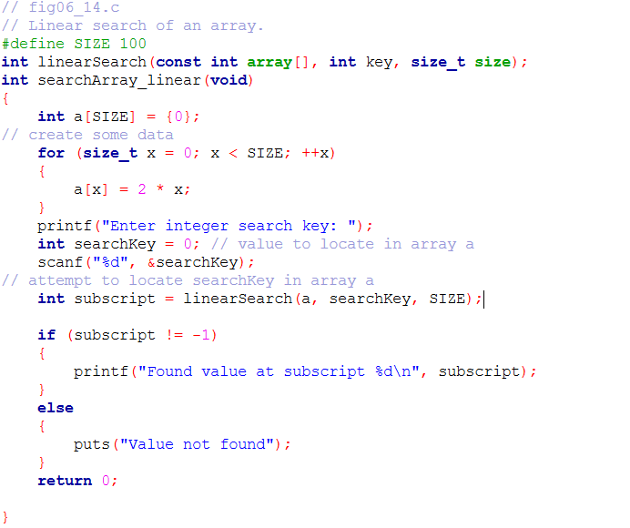
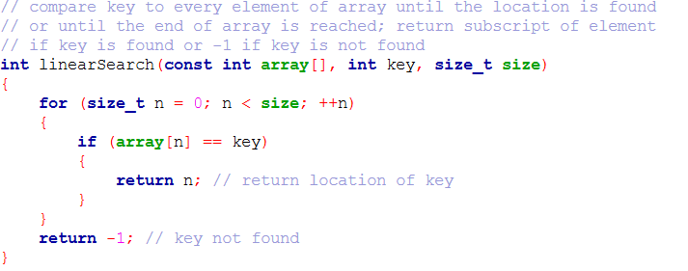

Slide 16

SU FACULTY of ENGINEERING
Computer Programming 143 lectures | 21 August 2026
Searching arrays
Compare each element of array with key value
Useful for small and unsorted arrays
Assumes unique key values, e.g. student numbers
Array does not have to be sorted
Only for arrays sorted by key
Compares middle element with key
If equal, match found
If key < middle, looks further in lower half of array
If key > middle, looks further in upper half of array
LINEAR SEARCH
BINARY SEARCH
Notes:
Very fast; at most n steps, where 2n > number of elements
A 30 element array takes at most 5 steps
24 <30 <25 so at most 5 steps
More efficient than linear search

Slide 17
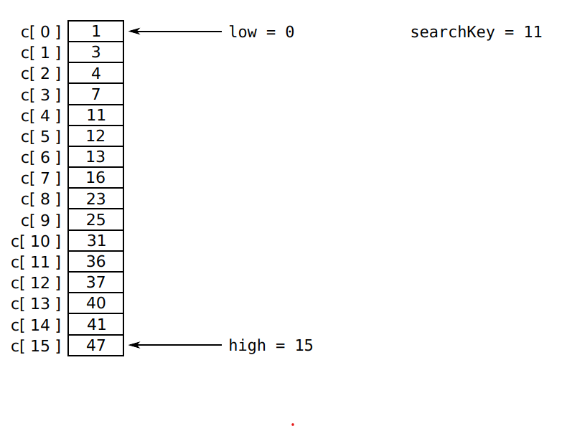

Slide 18
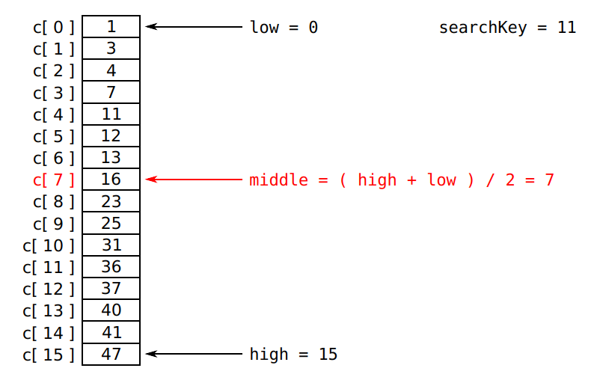

Slide 19
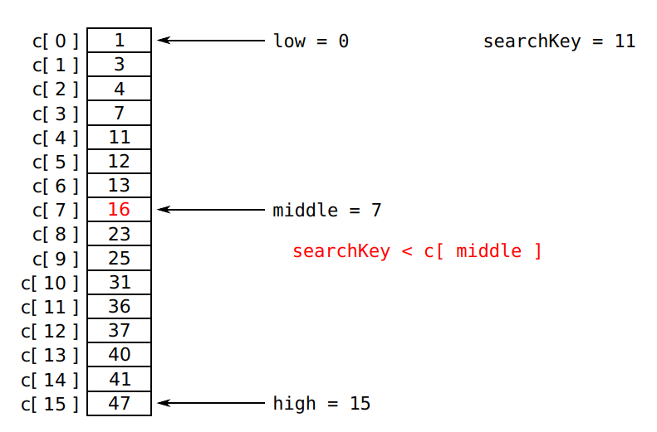

Slide 20
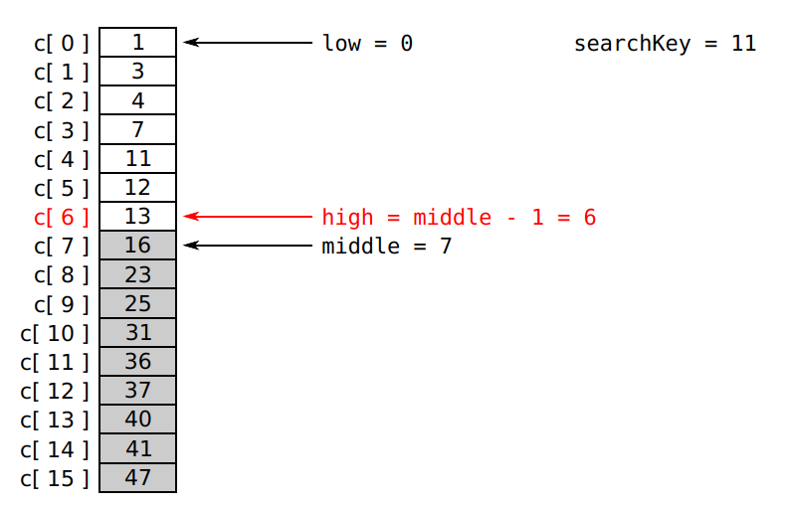

Slide 21
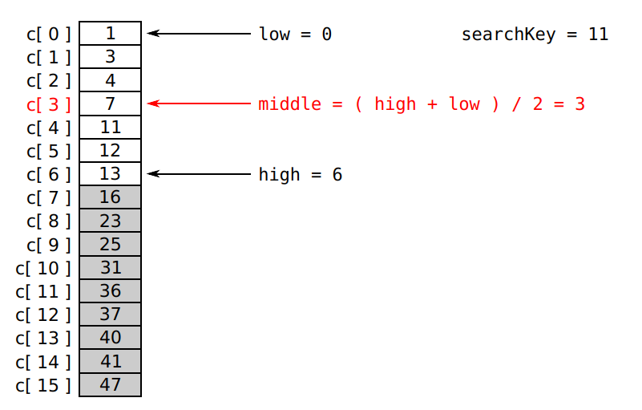

Slide 22
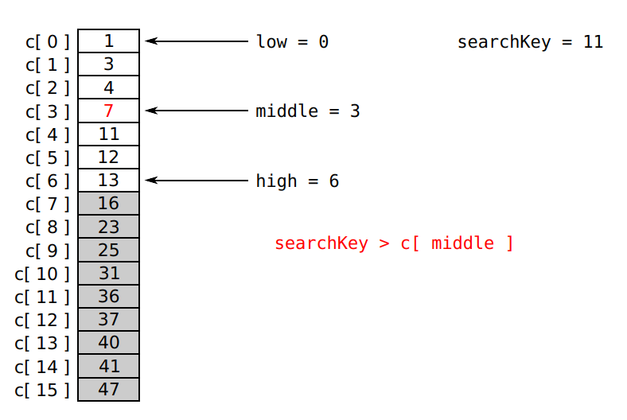

Slide 23
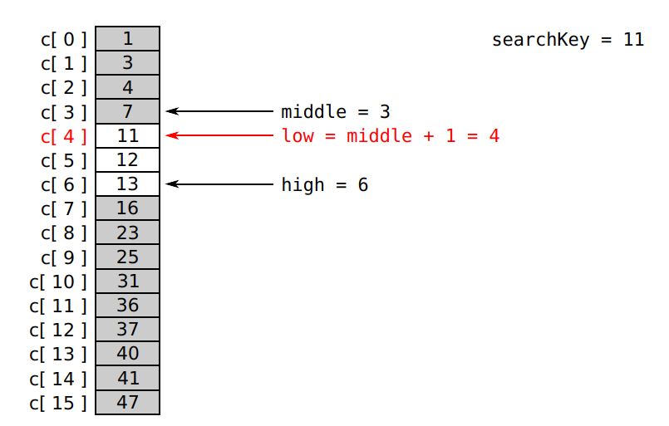

Slide 24
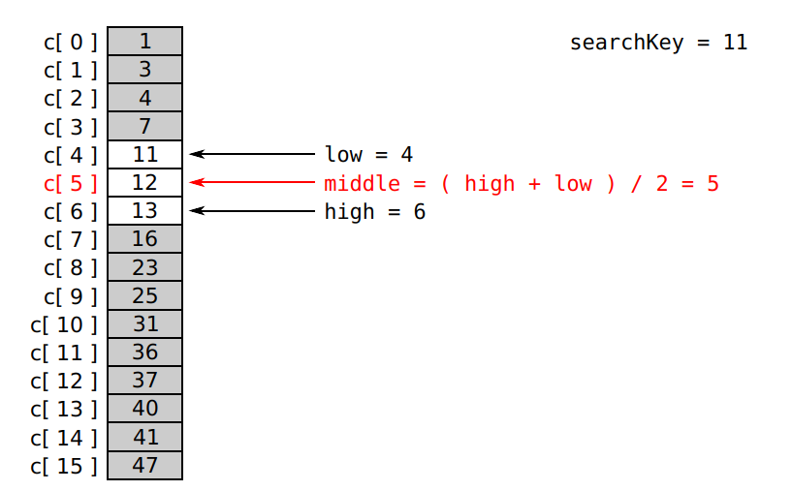

Slide 25
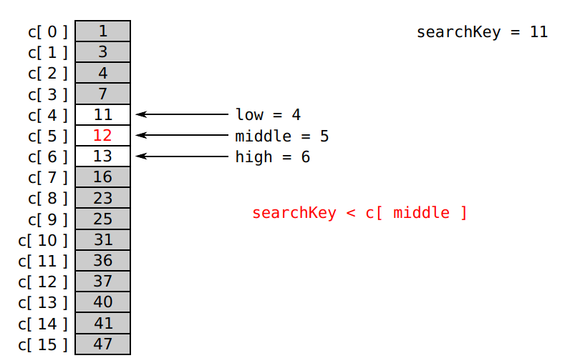

Slide 26
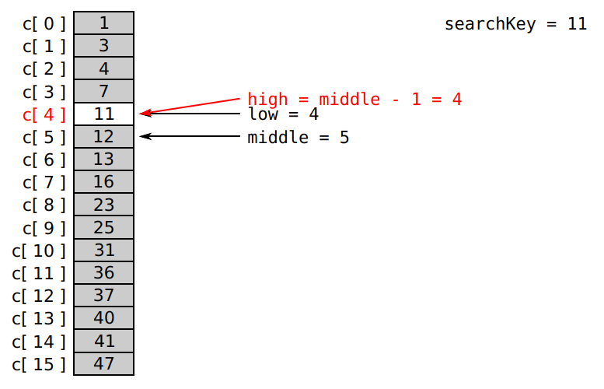

Slide 27
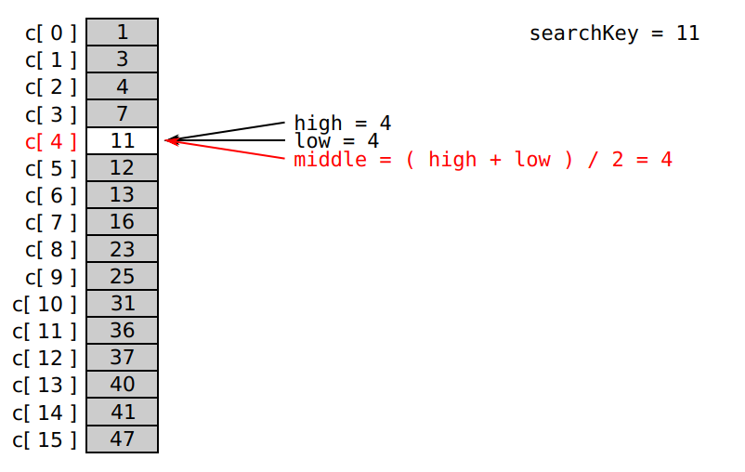

Slide 28
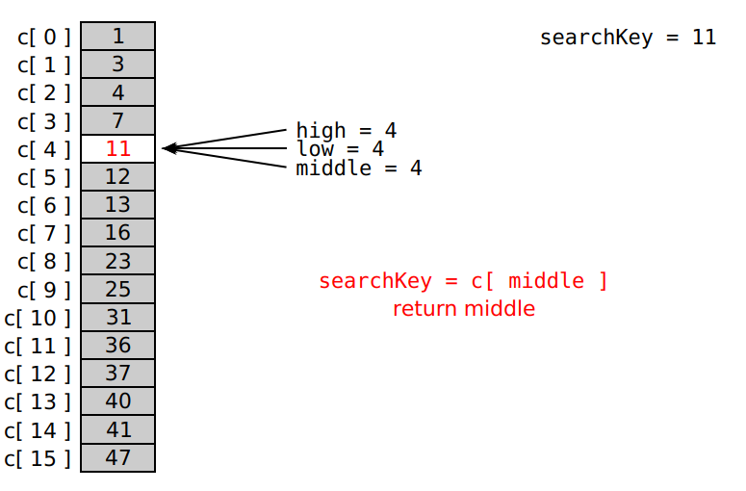

Slide 29
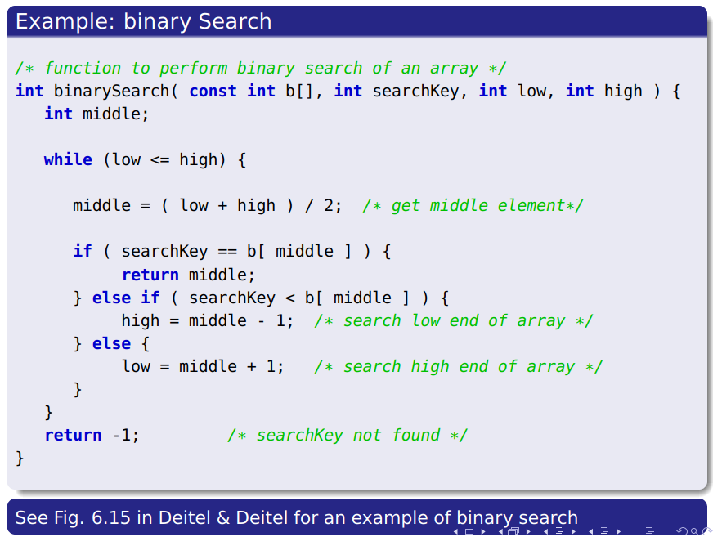

Slide 30



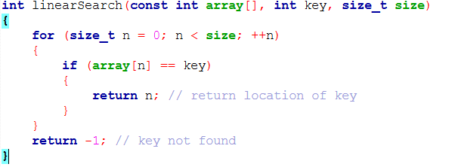
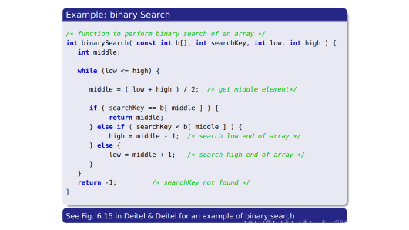
SU FACULTY of ENGINEERING
Computer Programming 143 lectures | 21 August 2026
HOMEWORK
Declarations & initialisations & passing into functions
Review linear and binary search
Linear search to find a target
Check whether array is sorted

