Slide 1

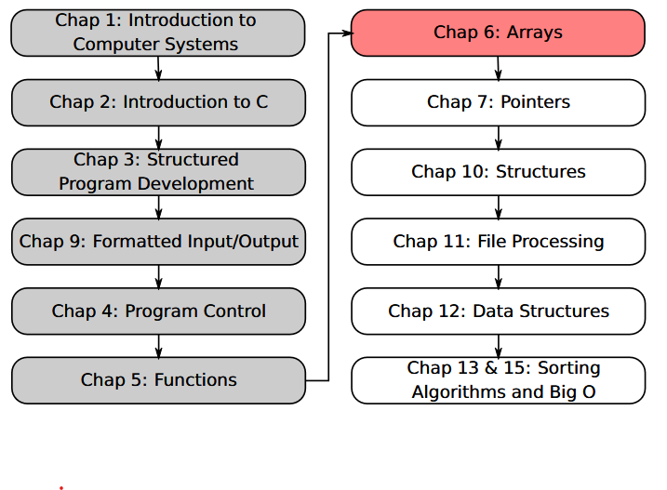
SU FACULTY of ENGINEERING
Computer Programming 143 lectures | 21 August 2026
PROGRAMMING IN C
6. Arrays III
Lecture 15| Sorting arrays
Bubblesort algorithm
Case study: computing mean, median, mode
Isaac Khobo, PhD (ilkhobo@sun.ac.za)
Chapters 6: Arrays
Notes:
Welcome to lecture 14. Today’s content focuses on storing and manipulating strings or array of characters

Slide 2
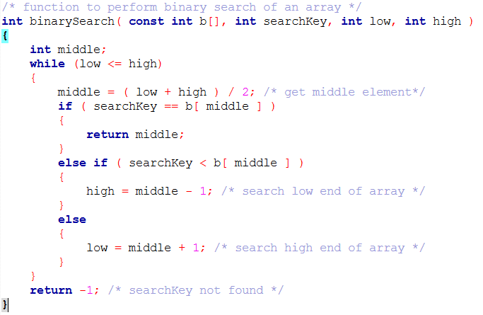
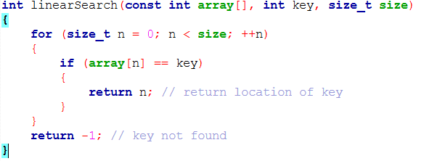
SU FACULTY of ENGINEERING
Computer Programming 143 lectures | 24 August 2026
Short recap: searching arrays

Slide 3
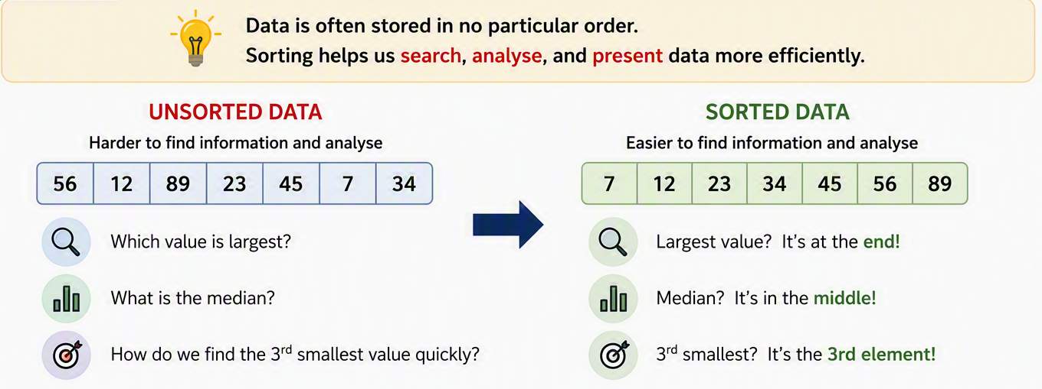
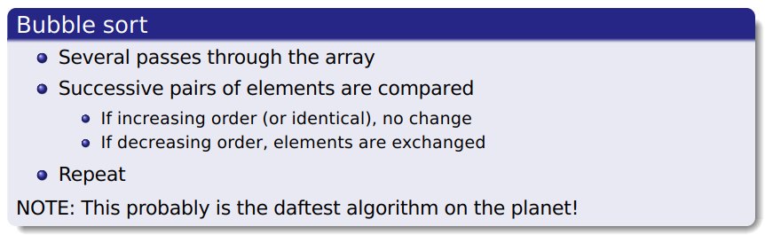
SU FACULTY of ENGINEERING
Computer Programming 143 lectures | 24 August 2026
Sorting arrays

Slide 4
SU FACULTY of ENGINEERING
Computer Programming 143 lectures | 24 August 2026
Bubblesort algorithm
pass = {1 to (size of array - 1) --- holds the last value}
i = {1 to (size of array - 2) --- performs the paired comparison}
int myArray[7] = {
13
,
4
,
1
,
12
,
3
,
7
,
11
}
myArray[0]
myArray[1]
myArray[2]
myArray[3]
myArray[4]
myArray[5]
myArray[6]

Slide 5
SU FACULTY of ENGINEERING
Computer Programming 143 lectures | 24 August 2026
Bubblesort algorithm
pass = 1
int myArray[7] = {
13
,
4
,
1
,
12
,
3
,
7
,
11
}
myArray[0]
myArray[1]
myArray[2]
myArray[3]
myArray[4]
myArray[5]
myArray[6]
i = 0

Slide 6
SU FACULTY of ENGINEERING
Computer Programming 143 lectures | 24 August 2026
Bubblesort algorithm
pass = 1
int myArray[7] = {
4
,
13
,
1
,
12
,
3
,
7
,
11
}
myArray[0]
myArray[1]
myArray[2]
myArray[3]
myArray[4]
myArray[5]
myArray[6]
i = 0

Slide 7
SU FACULTY of ENGINEERING
Computer Programming 143 lectures | 24 August 2026
Bubblesort algorithm
pass = 1
int myArray[7] = {
4
,
13
,
1
,
12
,
3
,
7
,
11
}
myArray[0]
myArray[1]
myArray[2]
myArray[3]
myArray[4]
myArray[5]
myArray[6]
i = 1

Slide 8
SU FACULTY of ENGINEERING
Computer Programming 143 lectures | 24 August 2026
Bubblesort algorithm
pass = 1
int myArray[7] = {
4
,
1
,
13
,
12
,
3
,
7
,
11
}
myArray[0]
myArray[1]
myArray[2]
myArray[3]
myArray[4]
myArray[5]
myArray[6]
i = 1

Slide 9
SU FACULTY of ENGINEERING
Computer Programming 143 lectures | 24 August 2026
Bubblesort algorithm
pass = 1
int myArray[7] = {
4
,
1
,
13
,
12
,
3
,
7
,
11
}
myArray[0]
myArray[1]
myArray[2]
myArray[3]
myArray[4]
myArray[5]
myArray[6]
i = 2

Slide 10
SU FACULTY of ENGINEERING
Computer Programming 143 lectures | 24 August 2026
Bubblesort algorithm
pass = 1
int myArray[7] = {
4
,
1
,
12
,
13
,
3
,
7
,
11
}
myArray[0]
myArray[1]
myArray[2]
myArray[3]
myArray[4]
myArray[5]
myArray[6]
i = 2

Slide 11
SU FACULTY of ENGINEERING
Computer Programming 143 lectures | 24 August 2026
Bubblesort algorithm
pass = 1
int myArray[7] = {
4
,
1
,
12
,
13
,
3
,
7
,
11
}
myArray[0]
myArray[1]
myArray[2]
myArray[3]
myArray[4]
myArray[5]
myArray[6]
i = 3

Slide 12
SU FACULTY of ENGINEERING
Computer Programming 143 lectures | 24 August 2026
Bubblesort algorithm
pass = 1
int myArray[7] = {
4
,
1
,
12
,
3
,
13
,
7
,
11
}
myArray[0]
myArray[1]
myArray[2]
myArray[3]
myArray[4]
myArray[5]
myArray[6]
i = 3

Slide 13
SU FACULTY of ENGINEERING
Computer Programming 143 lectures | 24 August 2026
Bubblesort algorithm
pass = 1
int myArray[7] = {
4
,
1
,
12
,
3
,
13
,
7
,
11
}
myArray[0]
myArray[1]
myArray[2]
myArray[3]
myArray[4]
myArray[5]
myArray[6]
i = 4

Slide 14
SU FACULTY of ENGINEERING
Computer Programming 143 lectures | 24 August 2026
Bubblesort algorithm
pass = 1
int myArray[7] = {
4
,
1
,
12
,
3
,
7
,
13
,
11
}
myArray[0]
myArray[1]
myArray[2]
myArray[3]
myArray[4]
myArray[5]
myArray[6]
i = 4

Slide 15
SU FACULTY of ENGINEERING
Computer Programming 143 lectures | 24 August 2026
Bubblesort algorithm
pass = 1
int myArray[7] = {
4
,
1
,
12
,
3
,
7
,
13
,
11
}
myArray[0]
myArray[1]
myArray[2]
myArray[3]
myArray[4]
myArray[5]
myArray[6]
i = 5

Slide 16
SU FACULTY of ENGINEERING
Computer Programming 143 lectures | 24 August 2026
Bubblesort algorithm
pass = 1
int myArray[7] = {
4
,
1
,
12
,
3
,
7
,
11
,
13
}
myArray[0]
myArray[1]
myArray[2]
myArray[3]
myArray[4]
myArray[5]
myArray[6]
i = 5

Slide 17
SU FACULTY of ENGINEERING
Computer Programming 143 lectures | 24 August 2026
Bubblesort algorithm
pass = 1
int myArray[7] = {
4
,
1
,
12
,
3
,
7
,
11
,
13
}
myArray[0]
myArray[1]
myArray[2]
myArray[3]
myArray[4]
myArray[5]
myArray[6]
Pass 1 complete

Slide 18
SU FACULTY of ENGINEERING
Computer Programming 143 lectures | 24 August 2026
Bubblesort algorithm
pass = 2
int myArray[7] = {
4
,
1
,
12
,
3
,
7
,
11
,
13
}
myArray[0]
myArray[1]
myArray[2]
myArray[3]
myArray[4]
myArray[5]
myArray[6]
i = 0

Slide 19
SU FACULTY of ENGINEERING
Computer Programming 143 lectures | 24 August 2026
Bubblesort algorithm
pass = 2
int myArray[7] = {
1
,
4
,
12
,
3
,
7
,
11
,
13
}
myArray[0]
myArray[1]
myArray[2]
myArray[3]
myArray[4]
myArray[5]
myArray[6]
i = 0

Slide 20
SU FACULTY of ENGINEERING
Computer Programming 143 lectures | 24 August 2026
Bubblesort algorithm
pass = 2
int myArray[7] = {
1
,
4
,
12
,
3
,
7
,
11
,
13
}
myArray[0]
myArray[1]
myArray[2]
myArray[3]
myArray[4]
myArray[5]
myArray[6]
i = 1

Slide 21
SU FACULTY of ENGINEERING
Computer Programming 143 lectures | 24 August 2026
Bubblesort algorithm
pass = 2
int myArray[7] = {
1
,
4
,
3
,
12
,
7
,
11
,
13
}
myArray[0]
myArray[1]
myArray[2]
myArray[3]
myArray[4]
myArray[5]
myArray[6]
i = 2

Slide 22
SU FACULTY of ENGINEERING
Computer Programming 143 lectures | 24 August 2026
Bubblesort algorithm
pass = 2
int myArray[7] = {
1
,
4
,
3
,
7
,
12
,
11
,
13
}
myArray[0]
myArray[1]
myArray[2]
myArray[3]
myArray[4]
myArray[5]
myArray[6]
i = 3

Slide 23
SU FACULTY of ENGINEERING
Computer Programming 143 lectures | 24 August 2026
Bubblesort algorithm
pass = 2
int myArray[7] = {
1
,
4
,
3
,
7
,
11
,
12
,
13
}
myArray[0]
myArray[1]
myArray[2]
myArray[3]
myArray[4]
myArray[5]
myArray[6]
i = 4

Slide 24
SU FACULTY of ENGINEERING
Computer Programming 143 lectures | 24 August 2026
Bubblesort algorithm
pass = 2
int myArray[7] = {
1
,
4
,
3
,
7
,
11
,
12
,
13
}
myArray[0]
myArray[1]
myArray[2]
myArray[3]
myArray[4]
myArray[5]
myArray[6]
Pass 2 complete

Slide 25
SU FACULTY of ENGINEERING
Computer Programming 143 lectures | 24 August 2026
Bubblesort algorithm
pass = 3
int myArray[7] = {
1
,
4
,
3
,
7
,
11
,
12
,
13
}
myArray[0]
myArray[1]
myArray[2]
myArray[3]
myArray[4]
myArray[5]
myArray[6]
i = 0

Slide 26
SU FACULTY of ENGINEERING
Computer Programming 143 lectures | 24 August 2026
Bubblesort algorithm
pass = 3
int myArray[7] = {
1
,
3
,
4
,
7
,
11
,
12
,
13
}
myArray[0]
myArray[1]
myArray[2]
myArray[3]
myArray[4]
myArray[5]
myArray[6]
i = 1

Slide 27
SU FACULTY of ENGINEERING
Computer Programming 143 lectures | 24 August 2026
Bubblesort algorithm
pass = 3
int myArray[7] = {
1
,
3
,
4
,
7
,
11
,
12
,
13
}
myArray[0]
myArray[1]
myArray[2]
myArray[3]
myArray[4]
myArray[5]
myArray[6]
i = 2

Slide 28
SU FACULTY of ENGINEERING
Computer Programming 143 lectures | 24 August 2026
Bubblesort algorithm
pass = 3
int myArray[7] = {
1
,
3
,
4
,
7
,
11
,
12
,
13
}
myArray[0]
myArray[1]
myArray[2]
myArray[3]
myArray[4]
myArray[5]
myArray[6]
i = 3

Slide 29
SU FACULTY of ENGINEERING
Computer Programming 143 lectures | 24 August 2026
Bubblesort algorithm
pass = 4
int myArray[7] = {
1
,
3
,
4
,
7
,
11
,
12
,
13
}
myArray[0]
myArray[1]
myArray[2]
myArray[3]
myArray[4]
myArray[5]
myArray[6]
i = 0

Slide 30
SU FACULTY of ENGINEERING
Computer Programming 143 lectures | 24 August 2026
Bubblesort algorithm
pass = 4
int myArray[7] = {
1
,
3
,
4
,
7
,
11
,
12
,
13
}
myArray[0]
myArray[1]
myArray[2]
myArray[3]
myArray[4]
myArray[5]
myArray[6]
i = 1

Slide 31
SU FACULTY of ENGINEERING
Computer Programming 143 lectures | 24 August 2026
Bubblesort algorithm
pass = 4
int myArray[7] = {
1
,
3
,
4
,
7
,
11
,
12
,
13
}
myArray[0]
myArray[1]
myArray[2]
myArray[3]
myArray[4]
myArray[5]
myArray[6]
i = 2

Slide 32
SU FACULTY of ENGINEERING
Computer Programming 143 lectures | 24 August 2026
Bubblesort algorithm
pass = 5
int myArray[7] = {
1
,
3
,
4
,
7
,
11
,
12
,
13
}
myArray[0]
myArray[1]
myArray[2]
myArray[3]
myArray[4]
myArray[5]
myArray[6]
i = 0

Slide 33
SU FACULTY of ENGINEERING
Computer Programming 143 lectures | 24 August 2026
Bubblesort algorithm
pass = 5
int myArray[7] = {
1
,
3
,
4
,
7
,
11
,
12
,
13
}
myArray[0]
myArray[1]
myArray[2]
myArray[3]
myArray[4]
myArray[5]
myArray[6]
i = 1

Slide 34
SU FACULTY of ENGINEERING
Computer Programming 143 lectures | 24 August 2026
Bubblesort algorithm
pass = 6
int myArray[7] = {
1
,
3
,
4
,
7
,
11
,
12
,
13
}
myArray[0]
myArray[1]
myArray[2]
myArray[3]
myArray[4]
myArray[5]
myArray[6]
i = 0

Slide 35
SU FACULTY of ENGINEERING
Computer Programming 143 lectures | 24 August 2026
Bubblesort algorithm
pass = 6
int myArray[7] = {
1
,
3
,
4
,
7
,
11
,
12
,
13
}
myArray[0]
myArray[1]
myArray[2]
myArray[3]
myArray[4]
myArray[5]
myArray[6]
Pass 6 complete -> array sorted

Slide 36
SU FACULTY of ENGINEERING
Computer Programming 143 lectures | 24 August 2026
Bubblesort algorithm
Sorted with bubblesort algorithm
int myArray[7] = {
1
,
3
,
4
,
7
,
11
,
12
,
13
}
myArray[0]
myArray[1]
myArray[2]
myArray[3]
myArray[4]
myArray[5]
myArray[6]
Original unsorted array
int myArray[7] = {
,
,
,
,
,
,
}
13
4
1
12
3
7
11
myArray[0]
myArray[1]
myArray[2]
myArray[3]
myArray[4]
myArray[5]
myArray[6]

Slide 37
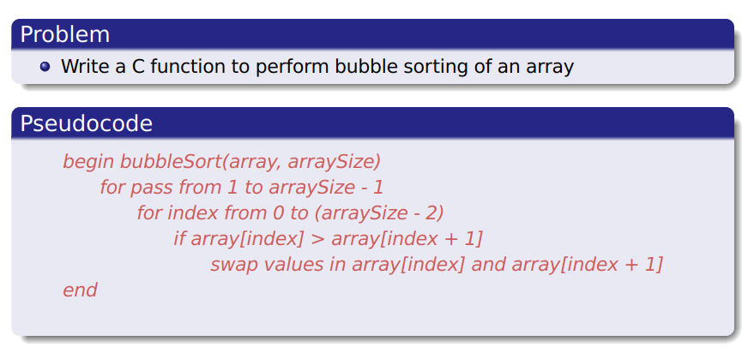

SU FACULTY of ENGINEERING
Computer Programming 143 lectures | 24 August 2026
Example 1: bubblesort algorithm

Slide 38
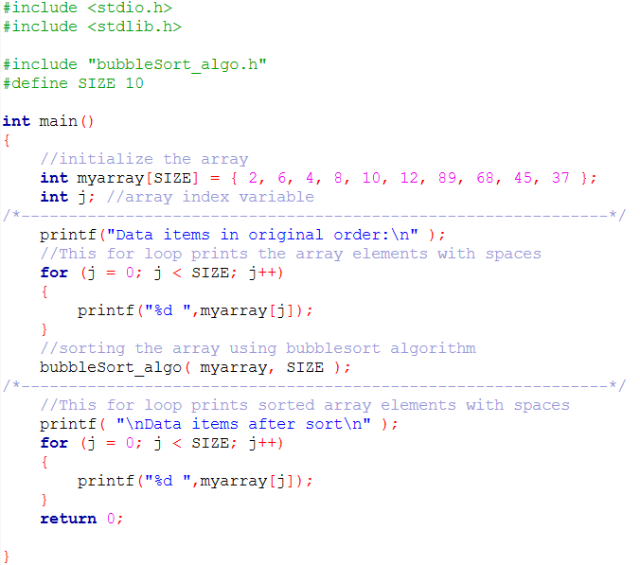
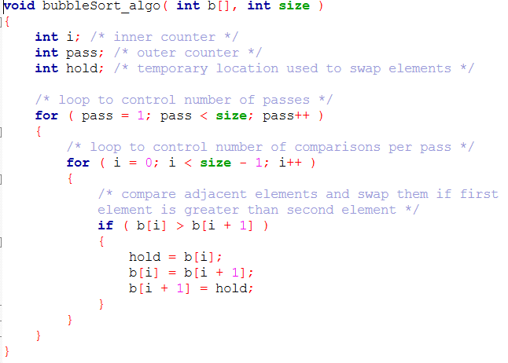
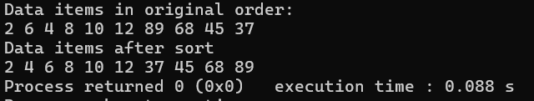
OUTPUT

Slide 39
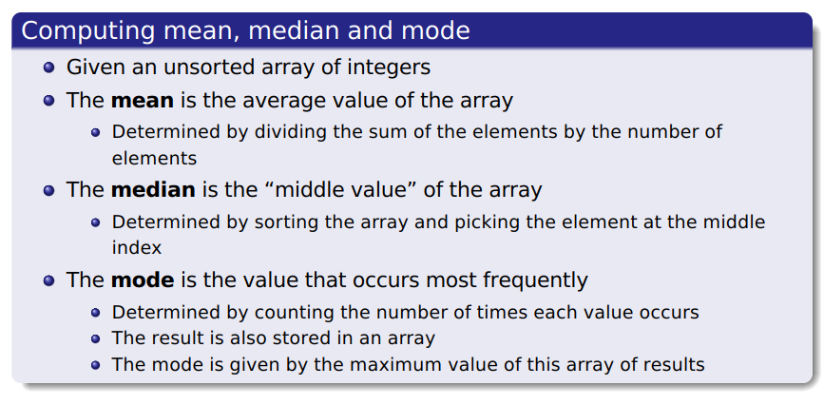
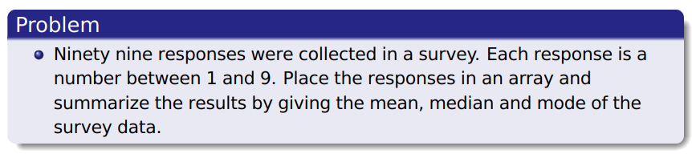
SU FACULTY of ENGINEERING
Computer Programming 143 lectures | 24 August 2026
Example 2: sorting and target values

Slide 40
