Slide 1

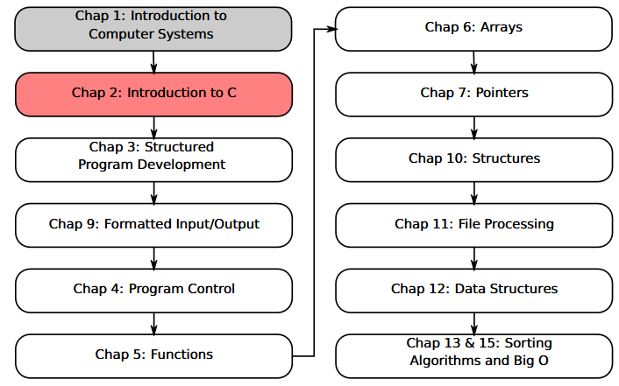
SU FACULTY of ENGINEERING
Computer Programming 143 lectures | 22 July 2026
A. WELCOME TO CP143
PROGRAMMING IN C
2. Print, Arithmetic
Lecture 2| Introduction to Programming in C continued
Printing text
Adding two integers
Memory concepts
Arithmetic
User input
Isaac Khobo, PhD (ilkhobo@sun.ac.za)
Chapter 2: Intro to C continued

Slide 2
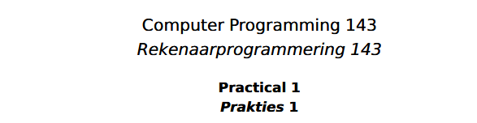
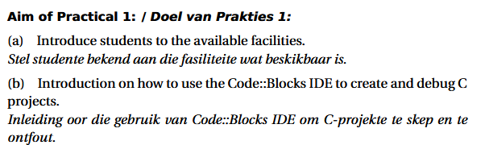
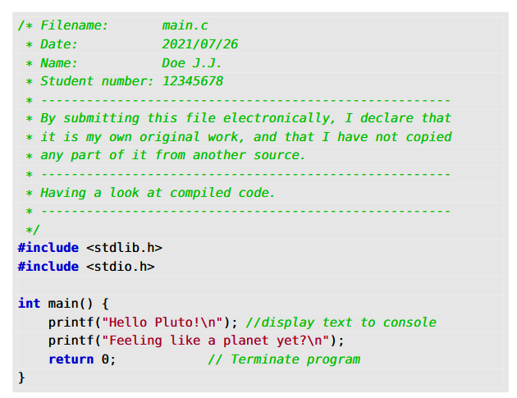
SU FACULTY of ENGINEERING
Computer Programming 143 lectures | 22 July 2026
RECAP: PRACTICAL 1 & PRACTICE TEST
Chapter 2 pg. 8

Slide 3
SU FACULTY of ENGINEERING
Computer Programming 143 lectures | 22 July 2026
RECAP: Single line & block comments
Comments:
Surrounded by /*…*/
---
Intended to make code easier to understand.
Ignored by compiler
Chapter 2 pg. 8

Slide 4
SU FACULTY of ENGINEERING
Computer Programming 143 lectures | 22 July 2026
RECAP: STANDARD C LIBRARY <stdio.h>
<stdio.h>
Includes functions like printf() --- output
And scanf() --- input (today’s lecture)
And file open fopen() or close a file fclose()
Chapter 2 pg. 8

Slide 5
SU FACULTY of ENGINEERING
Computer Programming 143 lectures | 22 July 2026
RECAP: MAIN FUNCTION INITIATION <int main()>
The main() function contains what your code is supposed to do
Chapter 2 pg. 8

Slide 6
SU FACULTY of ENGINEERING
Computer Programming 143 lectures | 22 July 2026
RECAP: PRINT TEXT using prinf() library function
printf() prints formatted output (“Hello World”, “Hello Pluto”, “Feeling like a planet yet?”) to the standard output (console)
Chapter 2 pg. 8

Slide 7
SU FACULTY of ENGINEERING
Computer Programming 143 lectures | 22 July 2026
RECAP: return 0
return 0 terminates the program. If your code has errors in it, then the exit outcome is 1.
Chapter 2 pg. 8

Slide 8
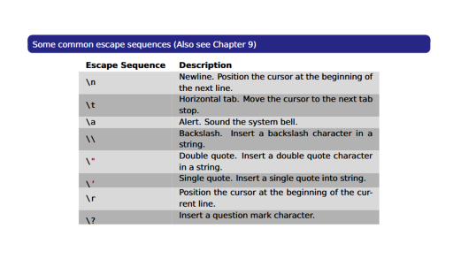
SU FACULTY of ENGINEERING
Computer Programming 143 lectures | 22 July 2026
ESCAPE SEQUENCE \n
Escape sequences tell the compiler to behave in a certain way
\n – newline escape sequence
Chapter 2 pg. 8

Slide 9
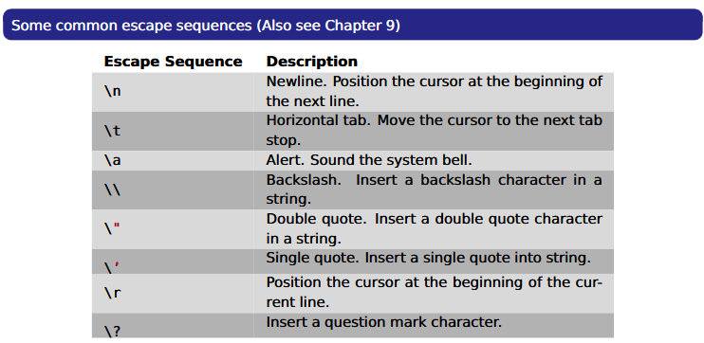

Slide 10
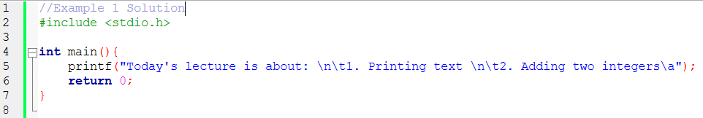
SU FACULTY of ENGINEERING
Computer Programming 143 lectures | 22 July 2026
ESCAPE CHARACTERS DEMONSTRATION
EXAMPLE 1:
Print the following text on the console:
Today’s lecture is about:
1. Printing text
2. Adding two integers
Chapter 2 pg. 8

Slide 11
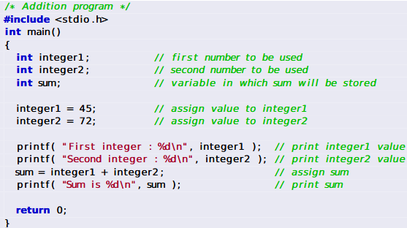
SU FACULTY of ENGINEERING
Computer Programming 143 lectures | 22 July 2026
ADDING TWO INTEGERS PART 1
Chapter 2 pg. 9

Slide 12
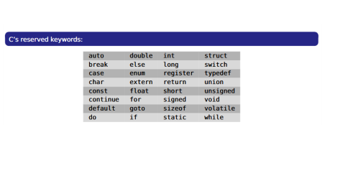
SU FACULTY of ENGINEERING
Computer Programming 143 lectures | 22 July 2026
DECLARATIONS OF VARIABLES
Variables are locations in memory where a value can be stored.
int here tells the compiler the variable (with the name “integer1” is an integer i.e. …,-2.-1,0,1,2,…).
Variables much be declared at the beginning of the code block (don’t use c keywords!!!)
Chapter 2 pg. 9

Slide 13
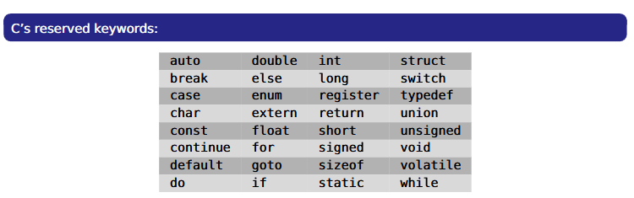

Slide 14
SU FACULTY of ENGINEERING
Computer Programming 143 lectures | 22 July 2026
ASSIGNMENT
Equals sign “=” tells the compiler to assign the values in that memory location
Chapter 2 pg. 9

Slide 15
SU FACULTY of ENGINEERING
Computer Programming 143 lectures | 22 July 2026
PRINT
Print statements tell the compiler to print the text in quotes and the assigned values in memory.
Important to note the special character %d.
%d tells the compiler that the printed integer value is a decimal integer.
Chapter 2 pg. 9

Slide 16
SU FACULTY of ENGINEERING
Computer Programming 143 lectures | 22 July 2026
ASSIGNMENT
Assign the value stored in integer1 plus the value stored in integer2 to the variable location “sum” which is declared as an integer too.
Note: variable receiving value on the left!! (incorrect syntax: integer1 + integer2 = sum)
Chapter 2 pg. 9

Slide 17
SU FACULTY of ENGINEERING
Computer Programming 143 lectures | 22 July 2026
PRINT
Print the text and the value stored in variable “sum”
Chapter 2 pg. 9

Slide 18
SU FACULTY of ENGINEERING
Computer Programming 143 lectures | 22 July 2026
termination
Exit program
Chapter 2 pg. 9

Slide 19
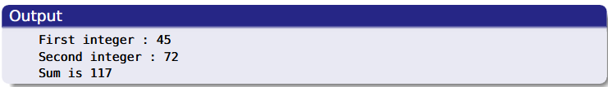
SU FACULTY of ENGINEERING
Computer Programming 143 lectures | 22 July 2026
termination
The sum of 45 + 72 is 117
Chapter 2 pg. 9

Slide 20
SU FACULTY of ENGINEERING
Computer Programming 143 lectures | 22 July 2026
MEMORY CONCEPTS: VARIABLES
Variables are used as temporary storage within the computer memory
Every variable has a name, a type, a size, and a value
Variables correspond to locations in the computer’s memory
Whenever a new value is placed into a variable, it replaces the previous value
Reading variable from memory doesn’t change them
Important: All variables must be declared before they are used.
Chapter 2 pg. 10

Slide 21
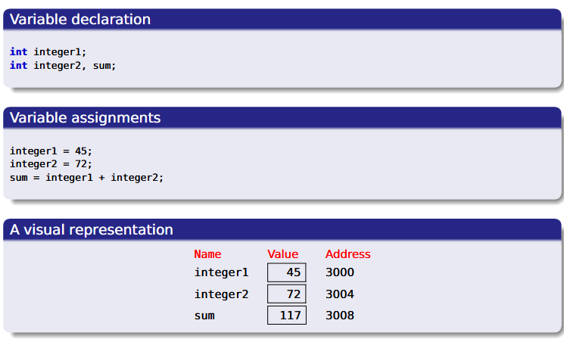
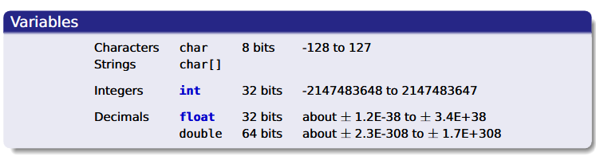
SU FACULTY of ENGINEERING
Computer Programming 143 lectures | 22 July 2026
MEMORY CONCEPTS: VISUAL REPRESENTATION
Chapter 2 pg. 11

Slide 22
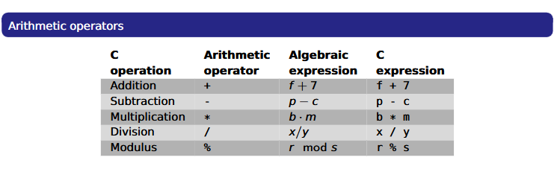
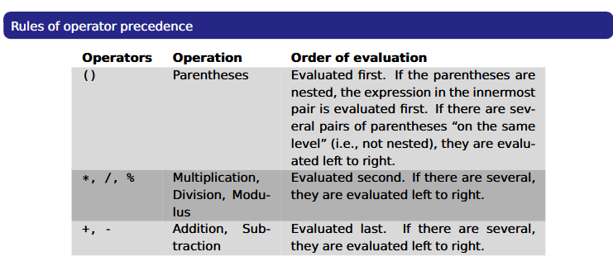
SU FACULTY of ENGINEERING
Computer Programming 143 lectures | 22 July 2026
ARITHMETIC
Use * for multiplication and / for division
Integer division truncates remainder
7/5 evaluates to 1
Modulus operator ( % ) returns the remainder
7%5 evaluates to 2
Some arithmetic operators act before others (i.e., multiplication before addition)
Use parenthesis when needed
Example: Find the average of three variables a, b and c
Do not use: a + b + c / 3
Use: (a + b + c ) / 3
Chapter 2 pg. 12

Slide 23
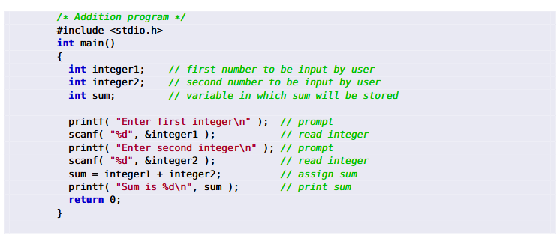
SU FACULTY of ENGINEERING
Computer Programming 143 lectures | 22 July 2026
USER INPUT WITH scanf()
Obtains a value from the user
--scanf uses standard input (usually keyboard)
This scanf statement has two arguments
--%d - indicates data should be a decimal integer
&integer1 - location in memory to store variable
--- & is confusing in beginning — for now, just remember to include it with the variable name in scanf statements
Chapter 2 pg. 13

Slide 24
SU FACULTY of ENGINEERING
Computer Programming 143 lectures | 22 July 2026
ADDING INTEGERS DEMONSTRATION
EXAMPLE 2:
Print the following text on the console:
Addition: 10 + 5 = 15
Subtraction: 10 – 5 = 5
Division: 10 / 5 = 2
Modulus: 10 % 5 = 2
Multiplication: 10 * 5 = 10
Chapter 2 pg. 8

