Slide 1

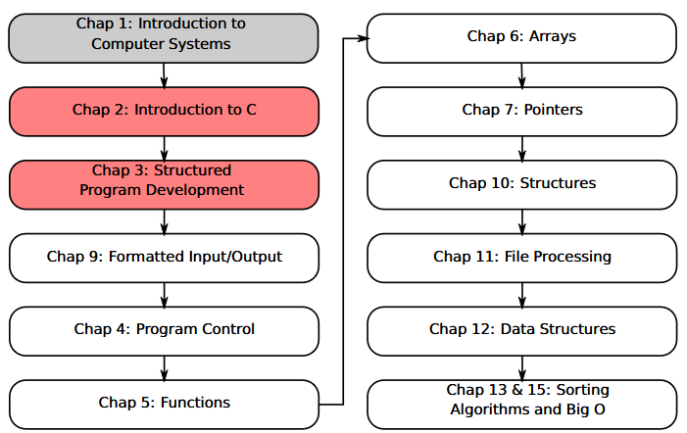
SU FACULTY of ENGINEERING
Computer Programming 143 lectures | 24 July 2026
A. WELCOME TO CP143
PROGRAMMING IN C
3. Structured Program
Development
Lecture 3| Programming Decisions
Algorithms, pseudocode, and flow diagrams
Introduction to “if” and “if…else” selection structure
Isaac Khobo, PhD (ilkhobo@sun.ac.za)
Chapter 3: Struct Program Dev II

Slide 2
SU FACULTY of ENGINEERING
Computer Programming 143 lectures | 24 July 2026
RECAP ON (USR INPUT) & (ARITHMETIC)
EXAMPLE 3 (using user input to perform arithmetic):
Print the following text on the console:
Enter the first integer: “X”
Enter the second integer: “Y”
Addition of first and second integer is “Z”
Division of first integer by the second integer is “D”
The multiplication of the first integer by the second integer is “M”
Chapter 2 pg. 9

Slide 3
SU FACULTY of ENGINEERING
Computer Programming 143 lectures | 24 July 2026
CONTROL STRUCTURES
ALL PROGRAMS ARE WRITTEN IN 3 CONTROL STRUCTURES
SEQUENCE STRUCTURE
SELECTION STRUCTURE
REPETITION STRUCTURE
Chapter 2 pg. 10

Slide 4
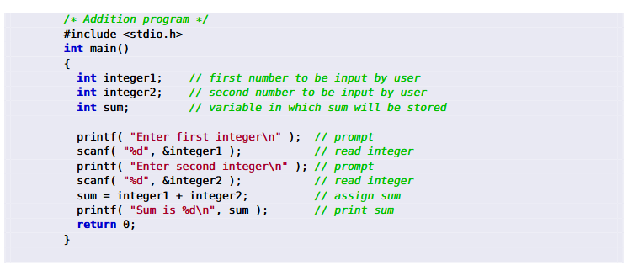
SU FACULTY of ENGINEERING
Computer Programming 143 lectures | 24 July 2026
CONTROL STRUCTURES
ALL PROGRAMS ARE WRITTEN IN 3 CONTROL STRUCTURES
Build into C. Programs execute sequentially by default.
SEQUENCE STRUCTURE
SELECTION STRUCTURE
REPETITION STRUCTURE
Chapter 2 pg. 10

Slide 5
SU FACULTY of ENGINEERING
Computer Programming 143 lectures | 24 July 2026
CONTROL STRUCTURES
ALL PROGRAMS ARE WRITTEN IN 3 CONTROL STRUCTURES
An IDE is software that provides a comprehensive set of features for software development
Examples:
Code::Blocks
Visual Studio/VSCode
CLion
Build into C. Programs execute sequentially by default.
Execute The C programming language has 3 types (while, do, while, and for)
SEQUENCE STRUCTURE
REPETITION STRUCTURE
SEQUENCE STRUCTURE
SELECTION STRUCTURE
Chapter 2 pg. 10

Slide 6
SU FACULTY of ENGINEERING
Computer Programming 143 lectures | 24 July 2026
CONTROL STRUCTURES
ALL PROGRAMS ARE WRITTEN IN 3 CONTROL STRUCTURES
Build into C. Programs execute sequentially by default.
The C programming language has 3 types (if, if…else, and switch)
The C programming language has 3 types (while, do, while, and for)
SEQUENCE STRUCTURE
SELECTION STRUCTURE
REPETITION STRUCTURE
Chapter 2 pg. 10

Slide 7
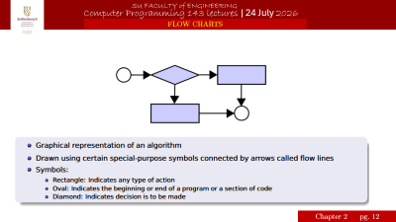
SU FACULTY of ENGINEERING
Computer Programming 143 lectures | 24 July 2026
CONTROL STRUCTURES
Control structures are building blocks of algorithms
Algorithms contain sequence, selection, & repetition
Sequence
Selection
Repetition/iteration
N
Y
N
Y
Yes/no
Action 1
start
Yes/no
Action 2
Action 1
Action 2
end
end
end
ALGORITHMS FLOW CHARTS
Chapter 2 pg. 11

Slide 8
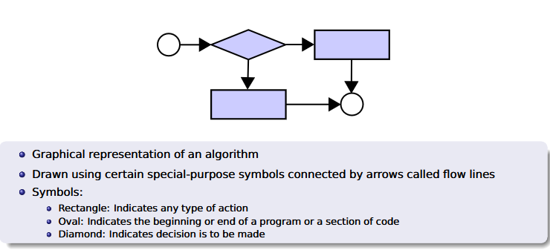
SU FACULTY of ENGINEERING
Computer Programming 143 lectures | 24 July 2026
FLOW CHARTS
Chapter 2 pg. 12

Slide 9
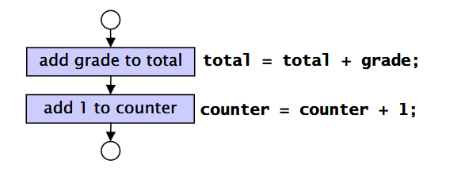
SU FACULTY of ENGINEERING
Computer Programming 143 lectures | 24 July 2026
SEQUENTIAL EXECUTION
Control Structure 1: Sequential execution
Statements executed one after the other in the order they were written
Chapter 2 pg. 13

Slide 10
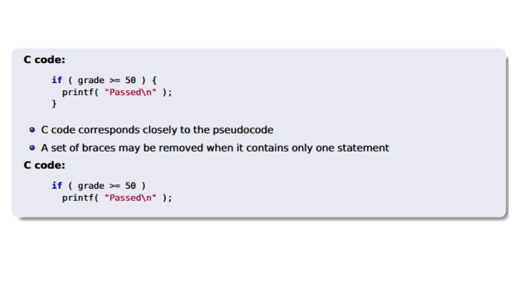
SU FACULTY of ENGINEERING
Computer Programming 143 lectures | 24 July 2026
if SELECTION STATEMENT I
Control structure 2: the ‘if’ statement
Example with Pseudocode:
If student’s grade is greater than or equal to 50
Print “Passed”
Example with C code:
if
Yes or no
true
false
Do this
Do that
Chapter 2 pg. 14

Slide 11
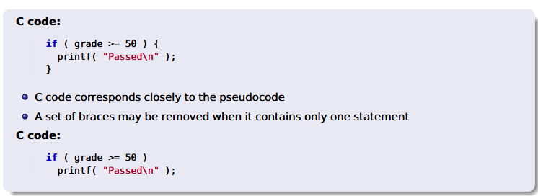

Slide 12
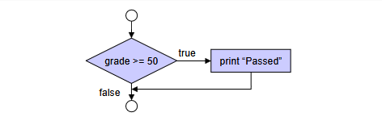
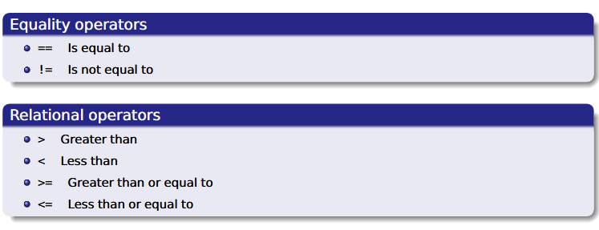
SU FACULTY of ENGINEERING
Computer Programming 143 lectures | 24 July 2026
if SELECTION STATEMENT II
if statement is a single-entry/single-exit structure:
A decision can be made on any expression.
If result is zero: then false
If result is nonzero: then true
Example:
a - b is true if a is not equal to b (valid expression but bad programming)
a != b is equivalent, but better programming
Chapter 2 pg. 15

Slide 13

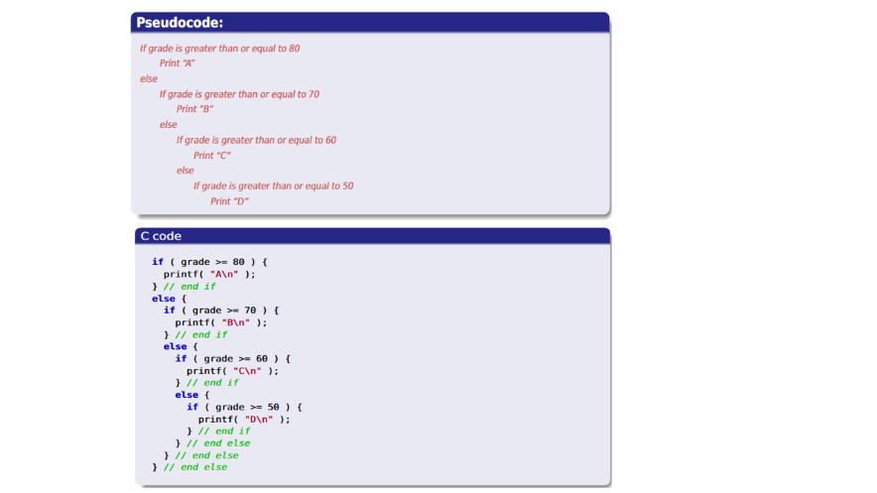
SU FACULTY of ENGINEERING
Computer Programming 143 lectures | 24 July 2026
if else SELECTION STATEMENT I
Specifies an action to be performed both when the condition is true and when it is false
Test multiple cases by placing if...else selection statements inside if...else selection
statement
Once condition is met, rest of statements skipped
Chapter 3 pg. 16

Slide 14
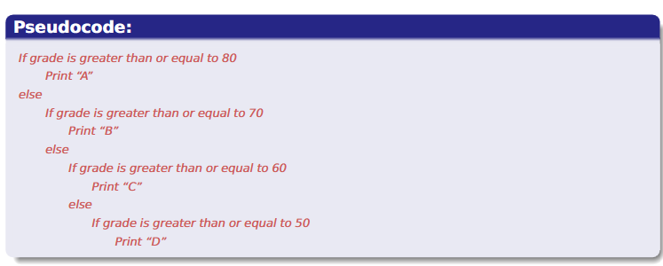
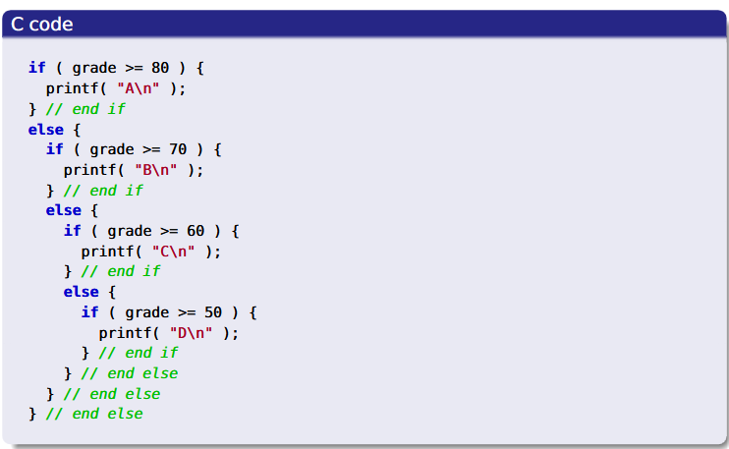

Slide 15
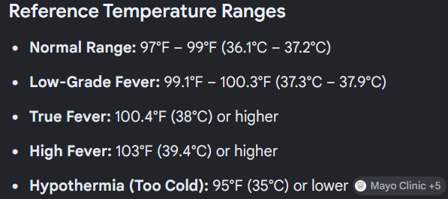
SU FACULTY of ENGINEERING
Computer Programming 143 lectures | 24 July 2026
Combining if STATEMENTS, (USR INPUT) & (ARITHMETIC)
EXAMPLE 4 using printf(), scanf(), and if statements:
Print the following text on the console:
The following program tells you whether you have a fever or hypothermia.
Enter your body temperature (in degrees Celsius): “37”
Output: Good news, you are fine!
Enter your body temperature: “0”
Output: Bad news, you are a corpse in antarctica.
Enter body temperature: 100
Output: Aaaaaaaaaaaaah, you are on fire!!!!! (sound alert bell)
Chapter 3 pg. 16

