Slide 1

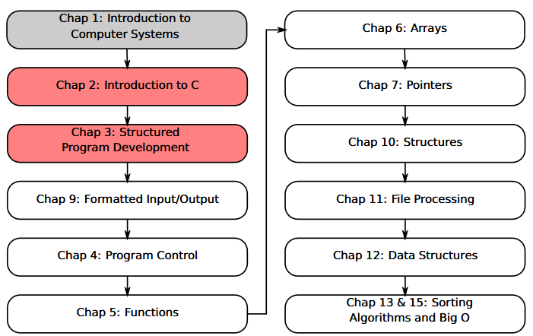
SU FACULTY of ENGINEERING
Computer Programming 143 lectures | 27 July 2026
A. WELCOME TO CP143
PROGRAMMING IN C
3. Structured Program
Development
Lecture 4| Review of structured programming so far
The ‘while’ repetition statement
Program design 1: counter-controlled repetition
Program design 2: sentinel-controlled repetition
Isaac Khobo, PhD (ilkhobo@sun.ac.za)
Chapter 3: Struct Program Dev 2

Slide 2
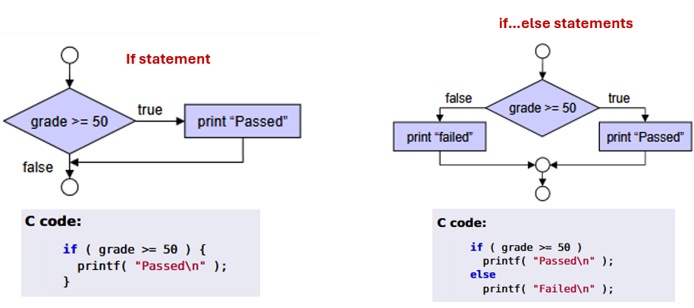
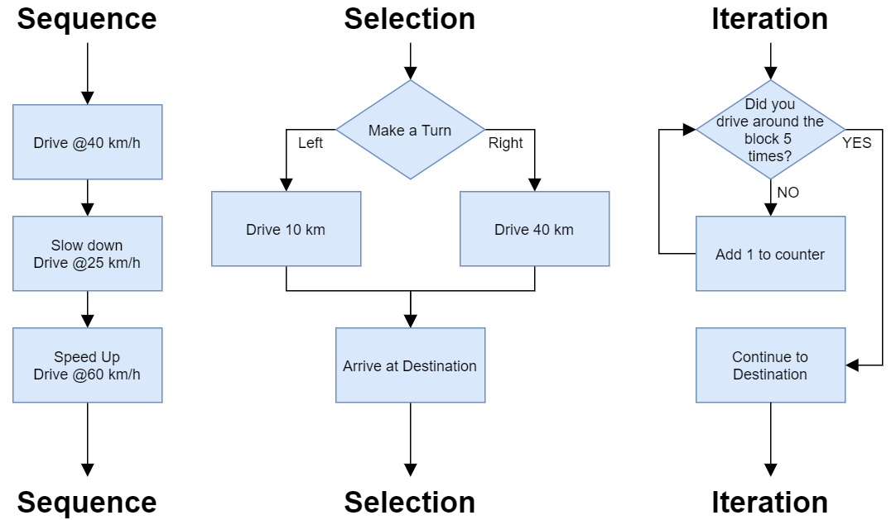
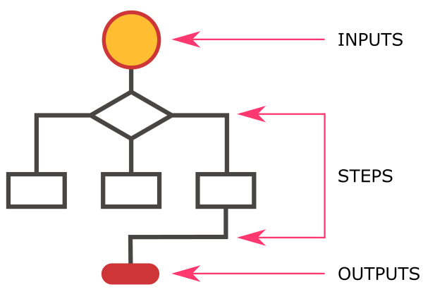
SU FACULTY of ENGINEERING
Computer Programming 143 lectures | 27 July 2026
RECAP: ALGORITHMS & CONTROL STRUCTURES
Algorithms – clear, step-by-step instructions used to solve a problem, perform calculation, or complete a task.
Pseudocode & flow charts (ovals, diamonds, rectangles) describe algorithms
3 control structures build algorithms: sequence, selection, and repetition.
Nested if-else statements
OVERVIEW OF STRUCTURE PROGRAM DEVELOPMENT
Chapter 3 pg. 17

Slide 3
SU FACULTY of ENGINEERING
Computer Programming 143 lectures | 27 July 2026
CONTROL STRUCTURES DEMONSTRATION
EXAMPLE 5 using printf(), scanf(), and if statements:
Print the following text on the console if the arithmetic is evaluated correctly:
Heading: This program checks your elementary math knowledge
What is 10 + 20?
(Well done, you are a math wizard! No more questions)
If x is 10, what is exp(-pow(x,2))*log(x)?
(You got that wrong, try the next question!)
Chapter 2 pg. 18

Slide 4
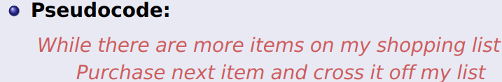
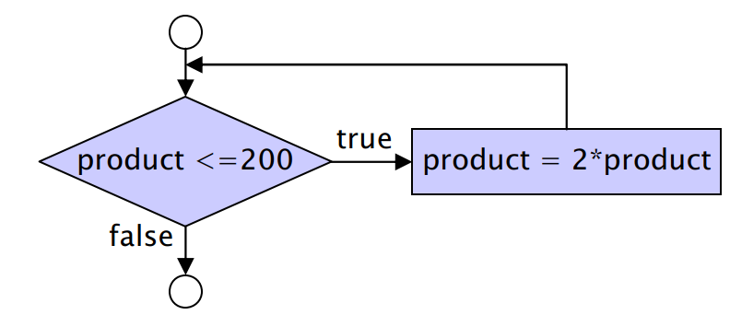
SU FACULTY of ENGINEERING
Computer Programming 143 lectures | 27 July 2026
while REPETITION STATEMENT I
Programmer specifies an action to be repeated while some condition remains true.
while loop repeated until condition becomes false
We do use loop, iteration, repetition interchangeably
Chapter 3 pg. 19

Slide 5
SU FACULTY of ENGINEERING
Computer Programming 143 lectures | 27 July 2026
COUNTER CONTROLLED VS SENTINEL REPETITION I
COUNTER-CONTROLLED
SENTINEL-CONTROLLED
Chapter 3 pg. 20

Slide 6
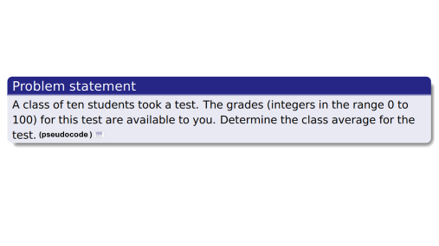
SU FACULTY of ENGINEERING
Computer Programming 143 lectures | 27 July 2026
COUNTER CONTROLLED VS SENTINEL REPETITION I
The number of repetitions is known before the loop begins executing. (controlled variable = counter)
COUNTER-CONTROLLED
SENTINEL-CONTROLLED
Chapter 3 pg. 20

Slide 7
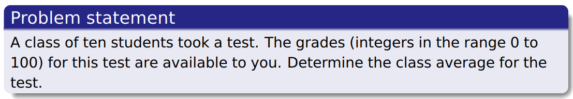
(pseudocode )

Slide 8
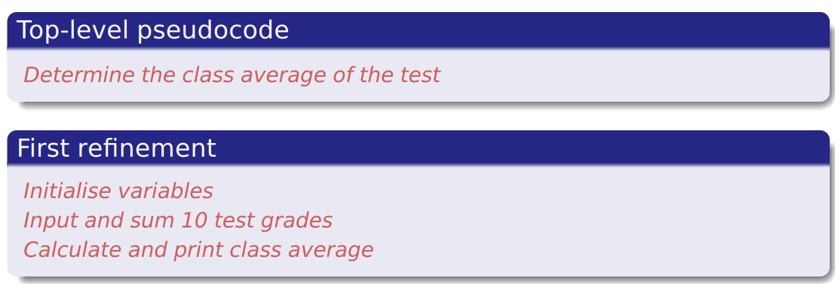
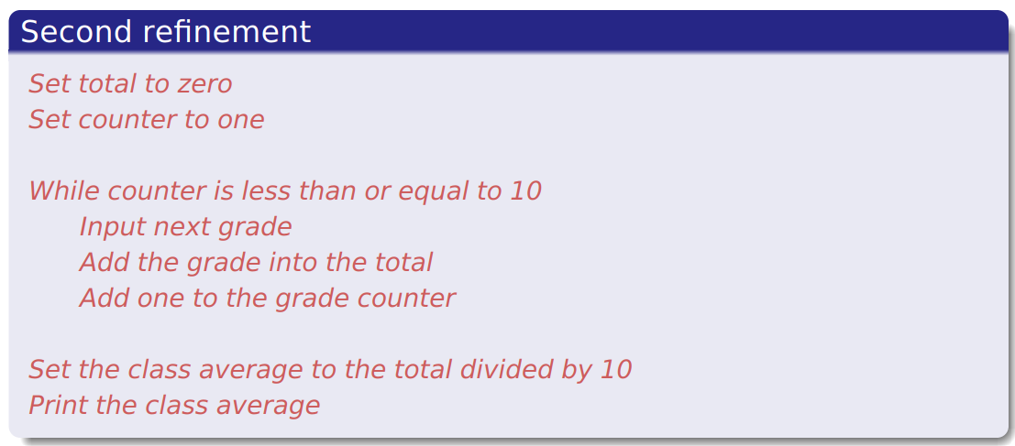

C code

Slide 9
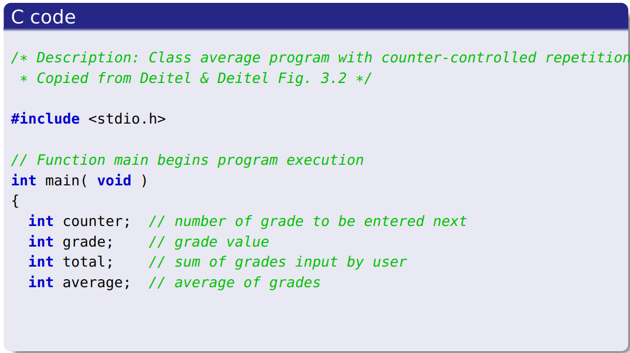
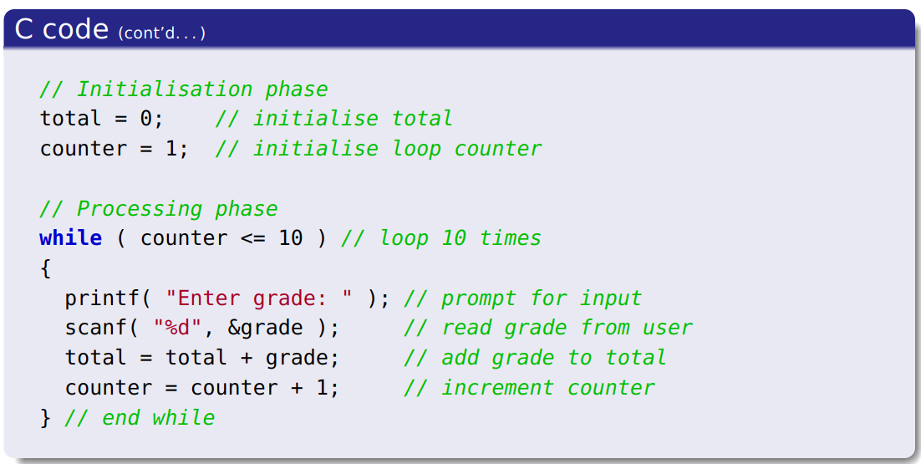
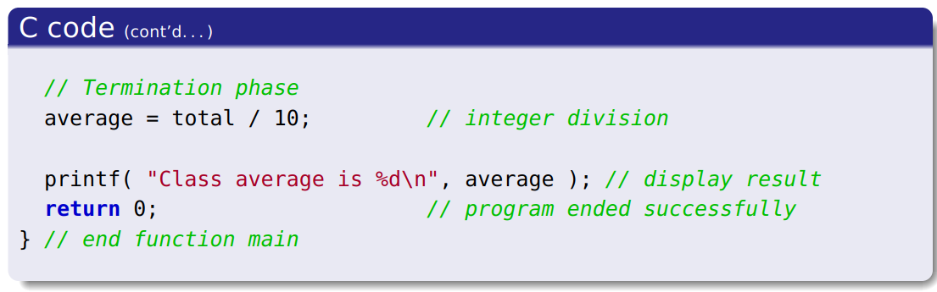
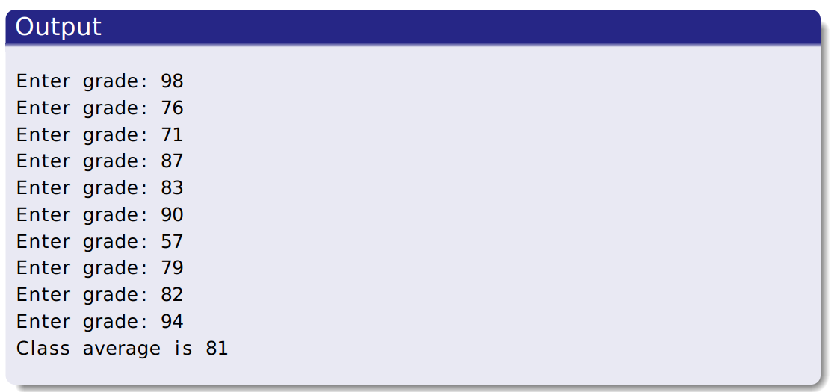

Slide 10

SU FACULTY of ENGINEERING
Computer Programming 143 lectures | 27 July 2026
COUNTER CONTROLLED VS SENTINEL REPETITION I
The number of repetitions is known before the loop begins executing. (controlled variable = counter)
COUNTER-CONTROLLED
SENTINEL-CONTROLLED
Chapter 3 pg. 20

Slide 11
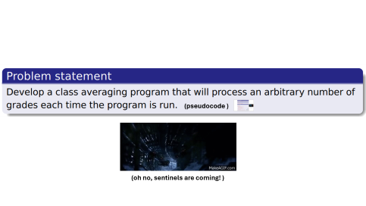
SU FACULTY of ENGINEERING
Computer Programming 143 lectures | 27 July 2026
COUNTER CONTROLLED VS SENTINEL REPETITION I
The number of repetitions is known before the loop begins executing. (controlled variable = counter)
The number of repetitions is NOT known before the loop begins executing. (controlled variable used = sentinel variable)
COUNTER-CONTROLLED
SENTINEL-CONTROLLED
Chapter 3 pg. 20

Slide 12
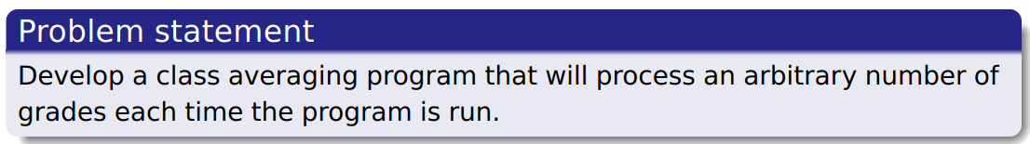

(pseudocode )
(oh no, sentinels are coming! )

Slide 13
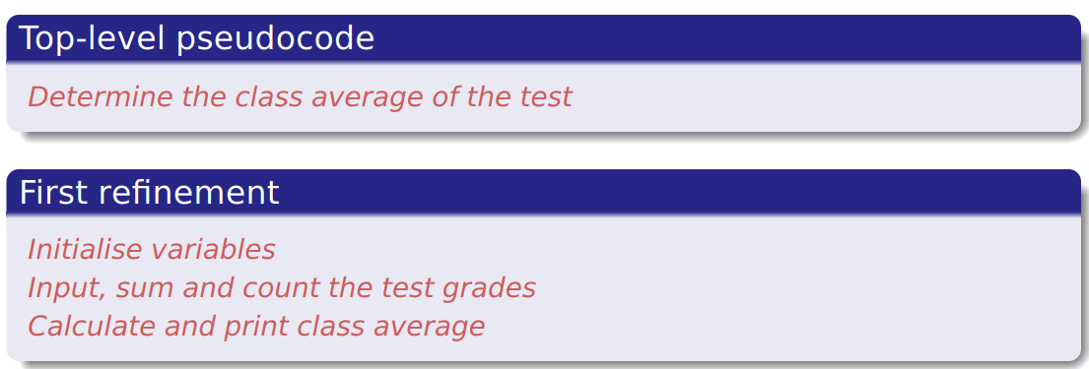
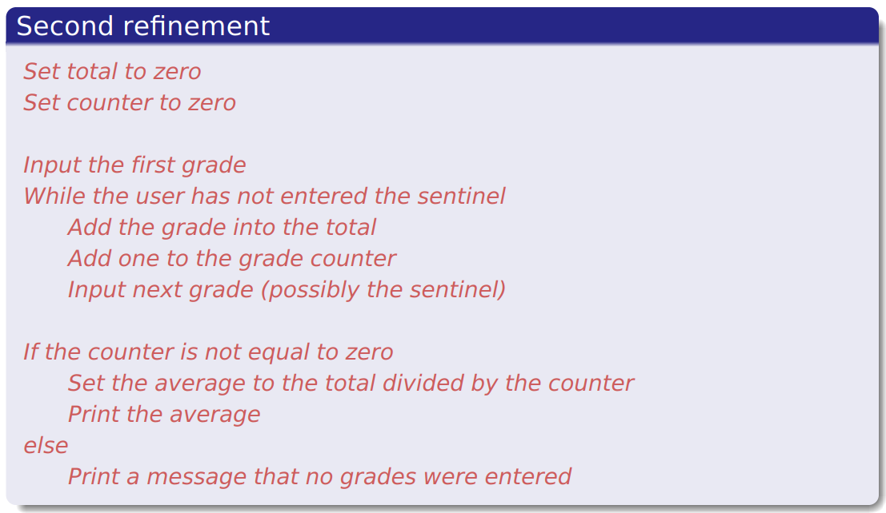
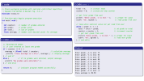
(oh yes, killed one sentinel
Let’s gooooo! )
C code

Slide 14
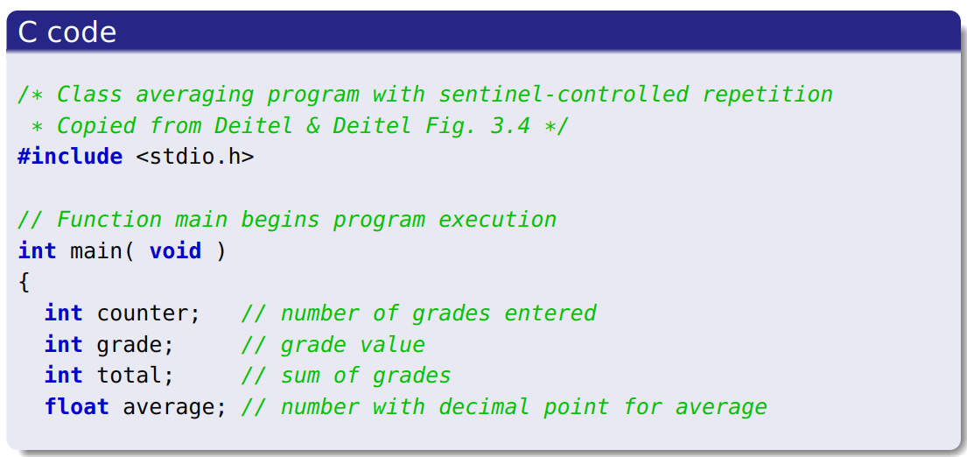
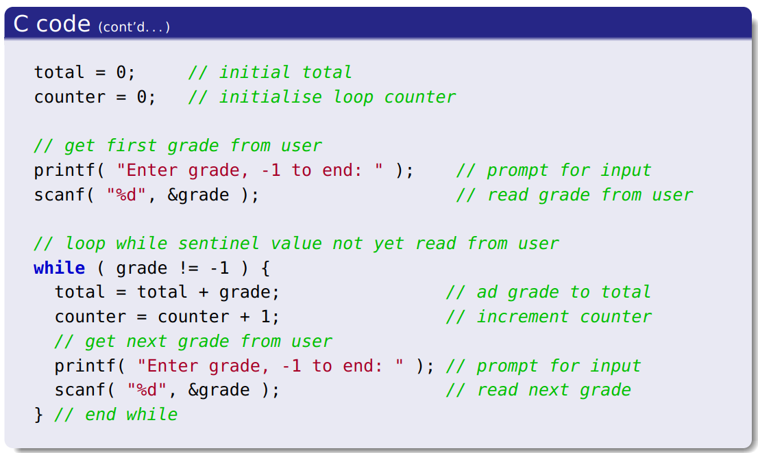
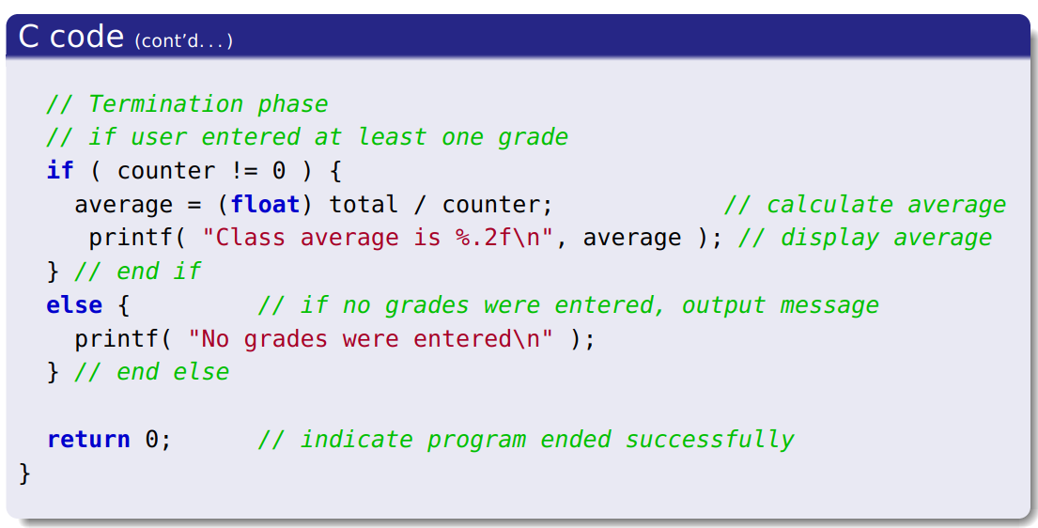
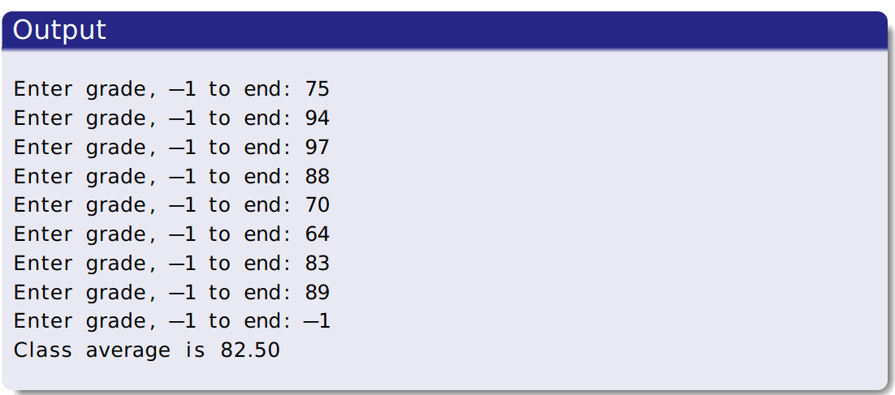

Slide 15

SU FACULTY of ENGINEERING
Computer Programming 143 lectures | 27 July 2026
COUNTER CONTROLLED VS SENTINEL REPETITION I
The number of repetitions is known before the loop begins executing. (controlled variable = counter)
The number of repetitions is NOT known before the loop begins executing. (controlled variable used = sentinel variable)
COUNTER-CONTROLLED
SENTINEL-CONTROLLED
Chapter 3 pg. 20

Slide 16
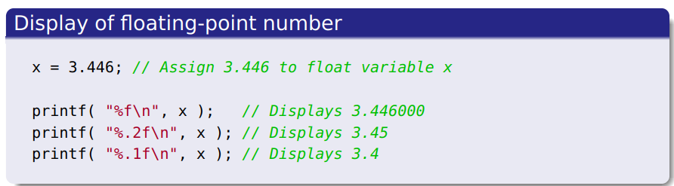
SU FACULTY of ENGINEERING
Computer Programming 143 lectures | 27 July 2026
FLOATING POINT NUMBERS I (float)
Describes real numbers
Declaration:
float average;
Casting: The conversion from one data type to another
Chapter 3 pg. 19

