Slide 1

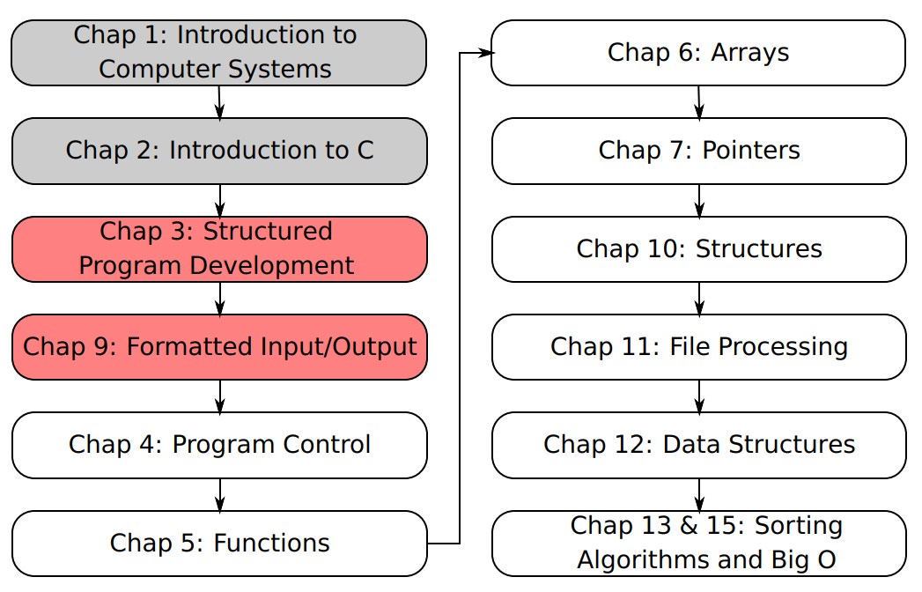
SU FACULTY of ENGINEERING
Computer Programming 143 lectures | 29 July 2026
A. WELCOME TO CP143
PROGRAMMING IN C
3&9. Formatted input/output
Lecture 5| Formatted input/output
Nested control structures
Assignment operators
Increment and decrement operators
Isaac Khobo, PhD (ilkhobo@sun.ac.za)
Chapters 3 and 9

Slide 2
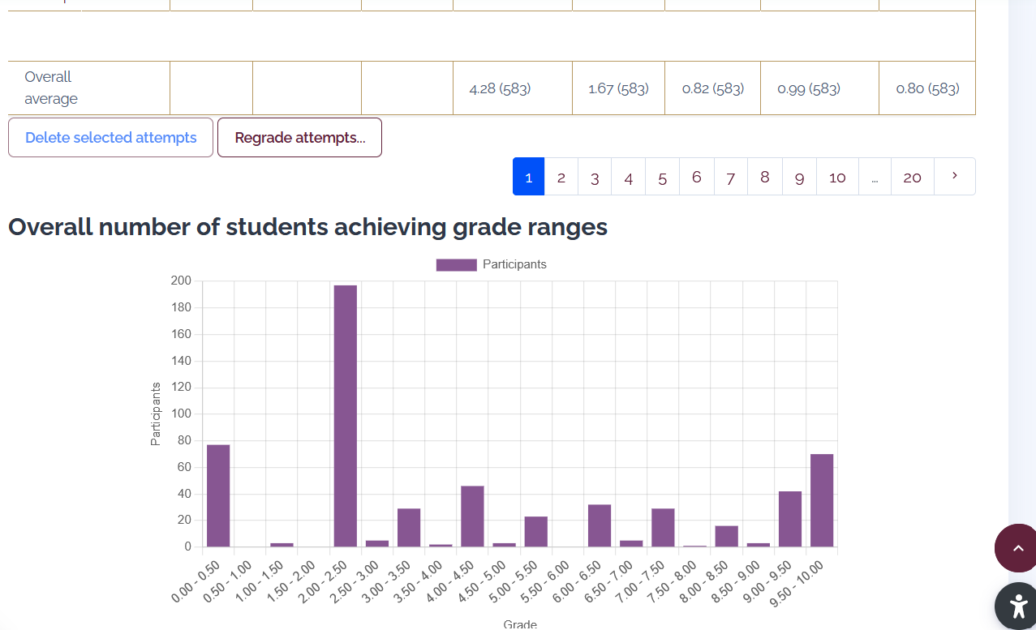
SU FACULTY of ENGINEERING
Computer Programming 143 lectures | 29 July 2026
RECAP: PRAC TEST
GRADES FOR PRAC 2 (NOT THAT GOOD)
Chapter 3 pg. 20

Slide 3
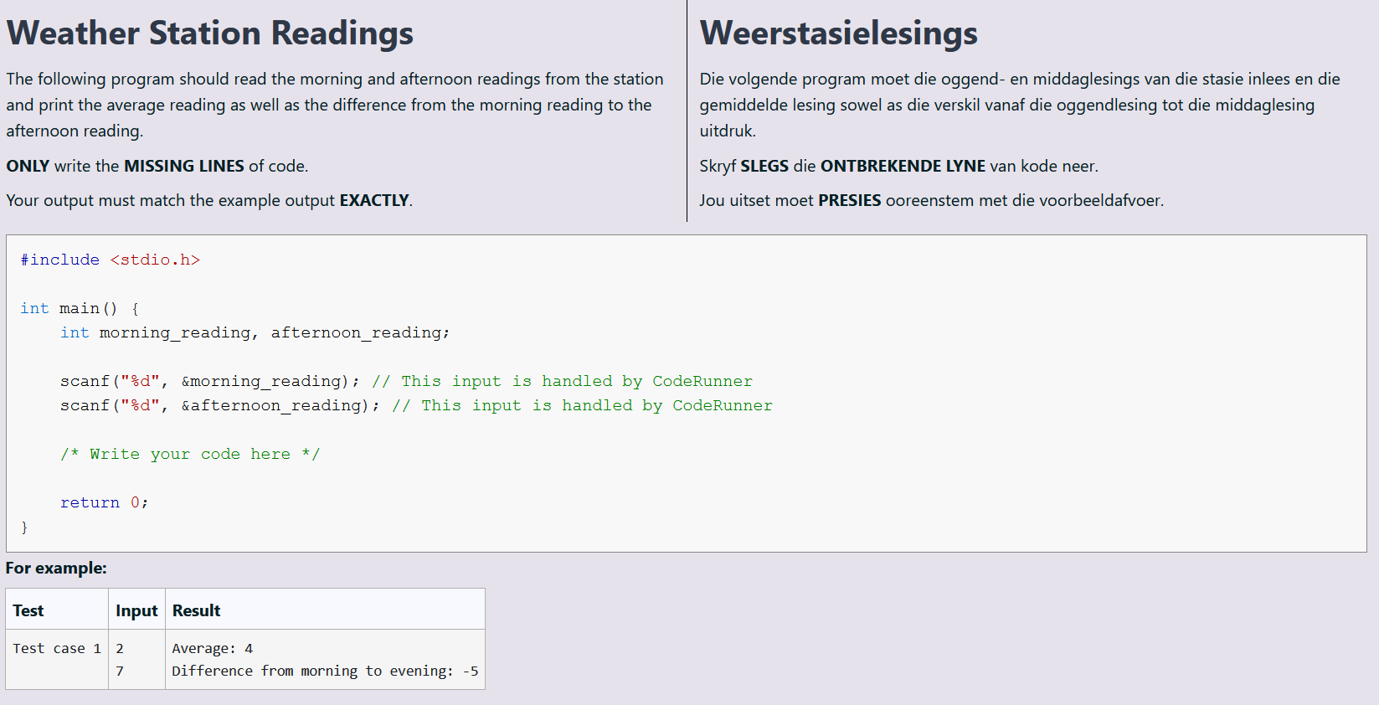
SU FACULTY of ENGINEERING
Computer Programming 143 lectures | 29 July 2026
RECAP: PRAC TEST
EXAMPLE 6: BASIC ARITHMETIC
Chapter 3 pg. 20

Slide 4
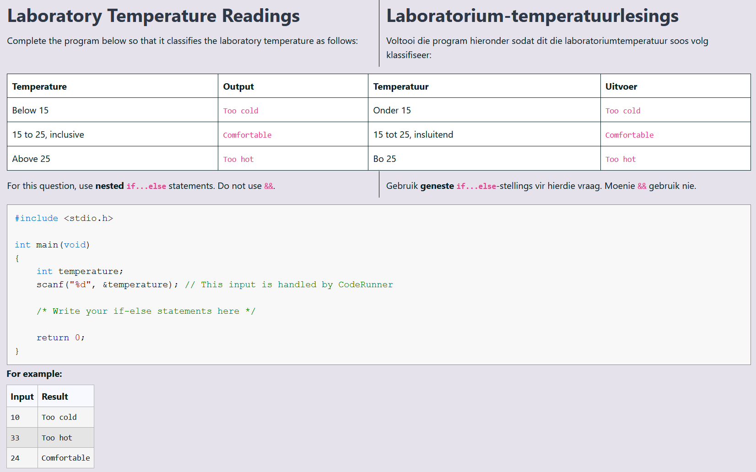
SU FACULTY of ENGINEERING
Computer Programming 143 lectures | 29 July 2026
RECAP: PRAC TEST
EXAMPLE 7: if..else
Chapter 3 pg. 21

Slide 5
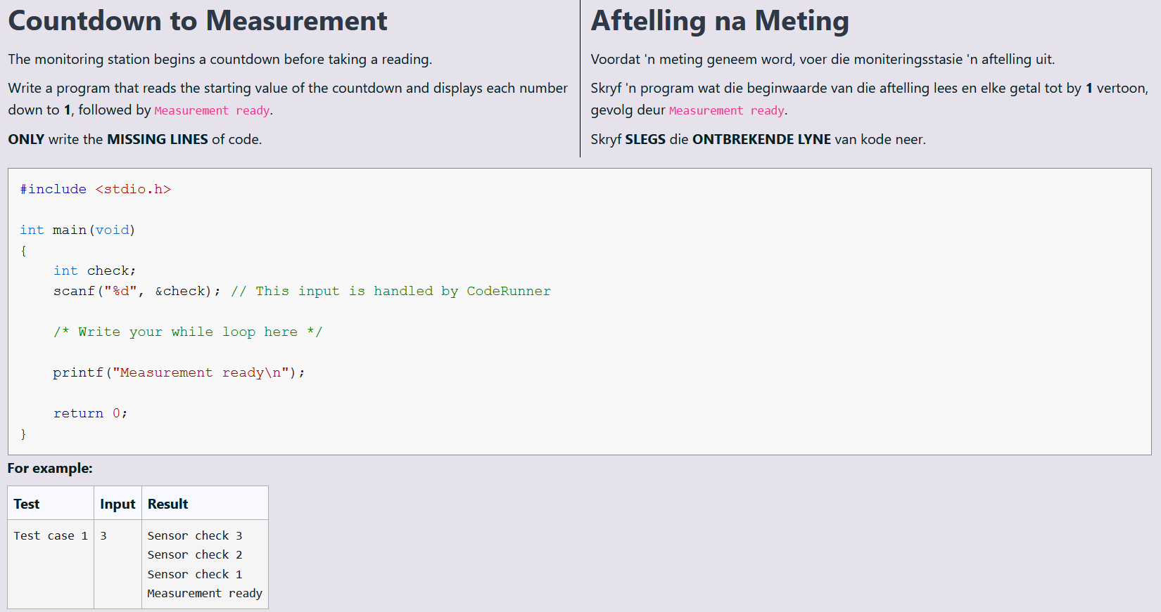
SU FACULTY of ENGINEERING
Computer Programming 143 lectures | 29 July 2026
RECAP: PRAC TEST
EXAMPLE 8: while loops
Chapter 3 pg. 22

Slide 6
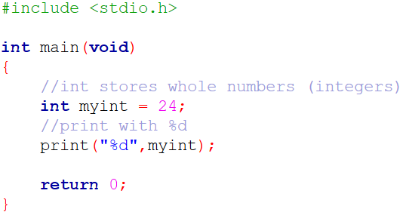
SU FACULTY of ENGINEERING
Computer Programming 143 lectures | 29 July 2026
FORMATTED INPUT/OUTPUT: DIFFERENT TYPES
int stores whole numbers (integers)
e.g., -5, -4, -3, -2, -1, 0, 1, 2, 3 , 4, 5
It is printed/flagged with %d
DATA TYPES (int)
Chapter 3&9 pg. 23

Slide 7
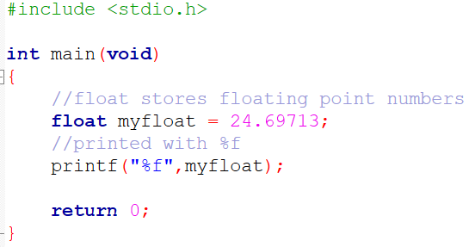
SU FACULTY of ENGINEERING
Computer Programming 143 lectures | 29 July 2026
FORMATTED INPUT/OUTPUT: DIFFERENT TYPES
float stores decimals (floating-point) numbers with single precision
(Print with %f)
E.g., 24.123456
Uses 32 bits of memory to provide a number with roughly 6 decimal points
DATA TYPES (float)
Chapter 3&9 pg. 24

Slide 8
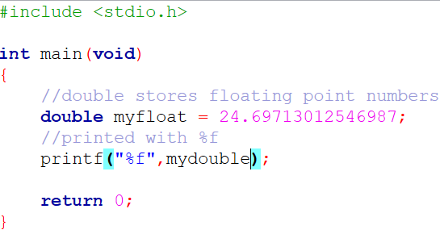
SU FACULTY of ENGINEERING
Computer Programming 143 lectures | 29 July 2026
FORMATTED INPUT/OUTPUT: DIFFERENT TYPES
double stores decimals (floating-point) numbers with double precision
(Print with %f)
e.g., 24.123456789101112
Uses 64 bits of memory to provide a number with roughly 14 decimal points
DATA TYPES (double)
Chapter 3&9 pg. 25

Slide 9
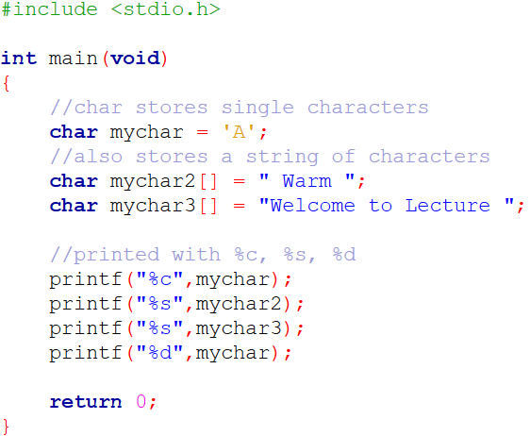
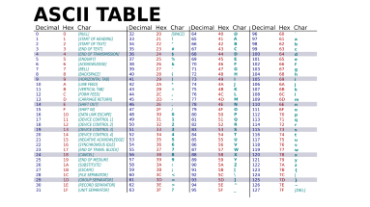
SU FACULTY of ENGINEERING
Computer Programming 143 lectures | 29 July 2026
FORMATTED INPUT/OUTPUT: DIFFERENT TYPES
char stores single characters, strings of characters (*character array*), also single character hex/decimal values (ASCII table)
DATA TYPES (char)
Chapter 3&9 pg. 27

Slide 10
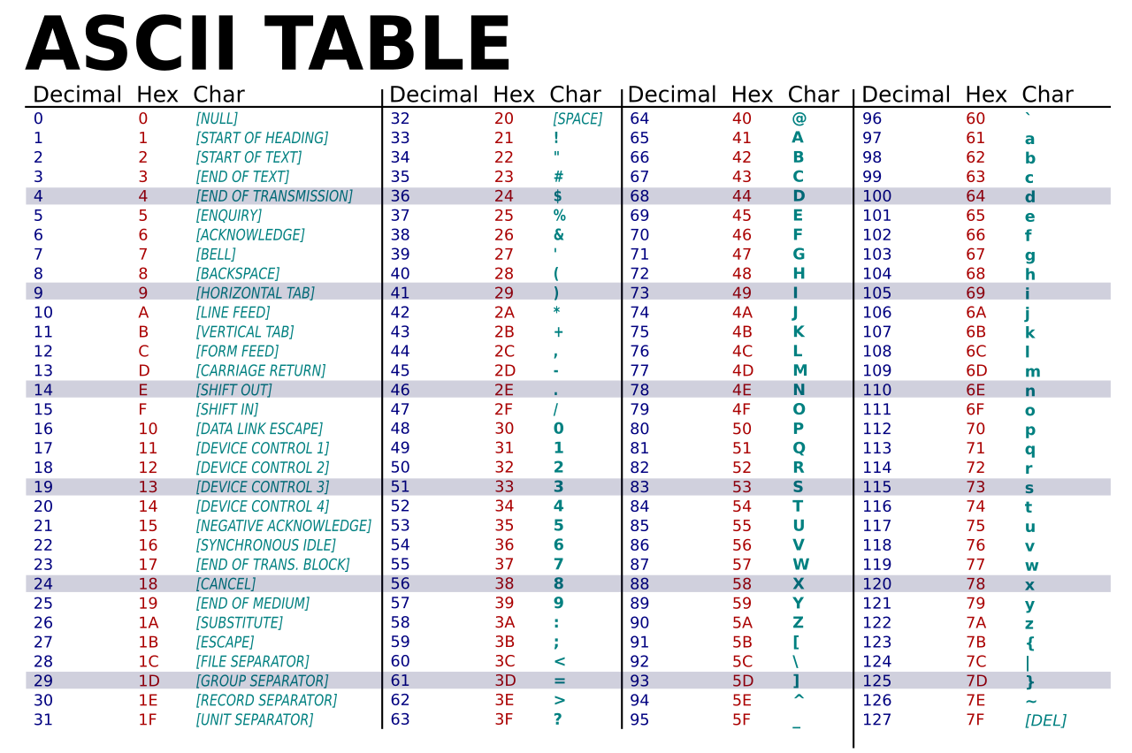

Slide 11
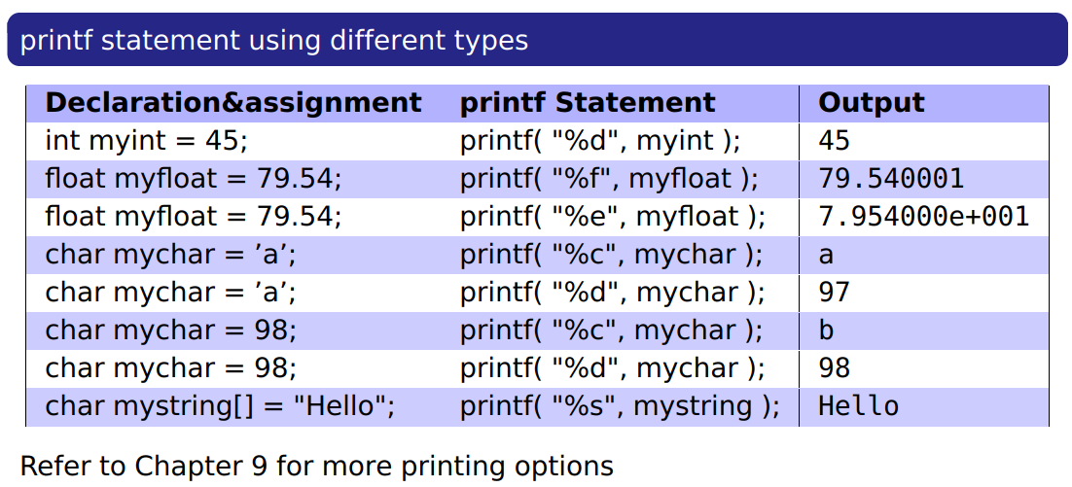
SU FACULTY of ENGINEERING
Computer Programming 143 lectures | 29 July 2026
FORMATTED INPUT/OUTPUT: DIFFERENT TYPES
Printing a floating-point number in scientific notation %e
DATA TYPES (others)
Chapter 3&9 pg. 28

Slide 12
SU FACULTY of ENGINEERING
Computer Programming 143 lectures | 29 July 2026
FORMATTED INPUT/OUTPUT: DIFFERENT TYPES
You can print a decimal equivalent of a single character (‘b’ corresponds to 98 decimal on ASCII table)
DATA TYPES (others)
Chapter 3&9 pg. 29

Slide 13
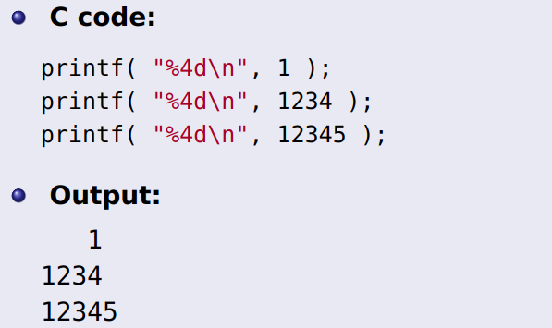
SU FACULTY of ENGINEERING
Computer Programming 143 lectures | 29 July 2026
FORMATTED INPUT/OUTPUT: FIELD WIDTH & PRECISION
This specifies the minimum space that a displayed integer should occupy syntax: %(leading space)d (decimals)
% (leading space)f floats
FIELD WIDTH
Chapter 3&9 pg. 30

Slide 14
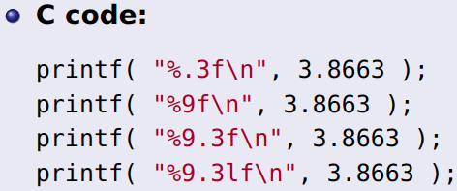
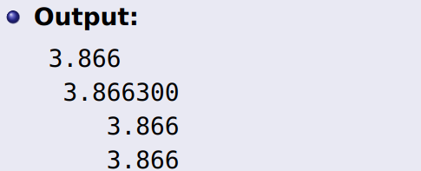
SU FACULTY of ENGINEERING
Computer Programming 143 lectures | 29 July 2026
FORMATTED INPUT/OUTPUT: FIELD WIDTH & PRECISION
This specifies the number of digits to appear after the decimal point.
Syntax: %.(number of digits)f
One can also combine field width and precision. The general syntax is:
%(field_width).(precision)(d/f)
PRECISION
Chapter 3&9 pg. 31

Slide 15
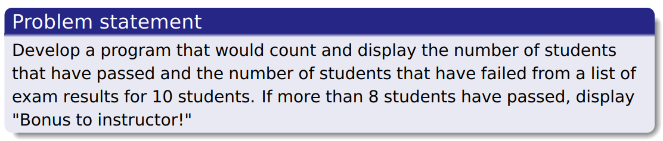
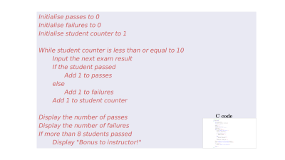
SU FACULTY of ENGINEERING
Computer Programming 143 lectures | 29 July 2026
NESTED CONTROL STRUCTURES I
This refers to the placement of one control statement (such as an if, if-else, while, etc) inside the body of another control statement.
pseudocode
Chapter 3&9 pg. 31

Slide 16
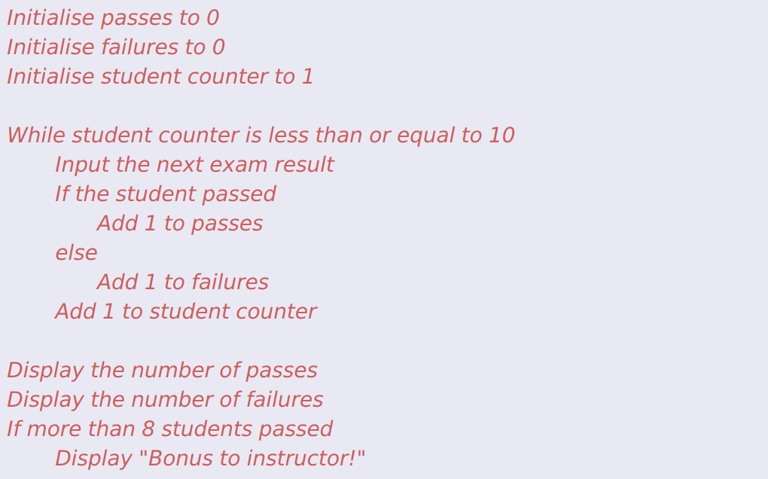
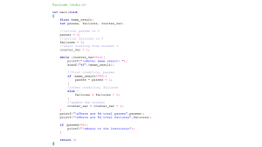
C code

Slide 17
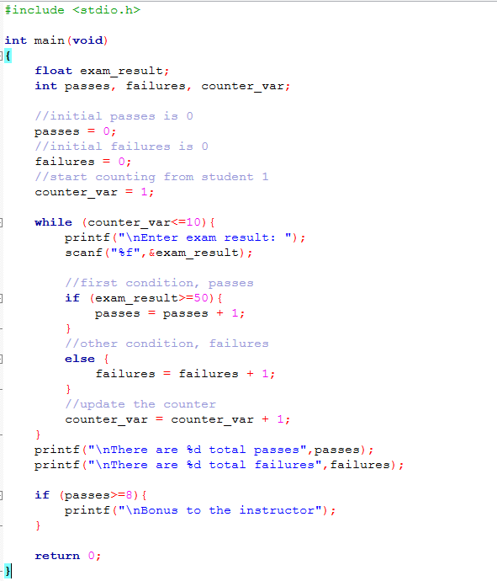

Slide 18

SU FACULTY of ENGINEERING
Computer Programming 143 lectures | 29 July 2026
NESTED CONTROL STRUCTURES I
This refers to the placement of one control statement (such as an if, if-else, while, etc) inside the body of another control statement.
pseudocode
Chapter 3&9 pg. 31

Slide 19
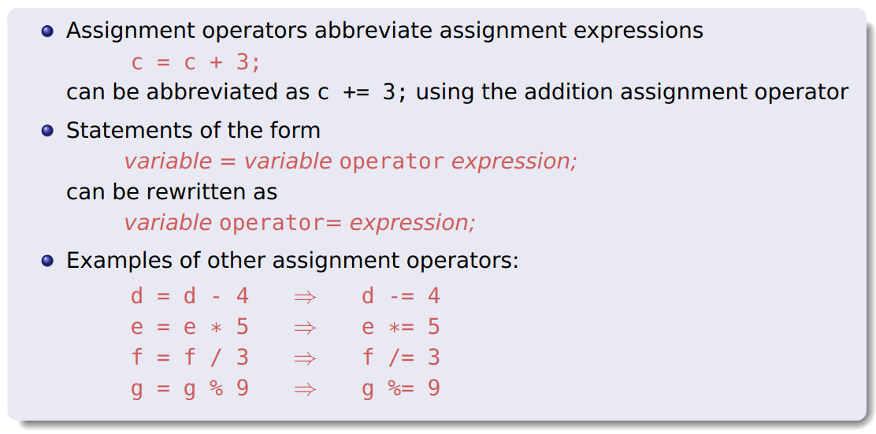
SU FACULTY of ENGINEERING
Computer Programming 143 lectures | 29 July 2026
SIMPLIFYING ASSIGNMENT EXPRESSION
Assignment operators can be simplified, to make the code easier to read and compiler quicker.
Chapter 3&9 pg. 31

Slide 20
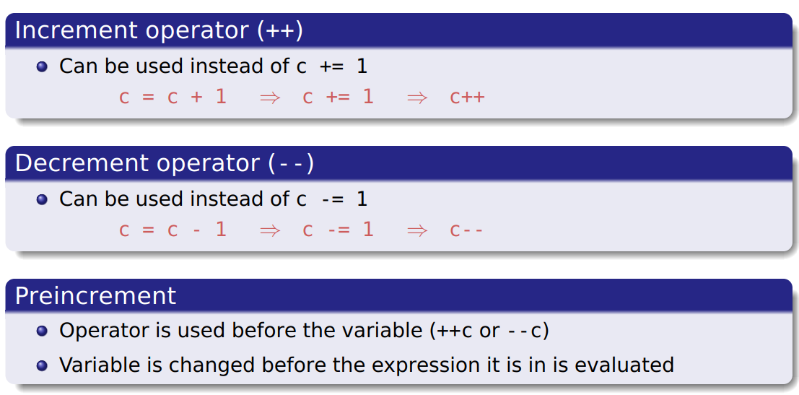
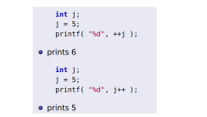
SU FACULTY of ENGINEERING
Computer Programming 143 lectures | 29 July 2026
ASSIGNMENT OPERATORS
Incrementing or decrementing by 1 can also be simplified. E.g., counter++ or counter-- for updating the counter by 1 after the first current instance of the process, and ++c or --c for updating the counter before the instance of the process.
Chapter 3&9 pg. 31

Slide 21
