Slide 1

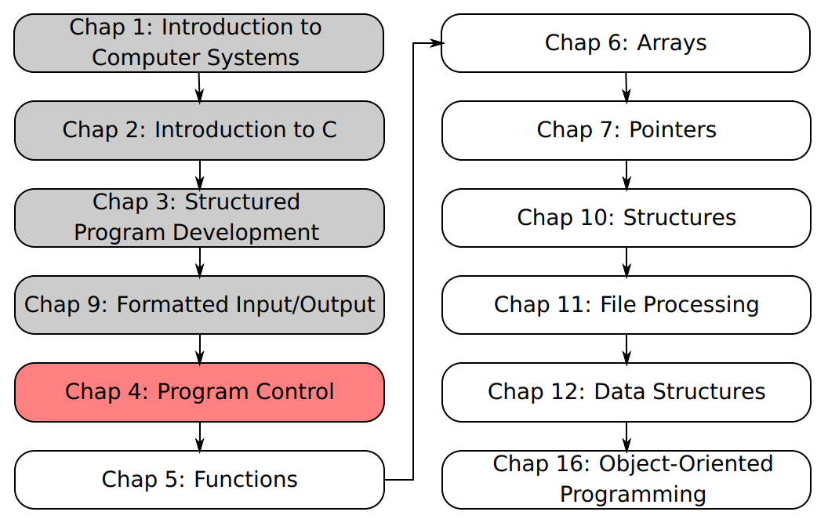
SU FACULTY of ENGINEERING
Computer Programming 143 lectures | 31 July 2026
A. WELCOME TO CP143
PROGRAMMING IN C
4. Program
control
Lecture 6| Essentials of iterations and counter-controlled repetition
The for loop (repetition) statement
For loop examples
Isaac Khobo, PhD (ilkhobo@sun.ac.za)
Chapters 4 Program control

Slide 2
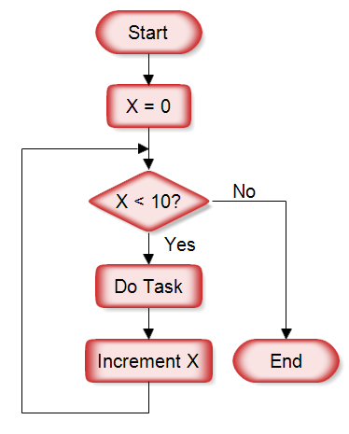
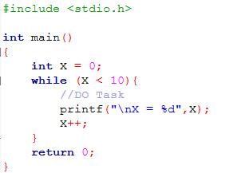
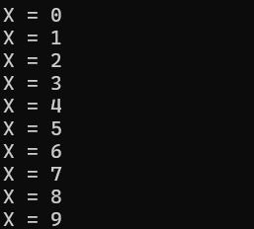
SU FACULTY of ENGINEERING
Computer Programming 143 lectures | 31 July 2026
IMPORTANT RECAP: LOOPS/REPETITIONS
C code
COUNTER-CONTROLLED:
Definite repetition: known beforehand how many times loop will execute
Control variable used to count repetitions
Output
Chapter 3, 4 & 9 pg. 32

Slide 3
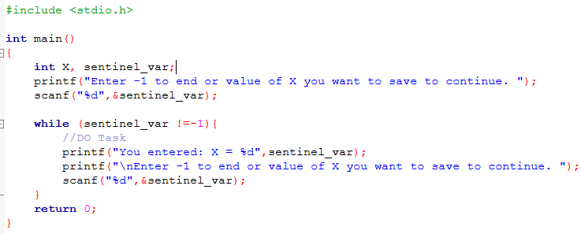
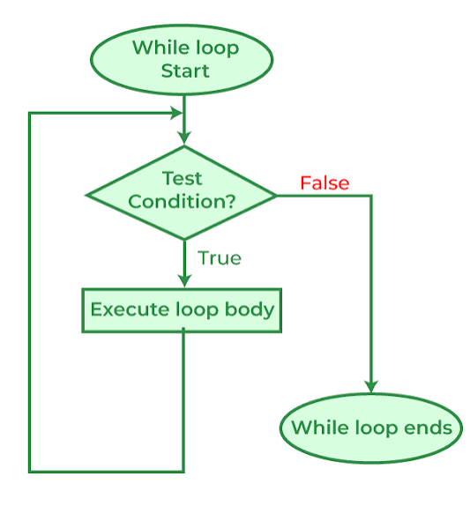
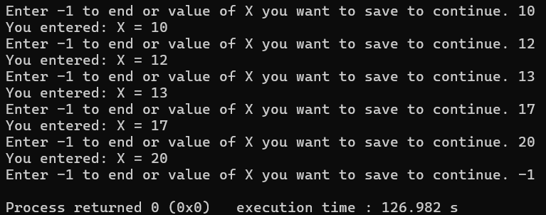
SU FACULTY of ENGINEERING
Computer Programming 143 lectures | 31 July 2026
IMPORTANT RECAP: LOOPS/REPETITIONS
C code
SENTINEL-CONTROLLED:
Indefinite repetition: not known beforehand how many times loop will
Execute.
Sentinel value indicates “end of data”
Output
Chapter 3, 4 & 9 pg. 33

Slide 4
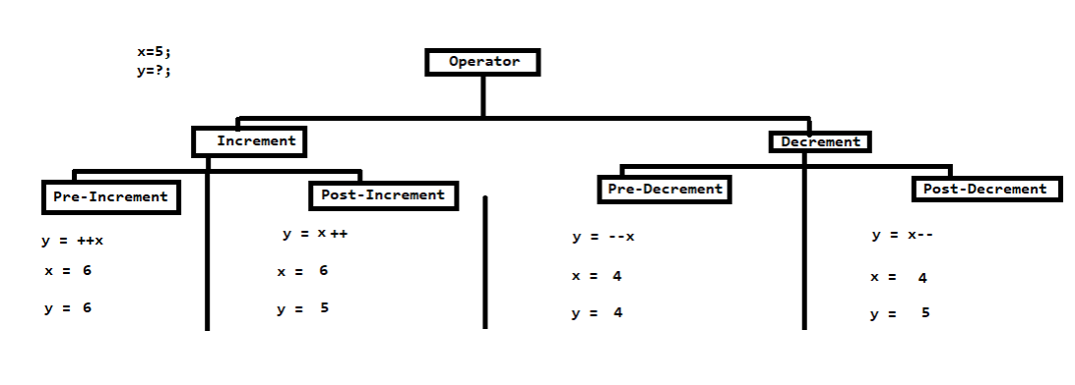
SU FACULTY of ENGINEERING
Computer Programming 143 lectures | 31 July 2026
RECAP: POST/PRE- INCREMENT EXAMPLE
Chapter 3, 4 & 9 pg. 34

Slide 5
SU FACULTY of ENGINEERING
Computer Programming 143 lectures | 31 July 2026
for REPETITION STATEMENT I
You use a for loop when you want to execute a block of code predetermined number of times.
For and while (counter-controlled) loops are interchangeable. But for loops tend to be simpler (cleaner) to implement.
INITIALISATION
CONDITION
UPDATE
Chapter 4 pg. 34

Slide 6
SU FACULTY of ENGINEERING
Computer Programming 143 lectures | 31 July 2026
for REPETITION STATEMENT I
INITIALISATION
CONDITION
UPDATE
Chapter 4 pg. 35

Slide 7
SU FACULTY of ENGINEERING
Computer Programming 143 lectures | 31 July 2026
for REPETITION STATEMENT I
INITIALISATION
CONDITION
UPDATE
Keyword: for
Shows you’re performing a for loop
Chapter 4 pg. 35

Slide 8
SU FACULTY of ENGINEERING
Computer Programming 143 lectures | 31 July 2026
for REPETITION STATEMENT I
INITIALISATION
CONDITION
UPDATE
Control variable name:
Assigns the starting value to the control variable
Chapter 4 pg. 35

Slide 9
SU FACULTY of ENGINEERING
Computer Programming 143 lectures | 31 July 2026
for REPETITION STATEMENT I
INITIALISATION
CONDITION
UPDATE
Loop-continuation condition:
Compares the control variable against a boundary value. The loop continues only if this evaluates to true.
Defines final value of control variable for which the condition is true.
Chapter 4 pg. 35

Slide 10
SU FACULTY of ENGINEERING
Computer Programming 143 lectures | 31 July 2026
for REPETITION STATEMENT I
INITIALISATION
CONDITION
UPDATE
Update:
Increments or decrements the control variable after every iteration to move it closer to breaking the condition.
Chapter 4 pg. 35

Slide 11
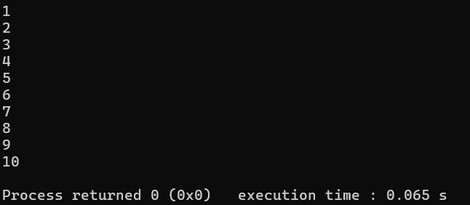
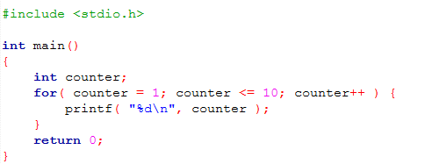
SU FACULTY of ENGINEERING
Computer Programming 143 lectures | 31 July 2026
for REPETITION STATEMENT I
INITIALISATION
CONDITION
UPDATE
Chapter 4 pg. 40

Slide 12
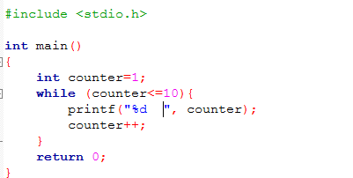
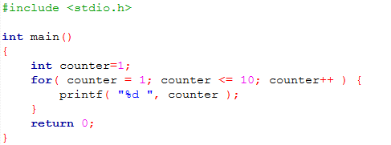


SU FACULTY of ENGINEERING
Computer Programming 143 lectures | 31 July 2026
for REPETITION STATEMENT I
INITIALISATION
CONDITION
UPDATE
WHILE LOOP
FOR LOOP
Chapter 4 pg. 41

Slide 13
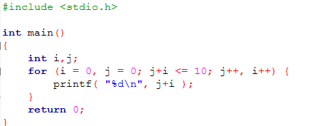
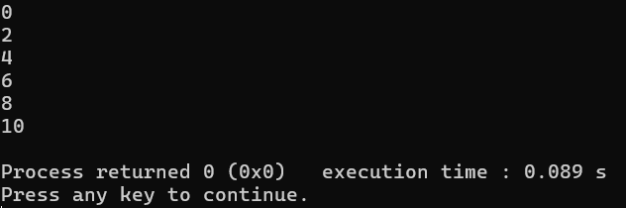
SU FACULTY of ENGINEERING
Computer Programming 143 lectures | 31 July 2026
for REPETITION STATEMENT NOTES I
ADVANTAGE 1:
Multiple control variables (can be used instead of nested control structures).
Listed as comma separated list.
Chapter 4 pg. 42

Slide 14
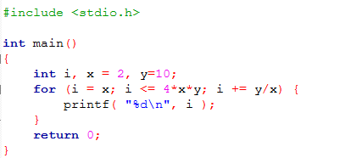
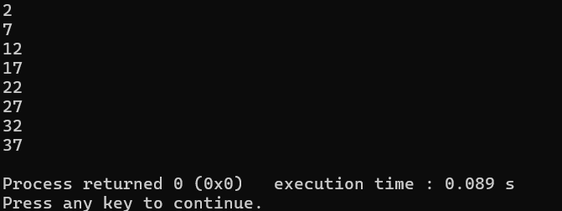
SU FACULTY of ENGINEERING
Computer Programming 143 lectures | 31 July 2026
for REPETITION STATEMENT NOTES I
ADVANTAGE 2:
Initialisation, condition (loop continuation), and update (increments/decrements) statements can be arithmetic expressions.
Chapter 4 pg. 43

Slide 15
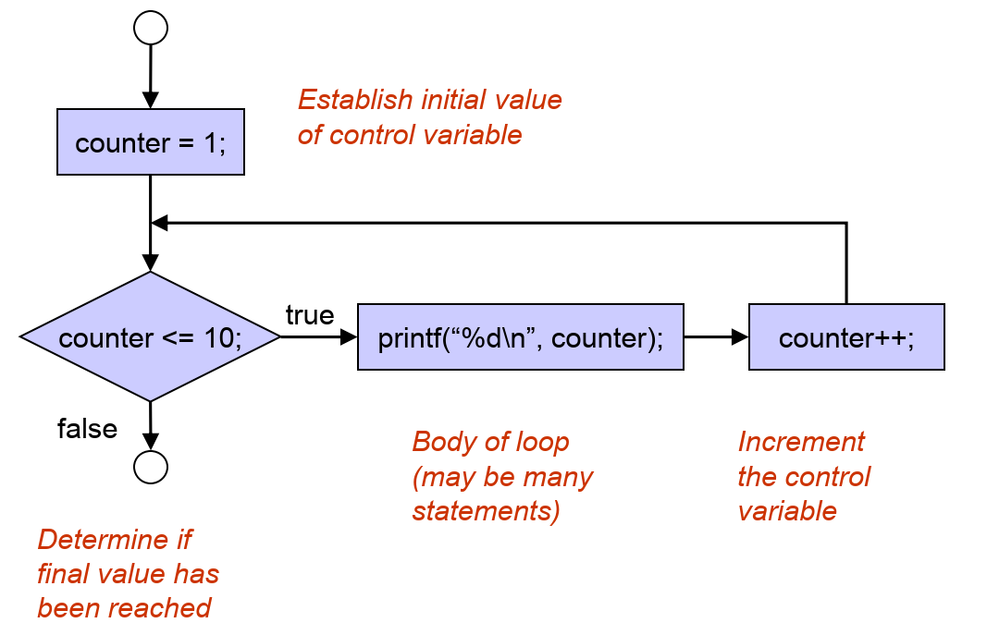
SU FACULTY of ENGINEERING
Computer Programming 143 lectures | 31 July 2026
for REPETITION STATEMENT NOTES I (SUMMARY)
Chapter 4 pg. 44

Slide 16
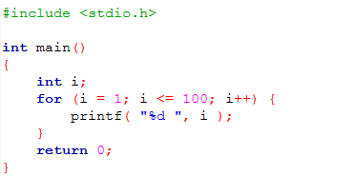
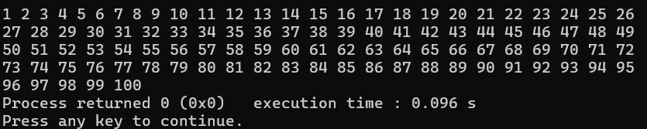
SU FACULTY of ENGINEERING
Computer Programming 143 lectures | 31 July 2026
for REPETITION STATEMENT EXAMPLES
SAMPLE CODE
OUTPUT
Chapter 4 pg. 45

Slide 17
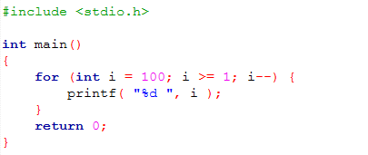
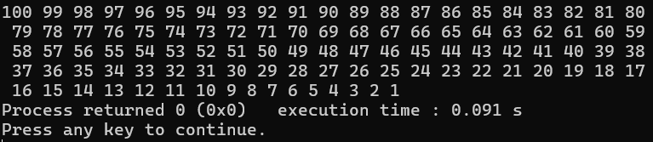
SU FACULTY of ENGINEERING
Computer Programming 143 lectures | 31 July 2026
for REPETITION STATEMENT EXAMPLES
SAMPLE CODE
OUTPUT
Chapter 4 pg. 46

Slide 18
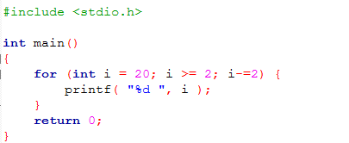

SU FACULTY of ENGINEERING
Computer Programming 143 lectures | 31 July 2026
for REPETITION STATEMENT EXAMPLES
SAMPLE CODE
OUTPUT
Chapter 4 pg. 47

Slide 19
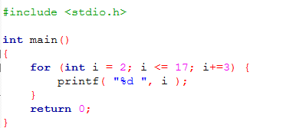

SU FACULTY of ENGINEERING
Computer Programming 143 lectures | 31 July 2026
for REPETITION STATEMENT EXAMPLES
SAMPLE CODE
OUTPUT
Chapter 4 pg. 48

Slide 20
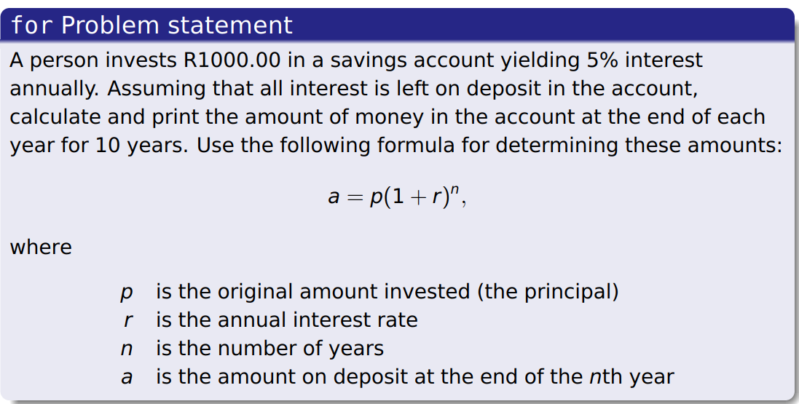
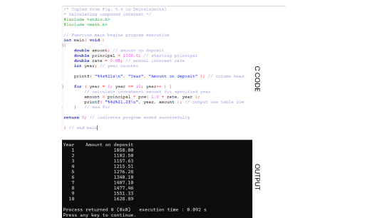
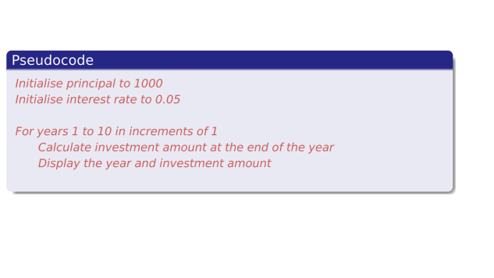
SU FACULTY of ENGINEERING
Computer Programming 143 lectures | 31 July 2026
for REPETITION STATEMENT EXAMPLES
EXAMPLE FROM TEXTBOOK
Chapter 4 pg. 49

Slide 21
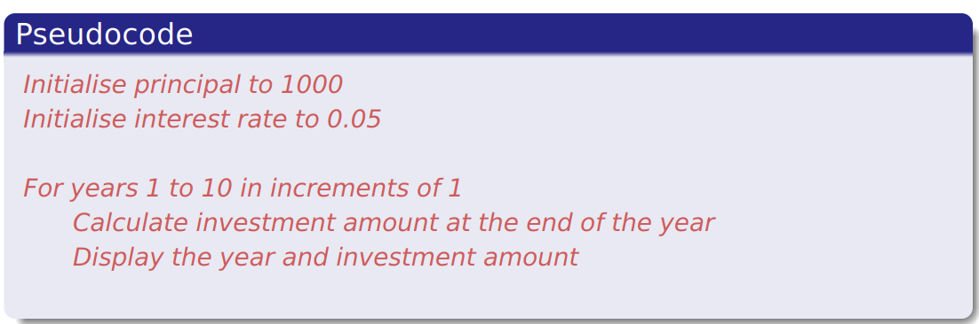

Slide 22
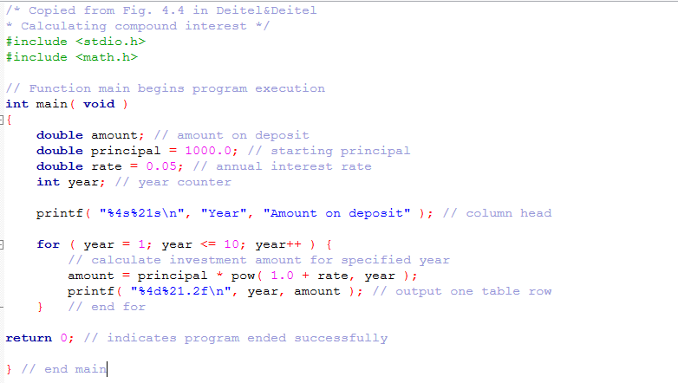
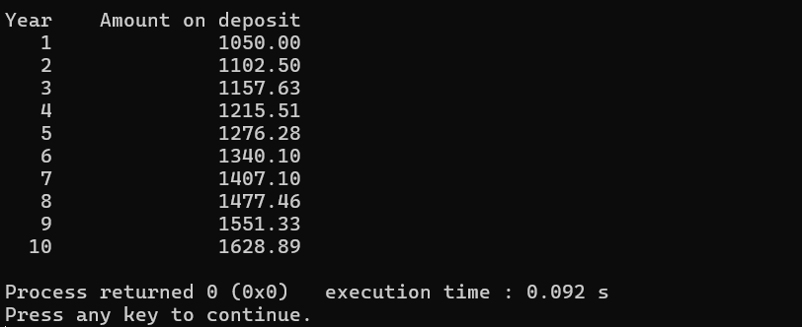
C CODE
OUTPUT

