Slide 1

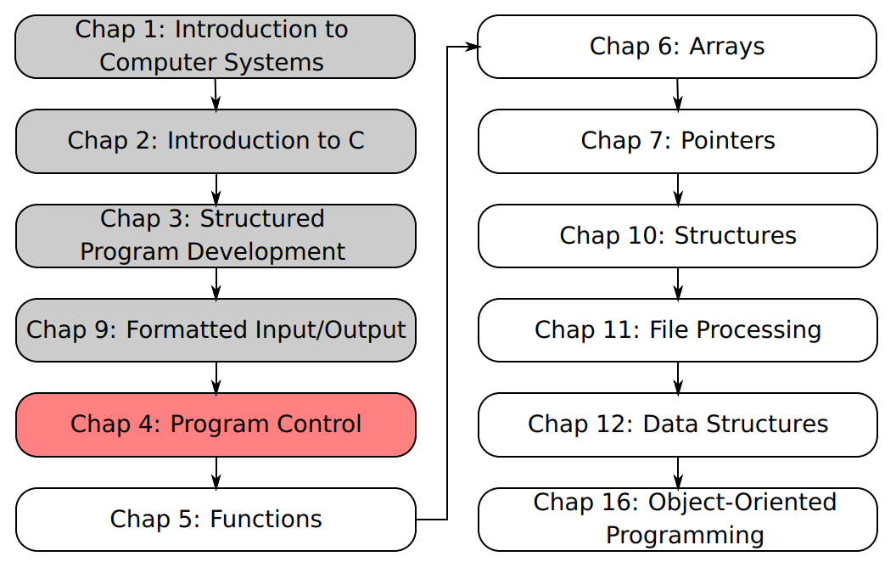
SU FACULTY of ENGINEERING
Computer Programming 143 lectures | 03 August 2026
A. WELCOME TO CP143
PROGRAMMING IN C
4. Program
Control I
Lecture 7| The do…while repetition statement
Logical operators
Confusing equality and assignment operators
Isaac Khobo, PhD (ilkhobo@sun.ac.za)
Chapters 4 Program control

Slide 2
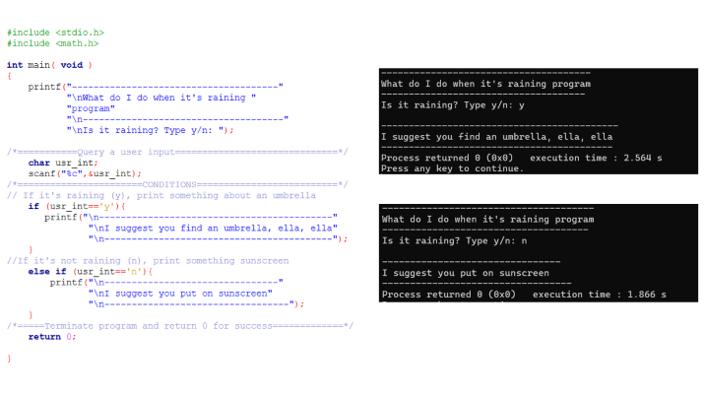
SU FACULTY of ENGINEERING
Computer Programming 143 lectures | 03 August 2026
RECAP: if, if else CONTROL STRUCTURES & while, for REPETITION STATEMENTS
start
start
C
Do this
C
Do that
Do this
end
end
if
if else
Chapter 4 pg. 50

Slide 3
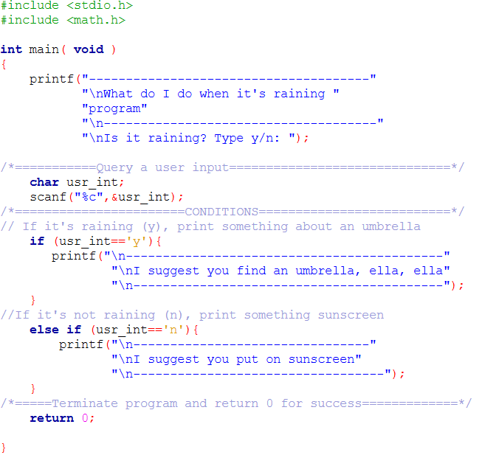
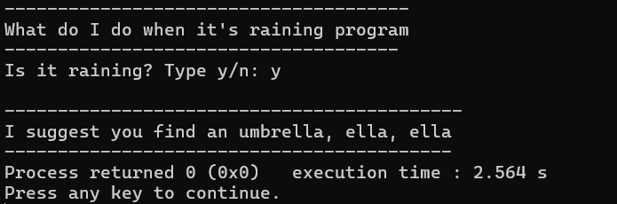
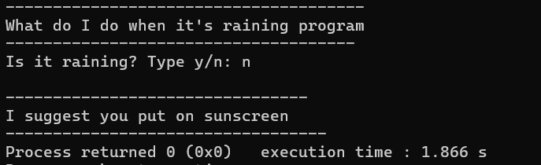

Slide 4
SU FACULTY of ENGINEERING
Computer Programming 143 lectures | 03 August 2026
RECAP: if, if else CONTROL STRUCTURES & while, for REPETITION STATEMENTS
start
start
C
Do this
C
Do that
Do this
end
end
if
if else
Chapter 4 pg. 50

Slide 5
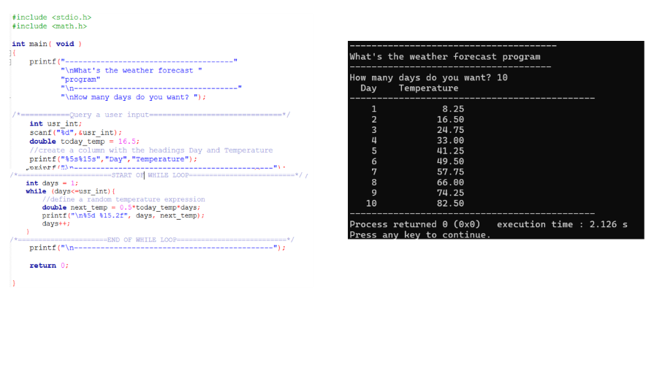
SU FACULTY of ENGINEERING
Computer Programming 143 lectures | 03 August 2026
RECAP: if, if else CONTROL STRUCTURES & while, for REPETITION STATEMENTS
start
start
start
C
Do this
C
Do that
C
Do this
Do this
end
end
end
if
if else
for/while
Chapter 4 pg. 50

Slide 6
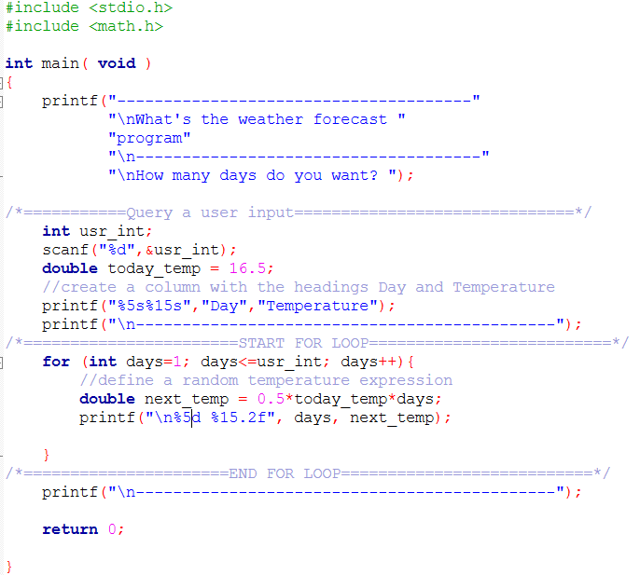
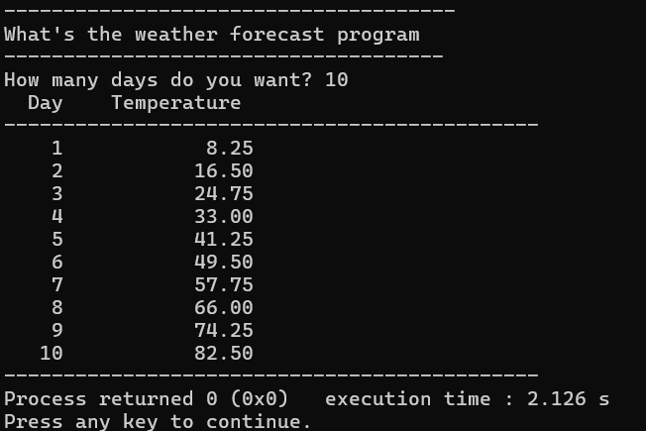
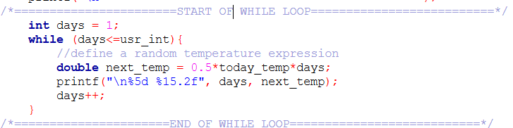

Slide 7
SU FACULTY of ENGINEERING
Computer Programming 143 lectures | 03 August 2026
RECAP: if, if else CONTROL STRUCTURES & while, for REPETITION STATEMENTS
start
start
start
C
Do this
C
Do that
C
Do this
Do this
end
end
end
if
if else
for/while
Chapter 4 pg. 50

Slide 8
SU FACULTY of ENGINEERING
Computer Programming 143 lectures | 03 August 2026
RECAP: if, if else CONTROL STRUCTURES & while, for REPETITION STATEMENTS
start
start
start
start
Do this
C
C
C
Do that
Do this
Do this
Do this
C
end
end
end
end
if
if else
for/while
do while
Chapter 4 pg. 50

Slide 9
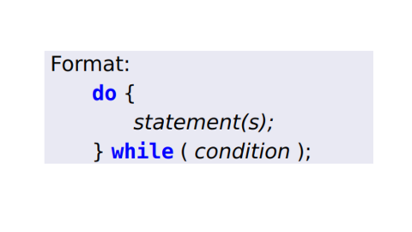
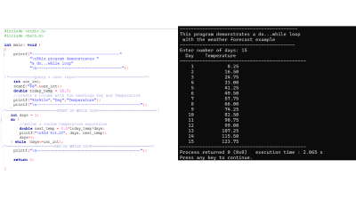
SU FACULTY of ENGINEERING
Computer Programming 143 lectures | 03 August 2026
do…while REPETITION STATEMENT
start
start
start
start
Similar to the while structure
Condition for repetition tested after the body of the loop is performed
All actions are performed at least once.
Do this
C
Do that
C
C
Do this
Do this
Do this
C
end
end
end
end
C Code
Example
if else
for/while
if
do while
Chapter 4 pg. 50

Slide 10
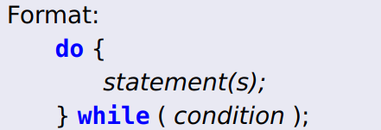

Slide 11
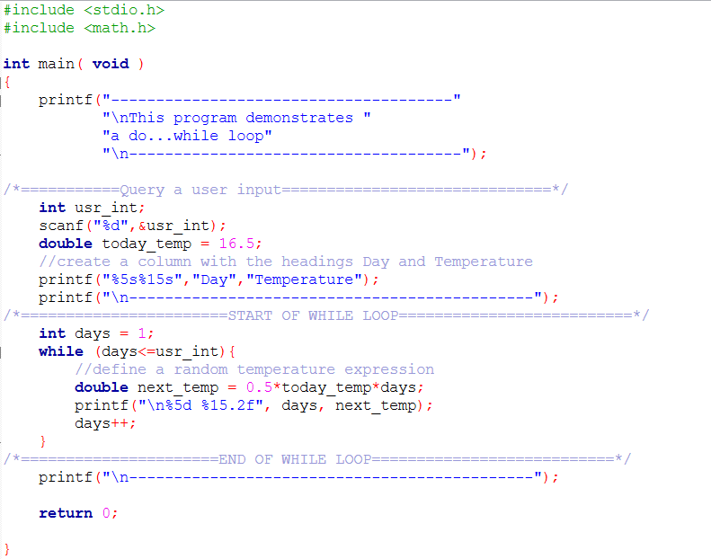
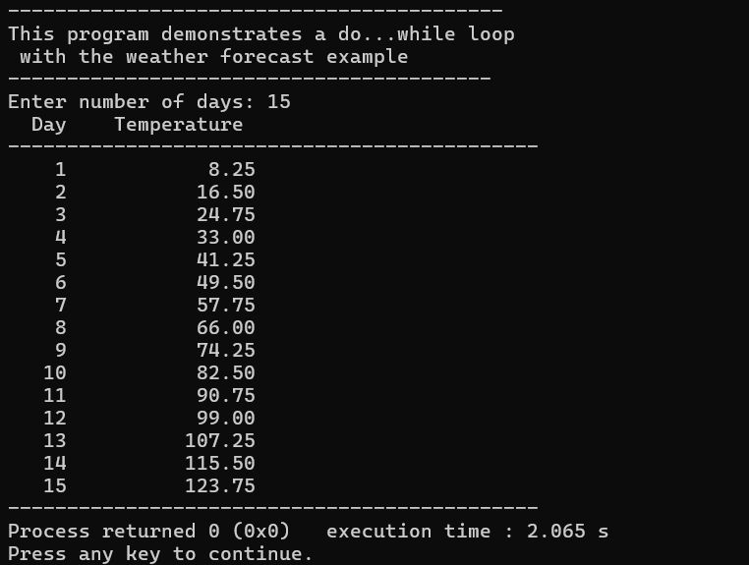
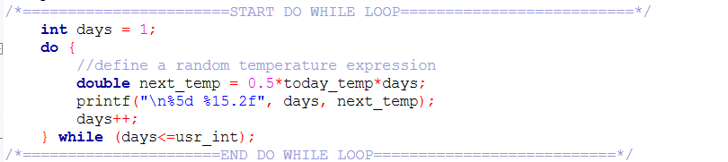

Slide 12
SU FACULTY of ENGINEERING
Computer Programming 143 lectures | 03 August 2026
LOGICAL OPERATORS
Useful when you want to compare conditions multiple conditions themselves
Logical AND (&&)
Logical OR (||)
Logical NOT/negation (!)
Chapter 4 pg. 51

Slide 13
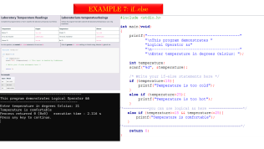
SU FACULTY of ENGINEERING
Computer Programming 143 lectures | 03 August 2026
LOGICAL OPERATORS
Useful when you want to compare conditions multiple conditions themselves
Returns true if both conditions are true
Logical AND (&&)
Logical OR (||)
Logical NOT/negation (!)
Chapter 4 pg. 51

Slide 14
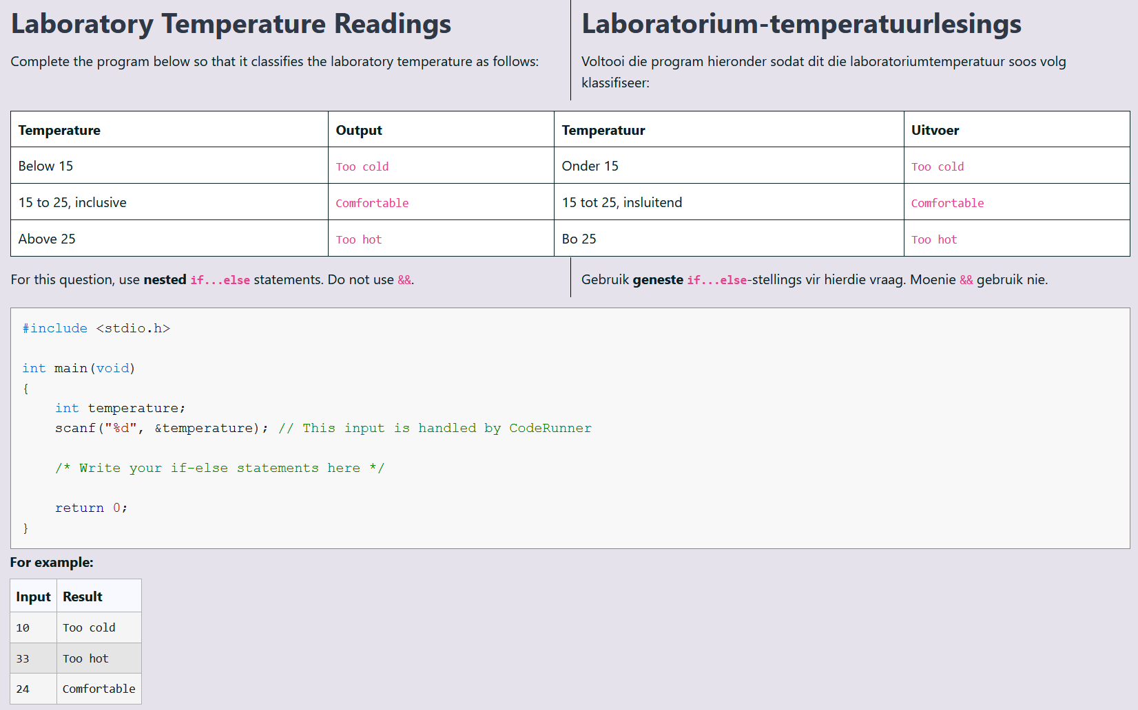
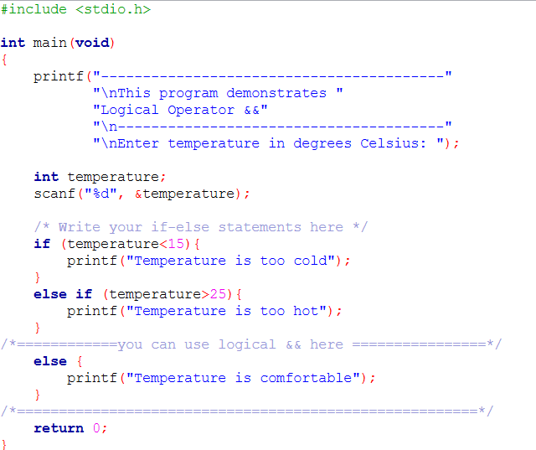
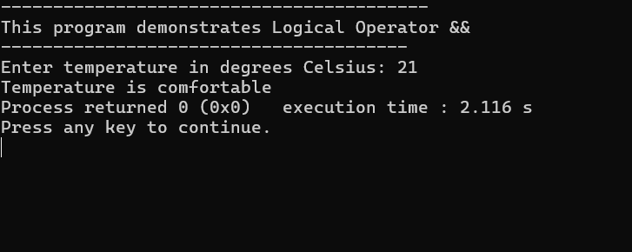
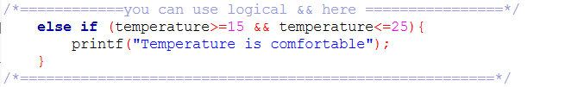
EXAMPLE 7: if..else

Slide 15
SU FACULTY of ENGINEERING
Computer Programming 143 lectures | 03 August 2026
LOGICAL OPERATORS
Useful when you want to compare conditions multiple conditions themselves
Returns true if both conditions are true
Logical AND (&&)
Logical OR (||)
Logical NOT/negation (!)
Chapter 4 pg. 51

Slide 16
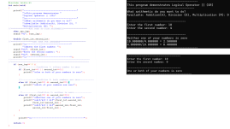
SU FACULTY of ENGINEERING
Computer Programming 143 lectures | 03 August 2026
LOGICAL OPERATORS
Useful when you want to compare conditions multiple conditions themselves
Returns true if both conditions are true
Returns true if either of its conditions are true
Logical AND (&&)
Logical OR (||)
Logical NOT/negation (!)
Chapter 4 pg. 51

Slide 17
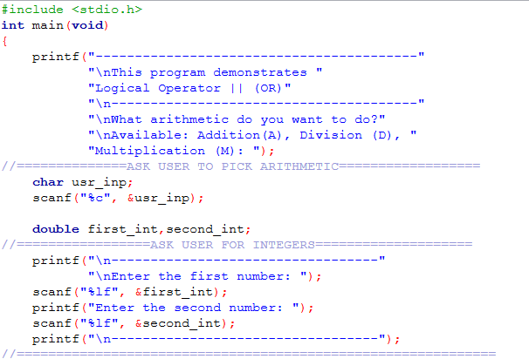
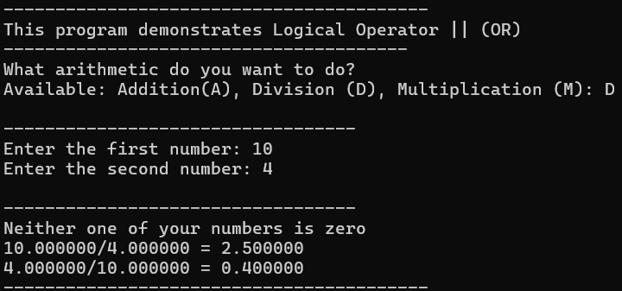
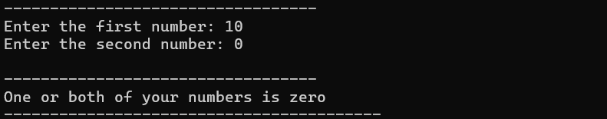
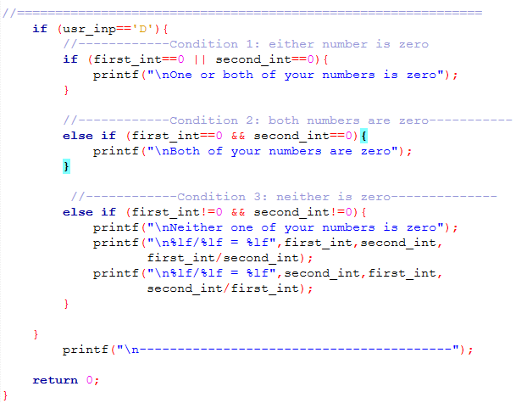

Slide 18
SU FACULTY of ENGINEERING
Computer Programming 143 lectures | 03 August 2026
LOGICAL OPERATORS
Useful when you want to compare conditions multiple conditions themselves
Returns true if both conditions are true
Returns true if either of its conditions are true
Logical AND (&&)
Logical OR (||)
Logical NOT/negation (!)
Chapter 4 pg. 51

Slide 19
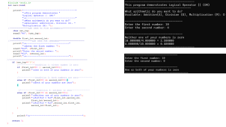
SU FACULTY of ENGINEERING
Computer Programming 143 lectures | 03 August 2026
LOGICAL OPERATORS
Useful when you want to compare conditions multiple conditions themselves
Returns true if both conditions are true
Returns true if either of its conditions are true
Reverses the truth/falsity of its condition (it takes one operand)
Logical AND (&&)
Logical OR (||)
Logical NOT/negation (!)
Chapter 4 pg. 51

Slide 21
SU FACULTY of ENGINEERING
Computer Programming 143 lectures | 03 August 2026
LOGICAL OPERATORS
Useful when you want to compare conditions multiple conditions themselves
Returns true if both conditions are true
Returns true if either of its conditions are true
Reverses the truth/falsity of its condition (it takes one operand)
Logical AND (&&)
Logical OR (||)
Logical NOT/negation (!)
Chapter 4 pg. 51

Slide 22
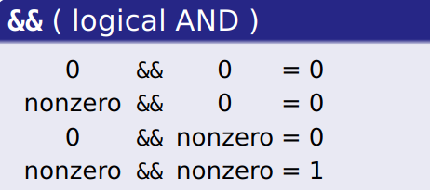
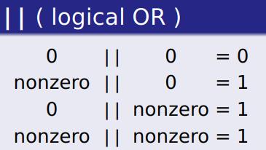
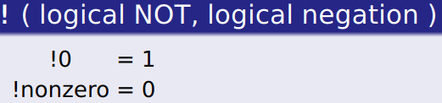
SU FACULTY of ENGINEERING
Computer Programming 143 lectures | 03 August 2026
LOGICAL OPERATORS
Useful when you want to compare conditions multiple conditions themselves
Returns true if both conditions are true
Returns true if either of its conditions are true
Reverses the truth/falsity of its condition (it takes one operand)
Logical AND (&&)
Logical OR (||)
Logical NOT/negation (!)
Chapter 4 pg. 51

Slide 23
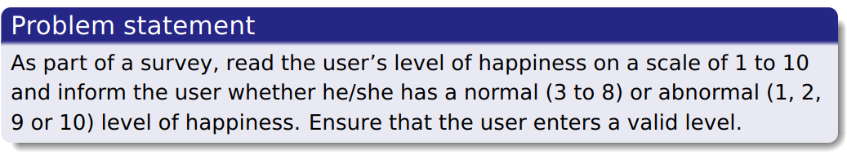
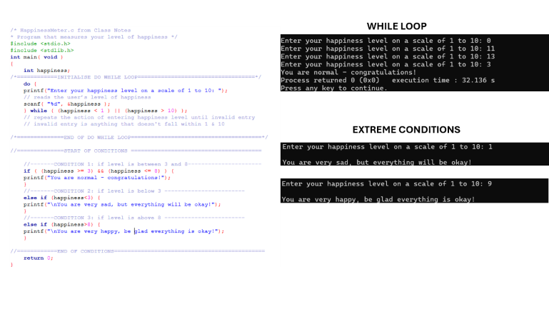
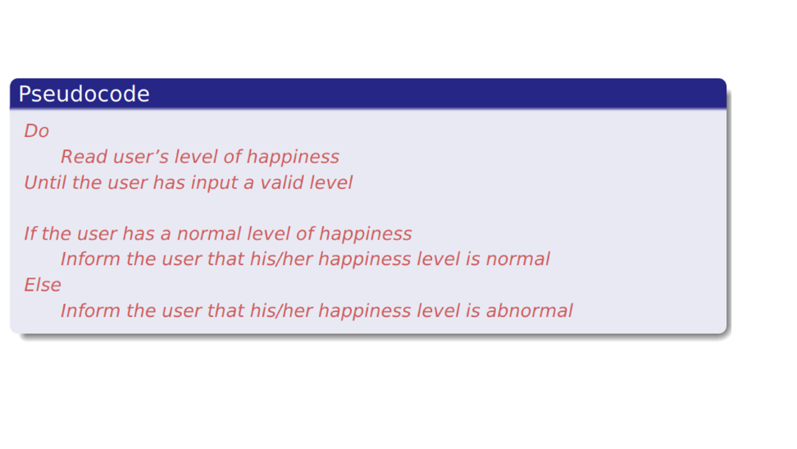
SU FACULTY of ENGINEERING
Computer Programming 143 lectures | 03 August 2026
EXAMPLE: do while & LOGICAL OPERATORS
EXAMPLE FROM NOTES
Chapter 4 pg. 51

Slide 24
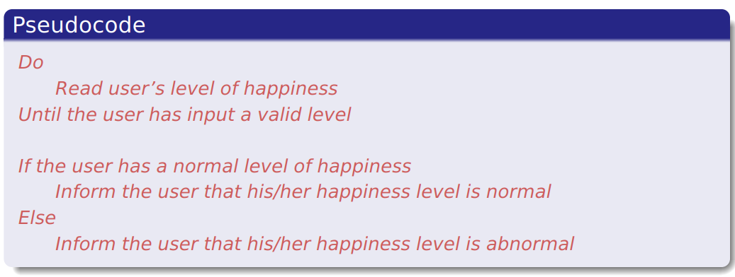

Slide 25
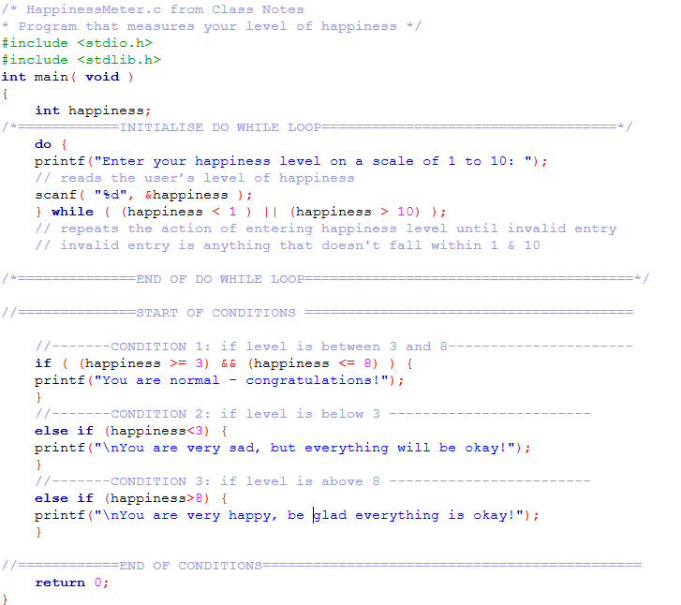
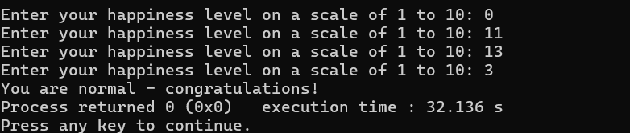
WHILE LOOP
EXTREME CONDITIONS

Slide 26
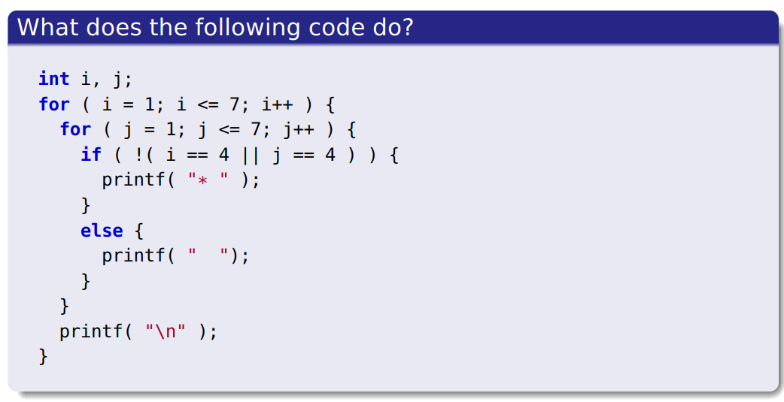
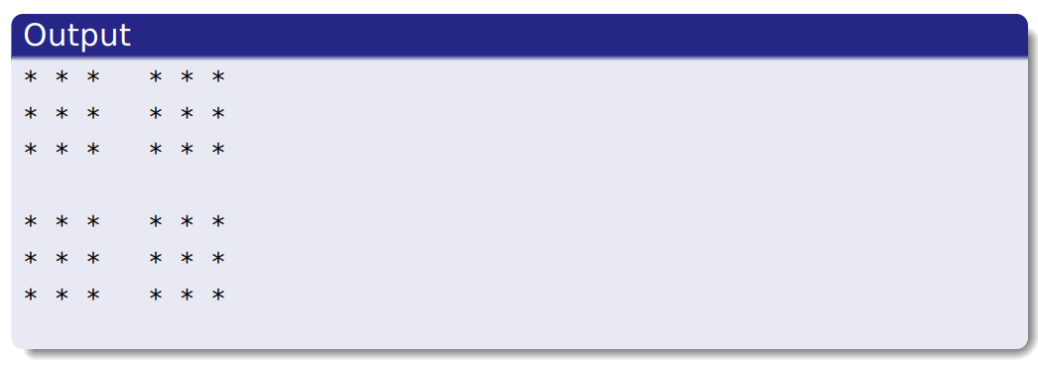
SU FACULTY of ENGINEERING
Computer Programming 143 lectures | 03 August 2026
MORE EXAMPLES: NESTED LOOPS & LOGICAL OPERATORS
Chapter 4 pg. 52

Slide 27
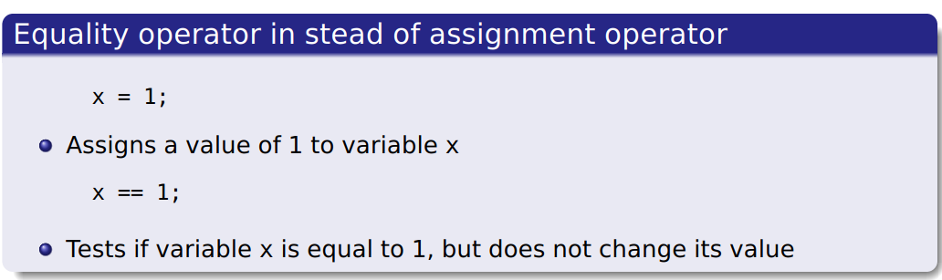
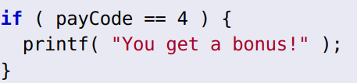
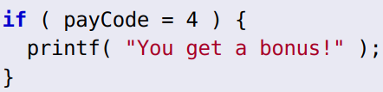
SU FACULTY of ENGINEERING
Computer Programming 143 lectures | 03 August 2026
CONFUSING EQUALITY & ASSIGNMENT OPERATORS I
Stores 4 in variable payCode and displays “You get a bonus!”
Displays “You get a bonus!” if variable payCodehas value 4
ASSIGNMENT
EQUALITY
Chapter 4 pg. 52

