Slide 1

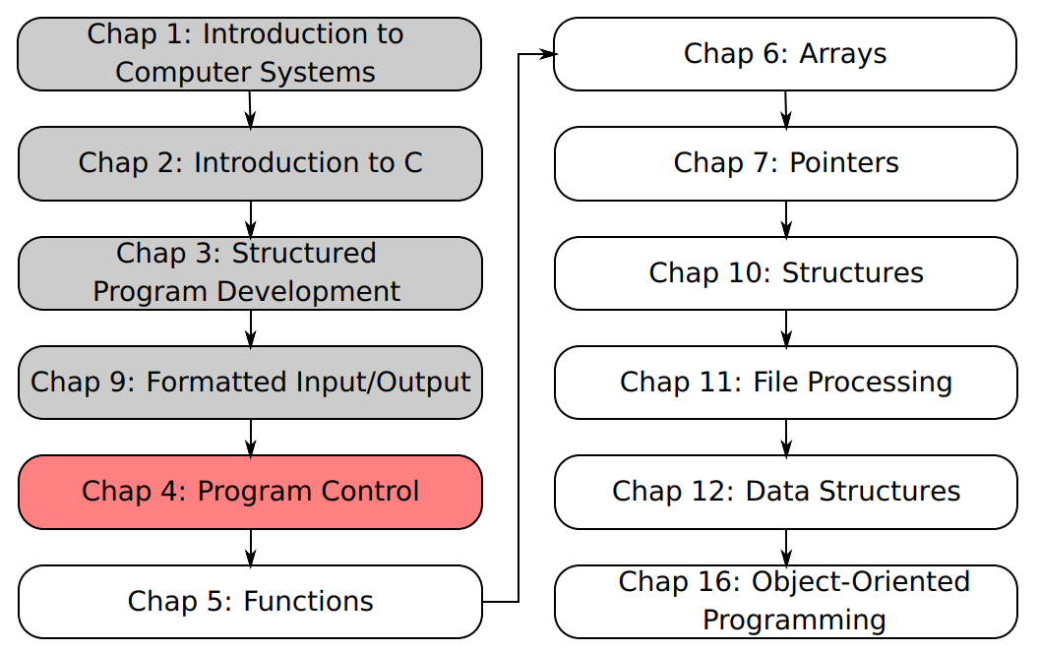
SU FACULTY of ENGINEERING
Computer Programming 143 lectures | 05 August 2026
A. WELCOME TO CP143
PROGRAMMING IN C
4. Program
Control III
Lecture 8| The switch multiple-selection statement
The break statement
Summary of structured programming
Isaac Khobo, PhD (ilkhobo@sun.ac.za)
Chapters 4 Program control

Slide 2
SU FACULTY of ENGINEERING
Computer Programming 143 lectures | 05 August 2026
switch multiple-selection statement I
start
when this case is true…do this action
Case A
Do this action
Break
TRUE
FALSE
Case B
Do that action
Break
Case C
Do that action
Break
Otherwise do this default action
default
default action
Break
end
Chapter 4 pg. 52

Slide 3
SU FACULTY of ENGINEERING
Computer Programming 143 lectures | 05 August 2026
switch multiple-selection statement I
start
when this case is true…do this action
Case A
Do this action
Break
Case B
Do that action
Break
Case C
Do that action
Break
Otherwise do this default action
default
default action
Break
end
Chapter 4 pg. 52

Slide 4
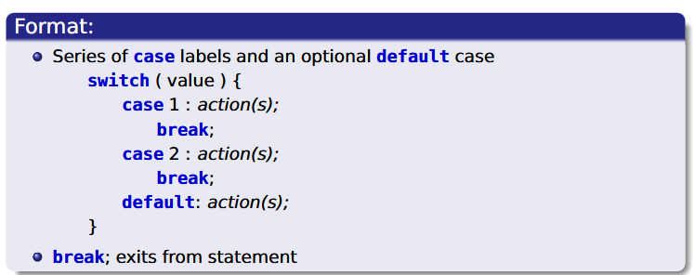
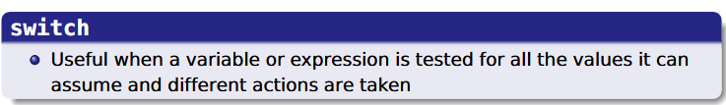
SU FACULTY of ENGINEERING
Computer Programming 143 lectures | 05 August 2026
switch multiple-selection statement I
start
when this case is true…do this action
Case A
Do this action
Break
Case B
Do that action
Break
Case C
Do that action
Break
Otherwise do this default action
default
default action
Break
end
Chapter 4 pg. 53

Slide 5
SU FACULTY of ENGINEERING
Computer Programming 143 lectures | 05 August 2026
Comparing switch & if else selection statements
start
start
if this condition is true…do this action
when this case is true…do this action
if
Do this action
Case A
Do this action
Break
Do that action
Case B
Do that action
Break
else if
Do that action
Case C
Do that action
Break
else if
else revert to this condition
Otherwise do this default action
default action
default
default action
Break
else
if else
switch
end
end
Chapter 4 pg. 54

Slide 6
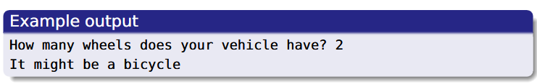
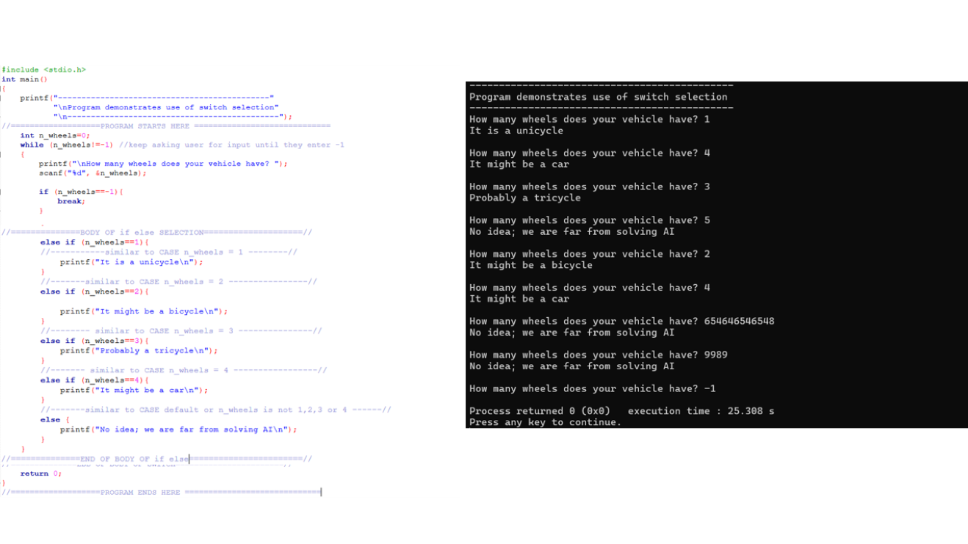
SU FACULTY of ENGINEERING
Computer Programming 143 lectures | 05 August 2026
Simple switch Example
EXAMPLE from notes (pg. 8&9):
Use the switch selection statement to match the cases for number of wheels and the type of vehicle.
Cases: 1=unicycle, 2=bicycle, 3=tricycle, 4=car
Chapter 4 pg. 55

Slide 7
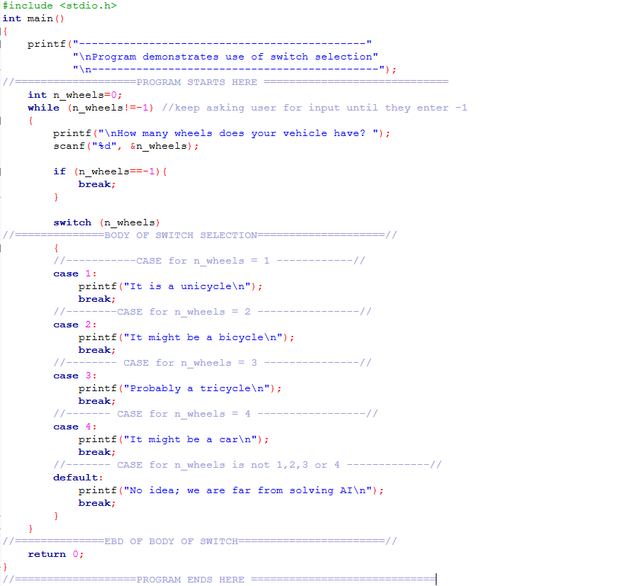
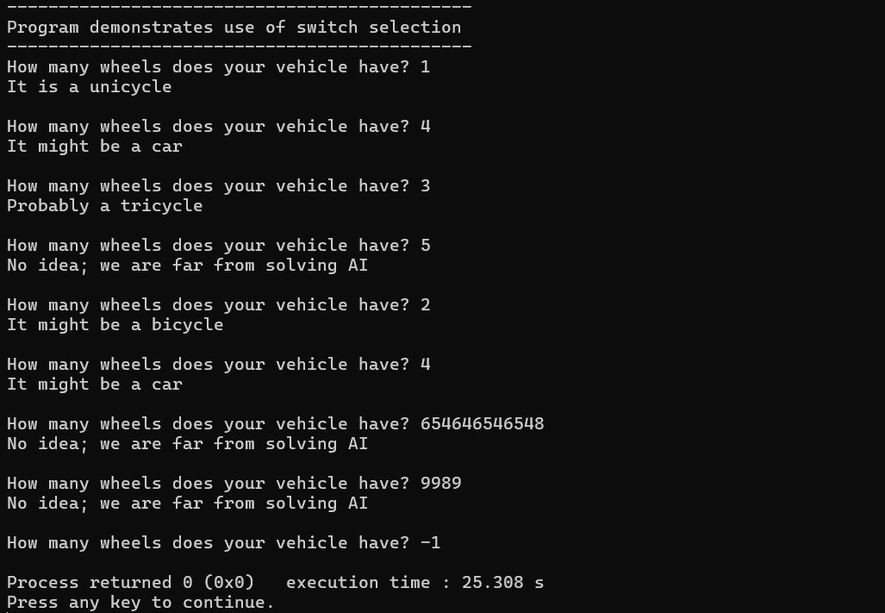
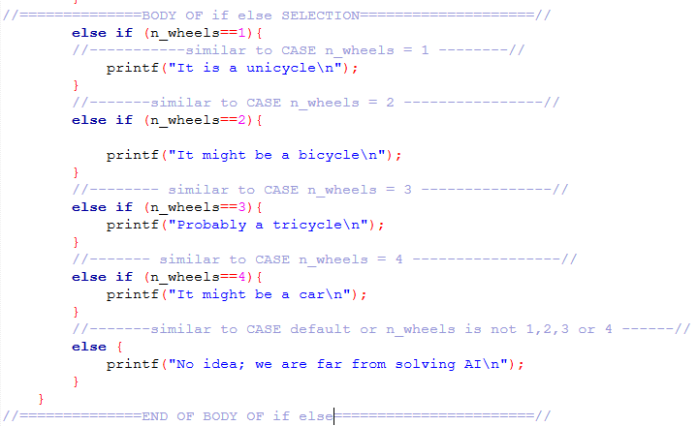

Slide 8
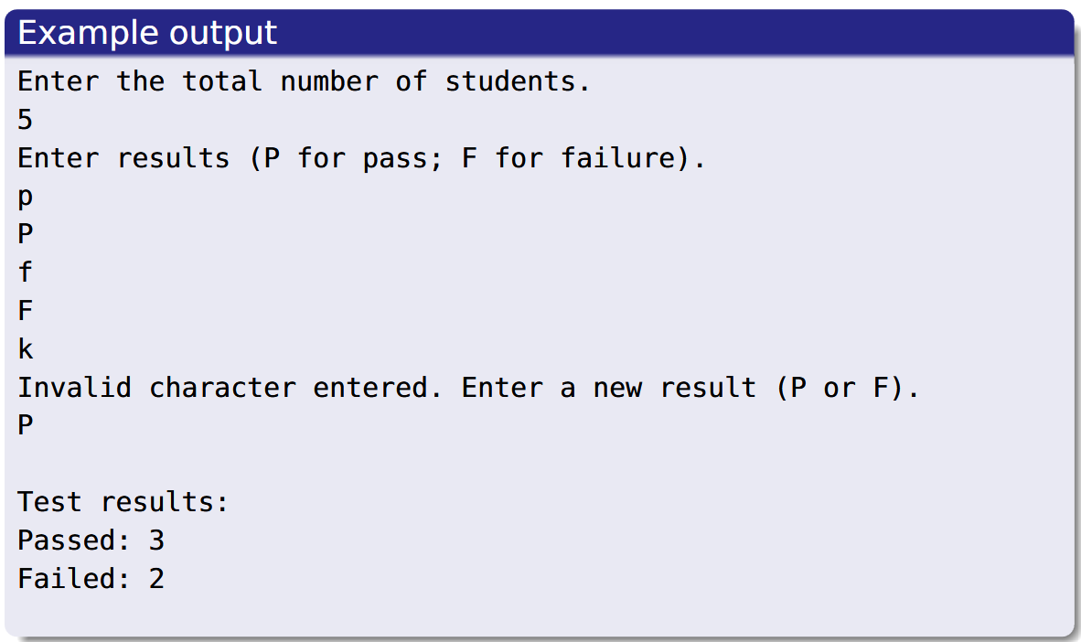
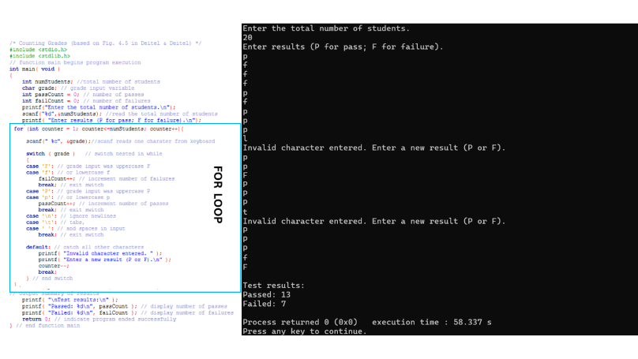

SU FACULTY of ENGINEERING
Computer Programming 143 lectures | 05 August 2026
Bigger switch Example
EXAMPLE from notes (pg. 10):
Calculate how many students have passed or failed (using switch statements).
User enters either P or F (not case sensitive, can be lowercase). Output displays total passes and failures.
Chapter 4 pg. 55

Slide 9
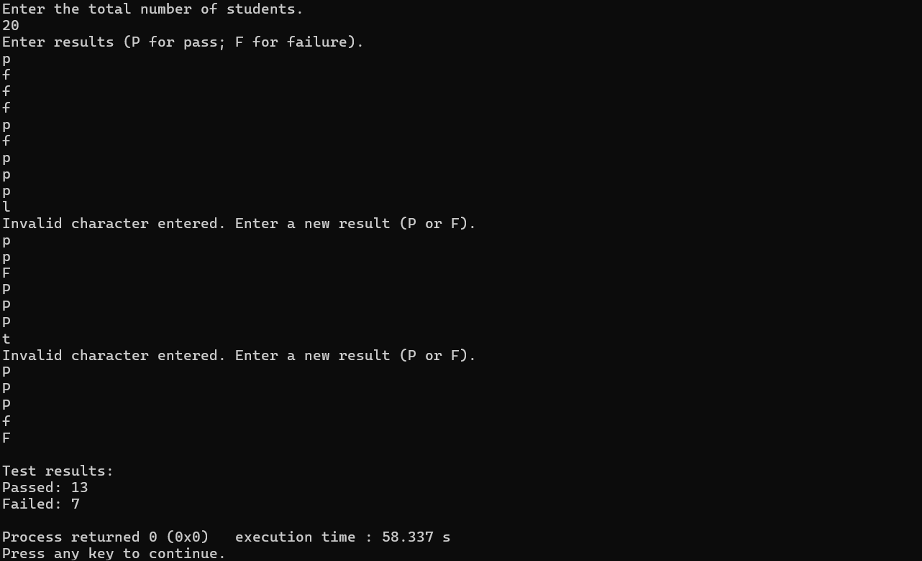
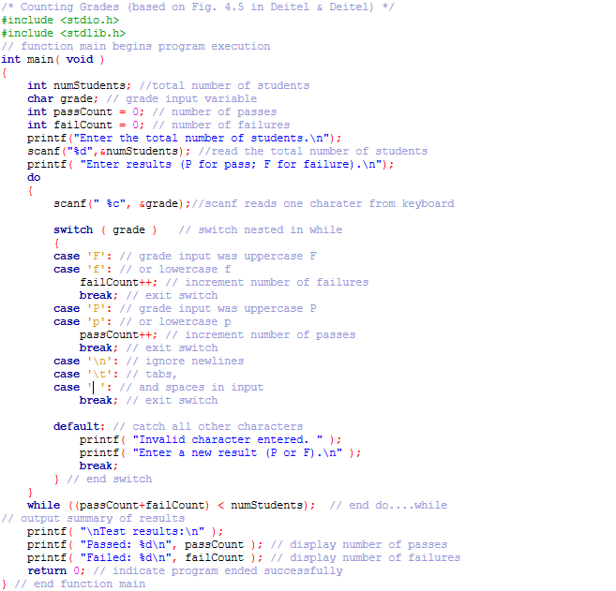
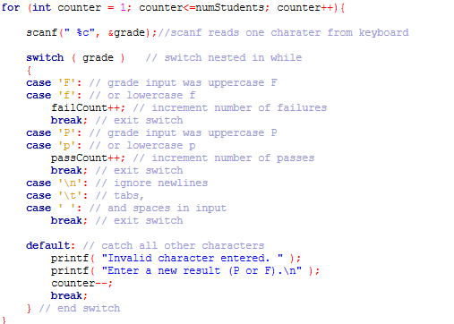
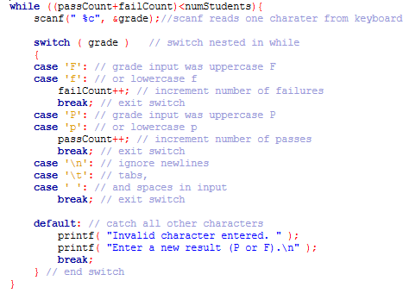
DO WHILE LOOP
FOR LOOP
WHILE LOOP

Slide 10
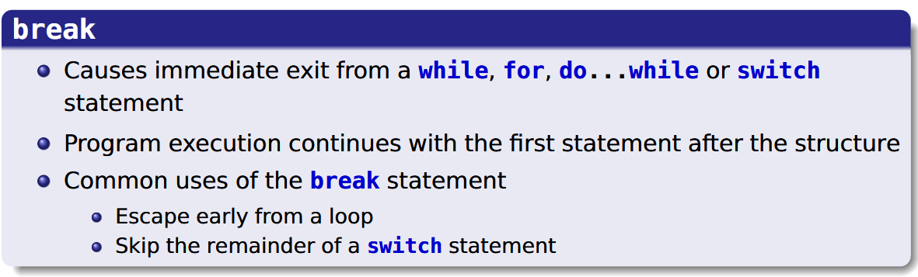
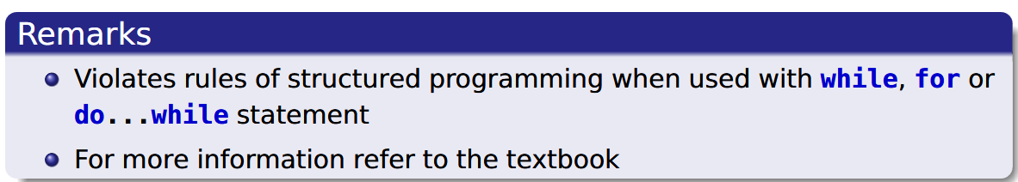
SU FACULTY of ENGINEERING
Computer Programming 143 lectures | 05 August 2026
break Statement
start
when this case is true…do this action
Do this action
break statements
Case A
Break
Case B
Do that action
Break
Case C
Do that action
Break
Otherwise do this default action
default
default action
Break
switch
end
Chapter 4 pg. 55

Slide 11
SU FACULTY of ENGINEERING
Computer Programming 143 lectures | 05 August 2026
Structured programming SUMMARY: sequence, selection
start
when this case is true…do this action
start
start
Case A
Do this action
Break
C
Do this
C
Do that
Case B
Do that action
Break
Do this
Case C
Do that action
Break
end
end
Otherwise do this default action
default
default action
Break
if
if else
switch
end
Chapter 4 pg. 55

Slide 12
SU FACULTY of ENGINEERING
Computer Programming 143 lectures | 05 August 2026
Structured programming SUMMARY: sequence, selection
start
when this case is true…do this action
start
start
Case A
Do this action
Break
C
Do this
C
Do that
Case B
Do that action
Break
Do this
Case C
Do that action
Break
end
end
Otherwise do this default action
default
default action
Break
if
if else
switch
end
Chapter 4 pg. 55

Slide 13
SU FACULTY of ENGINEERING
Computer Programming 143 lectures | 05 August 2026
Structured programming SUMMARY: sequence, selection
start
when this case is true…do this action
start
start
start
start
Case A
Do this action
Break
C
Do this
C
Do this
C
Do that
Case B
Do that action
Break
Do this
C
Do this
Case C
Do that action
Break
end
end
end
end
Otherwise do this default action
default
default action
Break
for/while
do while
if
if else
switch
end
Chapter 4 pg. 55

Slide 14
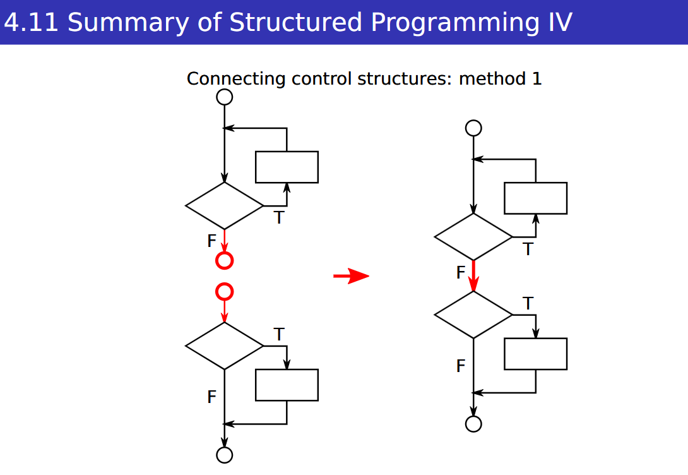
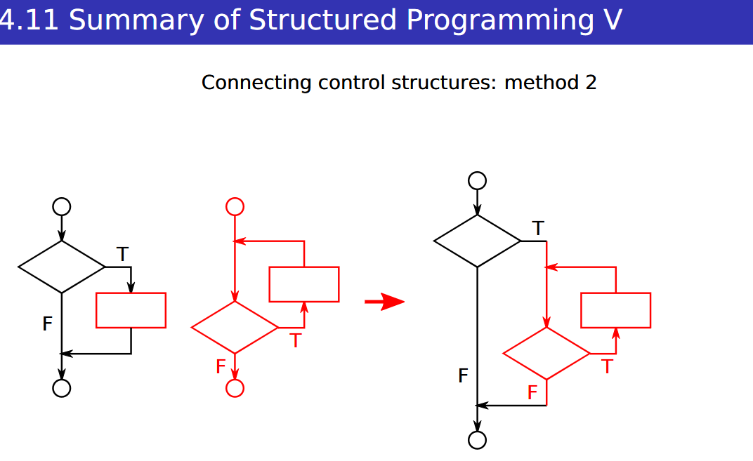
SU FACULTY of ENGINEERING
Computer Programming 143 lectures | 05 August 2026
start
when this case is true…do this action
start
start
Case A
Do this action
Break
C
Do this
C
Do that
Case B
Do that action
Break
Do this
Case C
Do that action
Break
end
end
Otherwise do this default action
default
default action
Break
if
if else
switch
end
Chapter 4 pg. 55

