Slide 1

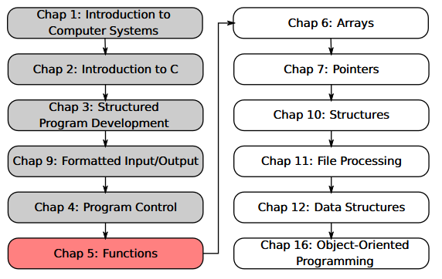
SU FACULTY of ENGINEERING
Computer Programming 143 lectures | 07 August 2026
PROGRAMMING IN C
5. Functions I
Lecture 9| Intro to functions
Benefits of functions
Function definitions
Math library functions
Function prototypes
Isaac Khobo, PhD (ilkhobo@sun.ac.za)
Chapters 5 Functions

Slide 2
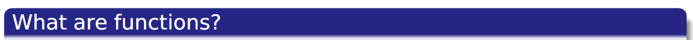

SU FACULTY of ENGINEERING
Computer Programming 143 lectures | 07 August 2026
Functions I

Slide 3
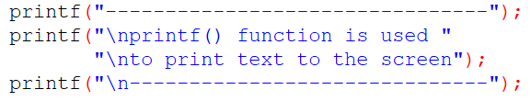

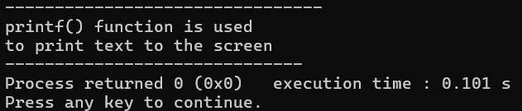
SU FACULTY of ENGINEERING
Computer Programming 143 lectures | 07 August 2026
Functions: standard I/O library
stdio.h printf()
Print text on the screen

Slide 4
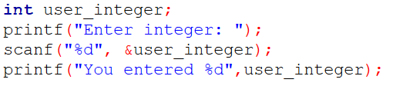

SU FACULTY of ENGINEERING
Computer Programming 143 lectures | 07 August 2026
Functions: standard I/O library
stdio.h scanf()
Read input from user

Slide 5
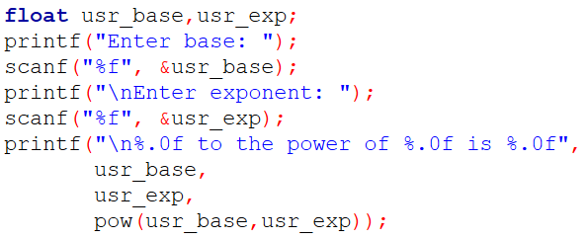

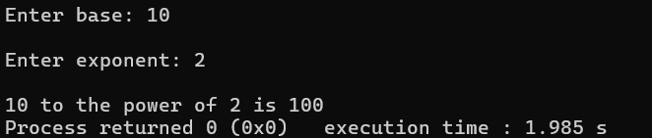
SU FACULTY of ENGINEERING
Computer Programming 143 lectures | 07 August 2026
Functions: math library
math.h pow()
Calculate one number raised to the power of a second number

Slide 6
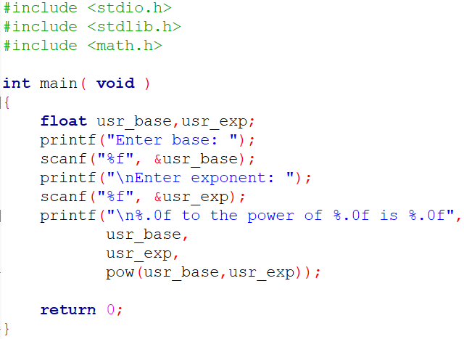
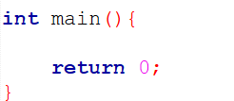
SU FACULTY of ENGINEERING
Computer Programming 143 lectures | 07 August 2026
Functions: main function
int main (){}
Main function in C programs

Slide 7
SU FACULTY of ENGINEERING
Computer Programming 143 lectures | 07 August 2026
Functions
ENCODED

Slide 8

SU FACULTY of ENGINEERING
Computer Programming 143 lectures | 07 August 2026
Functions
DECODED

Slide 9
SU FACULTY of ENGINEERING
Computer Programming 143 lectures | 07 August 2026
Functions
DECODED
functionName (argument1 , argument2 , … ) ;
FORMAT

Slide 10
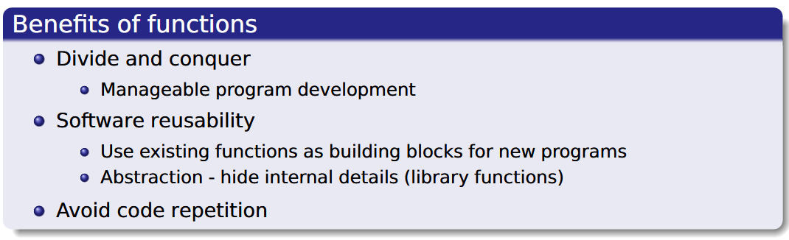
SU FACULTY of ENGINEERING
Computer Programming 143 lectures | 07 August 2026
Functions
DECODED
functionName (argument1 , argument2 , … ) ;
FORMAT

Slide 11
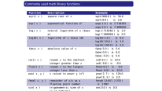
SU FACULTY of ENGINEERING
Computer Programming 143 lectures | 07 August 2026
Functions
stdio.h: printf(), scanf()
math.h: sqrt(), pow(), exp()
DECODED
C standard library functions
Calculateaverage(), temperaturereading(), calculategradepass()
User-defined functions
functionName (argument1 , argument2 , … ) ;
FORMAT

Slide 12
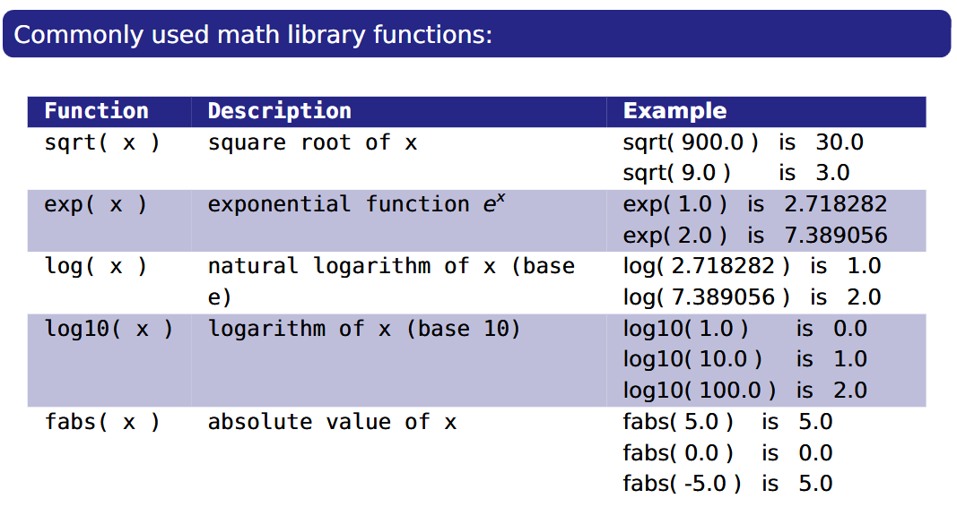
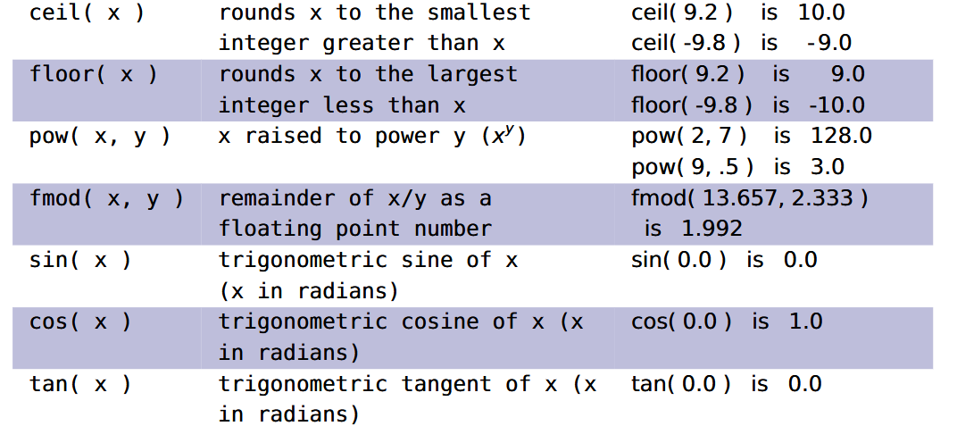

Slide 14
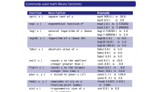
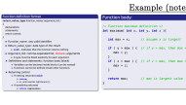
SU FACULTY of ENGINEERING
Computer Programming 143 lectures | 07 August 2026
Functions
stdio.h: printf(), scanf()
math.h: sqrt(), pow(), exp()
DECODED
C standard library functions
Calculateaverage(), temperaturereading(), calculategradepass()
User-defined functions
functionName (argument1 , argument2 , … ) ;
FORMAT

Slide 15
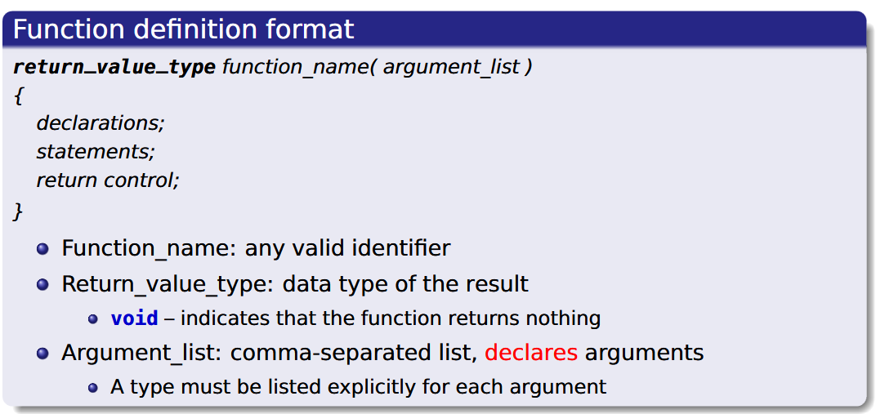
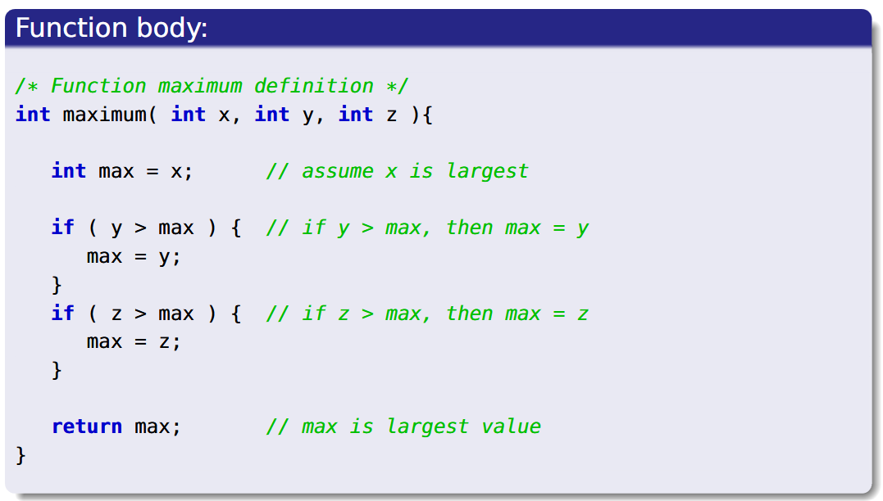
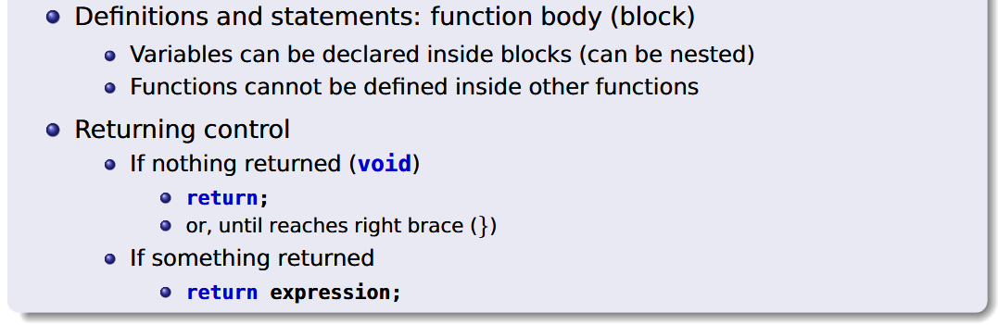
Example (notes pg. 14)

Slide 16
Example (notes pg. 14)

Slide 17
SU FACULTY of ENGINEERING
Computer Programming 143 lectures | 07 August 2026
Functions
stdio.h: printf(), scanf()
math.h: sqrt(), pow(), exp()
DECODED
C standard library functions
Calculateaverage(), temperaturereading(), calculategradepass()
User-defined functions
functionName (argument1 , argument2 , … ) ;
FORMAT

Slide 18
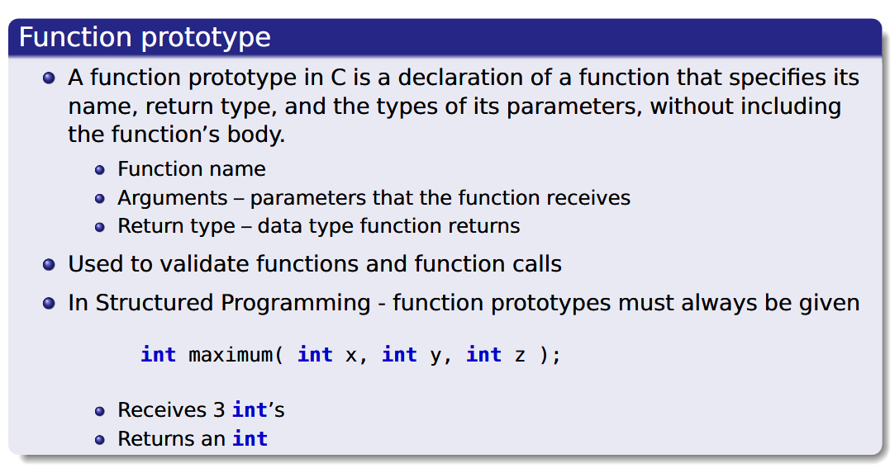
SU FACULTY of ENGINEERING
Computer Programming 143 lectures | 07 August 2026
Function prototype

Slide 19
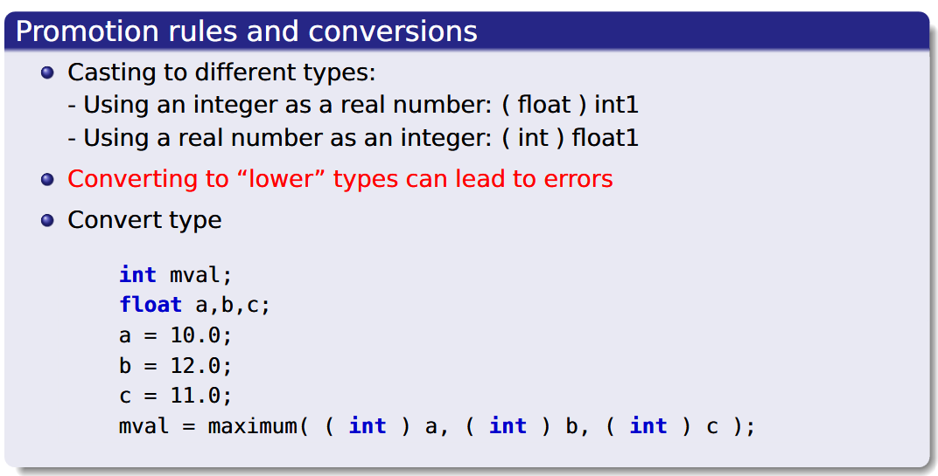
SU FACULTY of ENGINEERING
Computer Programming 143 lectures | 07 August 2026
Function prototype

Slide 20
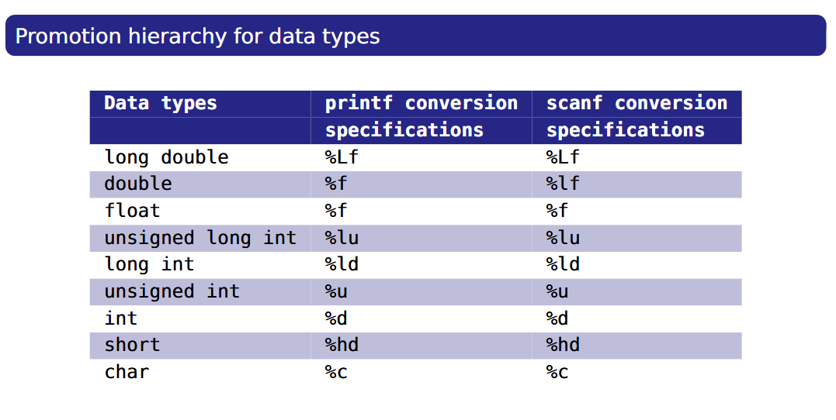
SU FACULTY of ENGINEERING
Computer Programming 143 lectures | 07 August 2026
Function prototype

