Slide 1

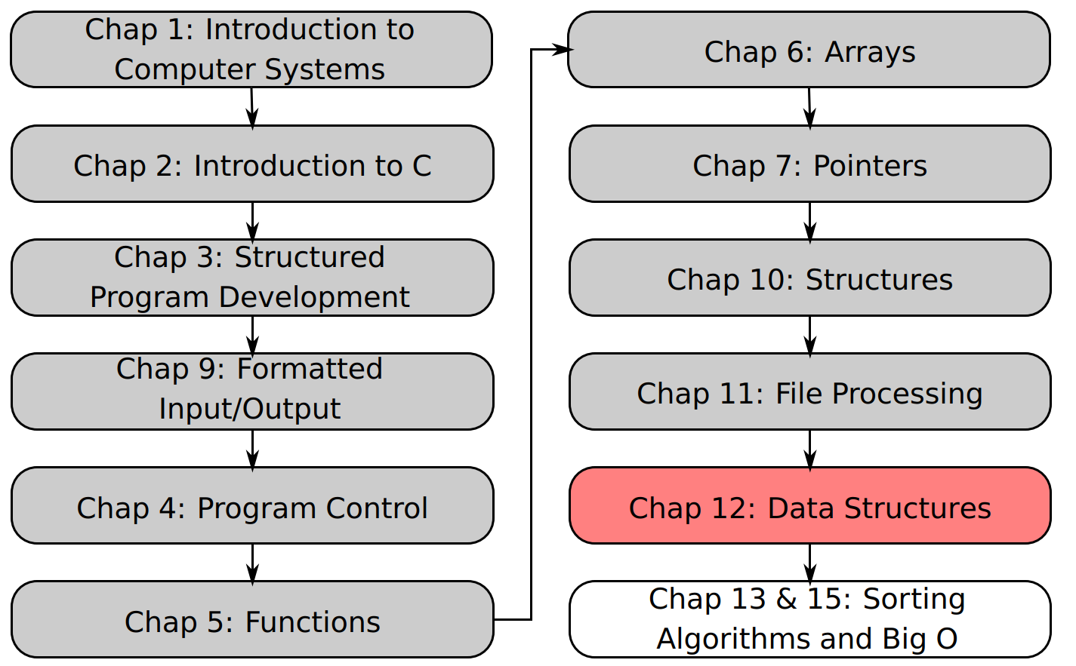
SU FACULTY of ENGINEERING
Computer Programming 143 lectures | 12 October 2026
Lecture Overview
12. Dynamic Data Structures III
Lecture 29| Trees
Isaac Khobo, PhD (ilkhobo@sun.ac.za)
Chapters 12: Data structures
Notes:
Thanks for attending Lecture 29. We are concluding our chapter on Dynamic Data Structure. I am going to give a overview of the chapter again.

Slide 2
SU FACULTY of ENGINEERING
Computer Programming 143 lectures | 14 October 2026
Chapter 12: Data structures
Data structures
Linear
Non-linear
static
dynamic
array
Linked list
Stack
Queue
Tree
Graph
Notes:
A data structure is a method of organizing and storing data so it can be accessed and modified efficiently.
Linear – data is organized in a sequence (one after another)
Non-linear data structure – the elements are not arranged sequentially
Static – static memory (fixed size)
Dynamic – dynamic memory allocation (size can change at run time)

Slide 3
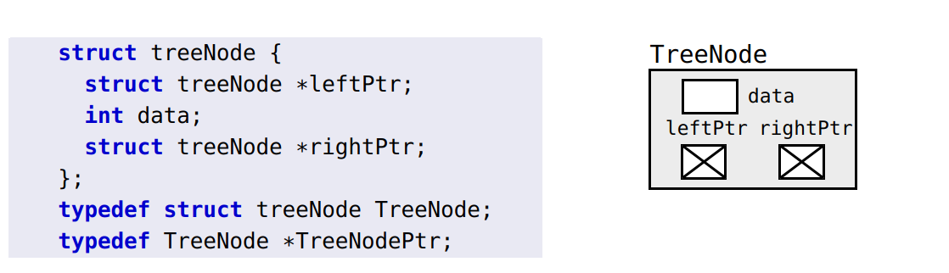
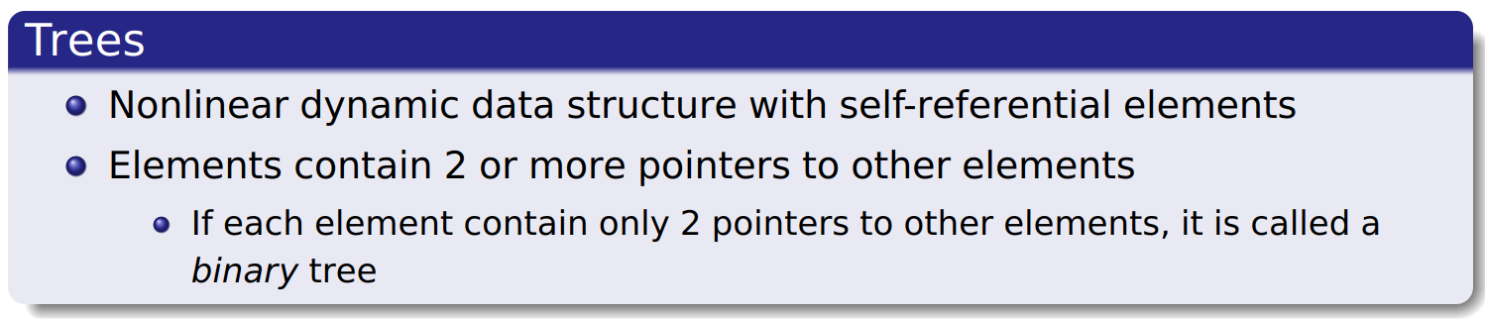
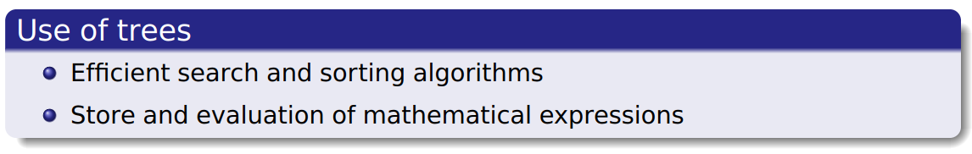
Eng Students
CP143
Applied Maths
Electro-techniques
Jane
John
Mary
May
Beau

Slide 4
Eng Students
CP143
Applied Maths
Electro-techniques
Jane
John
Mary
May
Beau

Slide 5
Eng Students
CP143
Applied Maths
Electro-techniques
Jane
John
Mary
May
Beau
Notes:
We are going to work with binary trees in the module. So the way you’d declare a self-referencing structures for a binary tree is with a left & right pointer

Slide 6
SU FACULTY of ENGINEERING
Computer Programming 143 lectures | 14 October 2026
Trees
B
.
.
A
D
.
C
Notes:
TERMINOLOGY

Slide 7
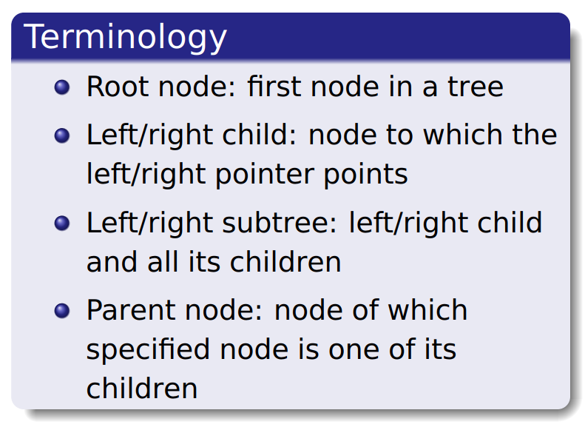
SU FACULTY of ENGINEERING
Computer Programming 143 lectures | 14 October 2026
Trees
B is the root node
B
.
.
A
D
.
C

Slide 8
SU FACULTY of ENGINEERING
Computer Programming 143 lectures | 14 October 2026
Trees
B
.
.
A (left) and D (right) child of B
A
D
.
C

Slide 9
SU FACULTY of ENGINEERING
Computer Programming 143 lectures | 14 October 2026
Trees
B
.
.
A
D
.
A constitutes left subtree
C

Slide 10
SU FACULTY of ENGINEERING
Computer Programming 143 lectures | 14 October 2026
Trees
B
.
.
A
D
.
D & C constitute right subtree
C

Slide 11
SU FACULTY of ENGINEERING
Computer Programming 143 lectures | 14 October 2026
Trees
B is parent of A & D
B
.
.
D is parent of C
A
D
.
C

Slide 12
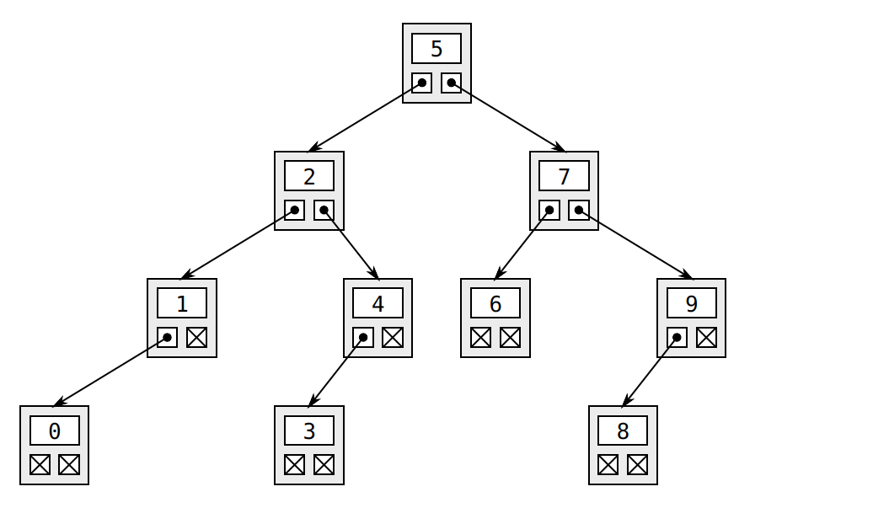
SU FACULTY of ENGINEERING
Computer Programming 143 lectures | 14 October 2026
Trees: sorted binary trees

Slide 13
SU FACULTY of ENGINEERING
Computer Programming 143 lectures | 14 October 2026
Trees: sorted binary trees
{0, 1, 2, 3, 4} left child < 5 (parent node)

Slide 14
SU FACULTY of ENGINEERING
Computer Programming 143 lectures | 14 October 2026
Trees: sorted binary trees
{6, 7, 8, 9} right child > 5 (parent node)

Slide 15
SU FACULTY of ENGINEERING
Computer Programming 143 lectures | 14 October 2026
Trees: sorted binary trees
{0, 1} left child < 2 (parent node)

Slide 16
SU FACULTY of ENGINEERING
Computer Programming 143 lectures | 14 October 2026
Trees: sorted binary trees
{3, 4} right child > 2 (parent node)

Slide 17
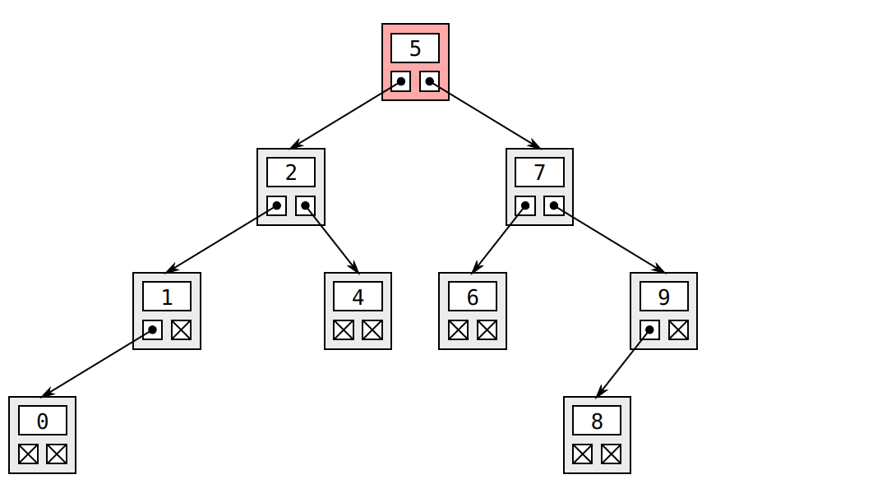
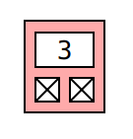
SU FACULTY of ENGINEERING
Computer Programming 143 lectures | 14 October 2026
Trees: Insertion in sorted binary trees

Slide 18
SU FACULTY of ENGINEERING
Computer Programming 143 lectures | 14 October 2026
Trees: Insertion in sorted binary trees
{2} < {5}, goes to the left subtree of parent node {5}

Slide 19
SU FACULTY of ENGINEERING
Computer Programming 143 lectures | 14 October 2026
Trees: Insertion in sorted binary trees
{2} is next node in the left subtree

Slide 20
SU FACULTY of ENGINEERING
Computer Programming 143 lectures | 14 October 2026
Trees: Insertion in sorted binary trees
{3} > {2} goes to right subtree of parent node {2}

Slide 21
SU FACULTY of ENGINEERING
Computer Programming 143 lectures | 14 October 2026
Trees: Insertion in sorted binary trees
{4} is the parent node

Slide 22
SU FACULTY of ENGINEERING
Computer Programming 143 lectures | 14 October 2026
Trees: Insertion in sorted binary trees
{3} < {4} so goes left of the parent node {4}

Slide 23
SU FACULTY of ENGINEERING
Computer Programming 143 lectures | 14 October 2026
Trees: Traversal of sorted binary trees
IN-ORDER
PRE-ORDER
POST-ORDER

Slide 24

SU FACULTY of ENGINEERING
Computer Programming 143 lectures | 14 October 2026
Trees: Traversal of sorted binary trees
IN-ORDER
1. Traverse the node’s left (L) subtree
2. Process the node value (N)
3. Traverse the node’s right subtree (R)
PRE-ORDER
POST-ORDER
L
N
R

Slide 25
D
.
.
B
F
.
.
.
.
A
C
E
G

Slide 26
D
.
.
B
F
.
.
.
.
A
C
E
G

Slide 27
D
.
.
B
F
.
.
.
.
A
C
E
G

Slide 28
D
.
.
B
F
.
.
.
.
A
C
E
G
A

Slide 29
D
.
.
B
F
.
.
.
.
A
C
E
G
A
B

Slide 30
D
.
.
B
F
.
.
.
.
A
C
E
G
A
B
C

Slide 31
D
.
.
B
F
.
.
.
.
A
C
E
G
A
B
C
D

Slide 32
D
.
.
B
F
.
.
.
.
A
C
E
G
A
B
C
D

Slide 33
D
.
.
B
F
.
.
.
.
A
C
E
G
A
B
C
D
E

Slide 34
D
.
.
B
F
.
.
.
.
A
C
E
G
A
B
C
D
E
F

Slide 35
L
N
R
D
.
.
B
F
.
.
.
.
A
C
E
G
A
B
C
D
E
F
G

Slide 36

SU FACULTY of ENGINEERING
Computer Programming 143 lectures | 14 October 2026
Trees: Traversal of sorted binary trees
IN-ORDER
PRE-ORDER
1. Traverse the node’s left (L) subtree
2. Process the node value (N)
3. Traverse the node’s right subtree (R)
1. Process the node value
2. Traverse the node’s left subtree
3. Traverse the node’s right subtree
POST-ORDER
L
N
R
N
R
L

Slide 37
N
L
R
A
.
.
B
E
.
.
.
.
C
D
F
G

Slide 38
N
L
R
A
.
.
B
E
.
.
.
.
C
D
F
G
A

Slide 39
N
L
R
A
.
.
B
E
.
.
.
.
C
D
F
G
A
B

Slide 40
N
L
R
A
.
.
B
E
.
.
.
.
C
D
F
G
A
B
C

Slide 41
N
L
R
A
.
.
B
E
.
.
.
.
C
D
F
G
A
B
C
D

Slide 42
N
L
R
A
.
.
B
E
.
.
.
.
C
D
F
G
A
B
C
D
E

Slide 43
N
L
R
A
.
.
B
E
.
.
.
.
C
D
F
G
A
B
C
D
E
F

Slide 44
N
L
R
A
.
.
B
E
.
.
.
.
C
D
F
G
A
B
C
D
E
F
G

Slide 45

SU FACULTY of ENGINEERING
Computer Programming 143 lectures | 14 October 2026
Trees: Traversal of sorted binary trees
IN-ORDER
PRE-ORDER
POST-ORDER
1. Traverse the node’s left (L) subtree
2. Process the node value (N)
3. Traverse the node’s right subtree (R)
1. Process the node value
2. Traverse the node’s left subtree
3. Traverse the node’s right subtree
1. Traverse the node’s left subtree
2. Traverse the node’s right subtree
3. Process the node value
L
N
R
N
R
L
R
N
L

Slide 46
L
R
N
G
.
.
C
F
.
.
.
.
A
B
D
E

Slide 47
L
R
N
G
.
.
C
F
.
.
.
.
A
B
D
E
A

Slide 48
L
R
N
G
.
.
C
F
.
.
.
.
A
B
D
E
A
B

Slide 49
L
R
N
G
.
.
C
F
.
.
.
.
A
B
D
E
A
B
C

Slide 50
L
R
N
G
.
.
C
F
.
.
.
.
A
B
D
E
A
B
C
D

Slide 51
L
R
N
G
.
.
C
F
.
.
.
.
A
B
D
E
A
B
C
D
E

Slide 52
L
R
N
G
.
.
C
F
.
.
.
.
A
B
D
E
A
B
C
D
E
F

Slide 53
L
R
N
G
.
.
C
F
.
.
.
.
A
B
D
E
A
B
C
D
E
F
G

Slide 54
L
R
N
G
.
.
C
F
.
.
.
.
A
B
D
E
A
B
C
D
E
F
G

Slide 55
SU FACULTY of ENGINEERING
Computer Programming 143 lectures | 14 October 2026
Trees: Traversal of sorted binary trees
IN-ORDER
PRE-ORDER
POST-ORDER
1. Traverse the node’s left (L) subtree
2. Process the node value (N)
3. Traverse the node’s right subtree (R)
1. Process the node value
2. Traverse the node’s left subtree
3. Traverse the node’s right subtree
1. Traverse the node’s left subtree
2. Traverse the node’s right subtree
3. Process the node value
L
N
R
N
R
L
R
N
L

Slide 56
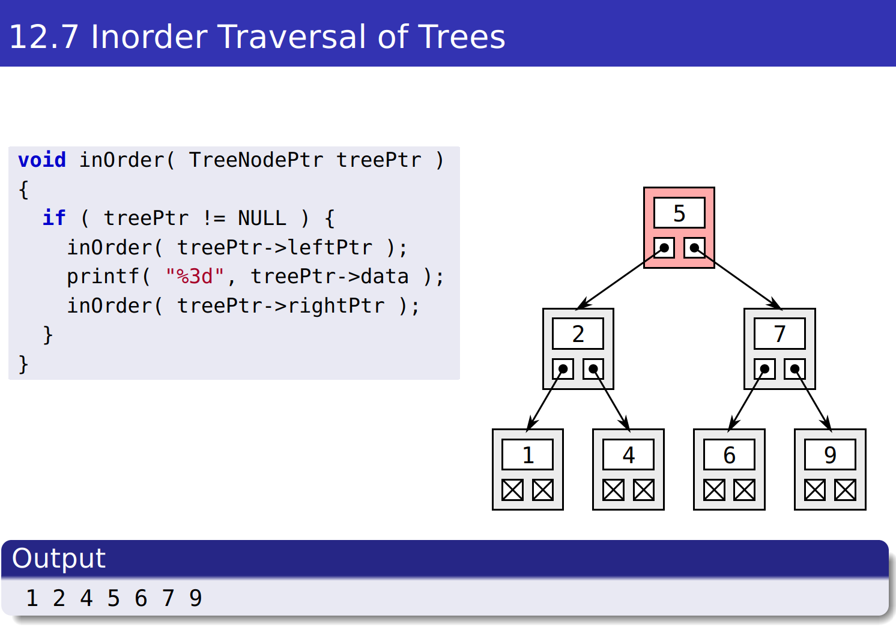
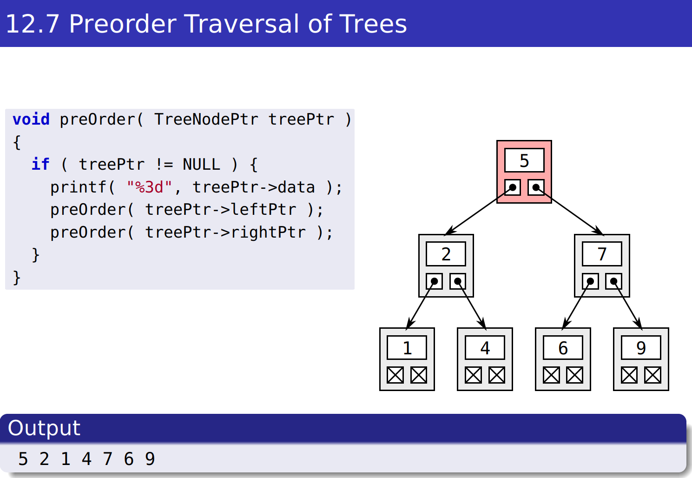
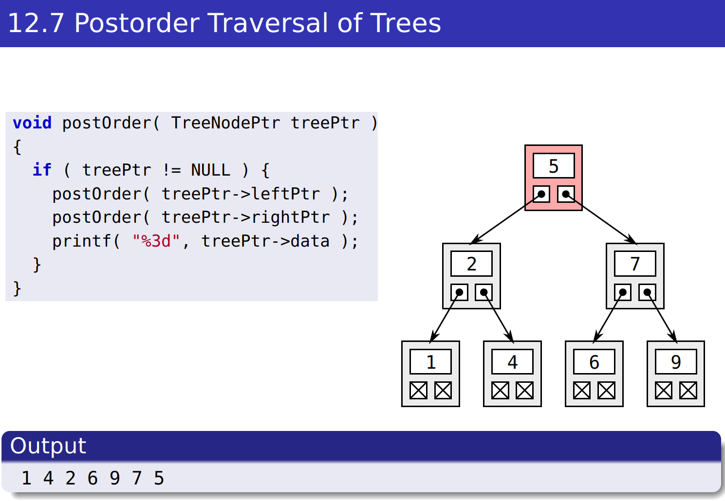
SU FACULTY of ENGINEERING
Computer Programming 143 lectures | 14 October 2026
Trees: Traversa;s
Notes:
In-order: L----N-----R::::::::::: W L E N R U D
Pre-order: N----L-----R::::::::: N L W E U R D
Post-order: L---R----N:::::::::: W E L R D U N

Slide 57
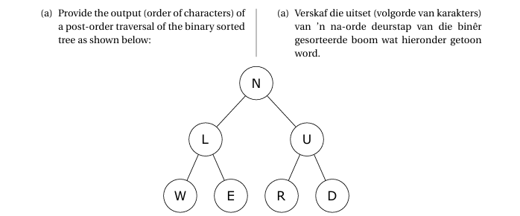
SU FACULTY of ENGINEERING
Computer Programming 143 lectures | 14 October 2026
Trees: Exercises
A2 2023
IN-ORDER (LNR):
PRE-ORDER (NLR):
POST-ORDER (LRN):
Notes:
In-order: L----N-----R::::::::::: W L E N R U D
Pre-order: N----L-----R::::::::: N L W E U R D
Post-order: L---R----N:::::::::: W E L R D U N

Slide 58
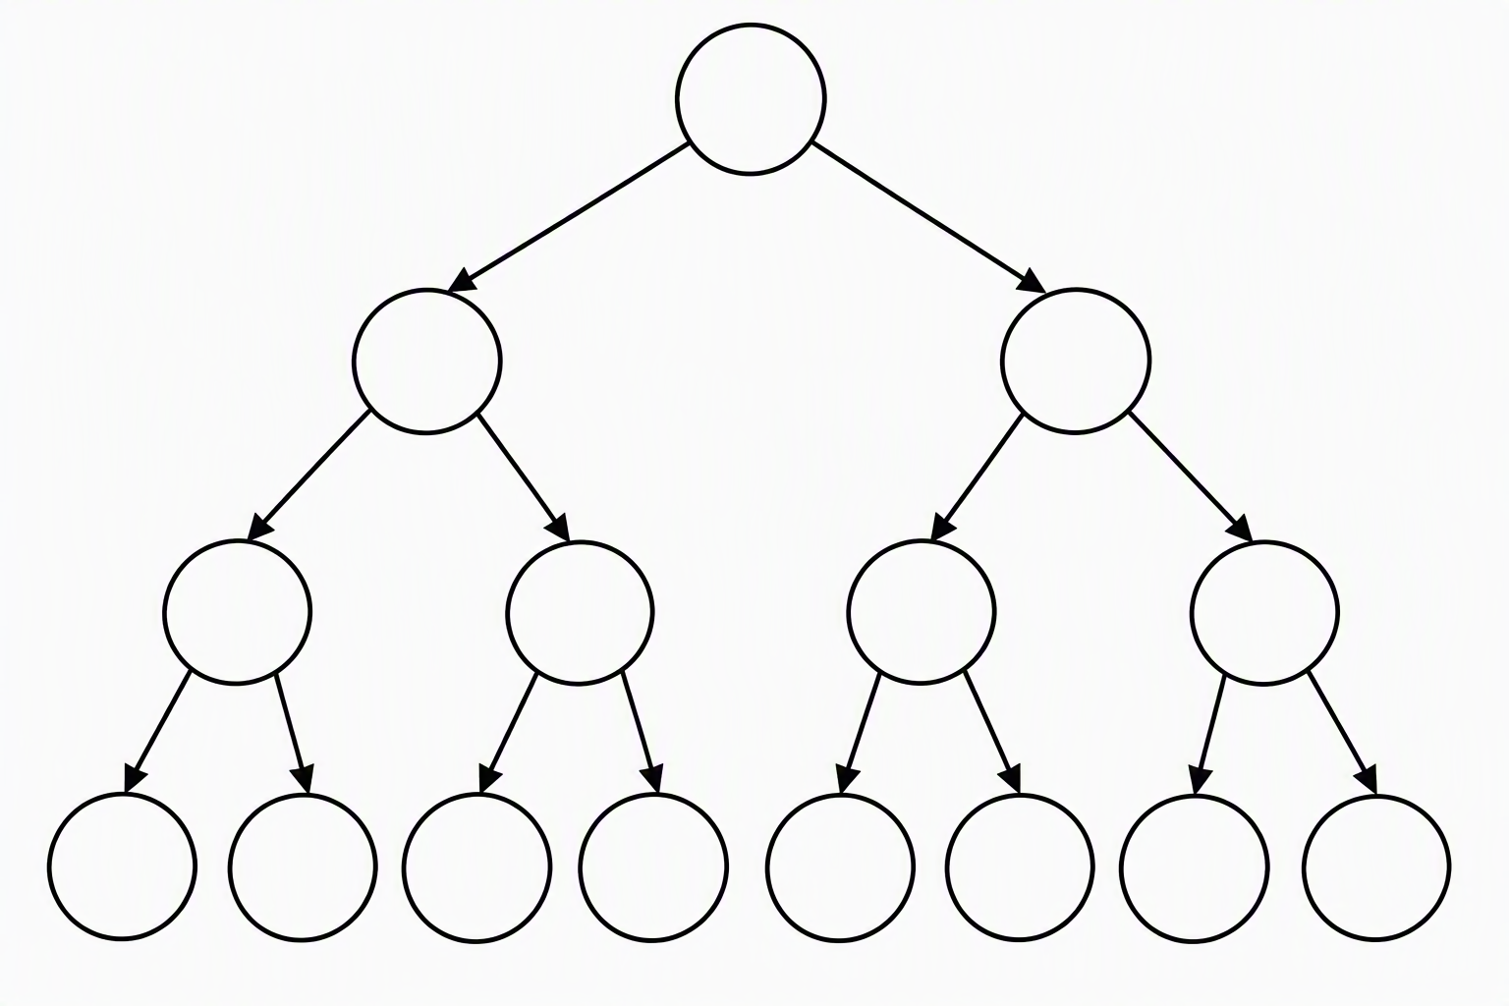
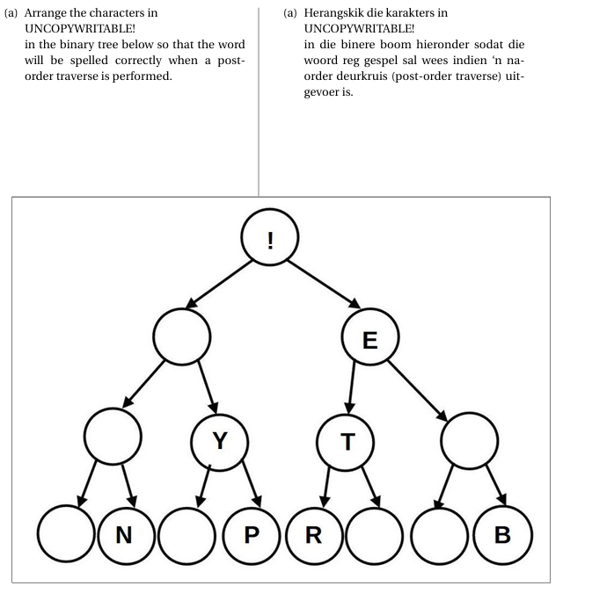
SU FACULTY of ENGINEERING
Computer Programming 143 lectures | 14 October 2026
Trees: Exercises
A2 2024
IN-ORDER (LNR):
PRE-ORDER (NLR):
POST-ORDER (LRN):

Slide 59
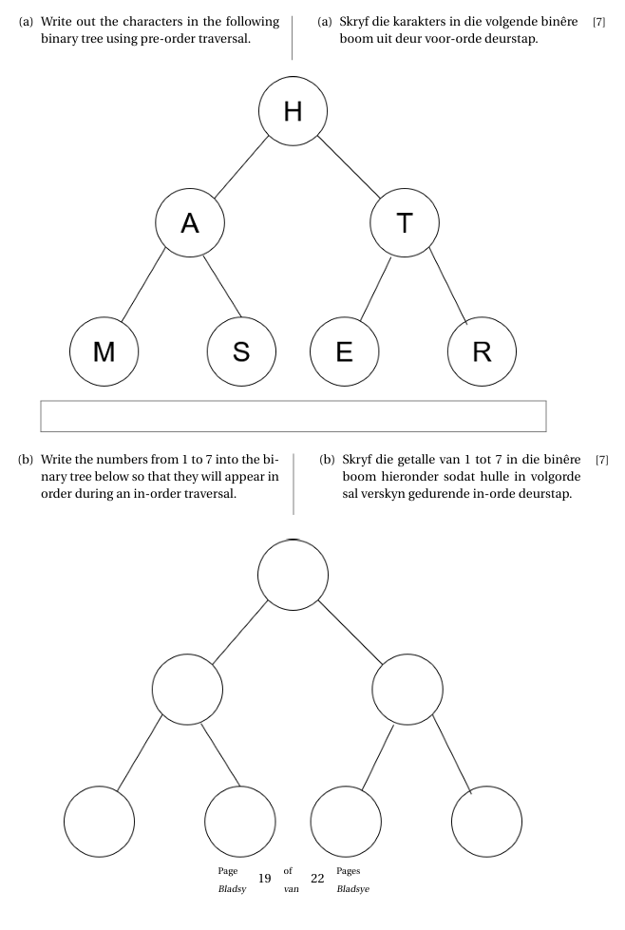
SU FACULTY of ENGINEERING
Computer Programming 143 lectures | 14 October 2026
Trees: Exercises
A2 2025
Notes:
Post-order:

Slide 60
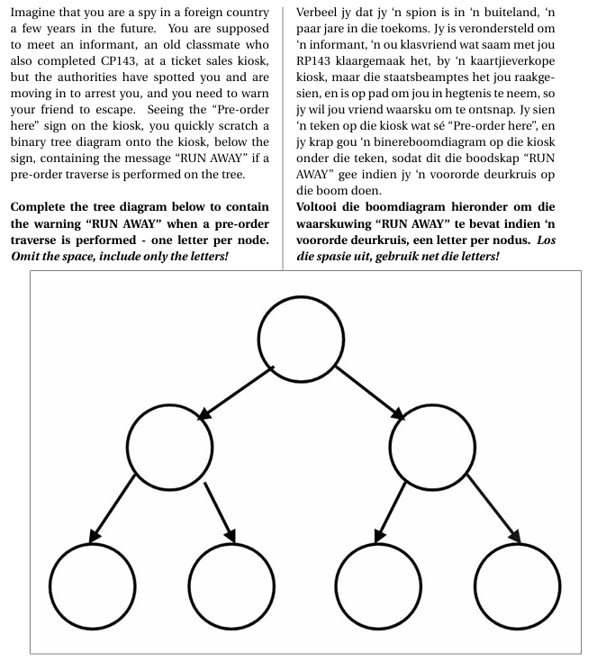
SU FACULTY of ENGINEERING
Computer Programming 143 lectures | 14 October 2026
Trees: Exercises
A3 2024
Notes:
Post-order:

Slide 61
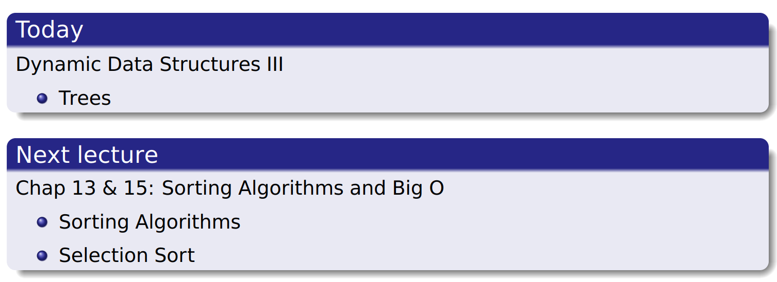
SU FACULTY of ENGINEERING
Computer Programming 143 lectures | 14 October 2026
Perspective
Notes:
F,lashback

Slide 62
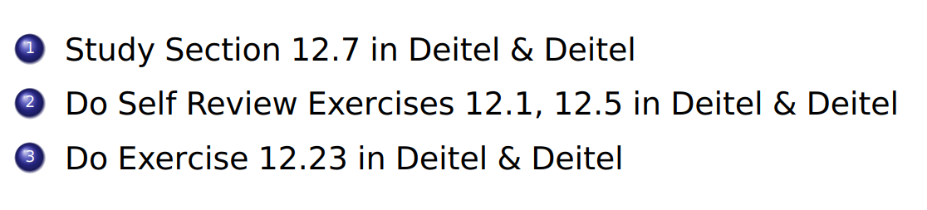
SU FACULTY of ENGINEERING
Computer Programming 143 lectures | 14 October 2026
HOMEWORK
Notes:
F,lashback

