Slide 1


SU FACULTY of ENGINEERING
Computer Programming 143 lectures | 23 September 2026
PROGRAMMING IN C
10. Structures
Lecture 22| Structure definitions
Initialising structures
Accessing members of structures
Using structures with functions
typedef (creating aliases/synonyms)
Isaac Khobo, PhD (ilkhobo@sun.ac.za)
Chapters 10: Structures

Slide 2
SU FACULTY of ENGINEERING
Computer Programming 143 lectures | 28 September 2026
Related recap
Data Type in C
Primitive
User defined
Derived
int
enum{}
array (string)
float
struct
function()
double
typedef
*pointer
char
Collections of related variables (aggregates) under one variable name
structures
Notes:
I wanted to start by stepping a bit and talking about the data types and variables we’ve used so far.

Slide 3
SU FACULTY of ENGINEERING
Computer Programming 143 lectures | 28 September 2026
struct
FORMAT
struct structName {
member1 ,
member2 ,
member3,
… } ;

Slide 4
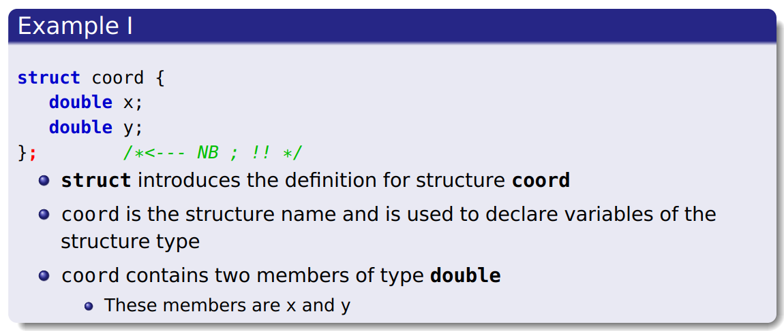
SU FACULTY of ENGINEERING
Computer Programming 143 lectures | 28 September 2026
struct: Example I

Slide 5
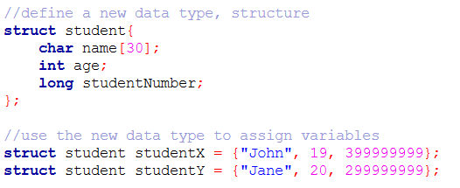

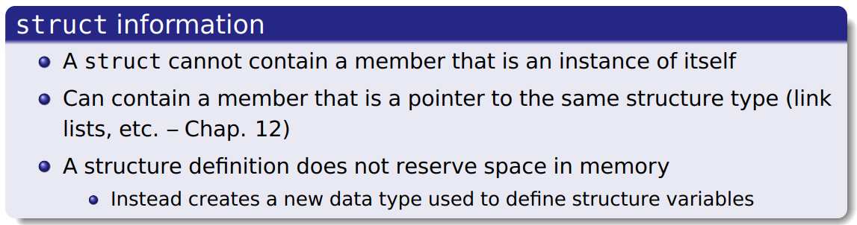
SU FACULTY of ENGINEERING
Computer Programming 143 lectures | 28 September 2026
struct: Example II

Slide 6
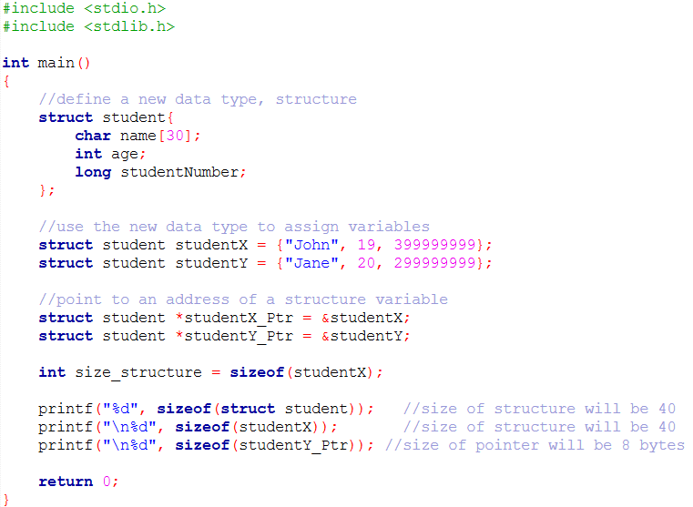
SU FACULTY of ENGINEERING
Computer Programming 143 lectures | 28 September 2026
struct: Valid operations
Assign a structure variable to a structure variable of the same type
i.e, studentX = studentY
Valid operations

Slide 7
SU FACULTY of ENGINEERING
Computer Programming 143 lectures | 28 September 2026
struct: Valid operations
Take the address (&) of a structure variable and point to it in memory
Valid operations

Slide 8
SU FACULTY of ENGINEERING
Computer Programming 143 lectures | 28 September 2026
struct: Valid operations
Access the individual members of a structure
i.e., studentX.name will access “John” (next section)
Valid operations

Slide 9
SU FACULTY of ENGINEERING
Computer Programming 143 lectures | 28 September 2026
struct: Valid operations
Use the sizeof operator to determine the size of a structure
Valid operations

Slide 10
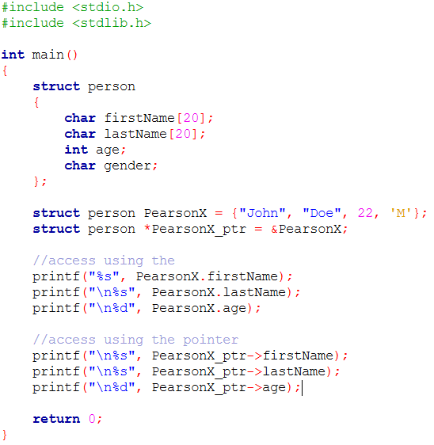
SU FACULTY of ENGINEERING
Computer Programming 143 lectures | 28 September 2026
struct: accessing members of structures
Dot operator (.) used to access members by means of the structure
name
(.)

Slide 11
SU FACULTY of ENGINEERING
Computer Programming 143 lectures | 28 September 2026
struct: accessing members of structures
Arrow operator (->) used to access members by means of a pointer to
the structure
(->)

Slide 12
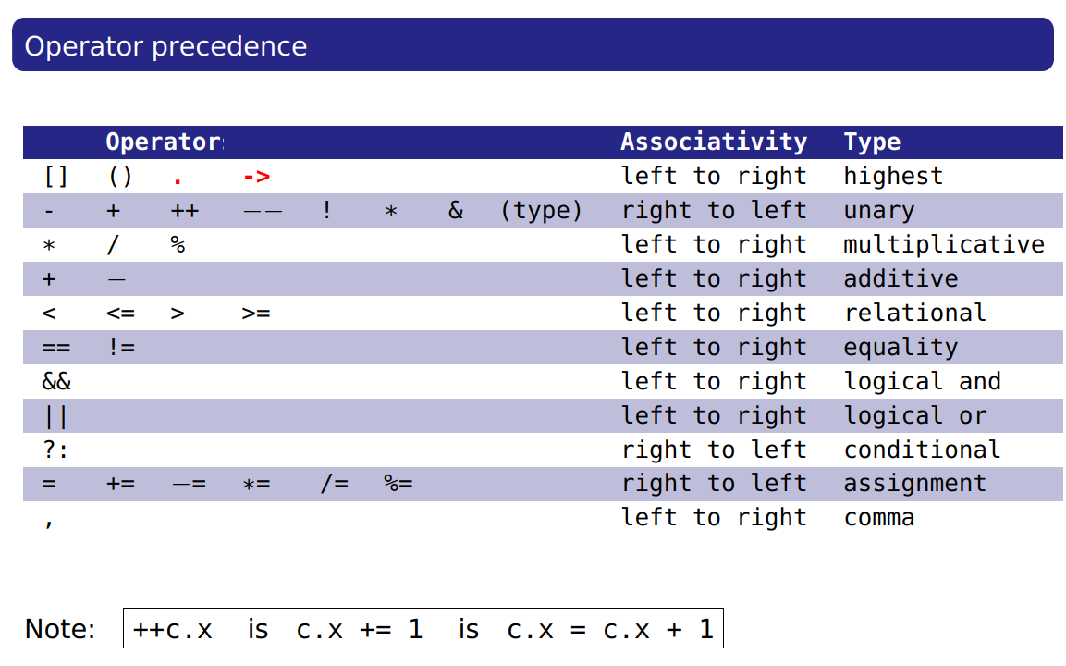
SU FACULTY of ENGINEERING
Computer Programming 143 lectures | 28 September 2026
struct: accessing members of structures

Slide 13
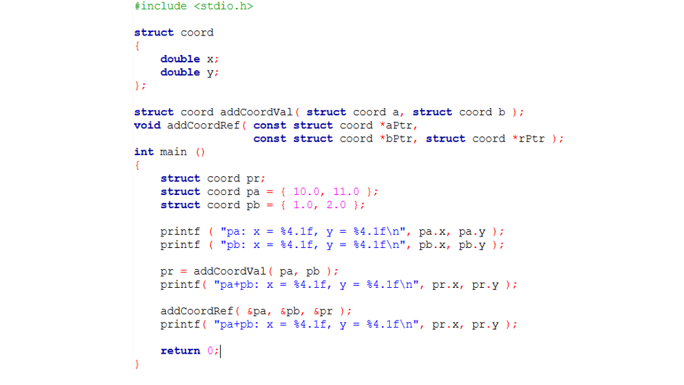
SU FACULTY of ENGINEERING
Computer Programming 143 lectures | 28 September 2026
struct: Using structures with functions

Slide 14
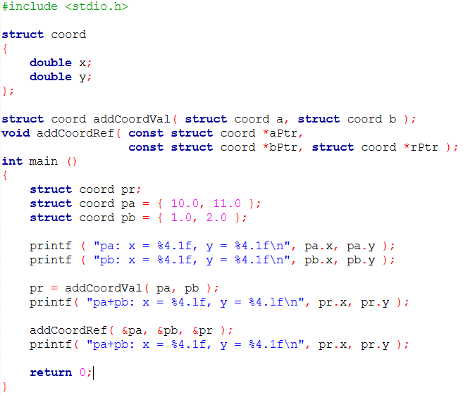
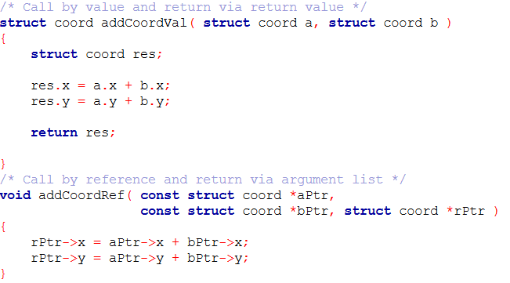
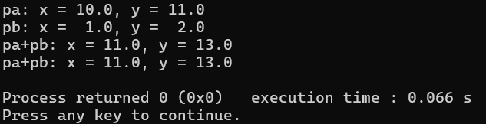

Slide 16
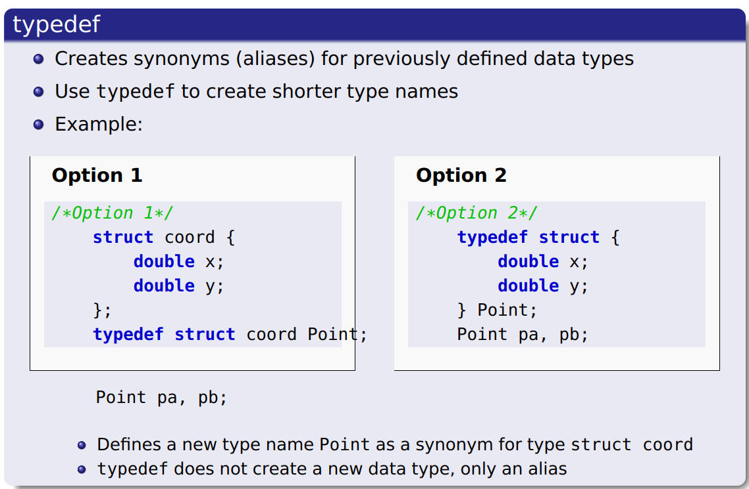
SU FACULTY of ENGINEERING
Computer Programming 143 lectures | 28 September 2026
typedef

Slide 17
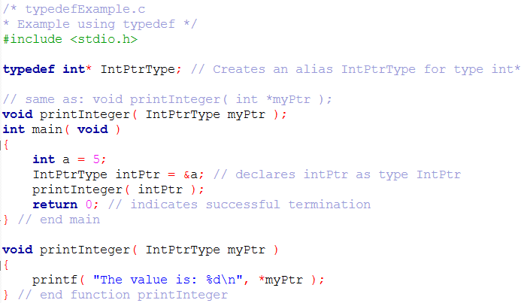
SU FACULTY of ENGINEERING
Computer Programming 143 lectures | 28 September 2026
typedef

