Slide 1

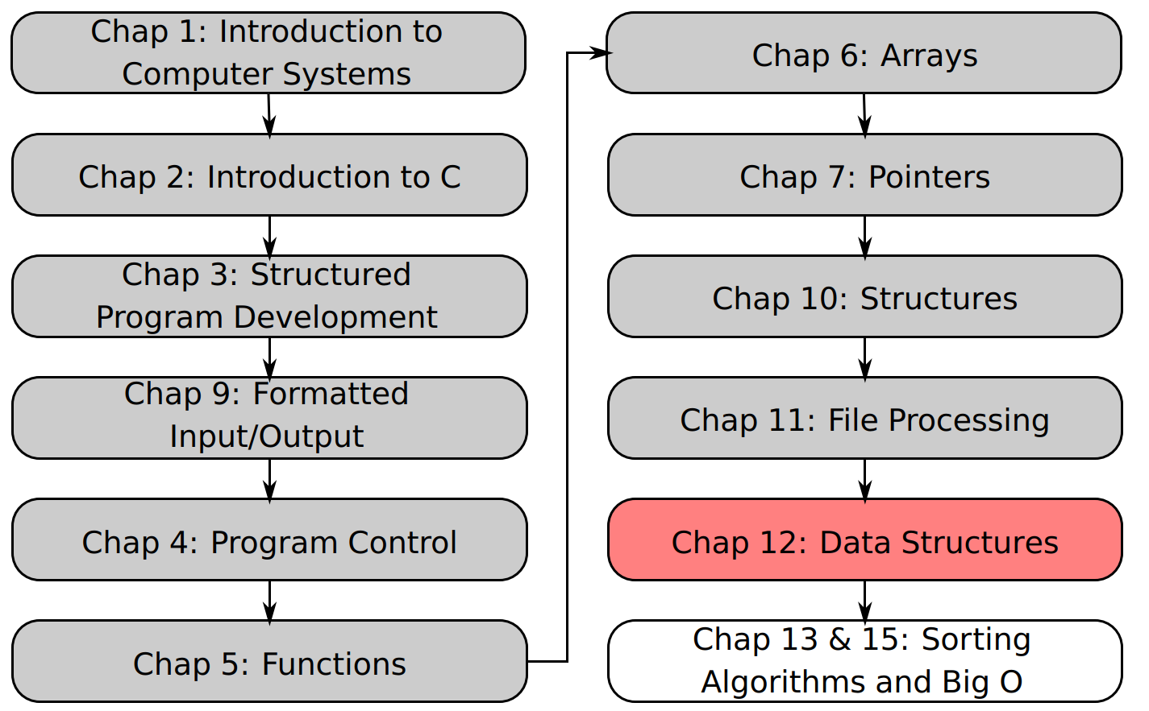
SU FACULTY of ENGINEERING
Computer Programming 143 lectures | 12 October 2026
Lecture Overview
12. Dynamic Data Structures II
Lecture 28| Stacks
Queues
Isaac Khobo, PhD (ilkhobo@sun.ac.za)
Chapters 12: Data structures

Slide 2
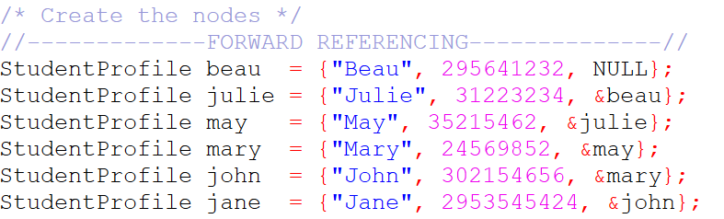
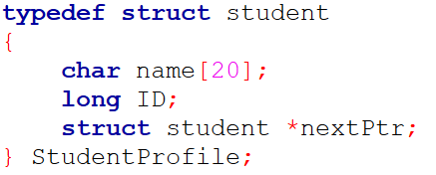
SU FACULTY of ENGINEERING
Computer Programming 143 lectures | 11 October 2026
Recap: Linked lists
Name = “Jane”
ID = 2953545424
nextPtr = &john
Name = “John”
ID = 302154656
nextPtr = &mary
Name = “Mary”
ID = 24569852
nextPtr = &may
Name = “May”
ID = 35215462
nextPtr = &julie
Name = “Julie”
ID = 31223234
nextPtr = &beau
Name = “Jane”
ID = 295641232
nextPtr = NULL
Node1: jane
Node2: john
Node3: mary
Node4: may
Node5: julie
Node6: beau

Slide 3
SU FACULTY of ENGINEERING
Computer Programming 143 lectures | 11 October 2026
Recap: Linked lists
Name = “Jane”
ID = 2953545424
nextPtr = &john
Name = “John”
ID = 302154656
nextPtr = &mary
Name = “Mary”
ID = 24569852
nextPtr = &may
Name = “May”
ID = 35215462
nextPtr = &julie
Name = “Julie”
ID = 31223234
nextPtr = &beau
Name = “Jane”
ID = 295641232
nextPtr = NULL
Node1: jane
Node2: john
Node3: mary
Node4: may
Node5: julie
Node6: beau

Slide 4
SU FACULTY of ENGINEERING
Computer Programming 143 lectures | 11 October 2026
Recap: Linked lists
Name = “Jane”
ID = 2953545424
nextPtr = &john
Name = “John”
ID = 302154656
nextPtr = &mary
Name = “Mary”
ID = 24569852
nextPtr = &may
Name = “May”
ID = 35215462
nextPtr = &julie
Name = “Julie”
ID = 31223234
nextPtr = &beau
Name = “Jane”
ID = 295641232
nextPtr = NULL
Node1: jane
Node2: john
Node3: mary
Node4: may
Node5: julie
Node6: beau

Slide 5
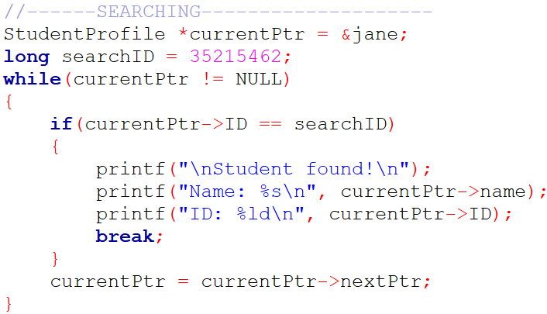
SU FACULTY of ENGINEERING
Computer Programming 143 lectures | 11 October 2026
Recap: Linked lists
Name = “Jane”
ID = 2953545424
nextPtr = &john
Name = “John”
ID = 302154656
nextPtr = &mary
Name = “Mary”
ID = 24569852
nextPtr = &may
Name = “May”
ID = 35215462
nextPtr = &julie
Name = “Julie”
ID = 31223234
nextPtr = &beau
Name = “Jane”
ID = 295641232
nextPtr = NULL
Node1: jane
Node2: john
Node3: mary
Node4: may
Node5: julie
Node6: beau

Slide 6
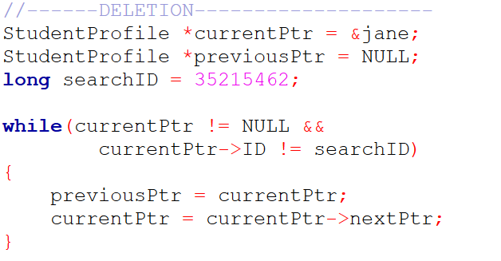
SU FACULTY of ENGINEERING
Computer Programming 143 lectures | 11 October 2026
Recap: Linked lists
Name = “May”
ID = 35215462
nextPtr = &julie
Node4: may
Name = “Jane”
ID = 2953545424
nextPtr = &john
Name = “John”
ID = 302154656
nextPtr = &mary
Name = “Mary”
ID = 24569852
nextPtr = &may
Name = “Julie”
ID = 31223234
nextPtr = &beau
Name = “Jane”
ID = 295641232
nextPtr = NULL
Node1: jane
Node2: john
Node3: mary
Node5: julie
Node6: beau

Slide 7
SU FACULTY of ENGINEERING
Computer Programming 143 lectures | 11 October 2026
Recap: Linked lists
Name = “Jane”
ID = 2953545424
nextPtr = &john
Name = “John”
ID = 302154656
nextPtr = &mary
Name = “Mary”
ID = 24569852
nextPtr = &julie
Name = “Julie”
ID = 31223234
nextPtr = &beau
Name = “Jane”
ID = 295641232
nextPtr = NULL
Node1: jane
Node2: john
Node3: mary
Node5: julie
Node6: beau

Slide 8
SU FACULTY of ENGINEERING
Computer Programming 143 lectures | 11 October 2026
Recap: Linked lists
Name = “Jane”
ID = 2953545424
nextPtr = &john
Name = “John”
ID = 302154656
nextPtr = &mary
Name = “Mary”
ID = 24569852
nextPtr = &julie
Name = “Julie”
ID = 31223234
nextPtr = &beau
Name = “Jane”
ID = 295641232
nextPtr = NULL
Node1: jane
Node2: john
Node3: mary
Node5: julie
Node6: beau

Slide 9
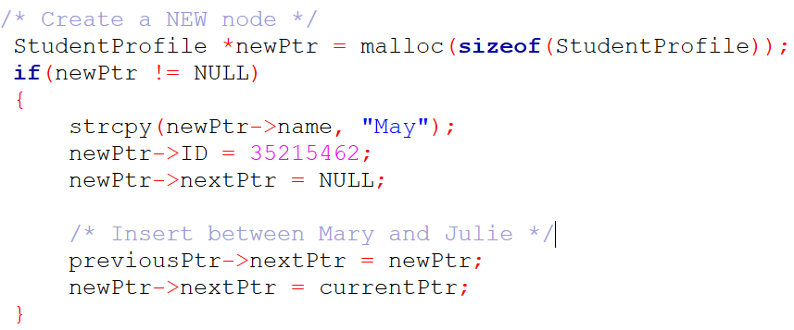
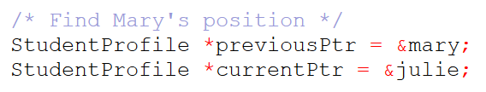
SU FACULTY of ENGINEERING
Computer Programming 143 lectures | 11 October 2026
Recap: Linked lists
Name = “May”
ID = 35215462
nextPtr = &julie
Node4: may
Name = “Jane”
ID = 2953545424
nextPtr = &john
Name = “John”
ID = 302154656
nextPtr = &mary
Name = “Mary”
ID = 24569852
nextPtr = &may
Name = “Julie”
ID = 31223234
nextPtr = &beau
Name = “Jane”
ID = 295641232
nextPtr = NULL
Node1: jane
Node2: john
Node3: mary
Node5: julie
Node6: beau

Slide 10
SU FACULTY of ENGINEERING
Computer Programming 143 lectures | 11 October 2026
Recap: Linked lists
Name = “Jane”
ID = 2953545424
nextPtr = &john
Name = “John”
ID = 302154656
nextPtr = &mary
Name = “Mary”
ID = 24569852
nextPtr = &may
Name = “May”
ID = 35215462
nextPtr = &julie
Name = “Julie”
ID = 31223234
nextPtr = &beau
Name = “Jane”
ID = 295641232
nextPtr = NULL
Node1: jane
Node2: john
Node3: mary
Node4: may
Node5: julie
Node6: beau

Slide 11
SU FACULTY of ENGINEERING
Computer Programming 143 lectures | 11 October 2026
Recap: Linked lists
Name = “Jane”
ID = 2953545424
nextPtr = &john
Name = “John”
ID = 302154656
nextPtr = &mary
Name = “Mary”
ID = 24569852
nextPtr = &may
Name = “May”
ID = 35215462
nextPtr = &julie
Name = “Julie”
ID = 31223234
nextPtr = &beau
Name = “Jane”
ID = 295641232
nextPtr = NULL
Node1: jane
Node2: john
Node3: mary
Node4: may
Node5: julie
Node6: beau

Slide 12
SU FACULTY of ENGINEERING
Computer Programming 143 lectures | 11 October 2026
Chapter 12: Data structures
Data structures
Linear
Non-linear
static
dynamic
array
Linked list
Stack
Queue
Tree
Graph
Notes:
A data structure is a method of organizing and storing data so it can be accessed and modified efficiently.
Linear – data is organized in a sequence (one after another)
Non-linear data structure – the elements are not arranged sequentially

Slide 13
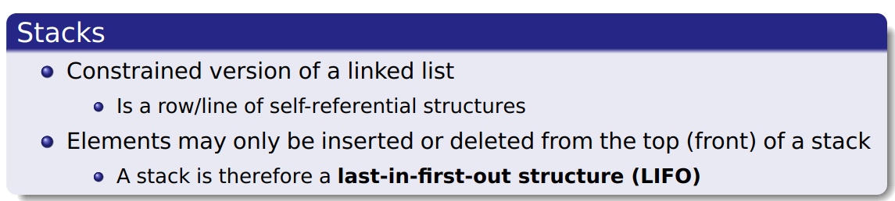
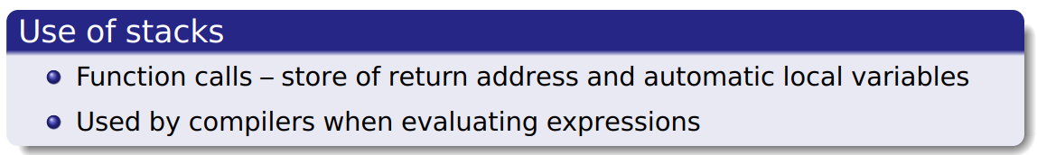
SU FACULTY of ENGINEERING
Computer Programming 143 lectures | 11 October 2026
Stack

Slide 14
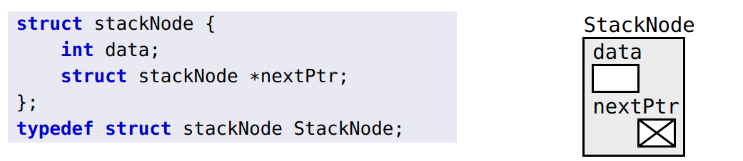
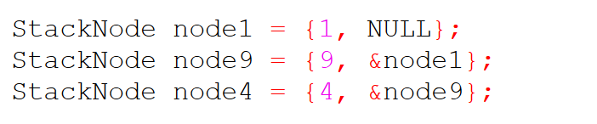
SU FACULTY of ENGINEERING
Computer Programming 143 lectures | 11 October 2026
Stack
Notes:
A stack node is initialised as a linked list (sequence of self-referencing structures)

Slide 15
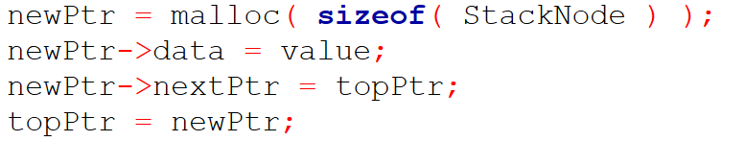
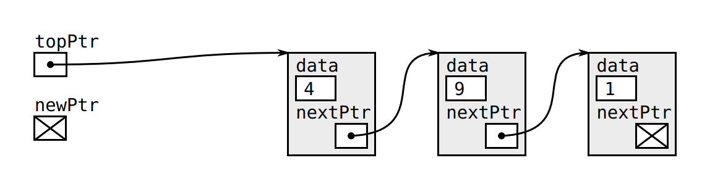
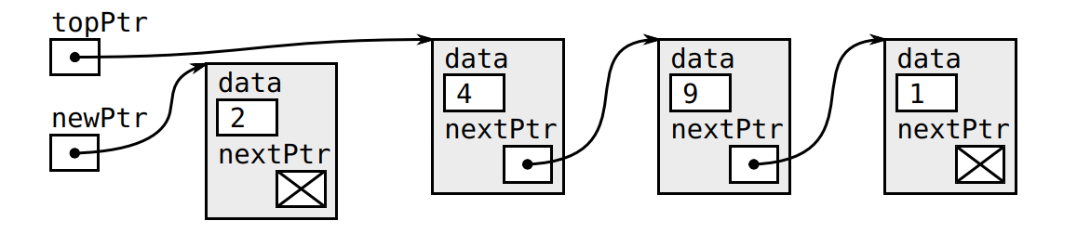
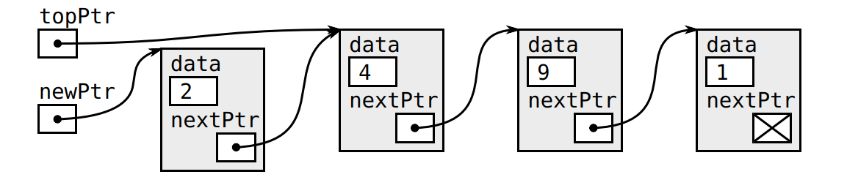
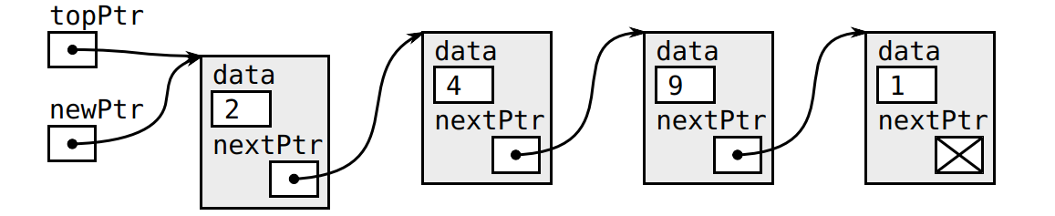
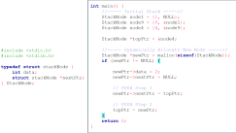
SU FACULTY of ENGINEERING
Computer Programming 143 lectures | 11 October 2026
Stack: PUSH

Slide 16
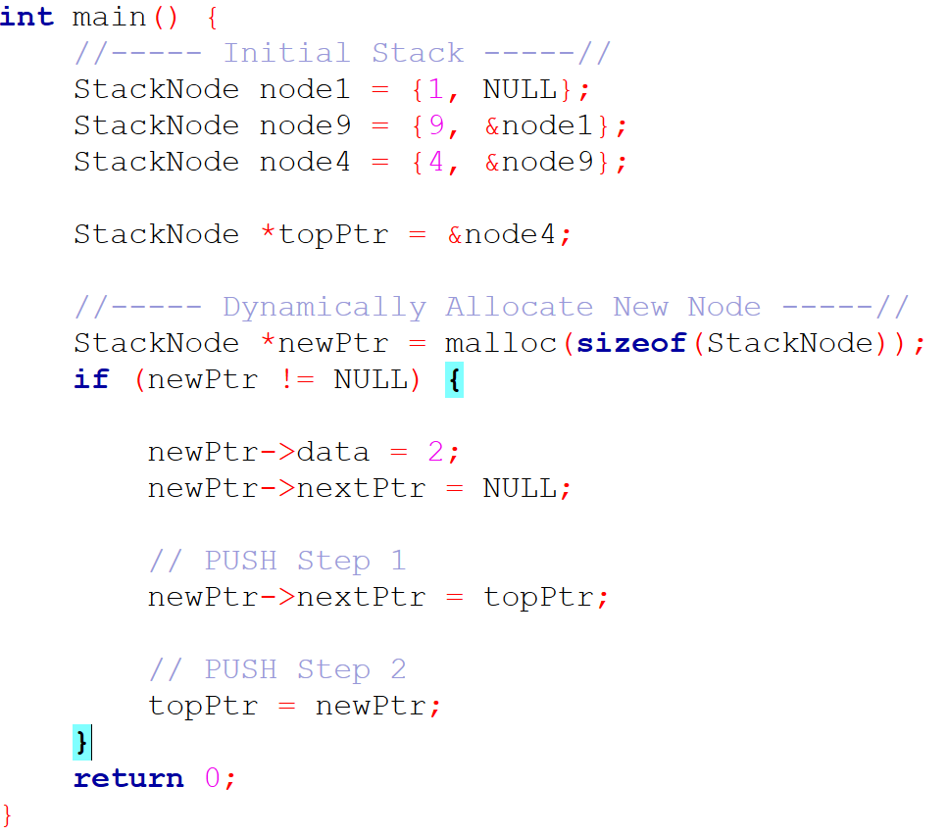
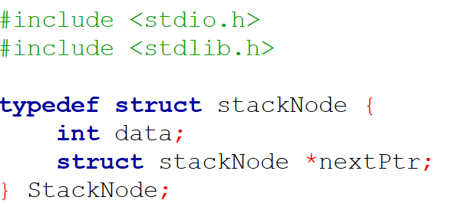

Slide 17
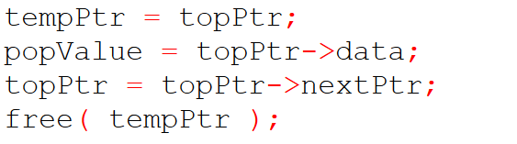
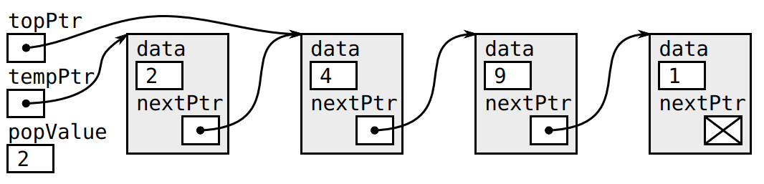
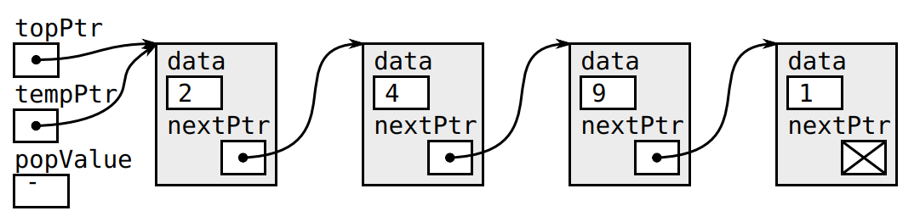
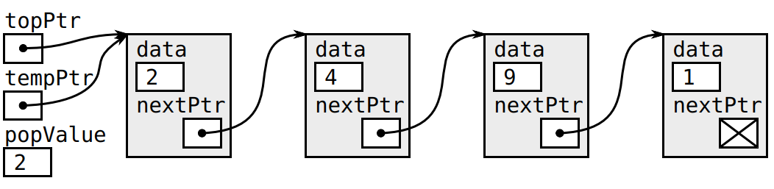
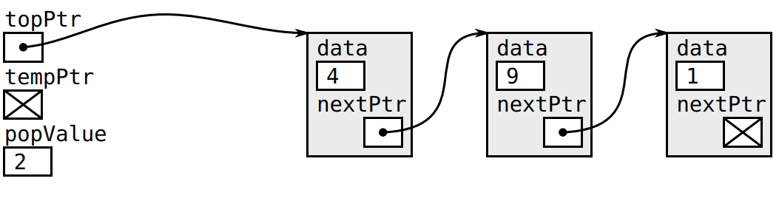
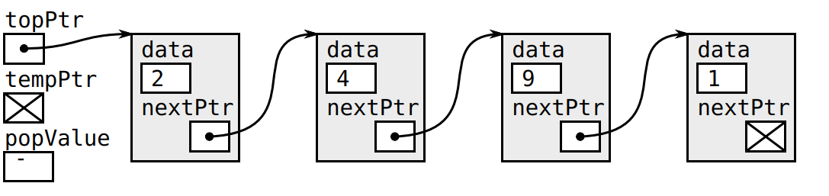
SU FACULTY of ENGINEERING
Computer Programming 143 lectures | 11 October 2026
Stack: POP

Slide 18
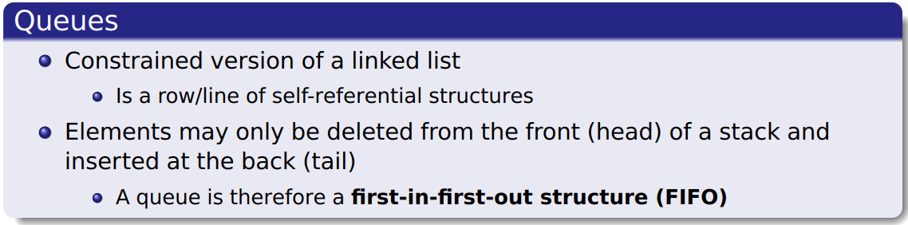
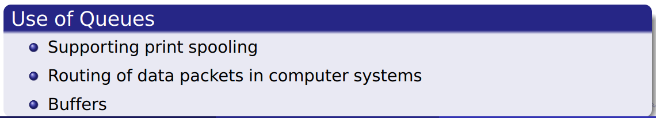
SU FACULTY of ENGINEERING
Computer Programming 143 lectures | 11 October 2026
Queue

Slide 19
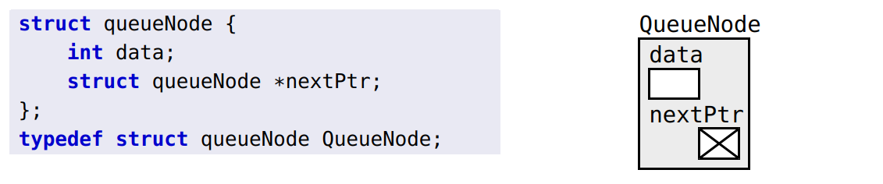
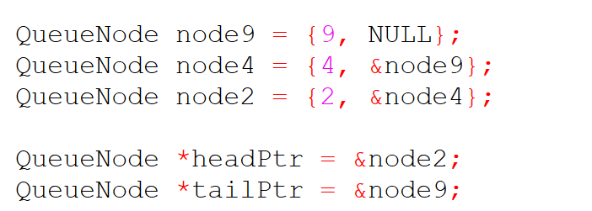
SU FACULTY of ENGINEERING
Computer Programming 143 lectures | 11 October 2026
Queue
Notes:
A queue node is initialised as a linked list (sequence of self-referencing structures)

Slide 20
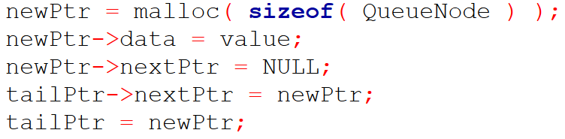
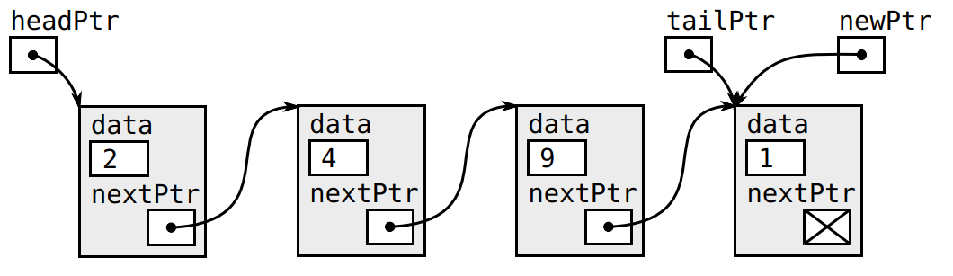
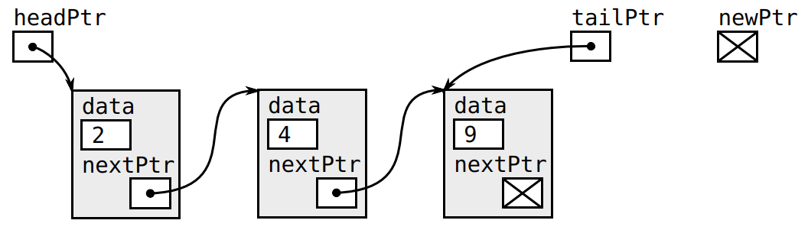
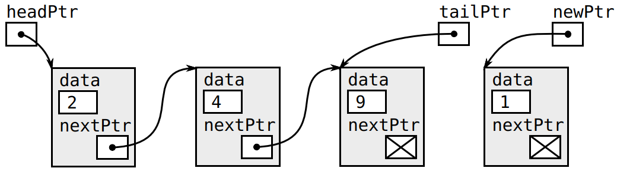
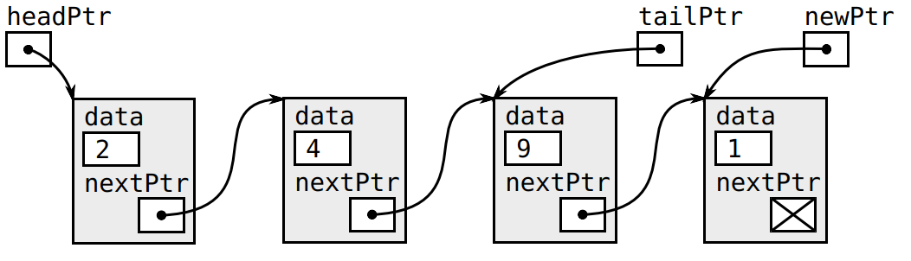
SU FACULTY of ENGINEERING
Computer Programming 143 lectures | 11 October 2026
Queue: ENQUEUE

Slide 21
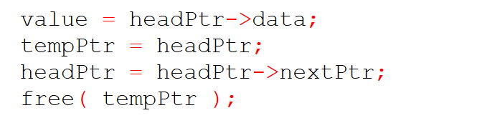
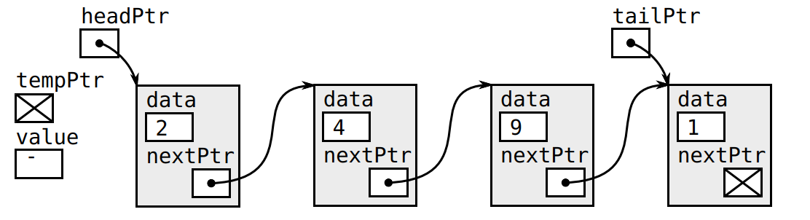
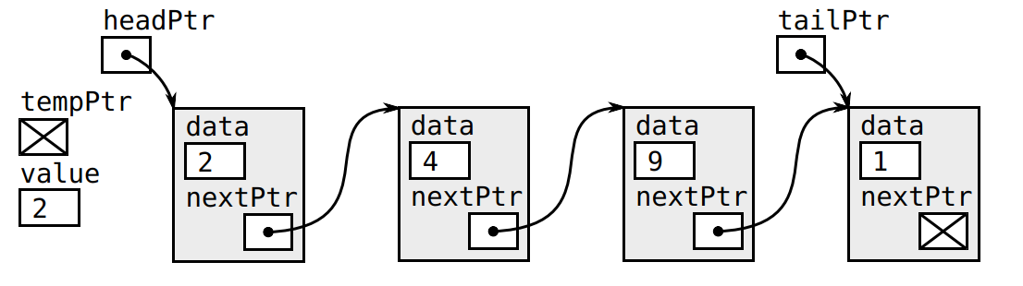
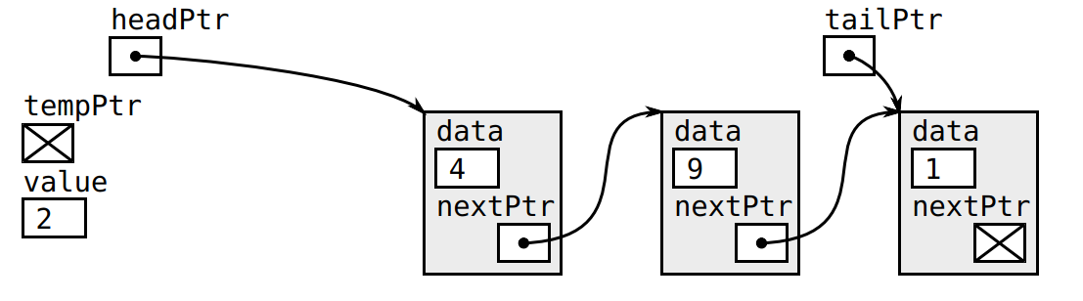
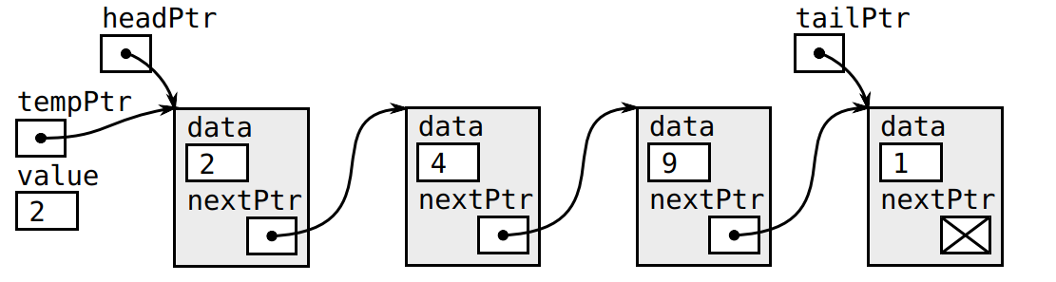
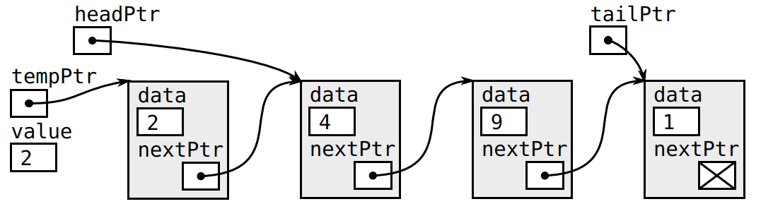
SU FACULTY of ENGINEERING
Computer Programming 143 lectures | 11 October 2026
Queue: DEQUEUE

Slide 22
SU FACULTY of ENGINEERING
Computer Programming 143 lectures | 11 October 2026
Student Linked lists example
Name = “Jane”
ID = 2953545424
nextPtr = &john
Name = “John”
ID = 302154656
nextPtr = &mary
Name = “Mary”
ID = 24569852
nextPtr = &may
Name = “May”
ID = 35215462
nextPtr = &julie
Name = “Julie”
ID = 31223234
nextPtr = &beau
Name = “Jane”
ID = 295641232
nextPtr = NULL
Node1: jane
Node2: john
Node3: mary
Node4: may
Node5: julie
Node6: beau

Slide 23
SU FACULTY of ENGINEERING
Computer Programming 143 lectures | 11 October 2026
Student Linked lists example
Name = “Jane”
ID = 2953545424
nextPtr = &john
Name = “John”
ID = 302154656
nextPtr = &mary
Name = “Mary”
ID = 24569852
nextPtr = &may
Name = “May”
ID = 35215462
nextPtr = &julie
Name = “Julie”
ID = 31223234
nextPtr = &beau
Name = “Jane”
ID = 295641232
nextPtr = NULL
Node1: jane
Node2: john
Node3: mary
Node4: may
Node5: julie
Node6: beau

Slide 24
SU FACULTY of ENGINEERING
Computer Programming 143 lectures | 11 October 2026
Student Linked lists example
Name = “Jane”
ID = 2953545424
nextPtr = &john
Name = “John”
ID = 302154656
nextPtr = &mary
Name = “Mary”
ID = 24569852
nextPtr = &may
Name = “May”
ID = 35215462
nextPtr = &julie
Name = “Julie”
ID = 31223234
nextPtr = &beau
Name = “Jane”
ID = 295641232
nextPtr = NULL
Node1: jane
Node2: john
Node3: mary
Node4: may
Node5: julie
Node6: beau

Slide 25
SU FACULTY of ENGINEERING
Computer Programming 143 lectures | 11 October 2026
Student Linked lists example
Name = “Jane”
ID = 2953545424
nextPtr = &john
Name = “John”
ID = 302154656
nextPtr = &mary
Name = “Mary”
ID = 24569852
nextPtr = &may
Name = “May”
ID = 35215462
nextPtr = &julie
Name = “Julie”
ID = 31223234
nextPtr = &beau
Name = “Jane”
ID = 295641232
nextPtr = NULL
Node1: jane
Node2: john
Node3: mary
Node4: may
Node5: julie
Node6: beau

Slide 26
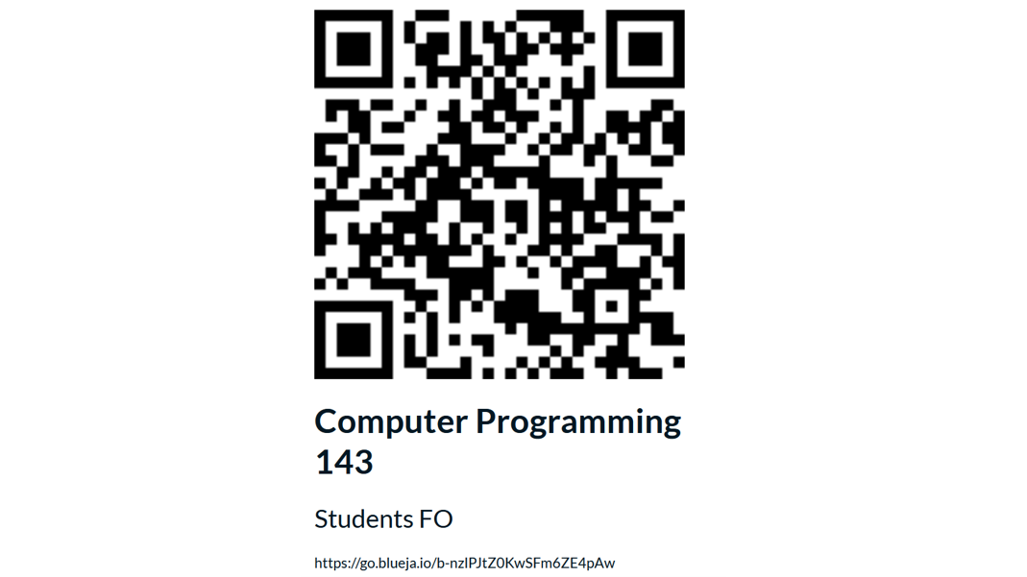
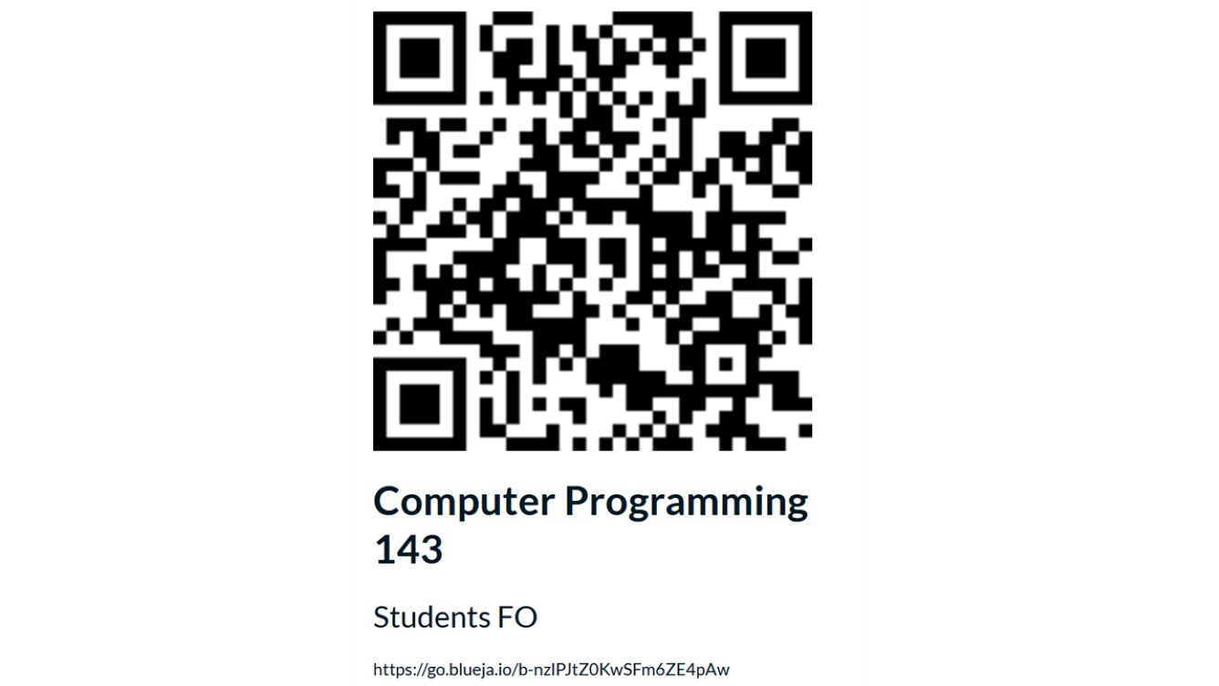
SU FACULTY of ENGINEERING
Computer Programming 143 lectures | 11 October 2026
End of semester feedback

Slide 27
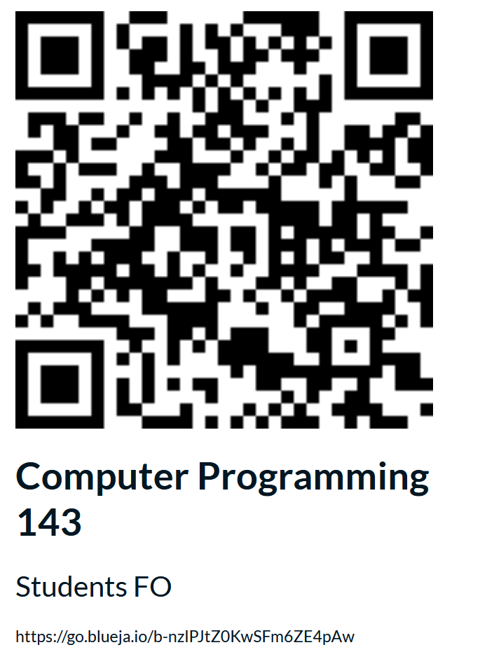

Slide 28
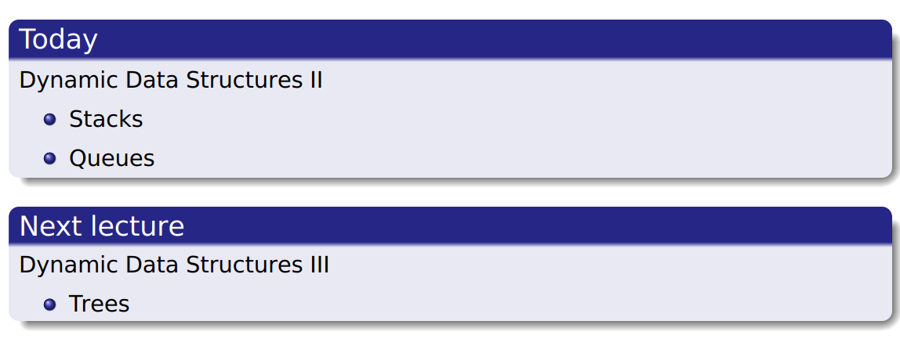
SU FACULTY of ENGINEERING
Computer Programming 143 lectures | 11 October 2026
Perspective
Notes:
F,lashback

Slide 29

SU FACULTY of ENGINEERING
Computer Programming 143 lectures | 11 October 2026
HOMEWORK
Notes:
F,lashback

