Slide 1


SU FACULTY of ENGINEERING
Computer Programming 143 lectures | 18 September 2026
PROGRAMMING IN C
7. Pointers III
Lecture 19| Using the const qualifier with pointers
Bubblesort using call-by-reference
sizeof operator
Isaac Khobo, PhD (ilkhobo@sun.ac.za)
Chapters 7: Pointers

Slide 2
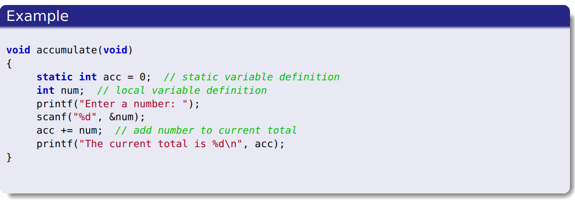
SU FACULTY of ENGINEERING
Computer Programming 143 lectures | 18 September 2026
Qualifiers: recap
Lecture 11: Storage duration, scope (global, local variables),
linkage (more in chapter 14)
For local variables defined in functions: static keep value after function ends, and the value is only known in the function
Qualifier: static

Slide 3
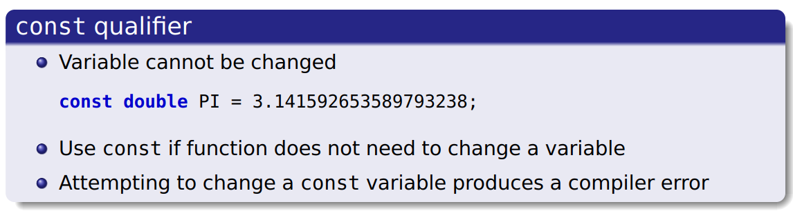
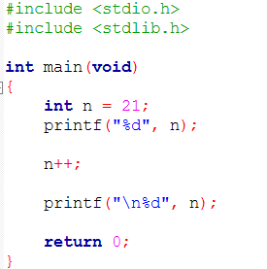
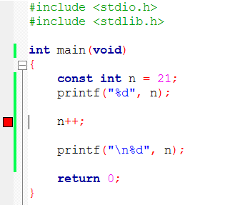
SU FACULTY of ENGINEERING
Computer Programming 143 lectures | 18 September 2026
const Qualifier

Slide 4
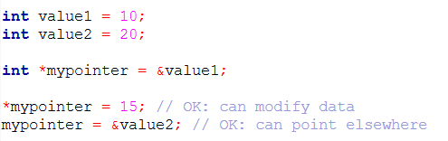
SU FACULTY of ENGINEERING
Computer Programming 143 lectures | 18 September 2026
const Qualifier with pointers
int
*
myPointer
Non-constant data – the integer the pointer points to CAN be changed
Non-constant pointer – the address the pointer points to CAN be changed
Qualifier: none

Slide 5
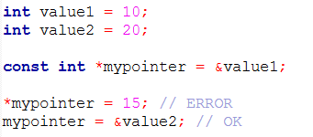
SU FACULTY of ENGINEERING
Computer Programming 143 lectures | 18 September 2026
const Qualifier with pointers
const
int
*
myPointer
Constant data – the integer the pointer points to CANNOT be changed
Non-constant pointer – the address the pointer points to CAN be changed
Qualifier: const

Slide 6
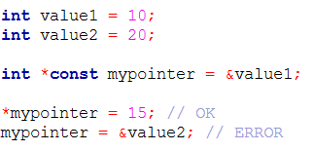
SU FACULTY of ENGINEERING
Computer Programming 143 lectures | 18 September 2026
const Qualifier with pointers
int
*
const
myPointer
Non-constant data – the integer the pointer points to CAN be changed
Constant pointer – the address the pointer points to CANNOT be changed
Qualifier: const

Slide 7
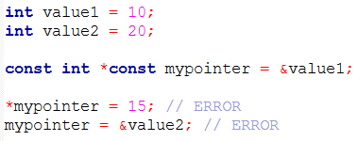
SU FACULTY of ENGINEERING
Computer Programming 143 lectures | 18 September 2026
const Qualifier with pointers
const
int
*
const
myPointer
Constant data – the integer the pointer points to CANNOT be changed
Constant pointer – the address the pointer points to CANNOT be changed
Qualifier: const

Slide 8
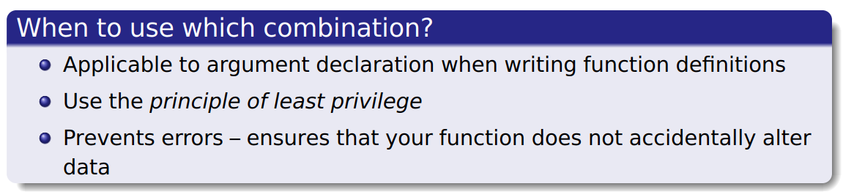
SU FACULTY of ENGINEERING
Computer Programming 143 lectures | 18 September 2026
const Qualifier with pointers

Slide 9
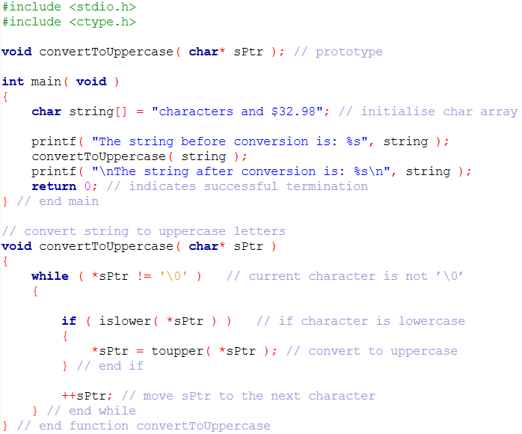
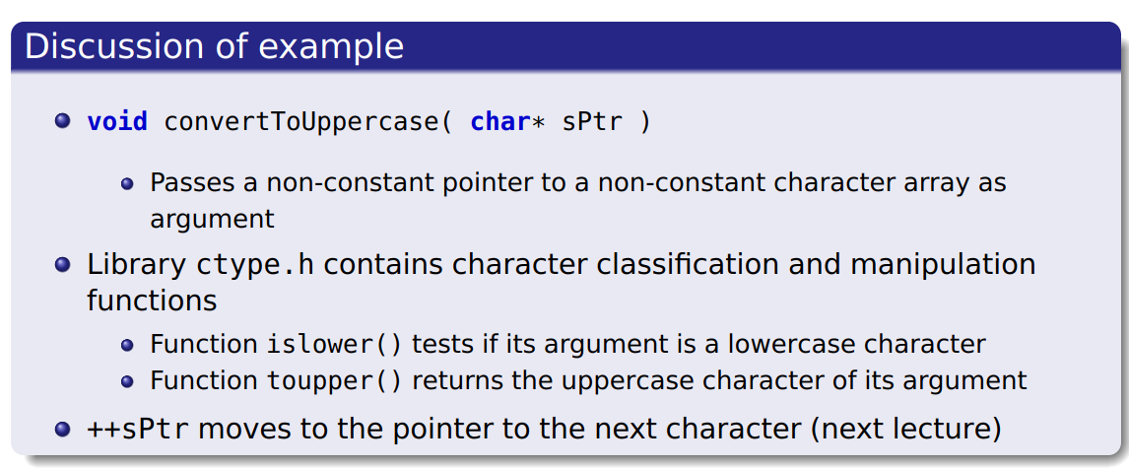
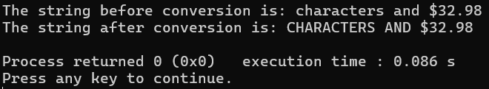
SU FACULTY of ENGINEERING
Computer Programming 143 lectures | 18 September 2026
const Qualifier with pointers: EXAMPLES
EXAMPLE 1: non-const data, non-const pointer

Slide 10
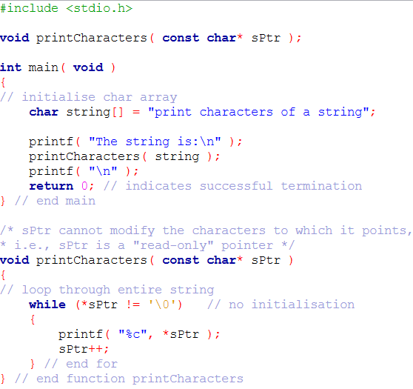
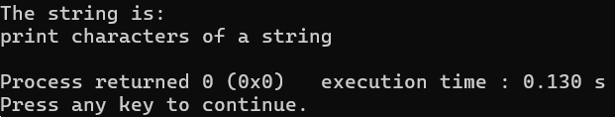
SU FACULTY of ENGINEERING
Computer Programming 143 lectures | 18 September 2026
const Qualifier with pointers: EXAMPLES
EXAMPLE 2: const data, non-const pointer

Slide 11
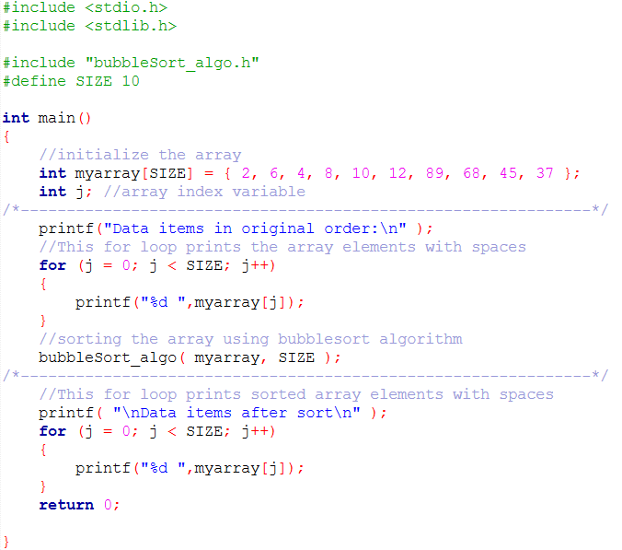
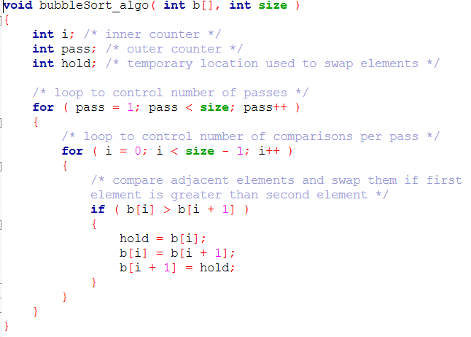
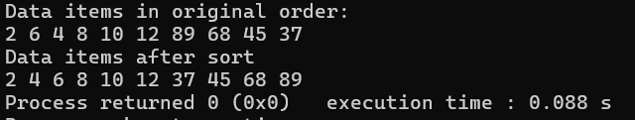
SU FACULTY of ENGINEERING
Computer Programming 143 lectures | 18 September 2026
const Qualifier with pointers: EXAMPLES
LECTURE 15: Arrays III (bubblesort – pass by value)

Slide 12
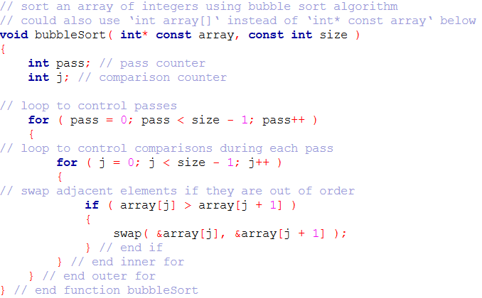
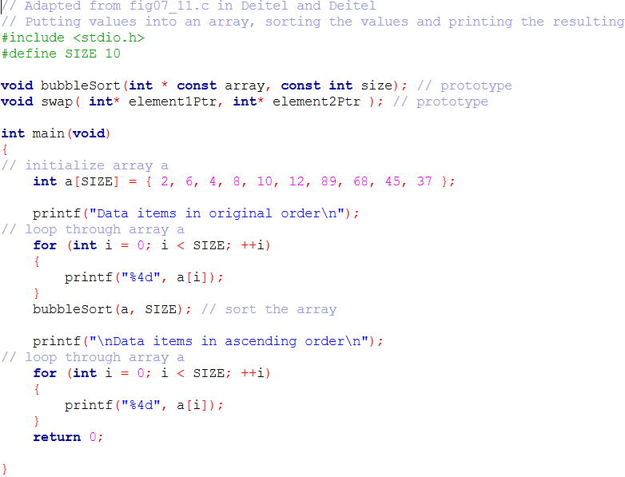
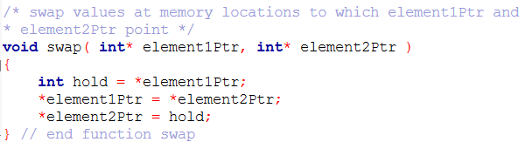
SU FACULTY of ENGINEERING
Computer Programming 143 lectures | 18 September 2026
const Qualifier with pointers: EXAMPLES
(bubblesort – pass by reference)

Slide 13
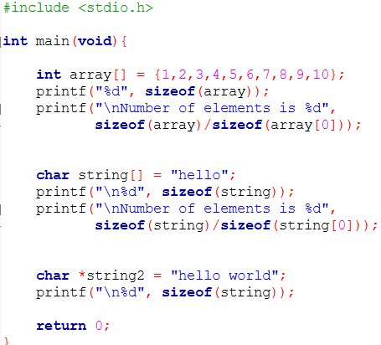
SU FACULTY of ENGINEERING
Computer Programming 143 lectures | 18 September 2026
sizeof OPERATOR
Sizeof | Size (bytes) 64bit machine
Integer (int) | 4
Short integer (short/ short int) | 2
Long integer (long/ long int) | 4
Floating point number (float) | 4
Double floating point number (double) | 8
Character (char) | 1
Pointer (*) | 8

