Slide 1


SU FACULTY of ENGINEERING
Computer Programming 143 lectures | 30 September 2026
Lecture Overview
10. Structures
Lecture 23| Array of structures
Malloc and structures
Example: card shuffling and dealing simulation
Isaac Khobo, PhD (ilkhobo@sun.ac.za)
Chapters 10: Structures
Notes:
Admin:
Group learning sessions are still ongoing, Monday 5pm to 7pm in M2002.

Slide 2
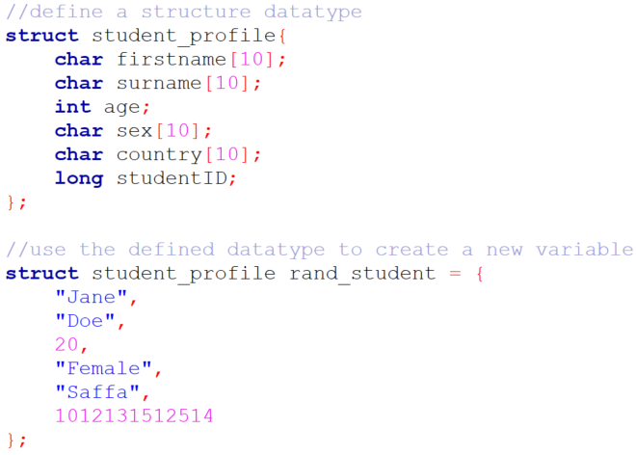
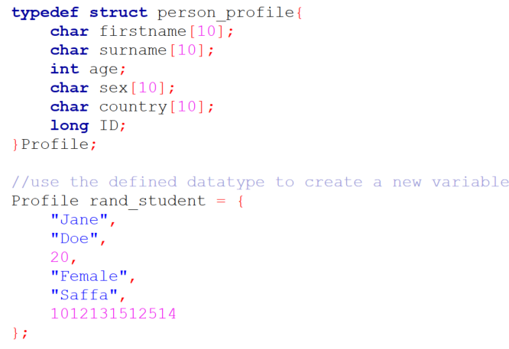
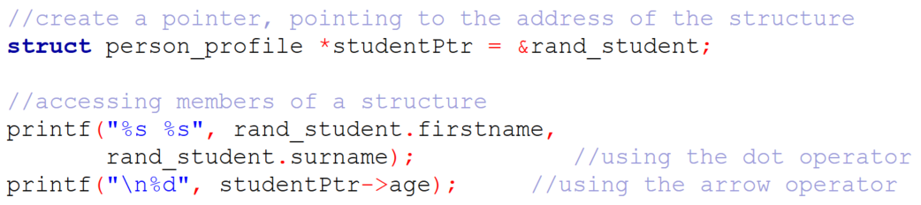
SU FACULTY of ENGINEERING
Computer Programming 143 lectures | 30 September 2026
Recap
Notes:
F,lashback

Slide 3
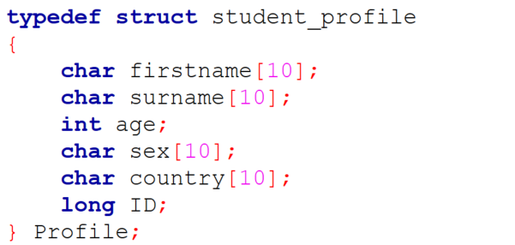
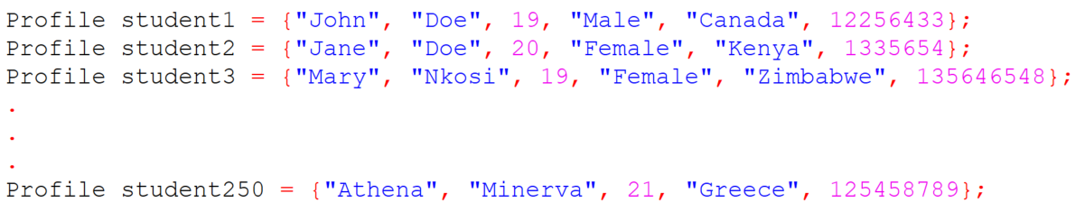
SU FACULTY of ENGINEERING
Computer Programming 143 lectures | 30 September 2026
Array of structures
Notes:
F,lashback

Slide 4
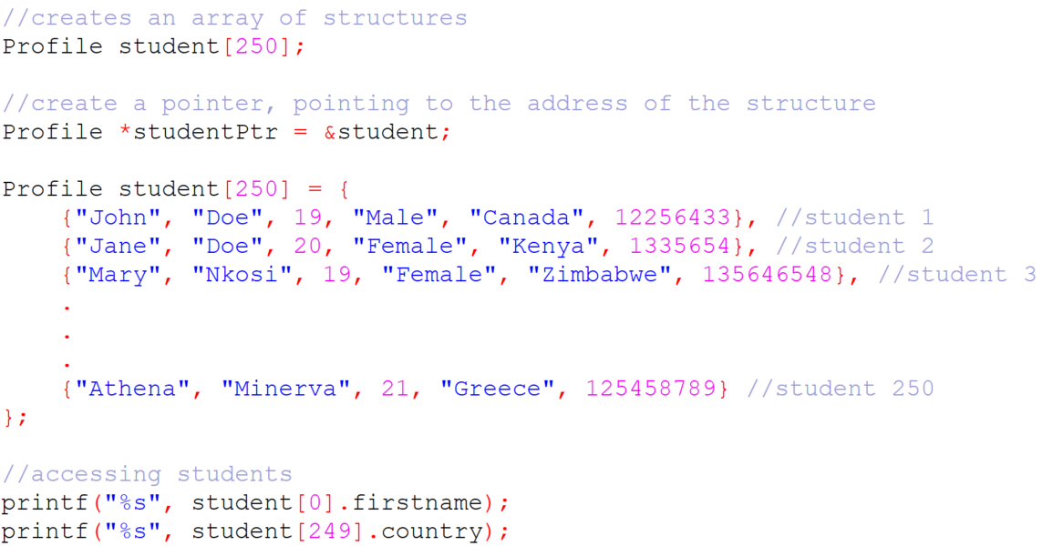
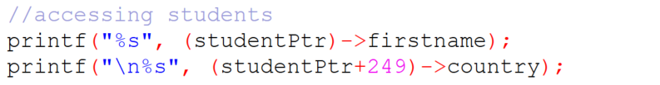
SU FACULTY of ENGINEERING
Computer Programming 143 lectures | 30 September 2026
Array of structures
Notes:
F,lashback

Slide 5
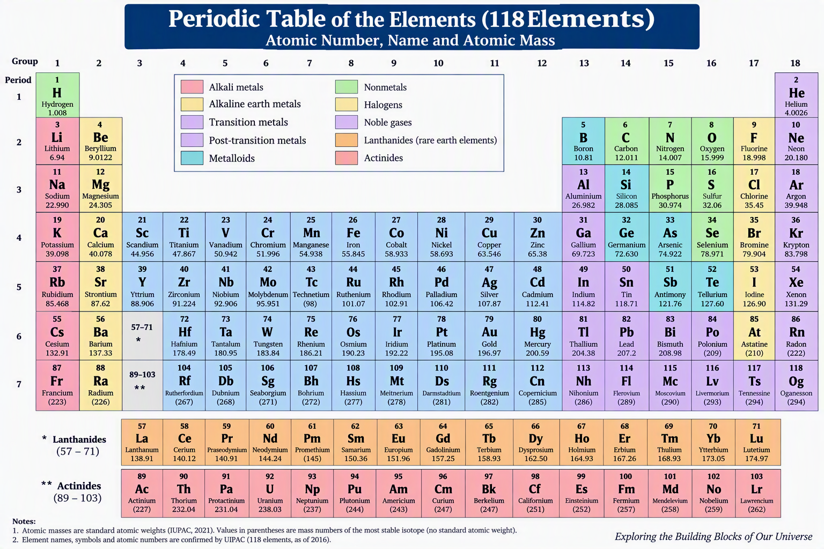
SU FACULTY of ENGINEERING
Computer Programming 143 lectures | 30 September 2026
Example I: Periodic Table

Slide 6
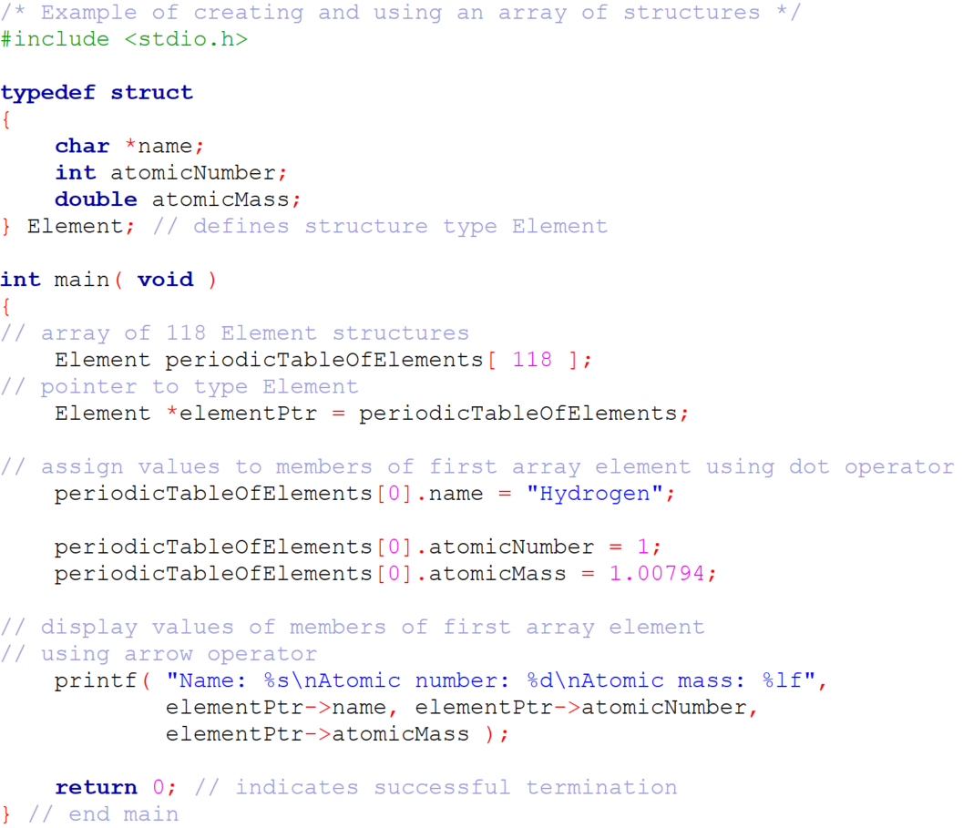
SU FACULTY of ENGINEERING
Computer Programming 143 lectures | 30 September 2026
Example I: Periodic Table

Slide 7
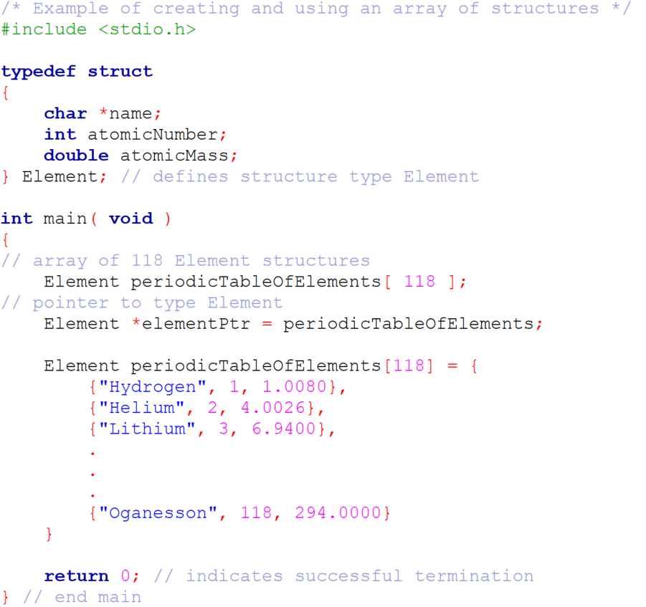
SU FACULTY of ENGINEERING
Computer Programming 143 lectures | 30 September 2026
Example I: Periodic Table

Slide 8
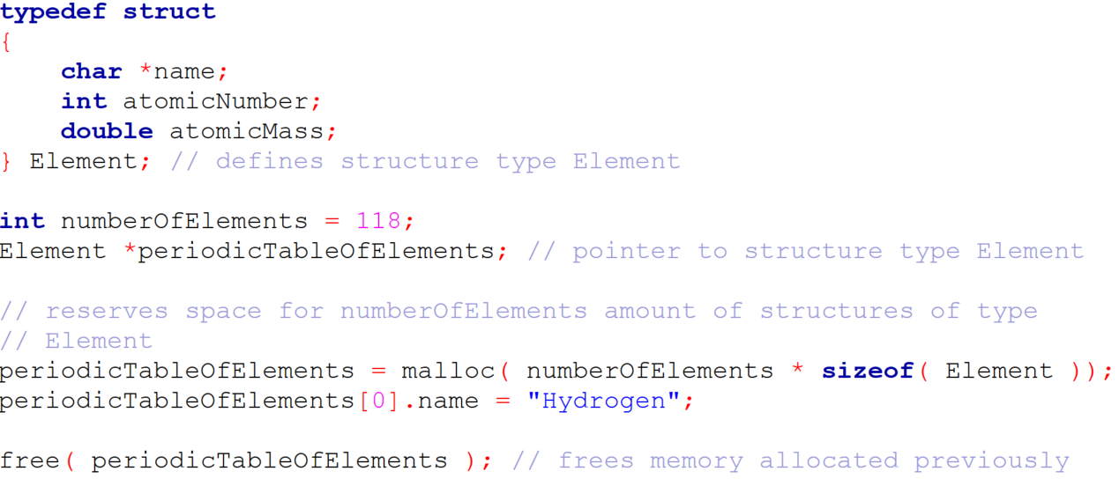
SU FACULTY of ENGINEERING
Computer Programming 143 lectures | 30 September 2026
Malloc() and Structures I

Slide 9
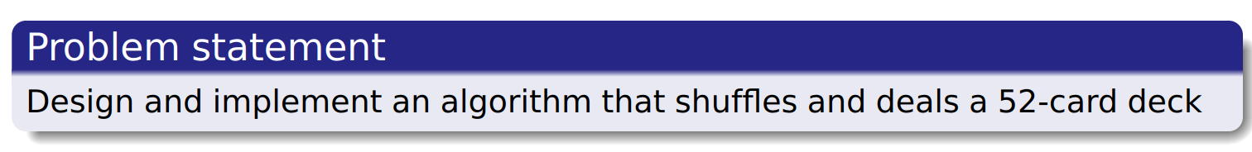
SU FACULTY of ENGINEERING
Computer Programming 143 lectures | 30 September 2026
Example 2: Card Shuffling and Dealing

Slide 10
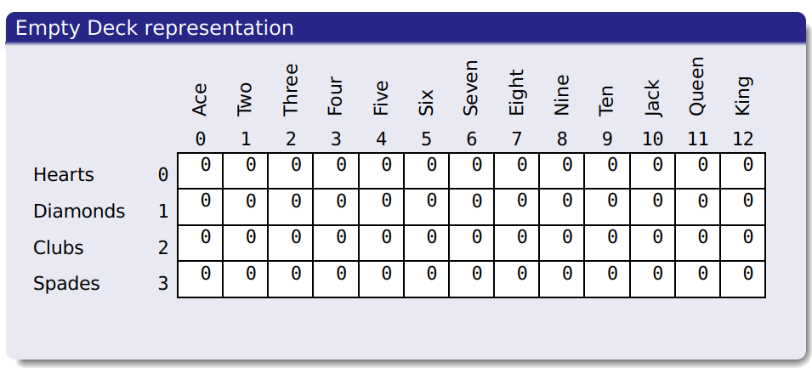
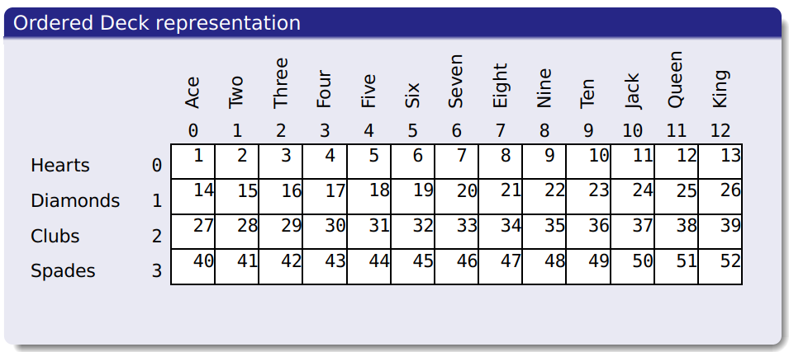
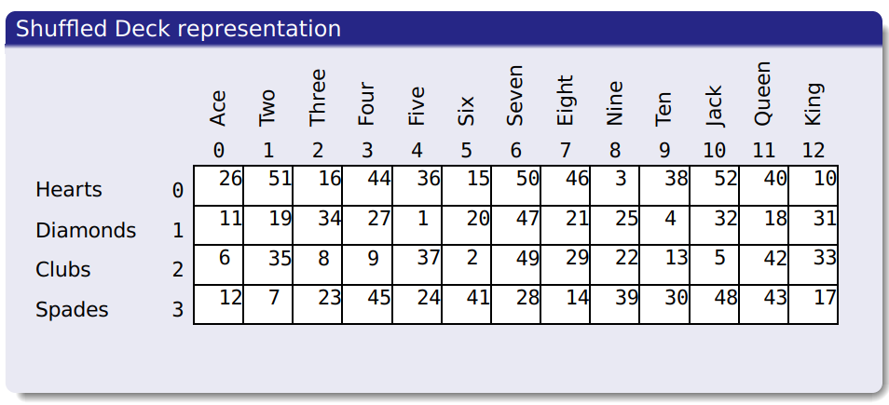
SU FACULTY of ENGINEERING
Computer Programming 143 lectures | 30 September 2026
Example: Card Shuffling and Dealing
LECTURE 21 RECAP

Slide 11
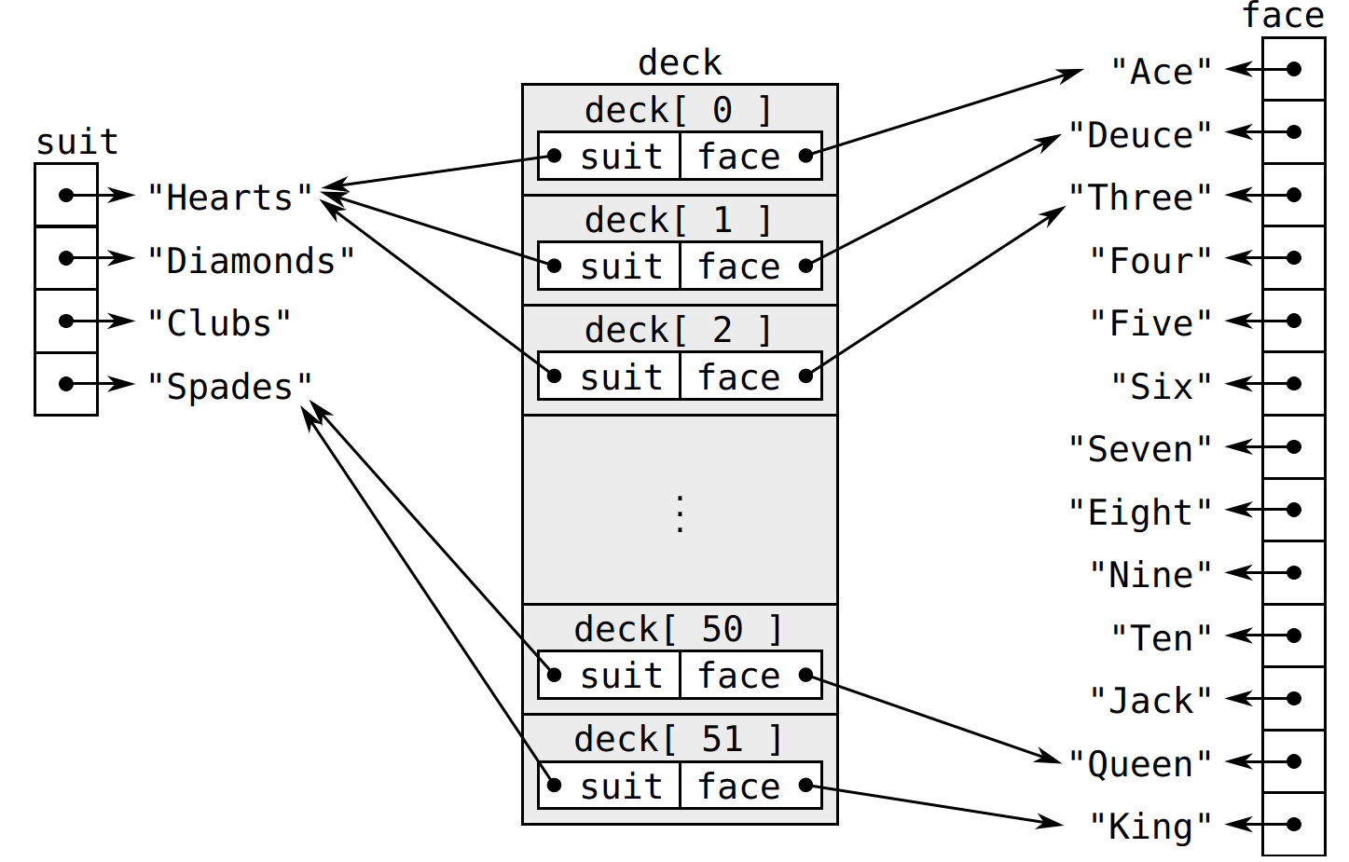
SU FACULTY of ENGINEERING
Computer Programming 143 lectures | 30 September 2026
Example: Card Shuffling and Dealing

Slide 12
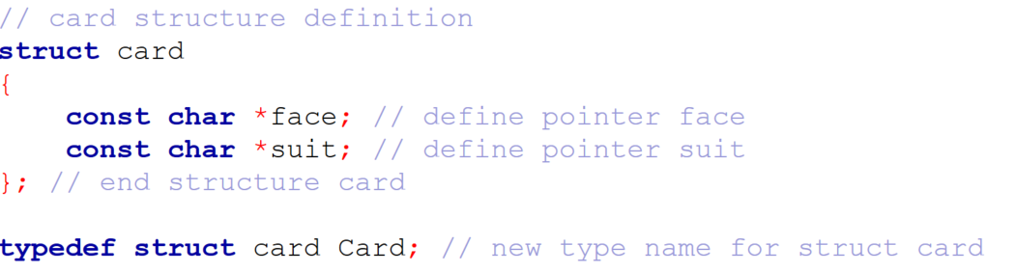
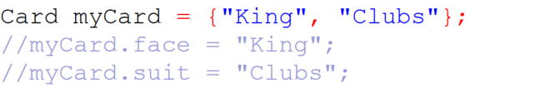
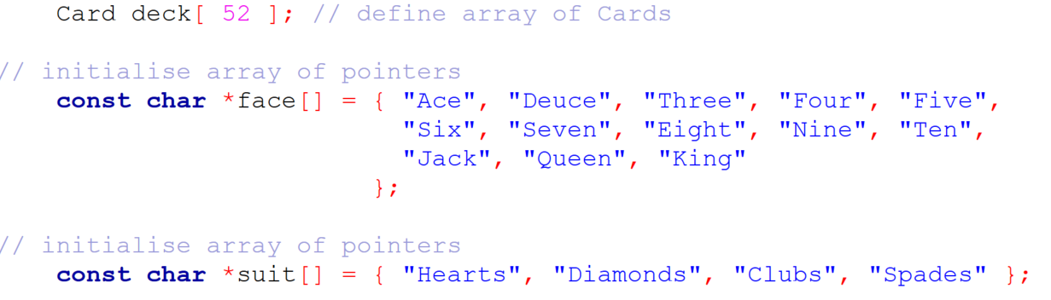
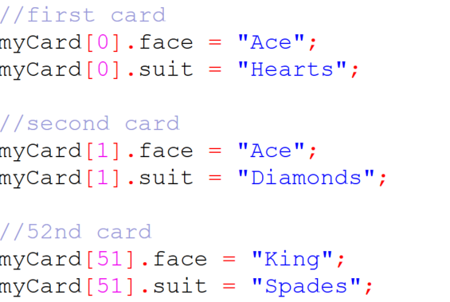
SU FACULTY of ENGINEERING
Computer Programming 143 lectures | 30 September 2026
Example 2

Slide 13
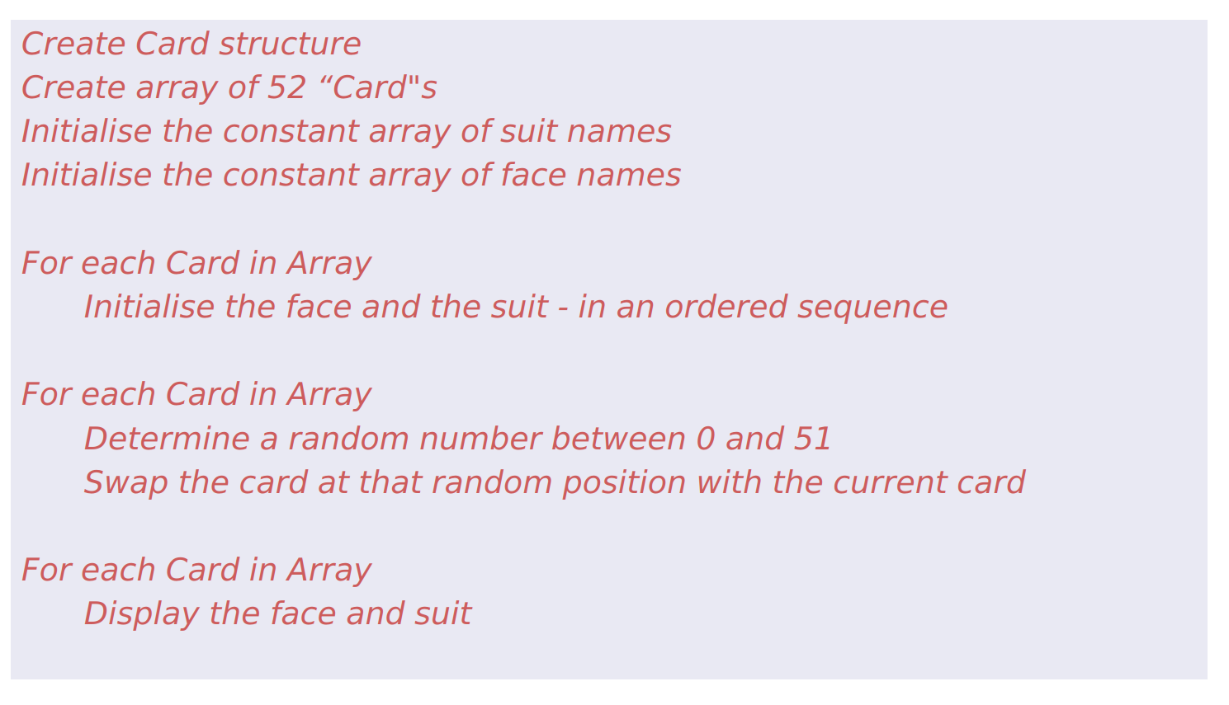
SU FACULTY of ENGINEERING
Computer Programming 143 lectures | 30 September 2026
Example: Pseudocode

Slide 14
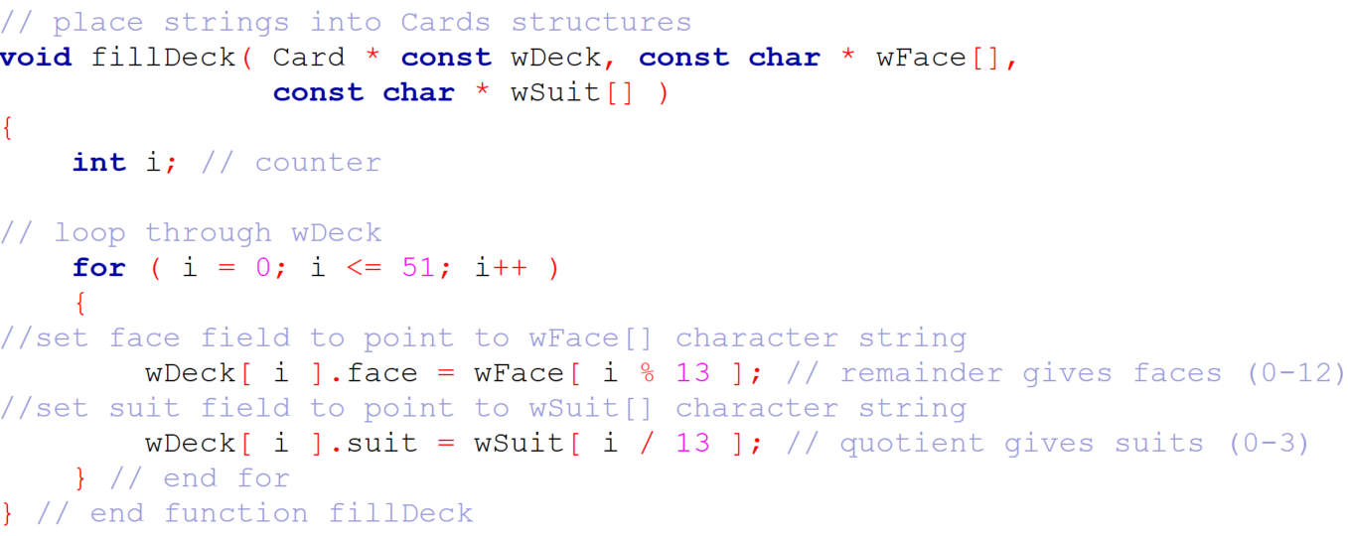
SU FACULTY of ENGINEERING
Computer Programming 143 lectures | 30 September 2026
Example: Functions (fillDeck)

Slide 15
SU FACULTY of ENGINEERING
Computer Programming 143 lectures | 30 September 2026
Example: C code
COMPLETE C CODE

Slide 16
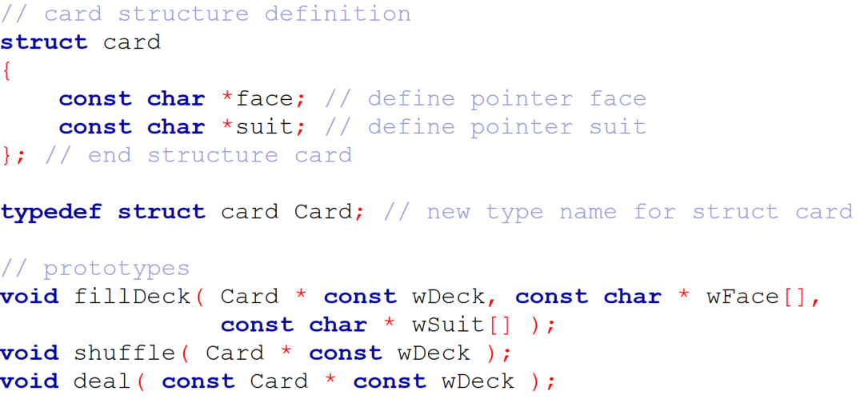
SU FACULTY of ENGINEERING
Computer Programming 143 lectures | 30 September 2026
Example: C code

Slide 17
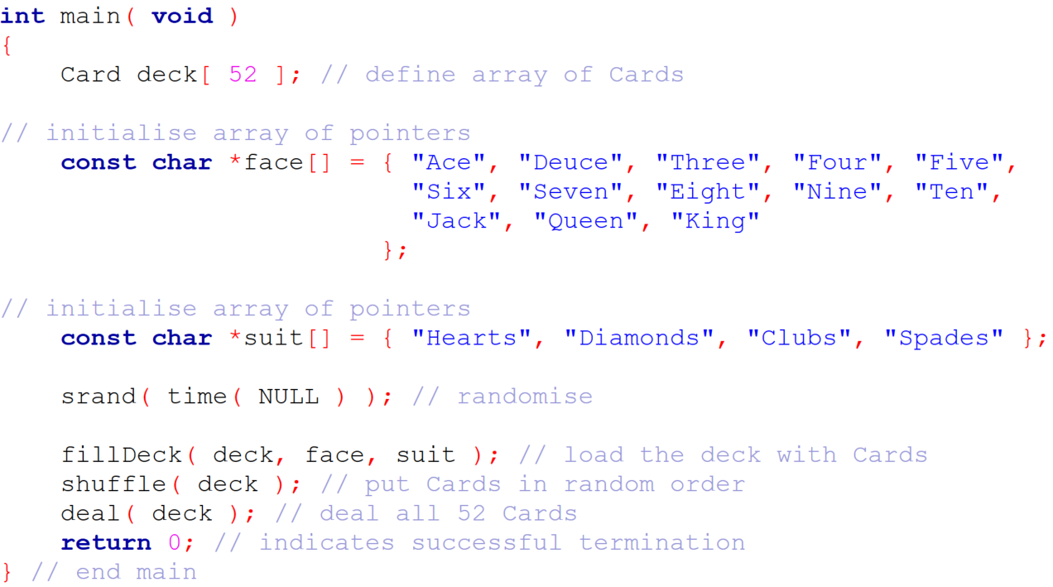
SU FACULTY of ENGINEERING
Computer Programming 143 lectures | 30 September 2026
Example: C code (main function)

Slide 18
SU FACULTY of ENGINEERING
Computer Programming 143 lectures | 30 September 2026
Example: Functions (fillDeck)

Slide 19
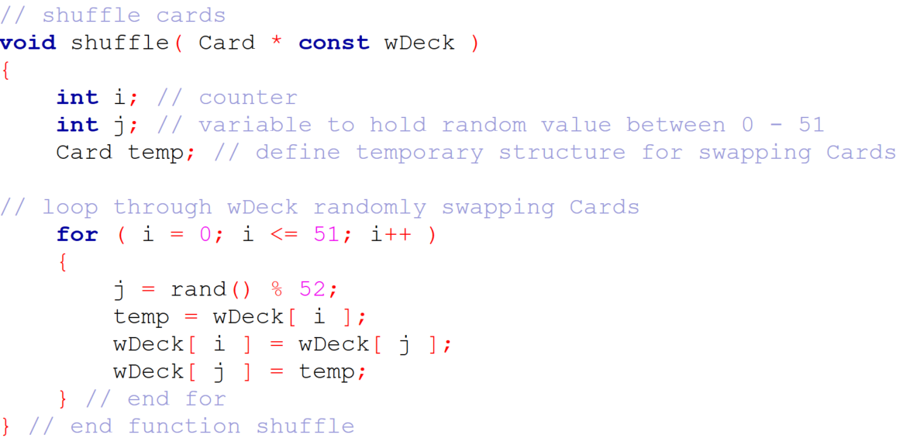
SU FACULTY of ENGINEERING
Computer Programming 143 lectures | 30 September 2026
Example: Functions (shuffle)

Slide 20
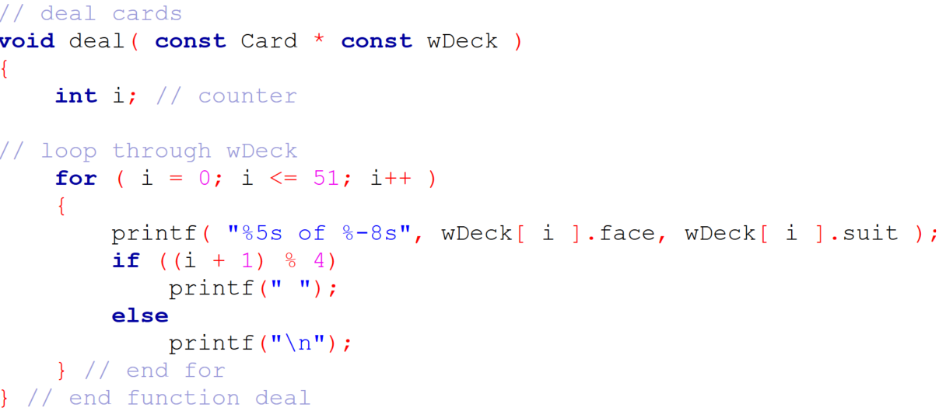
SU FACULTY of ENGINEERING
Computer Programming 143 lectures | 30 September 2026
Example: Functions (Deal)

Slide 21
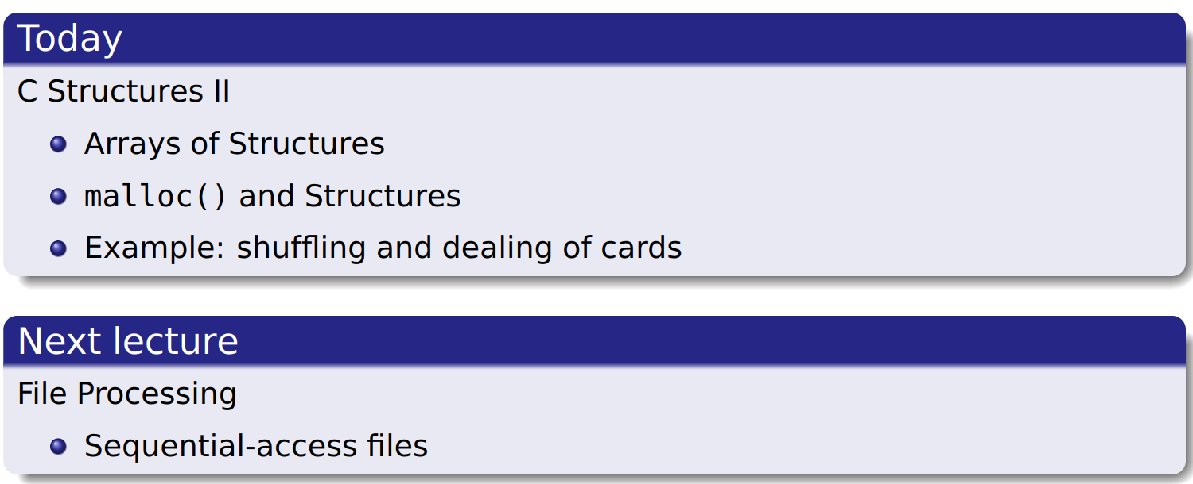
SU FACULTY of ENGINEERING
Computer Programming 143 lectures | 30 September 2026
Example: C code

Slide 22
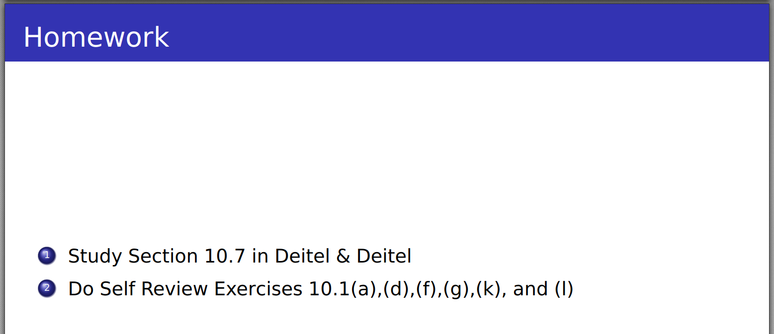
SU FACULTY of ENGINEERING
Computer Programming 143 lectures | 30 September 2026
Homework

