Slide 1

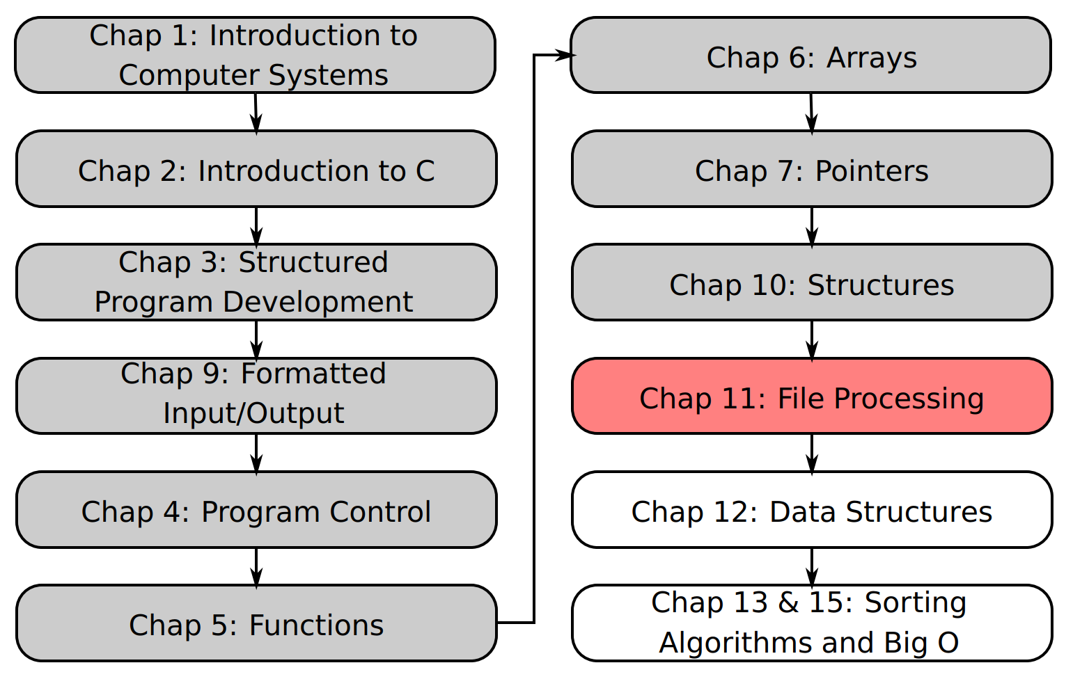
SU FACULTY of ENGINEERING
Computer Programming 143 lectures | 02 October 2026
Lecture Overview
11. File processing
Lecture 24| File types
Opening and closing files
Files and streams
Creating a text file for sequential access
Sequential reading from a text file
Isaac Khobo, PhD (ilkhobo@sun.ac.za)
Chapters 10: File processing
Notes:
Today we are looking at file processing, this is one of the most important use of any programming language. The ability to create files, update files, and process files.

Slide 2
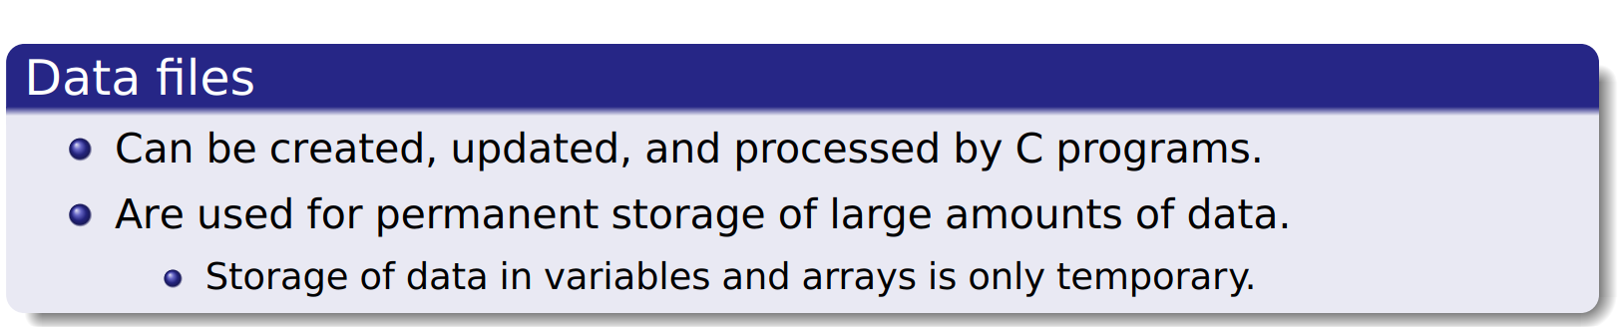
SU FACULTY of ENGINEERING
Computer Programming 143 lectures | 02 October 2026
Introduction
Notes:
F,lashback

Slide 3
SU FACULTY of ENGINEERING
Computer Programming 143 lectures | 02 October 2026
File types
BINARY FILES
TEXT FILES
Notes:
F,lashback

Slide 4

SU FACULTY of ENGINEERING
Computer Programming 143 lectures | 02 October 2026
File types
Unformatted (stored as “raw bytes”)
Data not human readable
Written and read sequentially or randomly
BINARY FILES
TEXT FILES
Notes:
F,lashback

Slide 5
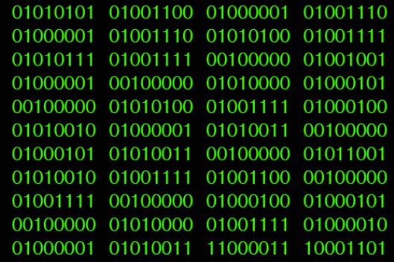

Slide 6
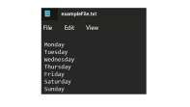
SU FACULTY of ENGINEERING
SU FACULTY of ENGINEERING
Computer Programming 143 lectures | 02 October 2026
Computer Programming 143 lectures | 02 October 2026
File types
File types
Unformatted (stored as “raw bytes”)
Data not human readable
Written and read sequentially or randomly
Data is stored as characters (char)
Usually only written and read sequentially
BINARY FILES
TEXT FILES
Notes:
F,lashback

Slide 7
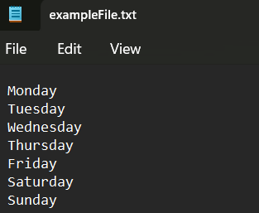

Slide 8
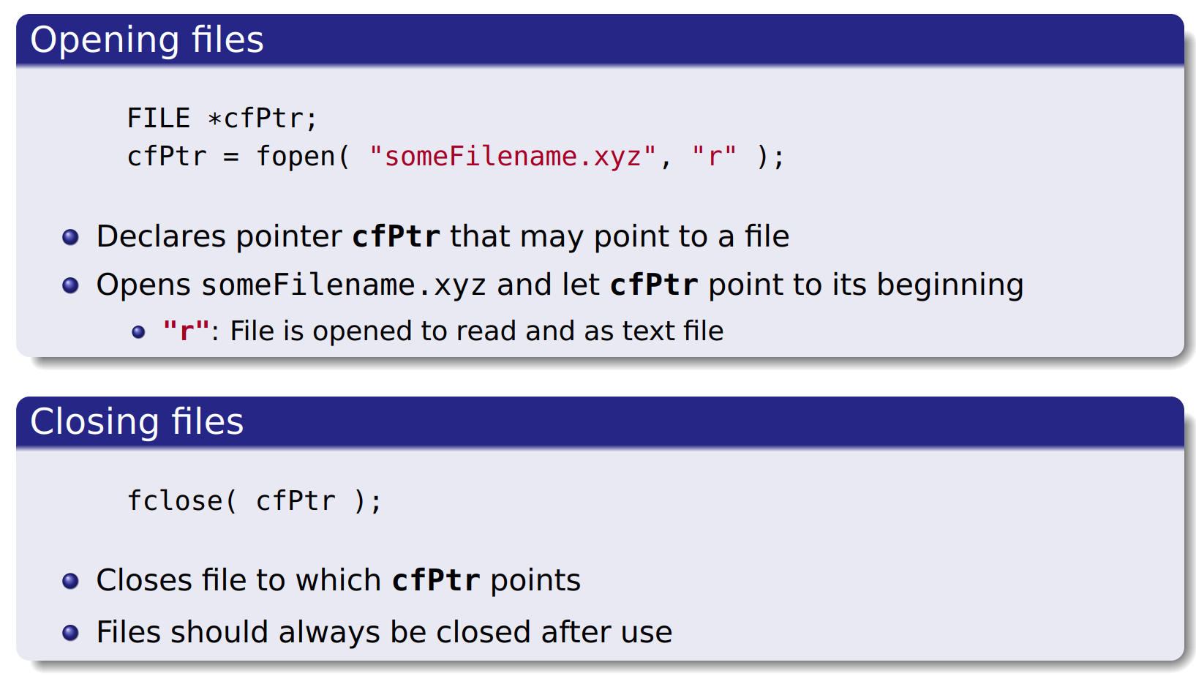
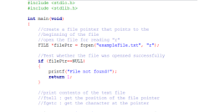
SU FACULTY of ENGINEERING
Computer Programming 143 lectures | 02 October 2026
File types
Notes:
F,lashback

Slide 9
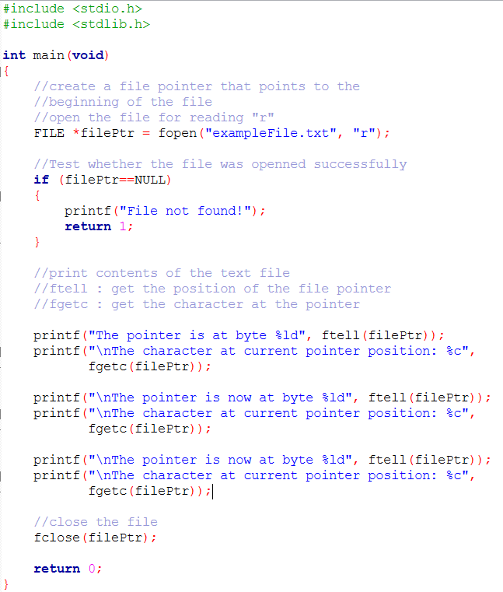

Slide 11
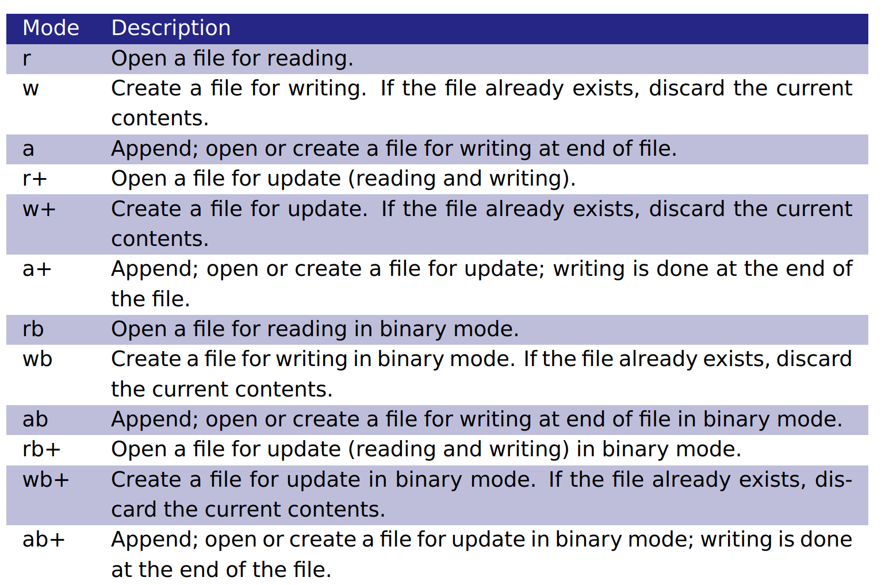
SU FACULTY of ENGINEERING
Computer Programming 143 lectures | 02 October 2026
File modes
Notes:
F,lashback

Slide 12
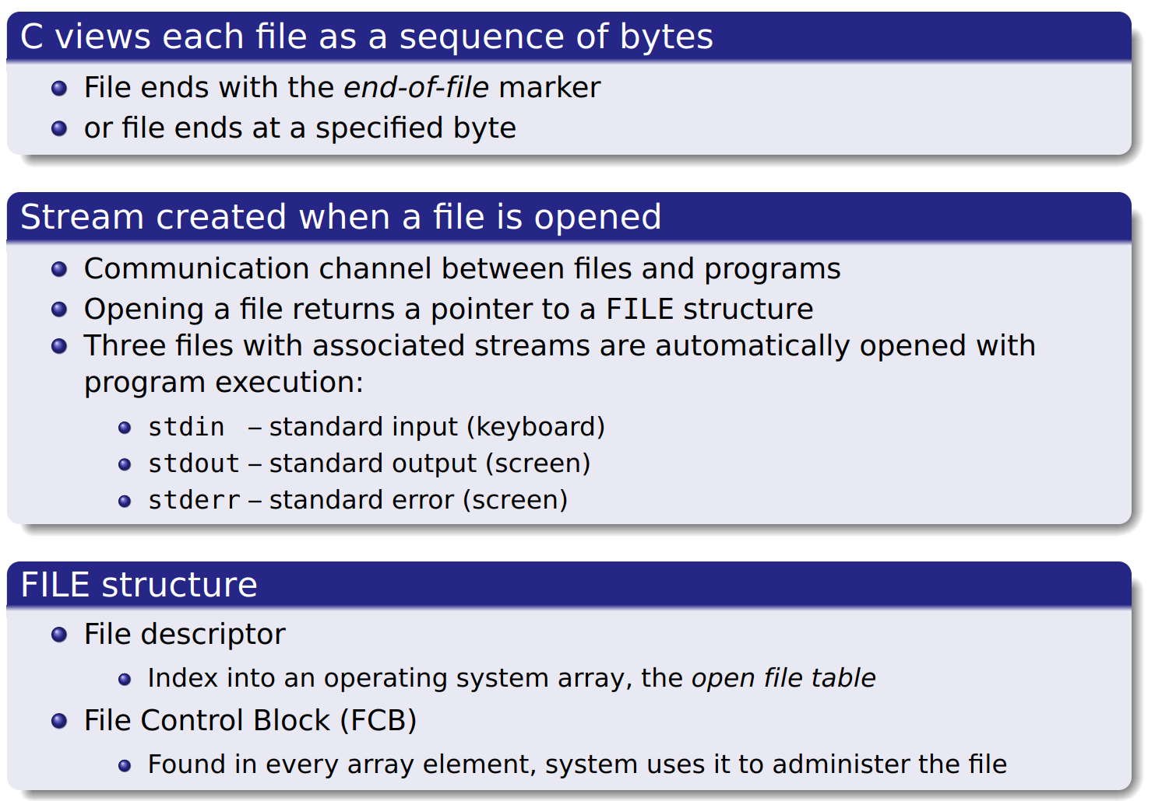
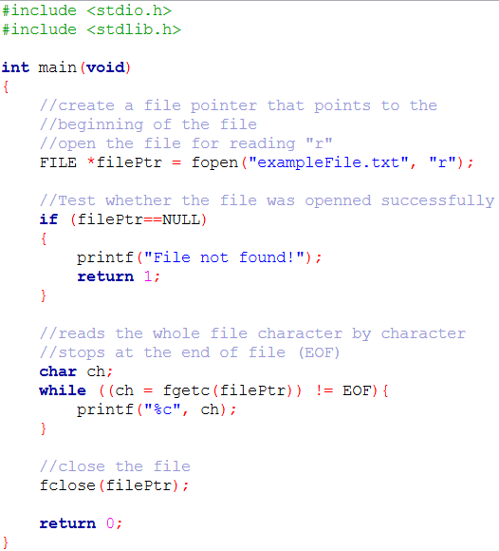
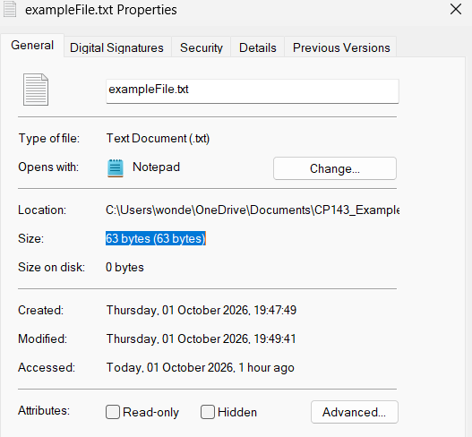
SU FACULTY of ENGINEERING
Computer Programming 143 lectures | 02 October 2026
File processing

Slide 13
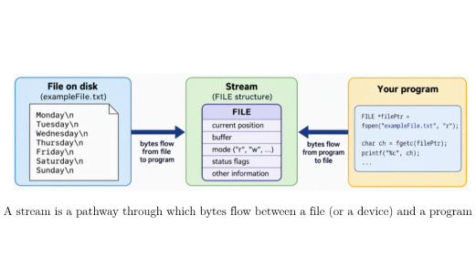
SU FACULTY of ENGINEERING
Computer Programming 143 lectures | 02 October 2026
File processing
Notes:
F,lashback

Slide 14
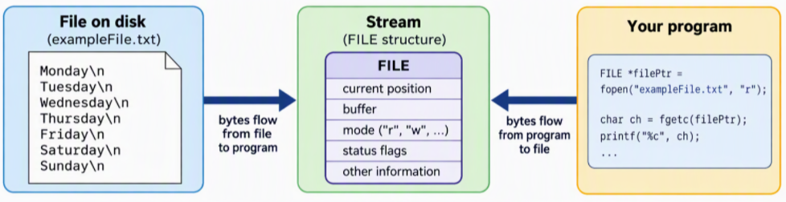
A stream is a pathway through which bytes flow between a file (or a device) and a program

Slide 15
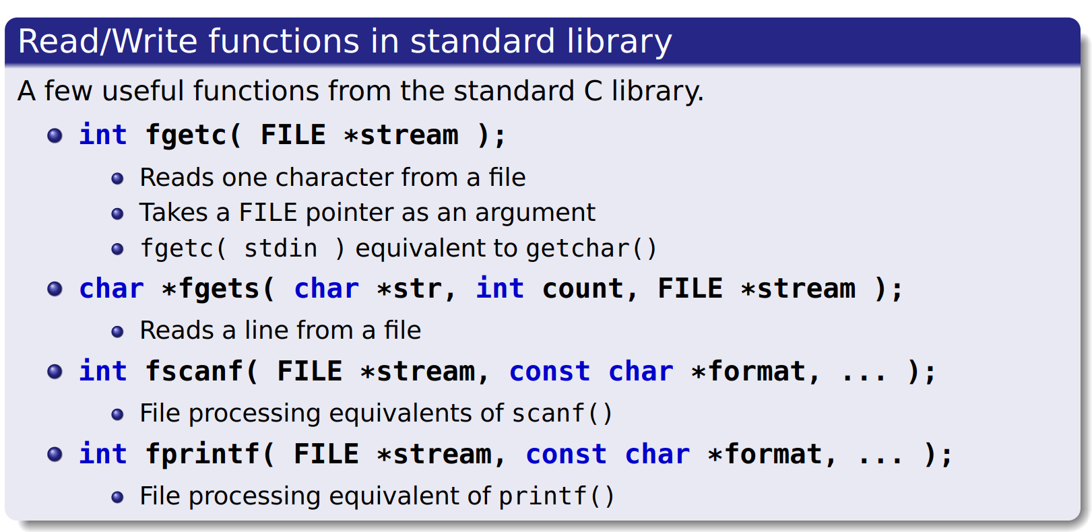
SU FACULTY of ENGINEERING
Computer Programming 143 lectures | 02 October 2026
Files and streams
Notes:
F,lashback

Slide 16
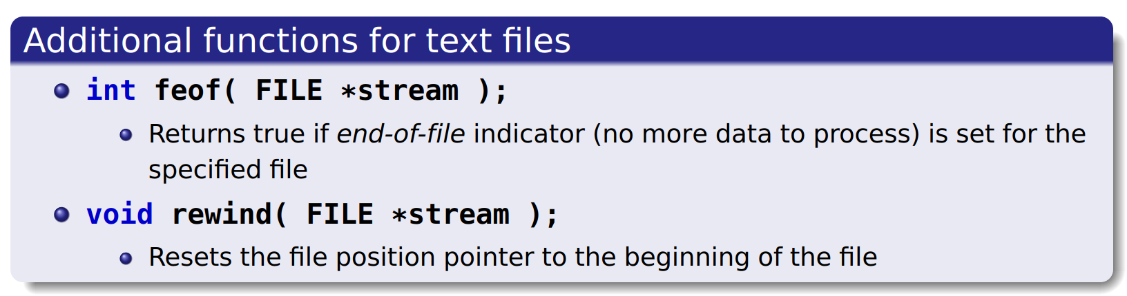
SU FACULTY of ENGINEERING
Computer Programming 143 lectures | 02 October 2026
Creating a text file for sequential access
Notes:
F,lashback

Slide 17
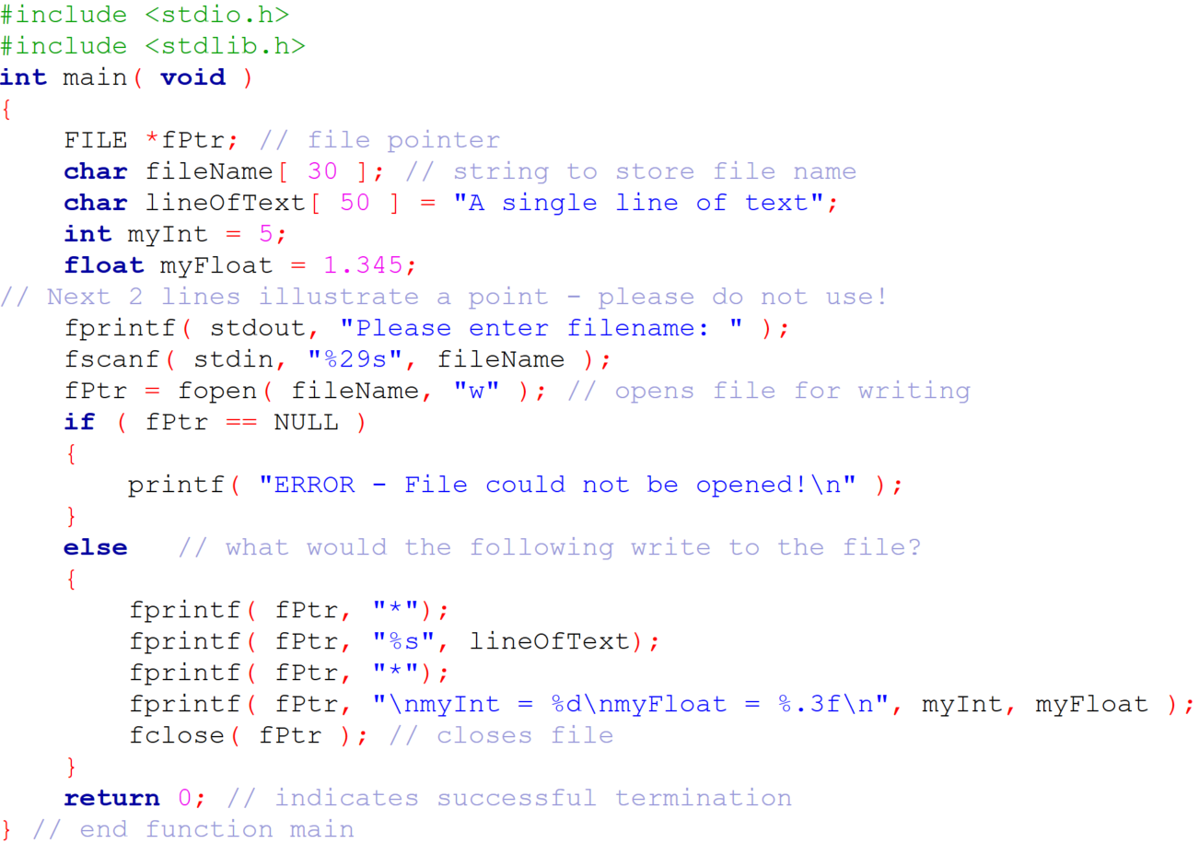
SU FACULTY of ENGINEERING
Computer Programming 143 lectures | 02 October 2026
Creating a text file for sequential access
Notes:
F,lashback

Slide 18
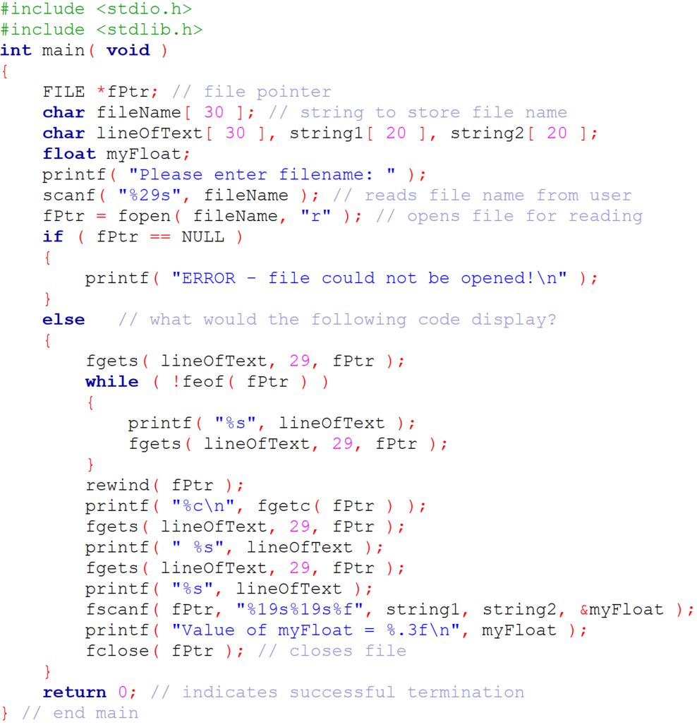
SU FACULTY of ENGINEERING
Computer Programming 143 lectures | 02 October 2026
Creating a text file for sequential access

Slide 19
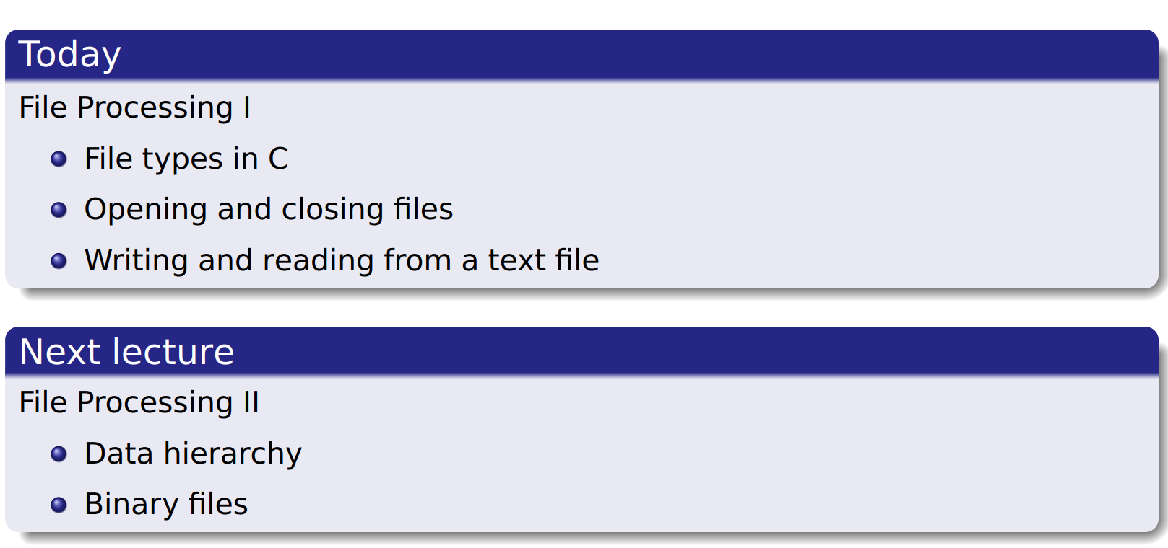
SU FACULTY of ENGINEERING
Computer Programming 143 lectures | 02 October 2026
Perspective
Notes:
F,lashback

Slide 20
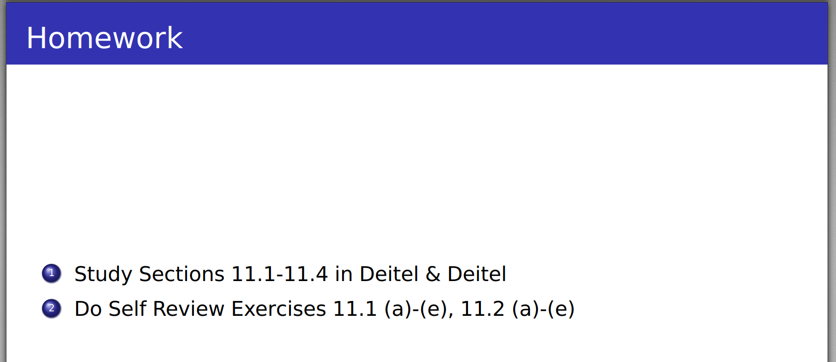
SU FACULTY of ENGINEERING
Computer Programming 143 lectures | 02 October 2026
Perspective
Revise file modes
Revise Structures: shuffle and deal functions for the card simulation program
Do the practical questions!
Notes:
F,lashback

