Slide 1


SU FACULTY of ENGINEERING
Computer Programming 143 lectures | 16 September 2026
PROGRAMMING IN C
7. Pointers II
Lecture 18| Review of pointer basics
Calling functions by reference
Isaac Khobo, PhD (ilkhobo@sun.ac.za)
Chapters 7: Pointers

Slide 2
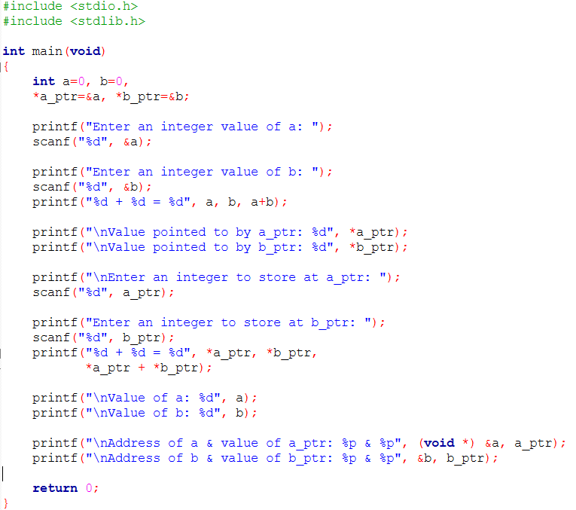
SU FACULTY of ENGINEERING
Computer Programming 143 lectures | 16 September 2026
Pointers basics review
A variable that stores a memory address.
(the pointer points to the variable at its stored memory address)
& - accesses memory of a variable
Pointers
PRACTICAL 7, PART A

Slide 3
SU FACULTY of ENGINEERING
Computer Programming 143 lectures | 16 September 2026
Pointers basics review
Declared with an asterisk symbol (*)
Pointer to address of an integer a is:
int *a_ptr = &a
Alternative declarations:
int* a_ptr = &a
int * a_ptr = &a
Pointers
PRACTICAL 7, PART A

Slide 4
SU FACULTY of ENGINEERING
Computer Programming 143 lectures | 16 September 2026
Pointers basics review
Direct reference to a (referring to the value of a directly)
Pointers
PRACTICAL 7, PART A

Slide 5
SU FACULTY of ENGINEERING
Computer Programming 143 lectures | 16 September 2026
Pointers basics review
referring to the value of a by using its address in memory
(*) is also an indirection or dereferencing operator
*a_ptr = stores the value of a (indirect reference)
Pointers
PRACTICAL 7, PART A

Slide 6
SU FACULTY of ENGINEERING
Computer Programming 143 lectures | 16 September 2026
Pointers basics review
Values of a and b have now been changed indirectly
Another example:
*a_ptr = (*a_ptr) * (*a_ptr) will square the value to which a_ptr points (i.e., squares value of a).
Pointers
PRACTICAL 7, PART A

Slide 7
SU FACULTY of ENGINEERING
Computer Programming 143 lectures | 16 September 2026
Pointers basics review
a_ptr are address, so & is not needed for scanf.
Similarly:
Arrays are not passed with &, because the array name is already an address/reference (pointer) to the first array element
char string[20];
scanf(“%s”, string);
Pointers
PRACTICAL 7, PART A

Slide 8
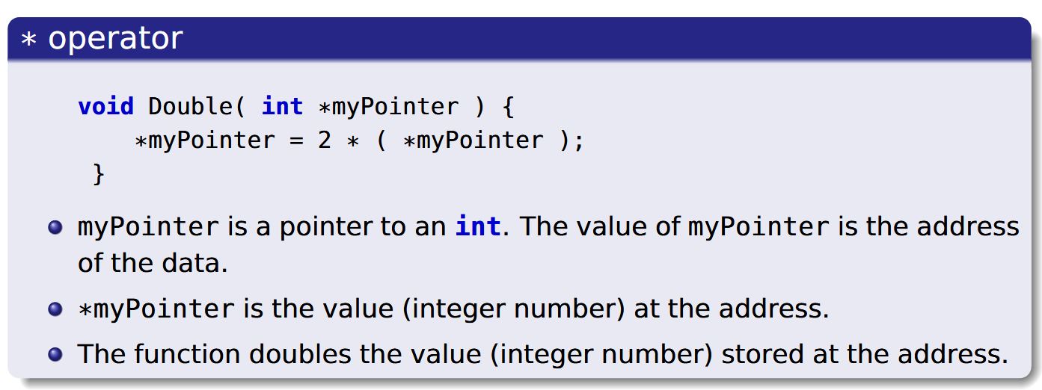
SU FACULTY of ENGINEERING
Computer Programming 143 lectures | 16 September 2026
Pointers: call-by-reference
Notes:
You can pass pointers into functions. That is “call-by-reference’ since the value of the pointer is the address of the data i.e., you are accessing it by reference (address) or indirectly

Slide 9
SU FACULTY of ENGINEERING
Computer Programming 143 lectures | 16 September 2026
Pointers & functions: call-by-value vs call-by-reference
PASS BY VALUE
PASS BY REFERENCE
data_type_x myFunction (data_type_y Value){
data_type_x result = arithmetic on Value;
return result;
}
void myFunction (data_type *Value){
*Value arithmetic
}
Call:
myFunction (random_value)
Call:
myFunction (&random_value)
FORMAT: FUNCTION PROTOTYPES
Declared with the variable
|
Declared with the pointer variable

Slide 10
SU FACULTY of ENGINEERING
Computer Programming 143 lectures | 16 September 2026
Pointers & functions: call-by-value vs call-by-reference
PASS BY VALUE
PASS BY REFERENCE
data_type_x myFunction (data_type_y Value){
data_type_x result = arithmetic on Value;
return result;
}
void myFunction (data_type *Value){
*Value arithmetic
}
Call:
myFunction (random_value)
Call:
myFunction (&random_value)
FORMAT: FUNCTION PROTOTYPES
Declared with the variable
|
Declared with the pointer variable

Slide 11
SU FACULTY of ENGINEERING
Computer Programming 143 lectures | 16 September 2026
Pointers & functions: call-by-value vs call-by-reference
PASS BY VALUE
PASS BY REFERENCE
data_type_x myFunction (data_type_y Value){
data_type_x result = arithmetic on Value;
return result;
}
void myFunction (data_type *Value){
*Value arithmetic
}
Call:
myFunction (random_value)
Call:
myFunction (&random_value)
WHAT HAPPENS DURING ARITHMETIC
Creates copy of value, performs arithmetic
Stores the result in the value’s address i.e.,
Function changes a copy
The arithmetic is performed on the value
at the address i.e., function changes the original
variable
|

Slide 12
SU FACULTY of ENGINEERING
Computer Programming 143 lectures | 16 September 2026
Pointers & functions: call-by-value vs call-by-reference
PASS BY VALUE
PASS BY REFERENCE
data_type_x myFunction (data_type_y Value){
data_type_x result = arithmetic on Value;
return result;
}
void myFunction (data_type *Value){
*Value arithmetic
}
Call:
myFunction (random_value)
Call:
myFunction (&random_value)
FUNCTION CALLS
Call by the value
|
Call by the address

Slide 13
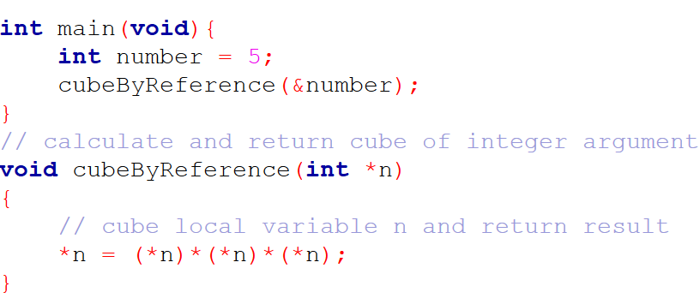
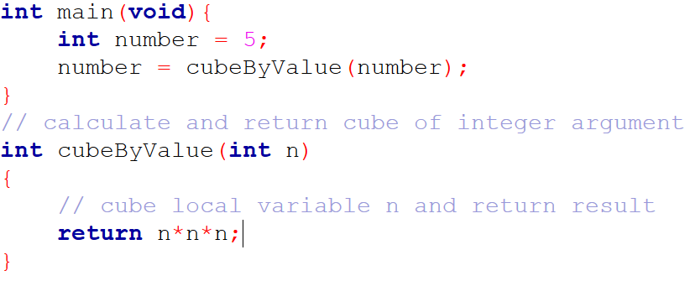
SU FACULTY of ENGINEERING
Computer Programming 143 lectures | 16 September 2026
EXAMPLES WITH CUBIC FUNCTIONS
PASS BY VALUE
PASS BY REFERENCE
Initialising the number
number
number
Value of number is the initialised value
|
Value of number is the initialised value
n
n

Slide 14
SU FACULTY of ENGINEERING
Computer Programming 143 lectures | 16 September 2026
EXAMPLES WITH CUBIC FUNCTIONS
PASS BY VALUE
PASS BY REFERENCE
number
number
n
n
Initialising the number
Value of number is the initialised value
|
Value of number is the initialised value

Slide 15
SU FACULTY of ENGINEERING
Computer Programming 143 lectures | 16 September 2026
EXAMPLES WITH CUBIC FUNCTIONS
PASS BY VALUE
PASS BY REFERENCE
number
number
5
5
n
n
undefined
undefined
Initialising the number
Value of number is the initialised value
|
Value of number is the initialised value

Slide 16
SU FACULTY of ENGINEERING
Computer Programming 143 lectures | 16 September 2026
EXAMPLES WITH CUBIC FUNCTIONS
PASS BY VALUE
PASS BY REFERENCE
number
number
5
5
n
n
5
&number
Function calls
“Creates copy” of number and stores
result in n
|
n “points to” the address of the initialised number

Slide 17
SU FACULTY of ENGINEERING
Computer Programming 143 lectures | 16 September 2026
EXAMPLES WITH CUBIC FUNCTIONS
PASS BY VALUE
PASS BY REFERENCE
number
number
5
125
n
n
125
&number
Arithmetic
Arithmetic performed on n and then copied
to the address of the number
n “points to” the address of the initial number,
Performs arithmetic on the value at the address
pointed to
|

Slide 18
SU FACULTY of ENGINEERING
Computer Programming 143 lectures | 16 September 2026
EXAMPLES WITH CUBIC FUNCTIONS
PASS BY VALUE
PASS BY REFERENCE
number
number
125
125
n
undefined
undefined
Arithmetic
Arithmetic performed on n and then copied
to the address of the number
|
Arithmetic performed at the number’s address
and result changed there

Slide 19
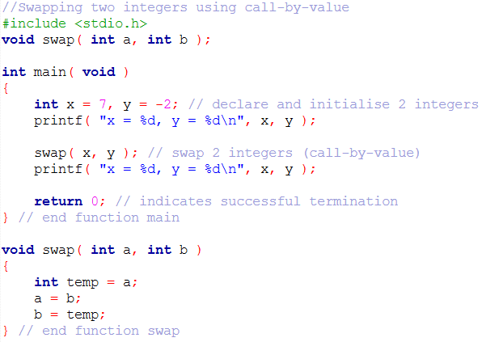
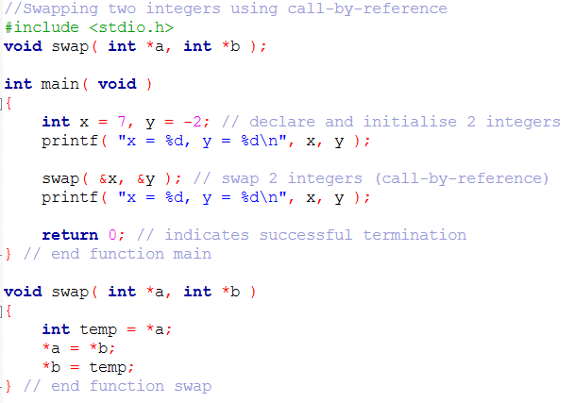
SU FACULTY of ENGINEERING
Computer Programming 143 lectures | 16 September 2026
EXAMPLE 2 SWAPPING VALUES
PASS BY VALUE
PASS BY REFERENCE

