Slide 1


SU FACULTY of ENGINEERING
Computer Programming 143 lectures | 23 September 2026
PROGRAMMING IN C
7. Pointers V
Lecture 21| Array of pointers
Design example: card shuffling and dealing
Isaac Khobo, PhD (ilkhobo@sun.ac.za)
Chapters 7: Pointers

Slide 2

SU FACULTY of ENGINEERING
Computer Programming 143 lectures | 23 September 2026
Recap
char myString[] = “programming”;
name
value
address
char *myPointer = myString;
….
….
myPointer
myString[0]
p
0x3000
myString[1]
r
0x3001
myArray[i] = *(myPointer+i) pointer offset notation
myArray[i] = myPointer[i] pointer subscript notation
myArray[i] = *(myArray+i) array offset notation
Relationship between pointers & arrays
myString[2]
0x3002
o
myString[3]
g
0x3003
myString[4]
r
0x3004
myString[5]
a
0x3005
myString[6]
m
0x3006
myString[7]
m
0x3007
myString[8]
i
0x3008
myString[9]
n
0x3009
myString[10]
g
0x3010
…
…
0xFF

Slide 3
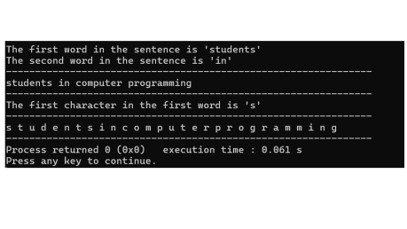
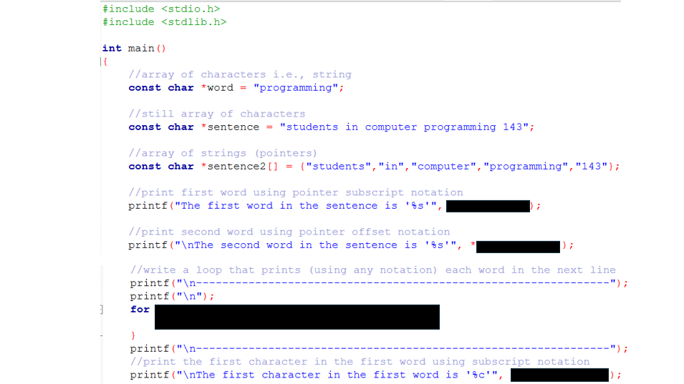
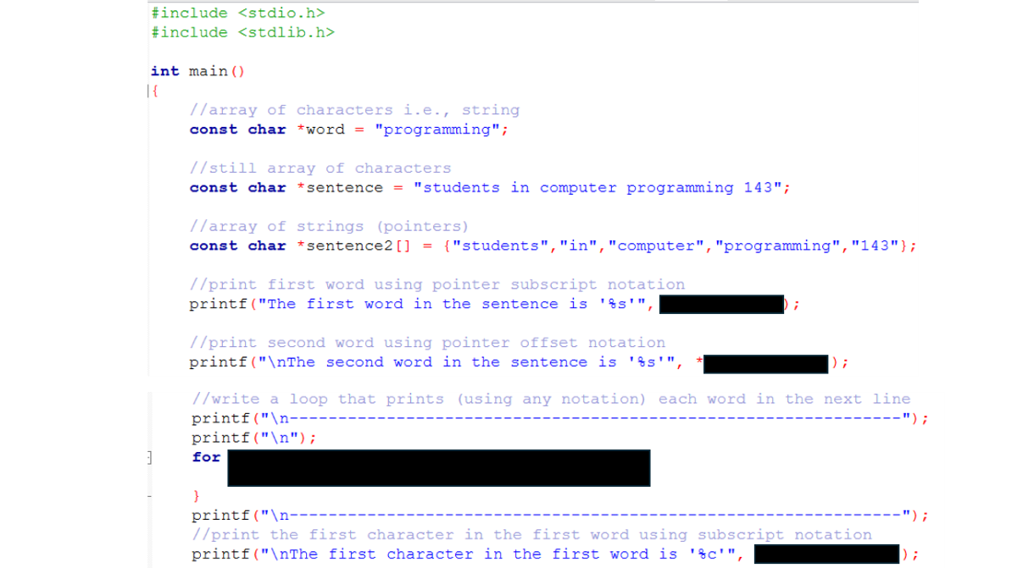
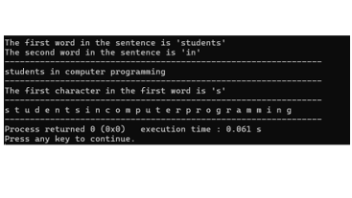
SU FACULTY of ENGINEERING
Computer Programming 143 lectures | 23 September 2026
Array of pointers

Slide 4
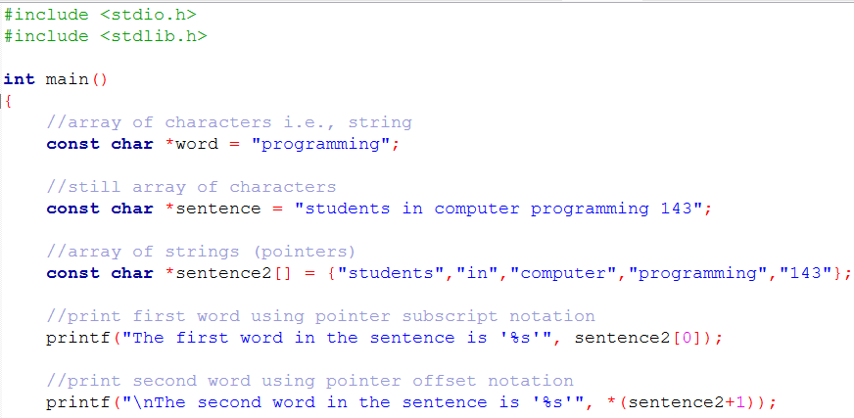
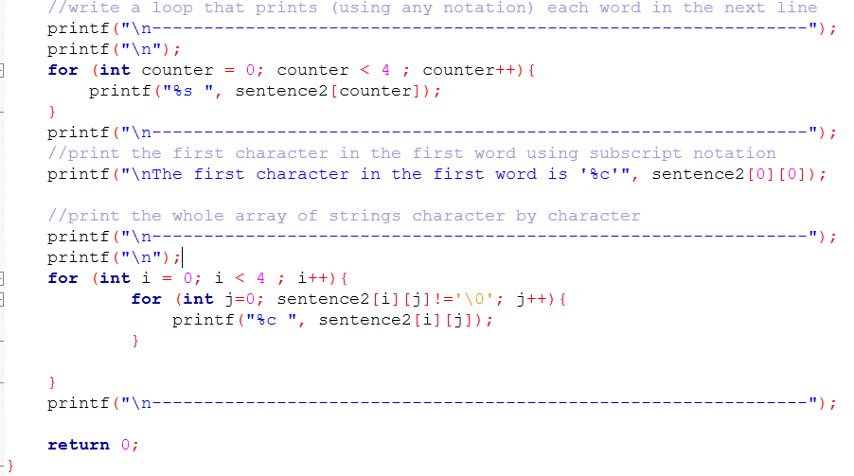

Slide 6
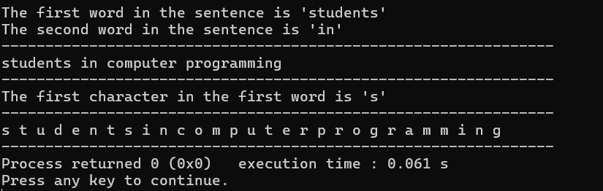

Slide 7
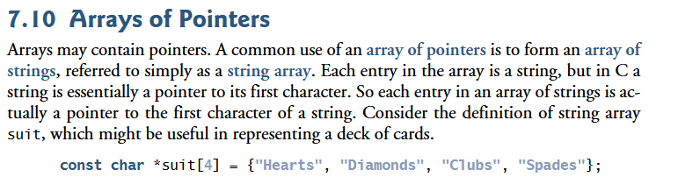
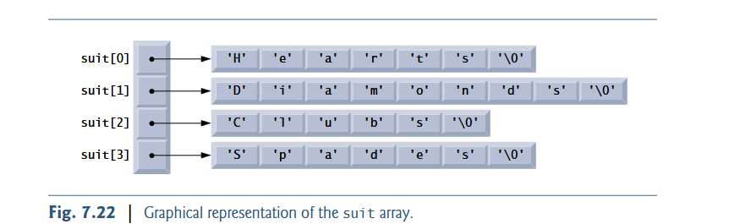
SU FACULTY of ENGINEERING
Computer Programming 143 lectures | 23 September 2026
Array of pointers

Slide 8
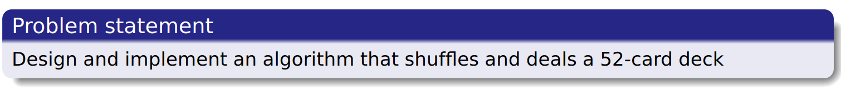
SU FACULTY of ENGINEERING
Computer Programming 143 lectures | 23 September 2026
Example: Card Shuffling and Dealing

Slide 9
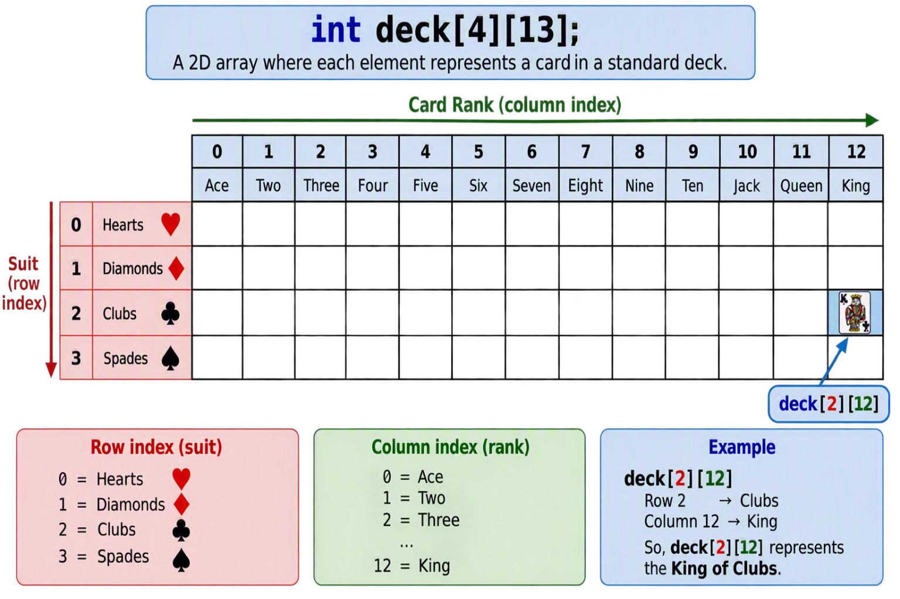
SU FACULTY of ENGINEERING
Computer Programming 143 lectures | 23 September 2026
Example: Card Shuffling and Dealing
Notes:
You can represent a deck of cards as a 2D array. Row 0 corresponds to hearts, Row 1 corresponds to Diamonds, etc.

Slide 10
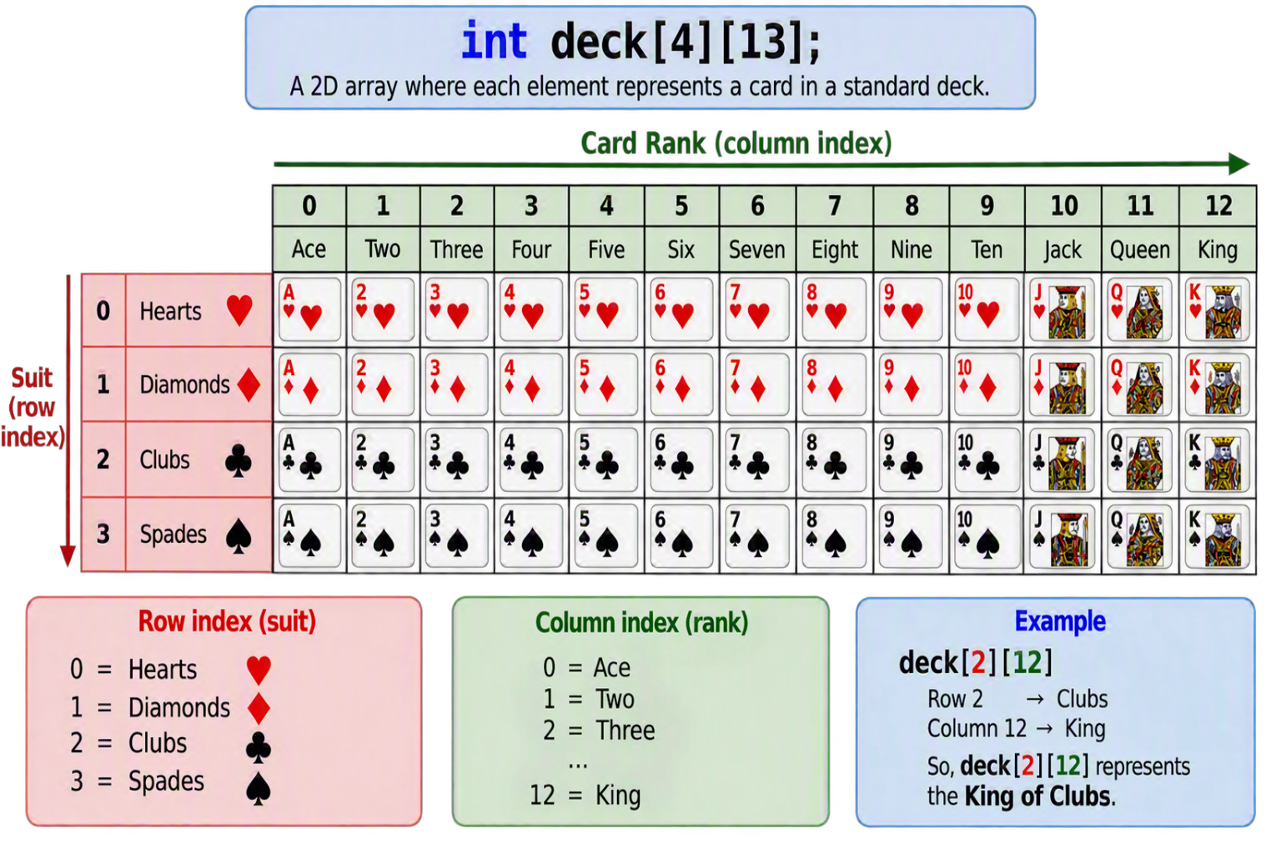

SU FACULTY of ENGINEERING
Computer Programming 143 lectures | 23 September 2026
Example: Card Shuffling and Dealing
Notes:
For an ordered deck, you’d have something like deck[0][0] would be “ace of hearts”

Slide 11
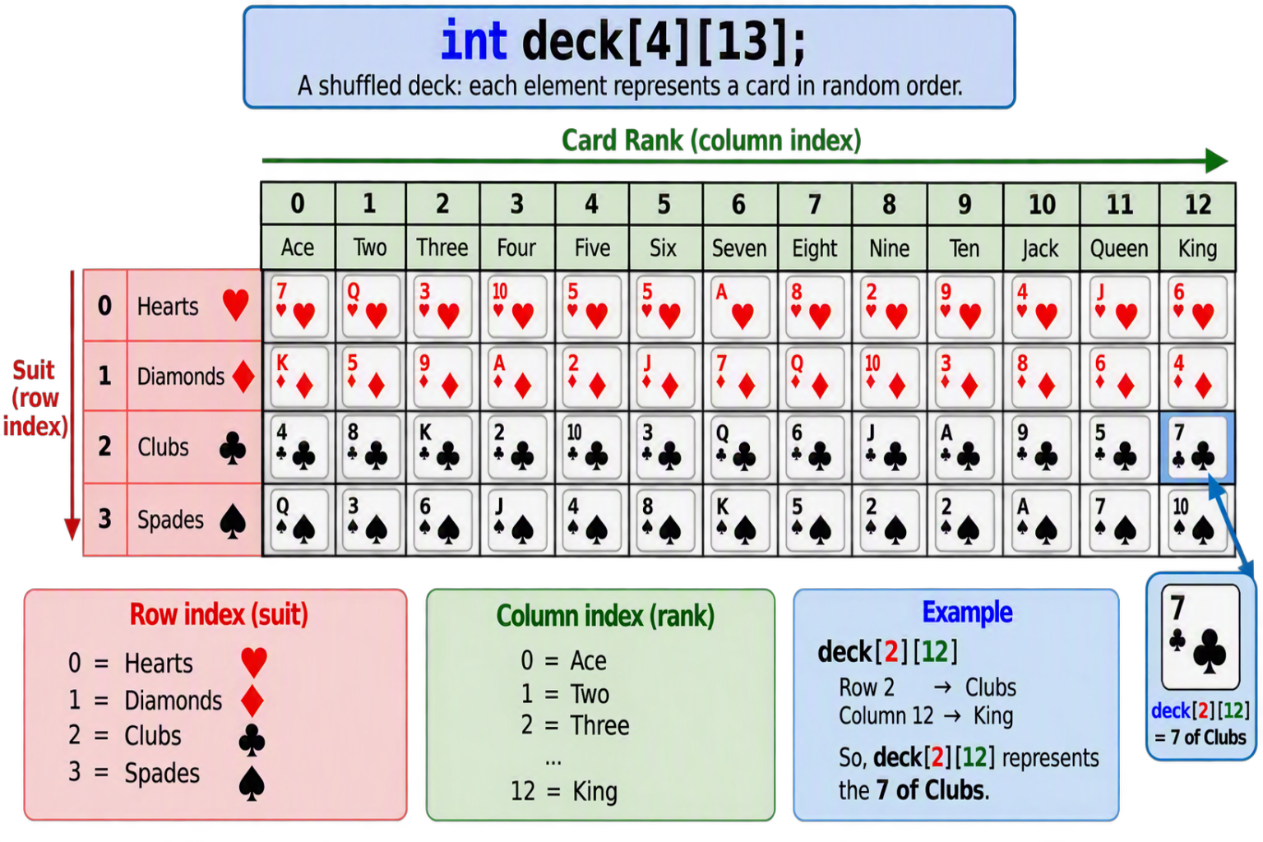

SU FACULTY of ENGINEERING
Computer Programming 143 lectures | 23 September 2026
Example: Card Shuffling and Dealing

Slide 12
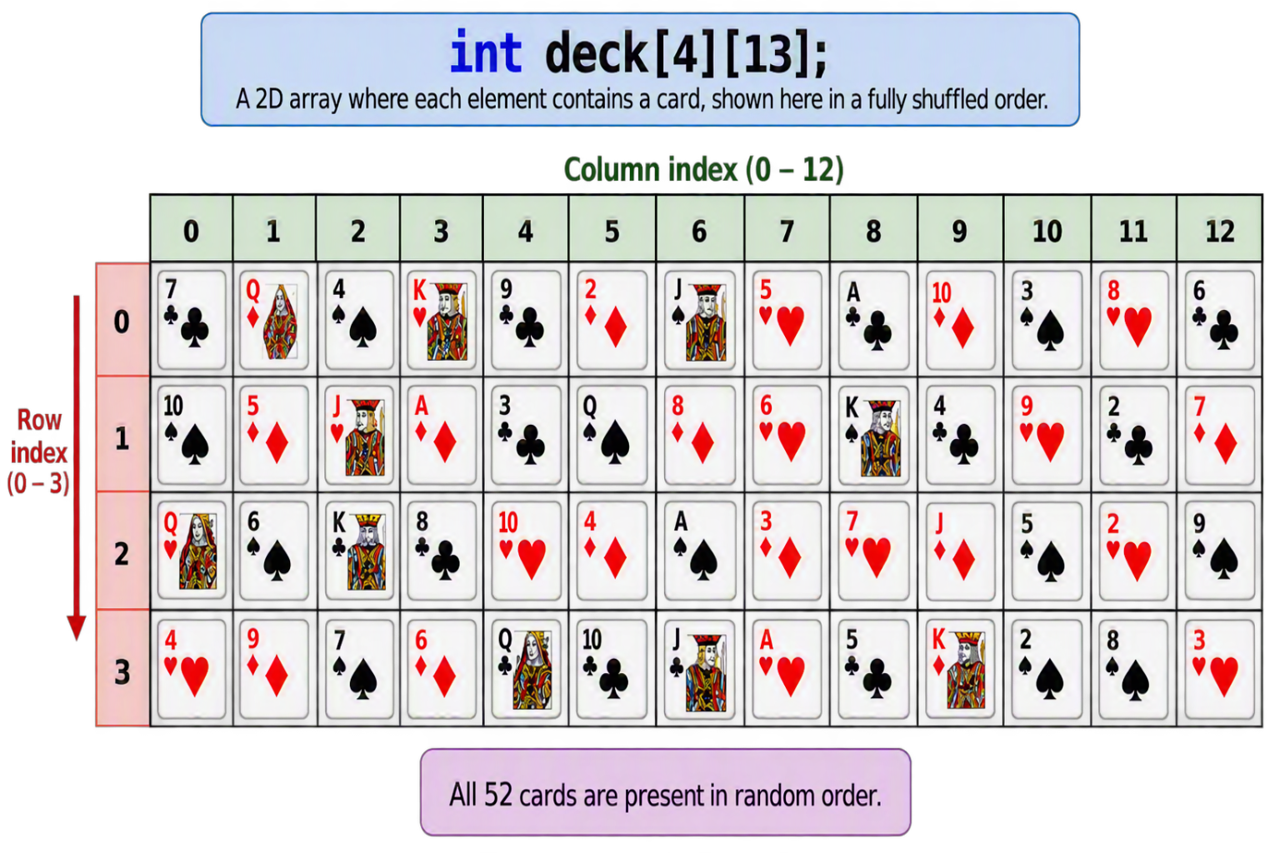
SU FACULTY of ENGINEERING
Computer Programming 143 lectures | 23 September 2026
Example: Card Shuffling and Dealing

Slide 13
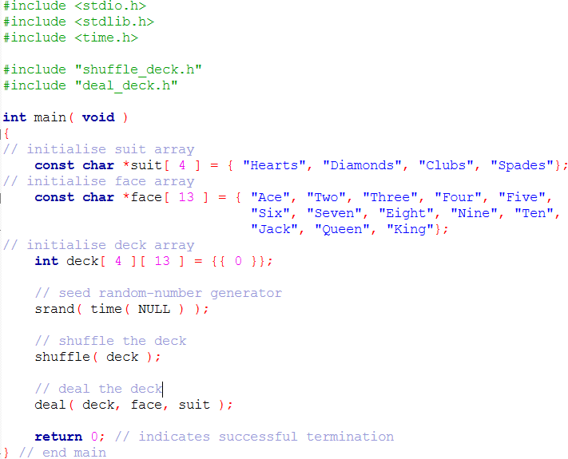
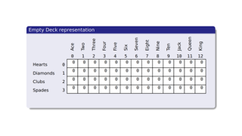
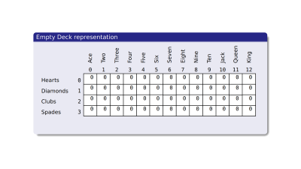
SU FACULTY of ENGINEERING
Computer Programming 143 lectures | 23 September 2026
Example: Card Shuffling and Dealing

Slide 14
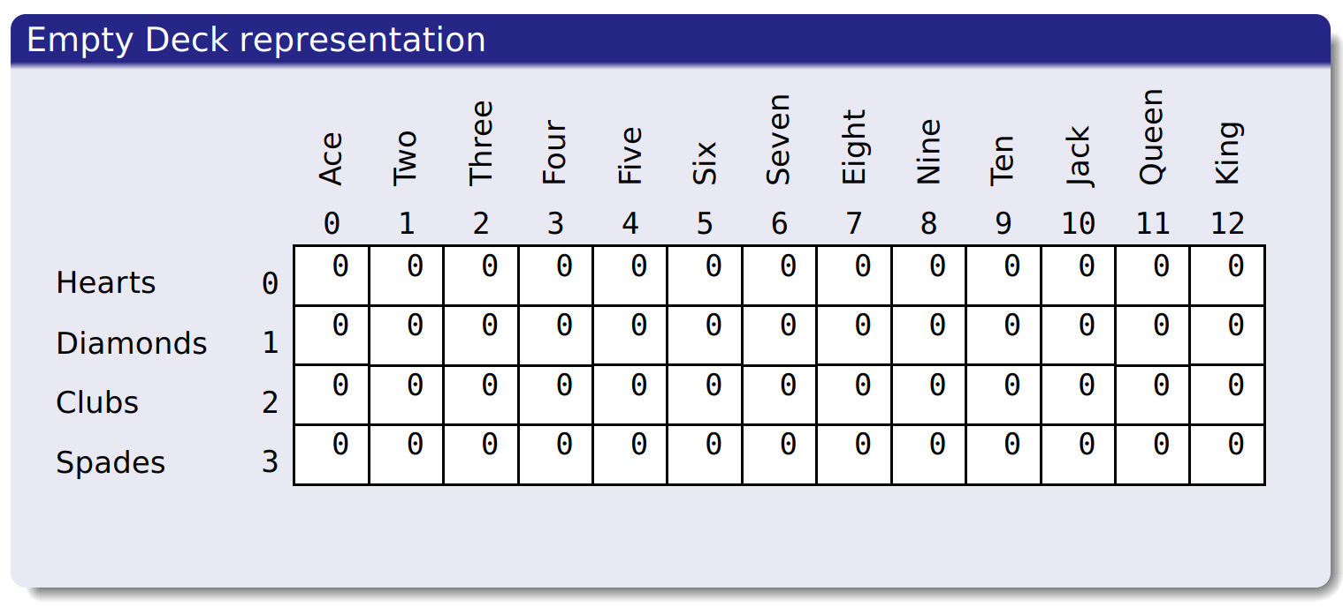

Slide 15
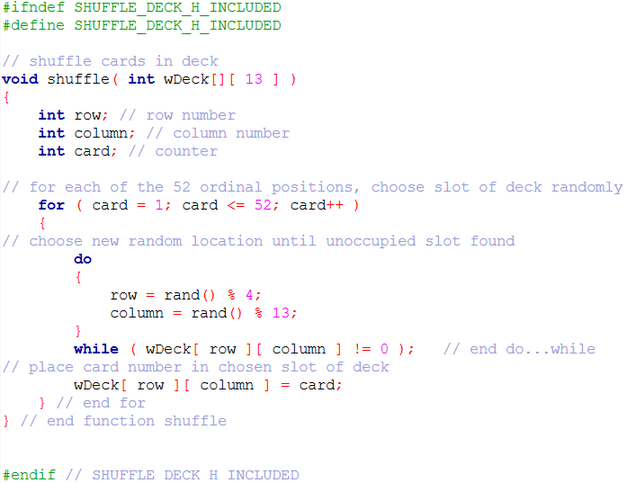
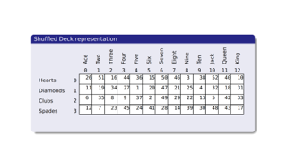
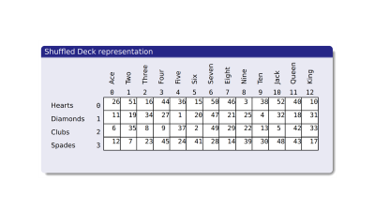
SU FACULTY of ENGINEERING
Computer Programming 143 lectures | 23 September 2026
Example: Card Shuffling and Dealing

Slide 16
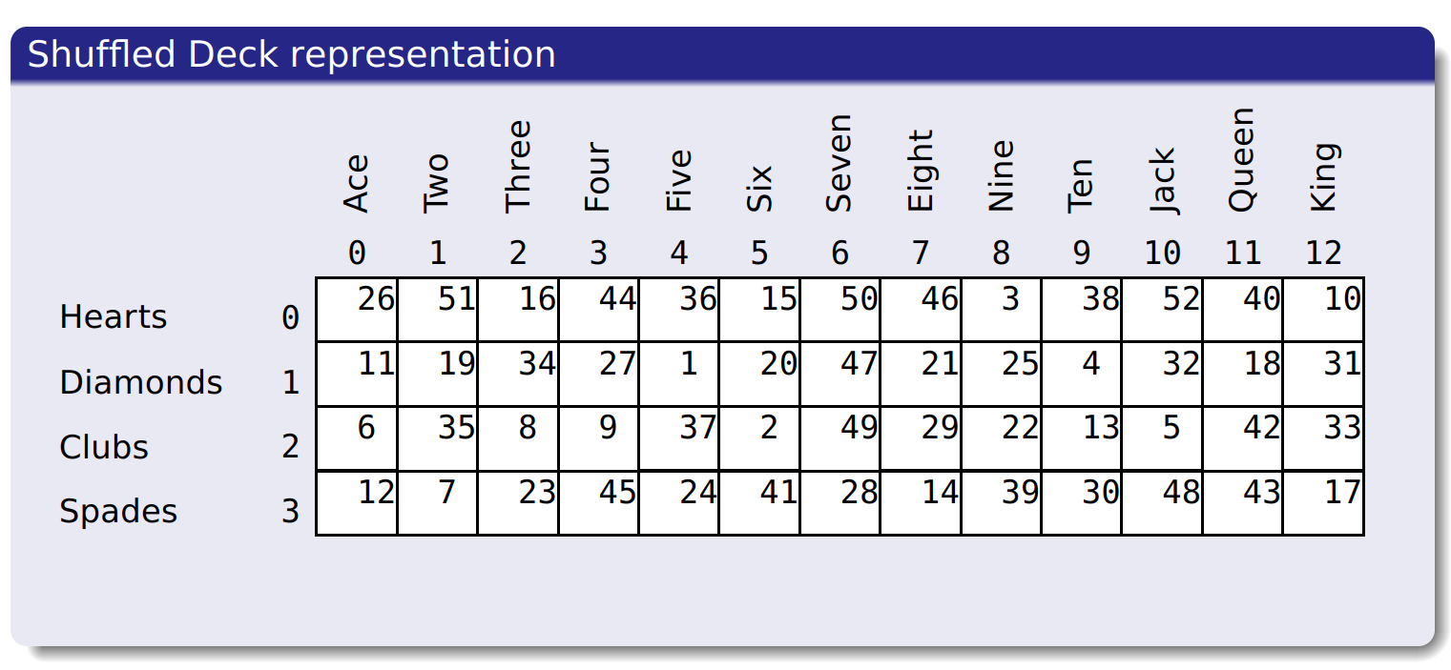

Slide 17
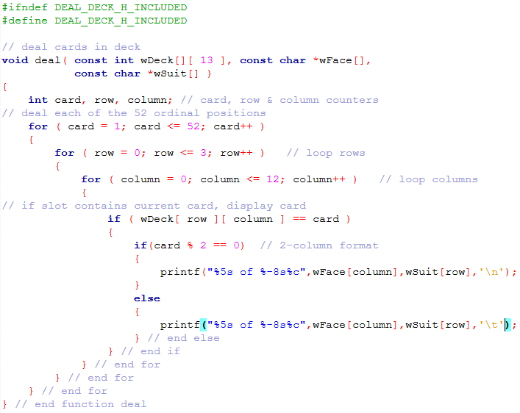
SU FACULTY of ENGINEERING
Computer Programming 143 lectures | 23 September 2026
Example: Card Shuffling and Dealing

Slide 18
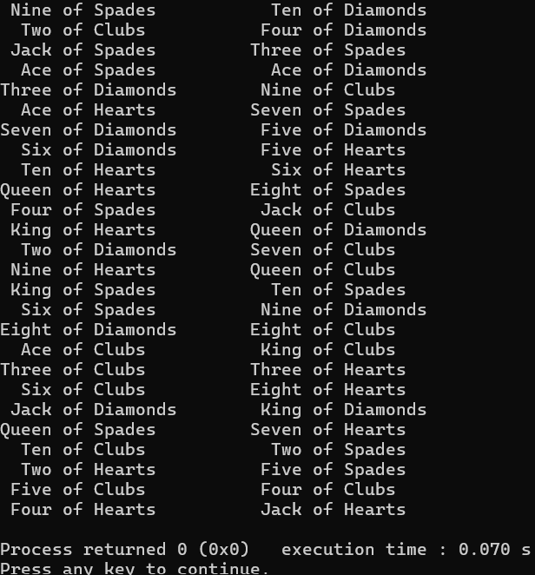
SU FACULTY of ENGINEERING
Computer Programming 143 lectures | 23 September 2026
Example: Card Shuffling and Dealing

