Slide 1

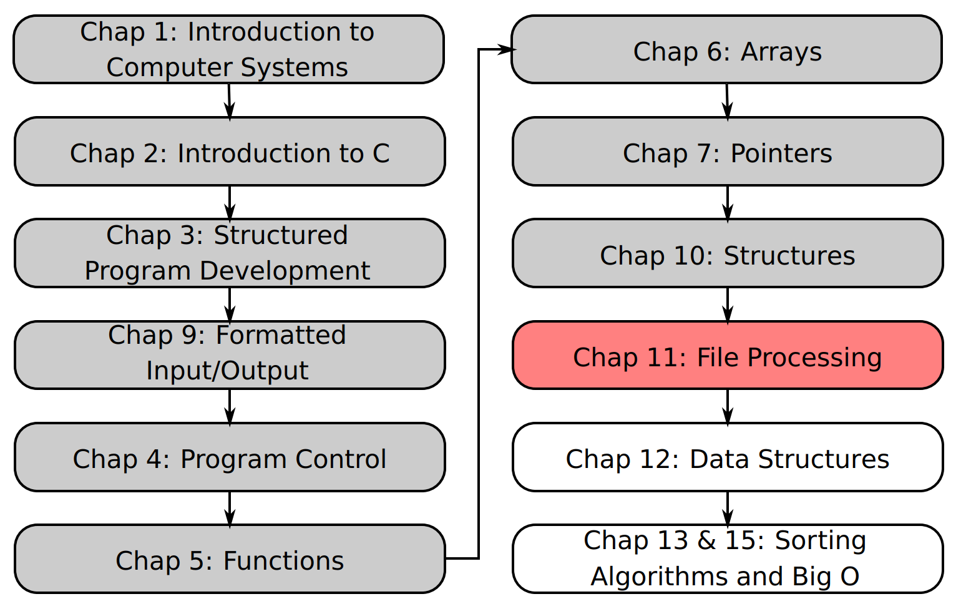
SU FACULTY of ENGINEERING
Computer Programming 143 lectures | 07 October 2026
Lecture Overview
11. File processing III
Lecture 26| Sequential vs random-access file processing
Understanding fixed-length records
Use fseek() to move within a file
Write records to specific locations
Read records from specific locations
Isaac Khobo, PhD (ilkhobo@sun.ac.za)
Chapters 10: File processing

Slide 2
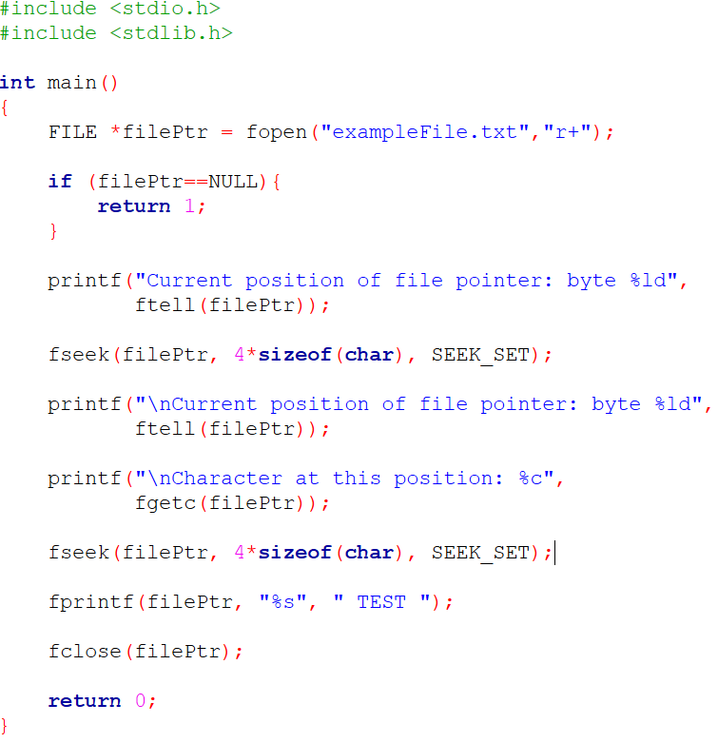
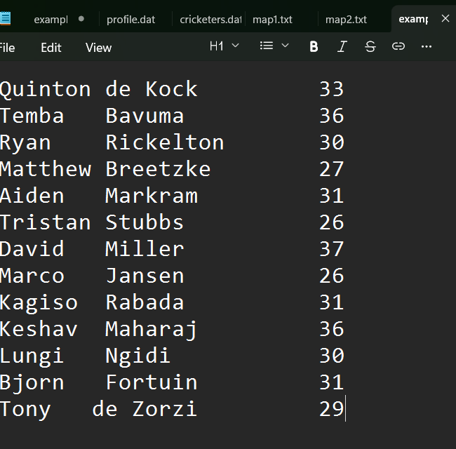
SU FACULTY of ENGINEERING
Computer Programming 143 lectures | 07 October 2026
Reading files sequentially

Slide 3
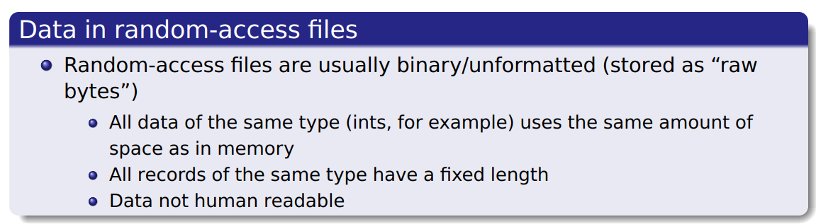
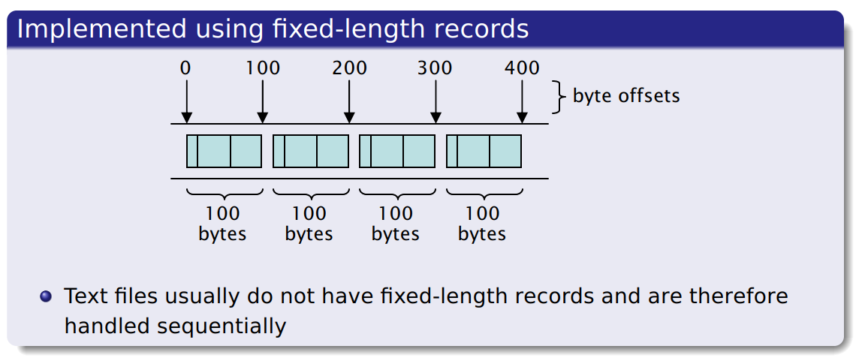
SU FACULTY of ENGINEERING
Computer Programming 143 lectures | 07 October 2026
Random access files
Notes:
F,lashback

Slide 4
SU FACULTY of ENGINEERING
Computer Programming 143 lectures | 07 October 2026
Random access files
Notes:
F,lashback

Slide 5
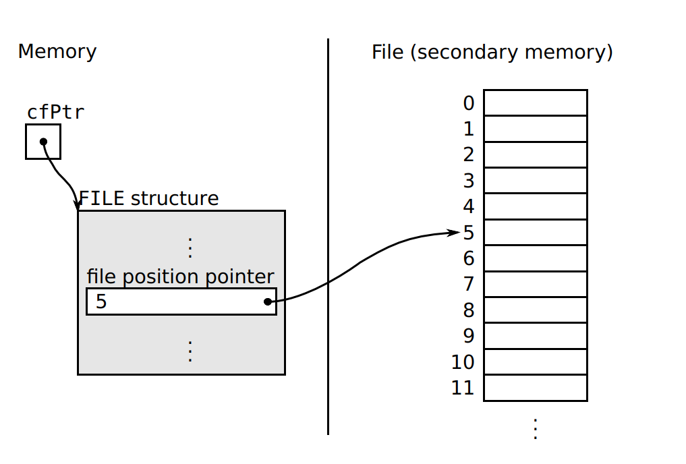
SU FACULTY of ENGINEERING
Computer Programming 143 lectures | 07 October 2026
Writing data to a random access file
Notes:
F,lashback

Slide 6
SU FACULTY of ENGINEERING
Computer Programming 143 lectures | 07 October 2026
fseek()
fseek(file pointer, offset, whence)
FILE *stream
Pointer to the file
Notes:
F,lashback

Slide 7
SU FACULTY of ENGINEERING
Computer Programming 143 lectures | 07 October 2026
fseek()
fseek(file pointer, offset, whence)
offset
File position to seek (relative to the position specified in whence)
x*sizeof(datatype) fixed-length record
Notes:
F,lashback

Slide 8
SU FACULTY of ENGINEERING
Computer Programming 143 lectures | 07 October 2026
fseek()
fseek(file pointer, offset, whence)
whence
Specifies reference point in file for offset
SEEK-SET: starts at beginning of file
SEEK-CUR: starts at current location in file
SEEK-END: starts at end of file
Notes:
F,lashback

Slide 9
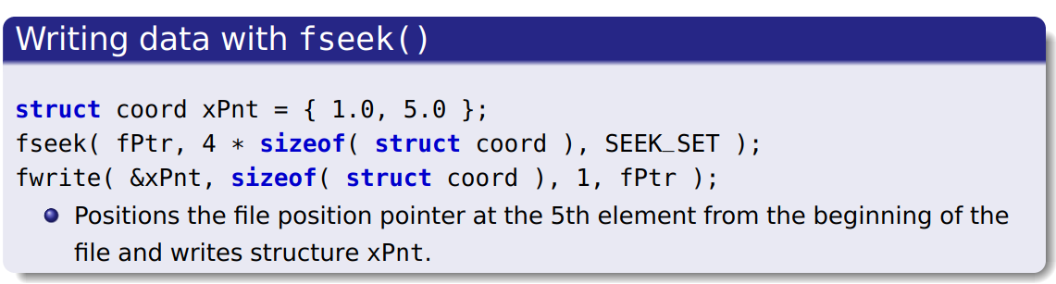
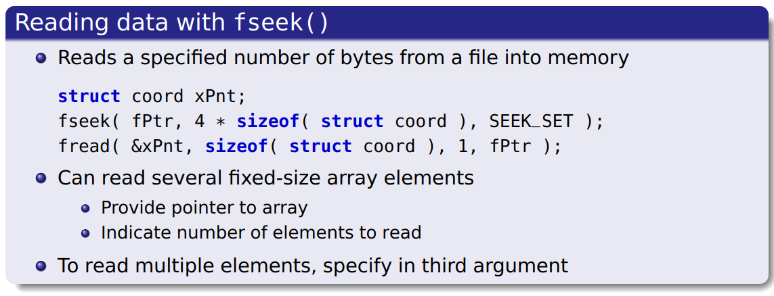
SU FACULTY of ENGINEERING
Computer Programming 143 lectures | 07 October 2026
fseek(): example
Notes:
F,lashback

Slide 10
SU FACULTY of ENGINEERING
Computer Programming 143 lectures | 07 October 2026
fseek(): example
Notes:
F,lashback

Slide 11
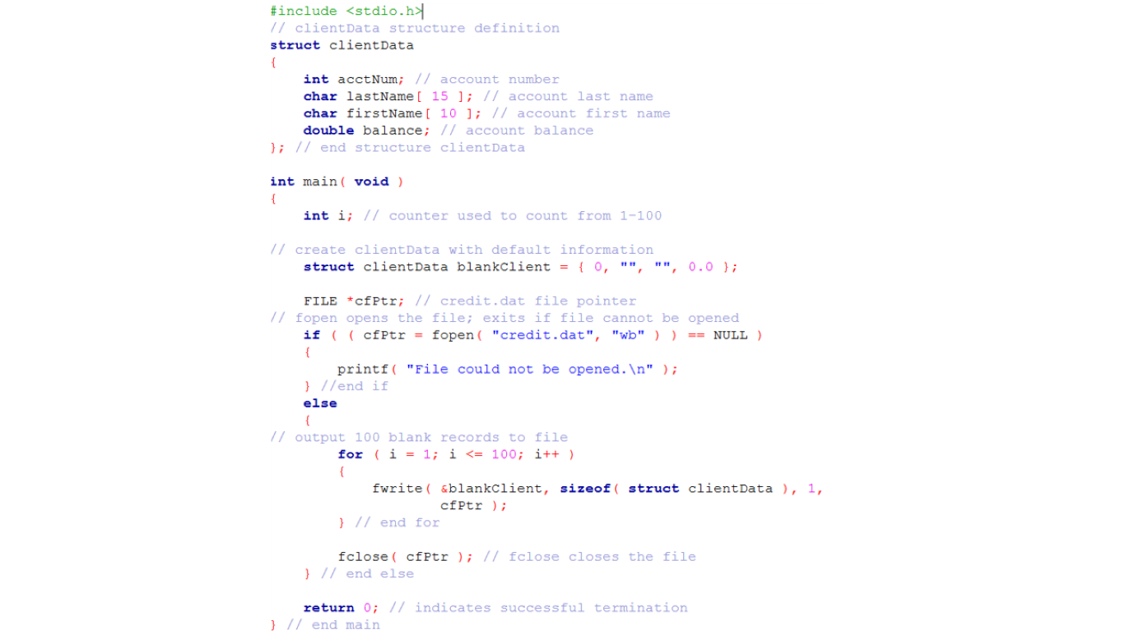
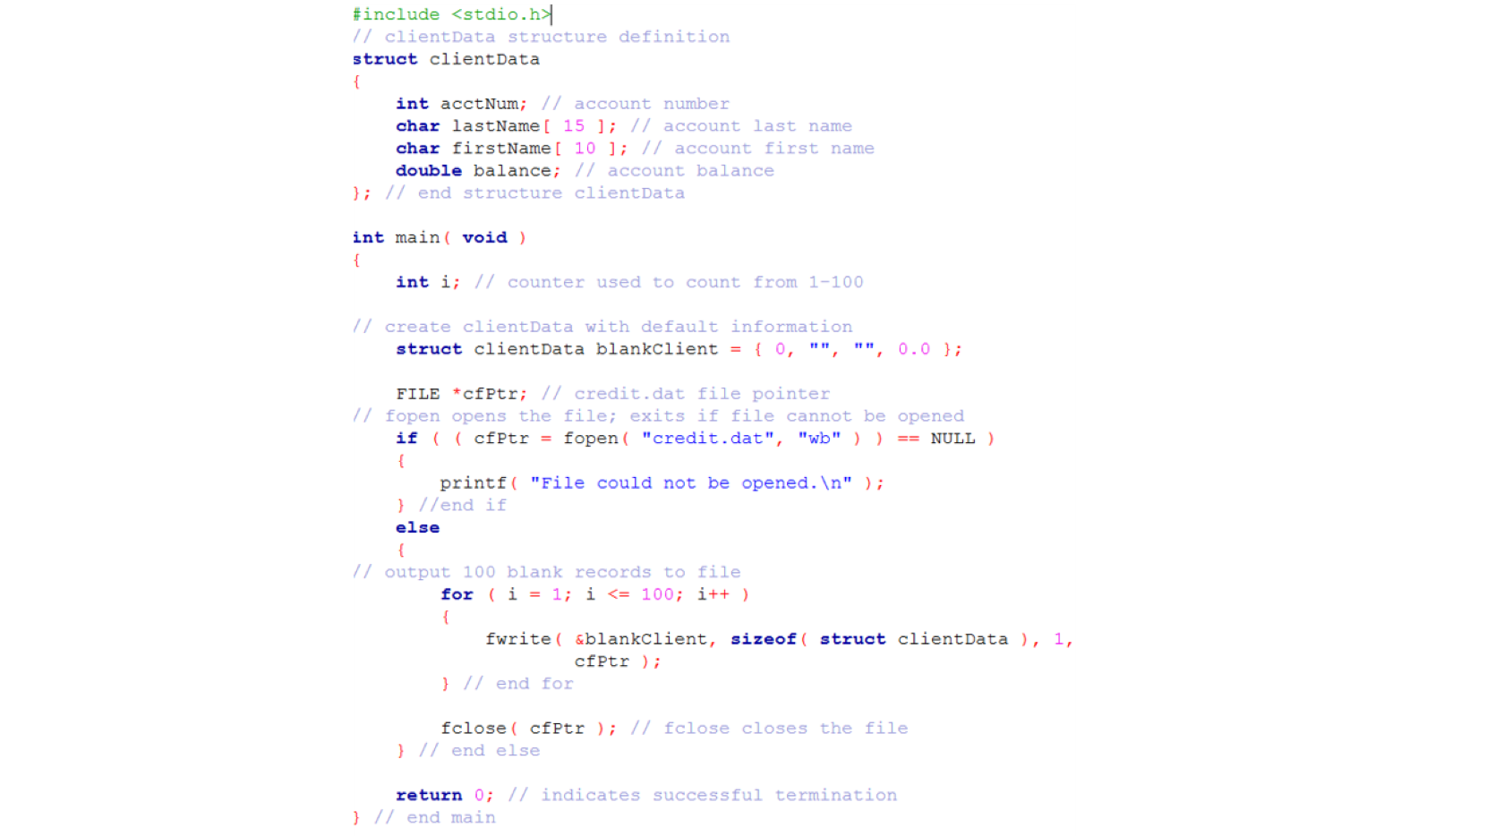
SU FACULTY of ENGINEERING
Computer Programming 143 lectures | 07 October 2026
Creating binary file for random file access
Notes:
F,lashback

Slide 12
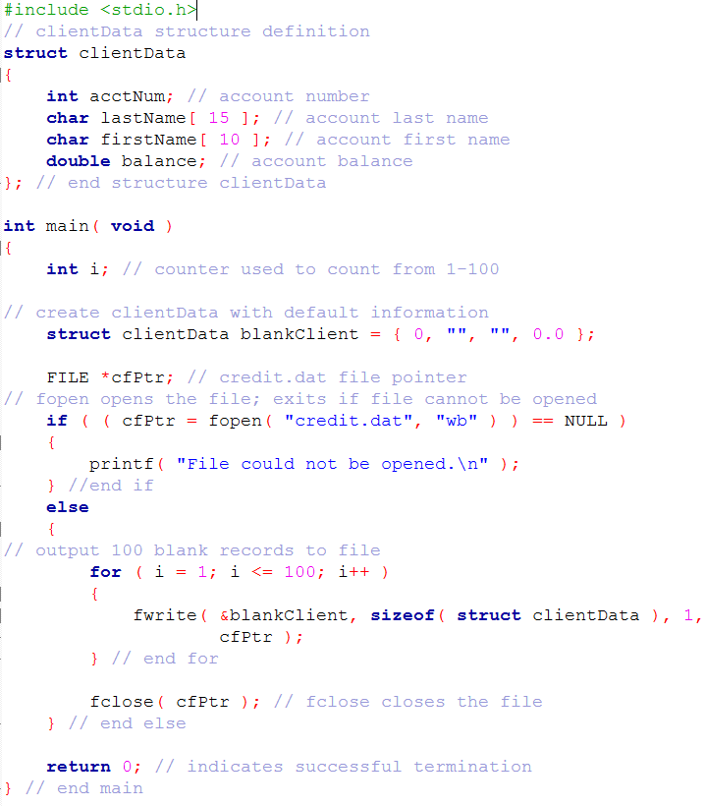

Slide 13
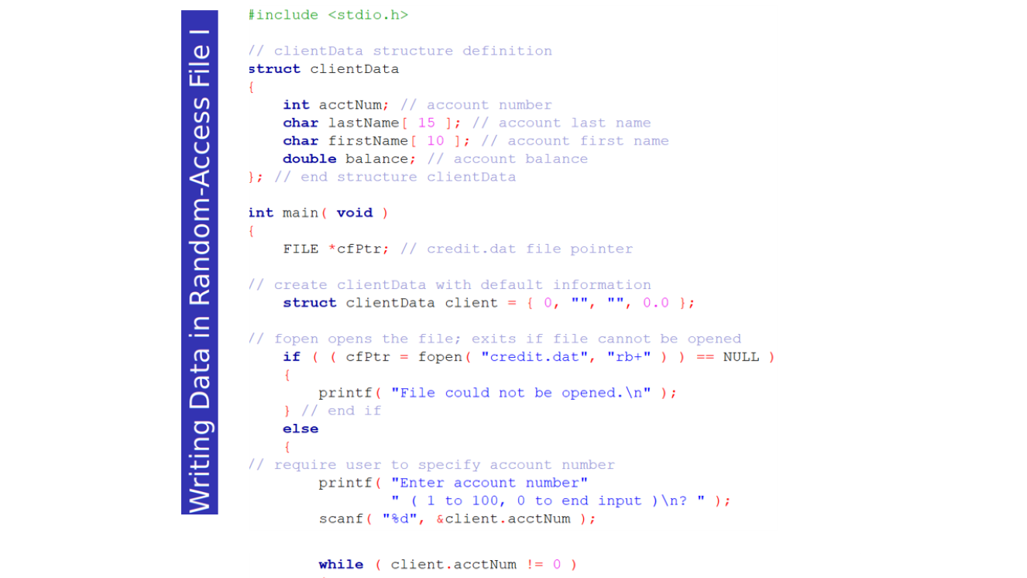
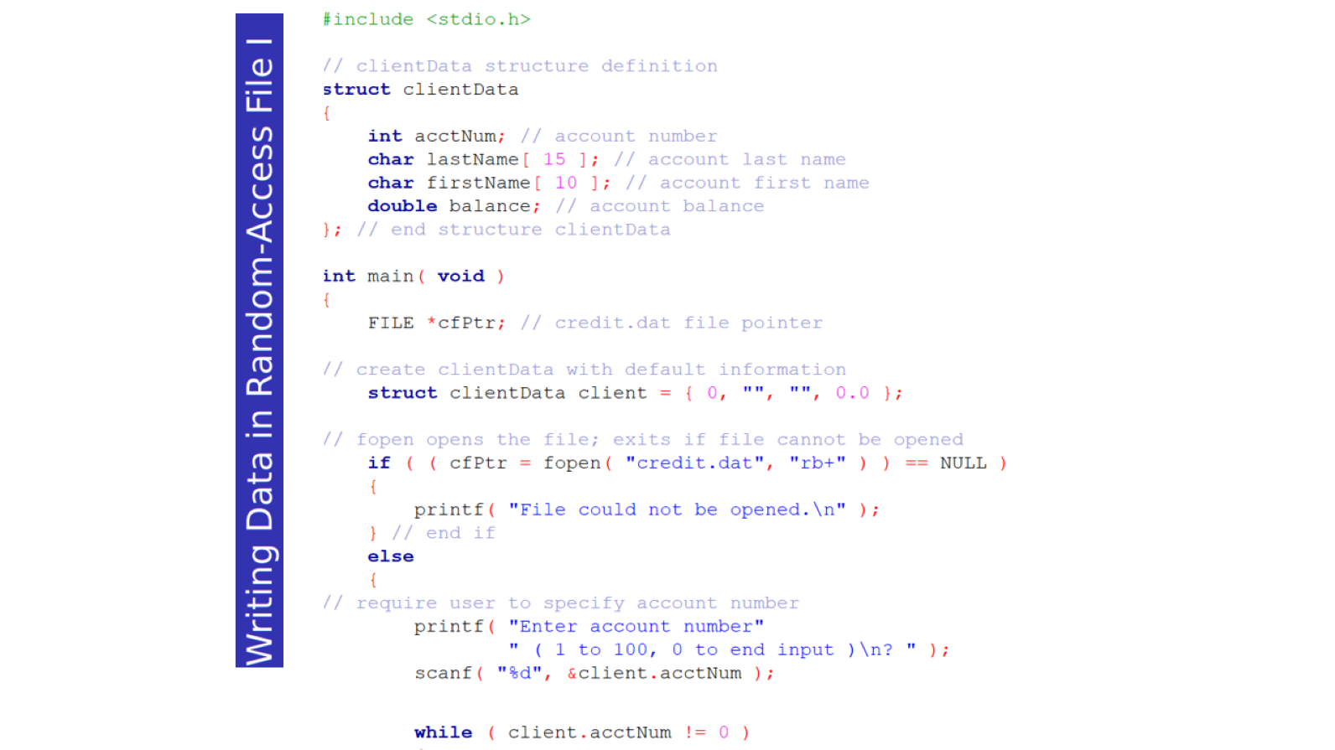
SU FACULTY of ENGINEERING
Computer Programming 143 lectures | 07 October 2026
Random access file: example
Notes:
F,lashback

Slide 14
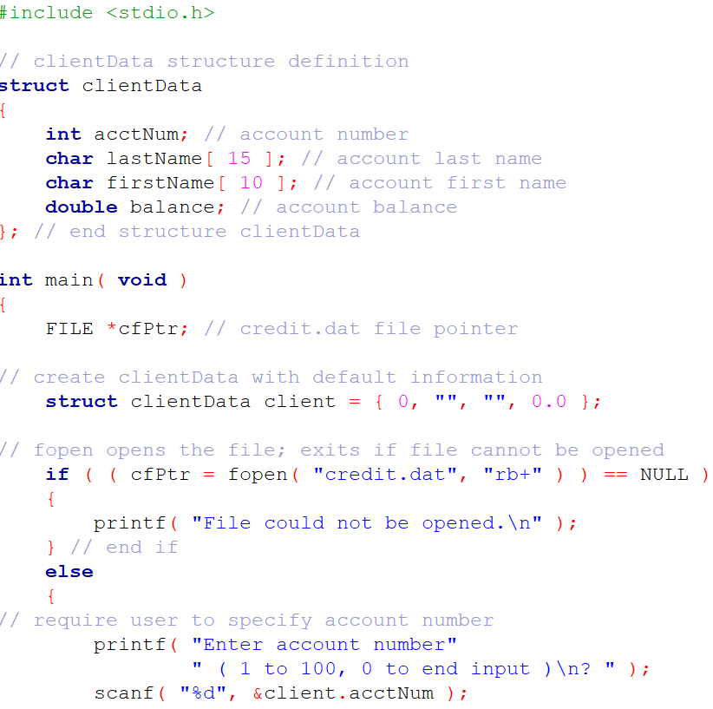
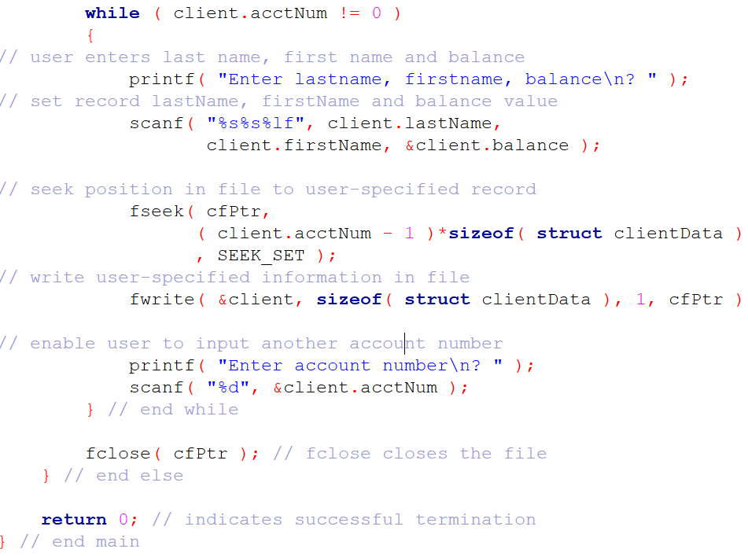

Slide 16
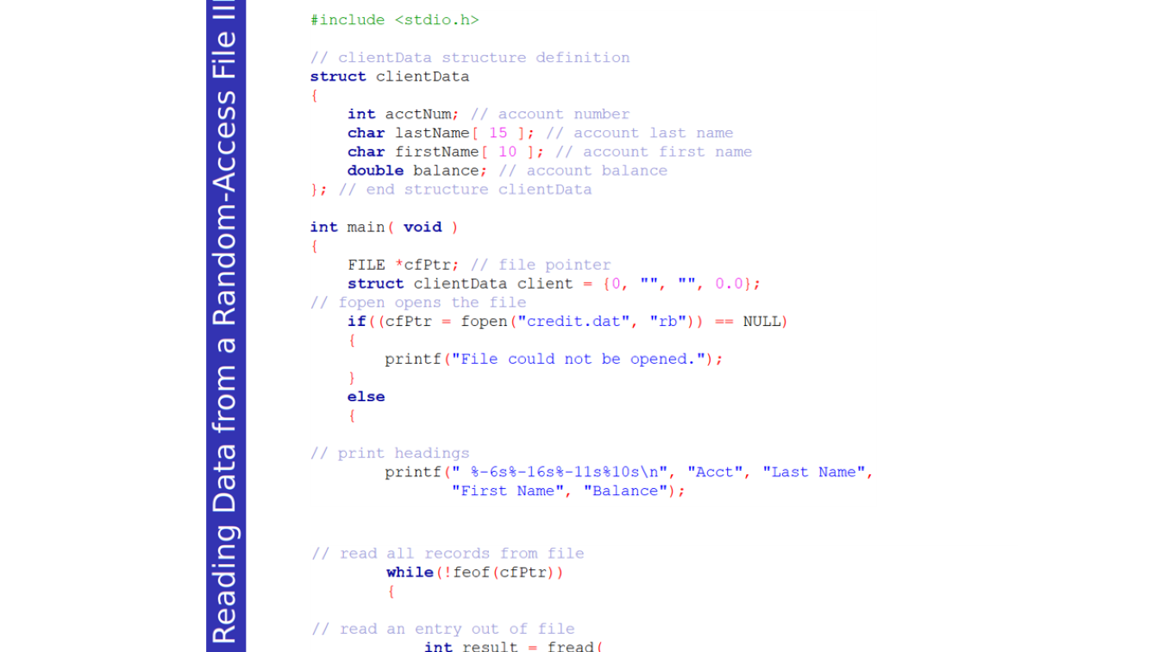
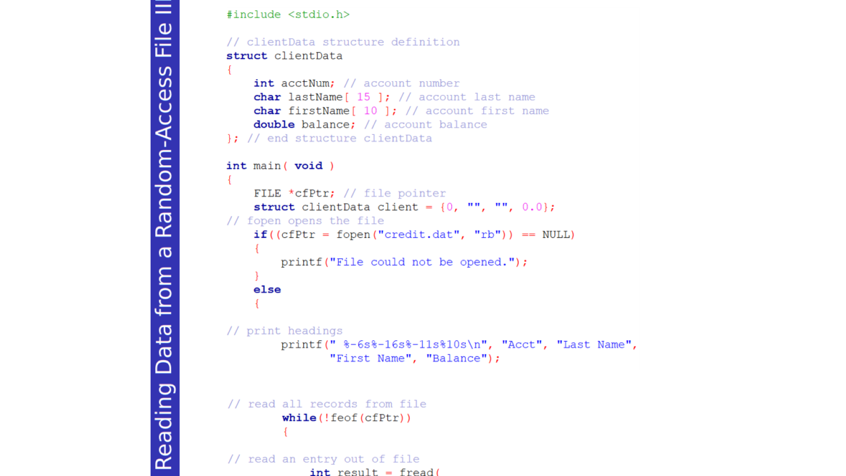
SU FACULTY of ENGINEERING
Computer Programming 143 lectures | 07 October 2026
Reading data from random access file
Notes:
F,lashback

Slide 17
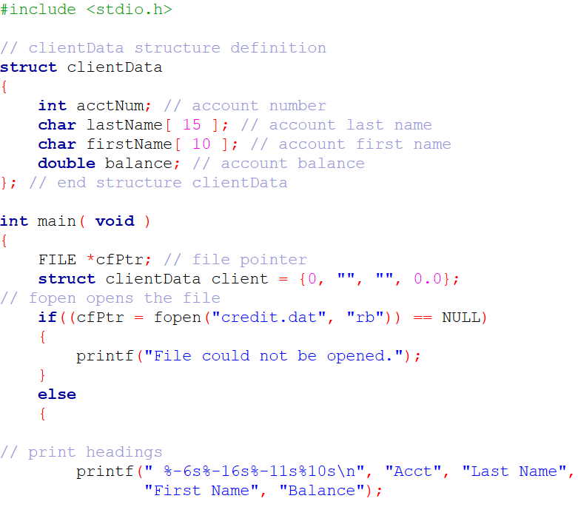
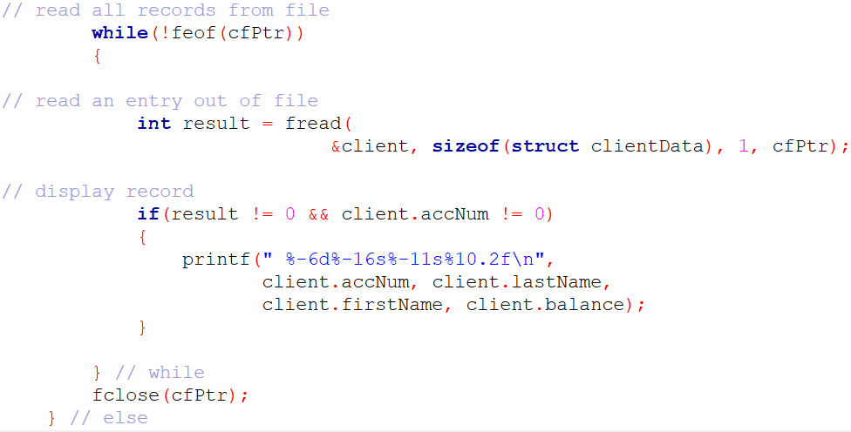

Slide 19
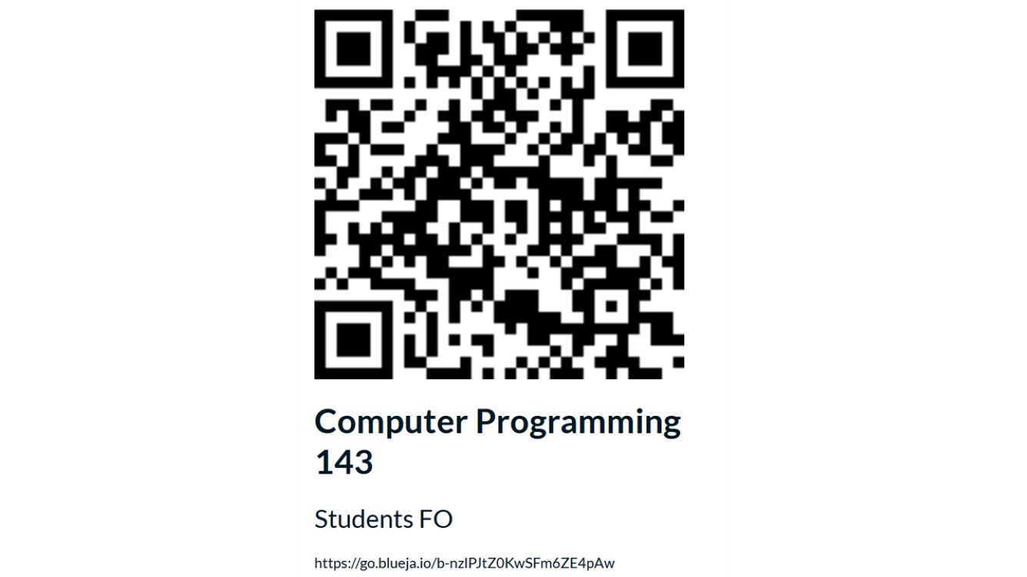

SU FACULTY of ENGINEERING
Computer Programming 143 lectures | 07 October 2026
End of semester feedback

Slide 20
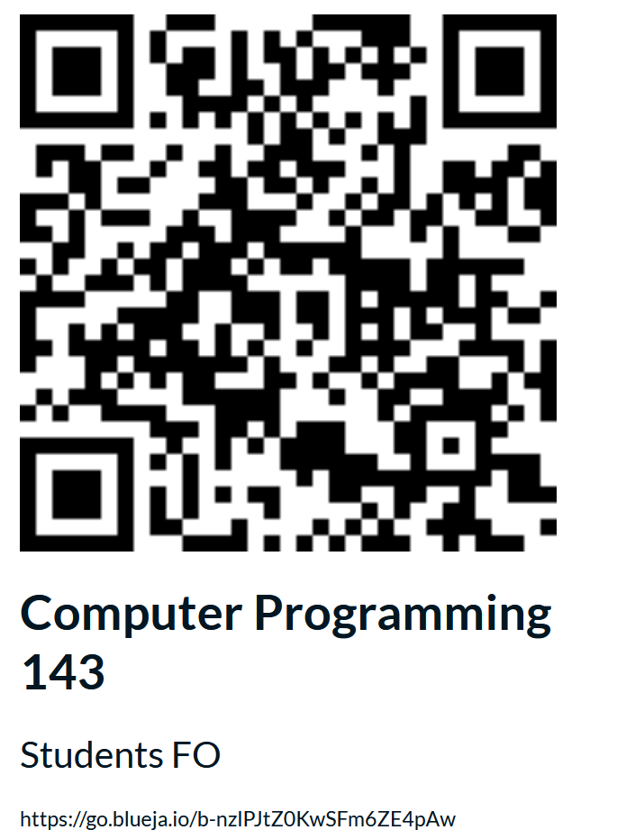

Slide 21
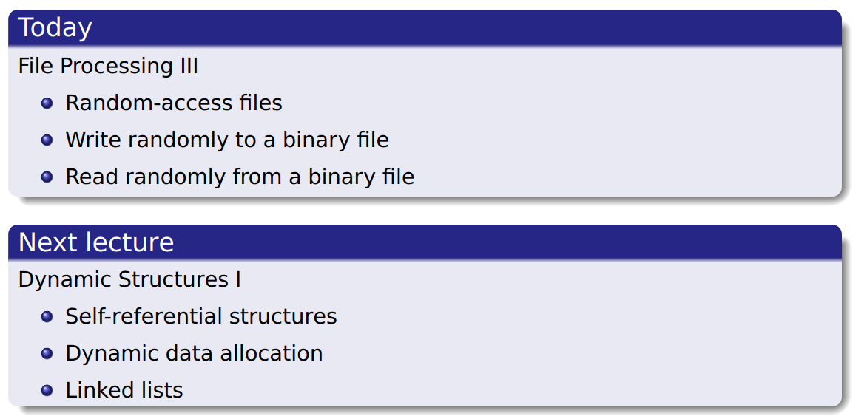
SU FACULTY of ENGINEERING
Computer Programming 143 lectures | 07 October 2026
Perspective
Notes:
F,lashback

Slide 22
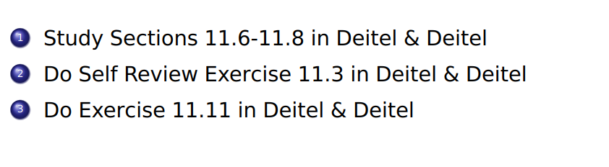
SU FACULTY of ENGINEERING
Computer Programming 143 lectures | 07 October 2026
HOMEWORK
Notes:
F,lashback

