Slide 1

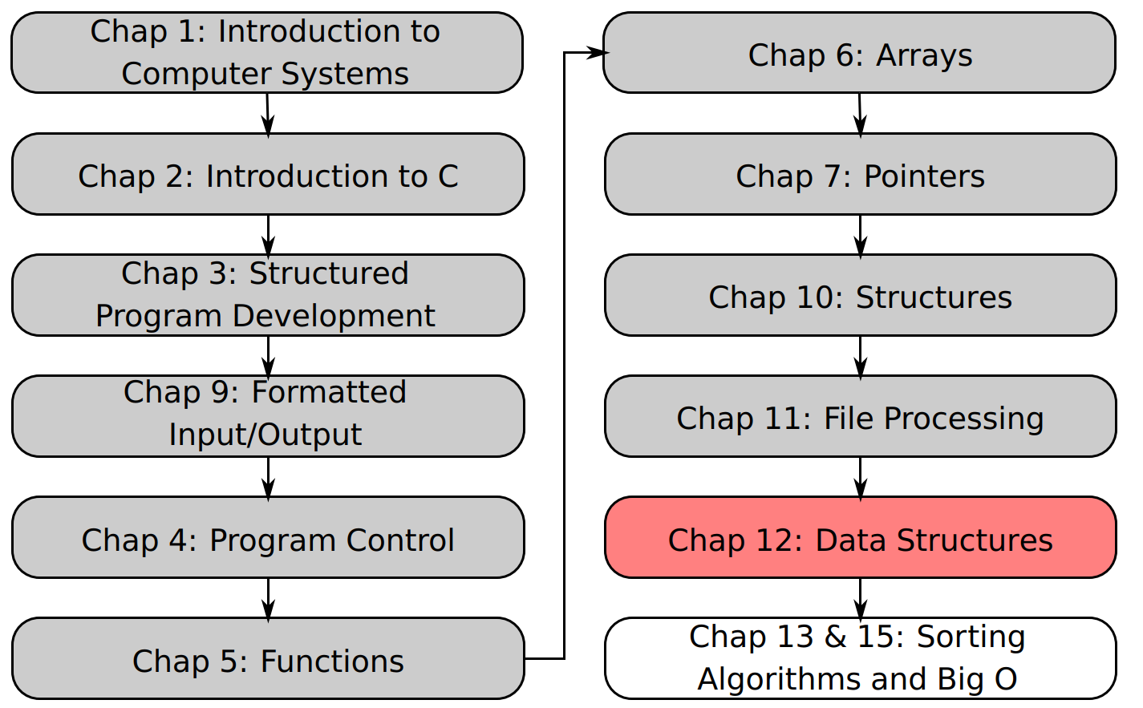
SU FACULTY of ENGINEERING
Computer Programming 143 lectures | 09 October 2026
Lecture Overview
12. Dynamic Data Structures
Lecture 27| Self-referencing structures
Dynamic memory allocation
Linked lists
Isaac Khobo, PhD (ilkhobo@sun.ac.za)
Chapters 12: Data structures

Slide 2
SU FACULTY of ENGINEERING
Computer Programming 143 lectures | 09 October 2026
Recap: Chapter 10 Structures
Data Type in C
Built-in/Primitive
User defined
Derived
int
enum{}
array (string)
float
struct
function()
double
typedef
*pointer
char
Notes:
A structure is a user defined data type that groups a collection of numerous data types.

Slide 3
SU FACULTY of ENGINEERING
Computer Programming 143 lectures | 09 October 2026
Chapter 12: Data structures
Data structures
Linear
Non-linear
static
dynamic
array
Linked list
Stack
Queue
Tree
Graph
Notes:
A data structure is a method of organizing and storing data so it can be accessed and modified efficiently.
Linear – data is organized in a sequence (one after another)
Non-linear data structure – the elements are not arranged sequentially

Slide 4
SU FACULTY of ENGINEERING
Computer Programming 143 lectures | 09 October 2026
Data structure
Static data structures
Dynamic data structures

Slide 5

SU FACULTY of ENGINEERING
Computer Programming 143 lectures | 09 October 2026
Data structure
Memory requirements remains unchanged for the entire program execution
Single subscript arrays
Multiple subscript arrays
Structures
Memory requirements change during the execution of the program
Linked lists
Stacks
Queues
Trees
Static data structures
Dynamic data structures
Notes:
Static data structure – they have a fixed size (so memory allocated to it remains unchanged throughout the entire program execution). So you define an array or structure at compile time, and the user cannot change its size after being compiled. The data can be changed, but then the new data will be assigned a specific size/memory.
Dynamic data structure – they don’t have a fixed size. Memory is allocated at run time, and its size can vary during program execution.

Slide 6
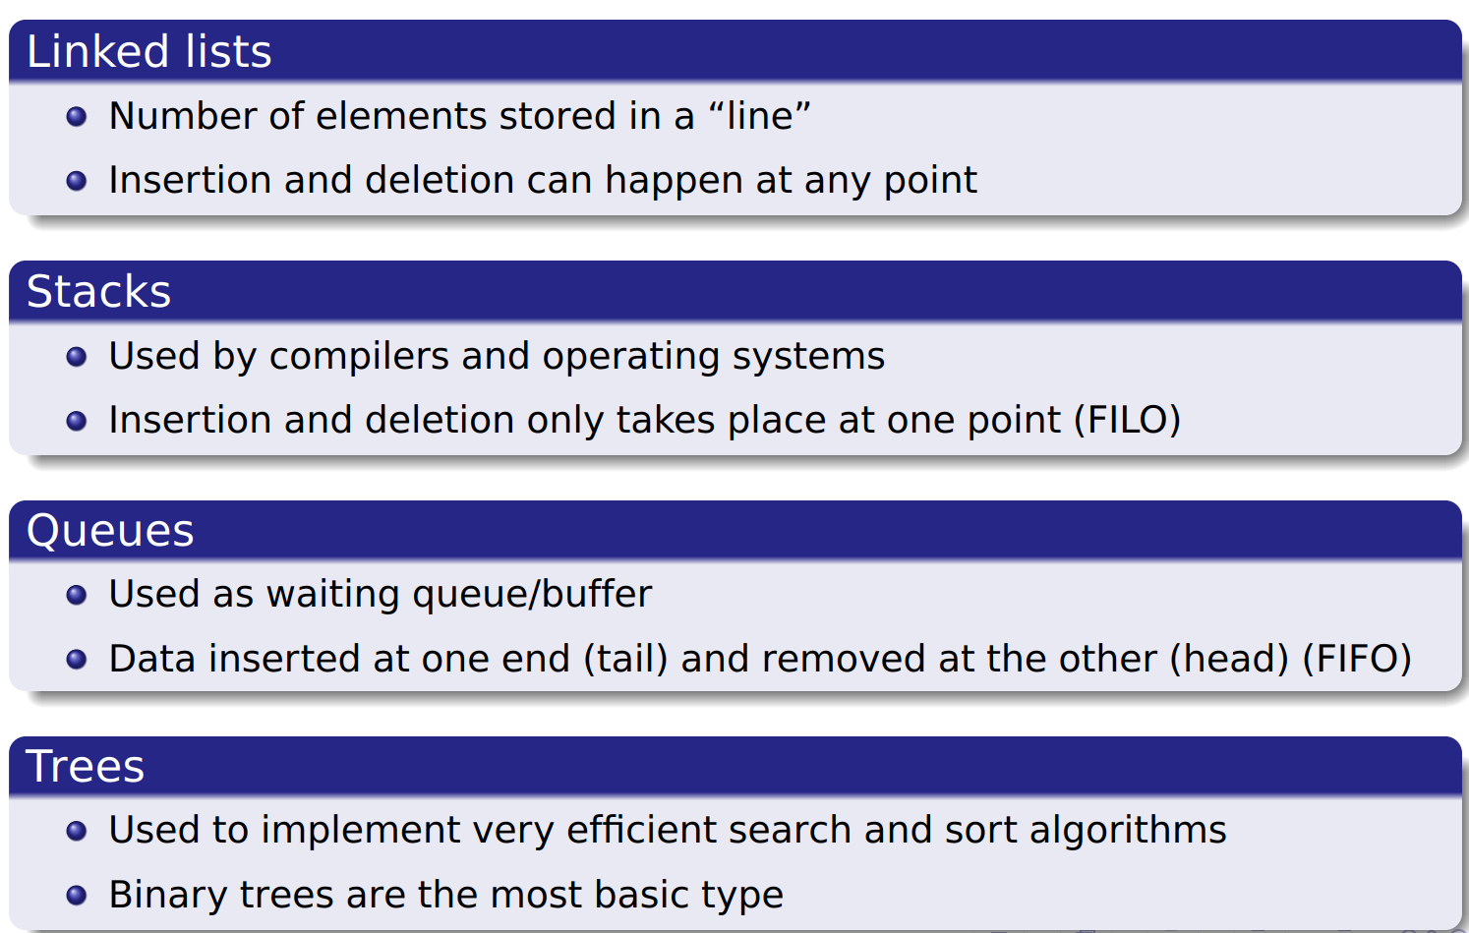
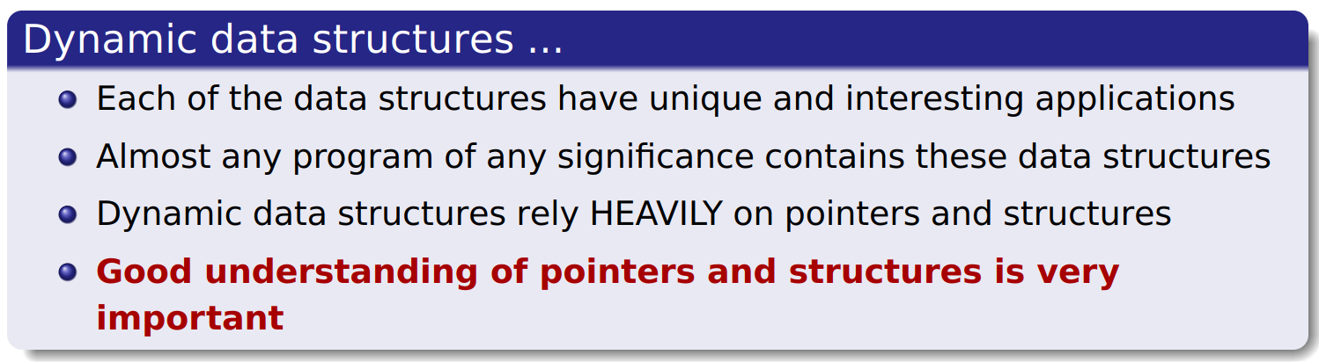

Slide 8
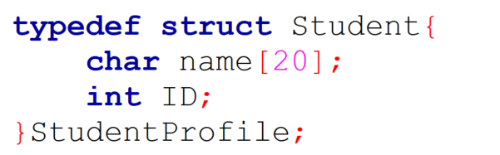
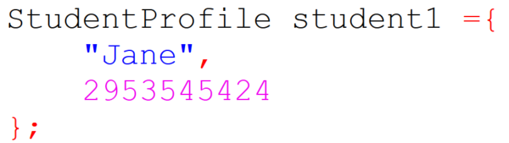
SU FACULTY of ENGINEERING
Computer Programming 143 lectures | 09 October 2026
Self-referencing structures
Name = “Jane”
ID = 2953545424
StudentProfile
What if you want to keep information for 2, 3, 100 or more students?

Slide 9
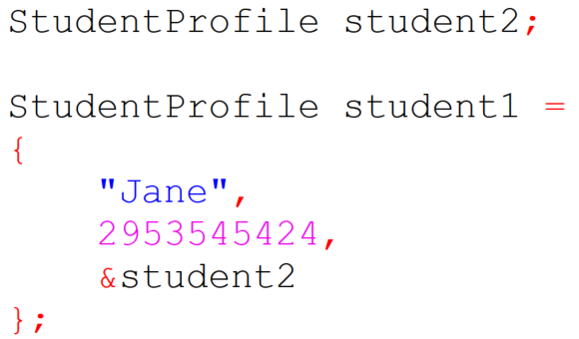
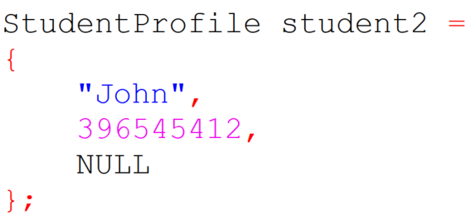
SU FACULTY of ENGINEERING
Computer Programming 143 lectures | 09 October 2026
Self-referencing structures
Name = “Jane”
ID = 2953545424
nextPtr = address of nextstudent
StudentProfile
What if you want to keep information for 2, 3, 100 or more students?

Slide 10
SU FACULTY of ENGINEERING
Computer Programming 143 lectures | 09 October 2026
Self-referencing structures
Name = “Jane”
ID = 2953545424
nextPtr = &john
Name = “John”
ID = 396545412
nextPtr = &mary
Name = “Mary”
ID = 29654512
nextPtr = &may
Name = “May”
ID = 4585412
nextPtr = NULL
StudentProfile1
StudentProfile2
StudentProfile3
StudentProfile4
Now the student can store not only its own information,
but also the address of another student record!

Slide 11
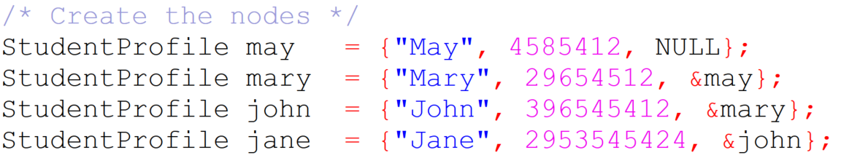
SU FACULTY of ENGINEERING
Computer Programming 143 lectures | 09 October 2026
Self-referencing structures
Name = “Jane”
ID = 2953545424
nextPtr = &john
Name = “John”
ID = 396545412
nextPtr = &mary
Name = “Mary”
ID = 29654512
nextPtr = &may
Name = “May”
ID = 4585412
nextPtr = NULL
StudentProfile1
StudentProfile2
StudentProfile3
StudentProfile4
Now the student can store not only its own information,
but also the address of another student record!

Slide 12
SU FACULTY of ENGINEERING
Computer Programming 143 lectures | 09 October 2026
Self-referencing structures
Name = “Jane”
ID = 2953545424
nextPtr = &john
Name = “John”
ID = 396545412
nextPtr = &mary
Name = “Mary”
ID = 29654512
nextPtr = &may
Name = “May”
ID = 4585412
nextPtr = NULL
StudentProfile1
StudentProfile2
StudentProfile3
StudentProfile4
Now the student can store not only its own information,
but also the address of another student record!
Notes:
So now we have built a simple linked list using StudentProfile structures.

Slide 13
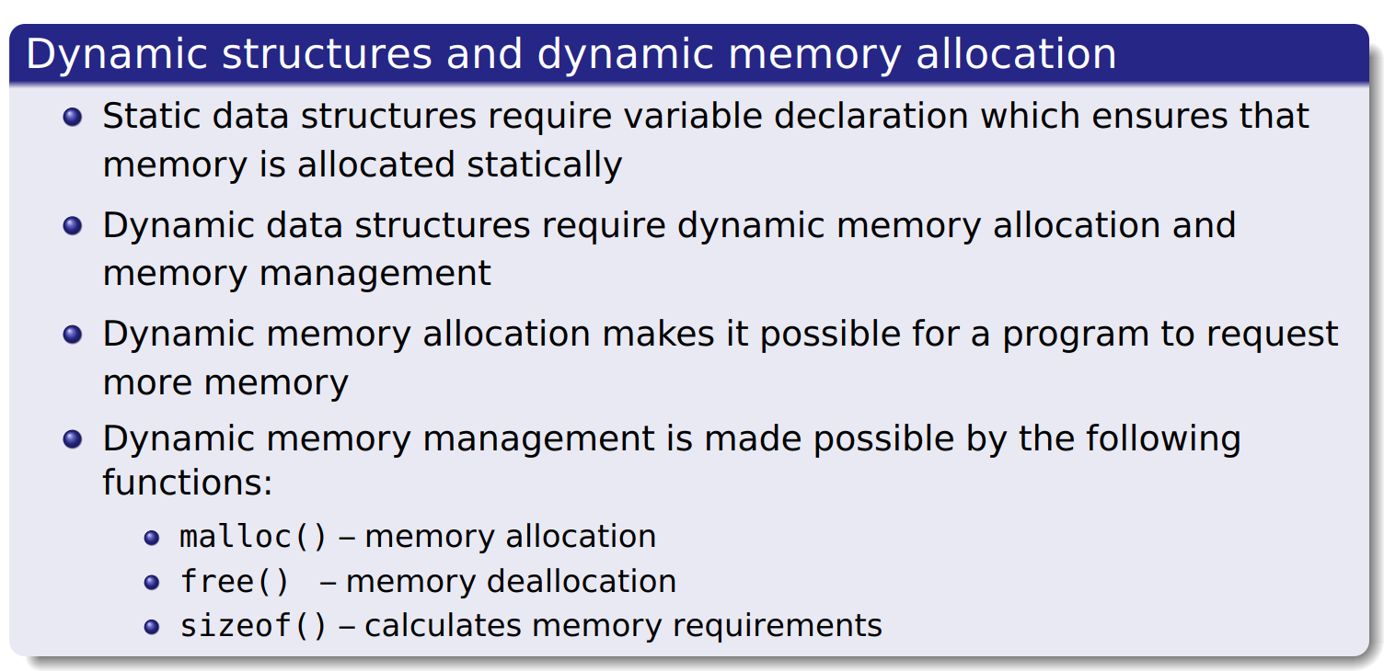
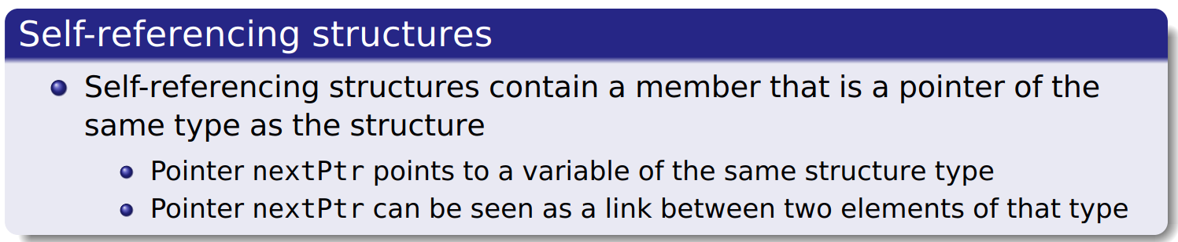
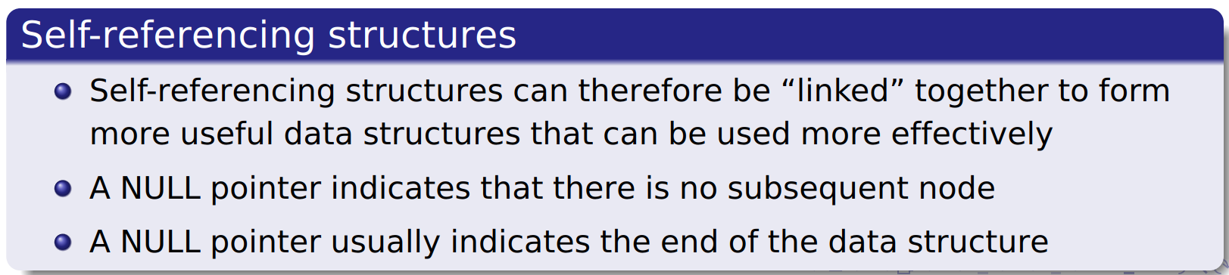
SU FACULTY of ENGINEERING
Computer Programming 143 lectures | 09 October 2026
Dynamic data structures

Slide 14
SU FACULTY of ENGINEERING
Computer Programming 143 lectures | 09 October 2026
Dynamic data structures

Slide 15

SU FACULTY of ENGINEERING
Computer Programming 143 lectures | 09 October 2026
Dynamic data structures

Slide 16
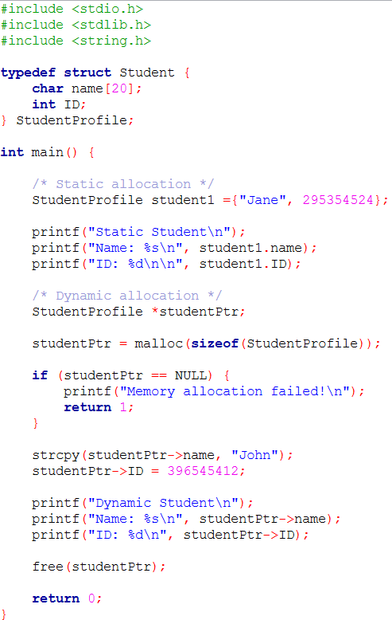
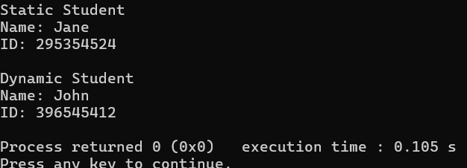
Notes:
Allocating one student dynamically is not particularly useful. We're doing it because the nodes in a linked list are normally created one at a time using malloc(). Before we study linked lists, we need to understand how a single node can be created dynamically.

Slide 17
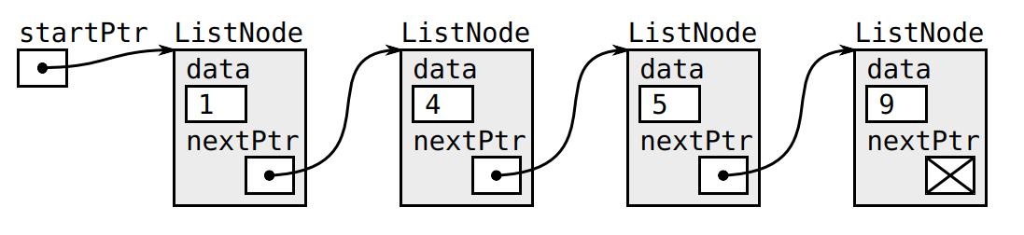
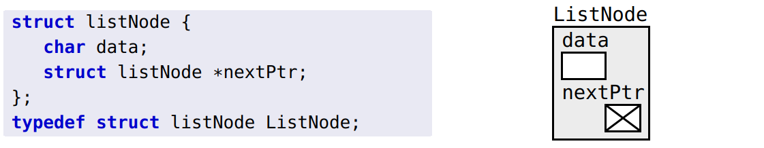
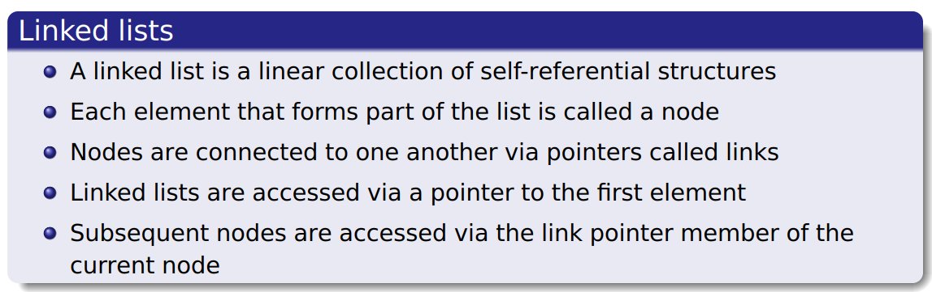
SU FACULTY of ENGINEERING
Computer Programming 143 lectures | 09 October 2026
Linked lists

Slide 18
SU FACULTY of ENGINEERING
Computer Programming 143 lectures | 09 October 2026
Linked lists

Slide 19
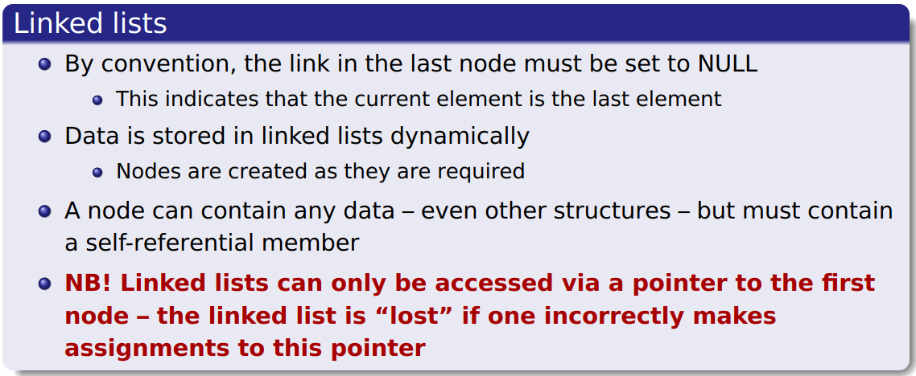
SU FACULTY of ENGINEERING
Computer Programming 143 lectures | 09 October 2026
Linked lists

Slide 20
SU FACULTY of ENGINEERING
Computer Programming 143 lectures | 09 October 2026
Linked lists

Slide 21
SU FACULTY of ENGINEERING
Computer Programming 143 lectures | 09 October 2026
Functions associated with linked lists
searching
insertion
deletion

Slide 22
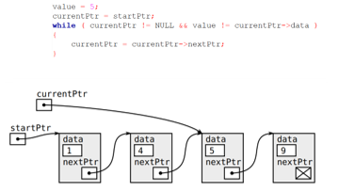
SU FACULTY of ENGINEERING
Computer Programming 143 lectures | 09 October 2026
Functions associated with linked lists
searching
insertion
deletion

Slide 23
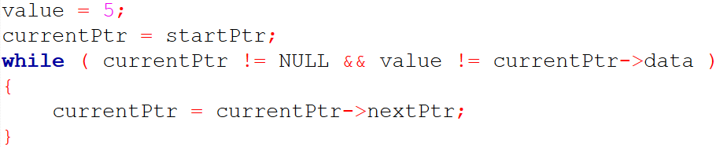
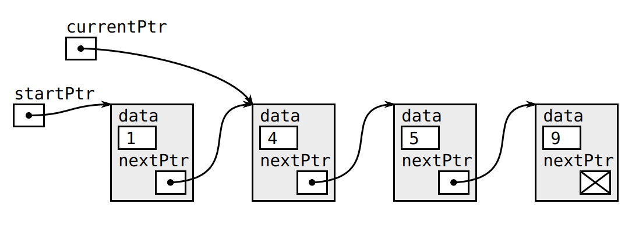
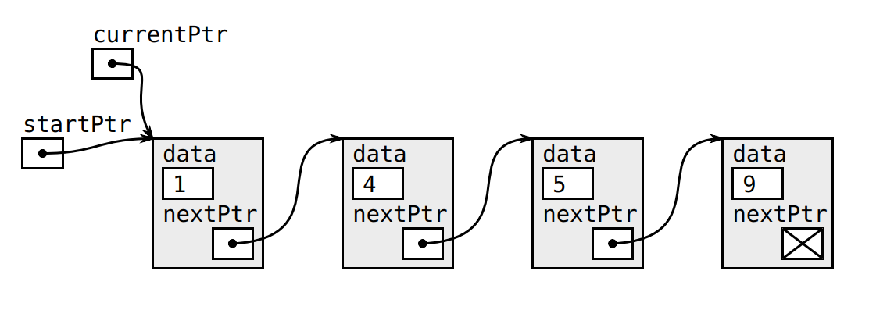
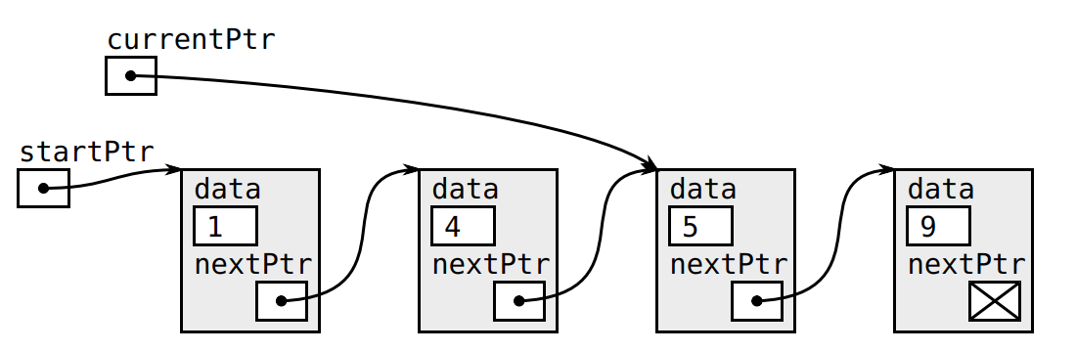

Slide 24
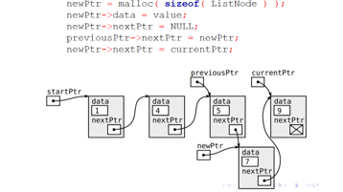
SU FACULTY of ENGINEERING
Computer Programming 143 lectures | 09 October 2026
Functions associated with linked lists
searching
insertion
deletion

Slide 25
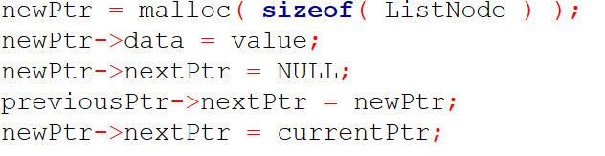
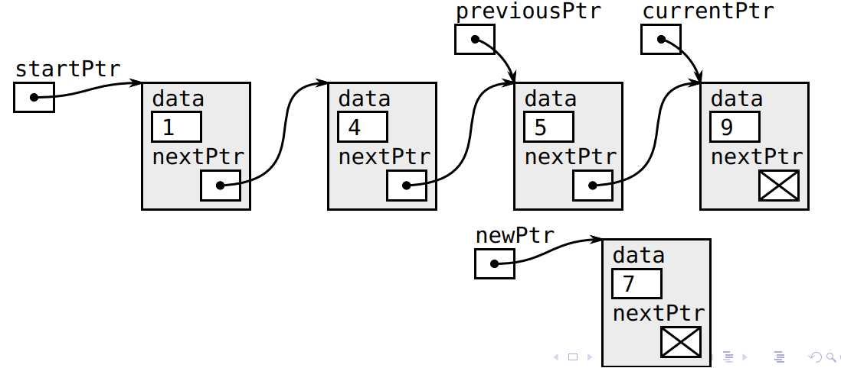
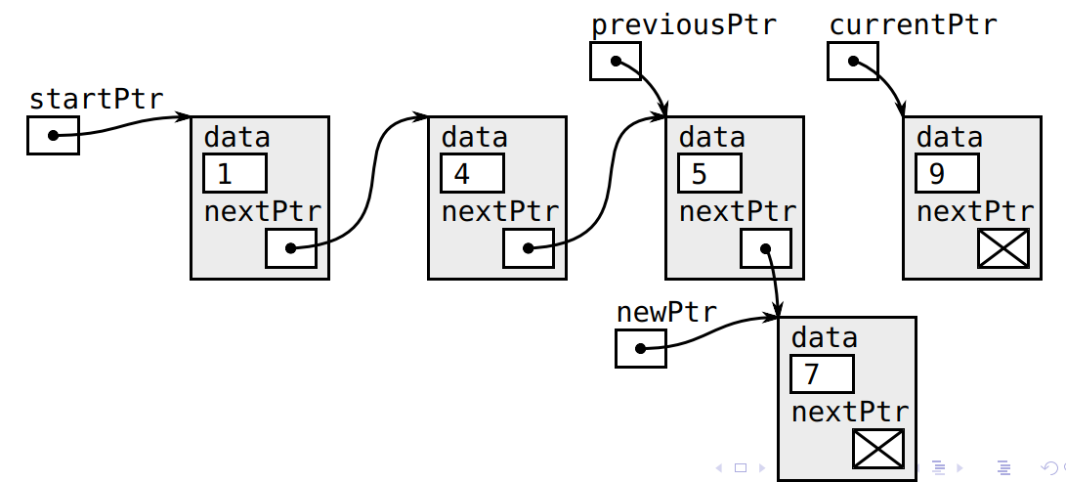
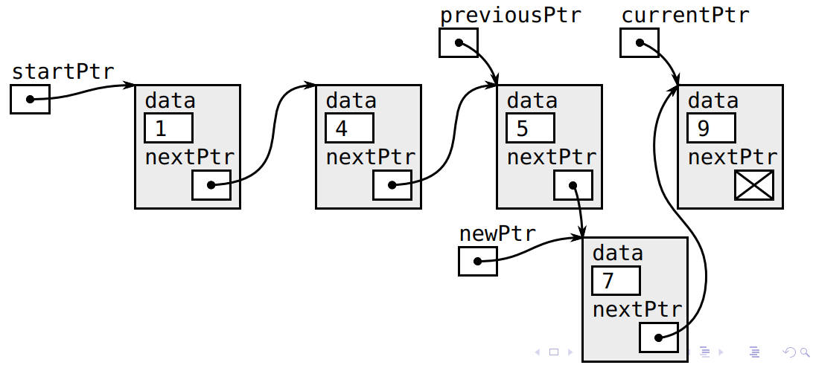
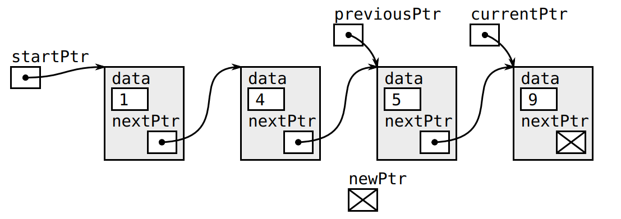

Slide 26
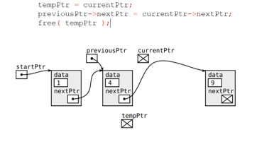
SU FACULTY of ENGINEERING
Computer Programming 143 lectures | 09 October 2026
Functions associated with linked lists
searching
insertion
deletion

Slide 27
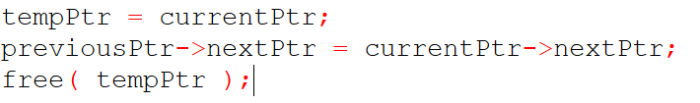
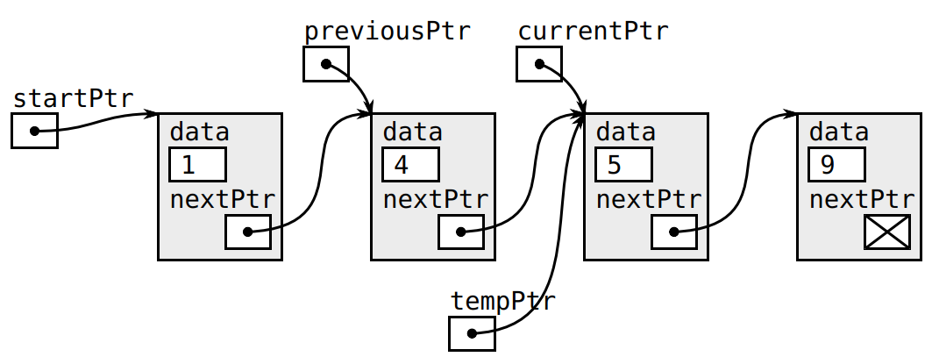
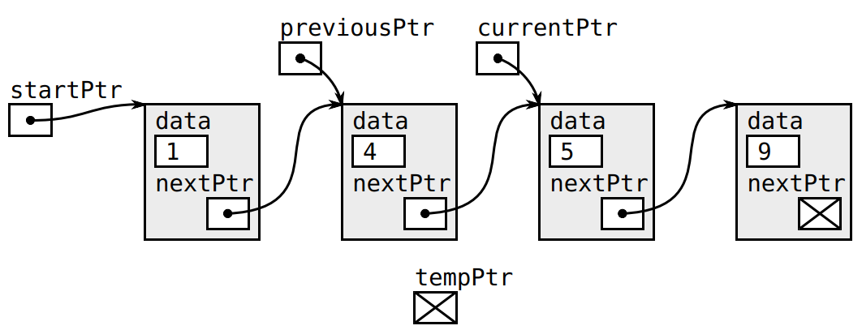
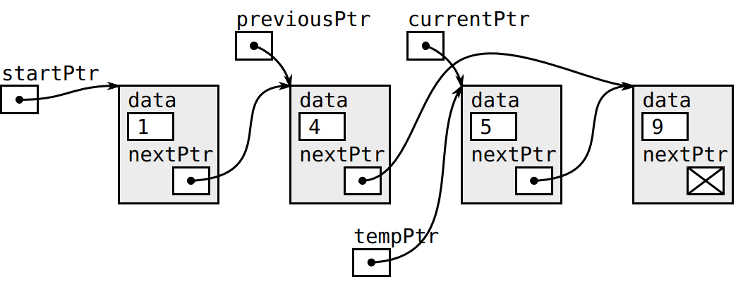
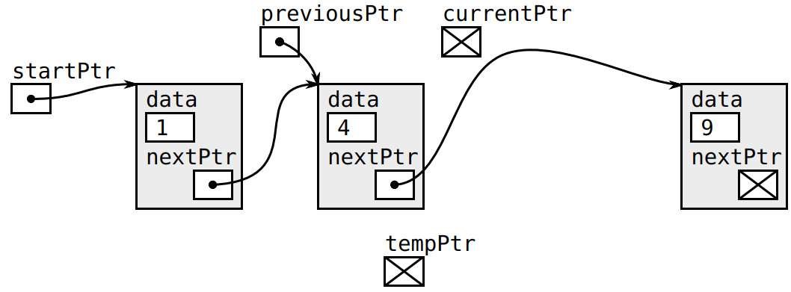

Slide 28
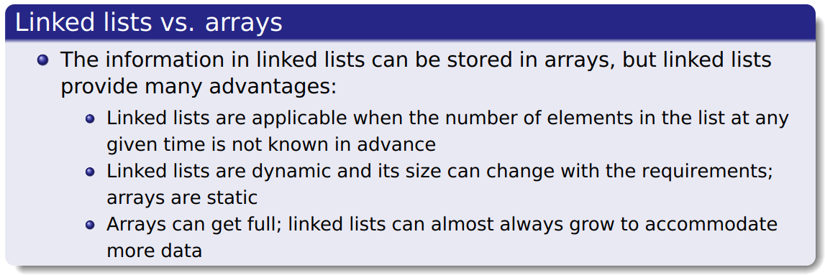
SU FACULTY of ENGINEERING
Computer Programming 143 lectures | 09 October 2026
Linked lists vs arrays

Slide 29
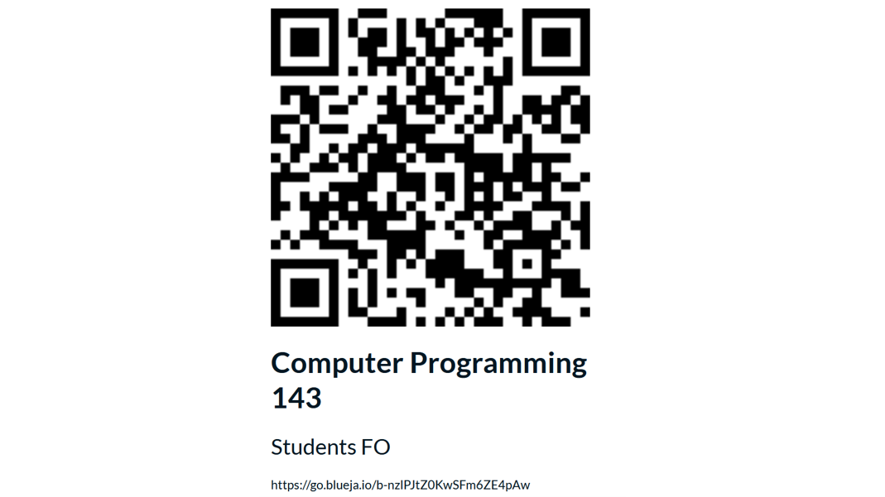
SU FACULTY of ENGINEERING
Computer Programming 143 lectures | 09 October 2026
End of semester feedback

Slide 30
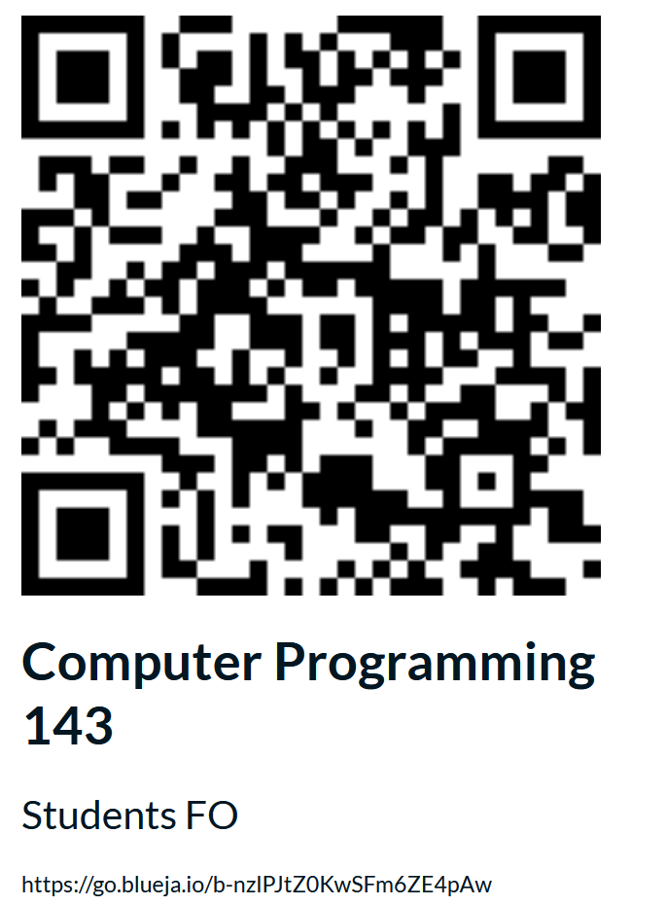

Slide 31
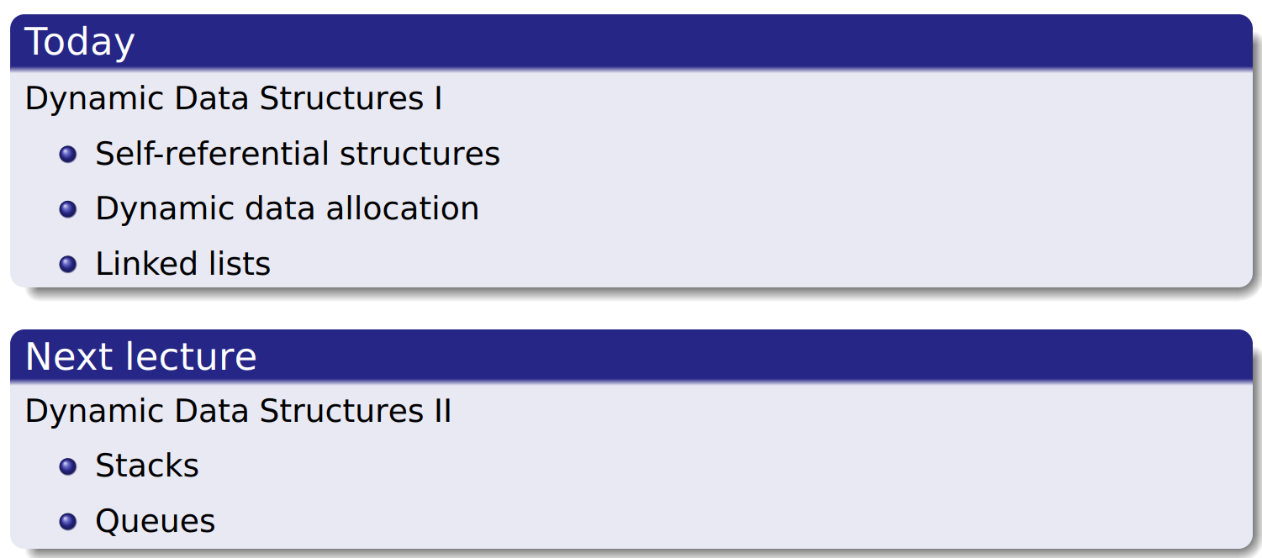
SU FACULTY of ENGINEERING
Computer Programming 143 lectures | 09 October 2026
Perspective
Notes:
F,lashback

Slide 32
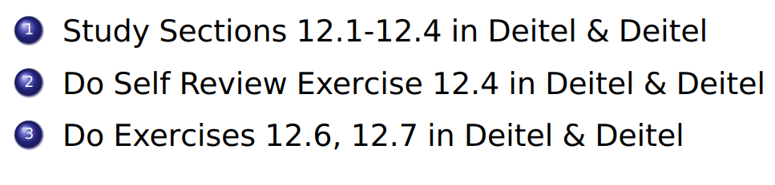
SU FACULTY of ENGINEERING
Computer Programming 143 lectures | 09 October 2026
HOMEWORK
Notes:
F,lashback

