Slide 1


SU FACULTY of ENGINEERING
Computer Programming 143 lectures | 14 September 2026
PROGRAMMING IN C
7. Pointers I
Lecture 17| Pointer declaration & initialization
Pointer operators
Isaac Khobo, PhD (ilkhobo@sun.ac.za)
Chapters 7: Pointers
Notes:
Good morning everybody, welcome back to the 4th term.
And Lecture 17:
We’ll be looking at Pointers for the next five or so lectures.
When I was introduced to C programming a while ago. Pointers where one of those unintuitive concepts in the module I struggled a bit with.
I will make them as simple as I can.
So broad overview, today we’re looking at pointers basics, so declaration and initialisations, and pointer operators.

Slide 2
SU FACULTY of ENGINEERING
Computer Programming 143 lectures | 14 September 2026
Related recap
Data Type in C
Primitive
User defined
Derived
int
enum
array (string)
float
function
double
pointer
char
Variables that store memory addresses of other variables
pointers
Notes:
I wanted to start by stepping a bit and talking about the data types and variables we’ve used so far.

Slide 3

SU FACULTY of ENGINEERING
Computer Programming 143 lectures | 14 September 2026
Memory concepts
name
value
address
int myVar1
10
0x00
float myVar2
2.5
2.521
0x01
double myVar3
char myVar4
‘A’
0x02
0x03
.
.
.
.
.
.
.
.
.
0xFE
0xFF

Slide 4
SU FACULTY of ENGINEERING
Computer Programming 143 lectures | 14 September 2026
Memory concepts
name
value
address
int myVar1
10
0x00
float myVar2
2.5
0x01
double myVar3
2.521
0x02
char myVar4
‘A’
(ASCII)
0x03
.
.
.
.
.
.
.
.
.
0xFE
0xFF

Slide 5
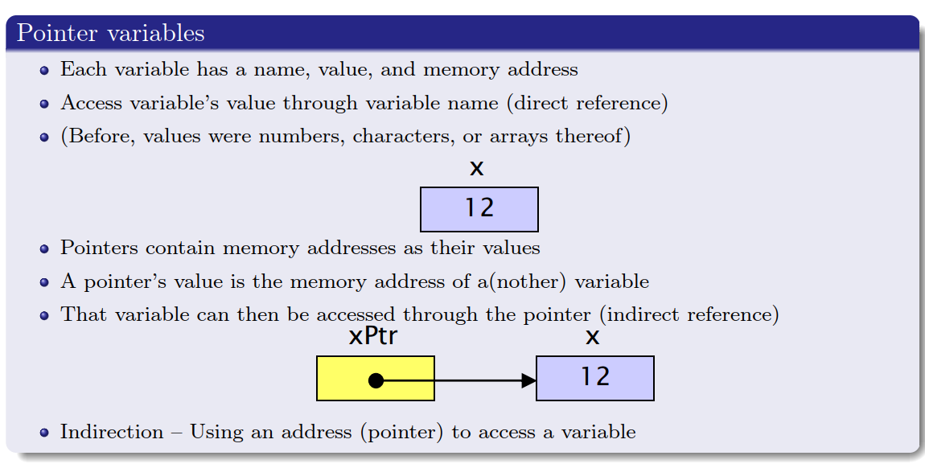
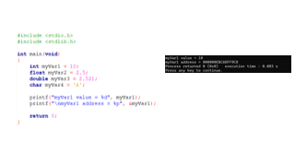
SU FACULTY of ENGINEERING
Computer Programming 143 lectures | 14 September 2026
Memory concepts

Slide 6
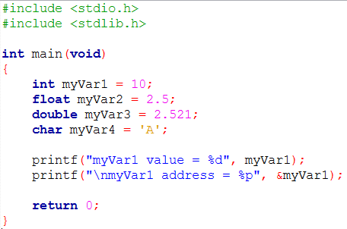


Slide 7
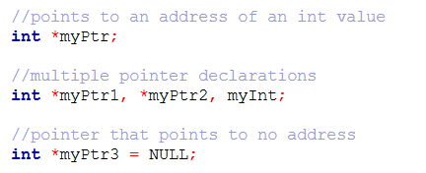
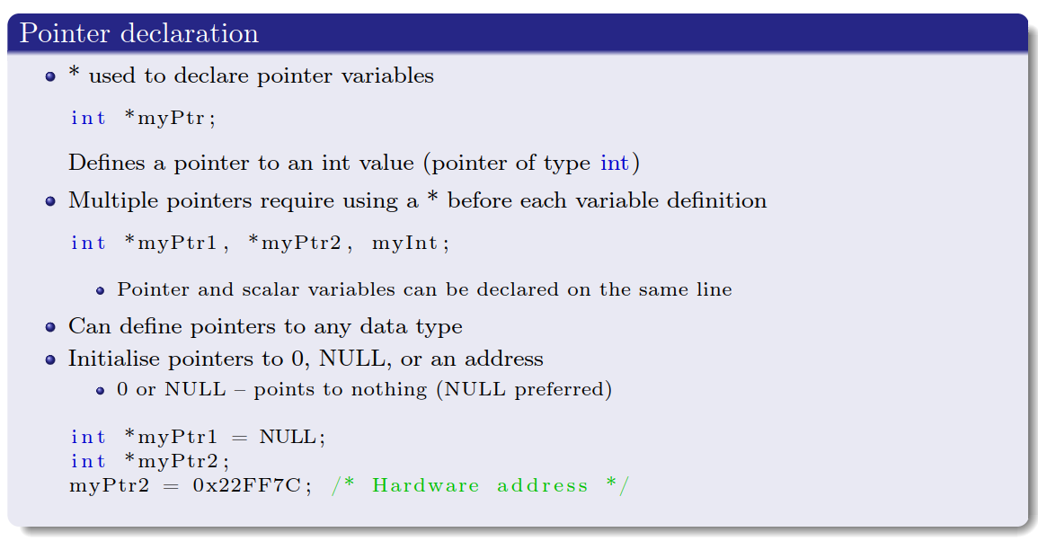
SU FACULTY of ENGINEERING
Computer Programming 143 lectures | 14 September 2026
Pointer declaration

Slide 8
SU FACULTY of ENGINEERING
Computer Programming 143 lectures | 14 September 2026
Pointer operators (&)
name
value
address
int myVar1
10
int myVar1
10
0x00
int *myVar1_Ptr
0x01
0x02
0x03
.
.
.
.
.
.
.
.
.
0xFE
int *myVar1_Ptr
(undeclared)
0xFF

Slide 9
SU FACULTY of ENGINEERING
Computer Programming 143 lectures | 14 September 2026
Pointer operators (&)
name
value
address
int myVar1
10
int myVar1
10
0x00
int *myVar1_Ptr
// Initialise a pointer variable
0x01
myVar1_Ptr
&myVar1
// Assign to address of myVar1
0x02
0x03
Value of myVar1_Ptr is the address of myVar1
myVar1_Ptr is said to “point to” myVar1
Return address (use &)
.
.
.
.
.
.
.
.
.
0xFE
int *myVar1_Ptr
0x00
0xFF
Notes:
They are called pointer variables because they point to address of other variables.

Slide 10
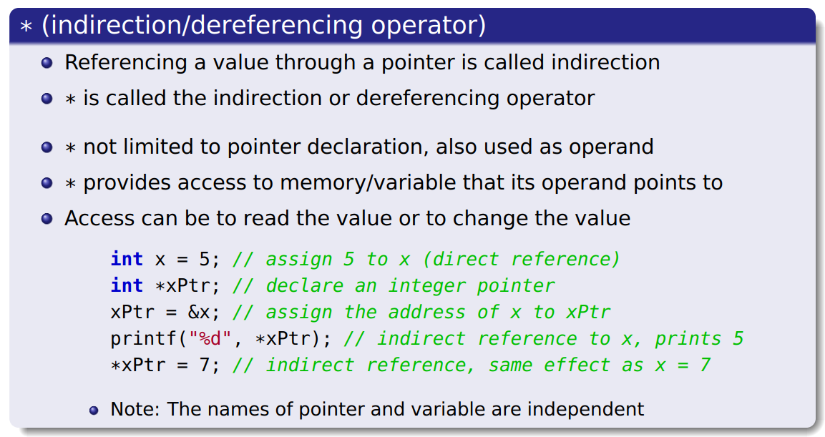
SU FACULTY of ENGINEERING
Computer Programming 143 lectures | 14 September 2026
Pointer operators (*)

Slide 11
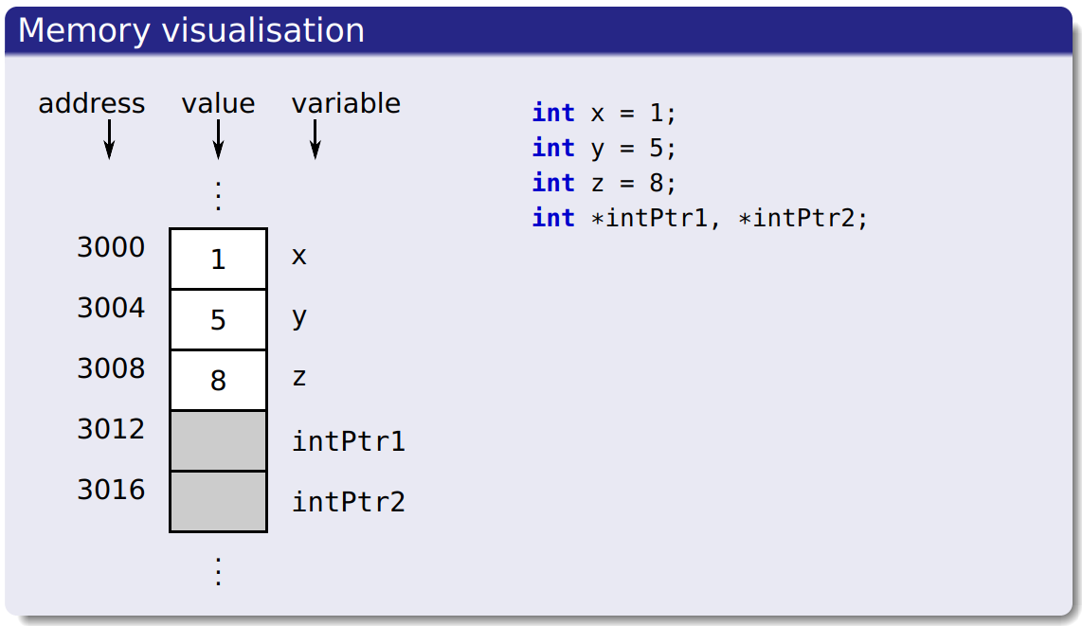
SU FACULTY of ENGINEERING
Computer Programming 143 lectures | 14 September 2026
Pointer operators (*)

Slide 12
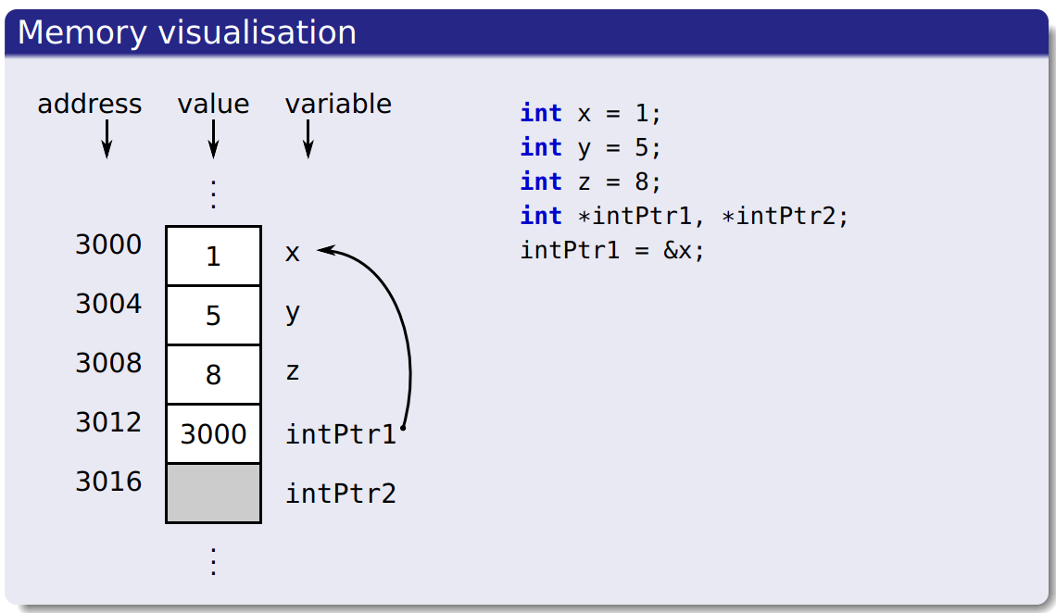
SU FACULTY of ENGINEERING
Computer Programming 143 lectures | 14 September 2026
Pointer operators (*)

Slide 13
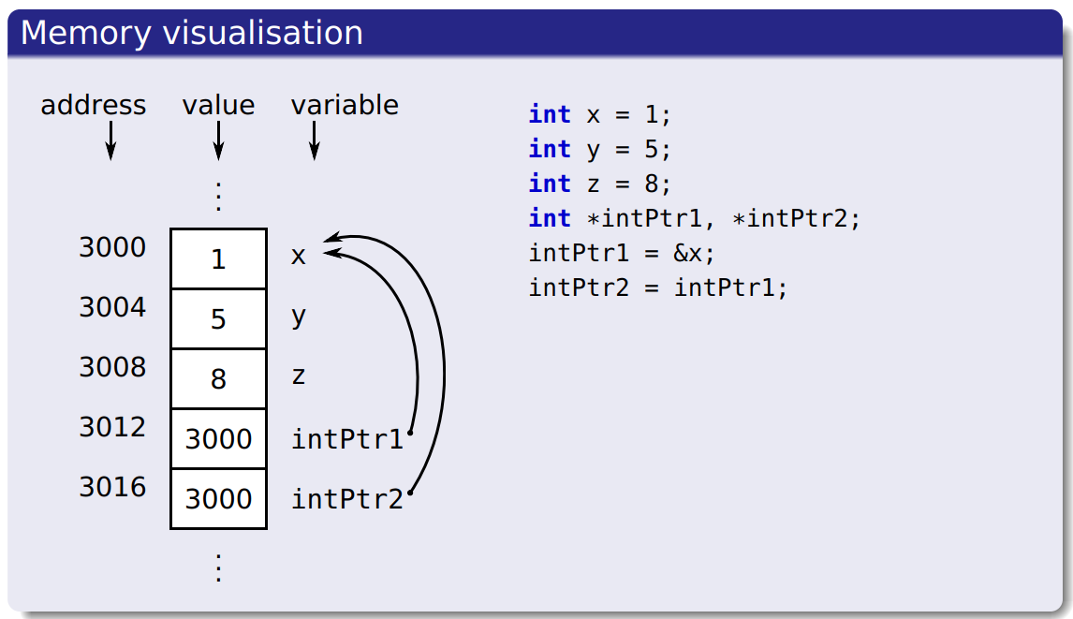
SU FACULTY of ENGINEERING
Computer Programming 143 lectures | 14 September 2026
Pointer operators (*)

Slide 14
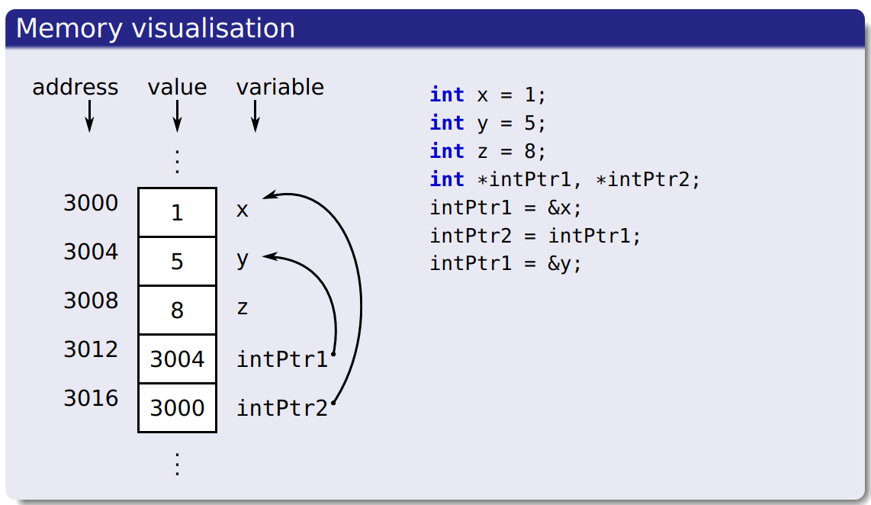
SU FACULTY of ENGINEERING
Computer Programming 143 lectures | 14 September 2026
Pointer operators (*)

Slide 15
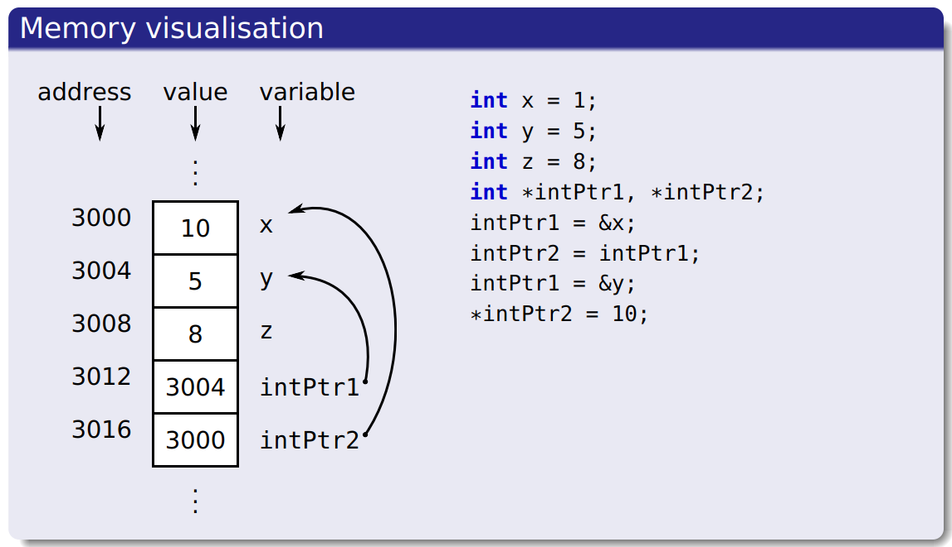
SU FACULTY of ENGINEERING
Computer Programming 143 lectures | 14 September 2026
Pointer operators (*)

Slide 16
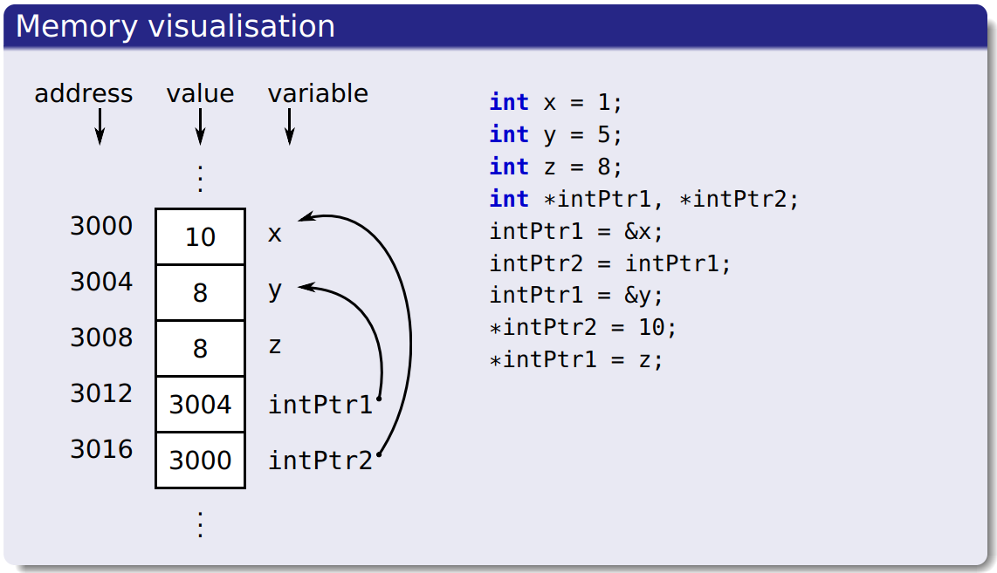
SU FACULTY of ENGINEERING
Computer Programming 143 lectures | 14 September 2026
Pointer operators (*)

Slide 17
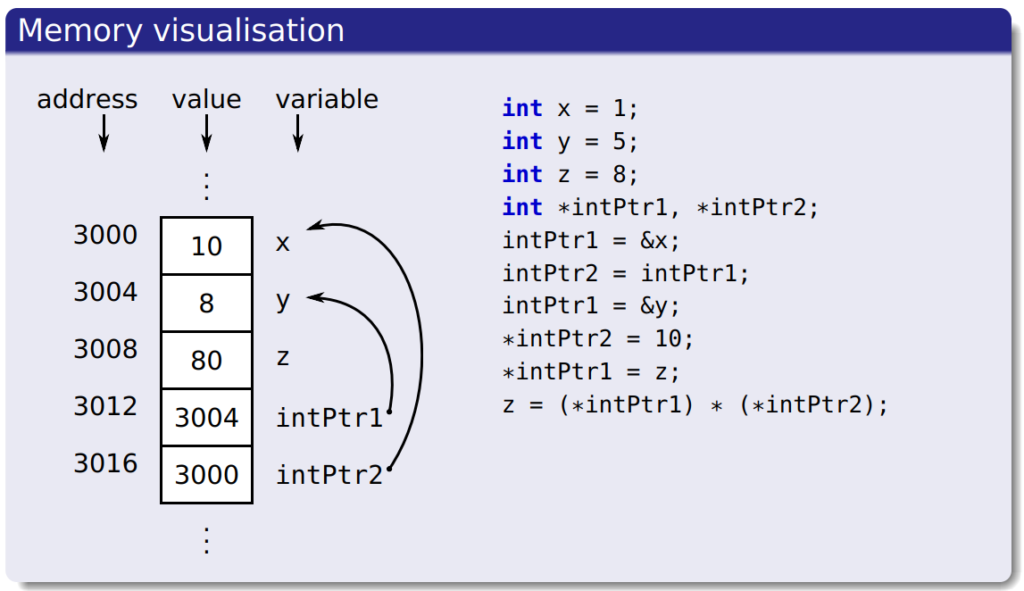
SU FACULTY of ENGINEERING
Computer Programming 143 lectures | 14 September 2026
Pointer operators (*)

Slide 18
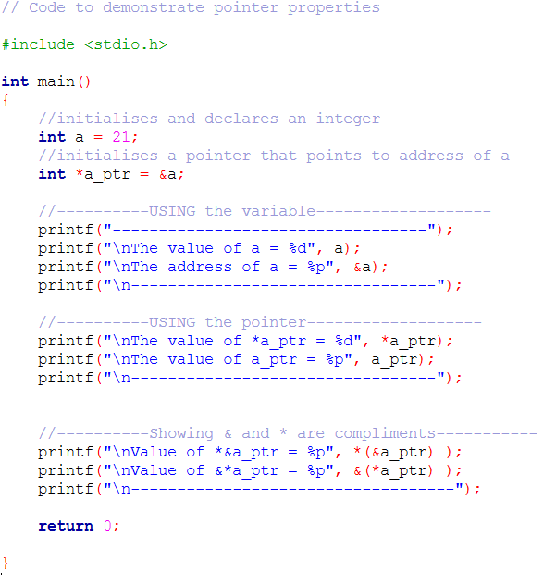
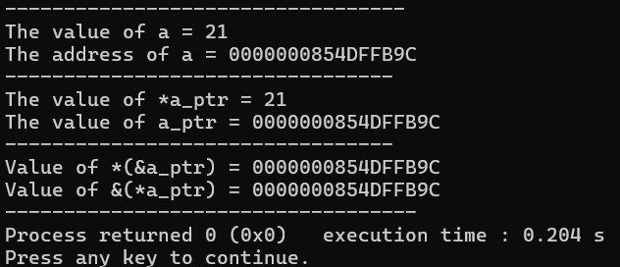
SU FACULTY of ENGINEERING
Computer Programming 143 lectures | 14 September 2026
Pointer operators (*)

Slide 19
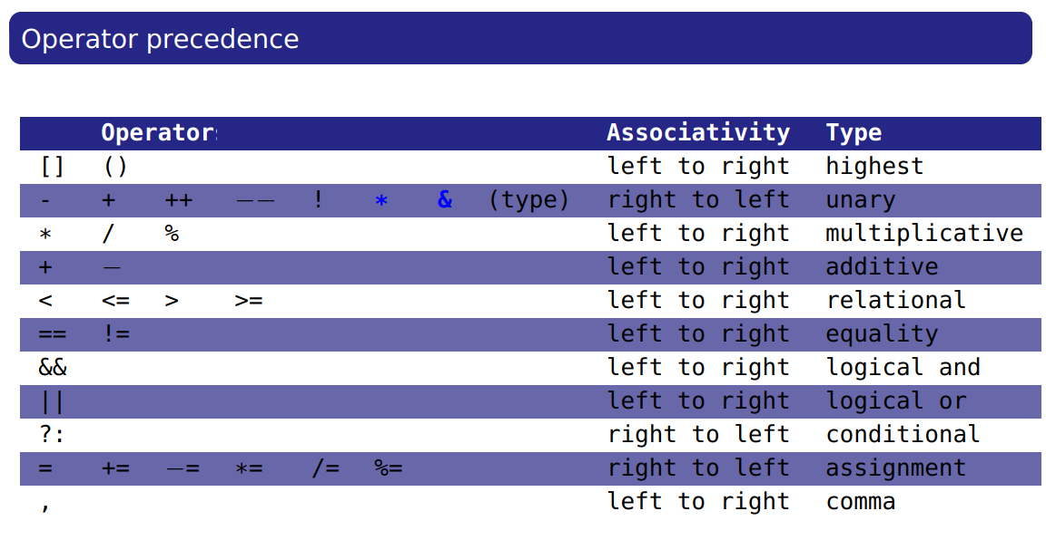
SU FACULTY of ENGINEERING
Computer Programming 143 lectures | 14 September 2026
Operators precedence

