Slide 1

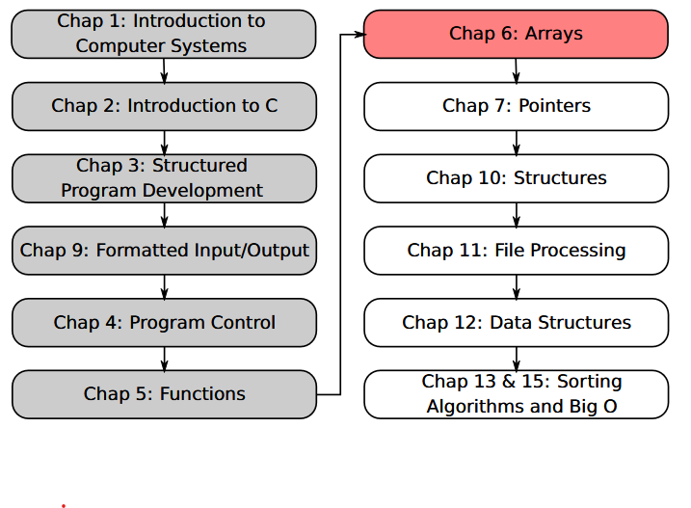
SU FACULTY of ENGINEERING
Computer Programming 143 lectures | 26 August 2026
PROGRAMMING IN C
6. Arrays IV
Lecture 16| Multiple-subscripted arrays
Debugging
Isaac Khobo, PhD (ilkhobo@sun.ac.za)
Chapters 6: Arrays

Slide 2
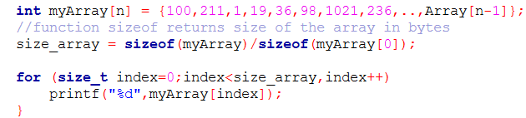
SU FACULTY of ENGINEERING
Computer Programming 143 lectures | 26 August 2026
Recap on arrays so far
{
}
int Array[n] =
100
211
1
19
36
98
1021
236
…
Array[n-1]
0
1
2
3
4
5
6
7
…
n-1
initialisation

Slide 3
SU FACULTY of ENGINEERING
Computer Programming 143 lectures | 26 August 2026
Recap on arrays so far
1D or 1 by n arrays (single-subscripted)
{
}
int Array[n] =
100
211
1
19
36
98
1021
236
…
Array[n-1]
0
1
2
3
4
5
6
7
…
n-1
indexing/printing

Slide 4
SU FACULTY of ENGINEERING
Computer Programming 143 lectures | 26 August 2026
Multiple-subscripted arrays
m by n arrays (multiple-subscripted)
m = 1 (single row)
{
}
int Array[1][n] =
Array
[0][0]
Array
[0][1]
Array
[0][2]
Array
[0][3]
Array
[0][4]
Array
[0][5]
Array
[0][6]
Array
[0][7]
…
Array
[0][n-1]
Array
[1][0]
Array
[1][1]
Array
[1][2]
Array
[1][3]
Array
[1][4]
Array
[1][5]
Array
[1][6]
Array
[1][7]
…
Array
[1][n-1]
Array
[2][0]
Array
[2][1]
Array
[2][2]
Array
[2][3]
Array
[2][4]
Array
[2][5]
Array
[2][6]
Array
[2][7]
…
Array
[2][N-1]
Array
[3][0]
Array
[3][1]
Array
[3][2]
Array
[3][3]
Array
[3][4]
Array
[3][5]
Array
[3][6]
Array
[3][7]
…
Array
[3][n-1]
Array
[4][0]
Array
[4][1]
Array
[4][2]
Array
[4][3]
…
Array
[4][4]
Array
[4][5]
Array
[4][6]
Array
[4][7]
…
Array
[4][N-1]
Array
[m-1][0]
Array
[m-1][1]
Array
[m-1][2]
Array
[m-1][3]
Array
[m-1][4]
Array
[m-1][5]
Array
[m-1][6]
Array
[m-1][7]
…
Array
[m-1][n-1]
Notes:
N = n-1

Slide 5
SU FACULTY of ENGINEERING
Computer Programming 143 lectures | 26 August 2026
Multiple-subscripted arrays
m by n arrays (multiple-subscripted)
m = 2 (two rows)
{
}
int Array[2][n] =
Array
[0][0]
Array
[0][1]
Array
[0][2]
Array
[0][3]
Array
[0][4]
Array
[0][5]
Array
[0][6]
Array
[0][7]
…
Array
[0][n-1]
Array
[1][0]
Array
[1][1]
Array
[1][2]
Array
[1][3]
Array
[1][4]
Array
[1][5]
Array
[1][6]
Array
[1][7]
…
Array
[1][n-1]
Array
[2][0]
Array
[2][1]
Array
[2][2]
Array
[2][3]
Array
[2][4]
Array
[2][5]
Array
[2][6]
Array
[2][7]
…
Array
[2][N-1]
Array
[3][0]
Array
[3][1]
Array
[3][2]
Array
[3][3]
Array
[3][4]
Array
[3][5]
Array
[3][6]
Array
[3][7]
…
Array
[3][n-1]
…
Array
[4][0]
Array
[4][1]
Array
[4][2]
Array
[4][3]
…
Array
[4][4]
Array
[4][5]
Array
[4][6]
Array
[4][7]
…
Array
[4][N-1]
Array
[m-1][0]
Array
[m-1][1]
Array
[m-1][2]
Array
[m-1][3]
Array
[m-1][4]
Array
[m-1][5]
Array
[m-1][6]
Array
[m-1][7]
…
Array
[m-1][n-1]

Slide 6
SU FACULTY of ENGINEERING
Computer Programming 143 lectures | 26 August 2026
Multiple-subscripted arrays
m by n arrays (multiple-subscripted)
m = 3 (three rows)
{
}
int Array[3][n] =
Array
[0][0]
Array
[0][1]
Array
[0][2]
Array
[0][3]
Array
[0][4]
Array
[0][5]
Array
[0][6]
Array
[0][7]
…
Array
[0][n-1]
Array
[1][0]
Array
[1][1]
Array
[1][2]
Array
[1][3]
Array
[1][4]
Array
[1][5]
Array
[1][6]
Array
[1][7]
…
Array
[1][n-1]
Array
[2][0]
Array
[2][1]
Array
[2][2]
Array
[2][3]
Array
[2][4]
Array
[2][5]
Array
[2][6]
Array
[2][7]
…
Array
[2][N-1]
Array
[3][0]
Array
[3][1]
Array
[3][2]
Array
[3][3]
Array
[3][4]
Array
[3][5]
Array
[3][6]
Array
[3][7]
…
Array
[3][n-1]
…
Array
[4][0]
Array
[4][1]
Array
[4][2]
Array
[4][3]
…
Array
[4][4]
Array
[4][5]
Array
[4][6]
Array
[4][7]
…
Array
[4][N-1]
Array
[m-1][0]
Array
[m-1][1]
Array
[m-1][2]
Array
[m-1][3]
Array
[m-1][4]
Array
[m-1][5]
Array
[m-1][6]
Array
[m-1][7]
…
Array
[m-1][n-1]

Slide 7
SU FACULTY of ENGINEERING
Computer Programming 143 lectures | 26 August 2026
Multiple-subscripted arrays
m by n arrays (multiple-subscripted)
m = 4 (four rows)
{
}
int Array[4][n] =
Array
[0][0]
Array
[0][1]
Array
[0][2]
Array
[0][3]
Array
[0][4]
Array
[0][5]
Array
[0][6]
Array
[0][7]
…
Array
[0][n-1]
Array
[1][0]
Array
[1][1]
Array
[1][2]
Array
[1][3]
Array
[1][4]
Array
[1][5]
Array
[1][6]
Array
[1][7]
…
Array
[1][n-1]
Array
[2][0]
Array
[2][1]
Array
[2][2]
Array
[2][3]
Array
[2][4]
Array
[2][5]
Array
[2][6]
Array
[2][7]
…
Array
[2][N-1]
Array
[3][0]
Array
[3][1]
Array
[3][2]
Array
[3][3]
Array
[3][4]
Array
[3][5]
Array
[3][6]
Array
[3][7]
…
Array
[3][n-1]
…
Array
[4][0]
Array
[4][1]
Array
[4][2]
Array
[4][3]
…
Array
[4][4]
Array
[4][5]
Array
[4][6]
Array
[4][7]
…
Array
[4][N-1]
Array
[m-1][0]
Array
[m-1][1]
Array
[m-1][2]
Array
[m-1][3]
Array
[m-1][4]
Array
[m-1][5]
Array
[m-1][6]
Array
[m-1][7]
…
Array
[m-1][n-1]

Slide 8
SU FACULTY of ENGINEERING
Computer Programming 143 lectures | 26 August 2026
Multiple-subscripted arrays
m by n arrays (multiple-subscripted)
m = 5 (five rows)
{
}
int Array[5][n] =
Array
[0][0]
Array
[0][1]
Array
[0][2]
Array
[0][3]
Array
[0][4]
Array
[0][5]
Array
[0][6]
Array
[0][7]
…
Array
[0][n-1]
Array
[1][0]
Array
[1][1]
Array
[1][2]
Array
[1][3]
Array
[1][4]
Array
[1][5]
Array
[1][6]
Array
[1][7]
…
Array
[1][n-1]
Array
[2][0]
Array
[2][1]
Array
[2][2]
Array
[2][3]
Array
[2][4]
Array
[2][5]
Array
[2][6]
Array
[2][7]
…
Array
[2][N-1]
Array
[3][0]
Array
[3][1]
Array
[3][2]
Array
[3][3]
Array
[3][4]
Array
[3][5]
Array
[3][6]
Array
[3][7]
…
Array
[3][n-1]
Array
[4][0]
Array
[4][1]
Array
[4][2]
Array
[4][3]
Array
[4][4]
Array
[4][5]
Array
[4][6]
Array
[4][7]
…
Array
[4][N-1]
…
…
Array
[m-1][0]
Array
[m-1][1]
Array
[m-1][2]
Array
[m-1][3]
Array
[m-1][4]
Array
[m-1][5]
Array
[m-1][6]
Array
[m-1][7]
…
Array
[m-1][n-1]

Slide 9
SU FACULTY of ENGINEERING
Computer Programming 143 lectures | 26 August 2026
Multiple-subscripted arrays
m by n arrays (multiple-subscripted)
m = m (m rows)
{
}
int Array[m][n] =
Array
[0][0]
Array
[0][1]
Array
[0][2]
Array
[0][3]
Array
[0][4]
Array
[0][5]
Array
[0][6]
Array
[0][7]
…
Array
[0][n-1]
Array
[1][0]
Array
[1][1]
Array
[1][2]
Array
[1][3]
Array
[1][4]
Array
[1][5]
Array
[1][6]
Array
[1][7]
…
Array
[1][n-1]
Array
[2][0]
Array
[2][1]
Array
[2][2]
Array
[2][3]
Array
[2][4]
Array
[2][5]
Array
[2][6]
Array
[2][7]
…
Array
[2][N-1]
Array
[3][0]
Array
[3][1]
Array
[3][2]
Array
[3][3]
Array
[3][4]
Array
[3][5]
Array
[3][6]
Array
[3][7]
…
Array
[3][n-1]
Array
[4][0]
Array
[4][1]
Array
[4][2]
Array
[4][3]
Array
[4][4]
Array
[4][5]
Array
[4][6]
Array
[4][7]
…
Array
[4][N-1]
…
Array
[m-1][0]
Array
[m-1][1]
Array
[m-1][2]
Array
[m-1][3]
Array
[m-1][4]
Array
[m-1][5]
Array
[m-1][6]
Array
[m-1][7]
…
Array
[m-1][n-1]

Slide 10
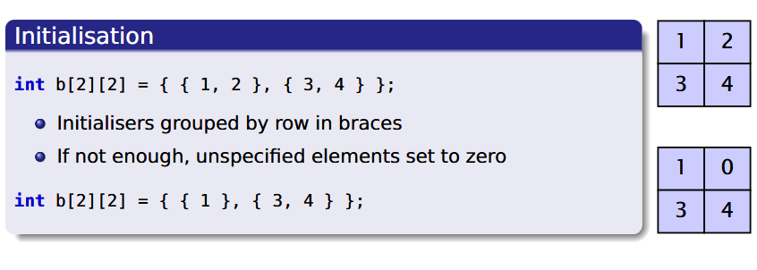
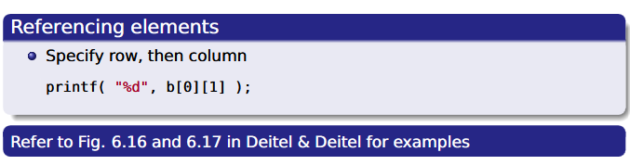
SU FACULTY of ENGINEERING
Computer Programming 143 lectures | 26 August 2026
Multiple-subscripted arrays

Slide 11
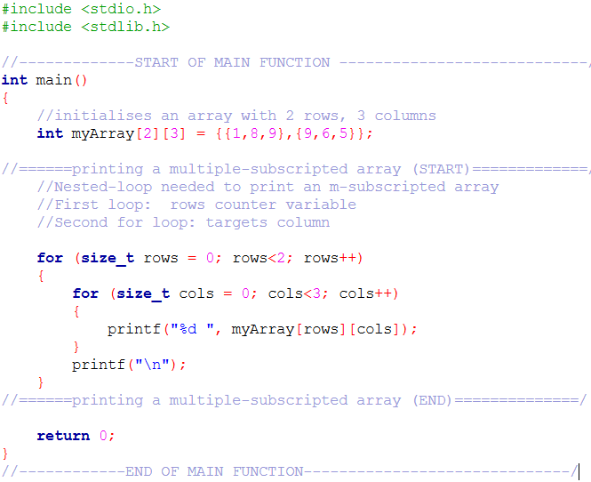
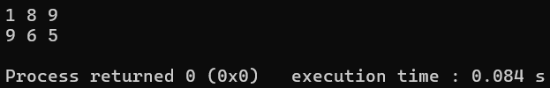
SU FACULTY of ENGINEERING
Computer Programming 143 lectures | 26 August 2026
Example 1| Multiple-subscripted arrays
OUTPUT
1
8
9
9
6
5

Slide 12
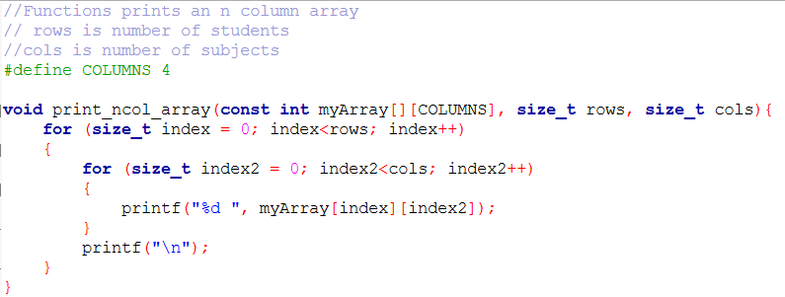
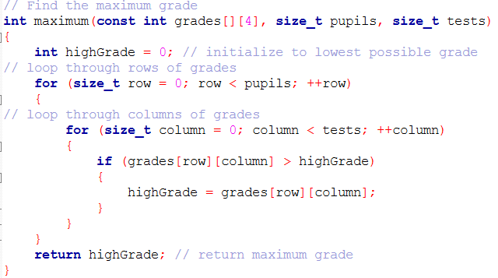
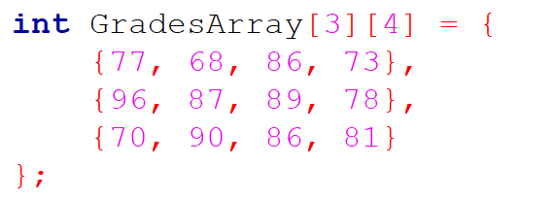
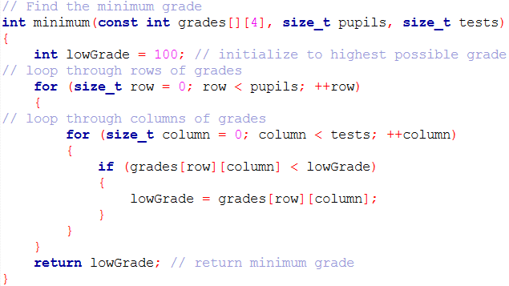
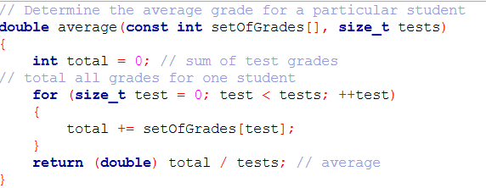
SU FACULTY of ENGINEERING
Computer Programming 143 lectures | 26 August 2026
Example 2| Multiple-subscripted arrays
CP143
CS214
ET300
AP414
77
68
86
73
Emma
Josh
96
87
89
78
Musa
70
90
86
81
Print the array
Minimum grade
Maximum grade
Average grade (each student)

Slide 13
SU FACULTY of ENGINEERING
Computer Programming 143 lectures | 26 August 2026
Example 2| Multiple-subscripted arrays
CP143
CS214
ET300
AP414
77
68
86
73
Emma
Josh
96
87
89
78
Musa
70
90
86
81
Print the array
Minimum grade
Maximum grade
Average grade (each student)

Slide 14
SU FACULTY of ENGINEERING
Computer Programming 143 lectures | 26 August 2026
Example 2| Multiple-subscripted arrays
CP143
CS214
ET300
AP414
77
68
86
73
Emma
Josh
96
87
89
78
Musa
70
90
86
81
Print the array
Minimum grade
Maximum grade
Average grade (each student)

Slide 15
SU FACULTY of ENGINEERING
Computer Programming 143 lectures | 26 August 2026
Example 2| Multiple-subscripted arrays
CP143
CS214
ET300
AP414
77
68
86
73
Emma
Josh
96
87
89
78
Musa
70
90
86
81
Print the array
Minimum grade
Maximum grade
Average grade (each student)

Slide 16

SU FACULTY of ENGINEERING
Computer Programming 143 lectures | 26 August 2026
Example 2| Multiple-subscripted arrays
CP143
CS214
ET300
AP414
77
68
86
73
Emma
Josh
96
87
89
78
Musa
70
90
86
81
Print the array
Minimum grade
Maximum grade
Average grade (each student)

Slide 17
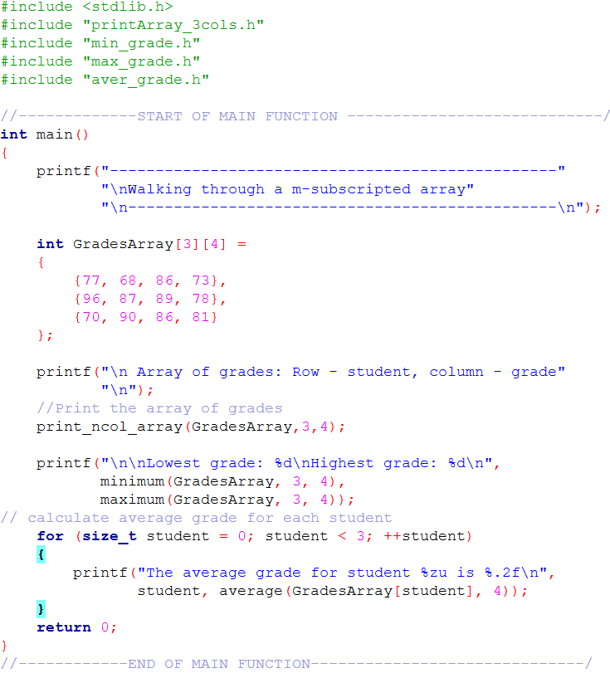
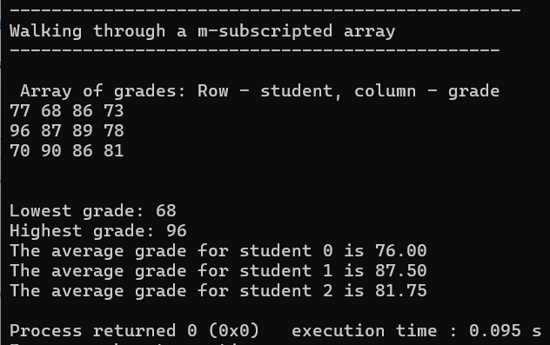
OUTPUT

Slide 18
SU FACULTY of ENGINEERING
Computer Programming 143 lectures | 26 August 2026
Debugging
Systematic process of identifying and fixing errors (bugs) in a comp program.
printf() statements
Comment blocks
Using the debugger

Slide 19
SU FACULTY of ENGINEERING
Computer Programming 143 lectures | 26 August 2026
Debugging
Systematic process of identifying and fixing errors (bugs) in a comp program.
printf() statements
Print out the data in a particular variable to see if it is as expected
To see if a certain line is executed:
printf("%s:%d\n", __FILE__, __LINE__);
To interrupt the program at specific point:
exit(-1); // defined in stdlib.h library
Comment blocks
Using the debugger

Slide 20
SU FACULTY of ENGINEERING
Computer Programming 143 lectures | 26 August 2026
Debugging
Systematic process of identifying and fixing errors (bugs) in a comp program.
printf() statements
Print out the data in a particular variable to see if it is as expected
To see if a certain line is executed:
printf("%s:%d\n", __FILE__, __LINE__);
To interrupt the program at specific point:
exit(-1); // defined in stdlib.h library
Comment blocks
Block out large sections that may be leading to an error
Unblock single statements / small sections until the error occurs
Using the debugger

Slide 21
SU FACULTY of ENGINEERING
Computer Programming 143 lectures | 26 August 2026
Debugging
Systematic process of identifying and fixing errors (bugs) in a comp program.
printf() statements
Print out the data in a particular variable to see if it is as expected
To see if a certain line is executed:
printf("%s:%d\n", __FILE__, __LINE__);
To interrupt the program at specific point:
exit(-1); // defined in stdlib.h library
Comment blocks
Block out large sections that may be leading to an error
Unblock single statements / small sections until the error occurs
Those red arrows etc at the right top in Code::Blocks
Install if not available - see STEMLearn
Using the debugger

