Slide 1

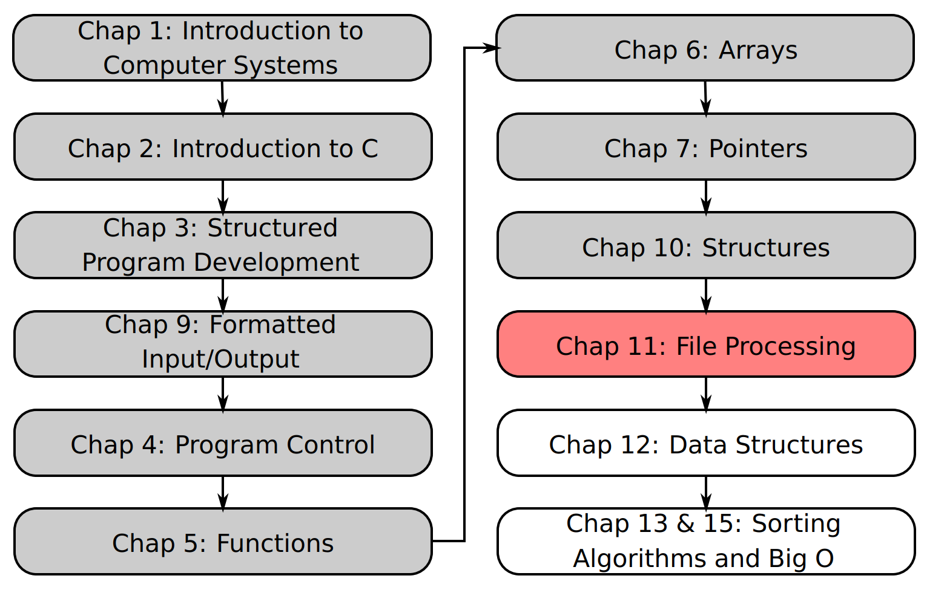
SU FACULTY of ENGINEERING
Computer Programming 143 lectures | 05 October 2026
Lecture Overview
11. File processing II
Lecture 25| The data hierarchy
Write to and read from binary files
Isaac Khobo, PhD (ilkhobo@sun.ac.za)
Chapters 10: File processing

Slide 2
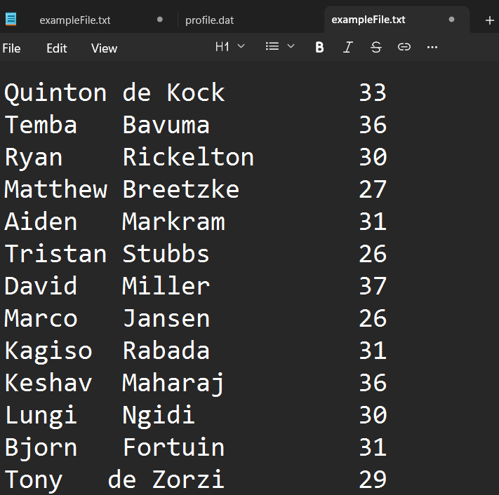
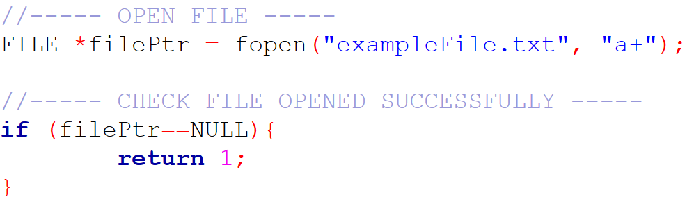
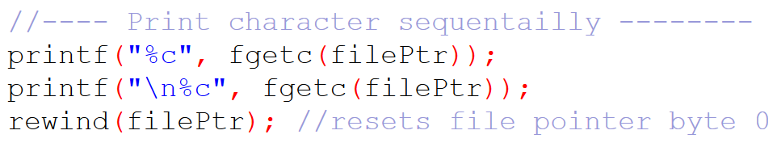

SU FACULTY of ENGINEERING
Computer Programming 143 lectures | 05 October 2026
Recap
OUTPUT
Notes:
F,lashback

Slide 3
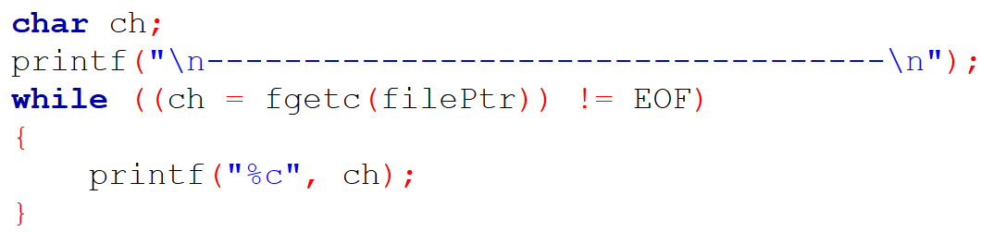
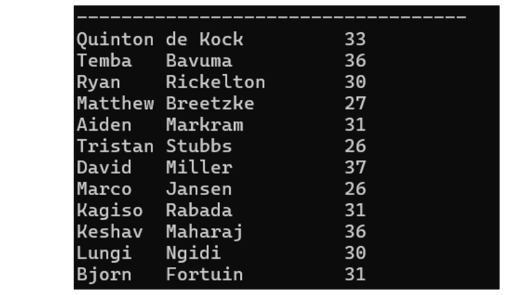
SU FACULTY of ENGINEERING
Computer Programming 143 lectures | 05 October 2026
Recap
OUTPUT
Notes:
F,lashback

Slide 4
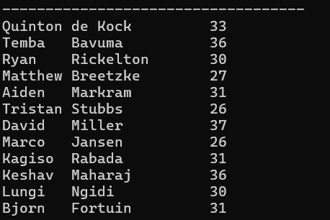

Slide 5
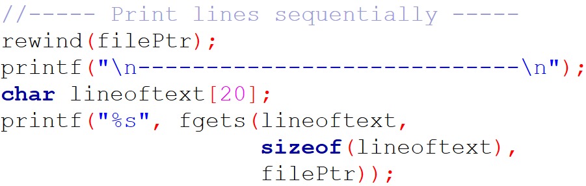

SU FACULTY of ENGINEERING
Computer Programming 143 lectures | 05 October 2026
Recap
OUTPUT
Notes:
F,lashback

Slide 6
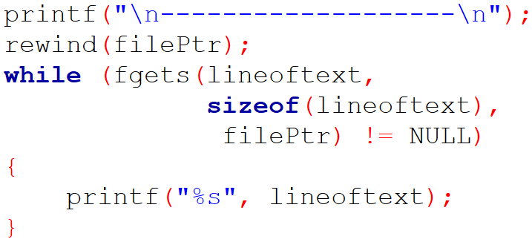
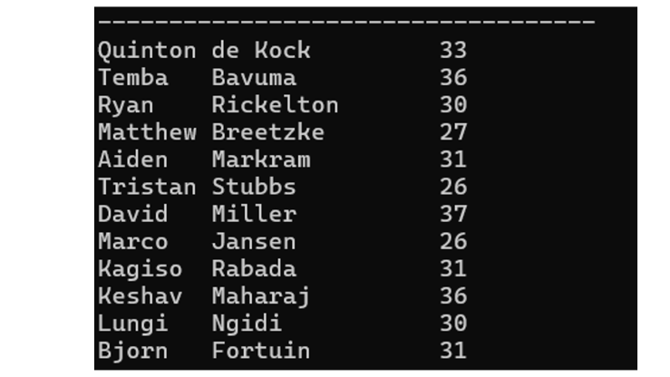
SU FACULTY of ENGINEERING
Computer Programming 143 lectures | 05 October 2026
Recap
OUTPUT
Notes:
F,lashback

Slide 8
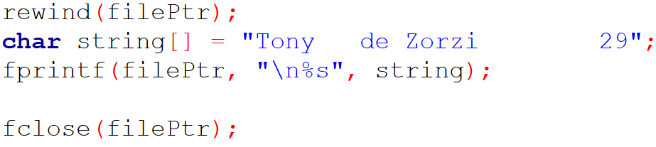
SU FACULTY of ENGINEERING
Computer Programming 143 lectures | 05 October 2026
Recap
Notes:
F,lashback

Slide 9
SU FACULTY of ENGINEERING
Computer Programming 143 lectures | 05 October 2026
Recap
Notes:
F,lashback

Slide 10
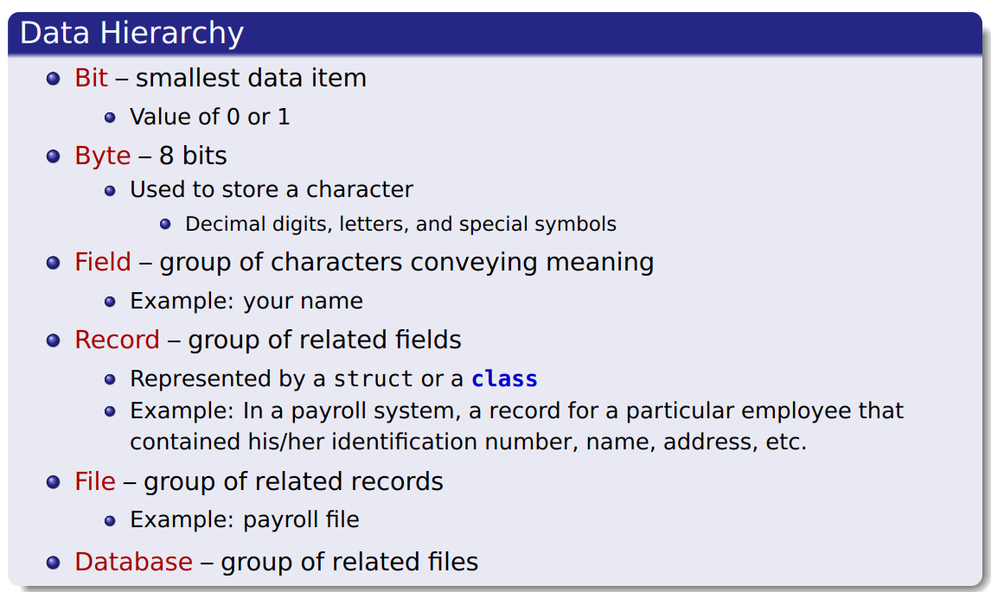
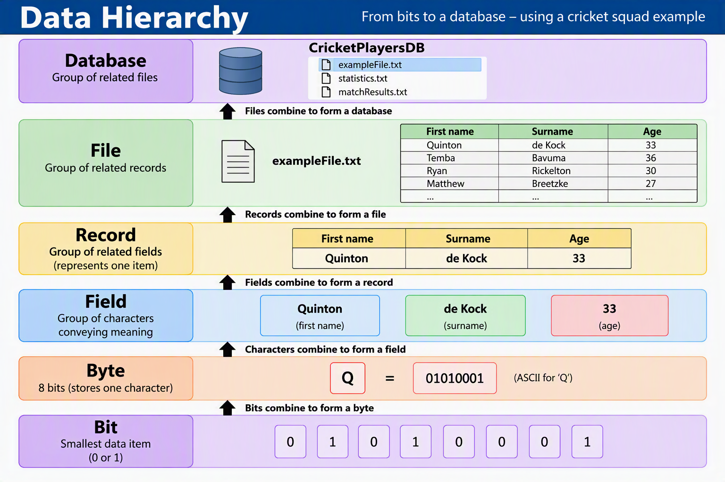
SU FACULTY of ENGINEERING
Computer Programming 143 lectures | 05 October 2026
Data hierarchy
Notes:
Data hierarchy refers to how data

Slide 11
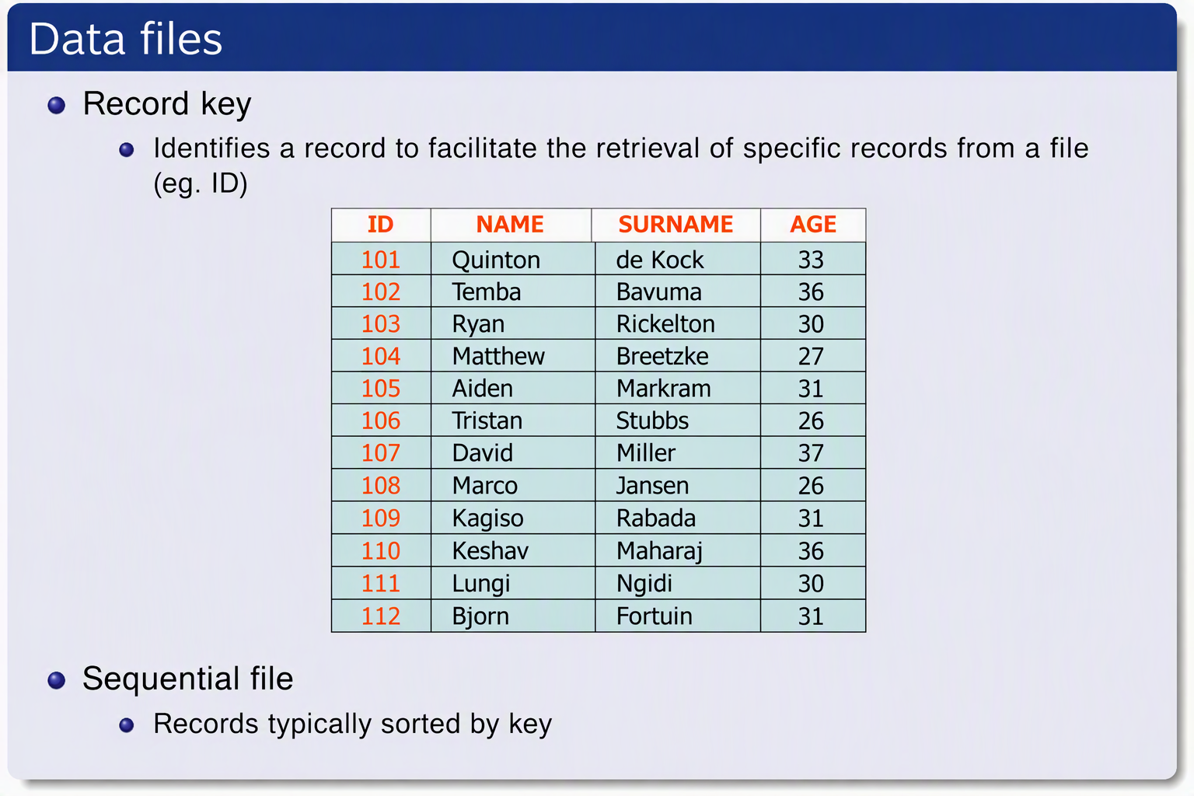
SU FACULTY of ENGINEERING
Computer Programming 143 lectures | 05 October 2026
Data hierarchy
Notes:
Data hierarchy refers to how data

Slide 12
SU FACULTY of ENGINEERING
Computer Programming 143 lectures | 05 October 2026
Data hierarchy
Notes:
Data hierarchy refers to how data

Slide 13
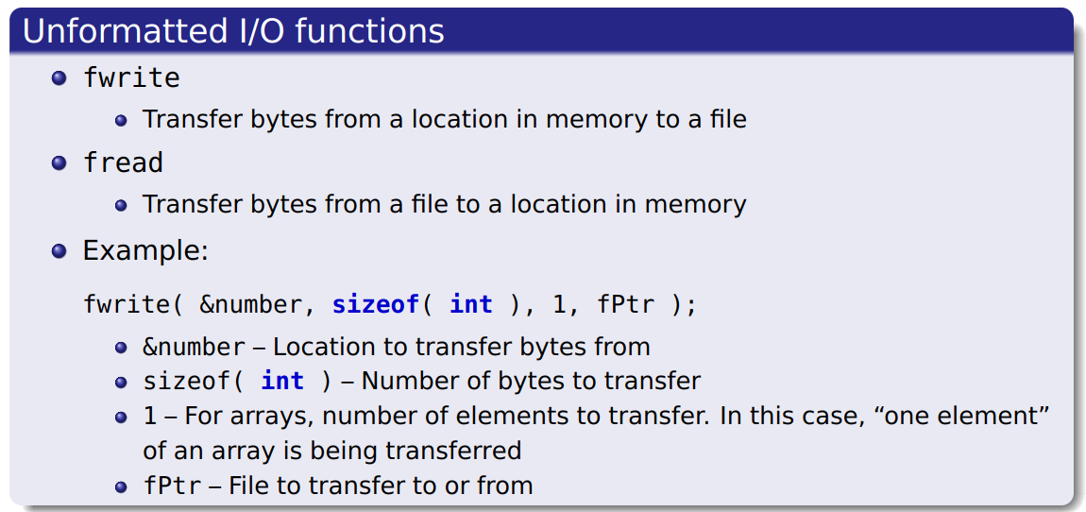
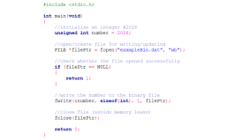
SU FACULTY of ENGINEERING
Computer Programming 143 lectures | 05 October 2026
Write to/read from binary file
Notes:
Data hierarchy refers to how data

Slide 14
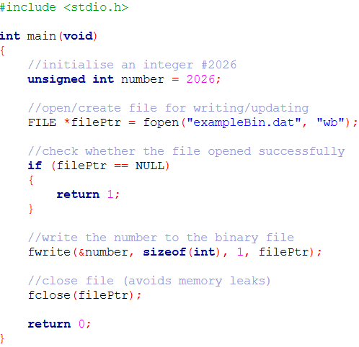

Slide 15
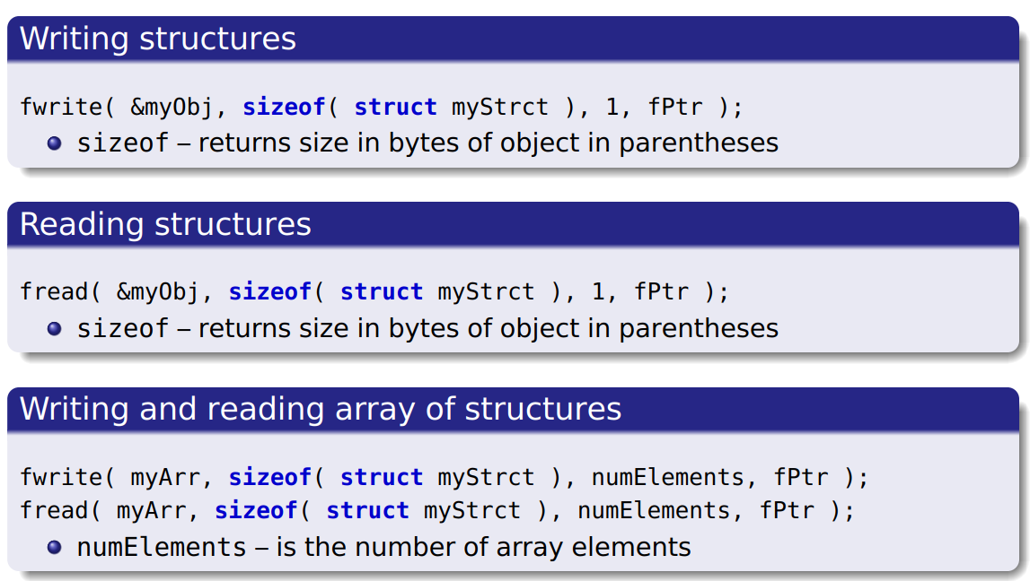
SU FACULTY of ENGINEERING
Computer Programming 143 lectures | 05 October 2026
Writing structures to a binary file
Notes:
F,lashback

Slide 16
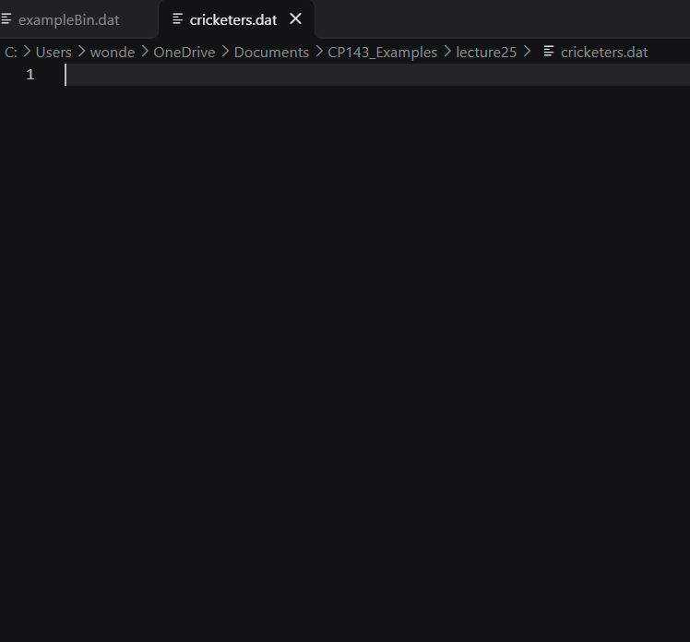
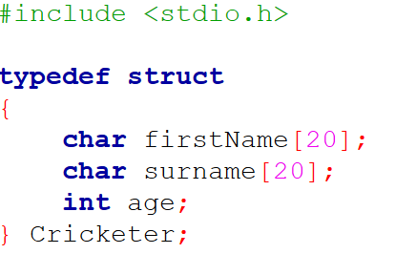
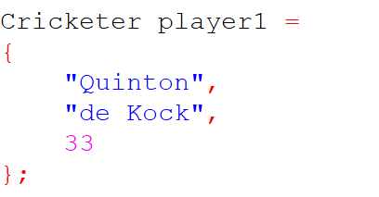
SU FACULTY of ENGINEERING
Computer Programming 143 lectures | 05 October 2026
Writing structures to a binary file
Notes:
F,lashback

Slide 17
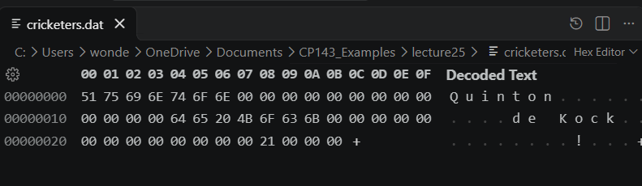
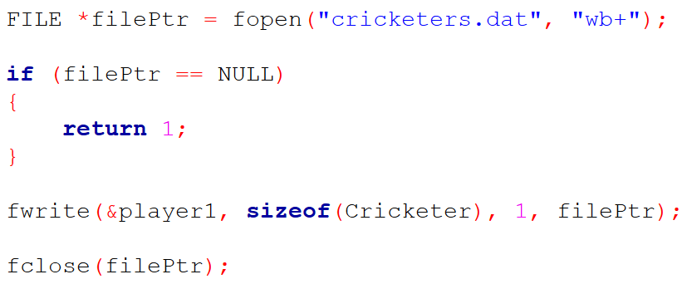
SU FACULTY of ENGINEERING
Computer Programming 143 lectures | 05 October 2026
Writing structures to a binary file
Notes:
F,lashback

Slide 18
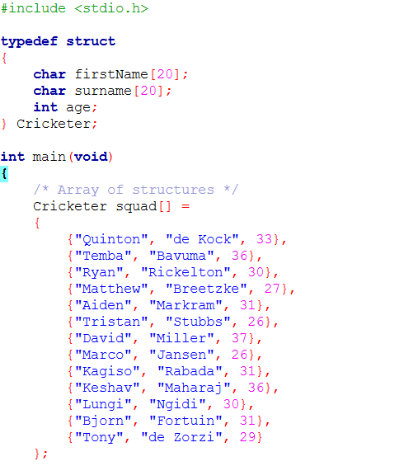
SU FACULTY of ENGINEERING
Computer Programming 143 lectures | 05 October 2026
Writing structures to a binary file
Notes:
F,lashback

Slide 19
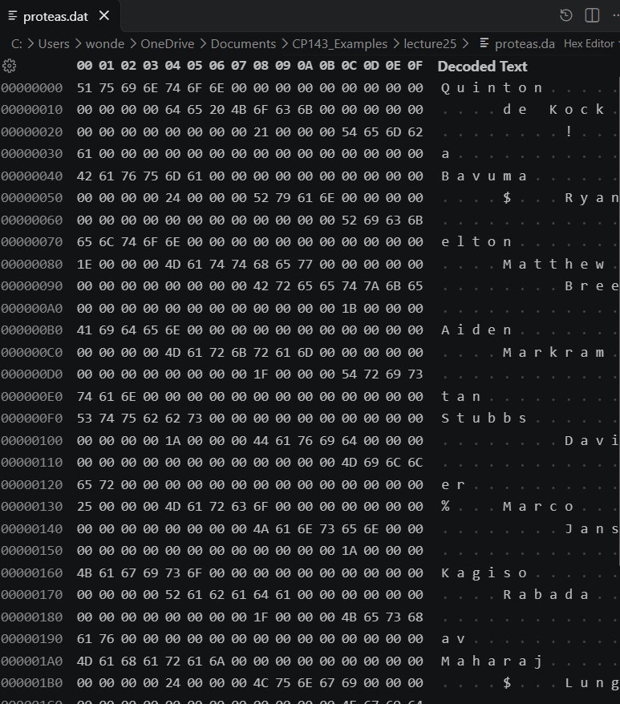
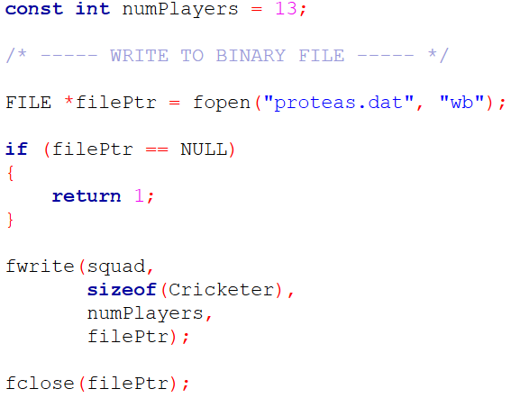
SU FACULTY of ENGINEERING
Computer Programming 143 lectures | 05 October 2026
Writing structures to a binary file
Notes:
F,lashback

Slide 20
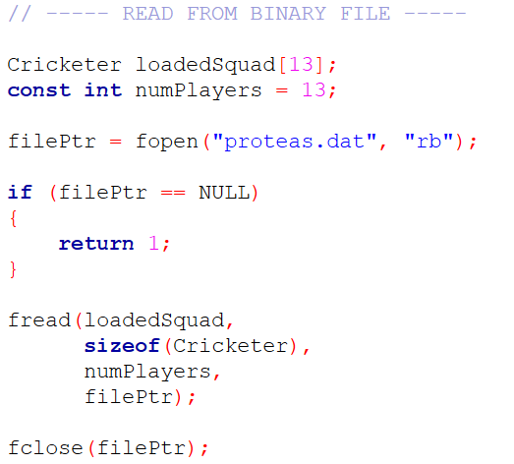
SU FACULTY of ENGINEERING
Computer Programming 143 lectures | 05 October 2026
Reading structures from a binary file
Notes:
F,lashback

Slide 21
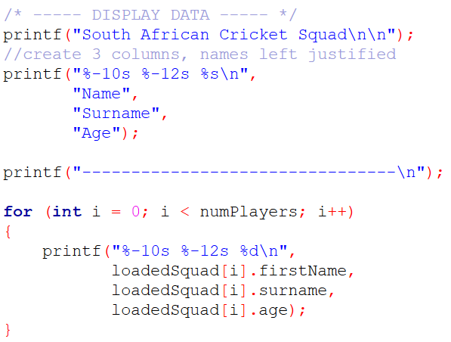
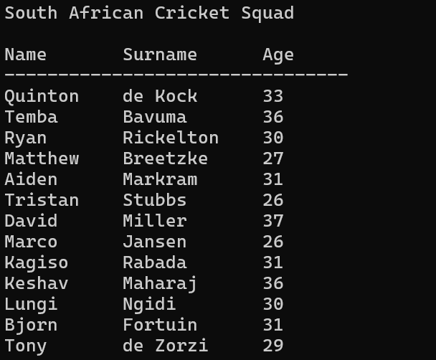
SU FACULTY of ENGINEERING
Computer Programming 143 lectures | 05 October 2026
Reading structures from a binary file
Notes:
F,lashback

Slide 22
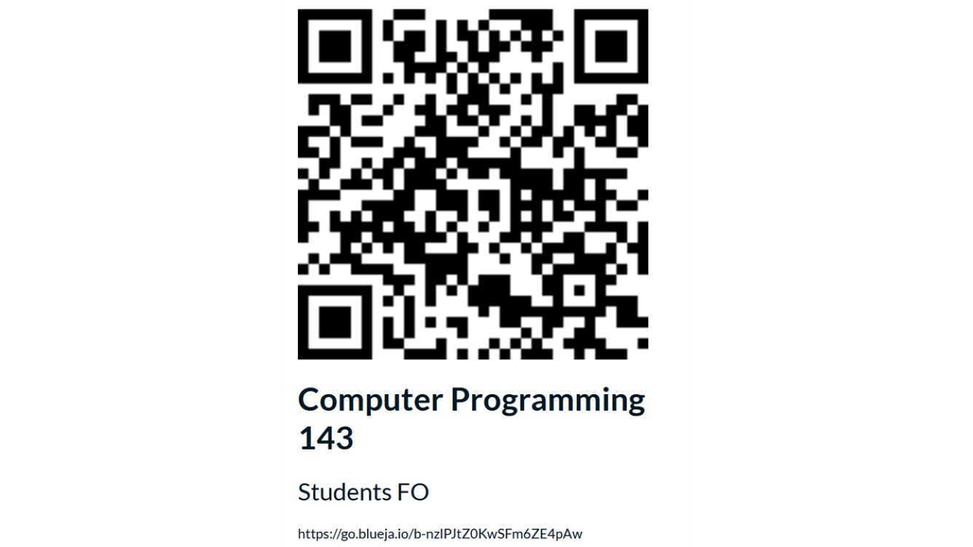
SU FACULTY of ENGINEERING
Computer Programming 143 lectures | 05 October 2026
End of semester feedback

Slide 23
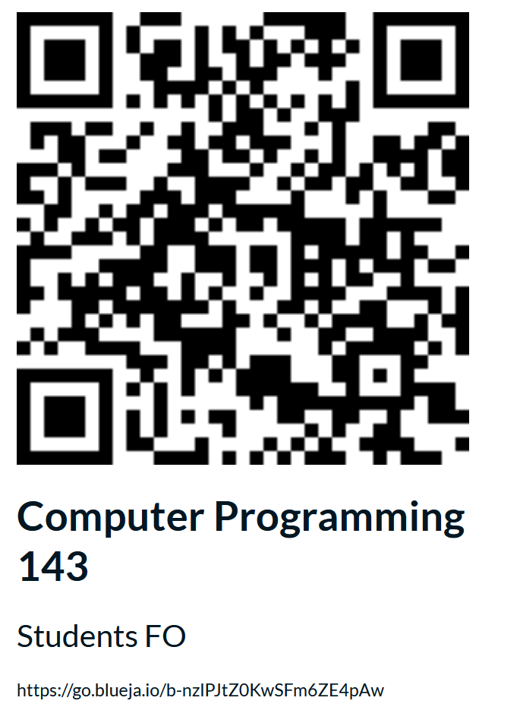

Slide 24
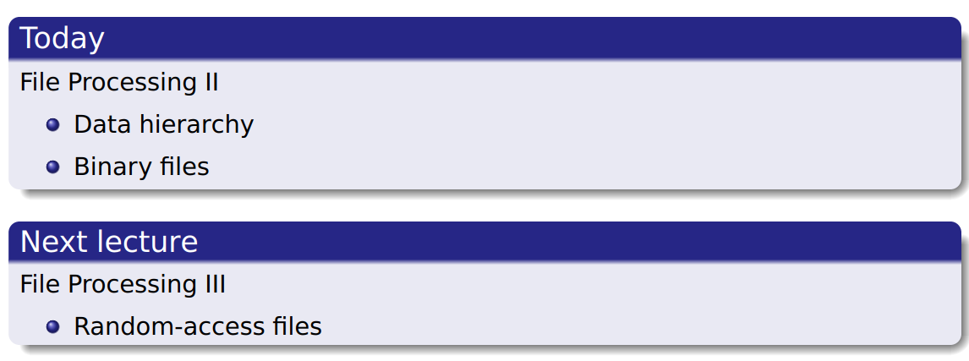
SU FACULTY of ENGINEERING
Computer Programming 143 lectures | 05 October 2026
Perspective
Notes:
F,lashback

Slide 25
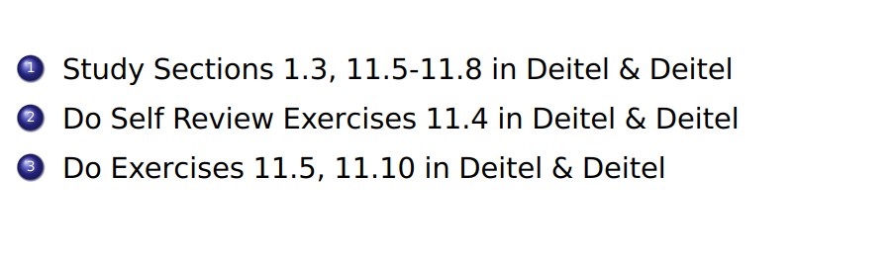
SU FACULTY of ENGINEERING
Computer Programming 143 lectures | 05 October 2026
HOMEWORK
Notes:
F,lashback

