Slide 1


SU FACULTY of ENGINEERING
Computer Programming 143 lectures | 21 September 2026
PROGRAMMING IN C
7. Pointers IV
Lecture 19| Pointer expression and arithmetic
Relationship between pointers and arrays
Dynamic memory allocation
Isaac Khobo, PhD (ilkhobo@sun.ac.za)
Chapters 7: Pointers

Slide 2
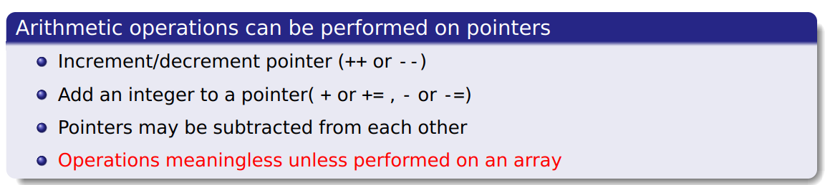
SU FACULTY of ENGINEERING
Computer Programming 143 lectures | 21 September 2026
Pointer expressions
int myArray[] = {21,1,2,12,0};
int *myPointer = myArray;

Slide 3
SU FACULTY of ENGINEERING
Computer Programming 143 lectures | 21 September 2026
Pointer expressions
int myArray[] = {21,1,2,12,0}
int *myPointer = myArray
myPointer ++
myPointer --

Slide 4
SU FACULTY of ENGINEERING
Computer Programming 143 lectures | 21 September 2026
Pointer expressions
int myArray[] = {21,1,2,12,0};
int *myPointer = myArray;
myPointer ++;
myPointer --;
myPointer +=2;
myPointer –=2;

Slide 5
SU FACULTY of ENGINEERING
Computer Programming 143 lectures | 21 September 2026
Pointer expressions
int myArray[] = {21,1,2,12,0};
int *myPointer = myArray;
myPointer ++;
myPointer --;
myPointer +=2;
myPointer –=2;
myPointer2 = myPointer;
myPointer3 = myPointer2 - myPointer;

Slide 6
SU FACULTY of ENGINEERING
Computer Programming 143 lectures | 21 September 2026
Pointer expressions
int myArray[] = {21,1,2,12,0};
int *myPointer = myArray;
myPointer ++;
myPointer --;
myPointer +=2;
myPointer –=2;
myPointer2 = myPointer;
myPointer3 = myPointer2 - myPointer;

Slide 7
SU FACULTY of ENGINEERING
Computer Programming 143 lectures | 21 September 2026
Important recap for the lecture
Sizeof | Size (bytes) 64bit machine
Integer (int) | 4
Character (char) | 1
Short integer (short/ short int) | 2
Long integer (long/ long int) | 4
Floating point number (float) | 4
Double floating point number (double) | 8
Pointer (*) | 8

Slide 8

SU FACULTY of ENGINEERING
Computer Programming 143 lectures | 21 September 2026
Pointer expressions
char myString[] = “programming”;
(char myString[12] = {‘p’, ‘r’, ‘o’, ‘g’,…, ‘g’, ‘\0’};)
name
value
address
….
….
char *myPointer = myString;
0x3000
(char *myPointer = &myString[0];)
0x3001
0x3002
0x3003
0x3004
0x3005
0x3006
0x3007
0x3008
0x3009
0x3010
…
…
0xFF

Slide 9
SU FACULTY of ENGINEERING
Computer Programming 143 lectures | 21 September 2026
Pointer expressions
char myString[] = “programming”;
(char myString[12] = {‘p’, ‘r’, ‘o’, ‘g’,…, ‘g’, ‘\0’};)
name
value
address
….
….
char *myPointer = myString;
myPointer
myString[0]
p
0x3000
(char *myPointer = &myString[0];)
myString[1]
r
0x3001
myString[2]
o
0x3002
myString[3]
g
0x3003
myString[4]
r
0x3004
myString[5]
a
0x3005
myString[6]
m
0x3006
myString[7]
m
0x3007
myString[8]
i
0x3008
myString[9]
n
0x3009
myString[10]
g
0x3010
…
…
0xFF

Slide 10
SU FACULTY of ENGINEERING
Computer Programming 143 lectures | 21 September 2026
Pointer expressions
char myString[] = “programming”;
(char myString[12] = {‘p’, ‘r’, ‘o’, ‘g’,…, ‘g’, ‘\0’};)
name
value
address
….
….
char *myPointer = myString;
myString[0]
0x3000
p
myPointer
(char *myPointer = &myString[0];)
myString[1]
r
0x3001
+1
myString[2]
o
0x3002
myString[3]
g
0x3003
myPointer++
myString[4]
r
0x3004
myString[5]
a
0x3005
myString[6]
m
0x3006
myString[7]
m
0x3007
myString[8]
i
0x3008
myString[9]
n
0x3009
myString[10]
g
0x3010
…
…
0xFF

Slide 11
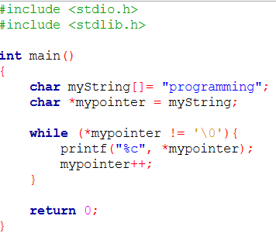

SU FACULTY of ENGINEERING
Computer Programming 143 lectures | 21 September 2026
Pointer expressions
char myString[] = “programming”;
(char myString[12] = {‘p’, ‘r’, ‘o’, ‘g’,…, ‘g’, ‘\0’};)
name
value
address
char *myPointer = myString;
….
….
myPointer
myString[0]
p
0x3000
(char *myPointer = &myString[0];)
myString[1]
0x3001
r
+1
myString[2]
o
0x3002
+2
myString[3]
g
0x3003
+3
myString[4]
r
0x3004
+4
myString[5]
a
0x3005
+5
myString[6]
m
0x3006
+6
myString[7]
m
0x3007
+7
myString[8]
i
0x3008
+8
myString[9]
n
0x3009
+9
myString[10]
g
0x3010
+10
…
…
0xFF

Slide 12
SU FACULTY of ENGINEERING
Computer Programming 143 lectures | 21 September 2026
Pointer arithmetic
int myArray[] = {21,1,2}
name
value
address
int *myPointer = myArray;
….
….
(int *myPointer = &myArray[0];)
myPointer
myArray[0]
0x3000
21
0x3001
0x3002
0x3003
myArray[1]
0x3004
1
0x3005
0x3006
0x3007
myArray[2]
0x3008
2
0x3009
0x3010
…
…

Slide 13
SU FACULTY of ENGINEERING
Computer Programming 143 lectures | 21 September 2026
Pointer expressions
int myArray[] = {21,1,2}
name
value
address
int *myPointer = myArray;
….
….
(int *myPointer = &myArray[0];)
myPointer
myArray[0]
0x3000
21
0x3001
0x3002
0x3003
myPointer
myPointer ++
myArray[1]
0x3004
+1
1
0x3005
0x3006
0x3007
myArray[2]
0x3008
2
0x3009
0x3010
…
…

Slide 14
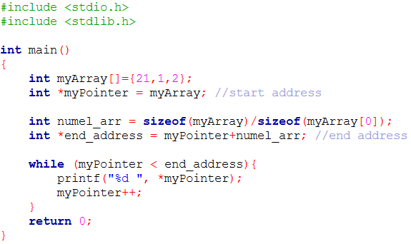

SU FACULTY of ENGINEERING
Computer Programming 143 lectures | 21 September 2026
Pointer expressions
int myArray[] = {21,1,2}
name
value
address
int *myPointer = myArray;
….
….
(int *myPointer = &myArray[0];)
myPointer
myArray[0]
0x3000
21
0x3001
0x3002
0x3003
myPointer
myArray[1]
0x3004
1
+1
0x3005
0x3006
0x3007
myPointer
myArray[2]
0x3008
2
+2
0x3009
0x3010
…
…
0xFF

Slide 15
SU FACULTY of ENGINEERING
Computer Programming 143 lectures | 21 September 2026
Pointer expressions
int myArray[] = {21,1,2}
name
value
address
int *myPointer1 = &myArray[0];
….
….
int *myPointer2 = &myArray[2];
myPointer1
myArray[0]
0x3000
21
myPointer2 - myPointer1 would produce 2
(i.e., the pointers are 2 int positions apart)
0x3001
0x3002
myPointer2 + myPointer1 would produce an error;
0x3003
myArray[1]
0x3004
Subtraction: number of array elements between the two pointers.
NB: does not return bytes
Addition: pointer address has no meaningful interpretation in C
1
Pointer arithmetic
0x3005
0x3006
0x3007
myPointer2
myArray[2]
0x3008
2
0x3009
0x3010
…
…
0xFF

Slide 16
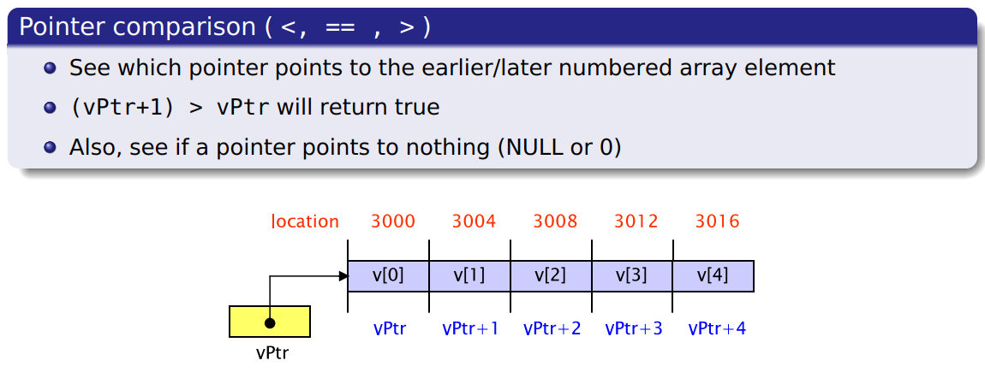
SU FACULTY of ENGINEERING
Computer Programming 143 lectures | 21 September 2026
Pointer expressions

Slide 17
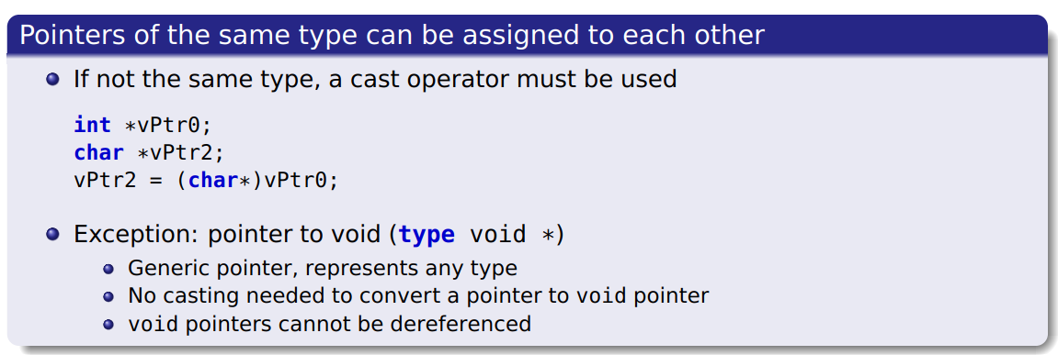
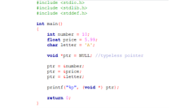
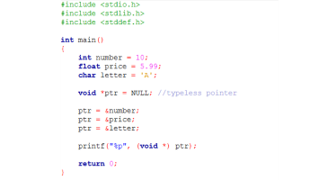
SU FACULTY of ENGINEERING
Computer Programming 143 lectures | 21 September 2026
Pointer expressions

Slide 18
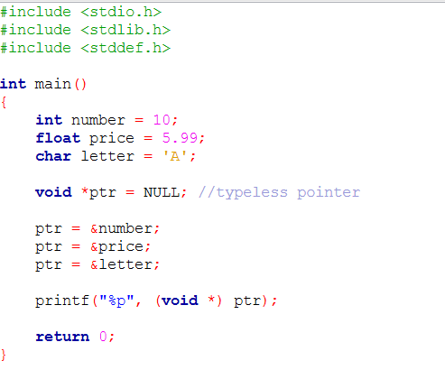

Slide 19
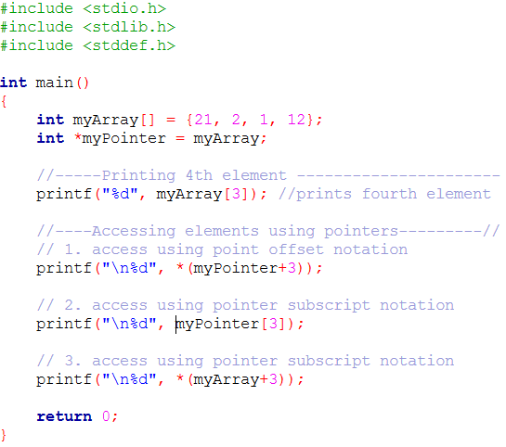
SU FACULTY of ENGINEERING
Computer Programming 143 lectures | 21 September 2026
Pointers & arrays
Offset notation:
*(myPointer+i)
Accesses the i-th element of the array.
i.e. myArray[3] = *(myPointer+3)
ACCESSING: myArray[i]

Slide 20
SU FACULTY of ENGINEERING
Computer Programming 143 lectures | 21 September 2026
Pointers & arrays
Pointer subscript notation:
myPointer[i]
Accesses the i-th element of the array.
i.e. myArray[3] = myPointer[3]
ACCESSING: myArray[i]

Slide 21
SU FACULTY of ENGINEERING
Computer Programming 143 lectures | 21 September 2026
Pointers & arrays
Array subscript notation:
myPointer[i]
Accesses the i-th element of the array.
i.e. myArray[3] = *(myArray+3)
ACCESSING: myArray[i]

Slide 22
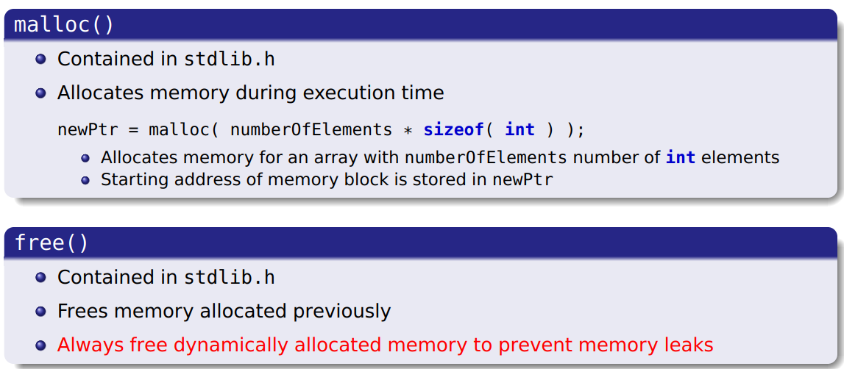
SU FACULTY of ENGINEERING
Computer Programming 143 lectures | 21 September 2026
Dynamic memory allocation

Slide 23
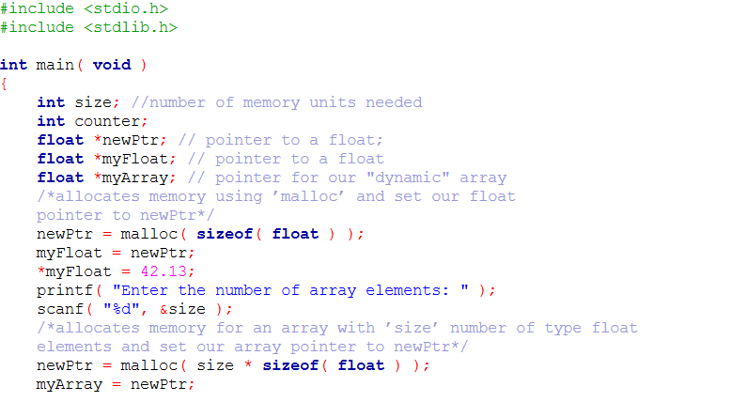
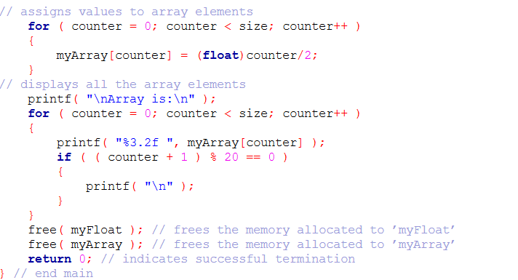
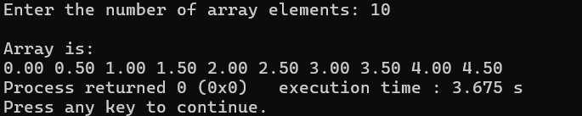
SU FACULTY of ENGINEERING
Computer Programming 143 lectures | 21 September 2026
Dynamic memory allocation

