Slide 1
MB
Moffat Bay Lodge
Functional Prototype + Landing Page Mockup
Navigational Wireframe PowerPoint
MB
MOFFAT BAY LODGE
Home
Rooms
Book
WELCOME TO MOFFAT BAY
One Island. One Lodge.
Salt Air and Quiet Water
Red Team
Comfortable lodging and island adventure in one simple reservation flow.
Matthew Rozendaal
Brayan Covarrubias
Rashai Robertson
Tiffany Davidson
Start Walkthrough
Jump to Home
Approval-ready package: page mockups, booking flow, page purposes, and clickable prototype links.
Slide 1 | Editable components | Use Slide Show mode to click through the prototype
Home
Rooms
Book
Lookup
Site Flow

Slide 2
Site Flow + Prototype Map
Moffat Bay Lodge Prototype
Approval walkthrough for the Moffat Bay Lodge navigation and reservation path.
Landing / Home
Rooms & Pricing
Book Your Stay
Reservation Summary
About
Attractions
Contact
Login / Register
Primary reviewer path: Home → Rooms & Pricing → Book Your Stay → Reservation Summary. Secondary paths support lodge information, activities, contact, account creation, and reservation lookup.
Reservation Lookup
Slide 2 | Editable components | Use Slide Show mode to click through the prototype
Home
Rooms
Book
Lookup
Site Flow

Slide 3
Landing Page Mockup
Moffat Bay Lodge Prototype
Realistic mockup of the website home page with header, hero, room cards, CTAs, and activity section.
moffatbaylodge.com/index.html
MB
MOFFAT BAY LODGE
Home
About
Rooms & Pricing
Attractions
Contact
Book
Login
Register
WELCOME TO MOFFAT BAY
One Island. One Lodge. Endless Adventure.
Comfortable lodging, coastal adventure, and a simple reservation experience come together at one island retreat.
Wake Up to Salt Air and Quiet Water
Book Your Stay
Rooms & Pricing
Hike, kayak, whale watch, or scuba dive, then return to a comfortable room.
4 Room Types
Family Friendly
STAY YOUR WAY
Find the Room That Fits Your Trip
Choose from four room types with clear nightly pricing.
01
02
POPULAR
03
04
Double Full Beds
Queen
Double Queen Beds
King
Families and small groups.
Couples or solo travelers.
Larger travel groups.
Added sleeping space and comfort.
$120 / night
$135 / night
$150 / night
$160 / night
Adventure Is Right Outside Your Door
Hiking
Kayaking
Whale Watching
Scuba Diving
View Attractions
Slide 3 | Editable components | Use Slide Show mode to click through the prototype
Home
Rooms
Book
Lookup
Site Flow

Slide 4
About Page Prototype
Moffat Bay Lodge Prototype
Purpose: explain the lodge experience and guide visitors to rooms, reservations, and attractions.
moffatbaylodge.com/about.html
MB
MOFFAT BAY LODGE
Home
About
Rooms & Pricing
Attractions
Contact
Book
Login
Register
DISCOVER MOFFAT BAY
About Moffat Bay Lodge
A comfortable island retreat built around simple lodging, straightforward reservations, and easy access to outdoor experiences.
A Comfortable Place to Call Home
Stay. Explore. Relax.
Moffat Bay Lodge is designed for travelers who want comfortable lodging and easy access to local island activities. Visitors can compare rooms, learn about adventures, and book from one simple site.
Start near the water, spend the day exploring trails or ocean activities, then return to a comfortable room at night. One lodge location keeps planning simple.
01
02
03
Comfortable Room Options
Simple Reservations
Island Adventure
Compare Double Full, Queen, Double Queen, and King rooms.
Select a room, dates, and guests before confirming.
Plan hiking, kayaking, whale watching, and scuba diving.
View Rooms →
Book Your Stay →
Explore Attractions →
Slide 4 | Editable components | Use Slide Show mode to click through the prototype
Home
Rooms
Book
Lookup
Site Flow

Slide 5
Rooms & Pricing Prototype
Moffat Bay Lodge Prototype
Purpose: help guests compare room types and continue directly to the reservation form.
moffatbaylodge.com/rooms.html
MB
MOFFAT BAY LODGE
Home
About
Rooms & Pricing
Attractions
Contact
Book
Login
Register
STAY AT MOFFAT BAY
Rooms & Pricing
Compare all four room types and nightly rates, then continue directly to the reservation page with the room choice selected.
01
Double Full Beds
Two Full Beds • Family Friendly • Single Lodge Location
$120
/ night
Select Room
Queen
One Queen Bed • Couples Favorite • Single Lodge Location
$135
/ night
02
POPULAR
Select Room
03
Double Queen Beds
Two Queen Beds • Extra Space • Single Lodge Location
$150
/ night
Select Room
04
King
One King Bed • Spacious Comfort • Single Lodge Location
$160
/ night
Select Room
Simple Pricing. Easy Reservations.
Start Reservation
Slide 5 | Editable components | Use Slide Show mode to click through the prototype
Home
Rooms
Book
Lookup
Site Flow

Slide 6
Attractions Page Prototype
Moffat Bay Lodge Prototype
Purpose: show nearby island activities and encourage guests to book after planning the trip.
moffatbaylodge.com/attractions.html
MB
MOFFAT BAY LODGE
Home
About
Rooms & Pricing
Attractions
Contact
Book
Login
Register
EXPLORE MOFFAT BAY
Island Adventures Await
From peaceful hiking trails to unforgettable ocean experiences, Moffat Bay offers outdoor activities for every kind of traveler.
THINGS TO DO
Experience the Island
View Rooms & Pricing
Make the most of your stay with adventures surrounding Moffat Bay Lodge.
01
02
03
04
Hiking
Kayaking
Whale Watching
Scuba Diving
Scenic coastal trails and cedar paths.
Paddle the waters around Moffat Bay.
Look for whales and marine wildlife.
Explore the underwater marine environment.
LAND ADVENTURE
WATER ADVENTURE
WILDLIFE EXPERIENCE
OCEAN ADVENTURE
MAKE IT YOUR TRIP
Adventure by Day. Relax at the Lodge by Night.
Reserve Your Room
Compare Rooms
Spend the day exploring, then return to the lodge to recharge before your next island adventure.
Slide 6 | Editable components | Use Slide Show mode to click through the prototype
Home
Rooms
Book
Lookup
Site Flow

Slide 7
Contact Page Prototype
Moffat Bay Lodge Prototype
Purpose: let guests ask questions before or after booking while keeping booking and lookup paths visible.
moffatbaylodge.com/contact.html
MB
MOFFAT BAY LODGE
Home
About
Rooms & Pricing
Attractions
Contact
Book
Login
Register
GET IN TOUCH
Contact Moffat Bay Lodge
Questions about rooms, activities, reservations, or your upcoming stay? Our lodge team is here to help.
Lodge Contact Details
Send an Inquiry
Phone: (555) 410-2233
Email: stay@moffatbaylodge.com
Address: 14 Harbor Crest Road, Moffat Bay Island
Front Desk Hours: 24/7
Full Name
Email
Your name
you@example.com
Message
How can we help?
View Rooms
Lookup Reservation
Send Message
Slide 7 | Editable components | Use Slide Show mode to click through the prototype
Home
Rooms
Book
Lookup
Site Flow

Slide 8
Login Page Prototype
Moffat Bay Lodge Prototype
Purpose: let returning guests sign in before confirming or managing reservations.
moffatbaylodge.com/login.html
MB
MOFFAT BAY LODGE
Home
About
Rooms & Pricing
Attractions
Contact
Book
Login
Register
GUEST ACCESS
Welcome Back
Log in with your email and password to continue to your Moffat Bay Lodge reservation.
Login
New to Moffat Bay?
Email Address
Create a free account to confirm a lodge reservation. You can browse rooms, rates, attractions, and other pages without signing in.
demo@moffatbay.com
Password
••••••••
Create Account
Browse Rooms
Login
Demo account: demo@moffatbay.com / DemoPass1
Slide 8 | Editable components | Use Slide Show mode to click through the prototype
Home
Rooms
Book
Lookup
Site Flow

Slide 9
Register Page Prototype
Moffat Bay Lodge Prototype
Purpose: collect guest account details before booking confirmation and future lookup.
moffatbaylodge.com/register.html
MB
MOFFAT BAY LODGE
Home
About
Rooms & Pricing
Attractions
Contact
Book
Login
Register
CREATE AN ACCOUNT
Register for Your Free Account
Create an account to confirm reservations and return later to look up your stay.
Guest Information
Why Register?
Email Address
Telephone
Browse freely, then use your account when you are ready to confirm a reservation. Registration supports booking, confirming reservations, and reservation lookup.
you@example.com
(555) 123-4567
First Name
Last Name
First
Last
Password
Confirm Password
••••••••
••••••••
Already Have an Account?
Create Account
Slide 9 | Editable components | Use Slide Show mode to click through the prototype
Home
Rooms
Book
Lookup
Site Flow

Slide 10
Book Your Stay Prototype
Moffat Bay Lodge Prototype
Purpose: collect room, guest, and travel date details before reservation review.
moffatbaylodge.com/reservation.html
MB
MOFFAT BAY LODGE
Home
About
Rooms & Pricing
Attractions
Contact
Book
Login
Register
PLAN YOUR GETAWAY
Book Your Vacation
Choose your room, guest count, and travel dates. Guests review the reservation before confirming it.
Reservation Details
Before You Confirm
Room Size
Number of Guests
All rooms are at the same Moffat Bay Lodge location. The guest chooses a room type, not a separate property. Confirmation requires a free account and login.
⌄
Queen ($135)
2
Check-In Date
Check-Out Date
mm/dd/yyyy
mm/dd/yyyy
Review Reservation
Compare Rooms
Login
Register
Already booked? Look up a reservation →
Slide 10 | Editable components | Use Slide Show mode to click through the prototype
Home
Rooms
Book
Lookup
Site Flow

Slide 11
Reservation Lookup Prototype
Moffat Bay Lodge Prototype
Purpose: help returning guests search reservations by ID or email address.
moffatbaylodge.com/reservation-lookup.html
MB
MOFFAT BAY LODGE
Home
About
Rooms & Pricing
Attractions
Contact
Book
Login
Register
FIND YOUR STAY
Reservation Lookup
Search by reservation ID or email address to view room type, guest count, dates, and reservation total.
Search Reservations
Reservation Details
Reservation ID or Email
Run a search to display reservation details.
Need to start a new reservation instead?
Example: MBL-2201 or demo@moffatbay.com
Search
View Rooms
Book a Stay
Lookup supports guests after booking and gives staff/professor a clear path to verify the reservation management flow.
Slide 11 | Editable components | Use Slide Show mode to click through the prototype
Home
Rooms
Book
Lookup
Site Flow

Slide 12
Reservation Summary Prototype
Moffat Bay Lodge Prototype
Purpose: final review page before confirming or cancelling a reservation.
moffatbaylodge.com/reservation-summary.html
MB
MOFFAT BAY LODGE
Home
About
Rooms & Pricing
Attractions
Contact
Book
Login
Register
FINAL REVIEW
Reservation Summary
Review booking details before final confirmation. Guests can cancel to make changes or confirm the reservation.
Reservation ID
MBL-2201
Room Type
Queen
Guests
2
Dates
09/06/2026 - 09/10/2026
Nightly Rate
$135
Estimated Total
$540
Cancel
Confirm Reservation
Success message appears after confirmation.
Slide 12 | Editable components | Use Slide Show mode to click through the prototype
Home
Rooms
Book
Lookup
Site Flow

Slide 13
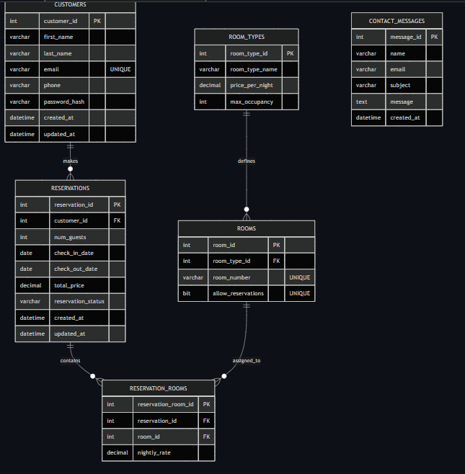
ERD

Slide 14
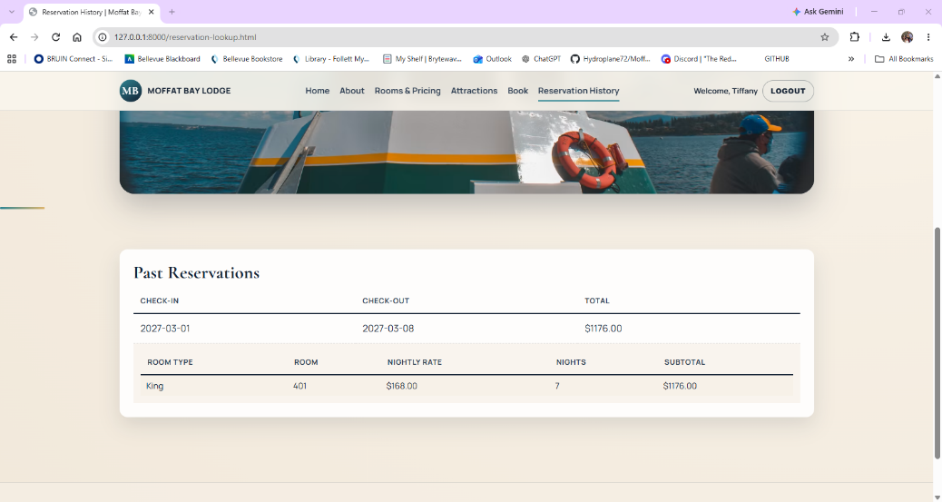
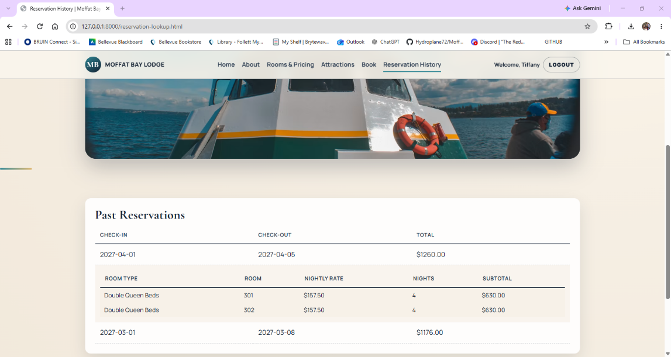
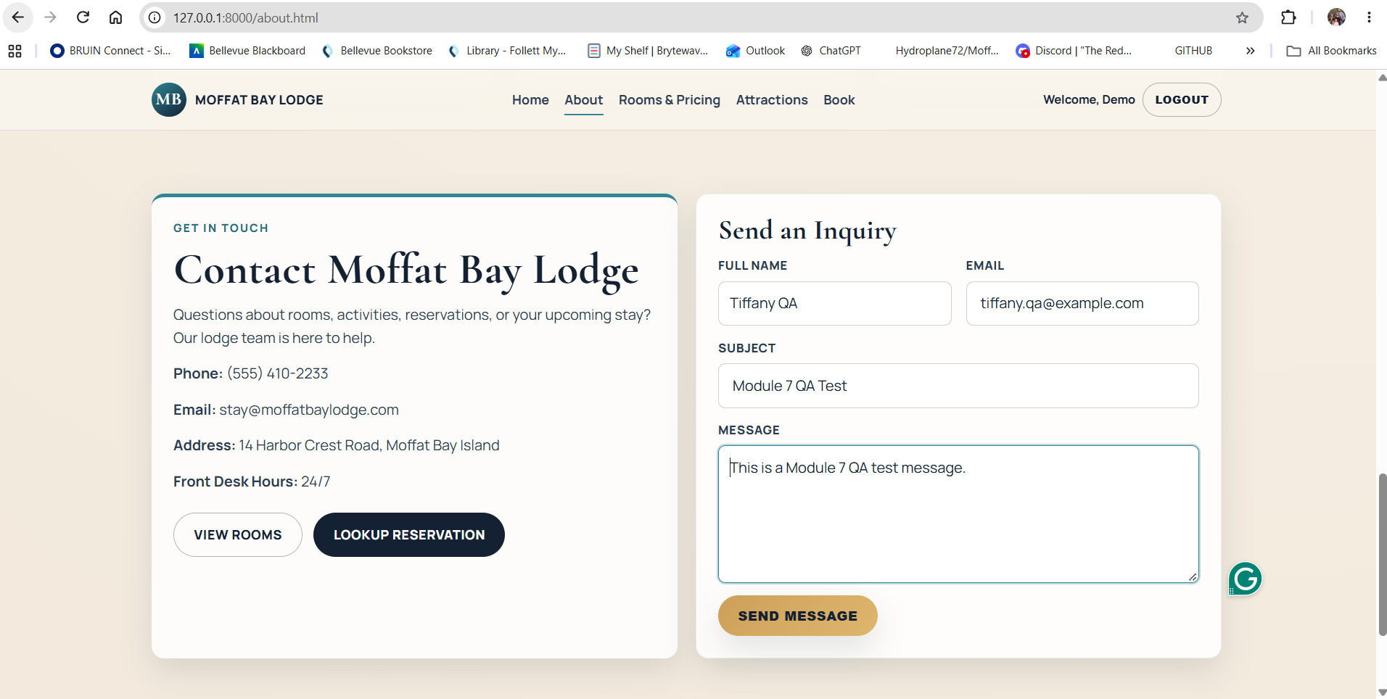
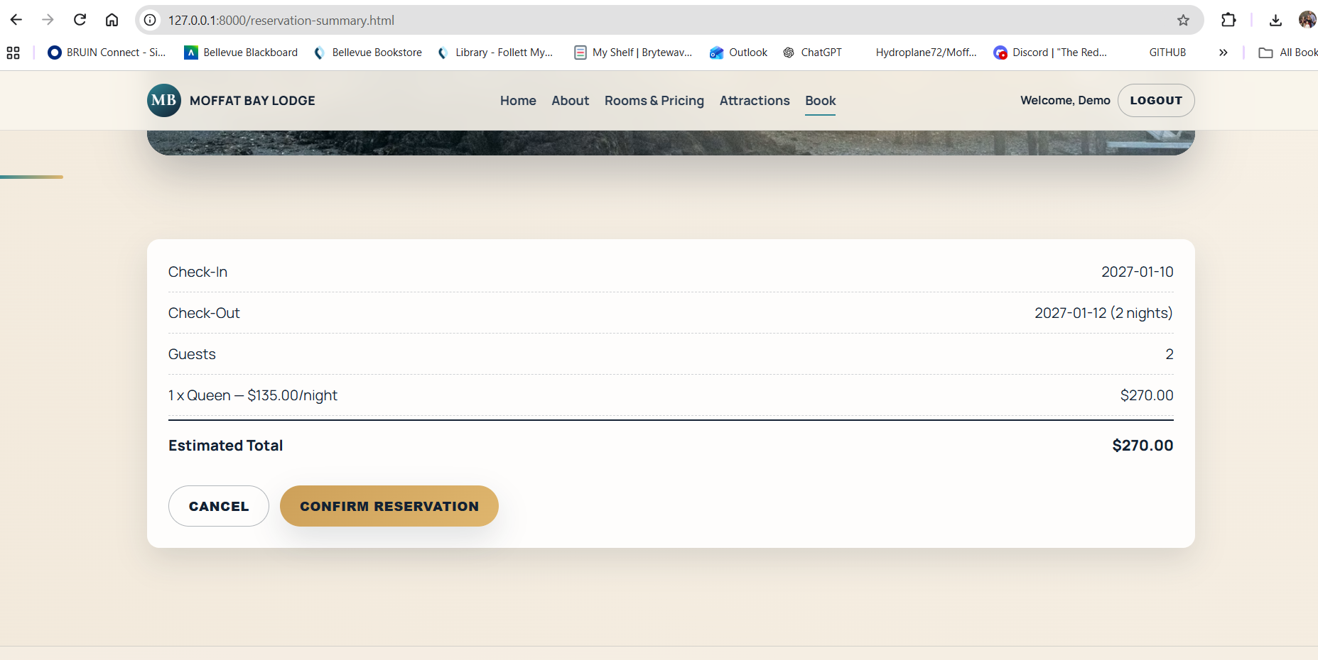
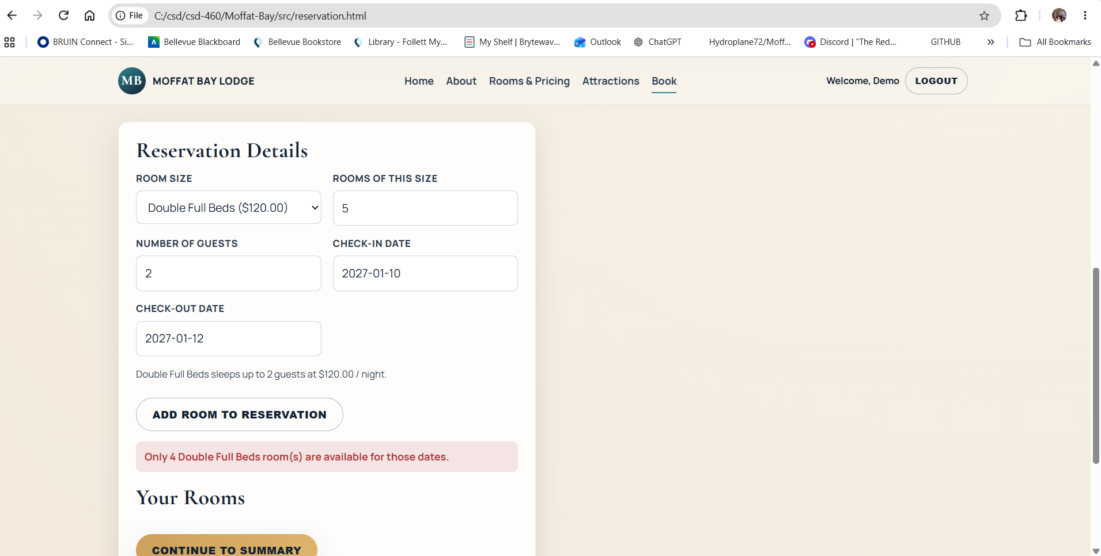
Tests Created
Test Name/Description | Result
Verify Reservation Lookup Connects to the Database
Verify Reservation Details Expand
About Page Loads with Merged Contact Section
Room Available for Selected Dates
Insufficient Rooms Are Rejected

Slide 15
Team Lessons Learned
Communication is key for Async work
Always have a back up ready incase someone is unable to complete work
QA is important
PLEASE ADD MORE EVERYONE

