Slide 1
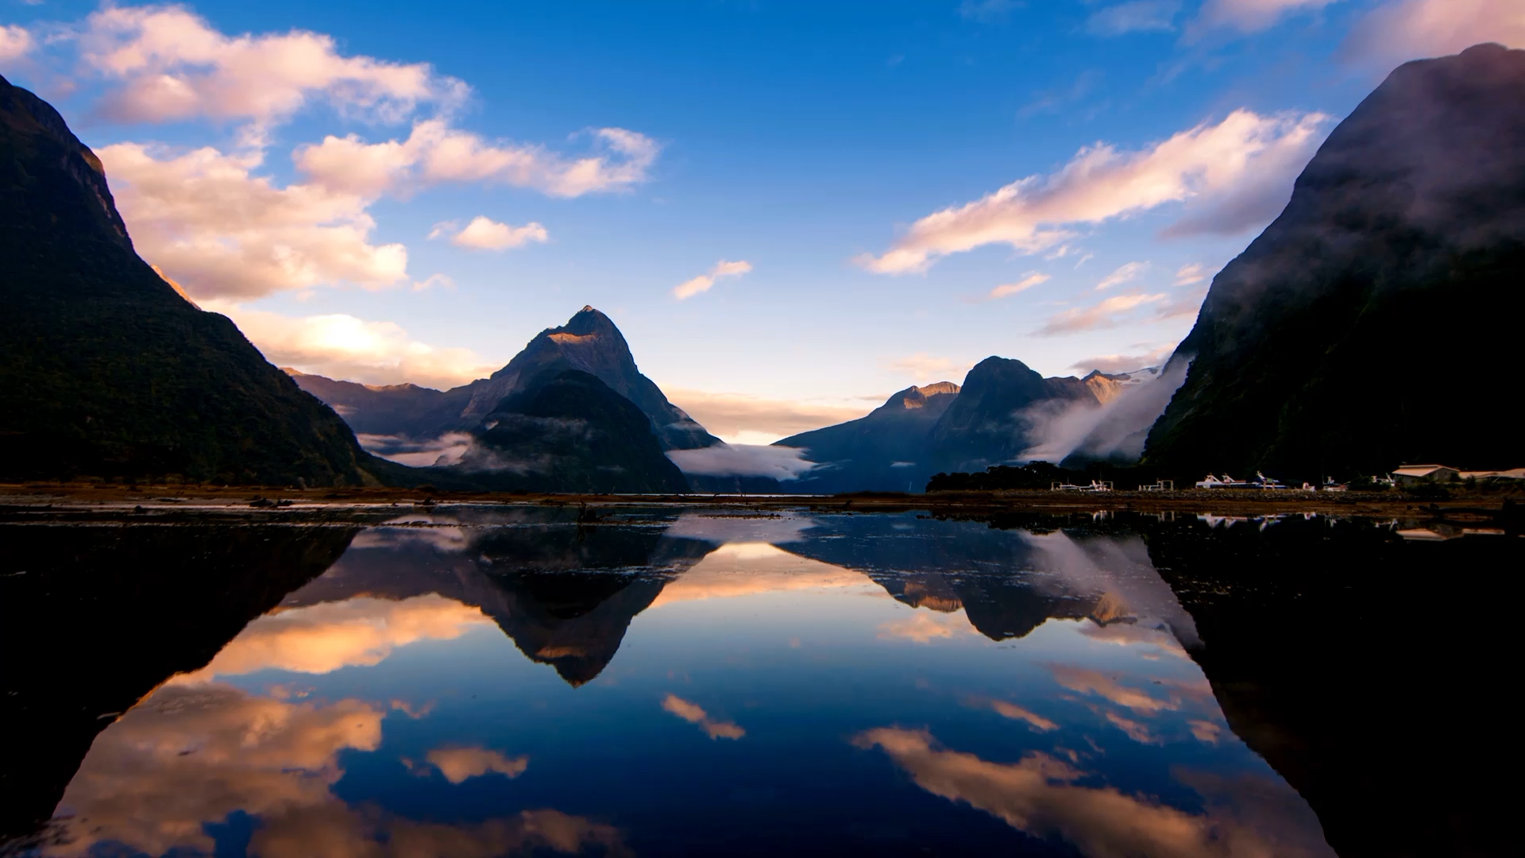
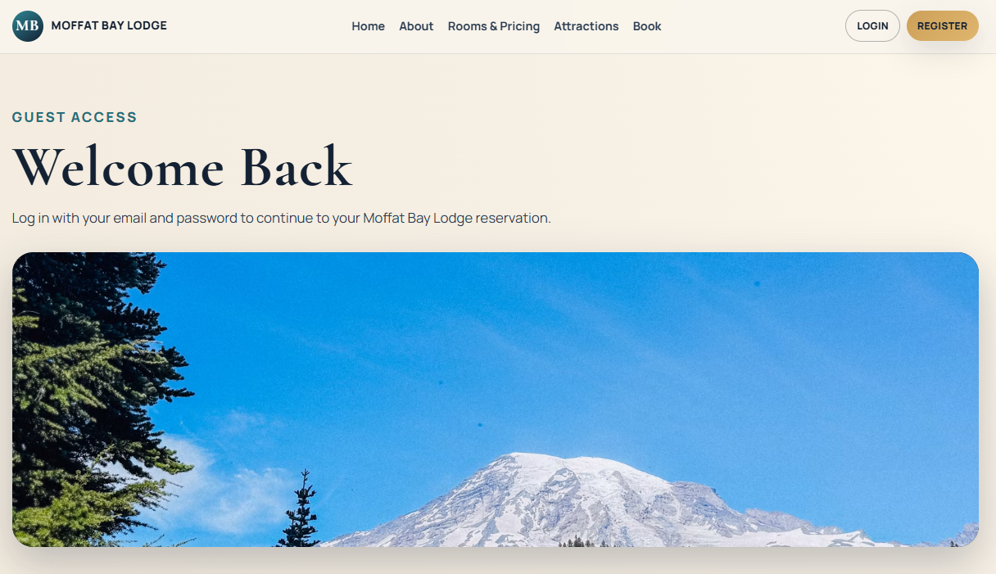
Moffat Bay Lodge
Red Team:
Brayan Covarrubias
Matthew Rozendaal
Rashai Robertson
Tiffany Davidson

Slide 2
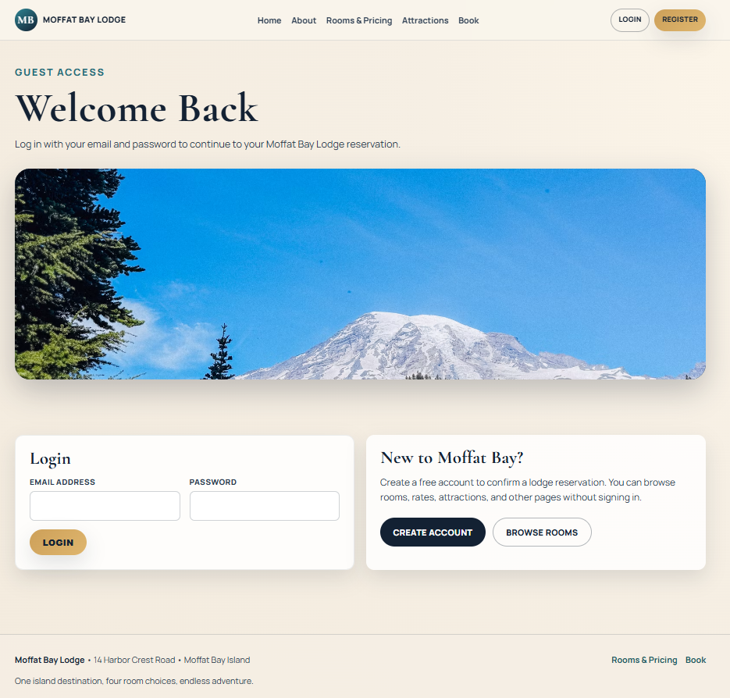
Landing Page

Slide 3
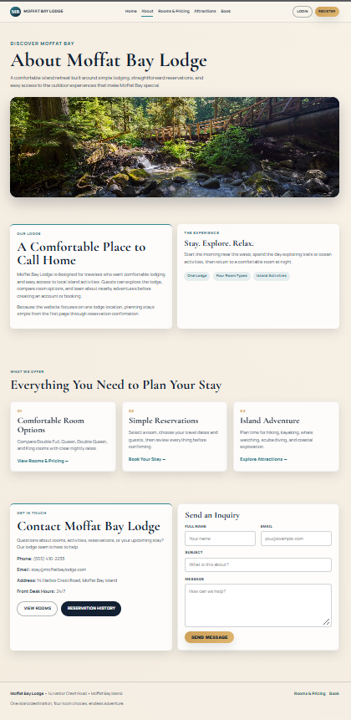
About Page

Slide 4
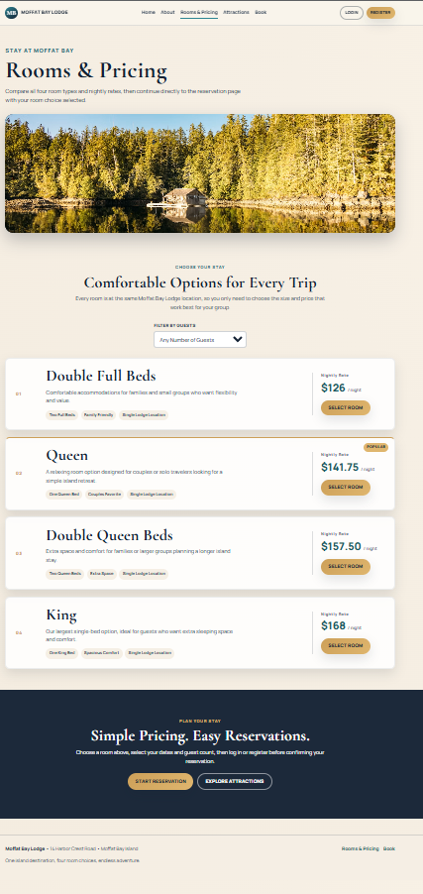
Rooms & Pricing

Slide 5
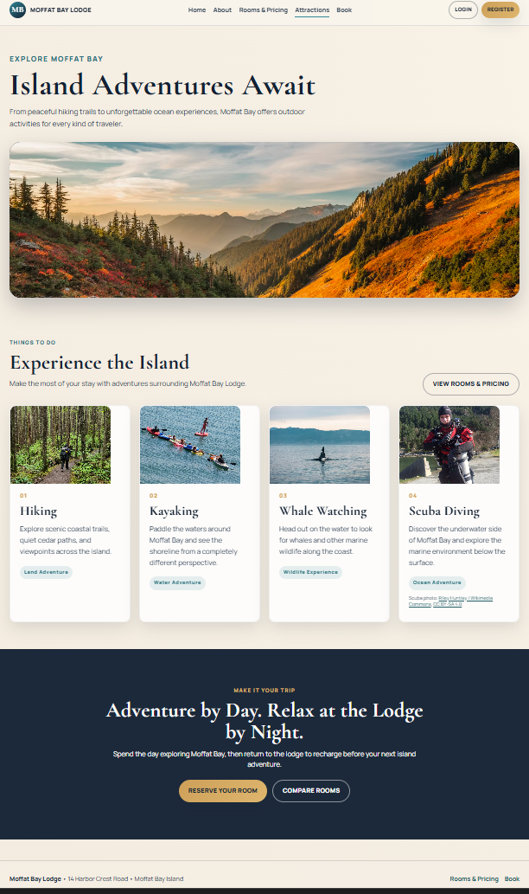
Attractions Page

Slide 6
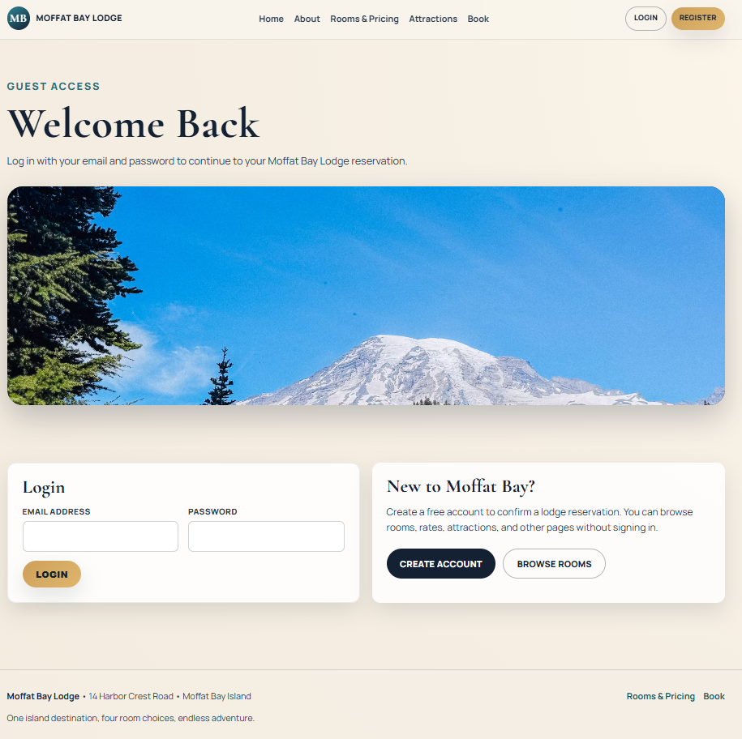
Login Page

Slide 7
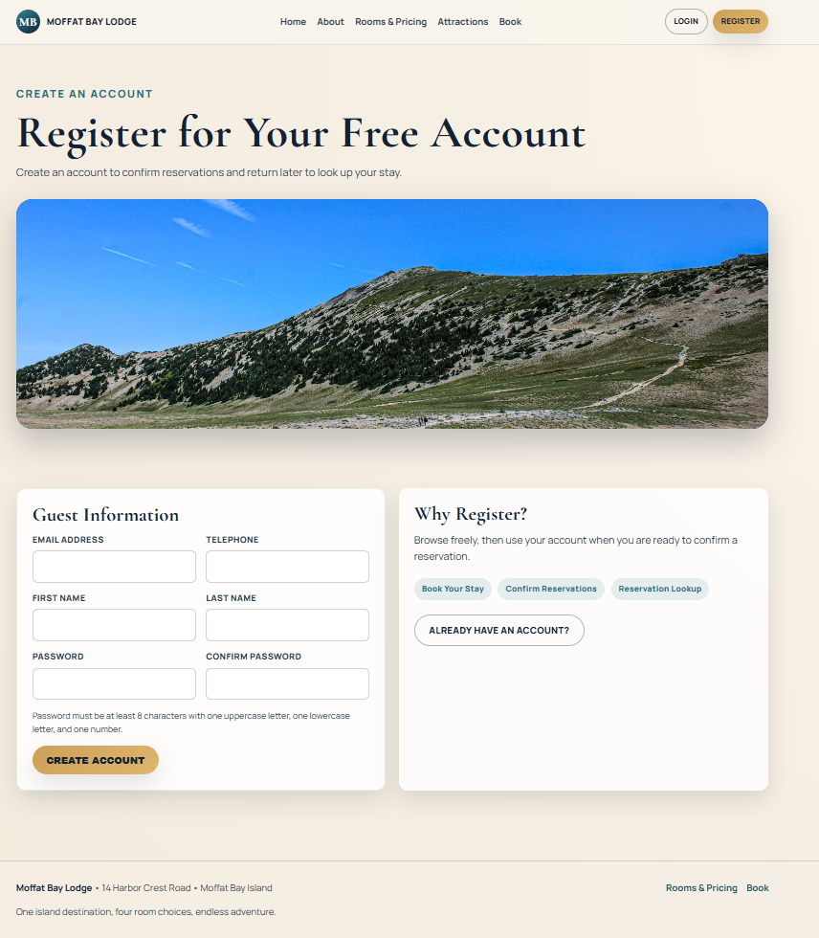
Register Page

Slide 8
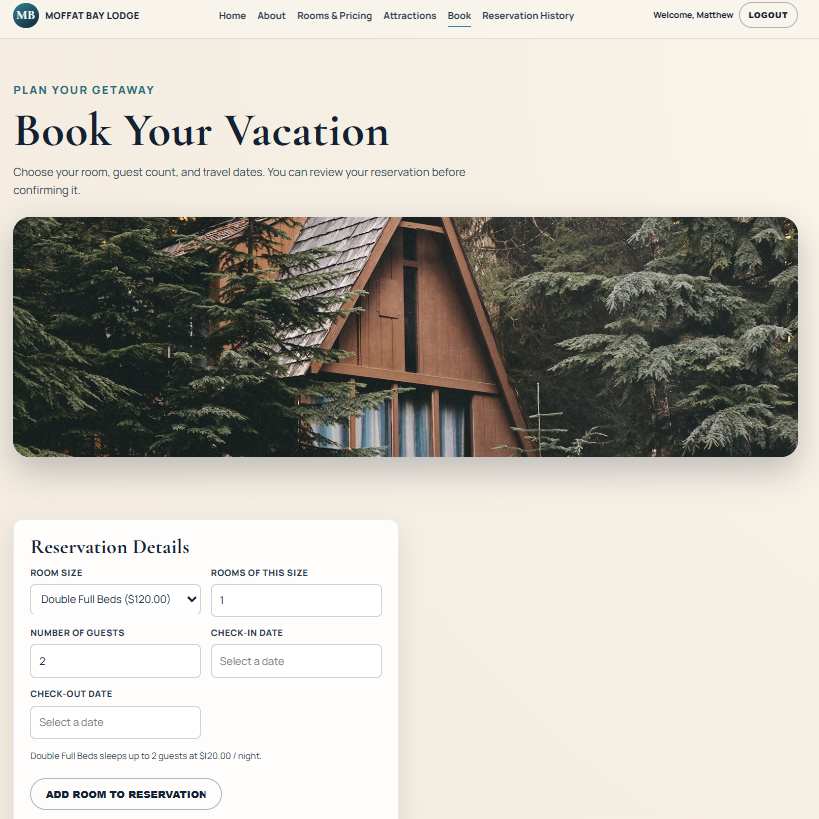
Book Your Stay Prototype

Slide 9
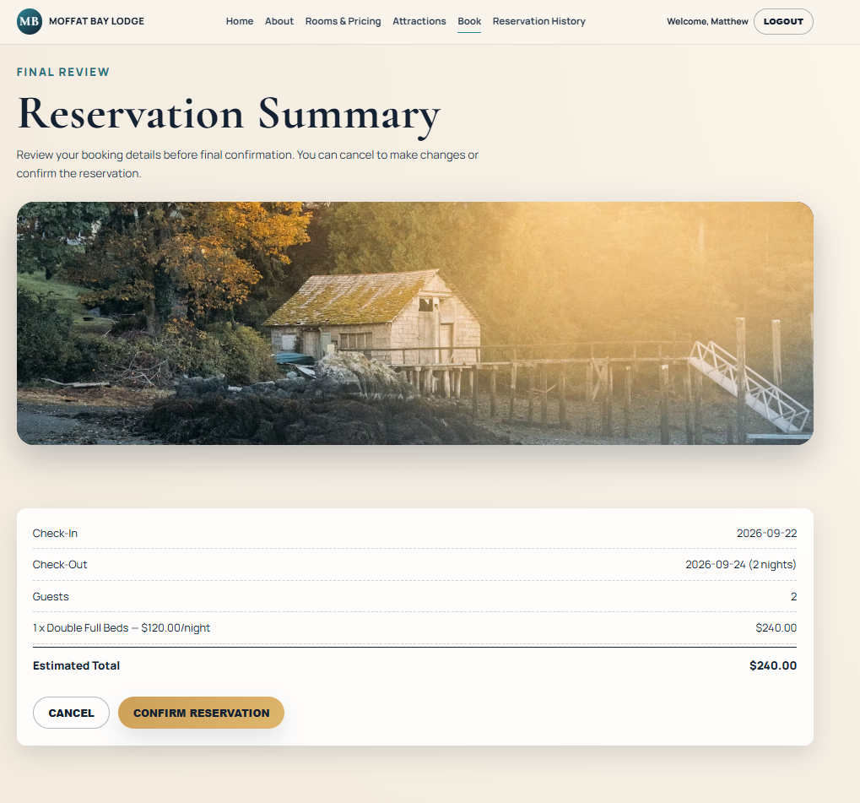
Reservation Summary

Slide 10
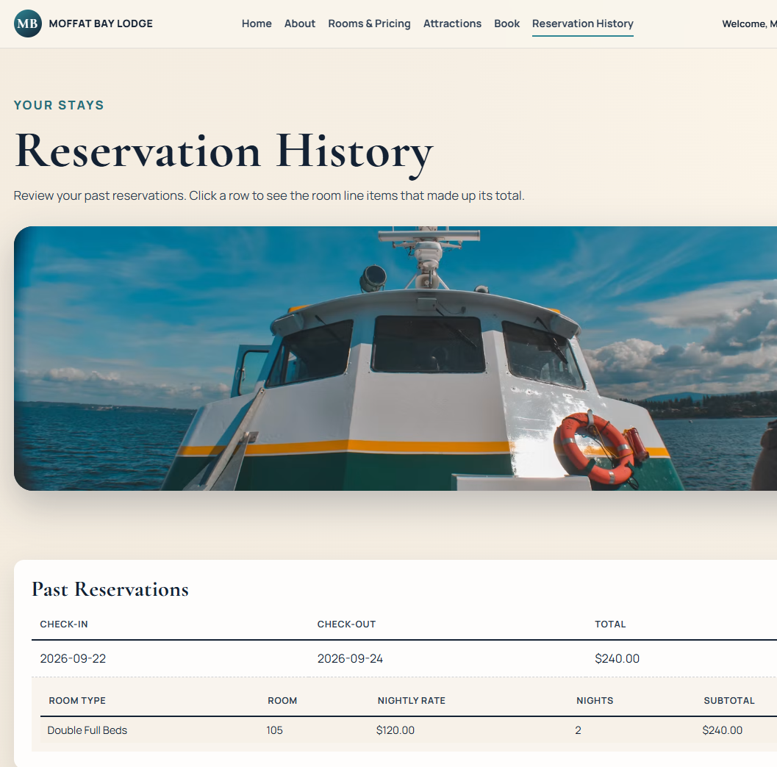
Reservation Lookup

