Slide 1
Transformer
Encoder Block
STEM
FFN

Slide 2
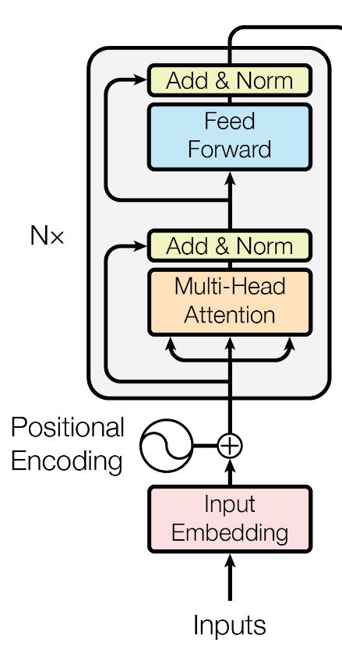
Pointwise
Conv
FFN
CNN
CNN
CNN
STEM

